Slide 1


SimReg: Regression as a Simple Yet Effective Tool for Self-supervised Knowledge Distillation
Navaneet K L¹, Soroush Koohpayegani¹, Ajinkya Tejankar¹, Hamed Pirsiavash^{1,2}
¹ University of Maryland, Baltimore County
² University of California, Davis

Slide 2
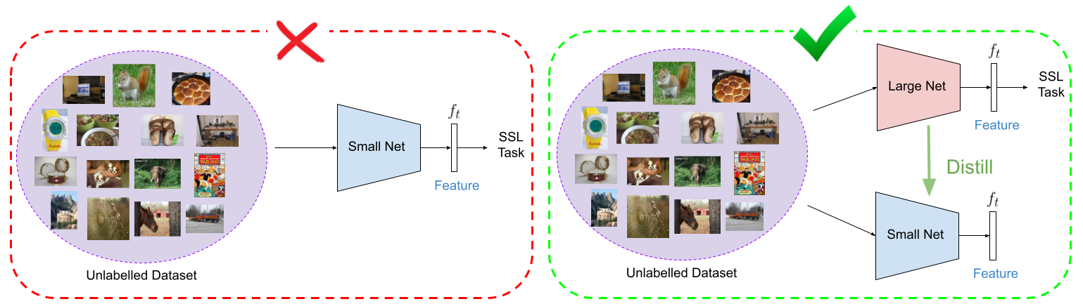
Self-supervised Knowledge Distillation
No access to labels during teacher / student training
Distilling from large to small net is better than training small net
Train Low-Capacity Network using SSL Method
Train and distill from a high-capacity net to a low-capacity net in an unsupervised fashion

Slide 3
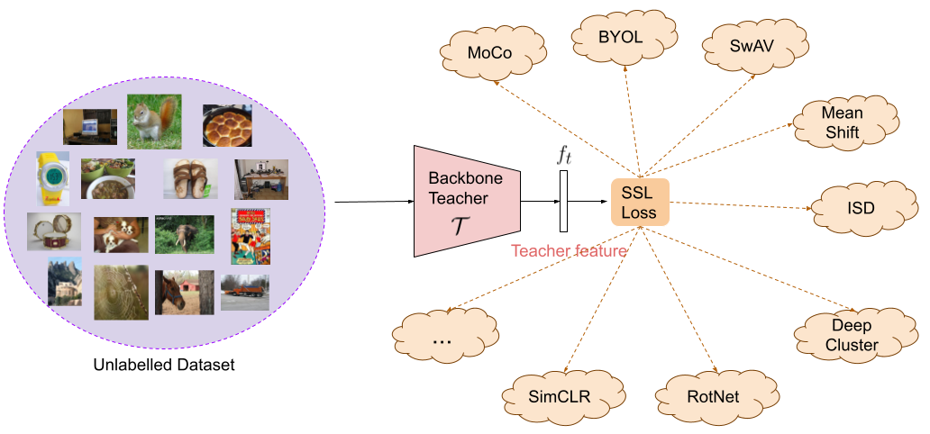
Teacher Network Training
Train teacher network using a self-supervised learning (SSL) method

Slide 4
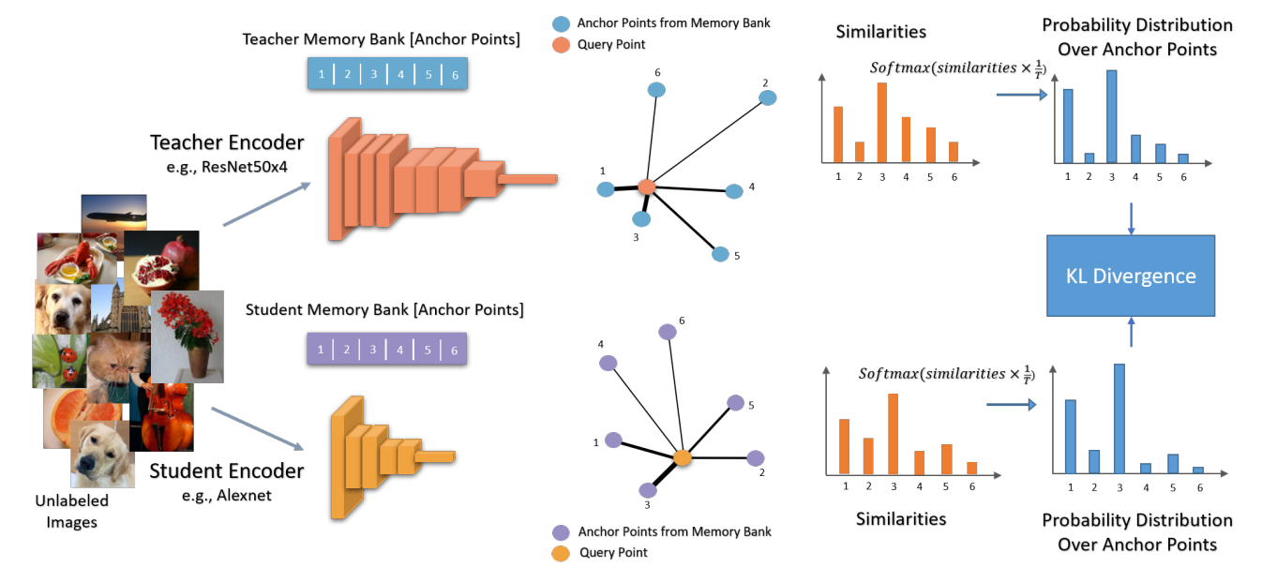
SSL Distillation – Existing Approach
CompRess^{[1]} – Match similarity distribution of teacher and student over an anchor set
No direct matching to teacher representation space
Anchor set – large memory requirement, especially for multi-teacher distillation
CompRess Architecture^{[1]}
[1] Abbasi Koohpayegani, S., Tejankar, A., & Pirsiavash, H. CompRess: Self-Supervised Learning by Compressing Representations. NeurIPS, 2020

Slide 5
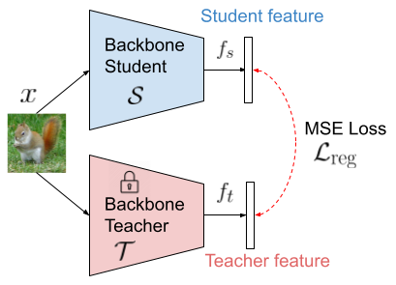
SSL Distillation – Regression
Explicitly match teacher and student representations
Lower performance compared to CompRess
Distillation through regression

Slide 6

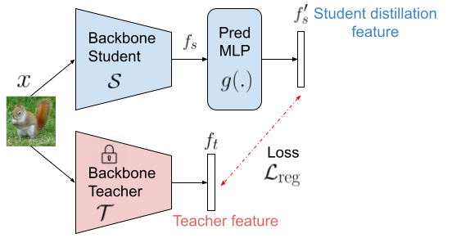

Regression with Additional MLP
Increase student network capacity → improve performance
Change in Student architecture, extra MLP!
Distillation through regression

Slide 7
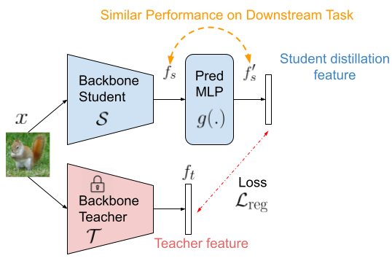
Regression with Additional MLP
Interestingly…
Performance of pre-MLP features f_{s} similar to that of final features f’_{s}!
Distillation through regression

Slide 8
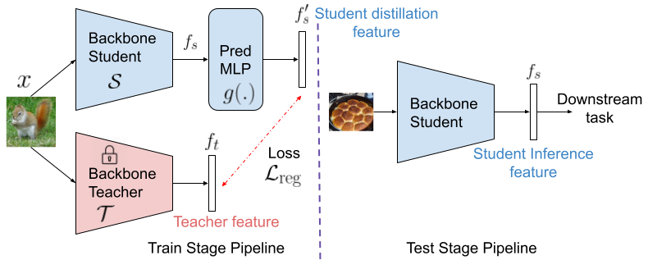
SimReg: Distillation through Regression
Performance of pre-MLP features f_{s} similar to that of final features f’_{s}!
Use features f’_{s} for distillation, f_{s} for inference
Train and test stage architectures for SimReg distillation

Slide 9
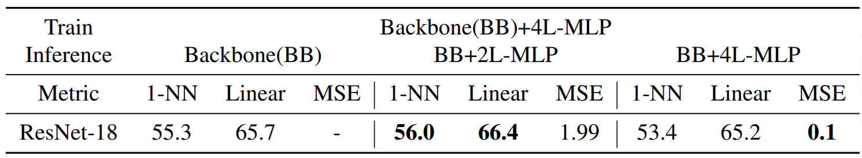
Performance of Pre- and Post-MLP Features
MLP Architecture – 4 layers → 4 x (Linear, Batch-norm, ReLU)
Train a single model, eval using different layer outputs
Performance of backbone (BB) ≈ final features (BB + 4L-MLP)
Best performance at intermediate layer (BB + 2L-MLP)

Slide 10
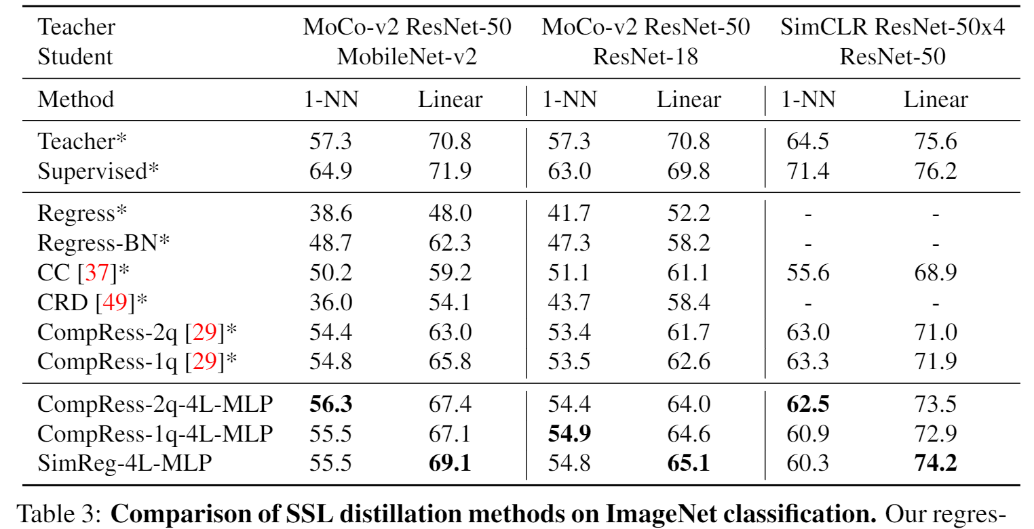
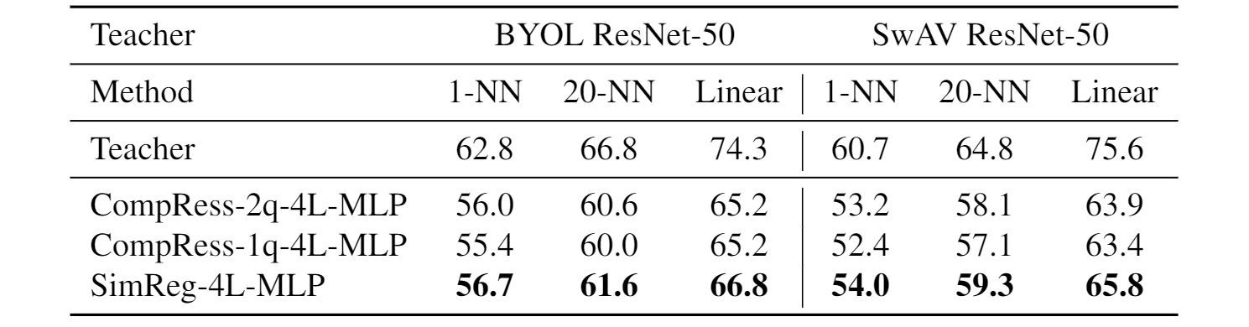
Comparison with SSL Distillation Methods
MLP Architecture – 4 layers → 4 x (Linear, Batch-norm, ReLU)
SimReg is better than state-of-the-art (CompRess-2q) on Nearest Neighbour (NN) and Linear evaluation for ImageNet classification
MLP also improves CompRess (CompRess-1/2q-4L-MLP)
Comparison of SSL distillation methods on ImageNet Classification Task

Slide 11
SimReg Reproducibility
Code and trained models are made publicly available at: https://github.com/UCDvision/simreg

