Slide 1
Chapter-3:BLOCKCIPHER AND DATA ENCRYPTION STANDARD

Slide 2
Traditional block cipher structure,
Data Encryption Standard,
the strength of DES,
Block cipher design principles
BLOCK CIPHER OPERATION
Multiple encryption and triple DES,
Electronic codebook,
Cipher block chaining mode

Slide 3
Block cipher Introduction….
Block cipher is an encryption and decryption method which operates on the blocks of plain text, instead of operating on each bit of plain text separately.
Each block is of equal size and has fixed no of bits.
The generated ciphertext has blocks equal to the number of blocks in plaintext and also has the same number of bits in each block as of plain text.
Block cipher uses the same key for encryption and decryption.

Slide 4
While decryption also only one block of ciphertext is operated to produce its corresponding plain text.
Data Encryption Standard (DES) is the best example of it.
DES divides the plain text into the number of blocks, each of 64-bit.
DES operates on one block of plain text at a time.
Key of 56-bit is applied to each block of plain text to produce its corresponding ciphertext of 64-bit.

Slide 5
Block Cipher Principles
A block cipher is designed by considering its three critical aspects which are listed as below:
  Number of Rounds
  Design of Function F
  Key Schedule Algorithm
1. Number of Rounds
The number of rounds judges the strength of the block cipher algorithm. It is considered that more is the number of rounds, difficult is for cryptanalysis to break the algorithm.
It is considered that even if the function F is relatively weak, the number of rounds would make the algorithm tough to break.

Slide 6
2.Design of Function F
The function F of the block cipher must be designed such that it must be impossible for any cryptanalysis to unscramble the substitution.
The criterion that strengthens the function F
More the function F is nonlinear, more it would be difficult to crack it.
while designing the function F it should be confirmed that it has a good avalanche property which states that a change in one-bit of input must reflect the change in many bits of output.

Slide 7
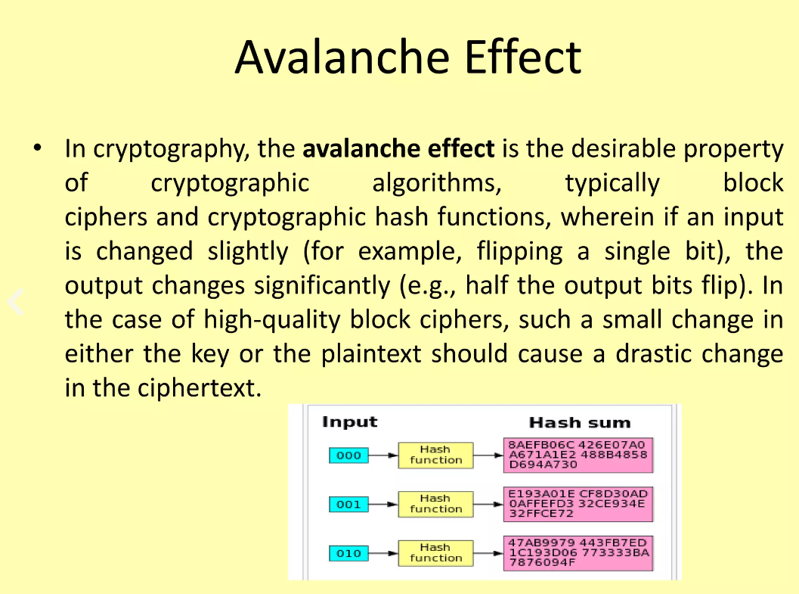

Slide 8
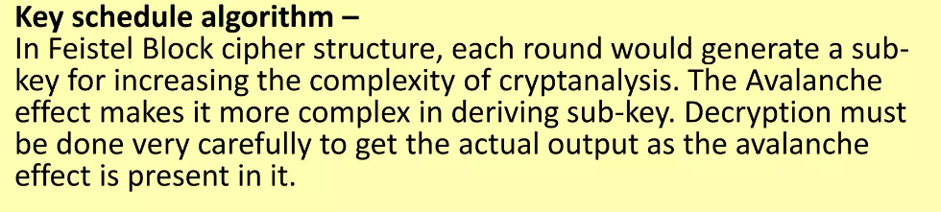
The Function F should be designed such that it possesses a bit independence criterion which states that the output bits must change independently if there is any change in the input bit.

Slide 9
Modes of Operation
There are five important block cipher modes of operation defined by NIST.
These five modes of operation enhance the algorithm so that it can be adapted by a wide range of applications which uses block cipher for encryption.
Electronic Code Book Mode(ECB)
Cipher Block Chaining Mode(CBC)
Cipher Feedback Mode(CFM)
Output Feedback Mode(OFM)
Counter Mode(CM)
EBC, CBC, CFB, OFB, CTR
Notes and Remarks on each modes

Slide 10
Modes of Operation
Block ciphers encrypt fixed size blocks
  eg. DES encrypts 64-bit blocks, with 56-bit key
Need way to use in practise, given usually have arbitrary amount of information to encrypt
  Partition message into separate block for ciphering
A mode of operation describes the process of encrypting each of these blocks under a single key
Some modes may use randomized addition input value
Notes:
DES (or any block cipher) forms a basic building block, which en/decrypts a fixed sized block of data. However to use these in practise, we usually need to handle arbitrary amounts of data, which may be available in advance (in which case a block mode is appropriate), and may only be available a bit/byte at a time (in which case a stream mode is used).

Slide 11
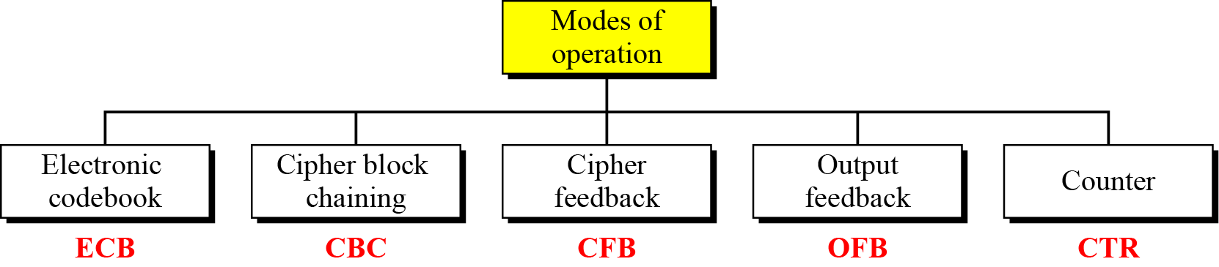
Modes of Operation Taxonomy
Current well-known modes of operation

Slide 12
Electronic Codebook Book (ECB)
Message is broken into independent blocks which are encrypted
Each block is a value which is substituted, like a codebook, hence name
Each block is encoded independently of the other blocks
  C_{i} = E_{K} (P_{i})
Uses: secure transmission of single values

Slide 13
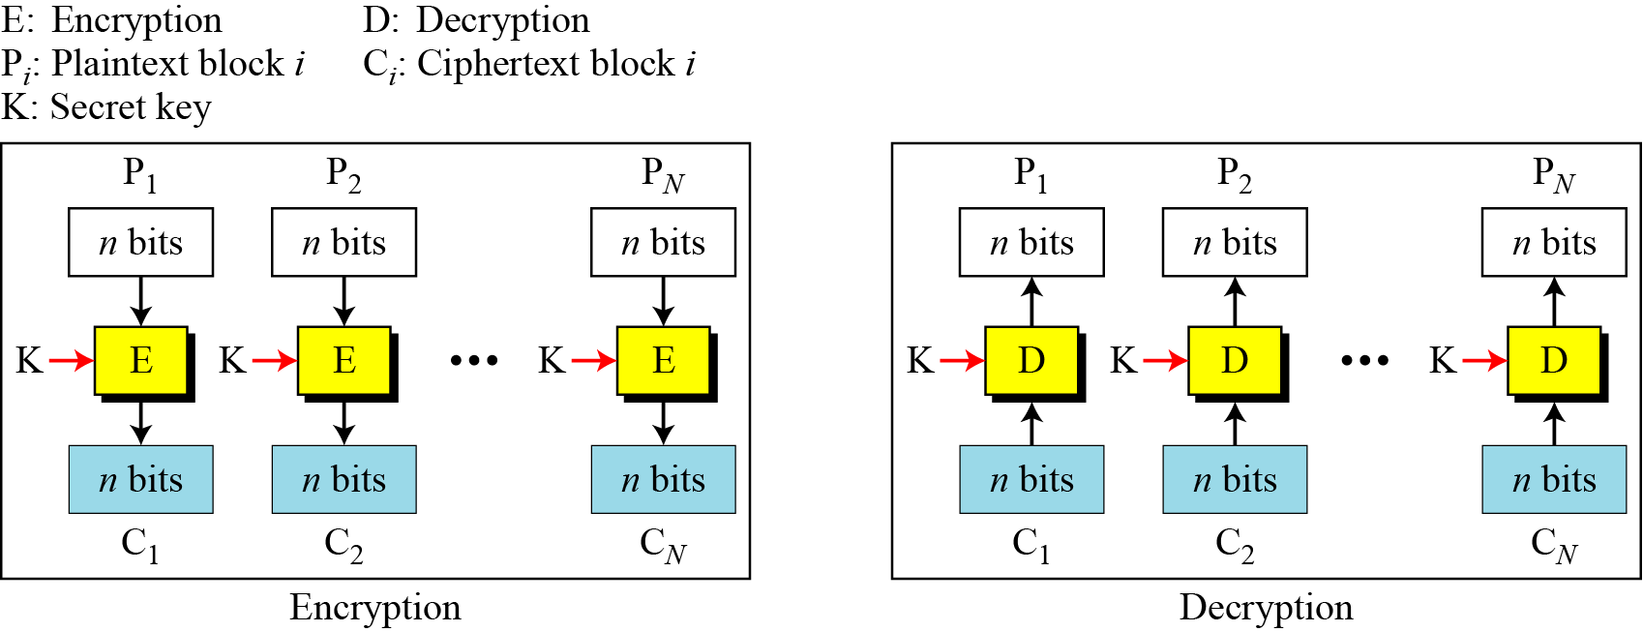
ECB Scheme
Notes:
Stallings Fig 3-11.

Slide 14
Remarks on ECB
Strength: it’s simple.
Weakness:
  Repetitive information contained in the plaintext may show in the ciphertext, if aligned with blocks.
  If the same message is encrypted (with the same key) and sent twice, their ciphertext are the same.
Typical application:
  secure transmission of short pieces of information (e.g. a temporary encryption key)

Slide 15
Cipher Block Chaining (CBC)
Solve security deficiencies in ECB
  Repeated same plaintext block result different ciphertext block
Each previous cipher blocks is chained to be input with current plaintext block, hence name
Use Initial Vector (IV) to start process
  C_{i} = E_{K} (P_{i} XOR C_{i-1})
  C₀ = IV
Uses: bulk data encryption, authentication
Notes:
To overcome the problems of repetitions and order independence in ECB, want some way of making the ciphertext dependent on all blocks before it. This is what CBC gives us, by combining the previous ciphertext block with the current message block before encrypting. To start the process, use an Initial Value (IV), which is usually well known (often all 0's), or otherwise is sent, ECB encrypted, just before starting CBC use. CBC mode is applicable whenever large amounts of data need to be sent securely, provided that its available in advance (eg email, FTP, web etc)

Slide 16
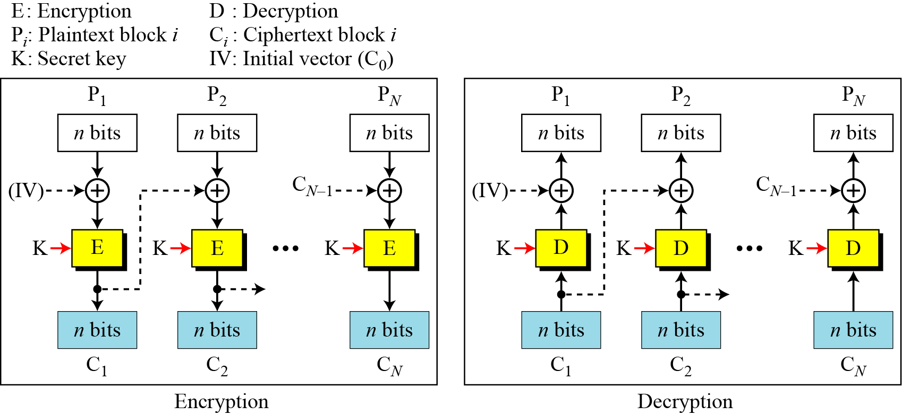
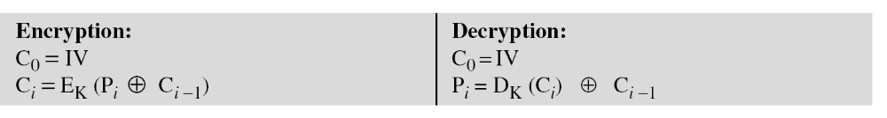
CBC scheme
Notes:
Stallings Fig 3-12.

Slide 17
Remarks on CBC
The encryption of a block depends on the current and all blocks before it.
So, repeated plaintext blocks are encrypted differently.
Initialization Vector (IV)
  May sent encrypted in ECB mode before the rest of ciphertext

Slide 18
Cipher FeedBack (CFB)
Use Initial Vector to start process
Encrypt previous ciphertext , then combined with the plaintext block using X-OR to produce the current ciphertext
Cipher is fed back (hence name) to concatenate with the rest of IV
Plaintext is treated as a stream of bits
  Any number of bit (1, 8 or 64 or whatever) to be feed back (denoted CFB-1, CFB-8, CFB-64)
Relation between plaintext and ciphertext
  C_{i} = P_{i} XOR SelectLeft(E_{K} (ShiftLeft(C_{i-1})))
  C₀ = IV
Uses: stream data encryption, authentication
Notes:
If the data is only available a bit/byte at a time (eg. terminal session, sensor value etc), then must use some other approach to encrypting it, so as not to delay the info. Idea here is to use the block cipher essentially as a pseudo-random number generator (see stream cipher lecture later) and to combine these "random" bits with the message. Note as mentioned before, XOR is an easily inverted operator (just XOR with same thing again to undo). Again start with an IV to get things going, then use the ciphertext as the next input. As originally defined, idea was to "consume" as much of the "random" output as needed for each message unit (bit/byte) before "bumping" bits out of the buffer and re-encrypting. This is wasteful though, and slows the encryption down as more encryptions are needed. An alternate way to think of it is to generate a block of "random" bits, consume them as message bits/bytes arrive, and when they're used up, only then feed a full block of ciphertext back. This is CFB-64 mode, the most efficient. This is the usual choice for quantities of stream oriented data, and for authentication use.

Slide 19
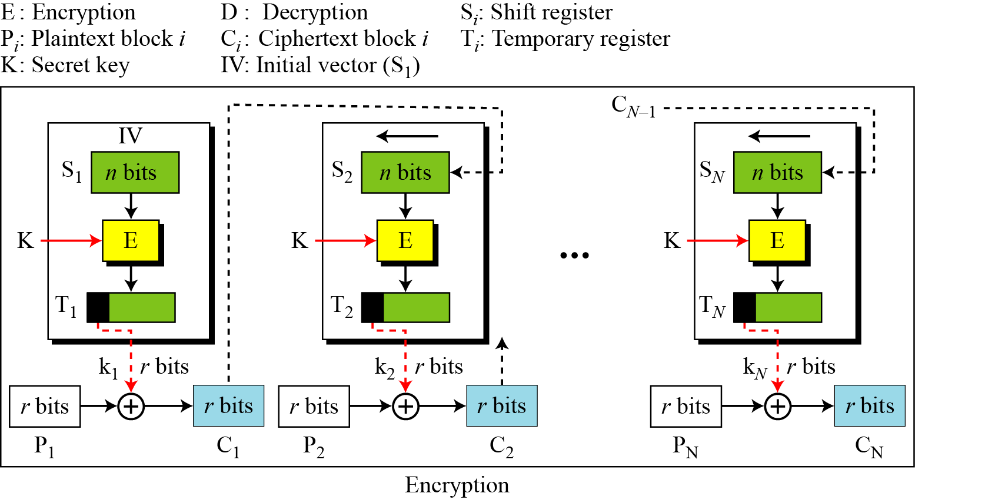
CFB Scheme

Slide 20
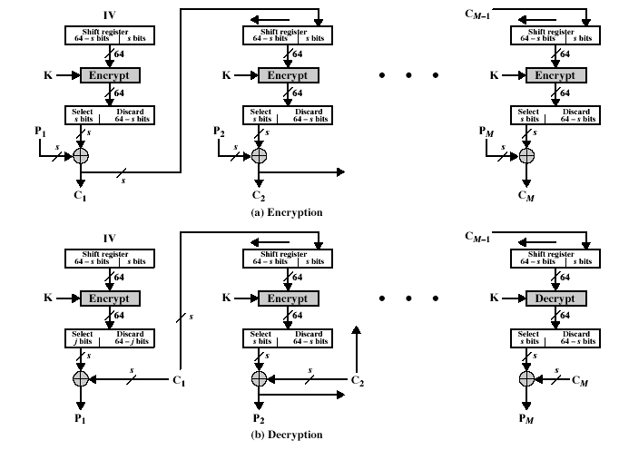
CFB Encryption/Decryption
Notes:
Stallings Fig 3-13.

Slide 21
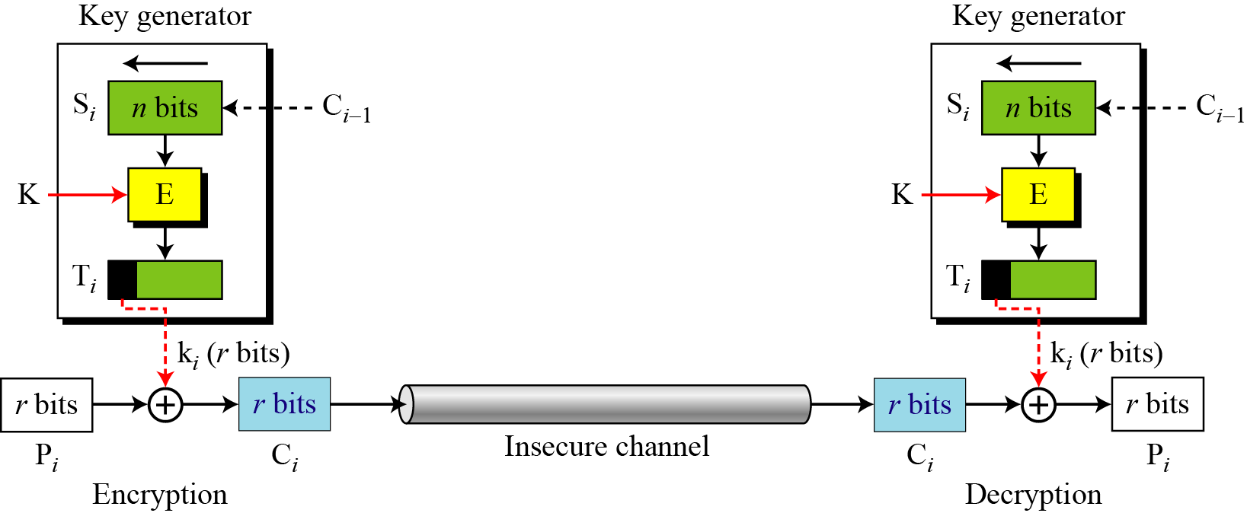
CFB as a Stream Cipher
In CFB mode, encipherment and decipherment use the encryption function of the underlying block cipher.

Slide 22
Remark on CFB
The block cipher is used as a stream cipher.
  enable to encrypt any number of bits e.g. single bits or single characters (bytes)
  S=1 : bit stream cipher
  S=8 : character stream cipher)
A ciphertext segment depends on the current and all preceding plaintext segments.
A corrupted ciphertext segment during transmission will affect the current and next several plaintext segments.

Slide 23
Output FeedBack (OFB)
Very similar to CFB
But output of the encryption function output of cipher is fed back (hence name), instead of ciphertext
Feedback is independent of message
Relation between plaintext and ciphertext
  C_{i} = P_{i} XOR O_{i}
  O_{i} = E_{K} (O_{i-1})
  O₀ = IV
Uses: stream encryption over noisy channels
Notes:
The alternative to CFB is OFB. Here the generation of the "random" bits is independent of the message being encrypted. The advantage is that firstly, they can be computed in advance, good for bursty traffic, and secondly, any bit error only affects a single bit. Thus this is good for noisy links (eg satellite TV transmissions etc).

Slide 24
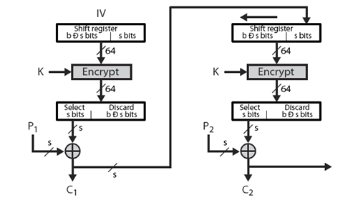
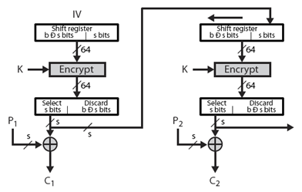
CFB V.S. OFB
Cipher Feedback
Output Feedback

Slide 25
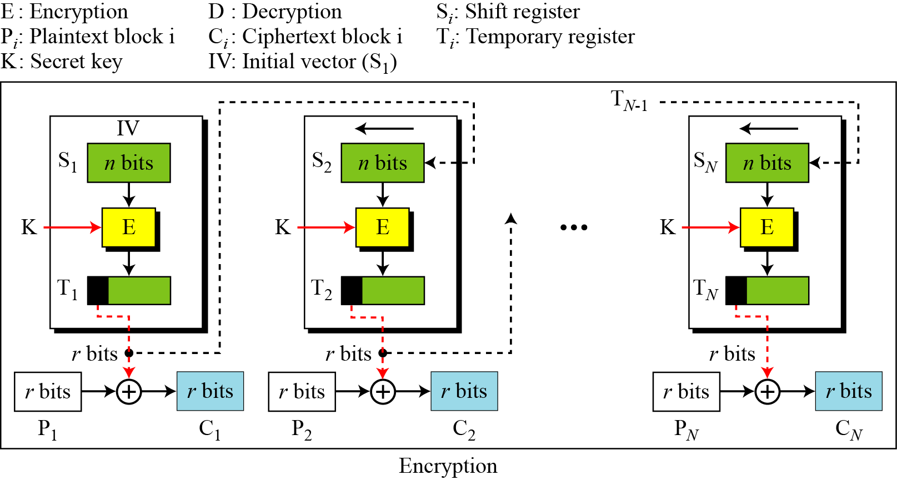
OFB Scheme

Slide 26
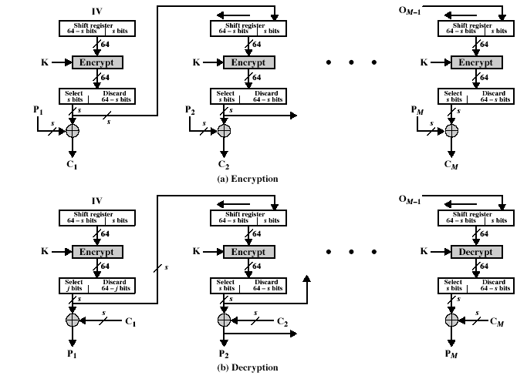
OFB Encryption and Decryption
Notes:
Stallings Fig 3-14.

Slide 27
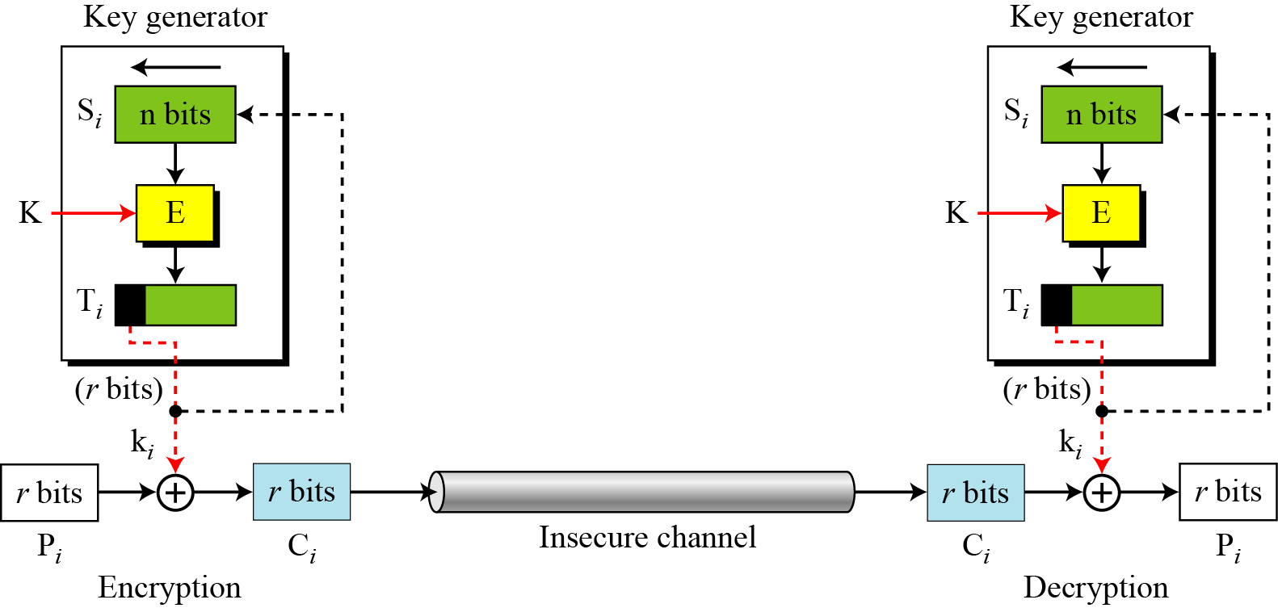
OFB as a Stream Cipher
In OFB mode, encipherment and decipherment use the encryption function of the underlying block cipher.

Slide 28
Remarks on OFB
Each bit in the ciphertext is independent of the previous bit or bits. This avoids error propagation
Pre-compute of forward cipher is possible
Security issue
  when j^{th} plaintext is known, the j^{th} output of the forward cipher function will be known
  Easily cover j^{th} plaintext block of other message with the same IV
Require that the IV is a nonce
Notes:
Because the "random" bits are independent of the message, they must never ever be used more than once (otherwise the 2 ciphertexts can be combined, cancelling these bits, and leaving a "book" cipher to solve). Also, as noted, should only ever use a full block feedback ie OFB-64 mode.

Slide 29
Counter (CTR)
Encrypts counter value with the key rather than any feedback value (no feedback)
Counter for each plaintext will be different
  can be any function which produces a sequence which is guaranteed not to repeat for a long time
Relation
  C_{i} = P_{i} XOR O_{i}
  O_{i} = E_{K} (i)
Uses: high-speed network encryptions

Slide 30
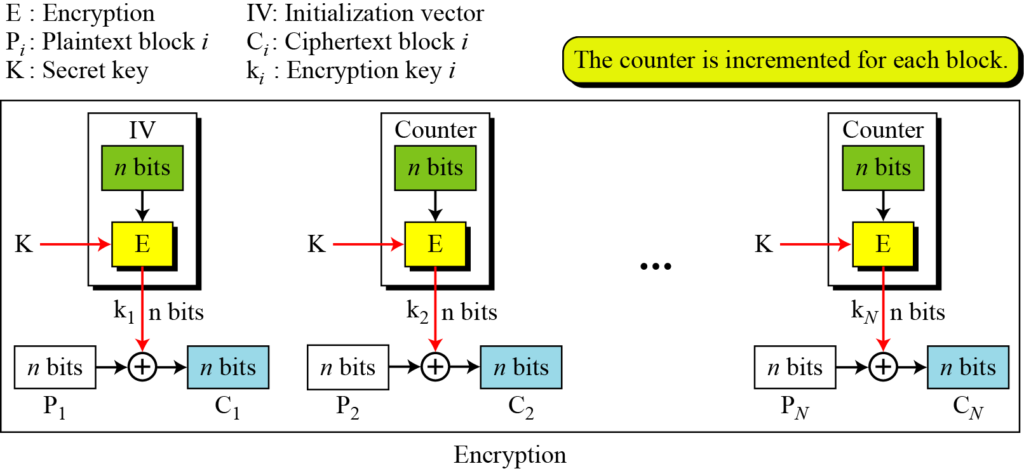
CTR Scheme

Slide 31
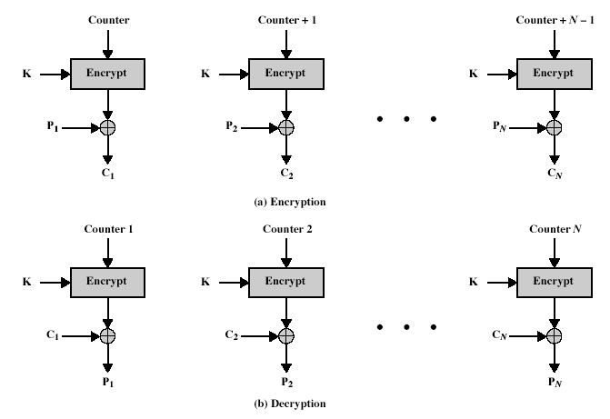
CTR Encryption and Decryption
Notes:
Stallings Fig 3-15.

Slide 32
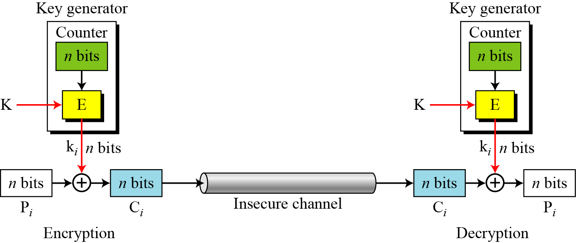
OFB as a Stream Cipher

Slide 33
Remark on CTR
Strengthes:
  Needs only the encryption algorithm
  Random access to encrypted data blocks
    blocks can be processed (encrypted or decrypted) in parallel
  Simple; fast encryption/decryption
Counter must be
  Must be unknown and unpredictable
  pseudo-randomness in the key stream is a goal

Slide 34
Topics
Overview of Modes of Operation
EBC, CBC, CFB, OFB, CTR
Notes and Remarks on each modes

Slide 35
Remark on each mode
Basically two types:
  block cipher
  stream cipher
CBC is an excellent block cipher
CFB, OFB, and CTR are stream ciphers
CTR is faster because simpler and it allows parallel processing

Slide 36
Modes and IV
An IV has different security requirements than a key
Generally, an IV will not be reused under the same key
CBC and CFB
  reusing an IV leaks some information about the first block of plaintext, and about any common prefix shared by the two messages
OFB and CTR
  reusing an IV completely destroys security

Slide 37
CBC and CTR comparison
CBC | CTR
Padding needed | No padding
No parallel processing | Parallel processing
Separate encryption and decryption functions | Encryption function alone is enough
Random IV or a nonce | Unique nonce
Nonce reuse leaks some information about initial plaintext block | Nonce reuse will leak information about the entire message

Slide 38
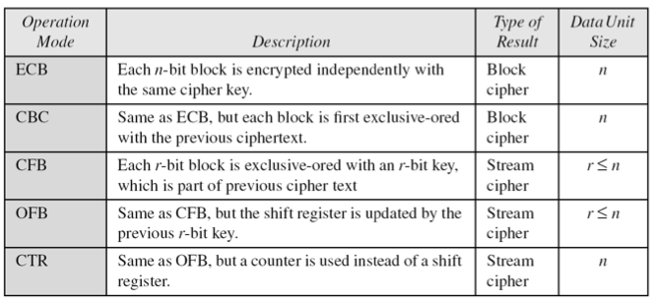
Comparison of Different Modes

Slide 39
Comparison of Modes
Mode | Description | Application
ECB | 64-bit plaintext block encoded separately | Secure transmission of encryption key
CBC | 64-bit plaintext blocks are XORed with preceding 64-bit ciphertext | Commonly used method. Used for authentication
CFB | s bits are processed at a time and used similar to CBC | Primary stream cipher. Used for authentication

Slide 40
Comparison of Modes
Mode | Description | Application
OFB | Similar to CFB except that the output is fed back | Stream cipher well suited for transmission over noisy channels
CTR | Key calculated using the nonce and the counter value. Counter is incremented for each block | General purpose block oriented transmission. Used for high-speed communications

Slide 41
Final Notes
ECB, CBC, OFB, CFB, CTR, and XTS modes only provide confidentiality
To ensure an encrypted message is not accidentally modified or maliciously tampered requires a separate Message Authentication Code (MAC)
Several MAC schemes
  HMAC, CMAC and GMAC
But.. compositing a confidentiality mode with an authenticity mode could be difficult and error prone
New modes combined confidentiality and data integrity into a single cryptographic primitive
  CCM, GCM, CWC, EAX, IAPM and OCB

Slide 42
Q&A

