Slide 1
Exploring Different Types of Malicious Software

Slide 2
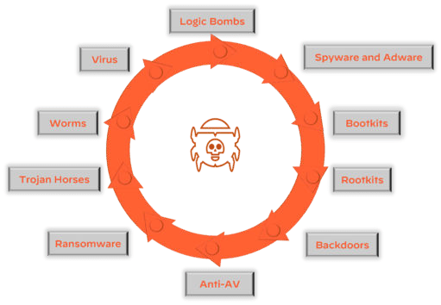
Types of malicious software

Slide 3

Virus
A Virus is a malicious executable code attached to another executable ﬁle.
The virus spreads when an infected ﬁle is passed from system to system. Once a program virus is active, it will infect other programs on the computer.

Slide 4
Worms
Worms replicate themselves on the system, attaching themselves to different ﬁles and looking for pathways between computers.
A virus needs a host program to run but worms can run by themselves.
After a worm affects a host, it is able to spread very quickly over the network.

Slide 5

Trojans
"Trojan," is a software
type of malicious
that disguises itself as
legitimate software to trick users into installing it on their systems.
A Trojan horse varies from a virus because the Trojan binds itself to non- executable ﬁles, such as image ﬁles, and audio ﬁles.

Slide 6

Ransomware
Ransomware grasps a computer system or the data it contains until the victim makes a payment.
Ransomware encrypts data in the computer with a key that is unknown to the user.
The user has to pay a ransom (price) to the criminals to retrieve data.

Slide 7

Rootkits
A rootkit modiﬁes the OS to make a backdoor. Attackers then use the backdoor to access the computer distantly. Most rootkits take advantage of software vulnerabilities to modify system ﬁles.

Slide 8



Backdoor
A backdoor is malware that allows an attacker to bypass authentication to gain access to a compromised system.
The purpose of the backdoor is to grant cyber criminals future access to
the system even if the organization ﬁxes the original vulnerability used to attack the system.

Slide 9
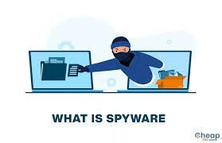
Spyware
Its purpose is to steal private information from a computer system for a third party. Spyware collects information and sends it to the hacker.

Slide 10
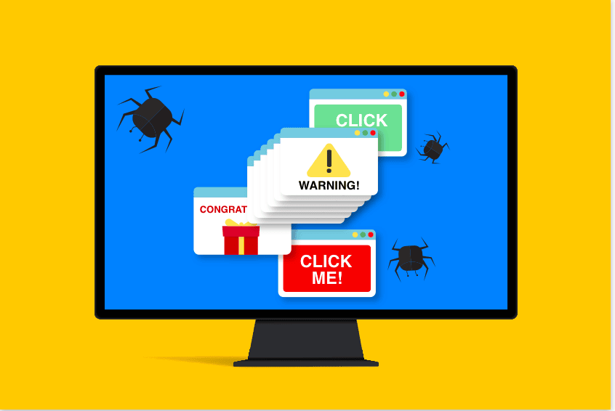
Adware
It displays unwanted ads and pop-ups on the computer. It comes along with software downloads and packages. It generates revenue for the software distributer by displaying ads.

Slide 11
Logic bombs
A logic bomb is malware that is triggered by a speciﬁed condition, such as a given date or a particular user account being disabled.

Slide 12
Bootkit
A bootkit is malware that is a kernel-mode variant of a rootkit, commonly used to attack computers that are protected by full-disk encryption.
Bootkit malware is a type of malicious software that infects the boot process of a computer's operating system, typically at a very low level, such as the Master Boot Record (MBR) or the boot sector.
Bootkits are particularly insidious because they load before the operating system itself, allowing them to evade detection by traditional antivirus software and security measures.

Slide 13
Good Thanks!

