Slide 1

USER AUTHENTICATION
KERBEROS

Slide 2
What is Kerberos?
Literal meaning : In Greek mythology, Kerberos is a multi-headed dog (usually three) which gaurds the entrance of Hades.
Technically Kerberos is
Network Authentication protocol implemented on Project Athena at MIT.
Client server architecture
Uses symmetric key encryption
Requires a third party KDC(Key distribution center ) for keys.

Slide 3

What's with the 3 heads?
Authentication: confirms that a user who is requesting services is a valid user of the network .
Authorization: granting of specific types of service to a user, based on their authentication.
Accounting : The tracking of the consumption of network resources by users.

Slide 4
Problem:
Cannot trust workstation to identify their users correctly in an open distributed environment
Solution:
Building elaborate authentication protocols at each server
A centralized authentication server (Kerberos)

Slide 5
The main components of Kerberos are:
Authentication Server (AS): The Authentication Server performs the initial authentication and ticket for Ticket Granting Service.
Database: The Authentication Server verifies the access rights of users in the database.
Ticket Granting Server (TGS): The Ticket Granting Server issues the ticket for the Server

Slide 6
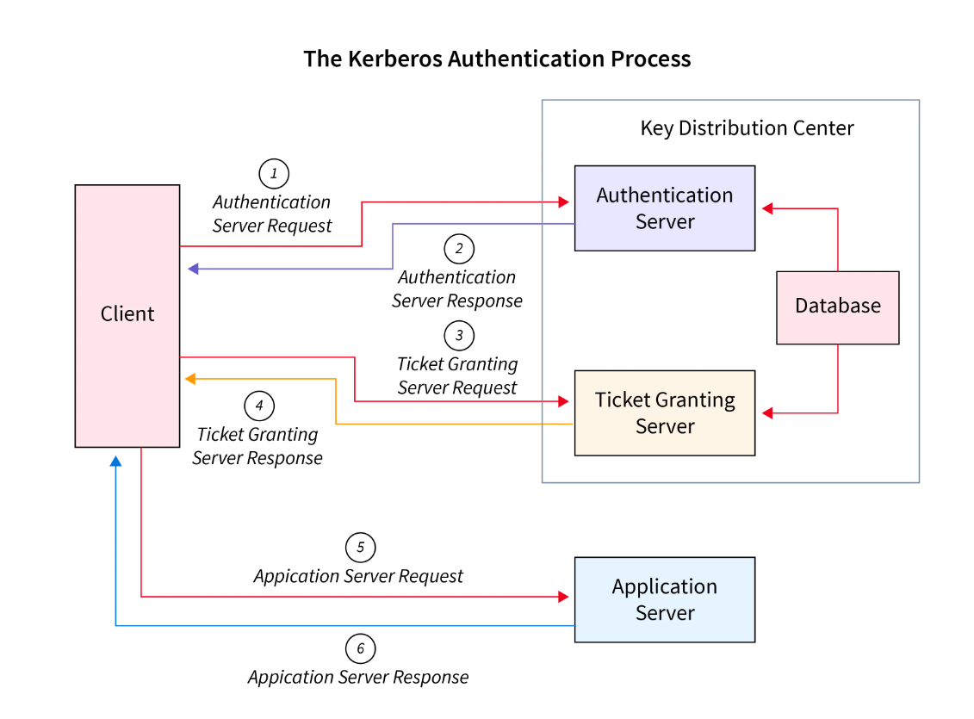

Slide 7
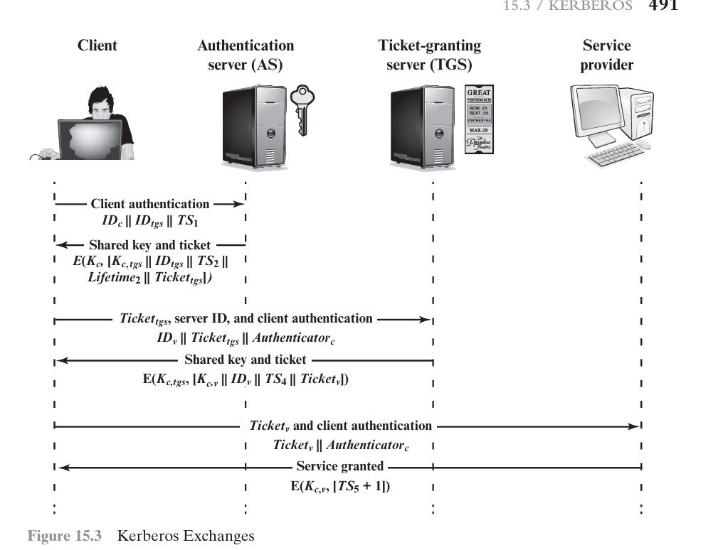

Slide 8
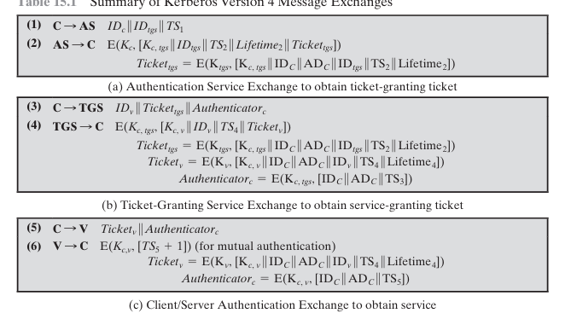

Slide 9
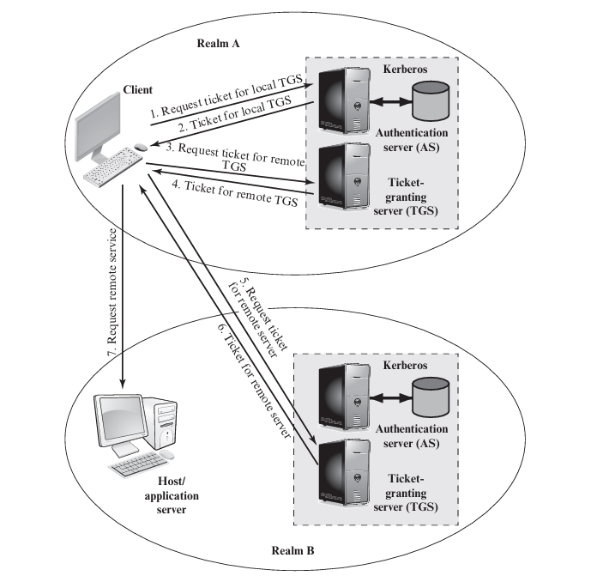

Slide 10
Versions :
Version 4 :
Version 5 (KRB5):
Most widely used version.
Used DES for encryption.
It provides ticket support.
the ticket lifetime has to be specified in units for a lifetime of 5 minutes.
The current version.
Introduced significant improvements over Version 4.
Utilizes stronger encryption algorithms.
the ticket lifetime is specified with the freedom of arbitrary time.
Provides better security and scalability.

Slide 11
Advantages and Disadvantages
ADVANTAGES:
Kerberos is suitable for authentication and confidentiality services within a network environment.
Once a user logs in to the system, then all the related Kerberos ticket operation happens automatically.
Kerberos protocol uses a unique ticketing system in order to provide faster authentication.
DISADVANTAGES:
Kerberos system is dependent on a centralized server. If server is down, no one can login.
If an hacker accesses KDC, then the entire Kerberos authentication system is at risk.
If the user's clock is not synchronized with the Kerberos server's clock, then the authentication will fail.

Slide 12
Thank You
K.GAYATRI
21131A0597

