Slide 1

WIRELESS SECURITY
KOLLABATTHINA RAHUL
21131A0596

Slide 2

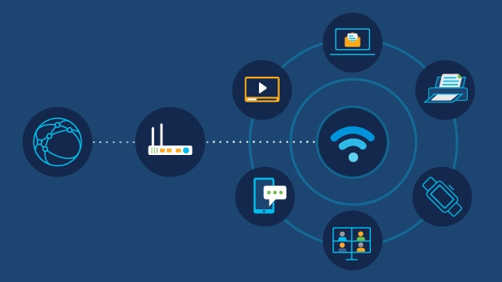
WIRELESS NETWORK
In the context of network security, a wireless network refers to a network that uses wireless communication technology to connect devices and transmit data.
Wireless networks introduce unique security challenges due to the inherent nature of radio waves being susceptible to interception and unauthorized access.

Slide 3
WIRELESS NETWORK THREATS
1.MALICIOUS ASSOCIATION
Malicious association in wireless networks refers to a type of attack where an unauthorized device or attacker gains access to a wireless network.
By associating with a legitimate access point or by impersonating a legitimate device.
This attack takes advantage of vulnerabilities in the wireless network's authentication and access control mechanisms.
In some cases, an attacker may deploy a rogue access point within the range of the wireless network.
The rogue access point may have a legitimate-sounding SSID (Service Set Identifier) or may impersonate an existing access point in the network.
An attacker may impersonate a legitimate wireless client or access point by spoofing MAC addresses or other identifying information.
By masquerading as a trusted device, the attacker can trick the wireless network into granting access privileges.

Slide 4
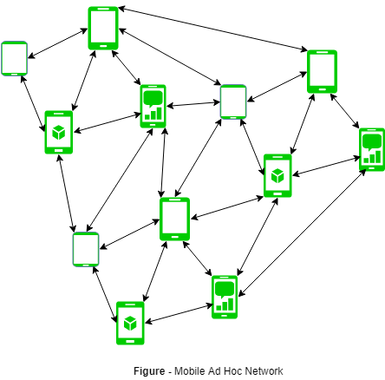
2.ADHOC NETWORKS
Ad hoc networks are decentralized wireless networks that are formed spontaneously without the need for a pre-existing infrastructure or centralized administration.
In ad hoc networks, devices communicate with each other directly, creating a temporary network for the purpose of sharing resources, information, or services.
The topology of ad hoc networks is dynamic and can change frequently as devices join or leave the network, or as they move within the network range.
Ad hoc networks face unique security challenges due to their decentralized nature and lack of centralized control.

Slide 5

3.NON-TRADITIONAL NETWORKS
Non-traditional networks" typically refer to types of networks that deviate from the conventional wired or wireless infrastructures commonly seen in traditional networking environments.
These networks often involve unconventional or emerging technologies and architectures.
They are commonly used in scenarios where traditional wired or infrastructure-based wireless networks are not feasible, such as military operations, disaster recovery, or peer-to-peer communication among mobile devices.Ex:IOT
Internet of Things (IoT) Networks: IoT networks connect a wide range of everyday objects and devices to the internet, allowing them to communicate, collect data, and perform automated tasks.

Slide 6
4.IDENTITY THEFT
Identity theft in wireless networks refers to the unauthorized acquisition and use of personal or sensitive information belonging to an individual or organization through wireless communication channels.
Attackers may intercept wireless communications between devices, such as laptops, smartphones, or IoT devices, to capture sensitive information transmitted over the airwaves.
This can include usernames, passwords, credit card numbers, or other personally identifiable information (PII) exchanged during online transactions or data transfers.
Man-in-the-Middle (MitM) Attacks: In a MitM attack, an attacker intercepts communications between two parties and may modify or manipulate the data exchanged between them.
Evil Twin Attacks: In an evil twin attack, the attacker sets up a rogue wireless access point with a name (SSID) and configuration identical to that of a legitimate network.
Phishing: Attackers may use wireless networks to launch phishing attacks, where they send deceptive emails, text messages, or pop-up notifications to trick users into providing their personal information, such as login credentials, Social Security numbers, or financial data.
Identity theft in wireless networks poses significant risks to individuals and organizations, as it can lead to financial loss, privacy violations, reputational damage, and legal consequences.

Slide 7
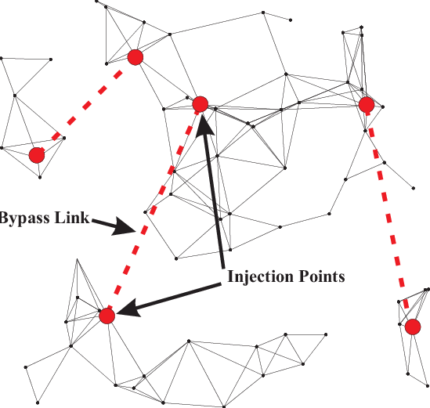
5.NETWORK INJECTION
Network injection, also known as packet injection or packet injection attack, is a technique used in computer networks to inject specially crafted packets into a data stream.
This technique is often employed for various purposes, including network testing, security assessment, and malicious exploitation.
Network injection can serve both legitimate and malicious purposes. Legitimate uses include network testing, debugging, and security assessment to identify vulnerabilities or assess the resilience of network defenses.
Network injection involves generating and transmitting packets that contain specific data payloads or instructions to manipulate the behavior of network devices or protocols.

Slide 8
MEASURES FOR WIRELESS SECURITY
1.Signal Hiding techniques
2.Encryption and authentication
3.Use antivirus s/w and Firewalls
4.Change Routers Pre-set password
5.Allow only specific computers to access your wireless network.

Slide 9
THANK YOU

