Slide 1
Google Kubernetes Engine (GKE) - 75 Real-World Demos
Kalyan Reddy Daida

Slide 2

AWS EKS Kubernetes
DevOps on
AWS & Azure
Jenkins
Azure AKS
Part-2
Ansible
Azure AKS Kubernetes
HashiCorp Certified
Vault & Consul
Azure Certs
AZ-900, 104, 204, 400
DevOps &
SRE
Roadmap
AWS ECS
Docker on AWS
Kubernetes Certifications
CKAD, CKA, CKS
Google Cloud
Associate & Professional Certs
AWS
CloudFormation
HashiCorp Certified Terraform Associate on AWS with 50 Practical Demos
Terraform on AWS with SRE and IaC DevOps with 20 Real-World Demos
HashiCorp Certified Terraform Associate on Azure with 75 Practical Demos
Terraform on Azure with IaC DevOps SRE with 25 Real-World Demos
Terraform on AWS EKS Elastic Kubernetes Service with 50+ Real-World Demos
Google Kubernetes Engine with DevOps - 75+ Real-World Demos
LIVE

Slide 3
Google Cloud Certifications
Road Map
Google Cloud Real-World
Courses Road Map
Digital Cloud Leader
GKE Google Kubernetes Engine with DevOps - 75+ Real-World Demos
Associate Cloud Engineer
Terraform on Google Cloud
with DevOps SRE - 50+ Real-World Demos
Professional Cloud Architect
AWS EKS Kubernetes
Professional Cloud Developer
Azure AKS Kubernetes
Professional Cloud DevOps Engineer
AWS ECS Docker on AWS
Professional Cloud Network Engineer
Terraform on AWS Cloud
Professional Cloud Security Engineer
Terraform on Azure Cloud
Professional Cloud Data Engineer
Terraform on AWS EKS
LIVE

Slide 4
Google Cloud Certifications
Road Map
Google Cloud Real-World
Courses Road Map
Digital Cloud Leader
GKE Google Kubernetes Engine with DevOps - 70+ Real-World Demos
Associate Cloud Engineer
Terraform on Google Cloud
with DevOps SRE - 50+ Real-World Demos
Professional Cloud Architect
Professional Cloud Developer
AWS EKS Kubernetes
Professional Cloud DevOps Engineer
Azure AKS Kubernetes
Best Selling
Courses
AWS ECS Docker on AWS
Professional Cloud Network Engineer
Terraform on AWS Cloud
Professional Cloud Security Engineer
Terraform on Azure Cloud
Professional Cloud Data Engineer
Terraform on AWS EKS
LIVE

Slide 5
Google Kubernetes Engine GKE with DevOps|75 Real-World Demos
Kalyan Reddy Daida

Slide 6

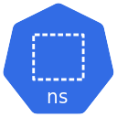



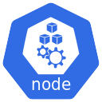
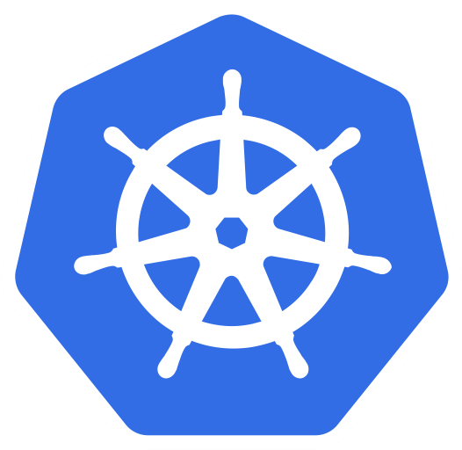
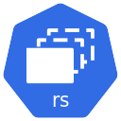

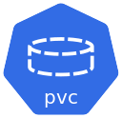
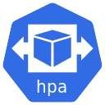
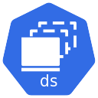
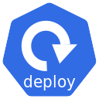


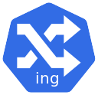

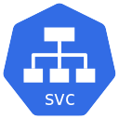

Namespace
Service
Account
Cluster
Autoscaler
Pod
Storage Class
Config Map
ReplicaSet
Namespace
Resource Quota
Persistent
Volume Claim
Volume Snapshot
Class
Horizontal Pod
Autoscaler
Daemonset
25+
Kubernetes
Concepts
Deployment
Namespace
Limit Range
Persistent
Volume
Volume
Snapshot
Ingress
Service
Requests
& Limits
NodePort
Service
Headless
Service
ClusterIP
Service
External Name
Service
Load Balancer
Service
Secrets

Slide 7
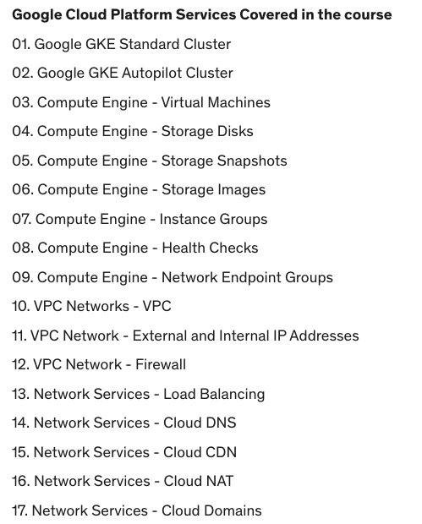
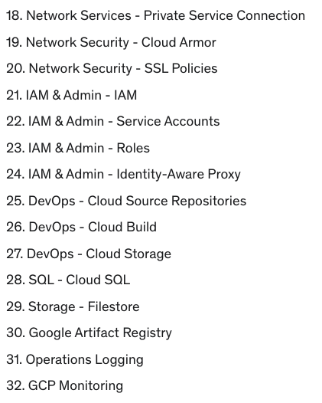
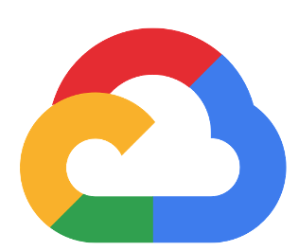
32+
Google Cloud
Services
75
Real-World
Demos

Slide 8
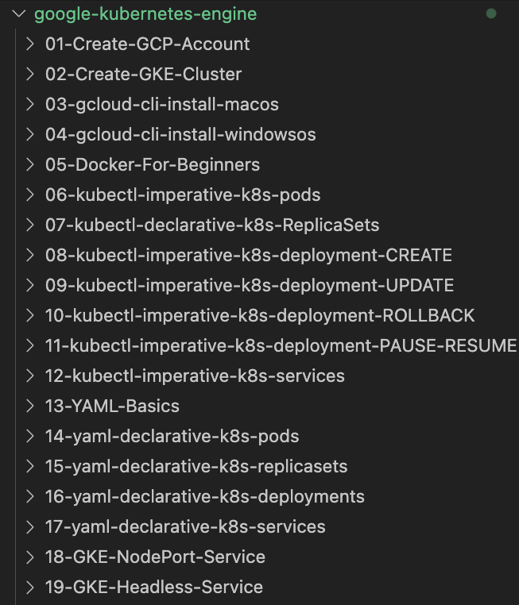
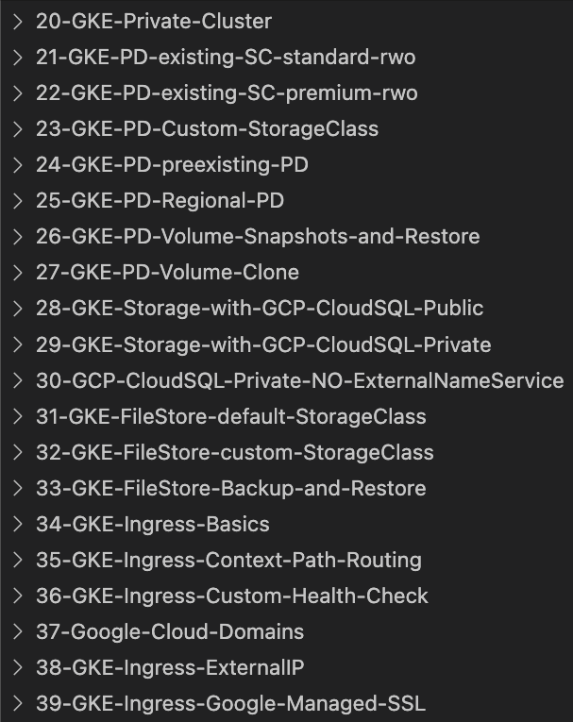
GitHub Step-by-Step Documentation

Slide 9
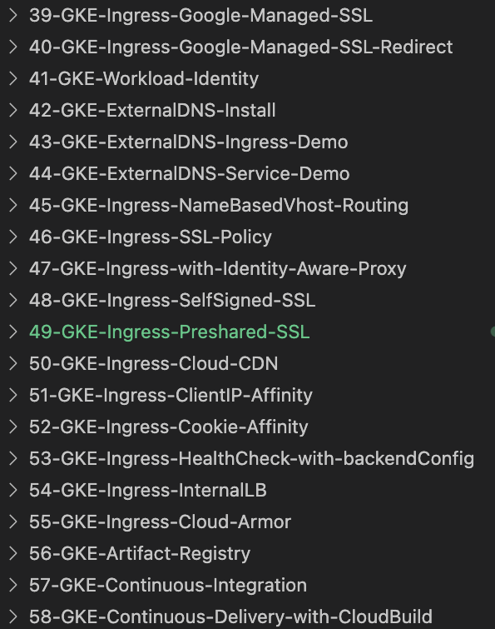
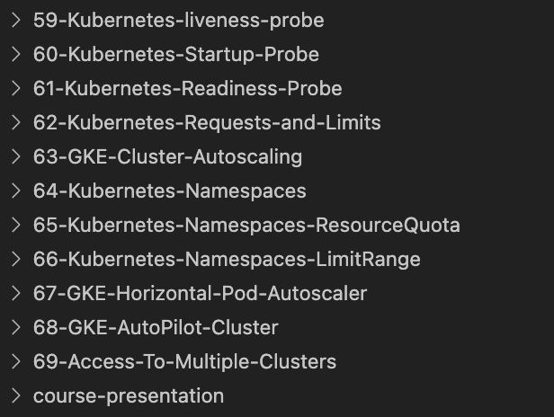
GitHub Step-by-Step Documentation

Slide 10
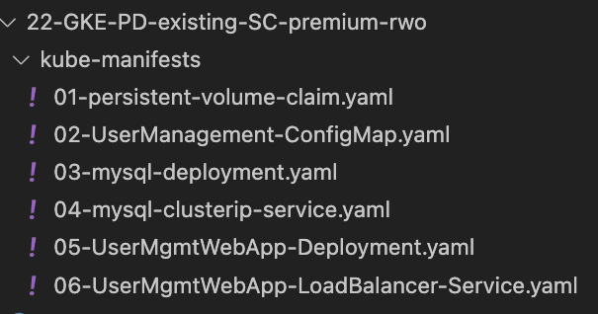
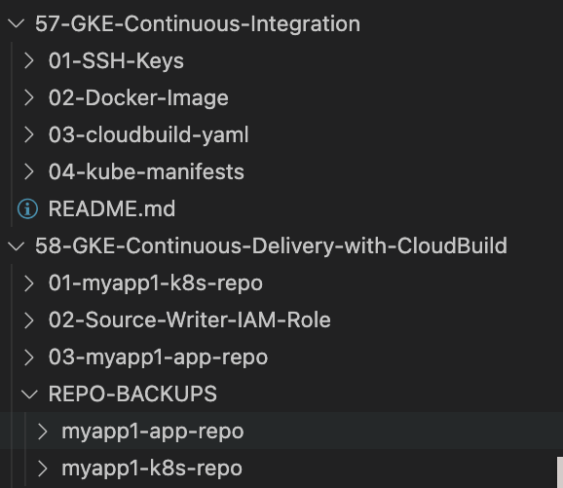
How are Kubernetes YAML Manifests organized ?
Every Demo is very well documented in GitHub and every file used is organized in sequential order based on how demo progresses.

Slide 11

GitHub Repository
Repository Used For | Repository URL
Course Main Repository with step-by-step documentation | https://github.com/stacksimplify/google-kubernetes-engine
Course Presentation | https://github.com/stacksimplify/google-kubernetes-engine/tree/main/course-presentation
Docker Fundamentals | https://github.com/stacksimplify/docker-fundamentals
Docker Fundamentals Presentation | https://github.com/stacksimplify/docker-fundamentals/tree/master/otherfiles/presentation
400+ presentation slides outlining various architectures and concepts we have implemented

Slide 12
Kubernetes - Architecture
Master
Worker Node
Kube Controller Manager
Cloud Controller Manager
Kubelet
Kube-Proxy
Container Runtime (Docker)
kube-apiserver
Worker Node
etcd
kube-scheduler
Kubelet
Kube-Proxy
Container Runtime (Docker)
Container Runtime (Docker)

Slide 13
Kubernetes - Imperative & Declarative
Kubernetes Fundamentals
Imperative
Declarative
kubectl
YAML & kubectl
Pod
Pod
ReplicaSet
ReplicaSet
Deployment
Deployment
Service
Service

Slide 14
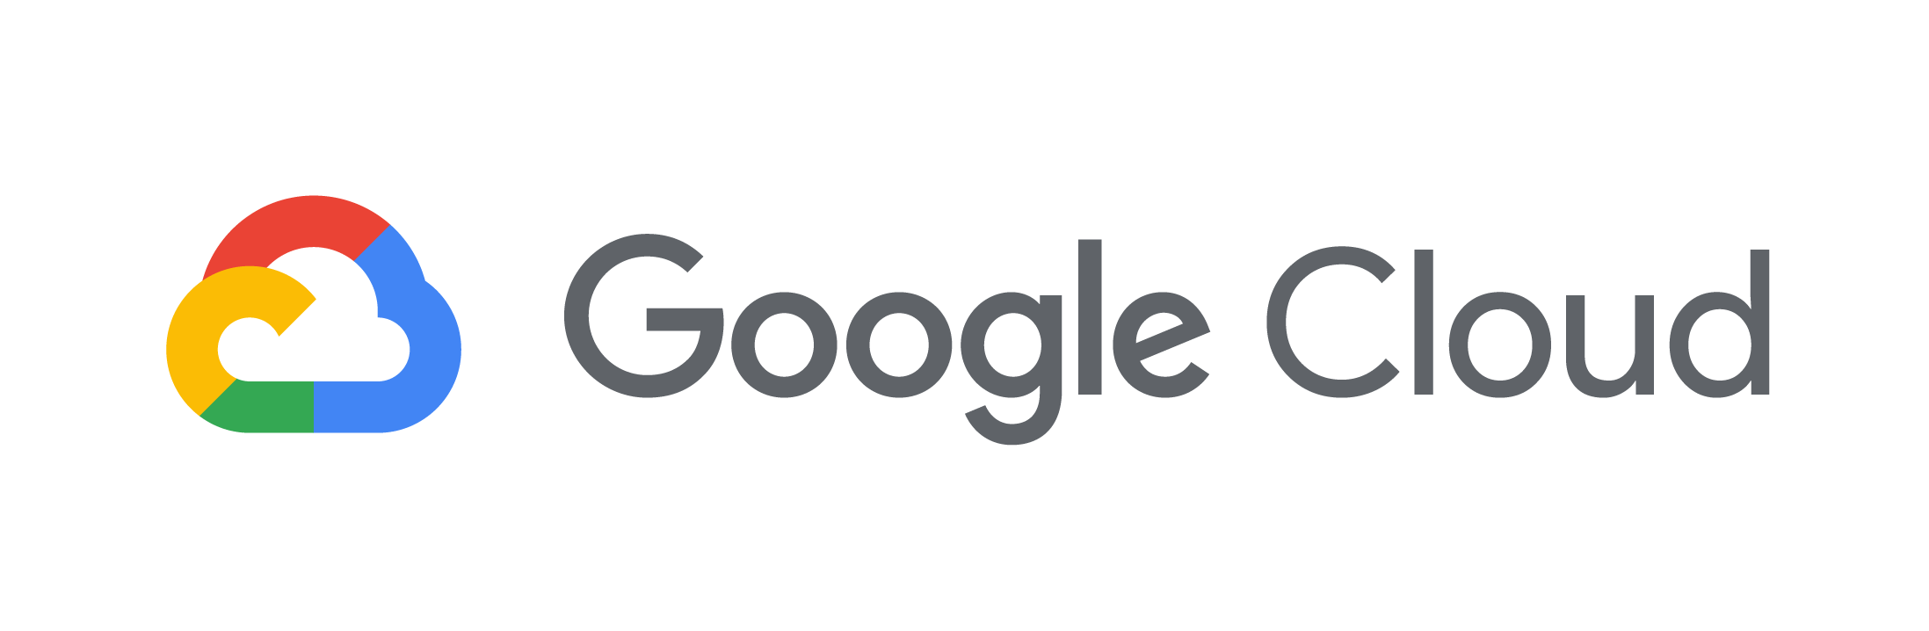





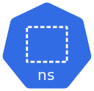


GKE Private Cluster - Network Design
Customer Project: kdaida123
Google Managed Project
Customer VPC: default
VPC Network Peering
Google Managed VPC Network
Private Connectivity
Region: us-central1
Region: us-central1
Cloud NAT
GKE Control Plane
GKE Cluster
Subnet: 10.128.0.0/20
Zone: us-central1-a
Zone: us-central1-b
GKE Node-1
GKE Node-2
Kubernetes Namespaces
kube-system
kube-public
kube-node-lease
default
NETWORK
DESIGN

Slide 15




GKE Private Cluster - Pull Docker Image from Docker Hub
Customer Project: kdaida123
Google Managed Project
Customer VPC: default
VPC Network Peering
Google Managed VPC Network
Private Connectivity
Users
Region: us-central1
Region: us-central1
Cloud
Load Balancing
Cloud NAT
GKE Control Plane
GKE Cluster
Subnet: 10.128.0.0/20
Zone: us-central1-a
Zone: us-central1-b
GKE Node-1
GKE Node-2
NETWORK
DESIGN
Load Balancer Service
Deployment
ReplicaSet
Docker Hub

Slide 16


GKE Storage with Compute Engine Persistent Disk CSI Driver
GKE Cluster
http://<LoadBalancer-IP>
UserMgmt - LB Service
REST API
LB Service - GCP LB
POD
Deployment
Users
ReplicaSet
Environment Variables
Deployment (UserMgmt)
YAML
MySQL – ClusterIP Service
GKE Storage GCE PD CSI Driver
GCE Persistence Disk
Storage Class
Environment Variables
Persistent Volume Claim
Volumes
MySql
Config Map
Volume Mounts
POD
ReplicaSet
Deployment
Deployment (mysql)
ClusterIP Service

Slide 17

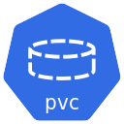


GKE Storage with Compute Engine Persistent Disk CSI Driver
default namespace
GKE Cluster
UserMgmt Deployment
http//<LB-IP>
Load Balancer Service
k8s Pods
k8s ReplicaSet
k8s Deployment
MySQL k8s ClusterIP Service
Note-1: PVC Claims must exist in the same namespace as the Pod using the claim. The cluster finds the claim in the Pod's namespace and uses it to get the PersistentVolume backing the claim
MySQL Deployment
Note-2: A PersistentVolume (PV) is a piece of storage in the cluster that has been provisioned by an administrator or dynamically provisioned using Storage Classes. It is a resource in the cluster just like a node is a cluster resource
k8s Persistent Volume Claim
k8s
Pods
k8s
ReplicaSet
k8s
Deployment
k8s
ConfigMap
Note-3: PVC Status changes from Pending to Bound after MySQL Deployment
k8s Storage Class
k8s Persistent Volume

Slide 18
GKE Storage - Custom Kubernetes Storage Class
default namespace
GKE Cluster
UserMgmt Deployment
http//<Load-Balancer-IP>
Load Balancer Service
k8s Pods
k8s ReplicaSet
k8s Deployment
We are going to create a Custom k8s Storage Class
gke-pd-standard-rwo-sc
MySQL k8s ClusterIP Service
MySQL Deployment
k8s Persistent Volume Claim
k8s
Pods
k8s
ReplicaSet
k8s
Deployment
k8s
ConfigMap
k8s Storage Class
k8s Persistent Volume

Slide 19
GKE Storage - Volume Snapshots
Project-02
GKE Cluster
default namespace
UserMgmt Deployment
http//<Load-Balancer-IP>
Volume Snapshots
Load Balancer Service
k8s Pods
k8s ReplicaSet
k8s Deployment
Volume Snapshot Class
MySQL k8s ClusterIP Service
Volume Snapshot
MySQL Deployment
k8s Persistent Volume Claim
k8s
Pods
k8s
ReplicaSet
k8s
Deployment
k8s
ConfigMap
k8s Storage Class
k8s Persistent Volume

Slide 20
GKE Storage with Compute Engine Persistent Disk CSI Driver
GKE Cluster
LB Services - GCP LB
http://<LoadBalancer-IP>
UserMgmt - LB Service
Deployment
Users
REST API
Environment Variables
GKE Storage GCE PD CSI Driver
POD
ReplicaSet
YAML
Deployment (UserMgmt)
MySQL – ClusterIP Service
StatefulSets
GCE Persistence Disk
Drawbacks of GCE PD CSI for MySQL DB
Storage Class
Environment Variables
Complex setup to achieve HA
Persistent Volume Claim
Volumes
Complex Master-Master MySQL setup
MySql
Config Map
Volume Mounts
Complex Master-Slave MySQL setup
POD
ReplicaSet
No Automatic Backup & Recovery
Deployment
Deployment (mysql)
ClusterIP Service
No Auto-Upgrade MySQL

Slide 21

Cloud SQL as Storage for GKE Workloads
http://<LoadBalancer-IP>
UserMgmt - LB Service
GKE Cluster
Users
LB Services - GCP LB
Deployment
REST API
Environment Variables
POD
ReplicaSet
External Name Service
Deployment (UserMgmt)
YAML
MySQL - ExternalName Service
GKE Storage Cloud SQL
High Availability
Metrics & Monitoring
Backup & Recovery
Automatic Upgrades
Fully Managed
Cloud SQL
Multi-Zone Support
Cloud SQL MySQL Full Feature List: https://cloud.google.com/sql/docs/features#mysql

Slide 22
GKE Workloads and Cloud SQL Public IP
Customer Project: kdaida123
Service Producer Project for Customer
Customer VPC: default
Service Producer VPC Network
Users
Region: us-central1
Region: us-central1
Cloud
Load Balancing
Cloud NAT
C
L
O
U
D
SQL
PUB
L
IC
IP
Subnet: UNKNOWN
NETWORK
DESIGN
GKE Cluster
Subnet: 10.128.0.0/20
Zone: us-central1-a
Zone: us-central1-a
Zone: us-central1-b
GKE Node-1
GKE Node-2
Communication is
via Internet
Cloud SQL
MySQL DB
Load Balancer Service
Deployment
ReplicaSet
UMS
Zone: us-central1-b
Cloud SQL
MySQL DB
External Name Service

Slide 23
GKE Workloads and Cloud SQL Private Service Access
Customer Project: kdaida123
Service Producer Project for Customer
Customer VPC: default
VPC Network Peering
Service Producer VPC Network
Private Connection
(10.240.0.0/16)
Users
Region: us-central1
Region: us-central1
Cloud
Load Balancing
C
L
O
U
D
SQL
PRIVATE IP
Subnet: 10.240.0.0/24
NETWORK
DESIGN
GKE Cluster
Subnet: 10.128.0.0/20
Zone: us-central1-a
Zone: us-central1-a
Zone: us-central1-b
GKE Node-1
GKE Node-2
Cloud SQL
MySQL DB
Load Balancer Service
Communication is
Private (Internal to
Google Cloud)
Deployment
ReplicaSet
UMS
Zone: us-central1-b
Cloud SQL
MySQL DB
External Name Service

Slide 24
GKE Workloads and Cloud SQL Private Service Access
Customer Project: kdaida123
Service Producer Project for Customer
Customer VPC: default
VPC Network Peering
Service Producer VPC Network
Private Connection
(10.240.0.0/16)
Users
Region: us-central1
Region: us-central1
Cloud
Load Balancing
C
L
O
U
D
SQL
PRIVATE IP
Subnet: 10.240.0.0/24
NETWORK
DESIGN
GKE Cluster
Subnet: 10.128.0.0/20
Zone: us-central1-a
Zone: us-central1-a
Zone: us-central1-b
GKE Node-1
GKE Node-2
Cloud SQL
MySQL DB
Load Balancer Service
Communication is
Private (Internal to
Google Cloud)
Deployment
ReplicaSet
Zone: us-central1-b
Cloud SQL
MySQL DB

Slide 25

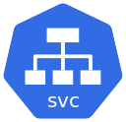



GKE Storage: FileStore Dynamic Provisioning
default namespace
GKE Cluster
myapp1
http://<LB-IP>/filestore/myapp1.txt
Load Balancer
Service
Pods
ReplicaSet
Deployment
We will use k8s Storage Class created by default
standard-rwx
Note-2: A PersistentVolume (PV) is a piece of storage in the cluster that has been provisioned by an administrator or dynamically provisioned using Storage Classes. It is a resource in the cluster just like a node is a cluster resource
GFS Writer POD
Persistent
Volume Claim
Pod
Note-1: PVC Claims must exist in the same namespace as the Pod using the claim. The cluster finds the claim in the Pod's namespace and uses it to get the PersistentVolume backing the claim
Dynamically Provisioned
File Store
Storage Class
Persistent Volume

Slide 26
GKE Storage: FileStore Volume Snapshot
Project-02
default namespace
GKE Cluster
myapp1
http://<LB-IP>/filestore/myapp1.txt
Load Balancer Service
Pods
ReplicaSet
Deployment
Volume Snapshots
for
myapp1
Volume Snapshot
Volume Snapshot Class
EFS Writer POD
Persistent
Volume Claim
Pod
Dynamically Provisioned
File Store
Storage Class
Persistent Volume

Slide 27
GKE Storage: FileStore Volume Restore
Project-03
default namespace
GKE Cluster
myapp2
http://<LB-IP>/filestore/myapp1.txt
Load Balancer
Service
Pods
ReplicaSet
Deployment
Volume Restore
for
myapp2 from myapp1 Volume Snapshot
Datasource
Volume Snapshot
Persistent
Volume Claim
Dynamically Provisioned
File Store
Storage Class
Persistent Volume

Slide 28
GKE Services supported based on OSI Layers
L4 Layer
L7 Layer
Protocols
TCP
UDP
Protocols
HTTP
HTTPS
HTTP2
GKE Services
Cluster IP Service
GKE Services
Internal Ingress Service
NodePort Service
Ingress
External Ingress Service
Internal Load Balancer Service
Multi Cluster Ingress Service
External Load Balancer Service

Slide 29
Ingress Basics
http://<LB-IP>
Customer Project: kdaida123
Customer VPC: default
Users
Region: us-central1
Cloud
Load Balancing
Subnet: 10.128.0.0/20
Zone: us-central1-a
Zone: us-central1-b
NETWORK
DESIGN
GKE Cluster
GKE Node-1
GKE Node-2
App1 NodePort Service
Default Backend
Ingress Service
App3 Deployment
Ingress

Slide 30

Ingress Context Path Based Routing
Customer Project: kdaida123
http://<LB-IP>/app1/index.html
http://<LB-IP>/app2/index.html
http://<LB-IP>/
Customer VPC: default
Users
Region: us-central1
Subnet: 10.128.0.0/20
Cloud
Load Balancing
Zone: us-central1-a
Zone: us-central1-b
GKE Node-1
GKE Node-2
NETWORK
DESIGN
GKE Cluster
App1 NodePort
App1 Deployment
/app1
/app2
App2 NodePort
App2 Deployment
Ingress Service
Default Backend
App3 NodePort
App3 Deployment
Ingress

Slide 31
Ingress - Custom Health Checks
Customer Project: kdaida123
http://<LB-IP>/app1/index.html
http://<LB-IP>/app2/index.html
http://<LB-IP>/
Customer VPC: default
Users
Region: us-central1
Subnet: 10.128.0.0/20
Cloud
Load Balancing
Zone: us-central1-a
Zone: us-central1-b
GKE Node-1
GKE Node-2
NETWORK
DESIGN
GKE Cluster
Custom Health Check
App1 NodePort
App1 Deployment
/app1
Custom Health Check
/app2
App2 NodePort
App2 Deployment
Custom Health Check
Ingress Service
Default Backend
App3 NodePort
App3 Deployment
Ingress

Slide 32


http://demo1.kalyanreddydaida.com/app1/index.html
Customer Project: kdaida123
Cloud DNS
Cloud Domains
kalyanreddydaida.com
http://demo1.kalyanreddydaida.com/app2/index.html
http://demo1.kalyanreddydaida.com/
Customer VPC: default
Users
Region: us-central1
Subnet: 10.128.0.0/20
Cloud External
IP Address
Zone: us-central1-a
Zone: us-central1-b
GKE Node-1
GKE Node-2
NETWORK
DESIGN
GKE Cluster
Cloud
Load Balancing
Custom Health Check
App1 NodePort
App1 Deployment
/app1
Custom Health Check
/app2
App2 NodePort
App2 Deployment
Custom Health Check
Ingress Service
Default Backend
External IP
App3 NodePort
App3 Deployment
Ingress
Ingress
External IP

Slide 33
http://demo1.kalyanreddydaida.com
https://demo1.kalyanreddydaida.com
Customer Project: kdaida123
Cloud DNS
Cloud Domains
kalyanreddydaida.com
Customer VPC: default
Users
Region: us-central1
Subnet: 10.128.0.0/20
Cloud External
IP Address
Zone: us-central1-a
Zone: us-central1-b
GKE Node-1
GKE Node-2
NETWORK
DESIGN
GKE Cluster
Google-Managed
SSL Certificates
Cloud
Load Balancing
Custom Health Check
App1 NodePort
App1 Deployment
/app1
Custom Health Check
/app2
App2 NodePort
App2 Deployment
Custom Health Check
Ingress Service
Default Backend
External IP
SSL
App3 NodePort
App3 Deployment
Ingress
Ingress
Managed
SSL

Slide 34
HTTP -> HTTPS
https://demo1.kalyanreddydaida.com
Customer Project: kdaida123
Cloud DNS
Cloud Domains
kalyanreddydaida.com
Customer VPC: default
Users
Region: us-central1
Subnet: 10.128.0.0/20
Cloud External
IP Address
Zone: us-central1-a
Zone: us-central1-b
GKE Node-1
GKE Node-2
NETWORK
DESIGN
GKE Cluster
Google-Managed
SSL Certificates
Cloud
Load Balancing
Custom Health Check
App1 NodePort
App1 Deployment
/app1
Custom Health Check
/app2
App2 NodePort
App2 Deployment
Custom Health Check
Ingress Service
Default Backend
External IP
SSL
App3 NodePort
App3 Deployment
SSL Redirect
Ingress
Ingress
SSL
Redirect

Slide 35




Customer Project: kdaida123
NETWORK
DESIGN
Customer VPC: default
GKE Cluster
Region: us-central1
IAM
Subnet: 10.128.0.0/20
Zone: us-central1-a, 1-b, 1-c
Authentication
Fixed Workload Identity Pool
GKE Node-1,2,3
Namespace: kube-system
IAM Policy Binding
GKE MDS DaemonSet
IAM Service Account
IAM Role
Compute Engine
Namespace: wid-kns
wid-no-sa
wid-with-sa
wid-ksa
GKE VM Node1
GKE VM Node2
GKE VM Node3
List VMs Access Granted
GKE
Workload
Identity
List VMs Access Denied

Slide 36
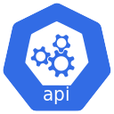
Deploy Ingress /service k8s Manifest with external-dns Annotations
GKE - External DNS Install
Customer Project: kdaida123
NETWORK
DESIGN
Customer VPC: default
GKE Cluster
Region: us-central1
IAM
Subnet: 10.128.0.0/20
Zone: us-central1-a, 1-b, 1-c
Authentication
Fixed Workload Identity Pool
GKE Node-1,2,3
Namespace: kube-system
IAM Policy Binding
K8s API Server
IAM Service Account
IAM Role
(Cloud DNS Admin)
GKE MDS DaemonSet
Cloud DNS
Namespace: external-dns-ns
app1.kalyanreddydaida.com
external-dns Deployment
app2.kalyanreddydaida.com
ext-dns-ksa
Create / Update / Delete DNS Records in Cloud DNS
app3.kalyanreddydaida.com
External-dns retrieves a list of resources (Services, Ingresses, etc.)
from the Kubernetes API Server to determine a desired list of DNS records that need to be created / updated / deleted from Google Cloud DNS

Slide 37
http://ingressextdns101.kalyanreddydaida.com
Customer Project: kdaida123
Cloud DNS
Cloud Domains
kalyanreddydaida.com
Customer VPC: default
Users
Region: us-central1
Subnet: 10.128.0.0/20
Cloud External
IP Address
Zone: us-central1-a
Zone: us-central1-b
GKE Node-1
GKE Node-2
NETWORK
DESIGN
GKE Cluster
Cloud
Load Balancing
Custom Health Check
Default Backend
App3 NodePort
App3 Deployment
Ingress Service
External DNS
Ingress
Ingress
ExternalDNS
Demo

Slide 38
http://extdns-k8s-svc-demo.kalyanreddydaida.com
Customer Project: kdaida123
Cloud DNS
Cloud Domains
kalyanreddydaida.com
Customer VPC: default
Users
Region: us-central1
Subnet: 10.128.0.0/20
Cloud External
IP Address
Zone: us-central1-a
Zone: us-central1-b
GKE Node-1
GKE Node-2
NETWORK
DESIGN
GKE Cluster
Cloud
Load Balancing
App Deployment
Kubernetes
Load Balancer Service
Kubernetes Load Balancer Service
External DNS
Demo
External DNS

Slide 39
SSL Policies
SSL policies specify the set of SSL features that Google Cloud load balancers use when negotiating SSL with clients
COMPATIBLE
Allows the broadest set of clients, including clients that support only out-of-date SSL features
MODERN
Supports a wide set of SSL features, allowing modern clients to negotiate SSL.
RESTRICTED
Supports a reduced set of SSL features, intended to meet stricter compliance requirements.
CUSTOM
CUSTOM profile lets you select SSL features individually

Slide 40
HTTP -> HTTPS
https://app1-ingress.kalyanreddydaida.com
Customer Project: kdaida123
https://app2-ingress.kalyanreddydaida.com
Cloud DNS
Cloud Domains
kalyanreddydaida.com
https://default-ingress.kalyanreddydaida.com
Customer VPC: default
Users
Region: us-central1
Subnet: 10.128.0.0/20
Cloud External
IP Address
Zone: us-central1-a
Zone: us-central1-b
GKE Node-1
GKE Node-2
NETWORK
DESIGN
GKE Cluster
Google-Managed
SSL Certificates
Cloud
Load Balancing
Custom Health Check
App1 NodePort
App1 Deployment
app1-ingress.kalyanreddydaida.com
Custom Health Check
app2-ingress.kalyanreddydaida.com
App2 NodePort
App2 Deployment
Custom Health Check
Ingress Service
default-ingress.kalyanreddydaida.com
External IP
Ingress
SSL
Policy
SSL
External DNS
App3 NodePort
App3 Deployment
SSL Redirect
SSL Policy
Ingress

Slide 41

HTTP -> HTTPS
https://app1-ingress.kalyanreddydaida.com
Customer Project: kdaida123
https://app2-ingress.kalyanreddydaida.com
Cloud DNS
Cloud Domains
kalyanreddydaida.com
https://app1-ingress.kalyanreddydaida.com
Customer VPC: default
Authenticate & Authorize using IAP
Users
Region: us-central1
Cloud External
IP Address
Subnet: 10.128.0.0/20
Zone: us-central1-a
Zone: us-central1-b
GKE Node-1
GKE Node-2
NETWORK
DESIGN
GKE Cluster
Cloud
Load Balancing
Google-Managed
SSL Certificates
Custom Health Check
Identity-Aware
Proxy
App1 NodePort
App1 Deployment
Ingress
Custom Health Check
app1-ingress.kalyanreddydaida.com
app2-ingress.kalyanreddydaida.com
App2 NodePort
App2 Deployment
default-ingress.kalyanreddydaida.com
Custom Health Check
Ingress Service
External IP
Ingress
With
Identity
Aware
Proxy
SSL
External DNS
BackendConfig
GCP IAP
App3 NodePort
App3 Deployment
SSL Redirect
SSL Policy

Slide 42
HTTP -> HTTPS
https://app1.kalyanreddydaida.com
Customer Project: kdaida123
https://app2.kalyanreddydaida.com
Cloud DNS
Cloud Domains
kalyanreddydaida.com
https://app3-default.kalyanreddydaida.com
Customer VPC: default
Users
Region: us-central1
Subnet: 10.128.0.0/20
Cloud External
IP Address
Zone: us-central1-a
Zone: us-central1-b
GKE Node-1
GKE Node-2
NETWORK
DESIGN
GKE Cluster
Self-Signed
SSL Certificates
Cloud
Load Balancing
Custom Health Check
App1 NodePort
App1 Deployment
app1.kalyanreddydaida.com
Custom Health Check
app2.kalyanreddydaida.com
App2 NodePort
App2 Deployment
Custom Health Check
Ingress Service
app3-default.kalyanreddydaida.com
Ingress
with
Self
Signed
SSL
Certs
External IP
SSL
App3 NodePort
App3 Deployment
SSL Redirect
External DNS
Ingress

Slide 43
HTTP -> HTTPS
https://app1.kalyanreddydaida.com
Customer Project: kdaida123
https://app2.kalyanreddydaida.com
Cloud DNS
Cloud Domains
kalyanreddydaida.com
https://app3-default.kalyanreddydaida.com
Customer VPC: default
Users
Region: us-central1
Subnet: 10.128.0.0/20
Cloud External
IP Address
Zone: us-central1-a
Zone: us-central1-b
GKE Node-1
GKE Node-2
NETWORK
DESIGN
GKE Cluster
Pre-shared
SSL Certificates
Cloud
Load Balancing
Custom Health Check
App1 NodePort
App1 Deployment
app1.kalyanreddydaida.com
Custom Health Check
app2.kalyanreddydaida.com
App2 NodePort
App2 Deployment
Custom Health Check
Ingress Service
app3-default.kalyanreddydaida.com
Ingress
with
Pre-shared
SSL
Certs
External IP
SSL
App3 NodePort
App3 Deployment
SSL Redirect
External DNS
Ingress

Slide 44

http://ingress-cdn-demo.kalyanreddydaida.com
Customer Project: kdaida123
Cloud DNS
Cloud Domains
kalyanreddydaida.com
Customer VPC: default
Users
Region: us-central1
Cloud
CDN
Subnet: 10.128.0.0/20
Zone: us-central1-a
Zone: us-central1-b
GKE Node-1
GKE Node-2
NETWORK
DESIGN
GKE Cluster
Cloud External
IP Address
Cloud
Load Balancing
Custom Health Check
Default Backend
cdn NodePort
cdn Deployment
Ingress Service
BackendConfig
External IP
Timeouts
Access Logs
Ingress
with Cloud CDN
External DNS
Cloud CDN
Ingress

Slide 45
http://ingress-with-clientip-affinity.kalyanreddydaida.com
Customer Project: kdaida123
Cloud DNS
Cloud Domains
kalyanreddydaida.com
Customer VPC: default
Users
Region: us-central1
Subnet: 10.128.0.0/20
Zone: us-central1-a
Zone: us-central1-b
Cloud External
IP Address
GKE Node-1
GKE Node-2
NETWORK
DESIGN
GKE Cluster
Cloud
Load Balancing
Custom Health Check
Default Backend
cdn NodePort
cdn Deployment
Ingress Service
BackendConfig
Ingress
with
Client IP
Affinity
External IP
Timeouts
Access Logs
External DNS
ClientIP Affinity
Ingress

Slide 46
http://ingress-with-cookie-affinity.kalyanreddydaida.com
Customer Project: kdaida123
Cloud DNS
Cloud Domains
kalyanreddydaida.com
Customer VPC: default
Users
Region: us-central1
Subnet: 10.128.0.0/20
Zone: us-central1-a
Zone: us-central1-b
Cloud External
IP Address
GKE Node-1
GKE Node-2
NETWORK
DESIGN
GKE Cluster
Cloud
Load Balancing
Custom Health Check
Default Backend
cdn NodePort
cdn Deployment
Ingress Service
BackendConfig
Ingress
with
Cookie
Affinity
External IP
Timeouts
Access Logs
External DNS
Cookie Affinity
Ingress

Slide 47
Customer Project: kdaida123
http://<loadbalancer-ip>
Customer VPC: default
Users
Region: us-central1
Subnet: 10.128.0.0/20
Zone: us-central1-a
Zone: us-central1-b
Cloud External
IP Address
GKE Node-1
GKE Node-2
NETWORK
DESIGN
GKE Cluster
Cloud
Load Balancing
Default Backend
cdn NodePort
cdn Deployment
Ingress Service
BackendConfig
Ingress
with
Custom
Health
Checks
External IP
Timeouts
Access Logs
External DNS
Health Check
Ingress

Slide 48
Ingress Internal Load Balancer
Customer Project: kdaida123
Customer VPC: default
curl http://<LB-IP>/app1/index.html
curl http://<LB-IP>/app2/index.html
curl http://<LB-IP>/
Users
Region: us-central1
Subnet: 10.128.0.0/20
Cloud Load Balancing (Internal LB)
Zone: us-central1-a
Zone: us-central1-b
GKE Node-1
GKE Node-2
NETWORK
DESIGN
Curl
Pod
GKE Cluster
App1 NodePort
App1 Deployment
/app1
/app2
App2 NodePort
App2 Deployment
Ingress Service
Default Backend
App3 NodePort
App3 Deployment
Ingress

Slide 49

http://cloudarmor-ingress.kalyanreddydaida.com
Customer Project: kdaida123
Cloud DNS
Cloud Domains
kalyanreddydaida.com
Customer VPC: default
Validates rule: throws 403 Forbidden Error if no match
Cloud Armor
Users
Region: us-central1
Subnet: 10.128.0.0/20
Zone: us-central1-a
Zone: us-central1-b
Validation rule: if matches forwards request to lb
GKE Node-1
GKE Node-2
NETWORK
DESIGN
GKE Cluster
Cloud External
IP Address
Cloud
Load Balancing
Custom Health Check
Ingress
Default Backend
App3 NodePort
App3 Deployment
BackendConfig
Ingress Service
Timeouts
Logging
External DNS
Security Policy
Ingress
Cloud Armor

Slide 50


Customer Project: kdaida123
http://<Load-Balancer-IP-Address>
Customer VPC: default
Users
Region: us-central1
Cloud
Load Balancing
Subnet: 10.128.0.0/20
Zone: us-central1-a
Zone: us-central1-b
GKE Node-1
GKE Node-2
NETWORK
DESIGN
GKE Cluster
Google
Artifact
Registry
Kubernetes
Load Balancer Service
Google
Artifact Registry
Pull Docker Image
Kubernetes Deployment
Push Docker Image
Admin

Slide 51


Continuous Integration
Continuous Integration Pipeline
Google
Cloud Source
Google
Cloud Build
Google
Artifact Registry
To Store Code
(Docker Files)
To Build Packages
(Build Docker Image)
To Store Packages
(Store Docker Image)

Slide 52

Google Cloud Build: Continuous Integration
Customer Project: kdaida123
Check-in Code
Google
Cloud Source
Admin
Region: us-central1
Trigger the Code Build CI Pipeline
Google
Cloud Build
Build and push new Docker Image
Google
Artifact Registry
© Kalyan Reddy Daida

Slide 53
GKE CI CD Pipelines
1
Check-in App Code
Admin
Customer Project: kdaida123
Cloud Source
(Application Code)
Push Kubernetes YAML Manifests with Docker Image tag as COMMIT_SHA
4
Cloud Source
(k8s yaml Code)
Region: us-central1
2
5
Trigger the Continuous Delivery Pipeline
Trigger the Continuous Integration Pipeline
Cloud Build
(myapp1-ci)
6
Pull Docker Image
Cloud Build
(myapp1-cd)
3
Deploy k8s Manifests to GKE Cluster
Build and push new Docker Image
7
Google
Artifact Registry
Google
GKE Cluster
Continuous Integration
Continuous Deployment
© Kalyan Reddy Daida

Slide 54
Kubernetes Probes
Liveness Probe
Startup Probe
Readiness Probe

Slide 55
Kubernetes Requests & Limits
Requests & Limits are the mechanisms Kubernetes uses to control resources such as CPU and Memory
Requests
CPU
Memory
Requests
CPU
Memory
Limits
CPU
Memory
Limits
CPU
Memory
Container-1
Container-2
Kubernetes Pod
Requests and Limits are per container basis in a Pod.

Slide 56
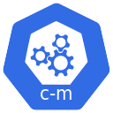

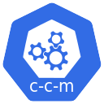
Customer Project: kdaida123
Customer VPC: default
Region: us-central1
Subnet: 10.128.0.0/20
Default Node Pool
GKE Cluster
Control Plane
GKE
Cluster
Autoscaler
Pods in Pending State
Node-1
Node-2
Node-3
Node-4
Scale-Out
Schedules Pods on
Nodes in a NodePool
CPU
CPU
CPU
CPU
MEM
MEM
MEM
MEM
Cluster Autoscaler Enabled

Slide 57
Customer Project: kdaida123
Customer VPC: default
Region: us-central1
Subnet: 10.128.0.0/20
Default Node Pool
GKE Cluster
Control Plane
GKE
Cluster
Autoscaler
Scale-In
Node-1
Node-2
Node-3
Schedules Pods on
Nodes in a NodePool
CPU
CPU
CPU
MEM
MEM
MEM
Cluster Autoscaler Enabled

Slide 58
Kubernetes Namespaces
GKE Cluster
kube-system Namespace
kube-public Namespace
Contains all the Kubernetes System Components.
Its good idea to not touch this Namespace.
Readable by all clients (including those not authenticated).
Mostly reserved for cluster usage, in case that some resources should be visible and readable publicly throughout the whole cluster
Not for Application Workloads
Not for Application Workloads
kube-node-lease Namespace
default Namespace
Holds Lease objects associated with each node.
Node leases allow the kubelet to send heartbeats so that the control plane can detect node failure.
Any Kubernetes object (Pod, Service, Deployment) by default creates in this namespace.
Kubernetes includes this namespace so that you can start using your new cluster without first creating a namespace.
Not for Application Workloads
For Application Workloads

Slide 59
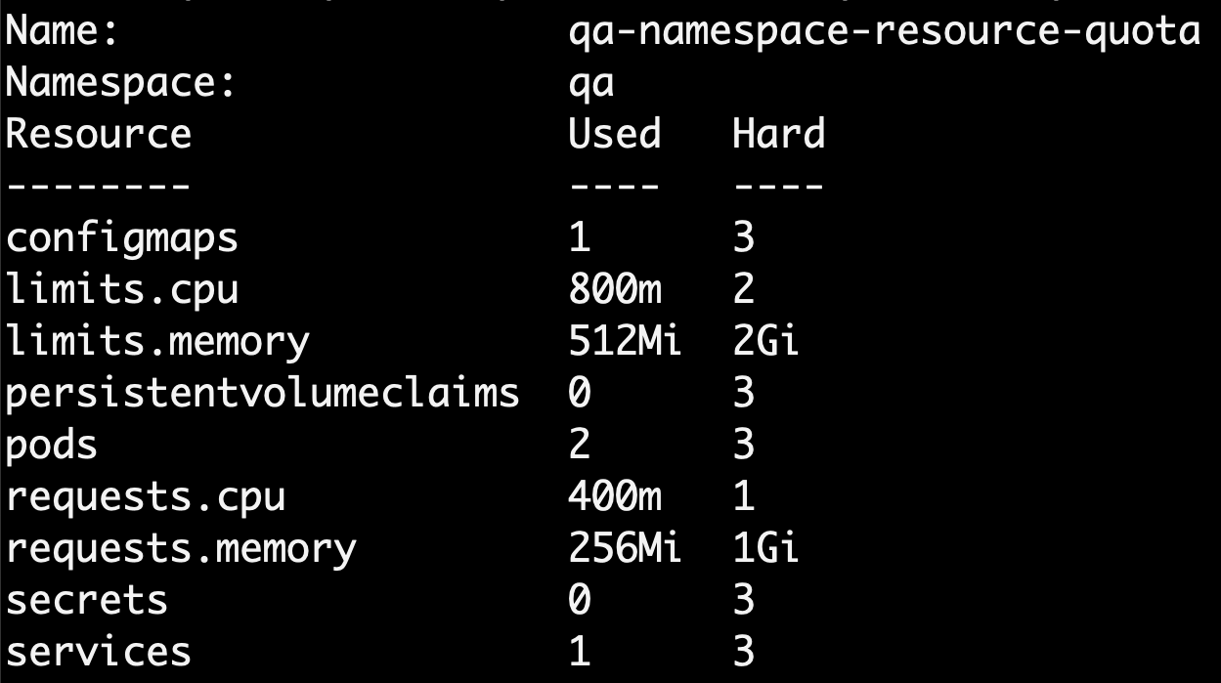
Kubernetes Namespace - Resource Quota
GKE Cluster
qa Namespace
Resource Quota (custom)

Slide 60
Kubernetes Namespace - Limit Range
Demo-01
GKE Cluster
qa Namespace
Resource Quota
Requests & Limits automatically set by LimitRange
Pods: 5
Services: 5
ConfigMaps: 5
Limits.CPU: 2
Requests.CPU: 1
Secrets: 5
Limits.Memory: 2Gi
Requests.Memory:2Gi
Storage (PVC): 3
Kubernetes Deployment
Limit Range
Type
CPU
Memory
Deployment Compute Resources: Requests & Limits
default
400m
256Mi
Type
CPU
Memory
defaultRequest
200m
128Mi
Requests
200m
128Mi
max
500m
500Mi
Limits
400m
256Mi
min
100m
100Mi

Slide 61
Kubernetes Namespace - Limit Range
Demo-02
Pods will not be scheduled and throws error
GKE Cluster
qa Namespace
Requests & Limits configured in Deployment is above max in Limit Range
Resource Quota
Pods: 5
Services: 5
ConfigMaps: 5
Limits.CPU: 2
Requests.CPU: 1
Secrets: 5
Limits.Memory: 2Gi
Requests.Memory:2Gi
Storage (PVC): 3
Kubernetes Deployment
Limit Range
Type
CPU
Memory
Deployment Compute Resources: Requests & Limits
default
400m
256Mi
Type
CPU
Memory
defaultRequest
200m
128Mi
Requests
450m
128Mi
max
500m
500Mi
Limits
600m
256Mi
min
100m
100Mi

Slide 62
GitHub Repository
Repository Used For | Repository URL
Course Main Repository with step-by-step documentation | https://github.com/stacksimplify/google-kubernetes-engine
Course Presentation | https://github.com/stacksimplify/google-kubernetes-engine/tree/main/course-presentation
Docker Fundamentals | https://github.com/stacksimplify/docker-fundamentals
Docker Fundamentals Presentation | https://github.com/stacksimplify/docker-fundamentals/tree/master/otherfiles/presentation
400+ presentation slides outlining various architectures and concepts we have implemented

Slide 63
END OF INTRODUCTION

Slide 64
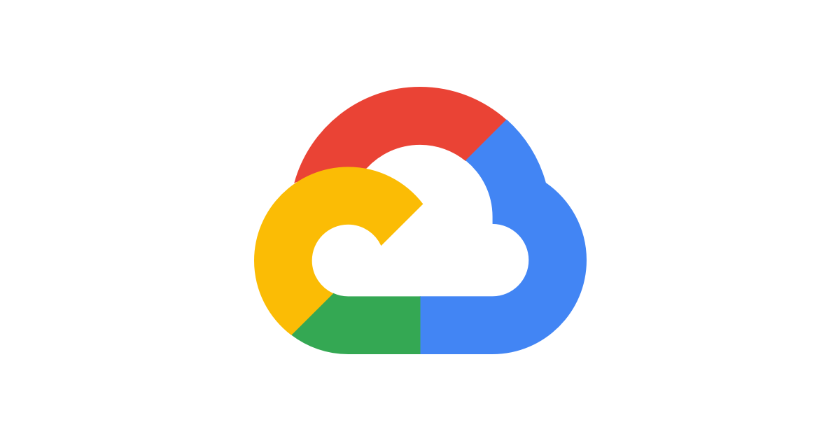

Google Cloud
Account

Slide 65
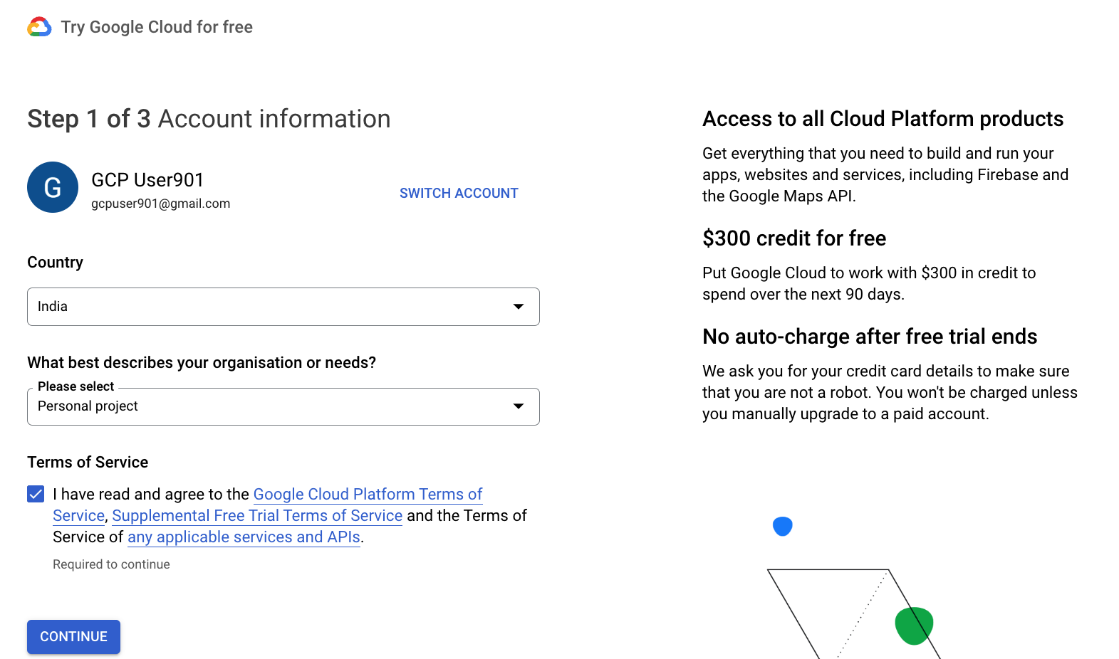
Google Cloud Account

Slide 66
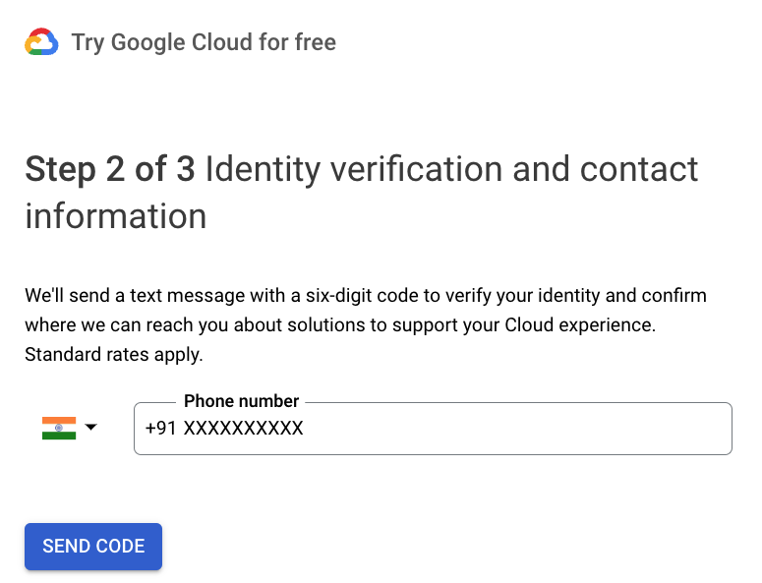
Google Cloud Account

Slide 67
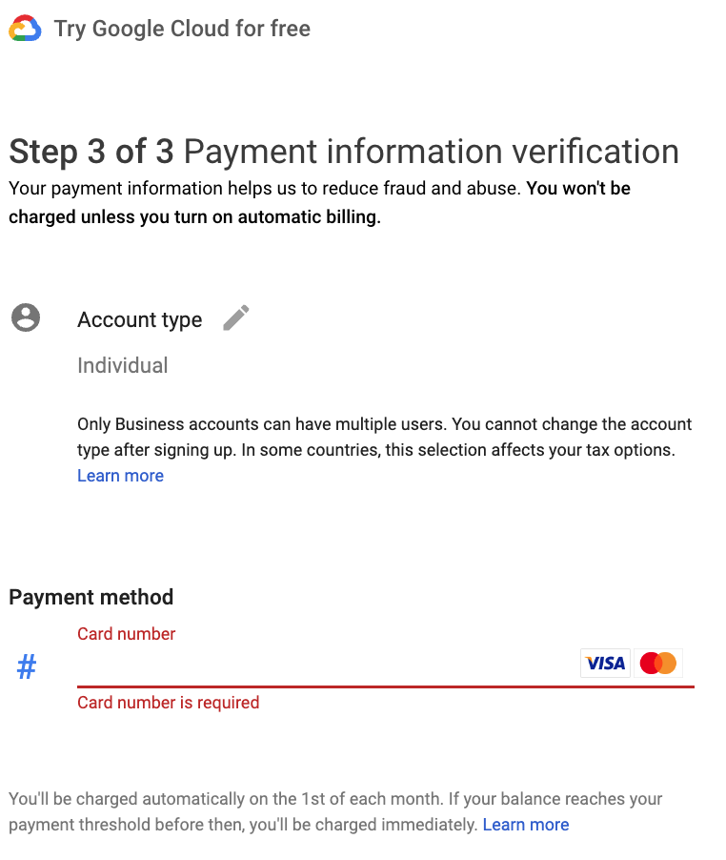
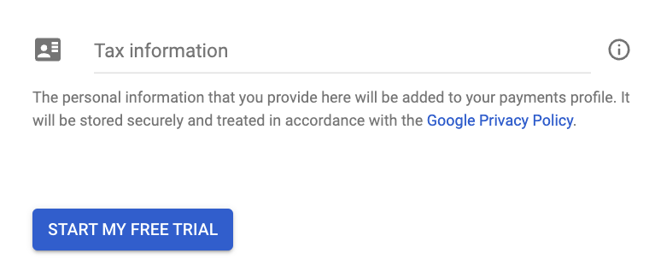
Google Cloud Account - Individual

Slide 68
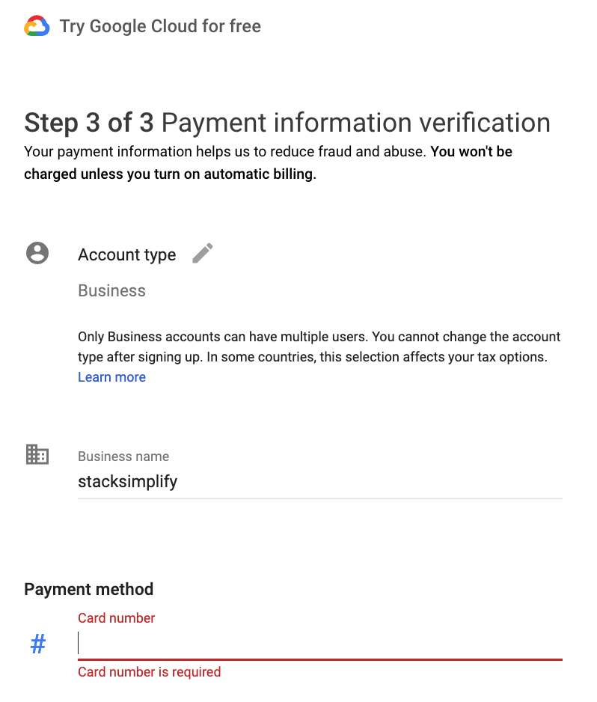
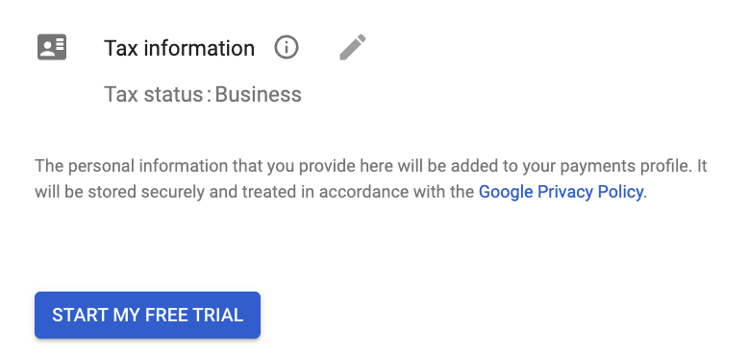
Google Cloud Account - Business

Slide 69
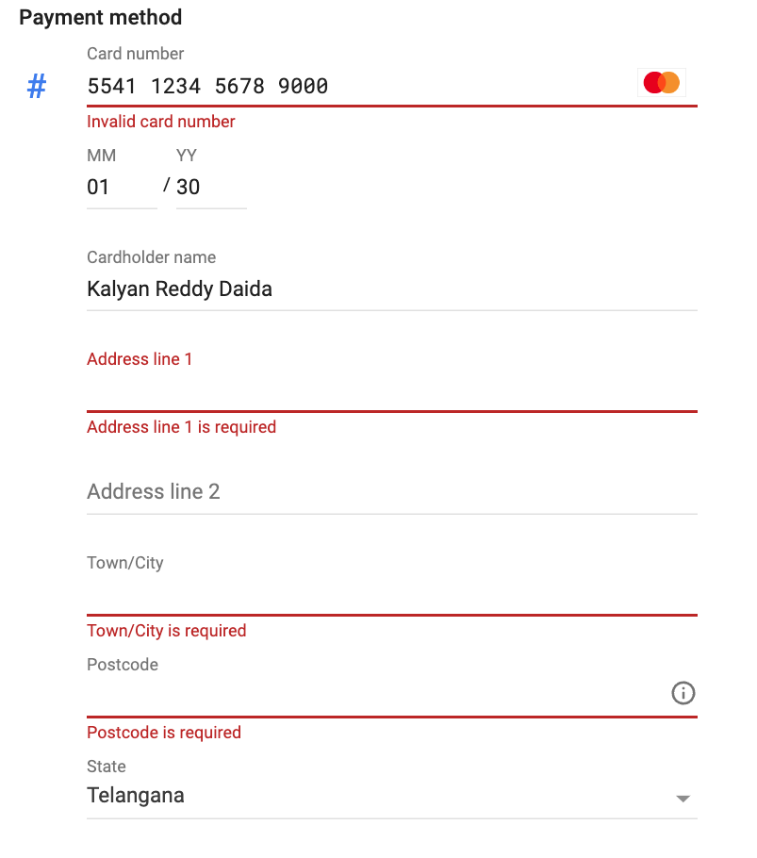
Google Cloud Account
Provide Address Details

Slide 70
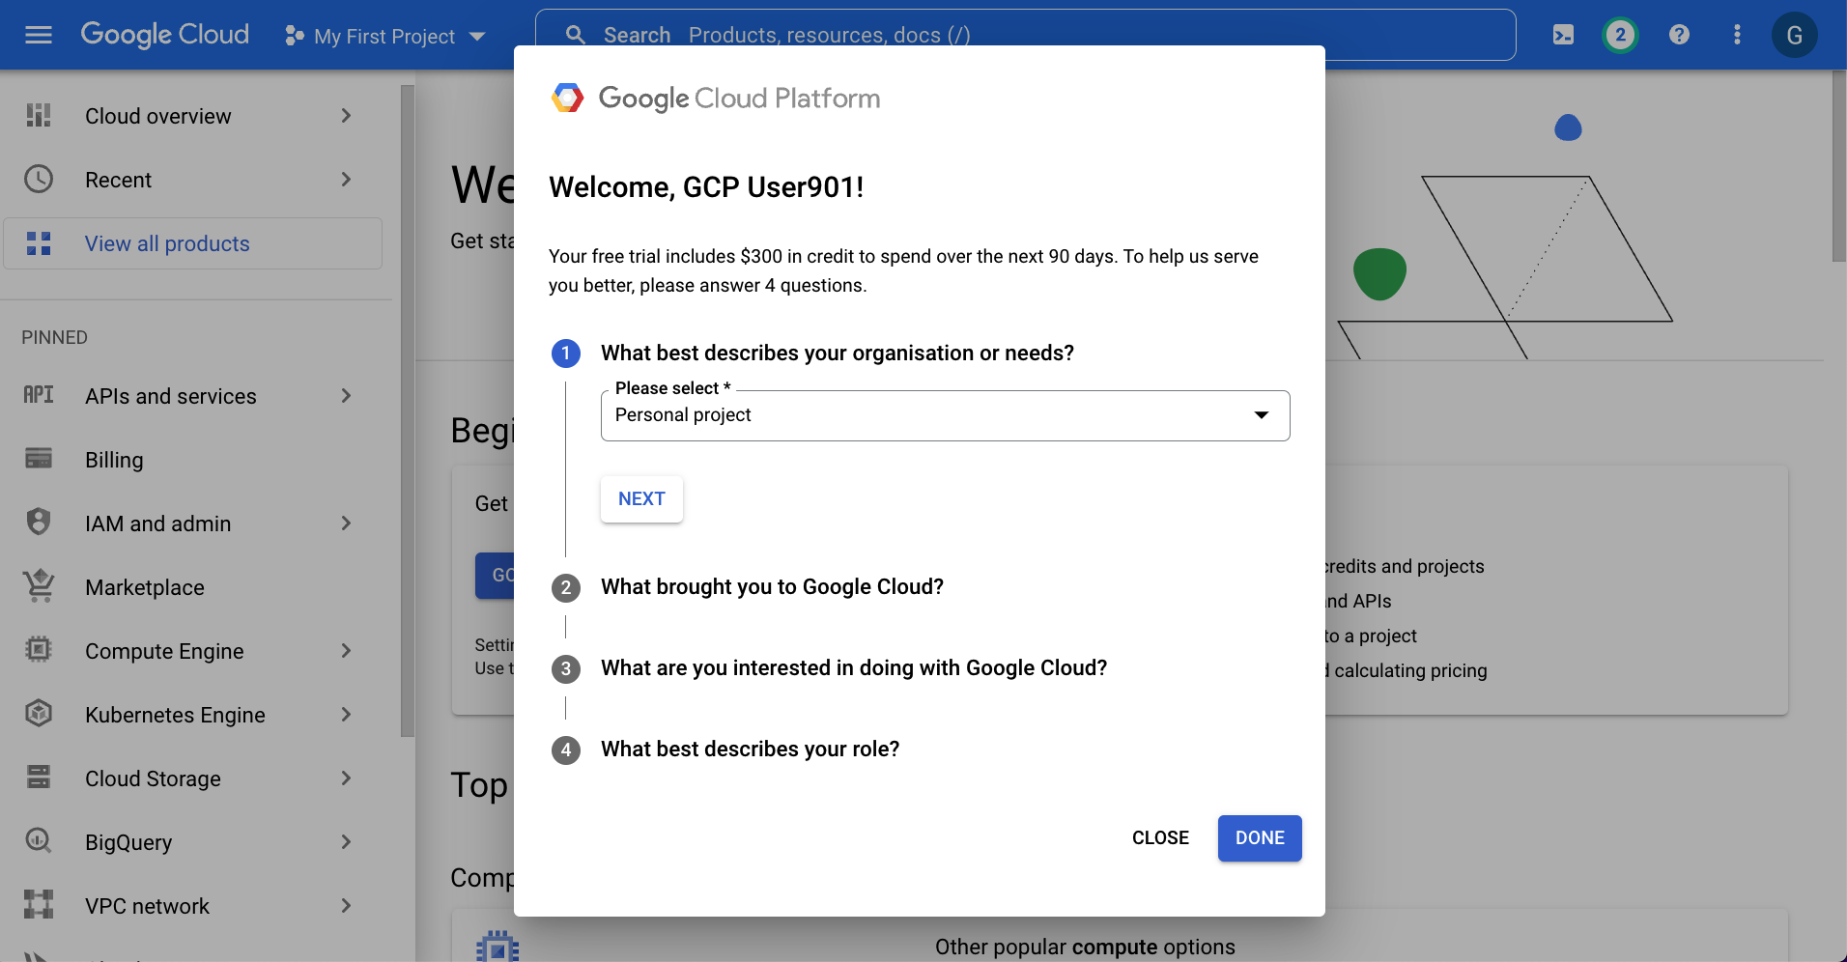
Google Cloud Account

Slide 71
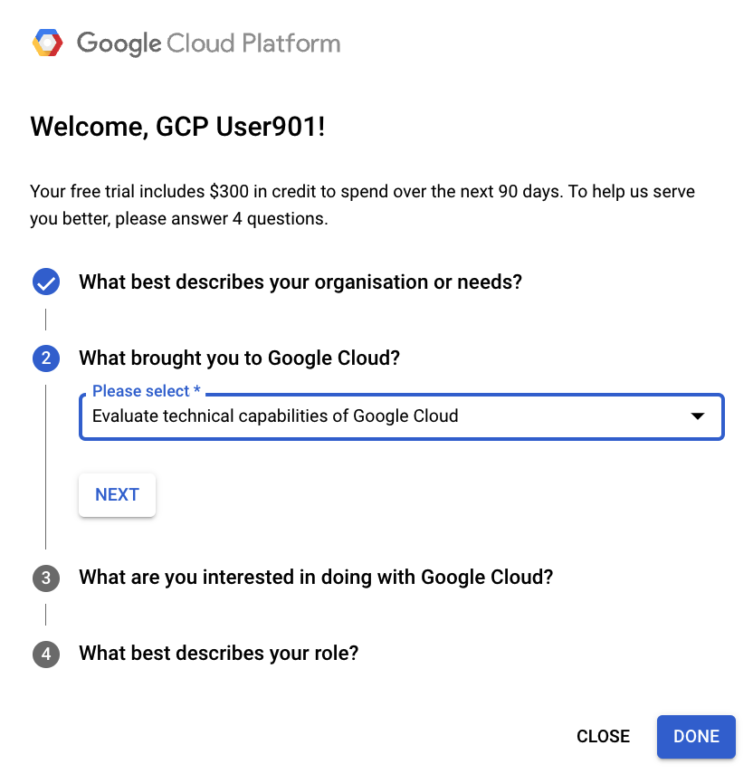
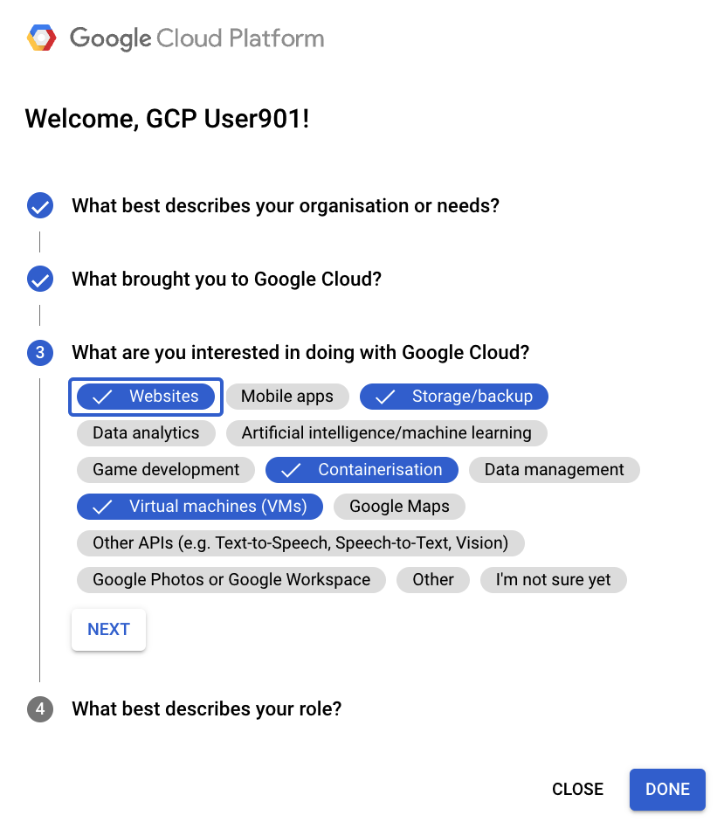
Google Cloud Account

Slide 72
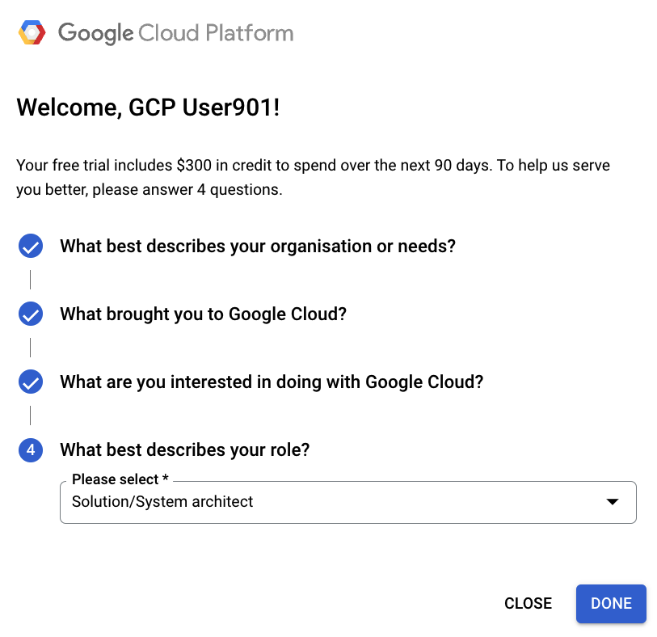
Google Cloud Account

Slide 73
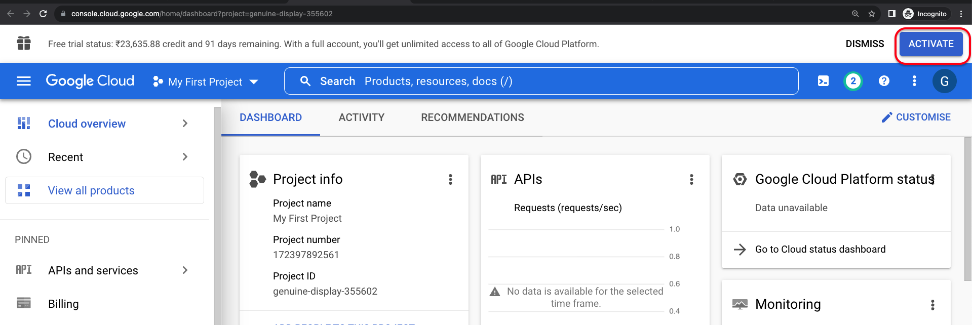
Google Cloud Account - ACTIVATE

Slide 74
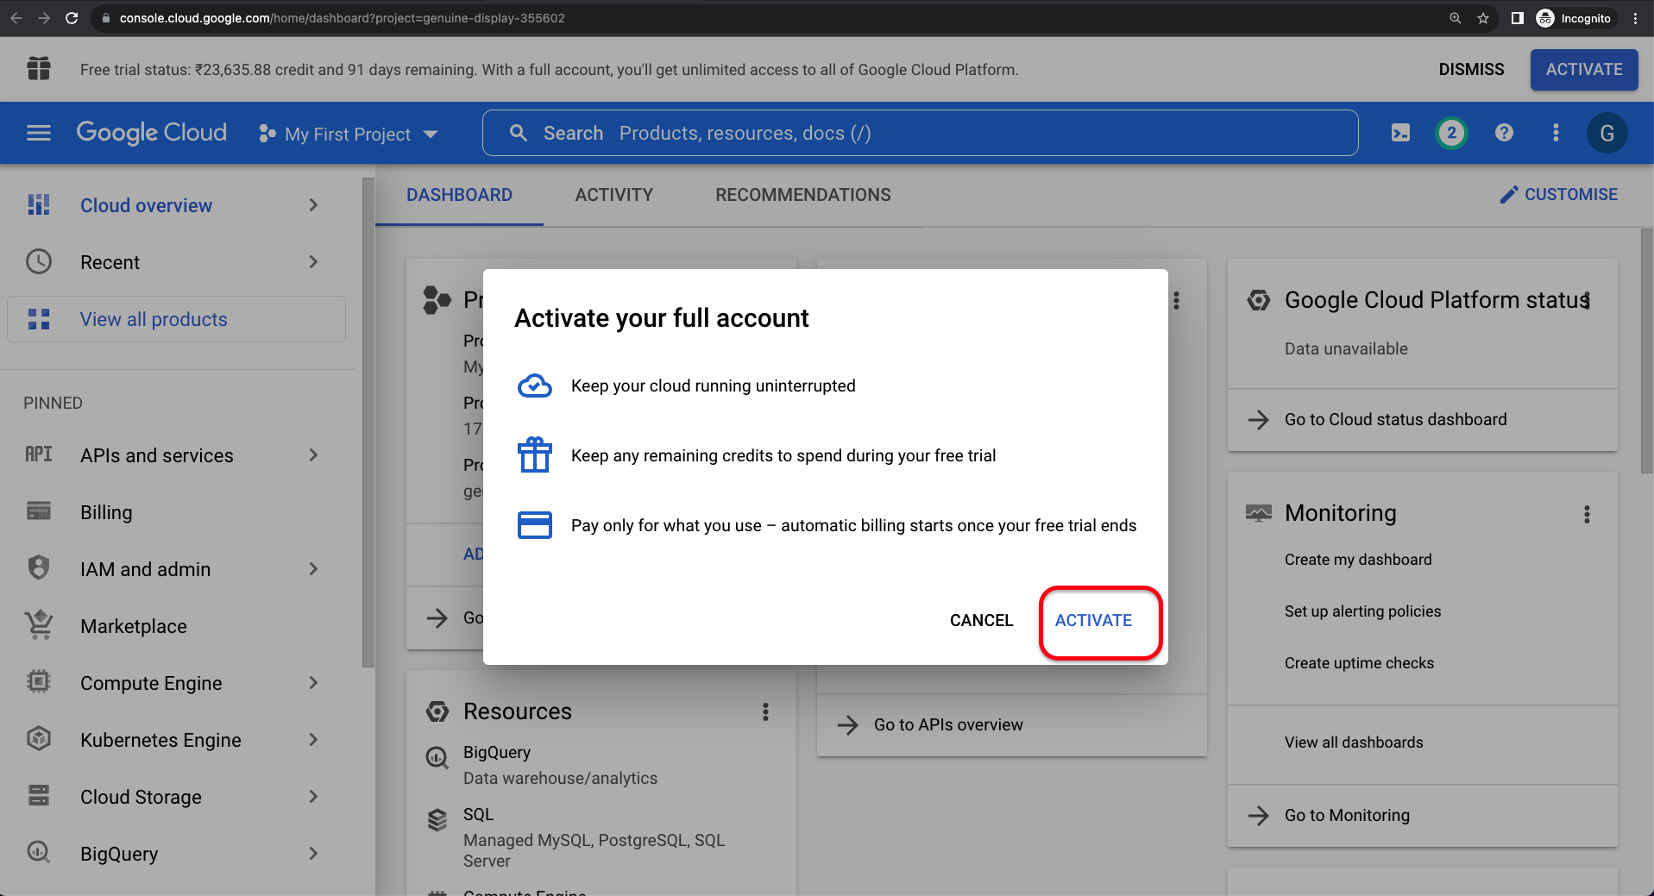
Google Cloud Account - ACTIVATE

Slide 75
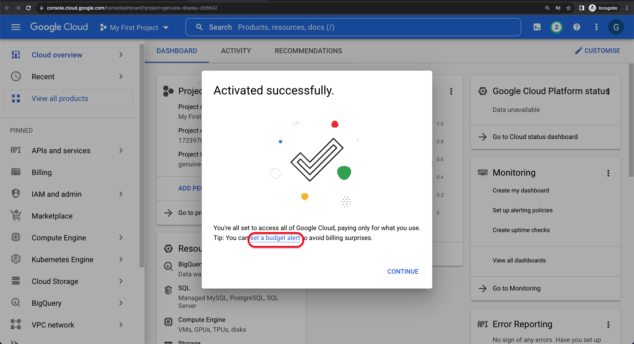
Google Cloud Account –Set a Budget Alert

Slide 76

Google Cloud
Create Budget Alerts

Slide 77
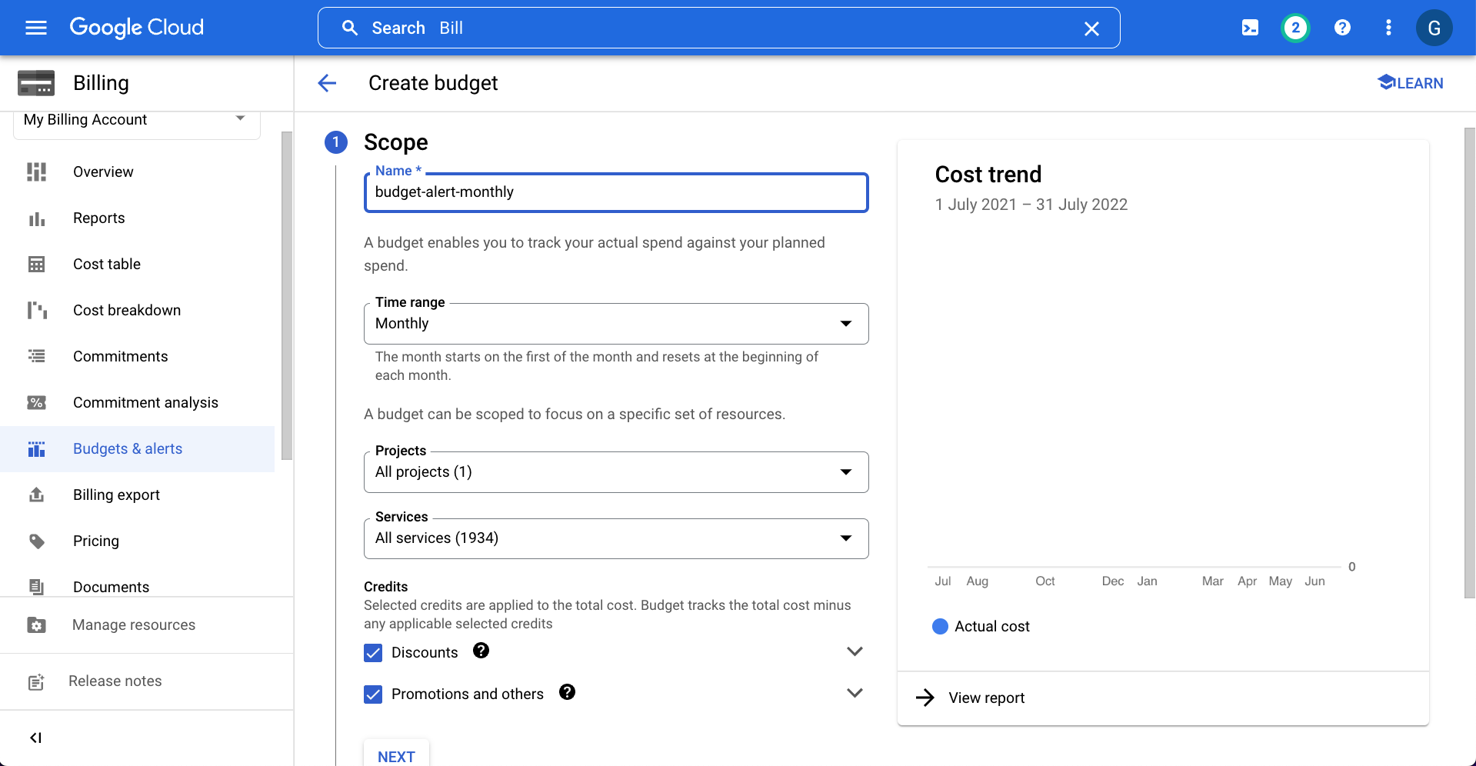
Google Cloud Account - Create Budget Alerts

Slide 78
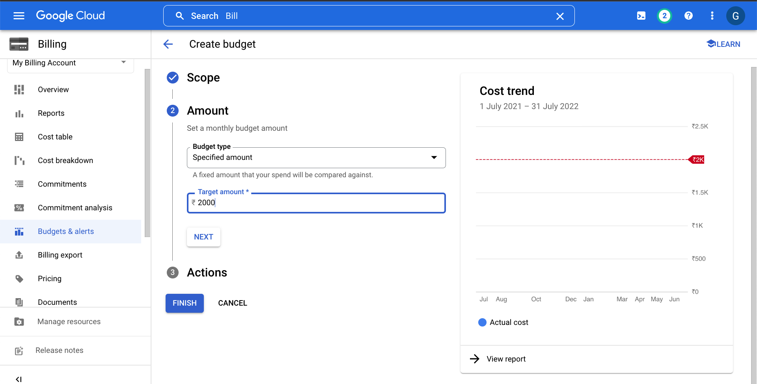
Google Cloud Account - Create Budget Alerts

Slide 79
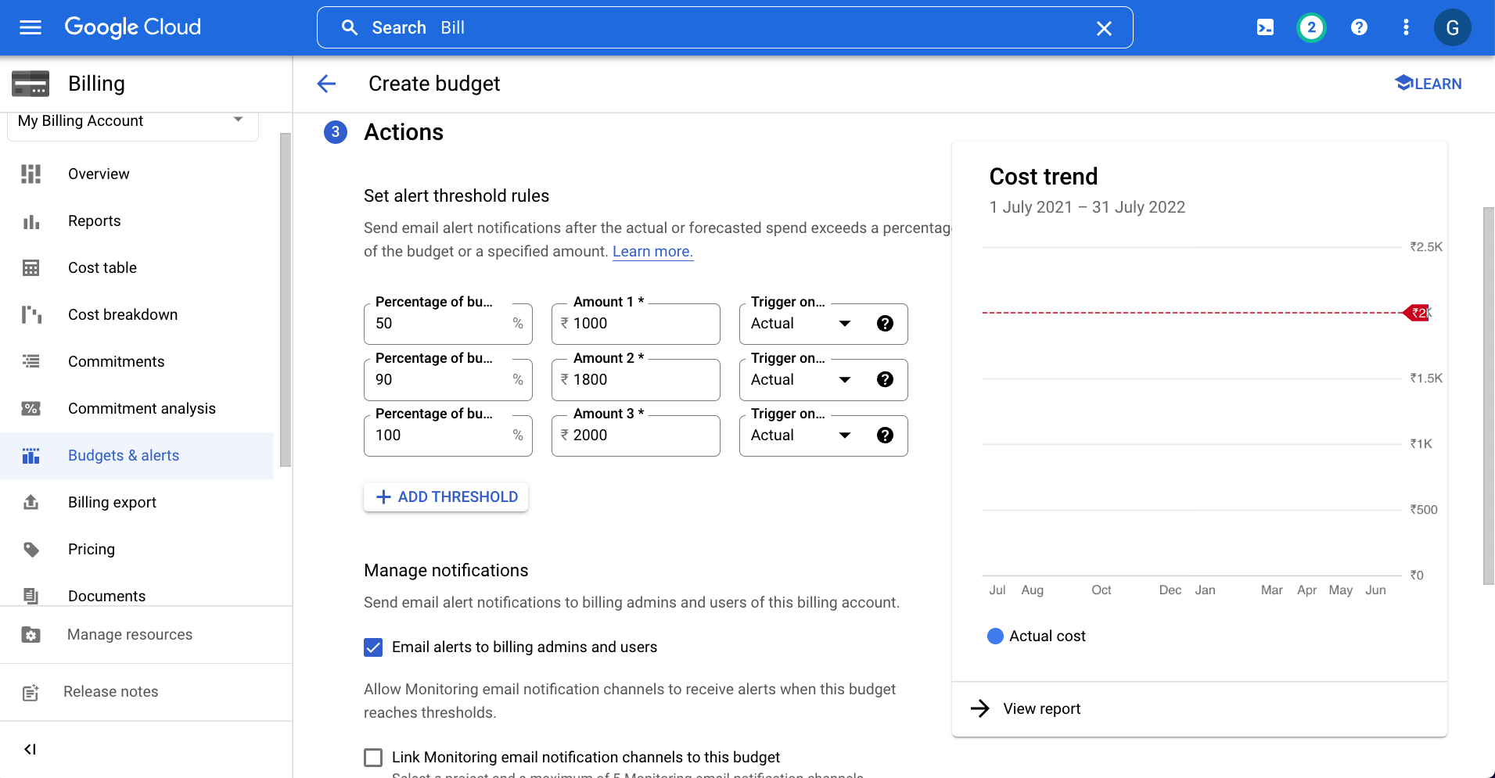
Google Cloud Account - Create Budget Alerts

Slide 80
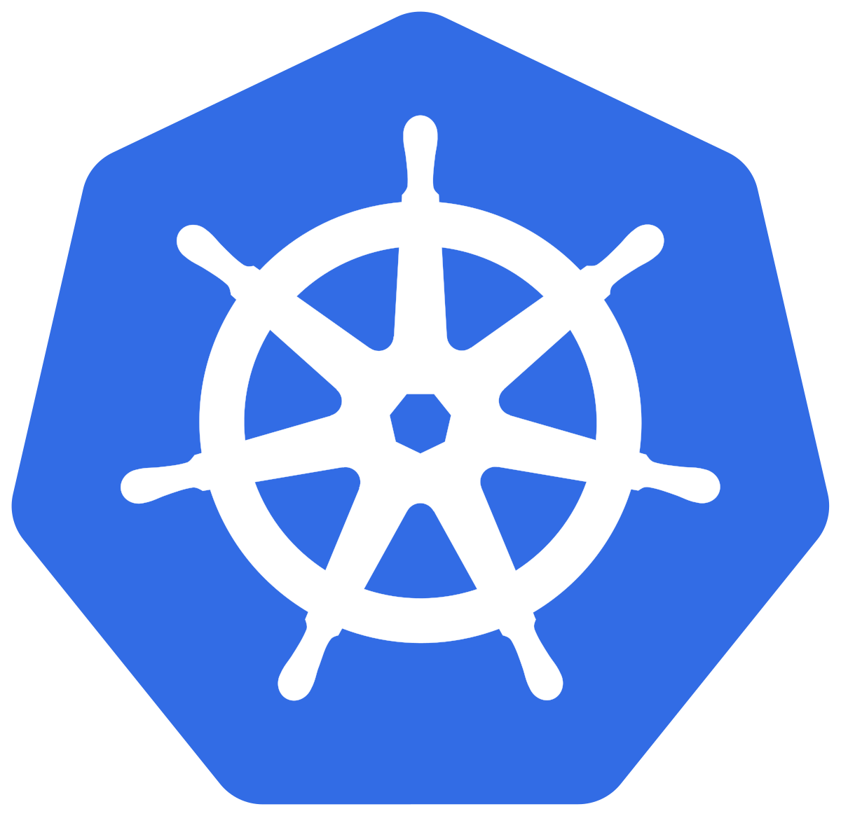
Google
Kubernetes Engine
Create GKE Standard Cluster
Demo-02

Slide 81
GKE Cluster Modes & Types
GKE Cluster Modes
GKE Cluster Types
GKE Zonal Cluster
GKE Regional Cluster
GKE Standard
GKE Public Cluster
GKE Private Cluster
GKE Autopilot
GKE Alpha Cluster
GKE Cluster using Windows Node Pools

Slide 82
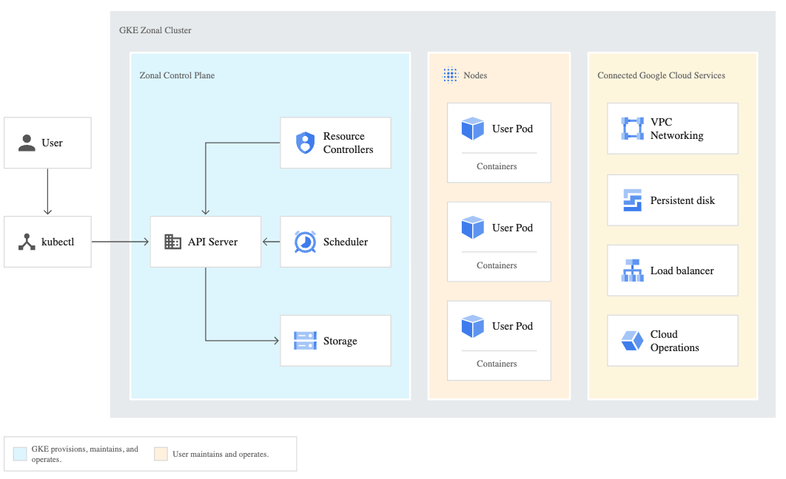
GKE Standard Cluster Architecture
GKE Control Plane
API Server
Resource Controllers
Scheduler
Storage
kubectl
Nodes
Pods
We have a series of Kubernetes Fundamental demos, outlining each concept in detail.
Reference: https://cloud.google.com/kubernetes-engine/docs/concepts/cluster-architecture

Slide 83
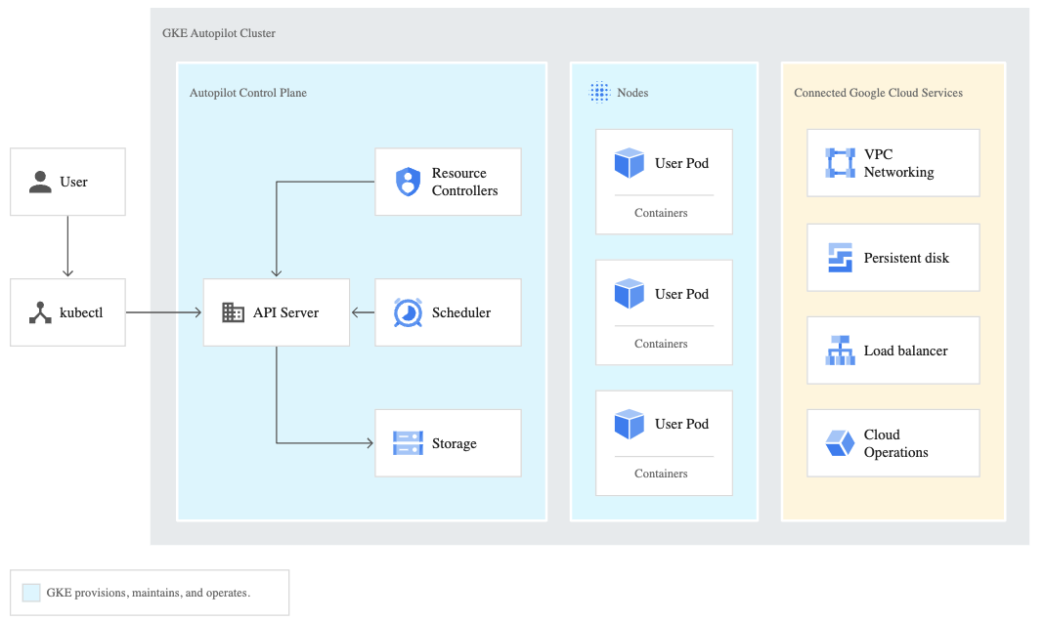
GKE Autopilot Cluster Architecture
Reference: https://cloud.google.com/kubernetes-engine/docs/concepts/autopilot-architecture

Slide 84
GKE Standard vs Autopilot Cluster Architecture
GKE Standard Cluster
GKE Autopilot Cluster
User maintains and operates
GKE Provisions, maintains and operates
Reference: https://cloud.google.com/kubernetes-engine/docs/concepts/cluster-architecture
Reference: https://cloud.google.com/kubernetes-engine/docs/concepts/autopilot-architecture

Slide 85
GKE Cluster Modes
Features
GKE Standard
GKE Autopilot
GKE Control Plane
Managed by GKE
Managed by GKE
Node and Node Pools
Managed and Configured by us
Managed by GKE
Provisioning Resources
You manually provision additional resources and set overall cluster size
GKE dynamically provisions resources based on your Pod specification.
Billing
Pay per node (CPU, memory, boot disk)
Pay per Pod resource requests (CPU, memory, and ephemeral storage)
Additional Reference: https://cloud.google.com/kubernetes-engine/docs/concepts/autopilot-overview#comparison

Slide 86
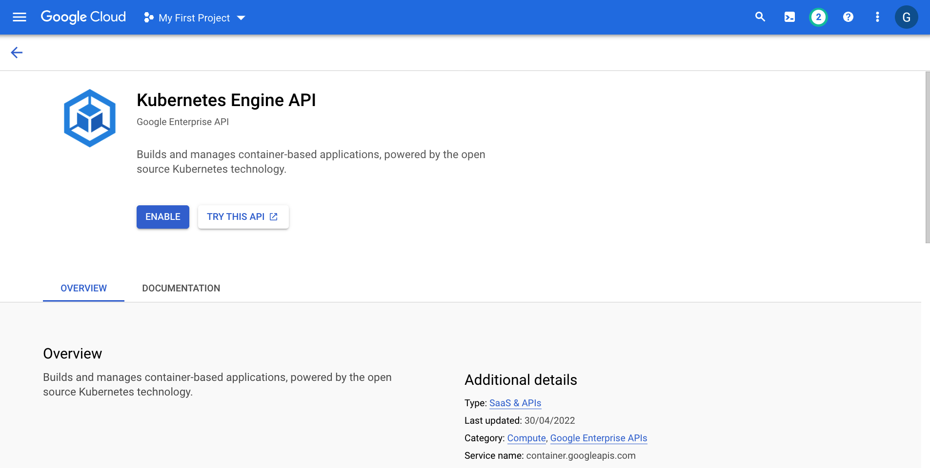
Google Kubernetes Engine - Enable API

Slide 87
Kubernetes Sample Application
default namespace
GKE Cluster
http//<load-balancer-ip>
User
k8s Load Balancer Service
k8s ReplicaSet
k8s Deployment
k8s Pods

Slide 88
Google
Kubernetes Engine
Install gcloud CLI
MacOS
Demo-03

Slide 89
Google
Kubernetes Engine
Install gcloud CLI
WindowsOS
Demo-04

Slide 90

Kubernetes
Architecture

Slide 91
Kubernetes - Architecture
Master
Worker Node
Kube Controller Manager
Cloud Controller Manager
Kubelet
Kube-Proxy
Container Runtime (Docker or Containerd)
kube-apiserver
Worker Node
etcd
kube-scheduler
Kubelet
Kube-Proxy
Container Runtime (Docker or Containerd)
Container Runtime (Docker or Containerd)

Slide 92
Kubernetes Architecture - Master
Master
kube-apiserver
It acts as front end for the Kubernetes control plane. It exposes the Kubernetes API
Command line tools (like kubectl), Users and even Master components (scheduler, controller manager, etcd) and Worker node components like (Kubelet) everything talk with API Server.
etcd
Consistent and highly-available key value store used as Kubernetes’ backing store for all cluster data.
It stores all the masters and worker node information.
kube-scheduler
Scheduler is responsible for distributing containers across multiple nodes.
It watches for newly created Pods with no assigned node, and selects a node for them to run on.
Kube Controller Manager
Cloud Controller Manager
kube-apiserver
etcd
kube-scheduler
Container Runtime (Docker or Containerd)

Slide 93
Kubernetes Architecture - Master
Master
kube-controller-manager
Controllers are responsible for noticing and responding when nodes, containers or endpoints go down. They make decisions to bring up new containers in such cases.
Node Controller: Responsible for noticing and responding when nodes go down.
Replication Controller: Responsible for maintaining the correct number of pods for every replication controller object in the system.
Endpoints Controller: Populates the Endpoints object (that is, joins Services & Pods)
Service Account & Token Controller: Creates default accounts and API Access for new namespaces.
Kube Controller Manager
Cloud Controller Manager
kube-apiserver
etcd
kube-scheduler
Container Runtime (Docker or Containerd)

Slide 94
Kubernetes Architecture - Master
Master
cloud-controller-manager
A Kubernetes control plane component that embeds cloud-specific control logic.
It only runs controllers that are specific to your cloud provider.
On-Premise Kubernetes clusters will not have this component.
Node controller: For checking the cloud provider to determine if a node has been deleted in the cloud after it stops responding
Route controller: For setting up routes in the underlying cloud infrastructure
Service controller: For creating, updating and deleting cloud provider load balancer
Many more controllers might be present and will differ from cloud to cloud based on that respective cloud Kubernetes Platform design and Integrations to their Cloud products
Kube Controller Manager
Cloud Controller Manager
kube-apiserver
etcd
kube-scheduler
Container Runtime (Docker or Containerd)

Slide 95
Kubernetes Architecture – Worker Nodes
Worker Node
Kubelet
Kubelet is the agent that runs on every node in the cluster
This agent is responsible for making sure that containers are running in a Pod on a node.
Kube-Proxy
It is a network proxy that runs on each node in your cluster.
It maintains network rules on nodes
In short, these network rules allow network communication to your Pods from network sessions inside or outside of your cluster.
Kubelet
Kube-Proxy
Container Runtime (Docker or Containerd)
Container Runtime
Container Runtime is the underlying software where we run all these Kubernetes components.
In GKE, default is containerd but we also have options like Ubuntu with Containerd, Ubuntu with Docker and Windows

Slide 96
Kubernetes - Architecture
Master
Worker Node
Kube Controller Manager
Cloud Controller Manager
Kubelet
Kube-Proxy
Container Runtime (Docker)
kube-apiserver
Worker Node
etcd
kube-scheduler
Kubelet
Kube-Proxy
Container Runtime (Docker)
Container Runtime (Docker)

Slide 97
GKE Standard Cluster Architecture
Reference: https://cloud.google.com/kubernetes-engine/docs/concepts/cluster-architecture

Slide 98
Kubernetes
Fundamentals
pod
ReplicaSet
Deployment
Service

Slide 99
Kubernetes Fundamentals
A POD is a single instance of an Application.
A POD is the smallest object, that you can create in Kubernetes.
pod
A ReplicaSet will maintain a stable set of replica Pods running at any given time.
In short, it is often used to guarantee the availability of a specified number of identical Pods
ReplicaSet
A Deployment runs multiple replicas of your application and automatically replaces any instances that fail or become unresponsive.
Deployments are well-suited for stateless applications.
Deployment
A service is an abstraction for pods, providing a stable, so-called virtual IP (VIP) address.
In simple terms, service sits Infront of a POD and acts as a load balancer.
Service

Slide 100
Kubernetes - Imperative & Declarative
Kubernetes Fundamentals
Imperative
Declarative
kubectl
YAML & kubectl
Pod
Pod
ReplicaSet
ReplicaSet
Deployment
Deployment
Service
Service

Slide 101
Imperative
Kubernetes
Pod
Kubernetes Pod
Demo-06

Slide 102
Kubernetes - POD
With Kubernetes our core goal will be to deploy our applications in the form of containers on worker nodes in a k8s cluster.
Kubernetes does not deploy containers directly on the worker nodes.
Container is encapsulated in to a Kubernetes Object named POD.
A POD is a single instance of an application.
A POD is the smallest object that we can create in Kubernetes.
N
Nginx Container
Image
N
N
POD
POD
Worker Node
Worker Node
Node
Worker Node
Kubernetes Cluster

Slide 103
Kubernetes - POD
PODs generally have one to one relationship with containers.
To scale up we create new POD and to scale down we delete the POD.
N
N
N
N
POD
POD
POD
POD
Worker Node - 1
Worker Node - 2
Kubernetes Cluster

Slide 104
Kubernetes – PODs
We cannot have multiple containers of same kind in a single POD.
Example: Two NGINX containers in single POD serving same purpose is not recommended.
N
N
N
N
N
POD
POD
POD
POD
Worker Node - 1
Worker Node - 2
Kubernetes Cluster

Slide 105
Kubernetes - Multi-Container Pods
We can have multiple containers in a single POD, provided they are not of same kind.
Helper Containers (Side-car)
Data Pullers: Pull data required by Main Container
Data pushers: Push data by collecting from main container (logs)
Proxies: Writes static data to html files using Helper container and Reads using Main Container.
Communication
The two containers can easily communicate with each other easily as they share same network space.
They can also easily share same storage space.
Multi-Container Pods is a rare use-case and we will try to focus on core fundamentals.
N
H
POD
Worker Node
Kubernetes Cluster
Helper
Containers
Node

Slide 106
Kubernetes Pods Demo

Slide 107
Cloud External IP Addresses
Cloud Load Balancing
Service
Kubernetes
Services
Load Balancer
Kubernetes Service

Slide 108


Kubernetes Service - LoadBalancer
Cloud External IP
Cloud Load Balancer
http://<External-IP>
We can expose an application running on a set of PODs using different types of Services available in k8s.
ClusterIP Service(Internal to k8s cluster)
NodePort Service (Internet + internal)
LoadBalancer Service (Internet + internal)
Ingress Service (Internet + internal)
LoadBalancer Service
To access our application outside of Google GKE k8s cluster, we can use Kubernetes LoadBalancer service which will be eventually mapped to Google Cloud Load Balancer.
When we deploy k8s load balancer service in GKE Cluster, the following will be created
Google Cloud Load Balancer
Google Cloud External IP
User
k8s Service
Port: 80
ClusterIP Service Port
targetPort: 80
Container Port in a POD
Node
N
POD
Worker Node
Worker Node
Worker Node
Node
GKE Cluster
Google Cloud

Slide 109
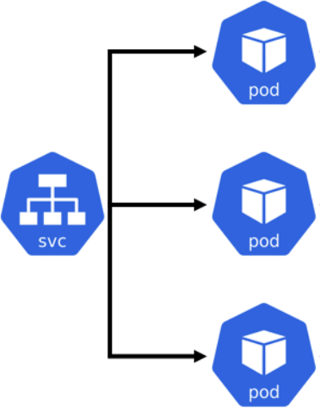
Kubernetes
Load Balancer Service
& Pods Demo

Slide 110
Declarative
Kubernetes
ReplicaSet
Demo-07
Kubernetes ReplicaSet

Slide 111
Kubernetes - ReplicaSet
High Availability
Load Balancing
ReplicaSet
Scaling
Labels & Selectors

Slide 112
Kubernetes - ReplicaSet
A ReplicaSet’s purpose is to maintain a stable set of replica Pods running at any given time.
If our application crashes (any pod dies), replicaset will recreate the pod immediately to ensure the configured number of pods running at any given time.
Reliability
Or
High Availability
N
N
N
POD
POD
POD
ReplicaSet
Worker Node
Kubernetes Cluster

Slide 113

Kubernetes - ReplicaSet
Load Balancing
To avoid overloading of traffic to single pod we can use load balancing.
Kubernetes provides pod load balancing out of the box using Services for the pods which are part of a ReplicaSet
Labels & Selectors are the key items which ties all 3 together (Pod, ReplicaSet & Service), we will know in detail when we are writing YAML manifests for these objects
Service
N
N
N
N
POD
POD
POD
POD
ReplicaSet
Worker Node
Worker Node
Kubernetes Cluster

Slide 114
Kubernetes - ReplicaSet
Scaling
When load become too much for the number of existing pods, Kubernetes enables us to easily scale up our application, adding additional pods as needed.
This is going to be seamless and super quick.
Service
N
N
N
N
POD
POD
POD
POD
ReplicaSet
Worker Node
Worker Node
Kubernetes Cluster

Slide 115

Kubernetes
ReplicaSet Demo

Slide 116
Imperative
Kubernetes
Deployment
Demo-08 to 11
Kubernetes Deployment

Slide 117
Kubernetes - Deployment
Service
N
N
N
N
POD
POD
POD
POD
ReplicaSet
Deployment
Worker Node - 1
Worker Node - 2
Kubernetes Cluster

Slide 118
Kubernetes - Deployment Usecases
Create a Deployment to rollout a ReplicaSet
1
5
Pausing and Resuming Deployment
Update Deployment
2
6
Use the Status of the Deployment
Roll back to an earlier Deployment revision
Cleanup Older ReplicaSets in a Deployment
3
7
Deployment
Scale up the Deployment to facilitate more load
Canary Deployments
4
8

Slide 119
Kubernetes
Deployment Demo

Slide 120
Imperative
Kubernetes
Service
Demo-12
Kubernetes Service

Slide 121
Kubernetes - Services
ClusterIP Service
LoadBalancer
NodePort Service
ExternalName Service
Service
Headless Service
Ingress Service

Slide 122
Kubernetes - Services
Cluster IP (default): Used for internal communication between applications inside k8s cluster with a stable Internal IP
LoadBalancer: Primarily for Cloud Providers to integrate with their Load Balancers
NodePort: Clients send requests to the IP address of a worker node on one or more nodePort values that are specified by the Service.
ExternalName: Internal clients use the DNS name of a Service as an alias for an external DNS name.
Ingress: Ingress is an advanced load balancer which provides Context path based routing, SSL, SSL Redirect and many more which operates at HTTP Layer7.
Service
Headless: It is used for discovering individual pods(especially Pod IPs) which allows another service to interact directly with the Pods instead of a proxy.

Slide 123

Kubernetes Service Demo
Kubernetes Cluster
Frontend App – LoadBalancer Service
Users
http://<SVC-Public-IP>/hello
N
POD
ReplicaSet
Deployment (app=frontend)
Backend App - ClusterIP Service
B
POD
ReplicaSet
Deployment (app=Backend)

Slide 124
Kubernetes
YAML Basics

Slide 125
YAML Basics
YAML is not a Markup Language
YAML is used to store information about different things
We can use YAML to define key, Value pairs like variables, lists and objects
YAML is very similar to JSON (Javascript Object Notation)
YAML primarily focuses on readability and user friendliness
YAML is designed to be clean and easy to read
We can define YAML files with two different extensions
abc.yml
abc.yaml

Slide 126
YAML Basics
YAML Comments
YAML Key Value Pairs
YAML Dictionary or Map
YAML Array / Lists
YAML Spaces
YAML Document Separator

Slide 127
Declarative
Kubernetes
Pod
Kubernetes Pod
Demo-14

Slide 128

Kubernetes Pod

Slide 129
Declarative
Kubernetes
ReplicaSet
Demo-15
Kubernetes ReplicaSet

Slide 130

Kubernetes ReplicaSet

Slide 131
Declarative
Kubernetes
Deployment
Demo-16
Kubernetes Deployment

Slide 132

Kubernetes Deployment

Slide 133
Declarative
Kubernetes
Service
Demo-17
Kubernetes Service

Slide 134


Kubernetes Service
ClusterIP Service
LoadBalancer Service

Slide 135
Kubernetes Service Demo
Kubernetes Cluster
Frontend App – LoadBalancer Service
Users
http://<SVC-Public-IP>/hello
N
POD
ReplicaSet
Deployment (app=frontend)
Backend App - ClusterIP Service
B
POD
ReplicaSet
Deployment (app=Backend)

Slide 136
Google
Kubernetes Engine
Kubernetes NodePort Service
Demo-18

Slide 137
Kubernetes NodePort Service
NodePort service allows external clients to access pods via network ports opened on the Kubernetes nodes
Node Port range 30000-32768 on Kubernetes Nodes (Range is customizable)
In real-world, NodePort Services are not used in production grade implementations
NodePort Services are generally used to test our application by external clients via Internet provided our Kubernetes Nodes are at internet edge
NodePort
Service
http://NODEIP:NODEPORT is generally not a recommended practice to use in production for our application.

Slide 138
GKE- Kubernetes Node Port Service
GKE Cluster
default namespace
http//<GKE-Node-PublicIP>:<NODEPORT>
MyApp1 Deployment
http//34.27.64.117:30080
Service
Port 80
Target
Port 80
Users
NodePort Service
Pods
ReplicaSet
Deployment

Slide 139

Kubernetes
NodePort Service
Customer Project: kdaida123
Users
Customer VPC: default
http//<GKE-Node-PublicIP>:<NODEPORT>
Region: us-central1
http//34.27.64.117:30080
GKE Cluster
Subnet: 10.128.0.0/20
Zone: us-central1-a
Zone: us-central1-b
GKE
Node-1
Node Port
(30080)
GKE
Node-2
Node Port
(30080)
Port 80
NodePort Service
Deployment
ReplicaSet
Target Port (80)
Target Port (80)

Slide 140

What are we going to learn ?
Kubernetes Manifests using YAML
Demo-18: Kubernetes NodePort Service
1
Create Kubernetes Deployment
2
Create Kubernetes Service of type NodePort

Slide 141
Google
Kubernetes Engine
Kubernetes Headless Service
Demo-19

Slide 142

Kubernetes Headless Service
When using Headless Service, we should use both the "Service Port and Target Port" same.
Headless Service directly sends traffic to Pod with Pod IP and Container Port.
DNS resolution directly happens from headless service to Pod IP.

Slide 143

Curl Pod
We cannot connect to ClusterIP Services directly from internet to test Headless Service Concept
We will deploy a curl pod in GKE Cluster so we can connect to curl pod in GKE Cluster and test the Headless Service Concept

Slide 144

What are we going to learn ?
Demo-19: Kubernetes Headless Service
Kubernetes Manifests using YAML
01-01
Create Kubernetes Deployment
01-02
Create Kubernetes Service of type ClusterIP
01-03
Create Kubernetes Service with ClusterIP: None
02-01
Create Kubernetes Pod with Curl Docker Image to Test Headless Service

Slide 145
Google
Kubernetes Engine
Private Cluster
(Type: Standard)
Demo-20

Slide 146

GKE Private Cluster
Reference: https://cloud.google.com/kubernetes-engine/docs/concepts/private-cluster-concept

Slide 147
GKE Private Cluster - Network Design
Customer Project: kdaida123
Google Managed Project
Customer VPC: default
VPC Network Peering
Google Managed VPC Network
Private Connectivity
Region: us-central1
Region: us-central1
Cloud NAT
GKE Control Plane
GKE Cluster
Subnet: 10.128.0.0/20
Zone: us-central1-a
Zone: us-central1-b
GKE Node-1
GKE Node-2
Kubernetes Namespaces
kube-system
kube-public
kube-node-lease
default
NETWORK
DESIGN

Slide 148

Namespaces
LoadBalancer Service
LoadBalancer Service
LoadBalancer Service
F
F
F
Pod
Pod
Pod
Namespace Manifest - Declarative
ReplicaSet
ReplicaSet
ReplicaSet
Deployment
Deployment
Deployment
ClusterIP Service
ClusterIP Service
ClusterIP Service
B
B
B
Pod
Pod
Pod
ReplicaSet
ReplicaSet
ReplicaSet
Deployment
Deployment
Deployment
Namespace: dev
Namespace: qa
Namespace: staging
Namespace Manifest - Imperative
Deployment

Slide 149

Namespaces

Slide 150

Workloads running in kube-system Namespace
We need to understand that either it is a Auto-Pilot or Standard GKE Cluster, there will be few system related Kubernetes Workloads that need to run for GKE Cluster to be operational which will be visible to us in kube-system namespace.

Slide 151
GKE Private Cluster - Pull Docker Image from Docker Hub
Customer Project: kdaida123
Google Managed Project
Customer VPC: default
VPC Network Peering
Google Managed VPC Network
Private Connectivity
Users
Region: us-central1
Region: us-central1
Cloud
Load Balancing
Cloud NAT
GKE Control Plane
GKE Cluster
Subnet: 10.128.0.0/20
Zone: us-central1-a
Zone: us-central1-b
GKE Node-1
GKE Node-2
NETWORK
DESIGN
Load Balancer Service
Deployment
ReplicaSet
Docker Hub

Slide 152
GKE Public vs Private Cluster
Feature | GKE Public Cluster | GKE Private Cluster
GKE API Endpoint | 1. Public Access 2. Authorized Networks | Private Access (Bastion Host required) Public Access Authorized Networks
GKE Nodes | Public IP & Private IP Address | Private IP Address
Outbound Communication to Internet (Egress to Internet) | Open by default | Requires Cloud NAT
 | Example: Pull Docker Image from Docker Hub

Slide 153


What are we going to learn ?
Kubernetes Manifests using YAML
Demo-20: GKE Private Cluster
1
Create Kubernetes Deployment with Docker Image from Docker Hub
2
Create Kubernetes Service of type Load Balancer

Slide 154
Google
Kubernetes Engine
Kubernetes Storage
Persistent Disk
Kubernetes Storage Resources
Introduction

Slide 155

Kubernetes Persistent Volumes
GKE Cluster
GCP Compute Engine
Kubernetes Persistent Volume
Persistent Disk
Persistent Volumes are used to manage durable storage in a cluster.
In GKE, a PersistentVolume is typically backed by a Google persistent disk
PersistentVolume lifecycle is managed by Kubernetes
A PersistentVolume can be dynamically provisioned; we do not have to manually create and delete the backing storage
PersistentVolume resources are cluster resources that exist independently of Pods. This means that the disk and data represented by a PersistentVolume continue to exist as the cluster changes and as Pods are deleted and recreated.
GKE provides a way for you to automatically deploy and manage the Compute Engine Persistent Disk CSI driver in your clusters.
Compute Engine Persistent Disk CSI driver is enabled by default in Autopilot clusters.

Slide 156
Kubernetes Storage Resources
Volume implementations such as Compute Engine persistent disk Container Storage Interface (CSI) Driver are configured through StorageClass resources.
In GKE we have Compute Engine PD CSI (ReadWriteOnce) and Kubernetes File Store CSI (ReadWriteMany)
PersistentVolume resources are used to manage durable storage in a cluster. In GKE, a PersistentVolume is typically backed by a persistent disk.
Persistent Disk
PersistentVolumeClaim objects request a specific size, access mode, and StorageClass for the PersistentVolume
If a PersistentVolume that satisfies the request exists or can be provisioned, the PersistentVolumeClaim is bound to that PersistentVolume.
Portability is another advantage of using PersistentVolumes and PersistentVolumeClaims. You can easily use the same Pod specification across different clusters and environments because PersistentVolume is an interface to the actual backing storage.

Slide 157
User Management Web Application - Architecture
Java Spring Boot
Create User
schema: webappdb
List User
Table: User
Delete User
Default User: admin101
User Management
Web Application
MySQL DB

Slide 158
GKE Storage GCE PD CSI Driver
GKE Storage with Compute Engine Persistent Disk CSI Driver
GKE Cluster
YAML
MySQL – ClusterIP Service
GCE Persistence Disk
Storage Class
Environment Variables
Persistent Volume Claim
Volumes
MySql
Config Map
Volume Mounts
POD
ReplicaSet
Deployment
Deployment (mysql)
ClusterIP Service

Slide 159
GKE Storage with Compute Engine Persistent Disk CSI Driver
GKE Cluster
http://<LoadBalancer-IP>
UserMgmt - LB Service
REST API
LB Service - GCP LB
POD
Deployment
Users
ReplicaSet
Environment Variables
Deployment (UserMgmt)
YAML
MySQL – ClusterIP Service
GKE Storage GCE PD CSI Driver
GCE Persistence Disk
Storage Class
Environment Variables
Persistent Volume Claim
Volumes
MySql
Config Map
Volume Mounts
POD
ReplicaSet
Deployment
Deployment (mysql)
ClusterIP Service

Slide 160
GKE Storage with Compute Engine Persistent Disk CSI Driver
default namespace
GKE Cluster
UserMgmt Deployment
http//<LB-IP>
Load Balancer Service
k8s Pods
k8s ReplicaSet
k8s Deployment
MySQL k8s ClusterIP Service
Note-1: PVC Claims must exist in the same namespace as the Pod using the claim. The cluster finds the claim in the Pod's namespace and uses it to get the PersistentVolume backing the claim
MySQL Deployment
Note-2: A PersistentVolume (PV) is a piece of storage in the cluster that has been provisioned by an administrator or dynamically provisioned using Storage Classes. It is a resource in the cluster just like a node is a cluster resource
k8s Persistent Volume Claim
k8s
Pods
k8s
ReplicaSet
k8s
Deployment
k8s
ConfigMap
Note-3: PVC Status changes from Pending to Bound after MySQL Deployment
k8s Storage Class
k8s Persistent Volume

Slide 161
GKE Persistent Storage Scenarios
Use Default Kubernetes Storage Class standard-rwo
1
2
Use Default Kubernetes Storage Class premium-rwo
GKE
Storage
Use Custom Kubernetes Storage Class with Reclaim Policy Retain
3
4
How to use pre-existing GCE Persistent Disk in GKE Cluster ?
How to use Regional Persistent Disk in GKE Cluster?
5
6
How to create Volume Snapshots and Volume Restore using Kubernetes Objects for GCE PD ?
7
How to use Cloned Volumes in GKE Cluster ?

Slide 162
Google
Kubernetes Engine
Kubernetes Storage
Persistent Disk
Kubernetes Storage Resources
Use Default Kubernetes Storage Class
standard-rwo
Demo-21

Slide 163

GKE Cluster - Default Kubernetes Storage Classes
Persistent Disks
Default Storage Class
kubernetes.io/gce-pd
standard-rwo
(Balanced Disk)
premium-rwo
(SSD Disk)
Uses In-Tree Provisioner - Old
Uses CSI Provisioner (Container Storage Interface) – LATEST & GREATEST
NOT RECOMMENDED
RECOMMENDED TO USE

Slide 164

Default Storage Class TO Persistent Disk Mapping

Slide 165
GKE Storage - Default Kubernetes Storage Class
default namespace
GKE Cluster
UserMgmt Deployment
http//<Load-Balancer-IP>
Load Balancer Service
k8s Pods
k8s ReplicaSet
k8s Deployment
We will use k8s Storage Class created by default
standard-rwo
MySQL k8s ClusterIP Service
MySQL Deployment
k8s Persistent Volume Claim
k8s
Pods
k8s
ReplicaSet
k8s
Deployment
k8s
ConfigMap
k8s Storage Class
k8s Persistent Volume

Slide 166


What are we going to learn ?
Kubernetes Manifests using YAML
Demo-21: Use Default Kubernetes Storage Class with standard-rwo
1
Create Kubernetes Persistent Volume Claim with Storage Class as standard-rwo
2
Create Kubernetes Config Map which will create the database schema in MySQL DB
3
Create Kubernetes Deployment for MySQL DB
4
Create Cluster IP Service for MySQL DB
5
Create Kubernetes Deployment for User Management Web Application
6
Create Kubernetes Service of type Load Balancer

Slide 167
Google
Kubernetes Engine
Kubernetes Storage
Persistent Disk
Kubernetes Storage Resources
Use Default Kubernetes Storage Class
premium-rwo
Demo-22

Slide 168
GKE Storage - Default Kubernetes Storage Class
default namespace
GKE Cluster
UserMgmt Deployment
http//<Load-Balancer-IP>
Load Balancer Service
k8s Pods
k8s ReplicaSet
k8s Deployment
We will use k8s Storage Class created by default
premium-rwo
MySQL k8s ClusterIP Service
MySQL Deployment
k8s Persistent Volume Claim
k8s
Pods
k8s
ReplicaSet
k8s
Deployment
k8s
ConfigMap
k8s Storage Class
k8s Persistent Volume

Slide 169


What are we going to learn ?
Kubernetes Manifests using YAML
Demo-2: Use Default Kubernetes Storage Class premium-rwo
1
Create Kubernetes Persistent Volume Claim with Storage Class as premium-rwo
2
Create Kubernetes Config Map which will create the database schema in MySQL DB
3
Create Kubernetes Deployment for MySQL DB
4
Create Cluster IP Service for MySQL DB
5
Create Kubernetes Deployment for User Management Web Application
6
Create Kubernetes Service of type Load Balancer

Slide 170
Google
Kubernetes Engine
Kubernetes Storage
Persistent Disk
Kubernetes Storage Resources
Use Custom Kubernetes Storage Class
with Reclaim Policy Retain
Demo-23

Slide 171
GKE Storage - Custom Kubernetes Storage Class
default namespace
GKE Cluster
UserMgmt Deployment
http//<Load-Balancer-IP>
Load Balancer Service
k8s Pods
k8s ReplicaSet
k8s Deployment
We are going to create a Custom k8s Storage Class
gke-pd-standard-rwo-sc
MySQL k8s ClusterIP Service
MySQL Deployment
k8s Persistent Volume Claim
k8s
Pods
k8s
ReplicaSet
k8s
Deployment
k8s
ConfigMap
k8s Storage Class
k8s Persistent Volume

Slide 172

GKE Storage - Custom Kubernetes Storage Class
Feature-1: Custom Storage Class
Feature-2: Allow Volume Expansion
Feature-3: Reclaim Policy: Retain

Slide 173


What are we going to learn ?
Demo-3: Use Custom Kubernetes Storage Class with Reclaim Policy Retain
Kubernetes Manifests using YAML
0
Create Custom Kubernetes Storage Class
1
Create Kubernetes Persistent Volume Claim
2
Create Kubernetes Config Map which will create the database schema in MySQL DB
3
Create Kubernetes Deployment for MySQL DB
4
Create Cluster IP Service for MySQL DB
5
Create Kubernetes Deployment for User Management Web Application
6
Create Kubernetes Service of type Load Balancer

Slide 174
Persistent Volume Access Modes
Access Modes
ReadWriteOnce
ReadOnlyMany
ReadWriteMany
Volume can be mounted as read-write by a single node.
Volume can be mounted read-only by many nodes.
Volume can be mounted as read-write by many nodes
Supported by Compute Engine Persistent Disks
NOT SUPPORTED
(We will use FileStore from Demo31, 32, 33)

Slide 175
Google
Kubernetes Engine
Kubernetes Storage
Persistent Disk
Kubernetes Storage Resources
How to use pre-existing GCE Persistent Disk in
GKE Cluster ?
Demo-24

Slide 176
GKE Storage - Use pre-existing Persistent Disk
default namespace
GKE Cluster
UserMgmt Deployment
http//<Load-Balancer-IP>
Load Balancer Service
k8s Pods
k8s ReplicaSet
k8s Deployment
Map Pre-existing Persistent Disk to k8s Persistent Volume in GKE Cluster
MySQL k8s ClusterIP Service
MySQL Deployment
k8s Persistent Volume Claim
k8s
Pods
k8s
ReplicaSet
k8s
Deployment
k8s
ConfigMap
GCE Persistence Disk
k8s Persistent Volume
k8s Storage Class

Slide 177

How to use pre-existing GCE Persistent Disk in GKE Cluster ?
We are going to use the Kubernetes Persistent Volume concept to use a pre-existing GCE Persistent Disk in GKE Cluster.

Slide 178

What are we going to learn ?
Demo-4: How to use pre-existing GCE Persistent Disk in
GKE Cluster ?
Kubernetes Manifests using YAML
0
Create Persistent Volume to map Pre-existing Persistent Disk
1
Create Kubernetes Persistent Volume Claim
2
Create Kubernetes Config Map which will create the database schema in MySQL DB
3
Create Kubernetes Deployment for MySQL DB
4
Create Cluster IP Service for MySQL DB
5
Create Kubernetes Deployment for User Management Web Application
6
Create Kubernetes Service of type Load Balancer

Slide 179
Google
Kubernetes Engine
Kubernetes Storage
Persistent Disk
Kubernetes Storage Resources
How to use Regional Persistent Disk in
GKE Cluster?
Demo-25

Slide 180
GKE Storage - Custom Kubernetes Storage Class
default namespace
GKE Cluster
UserMgmt Deployment
http//<Load-Balancer-IP>
Load Balancer Service
k8s Pods
k8s ReplicaSet
k8s Deployment
We are going to create a Custom k8s Storage Class with Regional PD settings
MySQL k8s ClusterIP Service
MySQL Deployment
k8s Persistent Volume Claim
k8s
Pods
k8s
ReplicaSet
k8s
Deployment
k8s
ConfigMap
k8s Storage Class
k8s Persistent Volume

Slide 181

Regional Persistent Disks
Regional PD are multi-zonal resources that replicate data between two zones in the same region.
In the event of a zonal outage or if cluster nodes in one zone become unschedulable, Kubernetes can failover workloads using the volume to the other zone.
Regional PD can be dynamically provisioned as needed or manually provisioned in advance by the cluster administrator (same as Zonal PD).

Slide 182

What are we going to learn ?
Demo-5: How to use Regional Persistent Disk in
GKE Cluster?
Kubernetes Manifests using YAML
0
Create Custom Storage Class with additional attributes to support regional PD.
1
Create Kubernetes Persistent Volume Claim
2
Create Kubernetes Config Map which will create the database schema in MySQL DB
3
Create Kubernetes Deployment for MySQL DB
4
Create Cluster IP Service for MySQL DB
5
Create Kubernetes Deployment for User Management Web Application
6
Create Kubernetes Service of type Load Balancer

Slide 183
Google
Kubernetes Engine
Kubernetes Storage
Persistent Disk
Kubernetes Storage Resources
How to create Volume Snapshots and Volume Restore
using Kubernetes Objects for GCE PD ?
Demo-26

Slide 184
Volume Snapshots & Volume Restore
Project-01
Project-02
Project-03
User Mgmt Web App
(Same
as
Demo-21)
Volume Snapshot
Volume Restore
Create 3 users
(admin101, admin102, admin103)
Take Volume Snapshot and Delete 2 Users
Restore from Snapshot
(We should see 3 users present in Database after Restore)

Slide 185
GKE Storage - Default Kubernetes Storage Class
Project-01
default namespace
GKE Cluster
UserMgmt Deployment
http//<Load-Balancer-IP>
Standard UserMgmt Web Application on GKE Cluster
Load Balancer Service
k8s Pods
k8s ReplicaSet
k8s Deployment
MySQL k8s ClusterIP Service
MySQL Deployment
k8s Persistent Volume Claim
k8s
Pods
k8s
ReplicaSet
k8s
Deployment
k8s
ConfigMap
k8s Storage Class
k8s Persistent Volume

Slide 186
GKE Storage - Volume Snapshots
Project-02
GKE Cluster
default namespace
UserMgmt Deployment
http//<Load-Balancer-IP>
Volume Snapshots
Load Balancer Service
k8s Pods
k8s ReplicaSet
k8s Deployment
Volume Snapshot Class
MySQL k8s ClusterIP Service
Volume Snapshot
MySQL Deployment
k8s Persistent Volume Claim
k8s
Pods
k8s
ReplicaSet
k8s
Deployment
k8s
ConfigMap
k8s Storage Class
k8s Persistent Volume

Slide 187


GKE Storage - Volume Snapshots
Volume Snapshot Class
Volume Snapshot
We are referencing the PVC name used for MySQL Deployment in Project-01 for which we need to take the Volume Snapshot.

Slide 188
GKE Storage - Volume Restore
Project-03
Volume Restore
default namespace
GKE Cluster
UserMgmt Deployment
http//<Load-Balancer-IP>
Load Balancer Service
k8s Pods
k8s ReplicaSet
k8s Deployment
Volume Restore
Resources
Volume Snapshot Class
MySQL k8s ClusterIP Service
Volume Snapshot
UPDATE
MySQL Deployment
k8s Restore
PVC
k8s Persistent
Volume Claim
k8s
Pods
k8s
ReplicaSet
k8s
Deployment
k8s
ConfigMap
k8s Persistent Volume
k8s Storage Class
k8s Persistent Volume

Slide 189

What are we going to learn ?
Demo-26: How to create Volume Snapshots and Volume Restore
using Kubernetes Objects for GCE PD ?
Kubernetes Manifests using YAML
Project-01: UserMgmt WebApp
1
Create Kubernetes Persistent Volume Claim
2
Create Kubernetes Config Map which will create the database schema in MySQL DB
3
Create Kubernetes Deployment for MySQL DB
4
Create Cluster IP Service for MySQL DB
5
Create Kubernetes Deployment for User Management Web Application
6
Create Kubernetes Service of type Load Balancer

Slide 190


What are we going to learn ?
Demo-26: How to create Volume Snapshots and Volume Restore
using Kubernetes Objects for GCE PD ?
Kubernetes Manifests using YAML
Project-02: Volume Snapshots
1
Create Volume Snapshot Class
2
Create Volume Snapshot
Project-03: Volume Restore
1
Create Kubernetes Persistent Volume Claim with Snapshot Datasource Attributes
2
Update MySQL Deployment with restore-pvc and deploy it.
Test the restored disk content.

Slide 191
Google
Kubernetes Engine
Kubernetes Storage
Persistent Disk
Kubernetes Storage Resources
How to Clone Volumes in GKE Cluster ?
Demo-27

Slide 192
Persistent Volume Clone
Uses PVC Datasource Concept
Project-02
Project-01
User Mgmt Web App
(Same
as
Demo-21)
User Mgmt WebApp2
Uses
CLONED PVC
Project-01 PVC
Cloning
Create 3 users
(admin101, admin102, admin103)
(We should see 3 users present in WebApp2)
CLONED k8s
Persistent Volume Claim

Slide 193
GKE Storage - Default Kubernetes Storage Class
Project-01
default namespace
GKE Cluster
UserMgmt Deployment
http//<Load-Balancer-IP>
Standard UserMgmt Web Application on GKE Cluster
Load Balancer Service
k8s Pods
k8s ReplicaSet
k8s Deployment
MySQL k8s ClusterIP Service
MySQL Deployment
k8s Persistent Volume Claim
k8s
Pods
k8s
ReplicaSet
k8s
Deployment
k8s
ConfigMap
k8s Storage Class
k8s Persistent Volume

Slide 194
GKE Storage - Default Kubernetes Storage Class
Project-02
default namespace
GKE Cluster
UserMgmt Deployment
http//<Load-Balancer-IP>
Standard UserMgmt Web Application on GKE Cluster
Load Balancer Service
k8s Pods
k8s ReplicaSet
k8s Deployment
Project-01 PVC
MySQL k8s ClusterIP Service
Cloning
MySQL Deployment
We create a PVC by cloning Project-01 PVC
CLONED k8s
Persistent Volume Claim
k8s
Pods
k8s
ReplicaSet
k8s
Deployment
k8s
ConfigMap
k8s Storage Class
k8s Persistent Volume

Slide 195

What are we going to learn ?
Demo-7: How to use Cloned Volumes in GKE Cluster ?
Kubernetes Manifests using YAML
Project-01: UserMgmt WebApp
1
Create Kubernetes Persistent Volume Claim
2
Create Kubernetes Config Map which will create the database schema in MySQL DB
3
Create Kubernetes Deployment for MySQL DB
4
Create Cluster IP Service for MySQL DB
5
Create Kubernetes Deployment for User Management Web Application
6
Create Kubernetes Service of type Load Balancer

Slide 196

What are we going to learn ?
Demo-7: How to use Cloned Volumes in GKE Cluster ?
Kubernetes Manifests using YAML
Project-02: PVC Clone UserMgmt WebApp
1
Create Kubernetes Persistent Volume Claim by cloning the Project-01 PVC using dataSource Attribute
2
Create Kubernetes Config Map which will create the database schema in MySQL DB
3
Create Kubernetes Deployment for MySQL DB
4
Create Cluster IP Service for MySQL DB
5
Create Kubernetes Deployment for User Management Web Application
All the k8s resource names will be appended with “2” for User Mgmt WebApp2 for Project-02
6
Create Kubernetes Service of type Load Balancer

Slide 197

Error occurs if Source PV and Cloned PV Zones doesn’t Match

Slide 198

Error occurs if Source PV and Cloned PV Zones doesn’t Match

Slide 199
What is the exact Issue?
We are using a Regional GKE Cluster.
We have 1 node in each zone (us-central-1a, us-central-1b, us-central-1c)
If project-01 MySQL Pod scheduled on us-central-1a node and if project-02 MySQL Pod scheduled on us-central-1b or 1c nodes then it will fail.
Source PV
us-central-1a
us-central-1a
Cloned PV
us-central-1a
us-central-1b
RESULT
CLONE will be SUCCESS
CLONE will FAIL

Slide 200
What is the Fix ?
In a super simple words, using Node Selectors we will be able to schedule the POD on a specific or desired Kubernetes Node
Kubernetes
Node Selectors

Slide 201

Google
Kubernetes Engine
Cloud SQL
GKE Workloads and Cloud SQL Public IP
Demo-28

Slide 202
GKE Storage with Compute Engine Persistent Disk CSI Driver
GKE Cluster
LB Services - GCP LB
http://<LoadBalancer-IP>
UserMgmt - LB Service
Deployment
Users
REST API
Environment Variables
GKE Storage GCE PD CSI Driver
POD
ReplicaSet
YAML
Deployment (UserMgmt)
MySQL – ClusterIP Service
StatefulSets
GCE Persistence Disk
Drawbacks of GCE PD CSI for MySQL DB
Storage Class
Environment Variables
Complex setup to achieve HA
Persistent Volume Claim
Volumes
Complex Master-Master MySQL setup
MySql
Config Map
Volume Mounts
Complex Master-Slave MySQL setup
POD
ReplicaSet
No Automatic Backup & Recovery
Deployment
Deployment (mysql)
ClusterIP Service
No Auto-Upgrade MySQL

Slide 203
Cloud SQL as Storage for GKE Workloads
http://<LoadBalancer-IP>
UserMgmt - LB Service
GKE Cluster
Users
LB Services - GCP LB
Deployment
REST API
Environment Variables
POD
ReplicaSet
External Name Service
Deployment (UserMgmt)
YAML
MySQL - ExternalName Service
GKE Storage Cloud SQL
High Availability
Metrics & Monitoring
Backup & Recovery
Automatic Upgrades
Fully Managed
Cloud SQL
Multi-Zone Support
Cloud SQL MySQL Full Feature List: https://cloud.google.com/sql/docs/features#mysql

Slide 204
GKE Workloads and Cloud SQL Public IP
Customer Project: kdaida123
Service Producer Project for Customer
Customer VPC: default
Service Producer VPC Network
Users
Region: us-central1
Region: us-central1
Cloud
Load Balancing
Cloud NAT
C
L
O
U
D
SQL
PUB
L
IC
IP
Subnet: UNKNOWN
NETWORK
DESIGN
GKE Cluster
Subnet: 10.128.0.0/20
Zone: us-central1-a
Zone: us-central1-a
Zone: us-central1-b
GKE Node-1
GKE Node-2
Communication is
via Internet
Cloud SQL
MySQL DB
Load Balancer Service
Deployment
ReplicaSet
UMS
Zone: us-central1-b
Cloud SQL
MySQL DB
External Name Service

Slide 205
GKE Workloads and Cloud SQL Public IP
Customer Project: kdaida123
Service Producer Project for Customer
Customer VPC: default
Service Producer VPC Network
Users
Region: us-central1
Region: us-central1
Cloud
Load Balancing
Cloud NAT
C
L
O
U
D
SQL
PUB
L
IC
IP
Subnet: UNKNOWN
NETWORK
DESIGN
GKE Cluster
Subnet: 10.128.0.0/20
Zone: us-central1-a
Zone: us-central1-a
Zone: us-central1-b
GKE Node-1
GKE Node-2
Communication is
via Internet
Cloud SQL
MySQL DB
Load Balancer Service
Deployment
ReplicaSet
UMS
Zone: us-central1-b
Cloud SQL
MySQL DB
External Name Service

Slide 206


What are we going to learn ?
Kubernetes Manifests using YAML
Demo-28: GKE Workloads and Cloud SQL Public IP
1
Create External Name Service with Public IP of Cloud SQL
2
Create Kubernetes Secret for MySQL DB Password
3
Create Kubernetes Deployment for User Management Web Application
4
Create Kubernetes Service of type Load Balancer

Slide 207
Google
Kubernetes Engine
Cloud SQL
GKE Workloads and Cloud SQL
Private Service Access
Demo-29

Slide 208
GKE Workloads and Cloud SQL Private Service Access
Customer Project: kdaida123
Service Producer Project for Customer
Customer VPC: default
VPC Network Peering
Service Producer VPC Network
Private Connection
(10.240.0.0/16)
Users
Region: us-central1
Region: us-central1
Cloud
Load Balancing
C
L
O
U
D
SQL
PRIVATE IP
Subnet: 10.240.0.0/24
NETWORK
DESIGN
GKE Cluster
Subnet: 10.128.0.0/20
Zone: us-central1-a
Zone: us-central1-a
Zone: us-central1-b
GKE Node-1
GKE Node-2
Cloud SQL
MySQL DB
Load Balancer Service
Communication is
Private (Internal to
Google Cloud)
Deployment
ReplicaSet
UMS
Zone: us-central1-b
Cloud SQL
MySQL DB
External Name Service

Slide 209
GKE Workloads and Cloud SQL Private Service Access
Customer Project: kdaida123
Service Producer Project for Customer
Customer VPC: default
VPC Network Peering
Service Producer VPC Network
Private Connection
(10.240.0.0/16)
Users
Region: us-central1
Region: us-central1
Cloud
Load Balancing
C
L
O
U
D
SQL
PRIVATE IP
Subnet: 10.240.0.0/24
NETWORK
DESIGN
GKE Cluster
Subnet: 10.128.0.0/20
Zone: us-central1-a
Zone: us-central1-a
Zone: us-central1-b
GKE Node-1
GKE Node-2
Cloud SQL
MySQL DB
Load Balancer Service
Communication is
Private (Internal to
Google Cloud)
Deployment
ReplicaSet
UMS
Zone: us-central1-b
Cloud SQL
MySQL DB
External Name Service

Slide 210

What are we going to learn ?
Kubernetes Manifests using YAML
Demo-29: GKE Workloads and Cloud SQL
Private Service Access
1
Create External Name Service with Private IP of Cloud SQL
2
Create Kubernetes Secret for MySQL DB Password
3
Create Kubernetes Deployment for User Management Web Application
4
Create Kubernetes Service of type Load Balancer

Slide 211
Google
Kubernetes Engine
Cloud SQL
GKE Workloads and Cloud SQL
Private Service Access without ExternalName Service
Demo-30

Slide 212
GKE Workloads and Cloud SQL Private Service Access
Customer Project: kdaida123
Service Producer Project for Customer
Customer VPC: default
VPC Network Peering
Service Producer VPC Network
Private Connection
(10.240.0.0/16)
Users
Region: us-central1
Region: us-central1
Cloud
Load Balancing
C
L
O
U
D
SQL
PRIVATE IP
Subnet: 10.240.0.0/24
NETWORK
DESIGN
GKE Cluster
Subnet: 10.128.0.0/20
Zone: us-central1-a
Zone: us-central1-a
Zone: us-central1-b
GKE Node-1
GKE Node-2
Cloud SQL
MySQL DB
Load Balancer Service
Communication is
Private (Internal to
Google Cloud)
Deployment
ReplicaSet
Zone: us-central1-b
Cloud SQL
MySQL DB

Slide 213



Update Kubernetes Deployment

Slide 214

What are we going to learn ?
Demo-30: GKE Workloads and Cloud SQL
Private Service Access without External Name Service
Kubernetes Manifests using YAML
1
Create Kubernetes Secret for MySQL DB Password
Create Kubernetes Deployment for User Management Web Application. Update Cloud SQL IP directly in Deployment.
2
3
Create Kubernetes Service of type Load Balancer

Slide 215
Google
Kubernetes Engine
File Store
File Store
Kubernetes Storage Resources
Use Default Storage Class standard-rwx with
Dynamic Provisioning
Demo-31

Slide 216
Google GKE - File Store CSI Driver
GKE Cluster
Google Cloud Platform
File Store CSI Driver
Kubernetes Persistent Volume
File Store
Google Filestore is a managed file storage service for applications that require a shared file system interface for data.
A Filestore instance is a fully managed network-attached storage (NAS) system we can use with our GKE instances.
GKE provides a way for us to automatically deploy and manage the Kubernetes Filestore CSI driver in our clusters.
Filestore CSI driver is enabled by default in Autopilot clusters.
We can use volume snapshots and volume expansion with the Filestore CSI driver

Slide 217

File Store CSI Driver Enablement in GKE Cluster

Slide 218

GKE Cluster - Default Kubernetes Storage Classes
File Store
Default Storage Class
enterprise-multishare-rwx
(tier=enterprise)
(multishare=true)
(instance-storageclass-label=enterprise-multishare-rwx)
standard-rwx
(tier=standard)
premium-rwx
(tier=premium)
enterprise-rwx
(tier=enterprise)

Slide 219

Default Storage Class - Storage Tier Mapping

Slide 220

Default Storage Class - Storage Tier Mapping

Slide 221
GKE Storage: FileStore Dynamic Provisioning
default namespace
GKE Cluster
myapp1
http://<LB-IP>/filestore/myapp1.txt
Load Balancer
Service
Pods
ReplicaSet
Deployment
We will use k8s Storage Class created by default
standard-rwx
Note-2: A PersistentVolume (PV) is a piece of storage in the cluster that has been provisioned by an administrator or dynamically provisioned using Storage Classes. It is a resource in the cluster just like a node is a cluster resource
GFS Writer POD
Persistent
Volume Claim
Pod
Note-1: PVC Claims must exist in the same namespace as the Pod using the claim. The cluster finds the claim in the Pod's namespace and uses it to get the PersistentVolume backing the claim
Dynamically Provisioned
File Store
Storage Class
Persistent Volume

Slide 222

GKE Storage: FileStore Dynamic Provisioning
default namespace
GKE Cluster
mypp1
Storage Class
http://<LB-IP>/filestore/myapp1.txt
Load Balancer Service
PVC
PV
File Store
Dynamically Provisioned
Pods
Request to any pod will serve the same content from GCP File Store File system (Context: /filestore/myapp1.txt)

Slide 223

What are we going to learn ?
Demo-31: Use Default Storage Class standard-rwx with
Dynamic Provisioning
Kubernetes Manifests using YAML
1
Create Kubernetes Persistent Volume Claim with Storage Class as standard-rwx
2
Create a write to k8s Pod with k8s Volume and Volume Mounts
3
Create a myapp1 deployment with k8s Volume and Volume Mounts
4
Create Kubernetes Service of type Load Balancer

Slide 224
Google
Kubernetes Engine
File Store
File Store
Kubernetes Storage Resources
Use Custom Storage Class standard-rwx with
Dynamic Provisioning
Demo-32

Slide 225

File Store CSI Driver - Storage Classes
Standard
Premium
Enterprise
Enterprise
Reference: https://cloud.google.com/filestore/docs/multishares#storageclasses_and_dynamic_volume_provisioning

Slide 226
GKE Storage: FileStore Dynamic Provisioning
default namespace
GKE Cluster
myapp1
http://<LB-IP>/filestore/myapp1.txt
Load Balancer
Service
Pods
ReplicaSet
Deployment
We will create k8s Custom Storage Class
tier: standard-rwx
EFS Writer POD
Persistent
Volume Claim
Pod
Dynamically Provisioned
File Store
Storage Class
Persistent Volume

Slide 227

File Store - Custom Storage Class

Slide 228

What are we going to learn ?
Demo-32: Use Custom Storage Class standard-rwx with
Dynamic Provisioning
Kubernetes Manifests using YAML
0
Create Custom Storage Class for File Store
1
Create Kubernetes Persistent Volume Claim with Storage Class as filestore-storage-class
2
Create a write to k8s Pod with k8s Volume and Volume Mounts
3
Create a myapp1 deployment with k8s Volume and Volume Mounts
4
Create Kubernetes Service of type Load Balancer

Slide 229
Google
Kubernetes Engine
File Store
File Store
Kubernetes Storage Resources
Implement Volume Snapshot & Volume Restore
Demo-33

Slide 230
GKE Storage: FileStore Volume Snapshot
Project-01
default namespace
GKE Cluster
myapp1
http://<LB-IP>/filestore/myapp1.txt
Same as Demo-31
Load Balancer
Service
Pods
ReplicaSet
Deployment
We will use k8s Storage Class created by default
tier: standard-rwx
EFS Writer POD
Persistent
Volume Claim
Pod
Dynamically Provisioned
File Store
Storage Class
Persistent Volume

Slide 231
GKE Storage: FileStore Volume Snapshot
Project-02
default namespace
GKE Cluster
myapp1
http://<LB-IP>/filestore/myapp1.txt
Load Balancer Service
Pods
ReplicaSet
Deployment
Volume Snapshots
for
myapp1
Volume Snapshot
Volume Snapshot Class
EFS Writer POD
Persistent
Volume Claim
Pod
Dynamically Provisioned
File Store
Storage Class
Persistent Volume

Slide 232
GKE Storage: FileStore Volume Restore
Project-03
default namespace
GKE Cluster
myapp2
http://<LB-IP>/filestore/myapp1.txt
Load Balancer
Service
Pods
ReplicaSet
Deployment
Volume Restore
for
myapp2 from myapp1 Volume Snapshot
Datasource
Volume Snapshot
Persistent
Volume Claim
Dynamically Provisioned
File Store
Storage Class
Persistent Volume

Slide 233

What are we going to learn ?
Kubernetes Manifests using YAML
Demo-33: Volume Snapshots and Volume Restore
1
Deploy Sample App (same as Demo-31)
2
Create Volume Snapshots for Sample App
3
Implement Volume Restore using Snapshot and Test

Slide 234
Google
Kubernetes Engine
Ingress Service
Cloud Load Balancer
Ingress Service
What is Ingress ?
Demo-34

Slide 235
OSI Layers
L4 Layer
Routes Traffic based on network information port (80, 8080) and protocol (TCP, UDP)
https://cloud.google.com/kubernetes-engine/docs/concepts/service-networking
L7 Layer
L7 layer has awareness of Application Information like HTTP URL Path, Host Header, Custom Headers.

Slide 236
GKE Services supported based on OSI Layers
L4 Layer
L7 Layer
Protocols
TCP
UDP
Protocols
HTTP
HTTPS
HTTP2
GKE Services
Cluster IP Service
GKE Services
Internal Ingress Service
NodePort Service
Ingress
External Ingress Service
Internal Load Balancer Service
Multi Cluster Ingress Service
External Load Balancer Service

Slide 237
Google
Kubernetes Engine
Ingress Service
Cloud Load Balancer
Ingress Service
Ingress Basics
Demo-34

Slide 238

Ingress Controller
In GKE, Google hosts the Ingress Controller.
We just need to ensure that below setting is enabled in NETWORKING section in our GKE Cluster

Slide 239

Ingress Class
Ingress Class helps the Ingress Service to associate with the respective Ingress Controller defined in Ingress Class Value
External Ingress
gce
Types of Ingress Classes
Internal Ingress
gce-internal
Multi-Cluster Ingress
k8s Resource
MultiClusterService
MultiClusterServiceIngress
Third-Party Ingress (Nginx)
nginx

Slide 240
Ingress Manifest - Key Items
Ingress Annotations
(Load Balancer Settings)
Ingress Spec
(Define Ingress Routing Rules, Default Backend)
Ingress Features: https://cloud.google.com/kubernetes-engine/docs/how-to/ingress-features

Slide 241
Ingress Basics
http://<LB-IP>
Customer Project: kdaida123
Customer VPC: default
Users
Region: us-central1
Cloud
Load Balancing
Subnet: 10.128.0.0/20
Zone: us-central1-a
Zone: us-central1-b
NETWORK
DESIGN
GKE Cluster
GKE Node-1
GKE Node-2
App1 NodePort Service
Default Backend
Ingress Service
App3 Deployment
Ingress

Slide 242


What are we going to learn ?
Kubernetes Manifests using YAML
Demo-34: Ingress Basics
1
Nginx App3 Deployment and Node Port Service
2
Define Ingress Service – Very basic Ingress YAML Manifest

Slide 243
Google
Kubernetes Engine
Ingress Service
Cloud Load Balancer
Ingress Service
Ingress Context Path Based Routing
Demo-35

Slide 244
Ingress Context Path Based Routing
Customer Project: kdaida123
http://<LB-IP>/app1/index.html
http://<LB-IP>/app2/index.html
http://<LB-IP>/
Customer VPC: default
Users
Region: us-central1
Subnet: 10.128.0.0/20
Cloud
Load Balancing
Zone: us-central1-a
Zone: us-central1-b
GKE Node-1
GKE Node-2
NETWORK
DESIGN
GKE Cluster
App1 NodePort
App1 Deployment
/app1
/app2
App2 NodePort
App2 Deployment
Ingress Service
Default Backend
App3 NodePort
App3 Deployment
Ingress

Slide 245

What are we going to learn ?
Kubernetes Manifests using YAML
Demo-35: Ingress Context Path based Routing
1
Nginx App1 Deployment and Node Port Service
2
Nginx App2 Deployment and Node Port Service
3
Nginx App3 Deployment and Node Port Service
4
Create Ingress Context Path based Routing YAML Manifest

Slide 246
Google
Kubernetes Engine
Ingress Service
Cloud Load Balancer
Ingress Service
Ingress Custom Health Check
Demo-36

Slide 247

GKE Ingress - Health Checks
Readiness Probe
BackendConfig CRD
This is defined at container level in your pod specification of your Kubernetes Deployment
This is referenced in your NodePort Service Annotations Section
GKE takes the parameters from readiness probe to create the health check for the Service's backend service
When to use BackendConfig CRDs instead of Readiness Probe?
If you're using Anthos
If you have more than one container in the serving Pods
If you need control over the port used for the load balancer's health checks
Reference: https://cloud.google.com/kubernetes-engine/docs/concepts/ingress#health_checks

Slide 248
Ingress - Custom Health Checks
Customer Project: kdaida123
http://<LB-IP>/app1/index.html
http://<LB-IP>/app2/index.html
http://<LB-IP>/
Customer VPC: default
Users
Region: us-central1
Subnet: 10.128.0.0/20
Cloud
Load Balancing
Zone: us-central1-a
Zone: us-central1-b
GKE Node-1
GKE Node-2
NETWORK
DESIGN
GKE Cluster
Custom Health Check
App1 NodePort
App1 Deployment
/app1
Custom Health Check
/app2
App2 NodePort
App2 Deployment
Custom Health Check
Ingress Service
Default Backend
App3 NodePort
App3 Deployment
Ingress

Slide 249



Readiness Probes for App1, App2 and App3
App1
Health Check
App2
Health Check
App3 Health Check

Slide 250

What are we going to learn ?
Kubernetes Manifests using YAML
Demo-36: Ingress Custom Health Checks - Readiness Probes
1
Nginx App1 Deployment - Add Readiness Probe
2
Nginx App2 Deployment - Add Readiness Probe
3
Nginx App3 Deployment - Add Readiness Probe
4
Ingress CPR Manifest - No changes

Slide 251

Google
Kubernetes Engine
Cloud Domains
Cloud Domains
Google Cloud Domains
Demo-37

Slide 252
Google
Kubernetes Engine
Ingress Service
Cloud Domains
Cloud DNS
Cloud External IP
Cloud Load Balancer
Ingress Service
Use Static External IP for Ingress Service
Demo-38

Slide 253
http://demo1.kalyanreddydaida.com/app1/index.html
Customer Project: kdaida123
Cloud DNS
Cloud Domains
kalyanreddydaida.com
http://demo1.kalyanreddydaida.com/app2/index.html
http://demo1.kalyanreddydaida.com/
Customer VPC: default
Users
Region: us-central1
Subnet: 10.128.0.0/20
Cloud External
IP Address
Zone: us-central1-a
Zone: us-central1-b
GKE Node-1
GKE Node-2
NETWORK
DESIGN
GKE Cluster
Cloud
Load Balancing
Custom Health Check
App1 NodePort
App1 Deployment
/app1
Custom Health Check
/app2
App2 NodePort
App2 Deployment
Custom Health Check
Ingress Service
Default Backend
External IP
App3 NodePort
App3 Deployment
Ingress
Ingress
External IP

Slide 254

What are we going to learn ?
Kubernetes Manifests using YAML
Demo-38: Ingress
External IP
1
Nginx App1 Deployment and NodePort Service
2
Nginx App2 Deployment and NodePort Service
3
Nginx App3 Deployment and NodePort Service
4
Add Ingress External IP Annotation

Slide 255
Google
Kubernetes Engine
Ingress Service
Cloud Domains
Cloud DNS
Cloud External IP
Cloud Load Balancer
Ingress Service
Google Managed SSL for Ingress Service
Demo-39

Slide 256
http://demo1.kalyanreddydaida.com
https://demo1.kalyanreddydaida.com
Customer Project: kdaida123
Cloud DNS
Cloud Domains
kalyanreddydaida.com
Customer VPC: default
Users
Region: us-central1
Subnet: 10.128.0.0/20
Cloud External
IP Address
Zone: us-central1-a
Zone: us-central1-b
GKE Node-1
GKE Node-2
NETWORK
DESIGN
GKE Cluster
Google-Managed
SSL Certificates
Cloud
Load Balancing
Custom Health Check
App1 NodePort
App1 Deployment
/app1
Custom Health Check
/app2
App2 NodePort
App2 Deployment
Custom Health Check
Ingress Service
Default Backend
External IP
SSL
App3 NodePort
App3 Deployment
Ingress
Ingress
SSL

Slide 257

Google Managed SSL Certificates
These are Domain Validation (DV) certificates that Google provisions, renews, and manages for your domain names.
These certificates do not demonstrate your individual or organizational identity.
Requires registered Domain Name on Google Domains (Ex: stacksimplify.com)
Supports both GKE Public and Private clusters.
Supports only Ingress for External HTTP(S) Load Balancing.
We need to use Kubernetes Custom Resource ManagedCertificate which is developed by GKE Team
Custom Resource
ManagedCertificate

Slide 258
Google Managed SSL Certificates
Limitations
These certificates are less flexible than certificates we obtain and manage ourself.
Do not support wildcard domains (Example: *.stacksimplify.com)
Supports up to 100 non-wildcard domains.
Domain Name length supported is only 64 bytes. In general, 253 bytes of domain name on internet is supported.

Slide 259

What are we going to learn ?
Kubernetes Manifests using YAML
Demo-39: Google Managed SSL for Ingress
1
Nginx App1 Deployment and NodePort Service
2
Nginx App2 Deployment and NodePort Service
3
Nginx App3 Deployment and NodePort Service
4
Add Ingress SSL Annotation
5
Create Kubernetes Custom Resource ManagedCertificate

Slide 260
Google
Kubernetes Engine
Ingress Service
Cloud Domains
Cloud DNS
Cloud External IP
Cloud Load Balancer
Ingress Service
HTTP to HTTPS Redirect
Demo-40

Slide 261
HTTP -> HTTPS
https://demo1.kalyanreddydaida.com
Customer Project: kdaida123
Cloud DNS
Cloud Domains
kalyanreddydaida.com
Customer VPC: default
Users
Region: us-central1
Subnet: 10.128.0.0/20
Cloud External
IP Address
Zone: us-central1-a
Zone: us-central1-b
GKE Node-1
GKE Node-2
NETWORK
DESIGN
GKE Cluster
Google-Managed
SSL Certificates
Cloud
Load Balancing
Custom Health Check
App1 NodePort
App1 Deployment
/app1
Custom Health Check
/app2
App2 NodePort
App2 Deployment
Custom Health Check
Ingress Service
Default Backend
External IP
SSL
App3 NodePort
App3 Deployment
SSL Redirect
Ingress
Ingress
SSL
Redirect

Slide 262

Frontend and Backend Configs
Kubernetes
Custom Resources

Slide 263

Custom Resource: FrontendConfig
Custom Resource
FrontendConfig
We create a Custom Resource: FrontendConfig
Reference this FrontendConfig in
annotations section of our Ingress Service.
Ingress Service
Annotation

Slide 264

What are we going to learn ?
Kubernetes Manifests using YAML
Demo-40: HTTP to HTTPS Redirect
1
Nginx App1 Deployment and NodePort Service
2
Nginx App2 Deployment and NodePort Service
3
Nginx App3 Deployment and NodePort Service
4
Add Ingress FrontendConfig Annotation
5
Create Kubernetes Custom Resource ManagedCertificate
6
Create Kubernetes Custom Resource FrontendConfig

Slide 265
Google
Kubernetes Engine
Workload Identity
Kubernetes Pod
GKE Workload Identity Demo
Demo-41

Slide 266
GKE Workload Identity
IAM
What is the best way for Applications running on GKE to access GCP Services ?
Using Workload Identity
What is Workload Identity ?
Workload Identity allows a Kubernetes service account in your GKE cluster to act as an IAM service account.
Pods that use the configured Kubernetes service account automatically authenticate as the IAM service account when accessing Google Cloud APIs.
Using Workload Identity allows you to assign distinct, fine-grained identities and authorization for each application in your cluster.
Fixed Workload Identity Pool
IAM Service Account
IAM Role
IAM Policy Binding
GKE Cluster
Namespace: wid-kns
List VMs
wid-with-sa
wid-ksa
Compute Engine
GKE VM Node1
GKE VM Node2
GKE VM Node3

Slide 267
Customer Project: kdaida123
NETWORK
DESIGN
Customer VPC: default
GKE Cluster
Region: us-central1
IAM
Subnet: 10.128.0.0/20
Zone: us-central1-a, 1-b, 1-c
Authentication
Fixed Workload Identity Pool
GKE Node-1,2,3
Namespace: kube-system
IAM Policy Binding
GKE MDS DaemonSet
IAM Service Account
IAM Role
Compute Engine
Namespace: wid-kns
wid-no-sa
wid-with-sa
wid-ksa
GKE VM Node1
GKE VM Node2
GKE VM Node3
List VMs Access Granted
GKE
Workload
Identity
List VMs Access Denied

Slide 268



What are we going to learn ?
Kubernetes Manifests using YAML
Demo-41: GKE Workload Identity
2
Demo Pod with Workload Identity Kubernetes Service Account
1
Demo Pod without Workload Identity Kubernetes Service Account

Slide 269

Google
Kubernetes Engine
Ingress Service
Cloud Domains
Cloud DNS
Cloud External IP
Cloud Load Balancer
Ingress Service
External DNS Install
Demo-42

Slide 270


Kubernetes External DNS
In previous SSL Demos, we added DNS Record manually in Google Cloud DNS (demo1.kalyanreddydaida.com)
Cloud DNS
Record Set
demo1.kalyanreddydaida.com
k8s Ingress
Service
With External DNS we can automatically add it for a Kubernetes Ingress Service or Kubernetes Service by defining it as Annotation
Record Set
demo2.kalyanreddydaida.com
k8s
Service

Slide 271
Deploy Ingress /service k8s Manifest with external-dns Annotations
GKE - External DNS Install
Customer Project: kdaida123
NETWORK
DESIGN
Customer VPC: default
GKE Cluster
Region: us-central1
IAM
Subnet: 10.128.0.0/20
Zone: us-central1-a, 1-b, 1-c
Authentication
Fixed Workload Identity Pool
GKE Node-1,2,3
Namespace: kube-system
IAM Policy Binding
K8s API Server
IAM Service Account
IAM Role
(Cloud DNS Admin)
GKE MDS DaemonSet
Cloud DNS
Namespace: external-dns-ns
app1.kalyanreddydaida.com
external-dns Deployment
app2.kalyanreddydaida.com
ext-dns-ksa
Create / Update / Delete DNS Records in Cloud DNS
app3.kalyanreddydaida.com
External-dns retrieves a list of resources (Services, Ingresses, etc.)
from the Kubernetes API Server to determine a desired list of DNS records that need to be created / updated / deleted from Google Cloud DNS

Slide 272
Google
Kubernetes Engine
Ingress Service
Cloud Domains
Cloud DNS
Cloud External IP
Cloud Load Balancer
Ingress Service
External DNS - Ingress Service Demo
Demo-43

Slide 273
http://ingressextdns101.kalyanreddydaida.com
Customer Project: kdaida123
Cloud DNS
Cloud Domains
kalyanreddydaida.com
Customer VPC: default
Users
Region: us-central1
Subnet: 10.128.0.0/20
Cloud External
IP Address
Zone: us-central1-a
Zone: us-central1-b
GKE Node-1
GKE Node-2
NETWORK
DESIGN
GKE Cluster
Cloud
Load Balancing
Custom Health Check
Default Backend
App3 NodePort
App3 Deployment
Ingress Service
External DNS
Ingress
Ingress
ExternalDNS
Demo

Slide 274

What are we going to learn ?
Kubernetes Manifests using YAML
Demo-43: External DNS -Ingress Service
1
Nginx App3 Deployment and NodePort Service
2
Add Ingress External DNS Annotation

Slide 275
Google
Kubernetes Engine
Ingress Service
Cloud Domains
Cloud DNS
Cloud External IP
Cloud Load Balancer
k8s Service
External DNS
Kubernetes Load Balancer Service Demo
Demo-44

Slide 276
http://extdns-k8s-svc-demo.kalyanreddydaida.com
Customer Project: kdaida123
Cloud DNS
Cloud Domains
kalyanreddydaida.com
Customer VPC: default
Users
Region: us-central1
Subnet: 10.128.0.0/20
Cloud External
IP Address
Zone: us-central1-a
Zone: us-central1-b
GKE Node-1
GKE Node-2
NETWORK
DESIGN
GKE Cluster
Cloud
Load Balancing
App Deployment
Kubernetes
Load Balancer Service
Kubernetes Load Balancer Service
External DNS
Demo
External DNS

Slide 277


What are we going to learn ?
Kubernetes Manifests using YAML
Demo-44: External DNS -Kubernetes Service
1
Simple Kubernetes Deployment Resource
2
Add External DNS Annotation in Kubernetes Service

Slide 278
Google
Kubernetes Engine
Ingress Service
Cloud Domains
Cloud DNS
Cloud External IP
Cloud Load Balancer
Ingress Service
External DNS +
Ingress Name Based Virtual Host Routing
Demo-45

Slide 279
HTTP -> HTTPS
https://app1-ingress.kalyanreddydaida.com
Customer Project: kdaida123
https://app2-ingress.kalyanreddydaida.com
Cloud DNS
Cloud Domains
kalyanreddydaida.com
https://default-ingress.kalyanreddydaida.com
Customer VPC: default
Users
Region: us-central1
Subnet: 10.128.0.0/20
Cloud External
IP Address
Zone: us-central1-a
Zone: us-central1-b
GKE Node-1
GKE Node-2
NETWORK
DESIGN
GKE Cluster
Google-Managed
SSL Certificates
Cloud
Load Balancing
Custom Health Check
App1 NodePort
App1 Deployment
app1-ingress.kalyanreddydaida.com
Custom Health Check
app2-ingress.kalyanreddydaida.com
App2 NodePort
App2 Deployment
Custom Health Check
Ingress Service
default-ingress.kalyanreddydaida.com
External IP
Ingress
Name
Based
Vritual
Host Routing
SSL
App3 NodePort
App3 Deployment
SSL Redirect
External DNS
Ingress

Slide 280

Google Managed SSL Certificates
We are using HTTPS URLs, so we need to add Google Managed SSL Certificates for Domains that will be part of the Name Based Virtual Host Demo

Slide 281


What are we going to learn ?
Kubernetes Manifests using YAML
Demo-45: External DNS +
Ingress Name Based Virtual Host Routing
1
Nginx App1 Deployment and NodePort Service
2
Nginx App2 Deployment and NodePort Service
3
Nginx App3 Deployment and NodePort Service
4
Add Ingress Name based Virtual Host Routing HOST Rules
5
Create Kubernetes Custom Resource ManagedCertificate
6
Create Kubernetes Custom Resource FrontendConfig

Slide 282
Google
Kubernetes Engine
Ingress Service
Cloud Domains
Cloud DNS
Cloud External IP
Cloud Load Balancer
Ingress Service
Ingress SSL Policy
Demo-46

Slide 283
SSL Policies
SSL policies specify the set of SSL features that Google Cloud load balancers use when negotiating SSL with clients
COMPATIBLE
Allows the broadest set of clients, including clients that support only out-of-date SSL features
MODERN
Supports a wide set of SSL features, allowing modern clients to negotiate SSL.
RESTRICTED
Supports a reduced set of SSL features, intended to meet stricter compliance requirements.
CUSTOM
CUSTOM profile lets you select SSL features individually

Slide 284

SSL Policy Features
Reference: https://cloud.google.com/load-balancing/docs/ssl-policies-concepts

Slide 285
HTTP -> HTTPS
https://app1-ingress.kalyanreddydaida.com
Customer Project: kdaida123
https://app2-ingress.kalyanreddydaida.com
Cloud DNS
Cloud Domains
kalyanreddydaida.com
https://default-ingress.kalyanreddydaida.com
Customer VPC: default
Users
Region: us-central1
Subnet: 10.128.0.0/20
Cloud External
IP Address
Zone: us-central1-a
Zone: us-central1-b
GKE Node-1
GKE Node-2
NETWORK
DESIGN
GKE Cluster
Google-Managed
SSL Certificates
Cloud
Load Balancing
Custom Health Check
App1 NodePort
App1 Deployment
app1-ingress.kalyanreddydaida.com
Custom Health Check
app2-ingress.kalyanreddydaida.com
App2 NodePort
App2 Deployment
Custom Health Check
Ingress Service
default-ingress.kalyanreddydaida.com
External IP
Ingress
SSL
Policy
SSL
External DNS
App3 NodePort
App3 Deployment
SSL Redirect
SSL Policy
Ingress

Slide 286


What are we going to learn ?
Kubernetes Manifests using YAML
Demo-46: Ingress SSL Policy
1
Nginx App1 Deployment and NodePort Service
2
Nginx App2 Deployment and NodePort Service
3
Nginx App3 Deployment and NodePort Service
4
Add Ingress Name based Virtual Host Routing HOST Rules
5
Create Kubernetes Custom Resource ManagedCertificate
6
Kubernetes Custom Resource FrontendConfig
Update SSL Policy Arguments

Slide 287
Identity-Aware
Proxy
Google
Kubernetes Engine
Ingress Service
Cloud Domains
Cloud DNS
Cloud External IP
Cloud Load Balancer
Ingress Service
Ingress with Identity Aware Proxy
Demo-47

Slide 288
Identity Aware Proxy - IAP
IAP enables Centralized Authentication & Authorization for our Applications accessed using HTTPS
Identity-Aware
Proxy
With IAP, we can enforce Access Control Policies to our Applications
With IAP, we can enable group based Application Access.
Example: A specific resource in our application can be given access to only Employees and not for Contractors

Slide 289

Ingress with Identity Aware Proxy
Reference: https://cloud.google.com/iap/docs/concepts-overview

Slide 290
HTTP -> HTTPS
https://app1-ingress.kalyanreddydaida.com
Customer Project: kdaida123
https://app2-ingress.kalyanreddydaida.com
Cloud DNS
Cloud Domains
kalyanreddydaida.com
https://app1-ingress.kalyanreddydaida.com
Customer VPC: default
Authenticate & Authorize using IAP
Users
Region: us-central1
Cloud External
IP Address
Subnet: 10.128.0.0/20
Zone: us-central1-a
Zone: us-central1-b
GKE Node-1
GKE Node-2
NETWORK
DESIGN
GKE Cluster
Cloud
Load Balancing
Google-Managed
SSL Certificates
Custom Health Check
Identity-Aware
Proxy
App1 NodePort
App1 Deployment
Ingress
Custom Health Check
app1-ingress.kalyanreddydaida.com
app2-ingress.kalyanreddydaida.com
App2 NodePort
App2 Deployment
default-ingress.kalyanreddydaida.com
Custom Health Check
Ingress Service
External IP
Ingress
With
Identity
Aware
Proxy
SSL
External DNS
BackendConfig
GCP IAP
App3 NodePort
App3 Deployment
SSL Redirect
SSL Policy

Slide 291

Custom Resource: BackendConfig
Key Point-1: FrontendConfig will be referenced in Ingress Service YAML manifest
Key Point-2: BackendConfig will be referenced in Kubernetes Service (NodePort) YAML manifest (App1, App2 and App3)

Slide 292

App1 Node Port Service
Important Note: Same Annotation will also be updated in App2 and App3 NodePort Services

Slide 293

What are we going to learn ?
Kubernetes Manifests using YAML
Demo-47: Ingress with Identity-Aware Proxy
1
Nginx App1 Deployment
Add BackendConfig Annotation to NodePort Service
2
Nginx App2 Deployment
Add BackendConfig Annotation to NodePort Service
3
Nginx App3 Deployment
Add BackendConfig Annotation to NodePort Service
4
Add Ingress Name based Virtual Host Routing HOST Rules
5
Create Kubernetes Custom Resource ManagedCertificate
7
Create Kubernetes
Custom Resource: BackendConfig
6
Kubernetes Custom Resource FrontendConfig

Slide 294

Unauthorized Access

Slide 295
Google
Kubernetes Engine
Ingress Service
Cloud Domains
Cloud DNS
Cloud External IP
Cloud Load Balancer
Ingress Service
Ingress with Self-Signed SSL Certificates
Demo-48

Slide 296
HTTP -> HTTPS
https://app1.kalyanreddydaida.com
Customer Project: kdaida123
https://app2.kalyanreddydaida.com
Cloud DNS
Cloud Domains
kalyanreddydaida.com
https://app3-default.kalyanreddydaida.com
Customer VPC: default
Users
Region: us-central1
Subnet: 10.128.0.0/20
Cloud External
IP Address
Zone: us-central1-a
Zone: us-central1-b
GKE Node-1
GKE Node-2
NETWORK
DESIGN
GKE Cluster
Self-Signed
SSL Certificates
Cloud
Load Balancing
Custom Health Check
App1 NodePort
App1 Deployment
app1.kalyanreddydaida.com
Custom Health Check
app2.kalyanreddydaida.com
App2 NodePort
App2 Deployment
Custom Health Check
Ingress Service
app3-default.kalyanreddydaida.com
Ingress
with
Self
Signed
SSL
Certs
External IP
SSL
App3 NodePort
App3 Deployment
SSL Redirect
External DNS
Ingress

Slide 297


What are we going to learn ?
Kubernetes Manifests using YAML
Demo-48: Ingress with Self-Signed SSL
1
Nginx App1 Deployment and NodePort Service
2
Nginx App2 Deployment and NodePort Service
3
Nginx App3 Deployment and NodePort Service
4
Add Ingress Self Signed SSL - TLS Argument
5
Kubernetes Custom Resource FrontendConfig

Slide 298
Google
Kubernetes Engine
Ingress Service
Cloud Domains
Cloud DNS
Cloud External IP
Cloud Load Balancer
Ingress Service
Ingress with Pre-shared SSL Certificates
Demo-49

Slide 299
HTTP -> HTTPS
https://app1.kalyanreddydaida.com
Customer Project: kdaida123
https://app2.kalyanreddydaida.com
Cloud DNS
Cloud Domains
kalyanreddydaida.com
https://app3-default.kalyanreddydaida.com
Customer VPC: default
Users
Region: us-central1
Subnet: 10.128.0.0/20
Cloud External
IP Address
Zone: us-central1-a
Zone: us-central1-b
GKE Node-1
GKE Node-2
NETWORK
DESIGN
GKE Cluster
Pre-shared
SSL Certificates
Cloud
Load Balancing
Custom Health Check
App1 NodePort
App1 Deployment
app1.kalyanreddydaida.com
Custom Health Check
app2.kalyanreddydaida.com
App2 NodePort
App2 Deployment
Custom Health Check
Ingress Service
app3-default.kalyanreddydaida.com
Ingress
with
Pre-shared
SSL
Certs
External IP
SSL
App3 NodePort
App3 Deployment
SSL Redirect
External DNS
Ingress

Slide 300

What are we going to learn ?
Kubernetes Manifests using YAML
Demo-49: Ingress with Pre-shared SSL
1
Nginx App1 Deployment and NodePort Service
2
Nginx App2 Deployment and NodePort Service
3
Nginx App3 Deployment and NodePort Service
4
Add Ingress Preshared SSL Certs - TLS Argument
5
Kubernetes Custom Resource FrontendConfig

Slide 301
Cloud CDN
Google
Kubernetes Engine
Ingress Service
Cloud Domains
Cloud DNS
Cloud External IP
Cloud Load Balancer
Ingress Service
Ingress with Cloud CDN
Demo-50

Slide 302
What is Cloud CDN ?
Cloud CDN can pull content from
Cloud CDN (Content Delivery Network) uses Google's global edge network to serve content closer to users, which accelerates our websites and applications.
Compute Engine
Cloud Storage
Google Kubernetes Engine

Slide 303
http://ingress-cdn-demo.kalyanreddydaida.com
Customer Project: kdaida123
Cloud DNS
Cloud Domains
kalyanreddydaida.com
Customer VPC: default
Users
Region: us-central1
Cloud
CDN
Subnet: 10.128.0.0/20
Zone: us-central1-a
Zone: us-central1-b
GKE Node-1
GKE Node-2
NETWORK
DESIGN
GKE Cluster
Cloud External
IP Address
Cloud
Load Balancing
Custom Health Check
Default Backend
cdn NodePort
cdn Deployment
Ingress Service
BackendConfig
External IP
Timeouts
Access Logs
Ingress
with Cloud CDN
External DNS
Cloud CDN
Ingress

Slide 304

Custom Resource: BackendConfig
Enable Cloud CDN using Custom Resource BackendConfig

Slide 305

What are we going to learn ?
Demo-50: Ingress with Cloud CDN
Kubernetes Manifests using YAML
1
Simple Kubernetes Deployment Resource
2
Kubernetes NodePort Service
Add BackendConfig Annotation
3
Ingress Service
4
Custom Resource: BackendConfig
Update Cloud CDN related arguments

Slide 306
Google
Kubernetes Engine
Ingress Service
Cloud Domains
Cloud DNS
Cloud External IP
Cloud Load Balancer
Ingress Service
Ingress with Client IP Affinity
Demo-51

Slide 307
http://ingress-with-clientip-affinity.kalyanreddydaida.com
Customer Project: kdaida123
Cloud DNS
Cloud Domains
kalyanreddydaida.com
Customer VPC: default
Users
Region: us-central1
Subnet: 10.128.0.0/20
Zone: us-central1-a
Zone: us-central1-b
Cloud External
IP Address
GKE Node-1
GKE Node-2
NETWORK
DESIGN
GKE Cluster
Cloud
Load Balancing
Custom Health Check
Default Backend
cdn NodePort
cdn Deployment
Ingress Service
BackendConfig
Ingress
with
Client IP
Affinity
External IP
Timeouts
Access Logs
External DNS
ClientIP Affinity
Ingress

Slide 308

BackendConfig - Client IP Affinity

Slide 309

What are we going to learn ?
Demo-51: Ingress with Client IP Affinity
Kubernetes Manifests using YAML
1
Simple Kubernetes Deployment Resource
2
Kubernetes NodePort Service
Add BackendConfig Annotation
3
Ingress Service
4
Custom Resource: BackendConfig
Update Client IP Affinity related arguments

Slide 310
Google
Kubernetes Engine
Ingress Service
Cloud Domains
Cloud DNS
Cloud External IP
Cloud Load Balancer
Ingress Service
Ingress with Cookie Affinity
Demo-52

Slide 311
http://ingress-with-cookie-affinity.kalyanreddydaida.com
Customer Project: kdaida123
Cloud DNS
Cloud Domains
kalyanreddydaida.com
Customer VPC: default
Users
Region: us-central1
Subnet: 10.128.0.0/20
Zone: us-central1-a
Zone: us-central1-b
Cloud External
IP Address
GKE Node-1
GKE Node-2
NETWORK
DESIGN
GKE Cluster
Cloud
Load Balancing
Custom Health Check
Default Backend
cdn NodePort
cdn Deployment
Ingress Service
BackendConfig
Ingress
with
Cookie
Affinity
External IP
Timeouts
Access Logs
External DNS
Cookie Affinity
Ingress

Slide 312

BackendConfig - Cookie Affinity

Slide 313

What are we going to learn ?
Demo-52: Ingress with Cookie Affinity
Kubernetes Manifests using YAML
1
Simple Kubernetes Deployment Resource
2
Kubernetes NodePort Service
Add BackendConfig Annotation
3
Ingress Service
4
Custom Resource: BackendConfig
Update Generated Cookie Affinity related arguments

Slide 314
Google
Kubernetes Engine
Ingress Service
Cloud Domains
Cloud DNS
Cloud External IP
Cloud Load Balancer
Ingress Service
Ingress with
Custom Health Checks with BackendConfig CRD
Demo-53

Slide 315
Ingress - Health Checks
1
BackendConfig CRD
2
Pod Template with a Container with Readiness Probe
3
Default Values

Slide 316


Health Check BackendConfig CRD
Health Check Pod Template Container Readiness Probe

Slide 317

Health Check - Default Values
Reference: https://cloud.google.com/kubernetes-engine/docs/concepts/ingress#health_checks

Slide 318
Customer Project: kdaida123
http://<loadbalancer-ip>
Customer VPC: default
Users
Region: us-central1
Subnet: 10.128.0.0/20
Zone: us-central1-a
Zone: us-central1-b
Cloud External
IP Address
GKE Node-1
GKE Node-2
NETWORK
DESIGN
GKE Cluster
Cloud
Load Balancing
Default Backend
cdn NodePort
cdn Deployment
Ingress Service
BackendConfig
Ingress
with
Custom
Health
Checks
External IP
Timeouts
Access Logs
External DNS
Health Check
Ingress

Slide 319

What are we going to learn ?
Demo-53: Ingress with Custom Health Checks
Kubernetes Manifests using YAML
1
Simple Kubernetes Deployment Resource
2
Kubernetes NodePort Service
Add BackendConfig Annotation
3
Ingress Service
4
Custom Resource: BackendConfig
Update Health Check related arguments

Slide 320
Google
Kubernetes Engine
Ingress Service
Cloud Domains
Cloud DNS
Cloud External IP
Cloud Load Balancer
Ingress Service
Ingress - Internal Load Balancer
Demo-54

Slide 321
Ingress Internal Load Balancer
Customer Project: kdaida123
Customer VPC: default
curl http://<LB-IP>/app1/index.html
curl http://<LB-IP>/app2/index.html
curl http://<LB-IP>/
Users
Region: us-central1
Subnet: 10.128.0.0/20
Cloud Load Balancing (Internal LB)
Zone: us-central1-a
Zone: us-central1-b
GKE Node-1
GKE Node-2
NETWORK
DESIGN
Curl
Pod
GKE Cluster
App1 NodePort
App1 Deployment
/app1
/app2
App2 NodePort
App2 Deployment
Ingress Service
Default Backend
App3 NodePort
App3 Deployment
Ingress

Slide 322

What are we going to learn ?
Kubernetes Manifests using YAML
Demo-54: Ingress Internal Load Balancer
P1-1
Nginx App1 Deployment and Node Port Service
P1-2
Nginx App2 Deployment and Node Port Service
P1-3
Nginx App3 Deployment and Node Port Service
P1-4
Create Ingress Context Path based Routing YAML Manifest with GCE Internal LB
P2-1
Curl Pod from which we can access the Internal Load Balancer Endpoint

Slide 323
Google
Kubernetes Engine
Ingress Service
Cloud Domains
Cloud DNS
Cloud External IP
Cloud Load Balancer
Cloud Armor
Ingress with Google Cloud Armor
Demo-55

Slide 324
Google Cloud Armor
Google Cloud Armor helps in protecting applications hosted on Google Cloud from Multiple Security Threats
DDOS Attacks
(Distributed Denial of Service)
Cross Site Scripting Attacks (XSS)
SQL Injection
(SQLi)
Supports Automatic Protections
Supports Manual Protection where we can configure protection rules manually
Google Cloud Armor Managed Protection
(Plans with Yearly Commitment)
Google Cloud Armor Adaptive Protection
(HTTP floods and other high-frequency layer 7 (application-level) malicious activity.)

Slide 325
http://cloudarmor-ingress.kalyanreddydaida.com
Customer Project: kdaida123
Cloud DNS
Cloud Domains
kalyanreddydaida.com
Customer VPC: default
Validates rule: throws 403 Forbidden Error if no match
Cloud Armor
Users
Region: us-central1
Subnet: 10.128.0.0/20
Zone: us-central1-a
Zone: us-central1-b
Validation rule: if matches forwards request to lb
GKE Node-1
GKE Node-2
NETWORK
DESIGN
GKE Cluster
Cloud External
IP Address
Cloud
Load Balancing
Custom Health Check
Ingress
Default Backend
App3 NodePort
App3 Deployment
BackendConfig
Ingress Service
Timeouts
Logging
External DNS
Security Policy
Ingress
Cloud Armor

Slide 326

BackendConfig

Slide 327

What are we going to learn ?
Kubernetes Manifests using YAML
Demo-55: Ingress with Google Cloud Armor
1
Kubernetes Deployment
2
Kubernetes Node Port Service with BackedConfig
3
Ingress Service
4
BackendConfig with Security Policy pointing to Cloud Armor Policy

Slide 328
Google
Kubernetes Engine
Artifact Registry
Artifact Registry
Demo-56

Slide 329
What is Google Artifact Registry ?
Artifact Registry provides a single location for storing and managing your packages and Docker container images
We can call it as Universal Build Artifact Management Service
Manage Docker Container Images
Manage Packages (Maven and npm)
Google Container Registry is very old service and not recommended
Google Artifact Registry expands on the capabilities of Google Container Registry and recommended for use going forward.
Supports Regional and Multi-Regional Repositories
Additional Reference: https://cloud.google.com/artifact-registry

Slide 330
What are we going to learn ?
Step-01: Build a Docker Image on local desktop
Step-02: Run Docker Image and Test it on local desktop
Step-03: Create Google Artifact Repository
Step-04: Configure Google Artifact Repository Authentication on local desktop
Step-05: Tag and Push Docker Image to Google Artifact Repository
Step-06: Verify Docker Image on Google Artifact Repository
Step-07: Update Docker Image from Google Artifact Repository in Kubernetes Deployment
Step-08: Deploy Kubernetes Manifests and Verify if Docker image successfully pulled from Google Artifact Registry

Slide 331
Customer Project: kdaida123
http://<Load-Balancer-IP-Address>
Customer VPC: default
Users
Region: us-central1
Cloud
Load Balancing
Subnet: 10.128.0.0/20
Zone: us-central1-a
Zone: us-central1-b
GKE Node-1
GKE Node-2
NETWORK
DESIGN
GKE Cluster
Google
Artifact
Registry
Kubernetes
Load Balancer Service
Google
Artifact Registry
Pull Docker Image
Kubernetes Deployment
Push Docker Image
Admin

Slide 332

What are we going to learn ?
Kubernetes Manifests using YAML
Demo-56: Google Cloud Artifact Registry
Project-01
1
Docker File to build Docker Image
2
Sample Application: index.html
Project-02
1
Kubernetes Deployment with Docker Image from Google Artifact Registry
2
Kubernetes Load Balancer Service

Slide 333
Google
Kubernetes Engine
Continuous Integration
Cloud Source
Artifact Registry
Cloud Build
Demo-57

Slide 334
Continuous Integration
Continuous Integration Pipeline
Google
Cloud Source
Google
Cloud Build
Google
Artifact Registry
To Store Code
(Docker Files)
To Build Packages
(Build Docker Image)
To Store Packages
(Store Docker Image)

Slide 335
Google Cloud Build: Continuous Integration
Customer Project: kdaida123
Check-in Code
Google
Cloud Source
Admin
Region: us-central1
Trigger the Code Build CI Pipeline
Google
Cloud Build
Build and push new Docker Image
Google
Artifact Registry
© Kalyan Reddy Daida

Slide 336

What are we going to learn ?
Step-01: Create Google Artifact Repository
Step-02: Create Access to Google Cloud Source Service from local desktop (SSH Authentication)
Step-03: Create Google Cloud Source Git Repository and Clone to local desktop
Step-04: Check-In Docker files to Google Cloud Source Git Repository
Step-05: Using command “gcloud builds” and test the Build Process
Cloud Build will pull the Docker files from Cloud Source
Cloud Build will build a Docker Image and pushes that Docker image to Cloud Artifact Repository

Slide 337

What are we going to learn ?
Step-06: Create cloudbuild.yaml file and push it to Cloud Source Repo

Slide 338
What are we going to learn ?
Step-07: Create Continuous Integration Pipeline in Google Cloud Build.
Step-08: Make changes to index.html (v2) and check-in the code. Cloud Build will trigger the CI Pipeline and creates a new docker image and pushes to Artifact Repository. Verify the same.
Step-09: Deploy Kubernetes Manifests with Docker Image V1 and V2 and Test it
Step-10: Clean-Up - Undeploy Kubernetes manifests

Slide 339
Customer Project: kdaida123
http://<Load-Balancer-IP-Address>
Customer VPC: default
Users
Region: us-central1
Cloud
Load Balancing
Subnet: 10.128.0.0/20
Zone: us-central1-a
Zone: us-central1-b
GKE Node-1
GKE Node-2
NETWORK
DESIGN
GKE Cluster
Kubernetes
Load Balancer Service
Google
Artifact
Registry
Google
Artifact Registry
Pull Docker Image
Kubernetes Deployment
Manually update the Docker Image in Kubernetes Deployment YAML Manifest for V1 and V2 Versions
NO CONTINUOUS DELIVERY OR DEPLOYMENT SETUP

Slide 340

What are we going to learn ?
Kubernetes Manifests using YAML
Demo-57: Continuous Integration
Project-01
1
Create SSH Keys for Cloud Source Authentication
2
Use SSH Public Key on Cloud Source, Private Key in local desktop SSH Config file
Project-02
1
Create Dockerfile to build Docker Image
2
Create index.html for sample Application

Slide 341
What are we going to learn ?
Kubernetes Manifests using YAML
Demo-57: Continuous Integration
Project-03
1
Create cloudbuild.yaml file which contains Docker Build and Push Code
Project-04
1
Kubernetes Deployment with Docker Image from Google Artifact Registry (V1 and V2)
2
Kubernetes Load Balancer Service

Slide 342
Google
Kubernetes Engine
Continuous Delivery
Cloud Source
Artifact Registry
Cloud Build
Demo-58

Slide 343
Google Cloud Build: Continuous Integration
Customer Project: kdaida123
Check-in Code
Google
Cloud Source
Admin
Region: us-central1
Trigger the Code Build CI Pipeline
Google
Cloud Build
Build and push new Docker Image
Google
Artifact Registry
© Kalyan Reddy Daida

Slide 344
GKE CI CD Pipelines
1
Check-in App Code
Admin
Customer Project: kdaida123
Cloud Source
(Application Code)
Push Kubernetes YAML Manifests with Docker Image tag as COMMIT_SHA
4
Cloud Source
(k8s yaml Code)
Region: us-central1
2
5
Trigger the Continuous Delivery Pipeline
Trigger the Continuous Integration Pipeline
Cloud Build
(myapp1-ci)
6
Pull Docker Image
Cloud Build
(myapp1-cd)
3
Deploy k8s Manifests to GKE Cluster
Build and push new Docker Image
7
Google
Artifact Registry
Google
GKE Cluster
Continuous Integration
Continuous Deployment
© Kalyan Reddy Daida

Slide 345

What are we going to learn ?
Kubernetes Manifests using YAML
Demo-58: Continuous Delivery
Project-01
1
Continuous Delivery Cloud Build YAML file
Project-02
Cloud Source Writer IAM role for Kubernetes Manifests Git repo - Will be assigned to Cloud Build Service Account
1

Slide 346
What are we going to learn ?
Kubernetes Manifests using YAML
Demo-58: Continuous Delivery
Project-03
1
cloudbuild.yaml updated to support the Continuous Delivery usecase
2
Dockerfile to build a Docker Image
3
Create index.html for sample Application
4
Kubernetes YAML Manifest Template file

Slide 347
Google
Kubernetes Engine
Liveness Probe
Demo-59

Slide 348
Kubernetes Probes
Liveness Probe
Startup Probe
Readiness Probe

Slide 349
Why do we need these probes in Kubernetes ?
Containers that haven’t started
Containers that are overloaded and cannot serve additional traffic
Probes are used to detect
Implement Application Health Checks
Implement a delay in Serving Traffic for High Start-Up Time Apps
Containers that are not serving traffic
Containers that are completely dead and not serving traffic

Slide 350
Kubernetes Liveness Probe
Liveness probes lets Kubernetes know whether our application running in a container inside a pod is healthy or not.
If a Pod fails health-checks continuously, Kubernetes kills the container and restarts it.
Liveness Probe
If our application is healthy Kubernetes will not involve with the pod functioning. If our application is unhealthy Kubernetes will mark the pod as unhealthy.
In short, Use liveness probe to remove unhealthy pods

Slide 351

What happens when we use Liveness Probes?
Kubelet will send a HTTP request every 10 seconds (periodSeconds: 10) and expect a response
If the Pod responds the HTTP code between 200-399 then the Kubelet considers Pod is healthy
If not kubelet will mark Pod as unhealthy
If the health-check fails 3 times consecutively (failureThreshold: 3) then Kubelet kills the container pod restarts it. (Its container and not pod)

Slide 352
How many ways we can deploy these probes ?
HTTP
Request
TCP
Command

Slide 353



Three Ways to Implement Probes
HTTP Request
Command
TCP Request

Slide 354

What are we going to learn ?
Kubernetes Manifests using YAML
Demo-59 Kubernetes Liveness Probes
P1
Liveness Probe with Linux Command
P2
Liveness Probe with HTTP Request
P3
Liveness Probe with TCP Request

Slide 355
Google
Kubernetes Engine
Startup Probe
Demo-60

Slide 356
Kubernetes Probes
Liveness Probe
Startup Probe
Readiness Probe

Slide 357
Kubernetes Startup Probe
Startup probes let Kubernetes know whether our application running in a container inside Pod has started.
Startup probes are useful in situations where our app can take a long time to start or could fail sometimes on startup.
Startup Probe
Example: If our container needs to work on loading large data during startup, we can use a startup probe.
Startup probe has higher priority over the liveness and readiness probes. Until the Startup Probe succeeds, all the other Probes are disabled.
If the startup probe never succeeds, the container is killed after 300s and subject to the pod's restartPolicy.

Slide 358

Kubernetes Startup Probe
failureThreshold * periodSeconds long enough to cover the worse case startup time.

Slide 359

What are we going to learn ?
Kubernetes Manifests using YAML
Demo-60: Kubernetes Startup Probes
1
Startup Probe with HTTP Request

Slide 360
Google
Kubernetes Engine
Readiness Probe
Demo-61

Slide 361
Kubernetes Probes
Liveness Probe
Startup Probe
Readiness Probe

Slide 362
Kubernetes Readiness Probe
Readiness probes let Kubernetes know when your application running in a container inside Pod is ready to serve traffic.
Liveness probes do not wait for readiness probes to succeed. If you want to wait before executing a liveness probe you should use initialDelaySeconds or a startupProbe.
Kubernetes makes sure the readiness probe passes before allowing a service to send traffic to the pod.
Readiness Probe
Readiness probes runs on the container during its whole lifecycle.
Readiness and liveness probes can be used in parallel for the same container. Using both can ensure that traffic does not reach a container that is not ready for it, and that containers are restarted when they fail.
When liveness probe failed, it killed and recreated the container in a pod, but if readiness probe fails Kubernetes will remove that pod from Kubernetes Service so that no traffic is sent to that pod.

Slide 363

Kubernetes Readiness Probe
Readiness probe configuration for Command, HTTP and TCP readiness probes also remains identical to liveness probes.

Slide 364

What are we going to learn ?
Kubernetes Manifests using YAML
Demo-61: Kubernetes Rediness Probes
1
Readiness Probe with HTTP Request

Slide 365
Google
Kubernetes Engine
Requests & Limits
Demo-62

Slide 366
Kubernetes Requests & Limits
Requests & Limits are the mechanisms Kubernetes uses to control resources such as CPU and Memory
Requests
CPU
Memory
Requests
CPU
Memory
Limits
CPU
Memory
Limits
CPU
Memory
Container-1
Container-2
Kubernetes Pod
Requests and Limits are per container basis in a Pod.

Slide 367
Kubernetes Requests & Limits
CPU Limit: 1000m
Memory Limit: 1024Mi
CPU Request : 200m
Memory Request : 128Mi
Container
Kubernetes Pod
Requests
Limits
Requests are what the container is guaranteed to get
Limits, make sure a container never goes above a certain value
If a container requests a resource, Kubernetes will only schedule it on a node that can give that resource.
The container is only allowed to go up to the limit, and then it is restricted.

Slide 368

Kubernetes Requests & Limits
CPU and Memory collectively called as Compute Resources or Resources.
These are distinct from k8s API Resources like Pods, Deployments and Services.

Slide 369

What are we going to learn ?
Kubernetes Manifests using YAML
Demo-62: Kubernetes Requests & Limits
1
Kubernetes Deployment
2
Kubernetes Load Balancer Service

Slide 370
Google
Kubernetes Engine
Cluster Autoscaler
Demo-63

Slide 371
Customer Project: kdaida123
Customer VPC: default
Region: us-central1
Subnet: 10.128.0.0/20
Default Node Pool
GKE Cluster
Control Plane
GKE
Cluster
Autoscaler
Node-1
Node-2
Node-3
Pods in Pending State
Schedules Pods on
Nodes in a NodePool
CPU
CPU
CPU
MEM
MEM
MEM
Cluster Autoscaler Not Enabled

Slide 372
Customer Project: kdaida123
Customer VPC: default
Region: us-central1
Subnet: 10.128.0.0/20
Default Node Pool
GKE Cluster
Control Plane
GKE
Cluster
Autoscaler
Node-1
Node-2
Node-3
Pods in Pending State
Schedules Pods on
Nodes in a NodePool
CPU
CPU
CPU
MEM
MEM
MEM
Cluster Autoscaler works on per node pool basis
Cluster Autoscaler Enabled

Slide 373
Customer Project: kdaida123
Customer VPC: default
Region: us-central1
Subnet: 10.128.0.0/20
Default Node Pool
GKE Cluster
Control Plane
GKE
Cluster
Autoscaler
Node-1
Node-2
Node-3
Pods in Pending State
Schedules Pods on
Nodes in a NodePool
CPU
CPU
CPU
MEM
MEM
MEM
Cluster Autoscaler Enabled

Slide 374
Customer Project: kdaida123
Customer VPC: default
Region: us-central1
Subnet: 10.128.0.0/20
Default Node Pool
GKE Cluster
Control Plane
GKE
Cluster
Autoscaler
Pods in Pending State
Node-1
Node-2
Node-3
Node-4
Scale-Out
Schedules Pods on
Nodes in a NodePool
CPU
CPU
CPU
CPU
MEM
MEM
MEM
MEM
Cluster Autoscaler Enabled

Slide 375
Customer Project: kdaida123
Customer VPC: default
Region: us-central1
Subnet: 10.128.0.0/20
Default Node Pool
Pods in
Pending
State = 0
GKE Cluster
Control Plane
GKE
Cluster
Autoscaler
Node-1
Node-2
Node-3
Node-4
Node-5
Scale-Out
Schedules Pods on
Nodes in a NodePool
CPU
CPU
CPU
CPU
CPU
MEM
MEM
MEM
MEM
MEM
Cluster Autoscaler Enabled

Slide 376
Customer Project: kdaida123
Node Draining Timeout: 10 Minutes (Not configurable)
Customer VPC: default
Region: us-central1
Subnet: 10.128.0.0/20
Default Node Pool
GKE Cluster
Control Plane
GKE
Cluster
Autoscaler
Scale-In
Node-1
Node-2
Node-3
Node-4
Node-5
Schedules Pods on
Nodes in a NodePool
CPU
CPU
CPU
CPU
CPU
MEM
MEM
MEM
MEM
MEM
Cluster Autoscaler Enabled

Slide 377
Customer Project: kdaida123
Customer VPC: default
Region: us-central1
Subnet: 10.128.0.0/20
Default Node Pool
GKE Cluster
Control Plane
GKE
Cluster
Autoscaler
Scale-In
Node-1
Node-2
Node-3
Node-4
Schedules Pods on
Nodes in a NodePool
CPU
CPU
CPU
CPU
MEM
MEM
MEM
MEM
Cluster Autoscaler Enabled

Slide 378
Customer Project: kdaida123
Node Draining Timeout: 10 Minutes (Not configurable)
Customer VPC: default
Region: us-central1
Subnet: 10.128.0.0/20
Default Node Pool
GKE Cluster
Control Plane
GKE
Cluster
Autoscaler
Scale-In
Node-1
Node-2
Node-3
Node-4
Schedules Pods on
Nodes in a NodePool
CPU
CPU
CPU
CPU
MEM
MEM
MEM
MEM
Cluster Autoscaler Enabled

Slide 379
Customer Project: kdaida123
Customer VPC: default
Region: us-central1
Subnet: 10.128.0.0/20
Default Node Pool
GKE Cluster
Control Plane
GKE
Cluster
Autoscaler
Scale-In
Node-1
Node-2
Node-3
Schedules Pods on
Nodes in a NodePool
CPU
CPU
CPU
MEM
MEM
MEM
Cluster Autoscaler Enabled

Slide 380
GKE Cluster Autoscaler
Cluster Autoscaler is primarily for GKE Standard Clusters only.
In GKE Autopilot Clusters, we don’t need to worry about provisioning nodes or managing node pools because node pools are automatically provisioned through node auto-provisioning feature
It is very well recommended to define the Kubernetes Requests and Limits for your Cluster Autoscaler to work effectively

Slide 381
Google
Kubernetes Engine
Namespaces
Demo-64

Slide 382
Kubernetes Namespaces
What is a Namespace ?
Namespaces are also called Virtual clusters in our physical k8s cluster
Why do we need to use Namespaces ?
We use this in environments where we have many users spread across multiple teams or projects
Clusters with tens of users ideally don’t need to use namespaces
Benefits of using Namespaces
Creates isolation boundary from other Kubernetes objects
We can limit the resources like CPU, Memory on per namespace basis using Kubernetes Resource Quota.

Slide 383
Kubernetes Namespaces
GKE Cluster
kube-system Namespace
kube-public Namespace
Contains all the Kubernetes System Components.
Its good idea to not touch this Namespace.
Readable by all clients (including those not authenticated).
Mostly reserved for cluster usage, in case that some resources should be visible and readable publicly throughout the whole cluster
Not for Application Workloads
Not for Application Workloads
kube-node-lease Namespace
default Namespace
Holds Lease objects associated with each node.
Node leases allow the kubelet to send heartbeats so that the control plane can detect node failure.
Any Kubernetes object (Pod, Service, Deployment) by default creates in this namespace.
Kubernetes includes this namespace so that you can start using your new cluster without first creating a namespace.
Not for Application Workloads
For Application Workloads

Slide 384
Kubernetes Namespaces
GKE Cluster
Dev Namespace
Staging Namespace
Load Balancer
Service
Pods
ReplicaSet
Deployment
Load Balancer
Service
Pods
ReplicaSet
Deployment
myapp1
myapp1
QA Namespace
Production Namespace
Load Balancer
Service
Pods
ReplicaSet
Deployment
Load Balancer
Service
Pods
ReplicaSet
Deployment
myapp1
myapp1

Slide 385

Kubernetes Namespaces
Demo-1
Namespaces Imperative
Demo-2
Namespaces Declarative
Very Important Note: Avoid creating namespace with a prefix “kube-”, it is reserved for Kubernetes System Components

Slide 386

What are we going to learn ?
Kubernetes Manifests using YAML
Demo-64: Kubernetes Namespaces
P1
Kubernetes Namespaces create using kubectl (Imperative Approach)
P2
Kubernetes Namespaces create using YAML
(Declarative Approach)

Slide 387
Google
Kubernetes Engine
Resource Quota
Demo-65

Slide 388

Kubernetes Namespace - Resource Quota
What is Kubernetes Namespace Resource Quota ?
Kubernetes Administrators can restrict consumption and creation of cluster resources (such as CPU, memory, and persistent storage) within a specified namespace using Resource Quota.
Within a Namespace, a pod can consume as much CPU and memory as is allowed by the Resource Quota that apply to that namespace.

Slide 389
Kubernetes Namespace - Resource Quota
GKE Cluster
qa namespace
Resource Quota (Custom)
Pods: 5
Services: 5
ConfigMaps: 5
Limits.CPU: 2
Requests.CPU: 1
Secrets: 5
Limits.Memory: 2Gi
Requests.Memory:2Gi
Storage (PVC): 3

Slide 390

Kubernetes Namespace - Resource Quota
GKE Cluster
qa Namespace
Resource Quota (GKE Default)

Slide 391
Kubernetes Namespace - Resource Quota
GKE Cluster
qa Namespace
Resource Quota (custom)

Slide 392

What are we going to learn ?
Kubernetes Manifests using YAML
Demo-65: Kubernetes Namespaces Resource Quota
1
Create Kubernetes Namespace
2
Create Kubernetes Namespace Resource Quota
3
Create Kubernetes Deployment
4
Create Kubernetes Load Balancer Service

Slide 393
Google
Kubernetes Engine
Limit Range
Demo-66

Slide 394

Kubernetes Namespace - LimitRange
What is LimitRange ?
With ResourceQuota we have ensured Cluster resources were not misused by a single pod in a namespace by defining a ResourceQuota for a Namespace.
We can add next level control for effectively distributing the resources (CPU, Memory) allocated to a single namespace for the workloads deployed in that namespace.
Kubernetes LimitRange Resource which helps to control the CPU and Memory resources in a namespace so that they can be effectively distributed across all pods in that Namespace.
We don’t need to define Requests and Limits per container basis in Kubernetes Pods.

Slide 395
Kubernetes Namespace - Limit Range
Demo-01
GKE Cluster
qa Namespace
Resource Quota
Requests & Limits automatically set by LimitRange
Pods: 5
Services: 5
ConfigMaps: 5
Limits.CPU: 2
Requests.CPU: 1
Secrets: 5
Limits.Memory: 2Gi
Requests.Memory:2Gi
Storage (PVC): 3
Kubernetes Deployment
Limit Range
Type
CPU
Memory
Deployment Compute Resources: Requests & Limits
default
400m
256Mi
Type
CPU
Memory
defaultRequest
200m
128Mi
Requests
200m
128Mi
max
500m
500Mi
Limits
400m
256Mi
min
100m
100Mi

Slide 396
Kubernetes Namespace - Limit Range
Demo-02
Pods will not be scheduled and throws error
GKE Cluster
qa Namespace
Requests & Limits configured in Deployment is above max in Limit Range
Resource Quota
Pods: 5
Services: 5
ConfigMaps: 5
Limits.CPU: 2
Requests.CPU: 1
Secrets: 5
Limits.Memory: 2Gi
Requests.Memory:2Gi
Storage (PVC): 3
Kubernetes Deployment
Limit Range
Type
CPU
Memory
Deployment Compute Resources: Requests & Limits
default
400m
256Mi
Type
CPU
Memory
defaultRequest
200m
128Mi
Requests
450m
128Mi
max
500m
500Mi
Limits
600m
256Mi
min
100m
100Mi

Slide 397
Kubernetes Namespace - Limit Range
Demo-02
Pods will be scheduled
GKE Cluster
qa Namespace
Requests & Limits configured in Deployment is equal or less from max in Limit Range
Resource Quota
Pods: 5
Services: 5
ConfigMaps: 5
Limits.CPU: 2
Requests.CPU: 1
Secrets: 5
Limits.Memory: 2Gi
Requests.Memory:2Gi
Storage (PVC): 3
Kubernetes Deployment
Limit Range
Type
CPU
Memory
Deployment Compute Resources: Requests & Limits
default
400m
256Mi
Type
CPU
Memory
defaultRequest
200m
128Mi
Requests
450m
128Mi
max
500m
500Mi
Limits
500m
256Mi
min
100m
100Mi

Slide 398

What are we going to learn ?
Kubernetes Manifests using YAML
Demo-66: Kubernetes Namespaces Limit Range
1
Create Kubernetes Namespace
2
Create Kubernetes Namespace Resource Quota & Limit Range
3
Create Kubernetes Deployment
4
Create Kubernetes Load Balancer Service

Slide 399
Google
Kubernetes Engine
Horizontal Pod Autoscaler
Demo-67

Slide 400
Kubernetes Horizontal Pod Autoscaler
Horizontal Scaling means increasing and decreasing the number of Replicas (Pods)
When we set a target CPU utilization percentage, the HPA scales our application in or out to try to meet that target.
HPA automatically scales the number of pods in a deployment, replication controller, or replica set, stateful set based on that resource's CPU and Memory Metrics.
HPA needs Kubernetes metrics server to verify CPU metrics of a pod. Metrics Server is by default installed in GKE Cluster
Horizontal
Pod Autoscaler
This can help our applications scale out to meet increased demand or scale in when resources are not needed, thus freeing up your worker nodes for other applications.
We do not need to deploy or install the HPA on our cluster to begin scaling our applications, its out of the box available as a default Kubernetes API resource.

Slide 401
Kubernetes Metrics Server
Metrics Server collects resource metrics from Kubelets and exposes them in Kubernetes apiserver through Metrics API for use by Horizontal Pod Autoscaler and Vertical Pod Autoscaler.
Metrics API can also be accessed by kubectl top, making it easier to debug autoscaling pipelines.
kube-system namespace
Metrics Server is not meant for non-autoscaling purposes.
For example, don't use it to forward metrics to monitoring solutions.
In short Metrics Server is for k8s autoscaling purpose only.
Metrics Server
Fast Autoscaling solution, collecting metrics every 15 seconds
Service
Pod
Deployment
Resource efficiency, using 1 mili core of CPU and 2 MB of memory for each node in a cluster
kubectl top pods
Scalable support up to 5,000 node clusters
Metrics Server used for CPU/Memory based horizontal autoscaling
Metrics Server used for Automatically adjusting/suggesting resources needed by containers (Vertical Autoscaling)

Slide 402
GKE Metrics Supported for HPA
Actual Resource Usage
Custom Metrics
(Inside Cluster)
External metrics
(External to Cluster)
CPU
based on any metric reported by a Kubernetes object in a cluster, such as the rate of client requests per second or I/O writes per second
based on a metric from an application or service external to your cluster
Memory
This can be useful if your application is prone to network bottlenecks, rather than CPU or memory.

Slide 403
Kubernetes Horizontal Pod Autoscaler
GKE Cluster
default namespace
Calculate the Replica’s
2
kube-system namespace
15 secs
Metrics Server
1
Query for Metrics
This control loop is executed every 15 seconds
Horizontal
Pod Autoscaler
Service
Pod
Deployment
Scale the app to desired replicas
3
MyApp1
Pod
Pod
Pod
Pod
Deployment
Pod
Pod
Pod
Pod
Service

Slide 404
How is HPA configured?
Scaling Metric: CPU Utilization
Target Value - CPU = 50%
HPA requires
Min Replicas = 2
Max Replicas = 10
Scaling Target Reference
(Deployment, ReplicaSet, StatefulSet)

Slide 405

Horizontal Pod Autoscaler - YAML Manifest
Horizontal
Pod Autoscaler

Slide 406

What are we going to learn ?
Kubernetes Manifests using YAML
Demo-67: Kubernetes Horizontal Pod Autoscaler
1
Create Kubernetes Deployment
2
Create Kubernetes Cluster IP Service
3
Create Kubernetes Horizontal Pod Autoscaler

Slide 407
Google
Kubernetes Engine
Autopilot Cluster
Demo-68

Slide 408

GKE Autopilot Cluster
Complete Comparison: https://cloud.google.com/kubernetes-engine/docs/resources/autopilot-standard-feature-comparison

Slide 409
GKE Autopilot Cluster
Pricing: Pay per pod, Pay for the CPU, memory and storage used by our workloads
Scaling: When high load, GKE provisions new nodes for those pods
Pricing: Not charged for system workloads, unused capacity on nodes, Operating System Costs
Resource Management: If we don’t specify resource values in workloads, Autopilot sets pre-configured default values
GKE
Autopilot
Cluster
Security: Clusters have a super hardened configs with many security settings enabled by default.
Release Management: All Autopilot clusters are enrolled in GKE release channel which ensures control plane and nodes run on latest versions in that channel
Security: GKE automatically applies the security patches.
Managed Flexibility: Autopilot supports specific hardware requirements (Compute Classes: General Purpose, Balanced, Scale-Out)
Node Management: Google manages Worker Nodes (Creation, Upgrades, Repairs)
Reduced Operational Complexity: Autopilot reduces platform administration overhead by removing need to continuously monitor nodes, scaling and scheduling operations
Networking: very advanced. All pod traffic passes through VPC Firewalls.

Slide 410

Autopilot Cluster
Observation: Once the Autopilot cluster is created, if we don’t deploy any workloads, after some time Number of nodes, Total vCPUs and Total Memory all will come to zero.

Slide 411

What are we going to learn ?
Kubernetes Manifests using YAML
Demo-68: Autopilot Cluster
1
Kubernetes Deployment Manifest with 5 replicas
2
Kubernetes Load Balancer Service Manifest

Slide 412
Google
Kubernetes Engine
Configure Access to Multiple Clusters
Demo-69

Slide 413



Configure Access to Multiple Clusters
GKE Cluster 1
GKE Cluster 1
kubectl
current-context
use-context
Kubernetes
Admin
GKE Cluster 2
GKE Cluster 2

Slide 414
Thank You

