Slide 1
GCP Terraform on Google Cloud: DevOps SRE 30 Real-World Demos
Kalyan Reddy Daida

Slide 2
Terraform on Google Cloud
Terraform Fundamentals
30+
Real-World Demos
GCP Services
Terraform CLI Install
1
10
GCP Managed Instance Groups
Terraform Commands
2
11
GCP Regional Application Load Balancer HTTP
Terraform Language Basics
3
12
MIG Private IP with Cloud NAT and Cloud Router
Meta-Argument Provider
4
13
GCP MIG Update Policy
Incremental approach to build complex infra
Input Variables &
Output Values
5
14
GCP Certificate Manager with self-signed SSL
Meta-Argument count
6
15
GCP Cloud Domains and Cloud DNS
Step by Step GitHub Documentation
Terraform Data sources
7
16
GCP Cloud DNS + Prod grade SSL with Certificate Manager
Meta-Argument for_each
8
17
GCP ALB Context Path Routing
Terraform Local Values
9
18
GCP ALB Domain Name based Routing

Slide 3
Terraform on Google Cloud
GCP Services
30+
Real-World Demos
GCP Services
GCP ALB Header based Routing
19
28
Terraform Modules from Public Registry
GCP Cloud Logging
(Send App logs to Cloud Logging)
20
29
Build Terraform Custom Module
GCP Cloud Monitoring
(Uptime Checks, Alert Policy)
21
30
GCP DevOps for Terraform Configs: Cloud Build & GitHub
GCP Cloud SQL
with Public IP
22
31
GCP Global Application Load Balancer
Incremental way to build complex infra
DNS to DB with Self-signed SSL + Cloud SQL Public IP
23
DNS to DB with Cloud DNS + Cloud SQL Public IP
24
Step by Step GitHub Documentation
GCP Cloud SQL
with Private IP
25
DNS to DB with Self-signed SSL + Cloud SQL Private IP
26
DNS to DB with Cloud DNS + Cloud SQL Private IP
27

Slide 4

















Terraform on Google Cloud
Google
Compute Engine
Virtual
Private Cloud
Cloud
Monitoring
17+
GCP Services
Cloud SQL
(MySQL)
Cloud
Load Balancing
Cloud
Logging
Cloud
IAM
Cloud
Storage
Cloud
Firewalls
Many more
Sub-services under each service
Cloud
Domains
Cloud
DNS
Cloud
External IP
Cloud
Router
Cloud
NAT
Cloud
Build
Automated with
Terraform
Persistent
Disks
Certificate
Manager

Slide 5
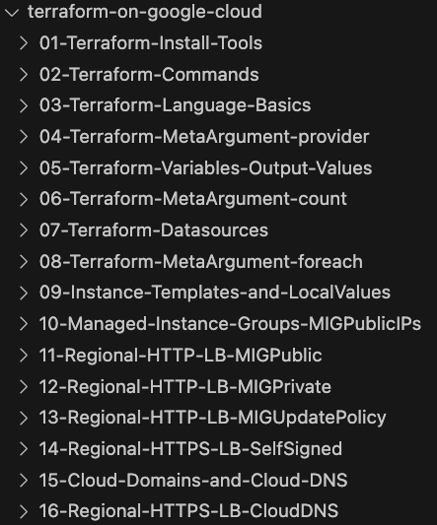
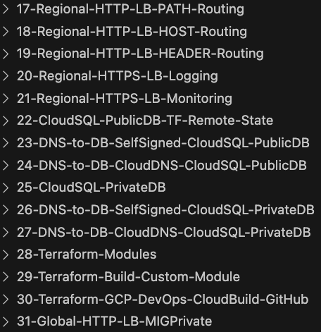
GitHub Step-by-Step Documentation

Slide 6
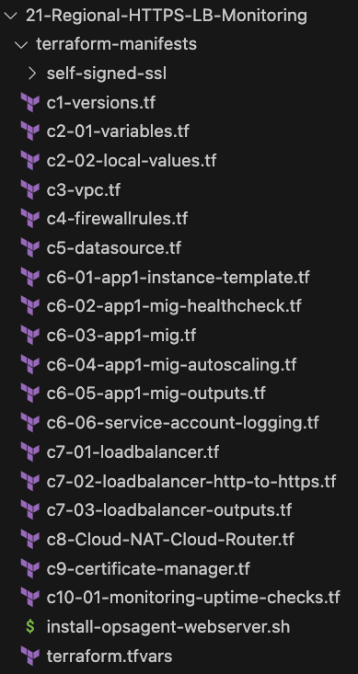
How are Terraform Configs organized ?
Every GCP resource is organized in an incremental manner with file number c1, c2, c3 for easy understanding, reading and troubleshooting
Every section or demo is well organized in GitHub and contains step by step documentation

Slide 7
GitHub Repository
Repository Used For | Repository URL
Course Main Repository with step-by-step documentation | https://github.com/stacksimplify/terraform-on-google-cloud
GCP DevOps for Terraform Configs using Cloud Build and GitHub | https://github.com/stacksimplify/gcp-terraform-devops

Slide 8
Terraform Workflow
init
validate
plan
apply
destroy
1
2
3
4
5
terraform init
terraform validate
terraform plan
terraform apply
terraform destroy

Slide 9
Terraform language uses a limited number of top-level block types, which are blocks that can appear outside of any other block in a TF configuration file.
Terraform
Top-Level
Blocks
Most of Terraform's features are implemented as top-level blocks.
Terraform Block
Input Variables Block
Data Sources Block
Providers Block
Output Values Block
Modules Block
Resources Block
Local Values Block
Calling / Referencing Blocks
Import Block
Fundamental Blocks
Variable Blocks
Moved Block
Removed Block
Check Block
NEW BLOCKS – Added Recently

Slide 10
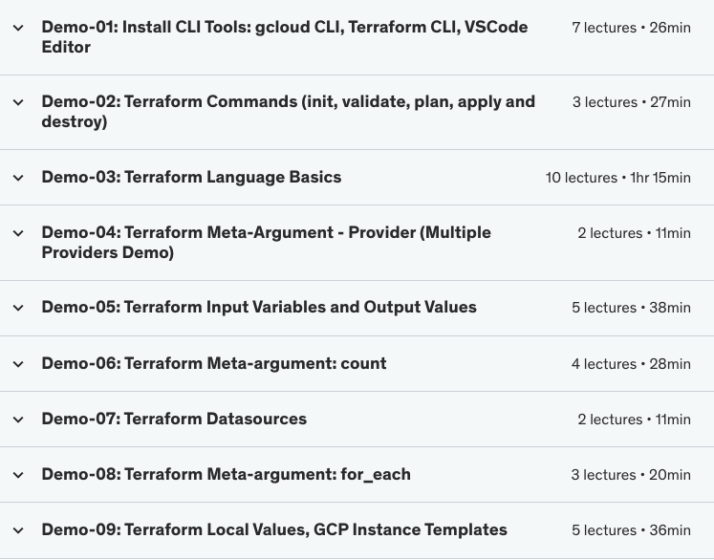
Terraform Fundamentals
Terraform Fundamentals
(4.5 Hours)

Slide 11

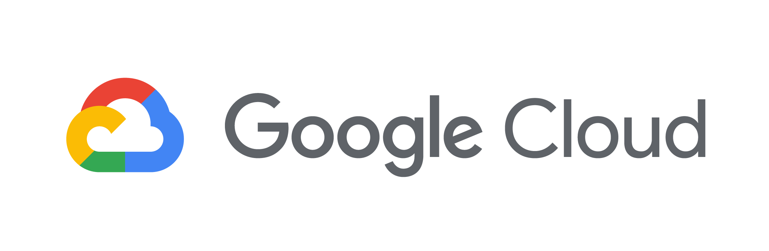
GCP External Regional Application Load Balancer
Users
Customer Project: gcplearn9
VPC: vpc1
fw_ssh22
fw_http80
Region: us-central1
Subnet: us-centra1-subnet-proxyonly
Proxy-Only Subnet (Regional)
Load Balancer
Forwarding Rule
(Regional)
Subnet: us-centra1-subnet
Zone:
us-central1-a
Zone:
us-central1-b
Zone:
us-central1-c
Target HTTP Proxy
(Regional)
VM1
VM2
VM3
URL Map
(Regional)
Zone:
us-central1-f
Zone:
us-central1-a
Zone:
us-central1-a
Backend Service
(Regional)
VM4
VM5
VM6
Instance Group: MIG1
Automated by Terraform

Slide 12

GCP Cloud Router + Cloud NAT
Users
Customer Project: gcplearn9
Use case
VPC: vpc1
Cloud
Load Balancing
When external IPs are disabled for VM instances, how will VM instances reach the external internet to download software (e.g., Nginx binary)?
fw_ssh22
fw_http80
fw_health
check
Region: us-central1
Subnet: us-centra1-subnet
Zone:
us-central1-a
Zone:
us-central1-b
Instance Group:
MIG1
VM1
VM2
How will you open an outbound internet connection for VM instances?
Cloud NAT
Cloud Router
Download
Webserver software
Internet
Automated by Terraform

Slide 13
GCP MIG Update Policy
Users
Use case
Customer Project: gcplearn9
VPC: vpc1
Cloud
Load Balancing
How will you update applications hosted in GCP Managed Instance Groups using Terraform?
fw_ssh22
fw_http80
fw_health
check
Region: us-central1
Subnet: us-centra1-subnet
Zone:
us-central1-a
Instance Group:
MIG1
Zone:
us-central1-b
Update
Policy
How do you upgrade the V1 version of app to V2 version using Terraform?
VM1
VM2
Internet
Cloud NAT
Cloud Router
Automated by Terraform

Slide 14
GCP Load Balancer Self-signed SSL
Users
HTTP -> HTTPS Redirect
HTTPS
Use case
Customer Project: gcplearn9
VPC: vpc1
Cloud
Load Balancing
How do you implement self-signed SSL using Certificate Manager for a GCP Regional Application Load Balancer?
fw_ssh22
fw_http80
fw_health
check
Region: us-central1
Subnet: us-centra1-subnet
Zone:
us-central1-a
Instance Group:
MIG1
Zone:
us-central1-b
Update
Policy
VM1
VM2
Certificate
Manager
Internet
Cloud NAT
Cloud Router
Self-signed SSL Certificates
Automated by Terraform

Slide 15
GCP Cloud DNS + Cloud Domains as Domain Registrar
Users
HTTP -> HTTPS Redirect
HTTPS
Use case
Customer Project: gcplearn9
VPC: vpc1
Cloud
Load Balancing
How do you implement production-grade SSL using Certificate Manager for a GCP Regional Application Load Balancer with a registered domain present in GCP Cloud Domains?
fw_ssh22
fw_http80
fw_health
check
Region: us-central1
Subnet: us-centra1-subnet
Zone:
us-central1-a
Instance Group:
MIG1
Zone:
us-central1-b
Update
Policy
D1
VM1
VM2
Internet
Cloud NAT
Cloud Router
Certificate
Manager
Production grade SSL certificates
Cloud Domains
Cloud DNS
Automated by Terraform

Slide 16
GCP Cloud DNS + AWS Route53 as Domain Registrar
Users
HTTP -> HTTPS Redirect
HTTPS
Use case
Customer Project: gcplearn9
VPC: vpc1
Cloud
Load Balancing
How do you implement production-grade SSL using Certificate Manager for a GCP Regional Application Load Balancer with a registered domain present in an external domain registrar like AWS Route 53, GoDaddy, or Namecheap?
fw_ssh22
fw_http80
fw_health
check
Region: us-central1
Subnet: us-centra1-subnet
Zone:
us-central1-a
Instance Group:
MIG1
Zone:
us-central1-b
Update
Policy
D2
VM1
VM2
Cloud NAT
Cloud Router
Certificate
Manager
Internet
Production grade SSL certificates
AWS
Route53
Cloud DNS
Automated by Terraform

Slide 17
GCP Load Balancer + Context Path Routing
Customer Project: gcplearn9
VPC: vpc1
fw_ssh22
fw_http80
fw_health
check
Region: us-central1
Subnet: us-centra1-subnet
Zone:
us-central1-a
MIG: APP1
Zone:
us-central1-b
/app1
HTTP
Cloud
Load Balancing
Internet
Default
VM1
VM2
Users
Cloud NAT
Download Nginx Binary
/app2
URL Map
Zone:
us-central1-a
MIG: APP2
Zone:
us-central1-b
Load Balancer Resources
Cloud Router
http://LB-IP/app1/index.html
http://LB-IP/app2/index.html
VM1
VM2
http://LB-IP/
Automated by Terraform

Slide 18
GCP Load Balancer + Domain Name based Routing
Customer Project: gcplearn9
VPC: vpc1
fw_ssh22
fw_http80
fw_health
check
Region: us-central1
Subnet: us-centra1-subnet
Zone:
us-central1-a
MIG: APP1
Zone:
us-central1-b
app1.stacksimplify.com
HTTP
Cloud
Load Balancing
Internet
default.stacksimplify.com
VM1
VM2
Users
Cloud NAT
Download Nginx Binary
app2.stacksimplify.com
URL Map
Zone:
us-central1-a
MIG: APP2
Zone:
us-central1-b
Load Balancer Resources
Cloud Router
http://app1.stacksimplify.com/
http://app2.stacksimplify.com/
VM1
VM2
http://default.stacksimplify.com/
Automated by Terraform

Slide 19
GCP Load Balancer + Header based Routing
Customer Project: gcplearn9
VPC: vpc1
fw_ssh22
fw_http80
fw_health
check
Region: us-central1
Subnet: us-centra1-subnet
Zone:
us-central1-a
MIG: APP1
Zone:
us-central1-b
appname: myapp1
HTTP
Cloud
Load Balancing
Internet
Default (Any header)
VM1
VM2
Users
Cloud NAT
Download Nginx Binary
appname: myapp2
URL Map
Zone:
us-central1-a
MIG: APP2
Zone:
us-central1-b
Load Balancer Resources
Cloud Router
http://LB-IP/ + Header appname: myapp1
http://LB-IP/ + Header appname: myapp3, any value
VM1
VM2
http://LB-IP/ + Header appname: myapp2
Automated by Terraform

Slide 20
GCP Cloud Logging
Customer Project: gcplearn9
VPC: vpc1
Cloud
Logging
fw_ssh22
fw_http80
fw_health
check
Region: us-central1
Subnet: us-centra1-subnet
HTTP -> HTTPS Redirect
Zone:
us-central1-a
Zone:
us-central1-b
HTTPS
Cloud
Load Balancing
Internet
Default
VM1
VM2
Users
URL Map
Ops Agent
Ops Agent
Cloud NAT
Self-signed SSL
Download Nginx Binary
https://LB-IP/
config.yaml for Nginx
config.yaml for Nginx
Certificate
Manager
Update
Policy
Cloud Router
Load Balancer Resources
MIG: APP1
Automated by Terraform

Slide 21
Cloud Logging + Cloud Monitoring
Customer Project: gcplearn9
VPC: vpc1
Cloud
Monitoring
Notification Channels
Cloud
Logging
Uptime Checks
Alert Policy
fw_ssh22
fw_http80
fw_health
check
Nginx Metrics
Region: us-central1
Subnet: us-centra1-subnet
HTTP -> HTTPS Redirect
Zone:
us-central1-a
Zone:
us-central1-b
HTTPS
Cloud
Load Balancing
Internet
Default
VM1
VM2
Users
URL Map
Ops Agent
Ops Agent
Cloud NAT
Self-signed SSL
Download Nginx Binary
https://LB-IP/
config.yaml for Nginx
config.yaml for Nginx
Certificate
Manager
Update
Policy
Cloud Router
Load Balancer Resources
MIG: APP1
Automated by Terraform

Slide 22

GCP Cloud SQL Public IP
Terraform Remote Backends Concept
Service Producer Project for Customer
Service Producer VPC Network
Subnet: UNKNOWN
C
L
O
U
D
SQL
PUB
L
IC
IP
Zone:
us-central1-a
Cloud SQL
(MySQL)
Users
Communication
is via Internet
Cloud Shell
Zone:
us-central1-b
Cloud SQL
(MySQL)
Automated by Terraform

Slide 23
Terraform Remote State Datasource
The terraform_remote_state data source retrieves the root module output values from project-1 Terraform configuration, using the latest state snapshot from the remote backend.
Project-1
Project-2
Terraform Resources
1. Cloud SQL Database
Terraform Resources
VPC, Subnets
Instance Templates, MIG
Service Account
Load Balancer
Cloud NAT, Cloud Router
Certificate Manager
Uptime Checks
terraform_remote_state data source
Outputs from Project-1
1. Cloud SQL Public IP
cloudsql/publicdb/default.tfstate
myapp1/httpslb-selfsigned-publicdb/default.tfstate

Slide 24
GCP DNS TO DB + LB (self-signed SSL) + Cloud SQL Public IP
Download
UMS Binary
Internet
Customer Project: gcplearn9
Service Producer Project for Customer
VPC: vpc1
Service Producer VPC Network
Cloud
Monitoring
Cloud
Logging
Subnet: UNKNOWN
fw_ssh22
fw_http80
fw_health
check
C
L
O
U
D
SQL
PUB
L
IC
IP
Zone:
us-central1-a
Region: us-central1
Subnet: us-centra1-subnet
Zone:
us-central1-a
Zone:
us-central1-b
Communication
is via Internet
HTTP -> HTTPS Redirect
Cloud NAT
Cloud SQL
(MySQL)
HTTPS
Cloud
Load Balancing
Default
VM1
VM2
Cloud Router
URL Map
User
Management
Web
Application
Ops Agent
Ops Agent
Self-signed SSL
Zone:
us-central1-b
config.yaml
config.yaml
Users
Certificate
Manager
https://LB-IP/
Load Balancer Resources
Update
Policy
Cloud SQL
(MySQL)
MIG: App1
Automated by Terraform

Slide 25
GCP DNS TO DB + LB (Prod-grade SSL, Cloud DNS) + Cloud SQL Public IP
Download
UMS Binary
Internet
Customer Project: gcplearn9
Service Producer Project for Customer
VPC: vpc1
Service Producer VPC Network
Cloud
Monitoring
Cloud
Logging
Subnet: UNKNOWN
fw_ssh22
fw_http80
fw_health
check
C
L
O
U
D
SQL
PUB
L
IC
IP
Zone:
us-central1-a
Region: us-central1
Subnet: us-centra1-subnet
https://myapp29.kalyanreddydaida.com
Zone:
us-central1-a
Zone:
us-central1-b
Communication
is via Internet
HTTP -> HTTPS Redirect
Cloud NAT
Cloud SQL
(MySQL)
HTTPS
Cloud
Load Balancing
Default
VM1
VM2
Cloud Router
URL Map
User
Management
Web
Application
Ops Agent
Ops Agent
Prod grade SSL
Zone:
us-central1-b
config.yaml
config.yaml
Users
Certificate
Manager
Load Balancer Resources
Update
Policy
Cloud SQL
(MySQL)
MIG: APP1
Cloud Domains
Cloud DNS
Automated by Terraform

Slide 26
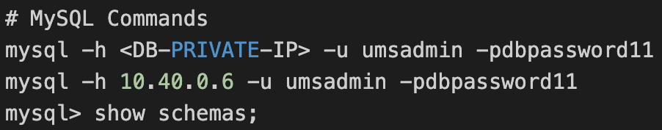
GCP Cloud SQL Private IP
Customer Project: gcplearn9
Service Producer Project for Customer
Customer VPC: VPC1
VPC Network Peering
Service Producer VPC Network
Region: us-central1
Private Service Connection
(10.240.0.0/16)
C
L
O
U
D
SQL
P
R
I
V
A
T
E
I
P
Subnet: UNKNOWN
Subnet: us-centra1-subnet
Zone:
us-central1-a
Zone: us-central1-a
MySQL Client
Users
VM1
Cloud SQL
(MySQL)
Communication is Private
(Internal to Google Cloud)
Zone:
us-central1-b
Cloud SQL
(MySQL)
Automated by Terraform

Slide 27
GCP DNS TO DB + LB (self-signed SSL) + Cloud SQL Private IP
Download
UMS Binary
Internet
Customer Project: gcplearn9
Service Producer Project for Customer
VPC: vpc1
VPC Network Peering
Service Producer VPC Network
Cloud
Monitoring
Cloud
Logging
Private Service Connection
(10.240.0.0/16)
C
L
O
U
D
SQL
P
R
I
V A
T
E
I
P
Subnet: UNKNOWN
fw_ssh22
fw_http80
fw_health
check
Zone:
us-central1-a
Region: us-central1
Subnet: us-centra1-subnet
Zone:
us-central1-a
Zone:
us-central1-b
HTTP -> HTTPS Redirect
Cloud NAT
Cloud SQL
(MySQL)
HTTPS
Cloud
Load Balancing
Default
VM1
VM2
Cloud Router
URL Map
User
Management
Web
Application
Ops Agent
Ops Agent
Self-signed SSL
Zone:
us-central1-b
config.yaml
config.yaml
Users
Certificate
Manager
https://LB-IP/
Load Balancer Resources
Update
Policy
Communication is Private
(Internal to Google Cloud)
Cloud SQL
(MySQL)
MIG: APP1
Automated by Terraform

Slide 28
GCP DNS TO DB + LB (Prod-grade SSL, Cloud DNS) + Cloud SQL Private IP
Download
UMS Binary
Internet
Customer Project: gcplearn9
Service Producer Project for Customer
VPC: vpc1
VPC Network Peering
Service Producer VPC Network
Cloud
Monitoring
Cloud
Logging
Private Service Connection
(10.240.0.0/16)
C
L
O
U
D
SQL
P
R
I
V A
T
E
I
P
Subnet: UNKNOWN
fw_ssh22
fw_http80
fw_health
check
Zone:
us-central1-a
Region: us-central1
Subnet: us-centra1-subnet
https://app1.kalyanreddydaida.com
Zone:
us-central1-a
Zone:
us-central1-b
HTTP -> HTTPS Redirect
Cloud NAT
Cloud SQL
(MySQL)
HTTPS
Cloud
Load Balancing
Default
VM1
VM2
Cloud Router
URL Map
User
Management
Web
Application
Ops Agent
Ops Agent
Prod
Grade
SSL
Zone:
us-central1-b
config.yaml
config.yaml
Users
Certificate
Manager
Communication is Private
(Internal to Google Cloud)
Load Balancer Resources
Update
Policy
Cloud SQL
(MySQL)
MIG: APP1
Cloud Domains
Cloud DNS
Automated by Terraform

Slide 29
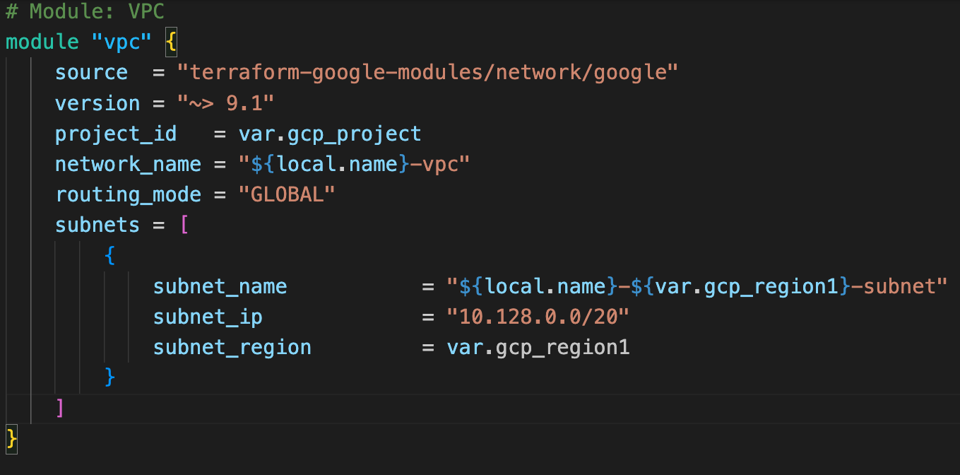
Terraform Registry - Use Publicly Available Modules
The Terraform Registry hosts a broad collection of publicly available Terraform modules for configuring many kinds of common infrastructure.
ModulesDemo 1
These modules are free to use, and Terraform can download them automatically if you specify the appropriate source and version in a module call block.

Slide 30
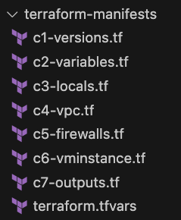
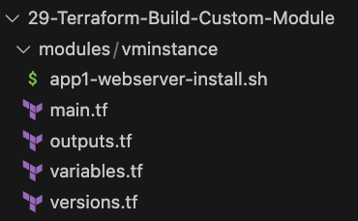
Build a Local Terraform Module
Root Module
Modules
Demo 2
Call VM Instance child module in
Root Module
Build a Local Terraform Module and call it from Root Module and Test
Child Module

Slide 31


GCP DevOps for Terraform Configs
Customer Project: gcplearn9
+
VPC: vpc1
fw_ssh22
fw_http80
Cloud Build
App
Region: us-central1
Connection
Link Repo
DEV Branch
Cloud Build
Create
Pull Request
Trigger
Merge
Build
Approver
Build
Approver
Create
Pull Request
& Merge
Feature Branch-1
Cloud Build Key Concepts
Subnet: us-centra1-subnet
PROD Branch
Zone: us-central1-a
MAIN Branch
Disk
20GB
Disk
20GB
GIT Repo
dev-vm
prod-vm
GitHub
Dev Environment
Prod Environment
Developer

Slide 32

GCP Global Application Load Balancer
Users
from
us-central1 or nearest regions
Customer Project: gcplearn9
VPC: vpc1
fw_ssh22
fw_http80
fw_health
check
Region: us-central1
Subnet: us-centra1-subnet
http://LB-IP/
Zone:
us-central1-a
Zone:
us-central1-b
MIG:
US-CENTRAL1
APP1
Cloud NAT
Download Nginx Binary
Cloud
Load Balancing
VM1
VM2
HTTP
Cloud Router
Global Application
Load Balancer
Region: asia-south1
Internet
Subnet: asia-south1 -subnet
http://LB-IP/
Zone:
asia-south1-a
Zone:
asia-south1-b
MIG:
ASIA-SOUTH1
APP1
Cloud NAT
Download Nginx Binary
Users
from
asia-south1 or nearest regions
VM2
VM1
Cloud Router
Automated by Terraform

Slide 33
END OF INTRODUCTION

Slide 34
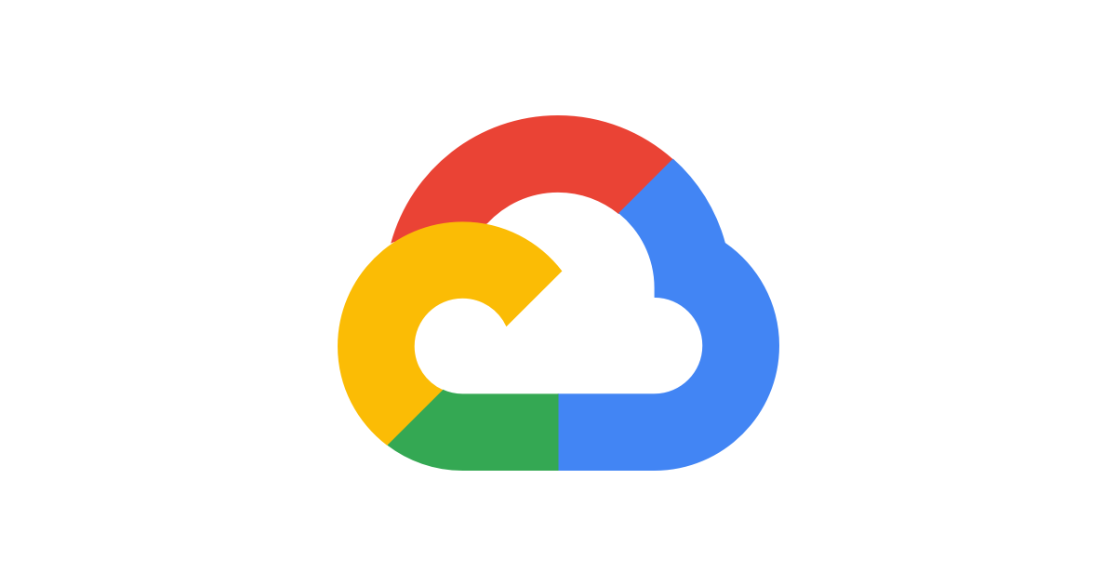

Demo
Terraform
Installation
CLI Tools

Slide 35
Terraform Installation
gcloud CLI
Terraform CLI
VS Code Editor
Terraform plugin for VS Code
Mac OS
Windows OS

Slide 36
Demo
Terraform
Command Basics

Slide 37
Terraform Workflow
init
validate
plan
apply
destroy
1
2
3
4
5
terraform init
terraform validate
terraform plan
terraform apply
terraform destroy

Slide 38
Terraform Workflow
init
validate
plan
apply
destroy
1
2
3
4
5
Used to Initialize a working directory containing terraform config files
This is the first command that should be run after writing a new Terraform configuration
Downloads Providers
Validates the terraform configurations files in that respective directory to ensure they are syntactically valid and internally consistent.
Creates an execution plan
Terraform performs a refresh and determines what actions are necessary to achieve the desired state specified in configuration files
Used to apply the changes required to reach the desired state of the configuration.
By default, apply scans the current directory for the configuration and applies the changes appropriately.
Used to destroy the Terraform-managed infrastructure
This will ask for confirmation before destroying.

Slide 39
Demo
Terraform What are we going
to automate as part of this demo
using
Terraform?

Slide 40
Terraform Language Basics
Customer Project: gcplearn9
VPC: vpc1
Automated by Terraform
Region: us-central1
Subnet: us-centra1-subnet
Zone: us-central1-a
http://<VM-External-IP:80>
fw_ssh22
User
fw_http80
VM1

Slide 41
Demo
Terraform
Language Basics

Slide 42
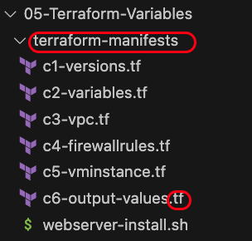
Terraform Language Basics - Files
Terraform Working Directory
Code in the Terraform language is stored in plain text files with the .tf file extension.
There is also a JSON-based variant of the language that is named with the .tf.json file extension.
We can call the files containing terraform code as Terraform Configuration Files or Terraform Manifests
Terraform files should be saved in a directory (Terraform Working Directory)
Terraform Configuration Files ending with .tf as extension

Slide 43
Terraform Language Basics - Configuration Syntax
Blocks
Arguments
HCL – HashiCorp Language
Terraform
Identifiers
Comments

Slide 44
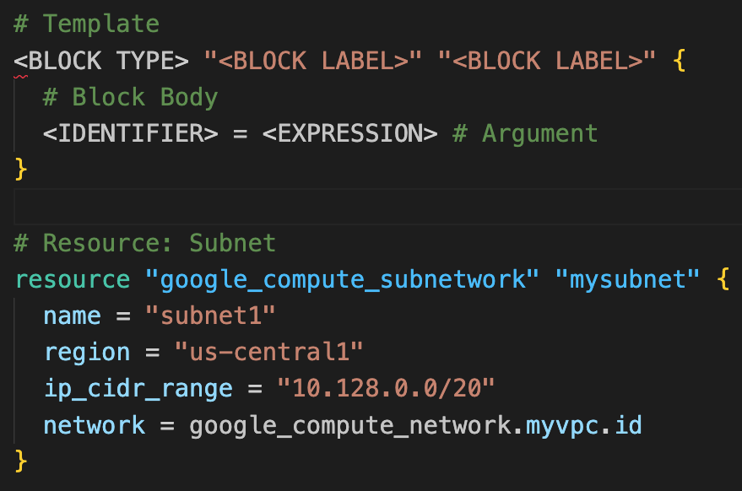
Terraform Language Basics - Configuration Syntax
Based on Block Type, block labels can be 1 or 2
Example:
Resources: 2 block labels
Variables: 1 block label
Block Labels
Block Type
Arguments
Top Level & Block inside Blocks
Top Level Blocks: resource, provider, terraform, variable, data, module, output
Block Inside Block: provisioners, resource specific blocks like tags

Slide 45
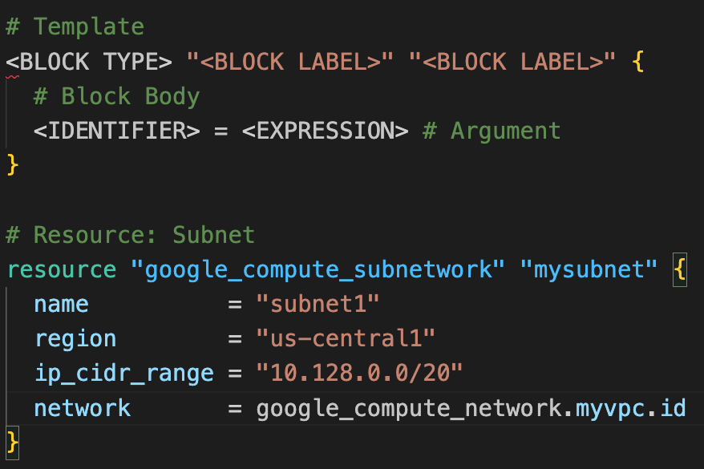
Terraform Language Basics - Configuration Syntax
Argument Name
[OR]
Identifier
Argument Value
[OR]
Expression

Slide 46
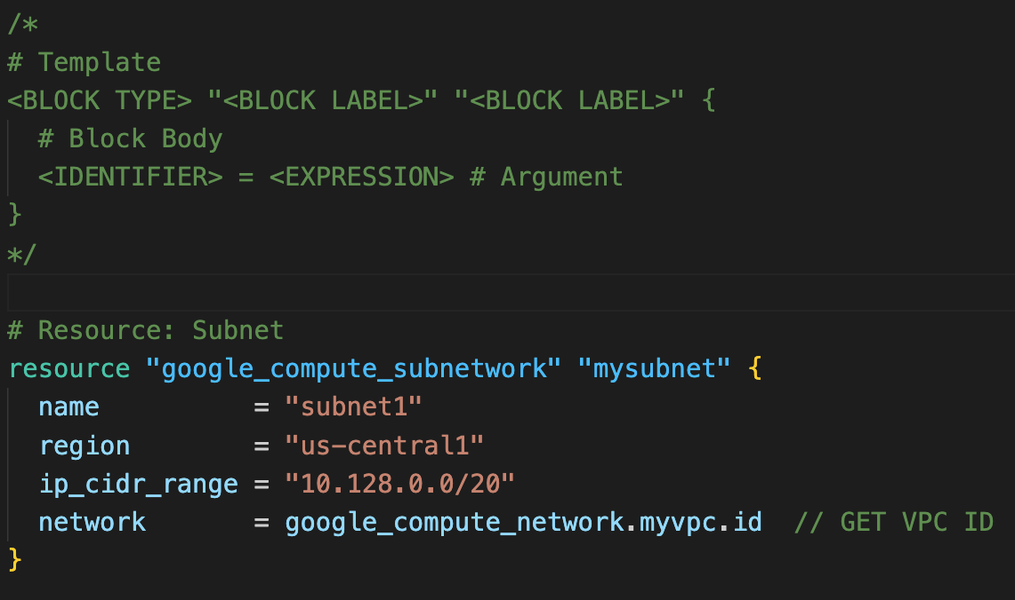
Terraform Language Basics - Configuration Syntax
Multi-line comment /* ….. */
Single Line Comments with # or //

Slide 47
Terraform language uses a limited number of top-level block types, which are blocks that can appear outside of any other block in a TF configuration file.
Terraform
Top-Level
Blocks
Most of Terraform's features are implemented as top-level blocks.
Terraform Block
Input Variables Block
Data Sources Block
Providers Block
Output Values Block
Modules Block
Resources Block
Local Values Block
Calling / Referencing Blocks
Import Block
Fundamental Blocks
Variable Blocks
Moved Block
Removed Block
Check Block
NEW BLOCKS – Added Recently

Slide 48
Demo
Terraform
Fundamental Blocks

Slide 49
Terraform Basic Blocks
Terraform
Block
Provider
Block
Resource
Block
Special block used to configure some behaviors
HEART of Terraform
Each Resource Block describes one or more Infrastructure Objects
Specifying a required Terraform Version
Terraform relies on providers to interact with Remote Systems
Resource Syntax:
How to declare Resources?
Specifying Provider Requirements
Declare providers for Terraform to install providers & use them
Resource Behavior: How Terraform handles resource declarations?
Configuring a Terraform Backend (Terraform State)
Provider configurations belong to Root Module
Provisioners: We can configure Resource post-creation actions

Slide 50
Demo
Terraform
Terraform Block

Slide 51
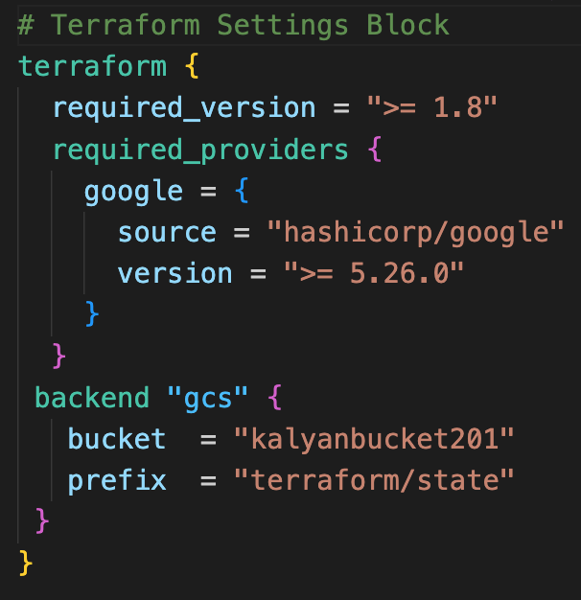
Terraform Block
This block can be called in 3 ways. All means the same.
Terraform Block
Terraform Settings Block
Terraform Configuration Block
Each terraform block can contain a number of settings related to Terraform's behavior.
Within a terraform block, only constant values can be used; arguments may not refer to named objects such as resources, input variables, etc, and may not use any of the Terraform language built-in functions.

Slide 52
Demo
Terraform
Providers

Slide 53


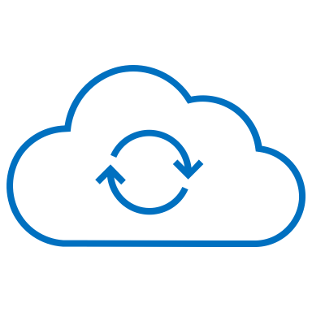
Terraform Providers
Providers are HEART of Terraform
Every Resource Type (example: VM Instance), is implemented by a Provider
Without Providers Terraform cannot manage any infrastructure.
Terraform Admin
Providers are distributed separately from Terraform and each provider has its own release cycles and Version Numbers
Terraform Registry is publicly available which contains many Terraform Providers for most major Infra Platforms
Local Desktop
1
Google Cloud
terraform init
Terraform CLI
Download Provider
Terraform Registry
Terraform GCP
Provider
4
terraform apply
GCP
APIs
5
terraform destroy
VM Instance
2
terraform validate
3
terraform plan

Slide 54
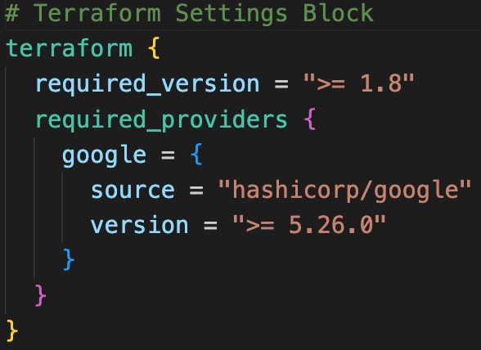
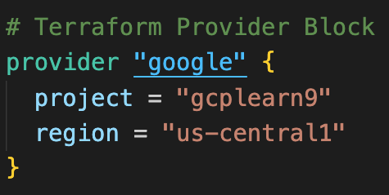
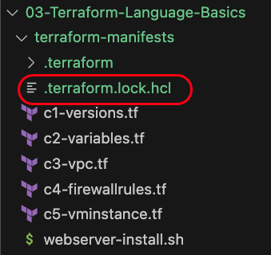
Terraform
Providers
Provider Requirements
Provider Configuration
Dependency Lock File

Slide 55
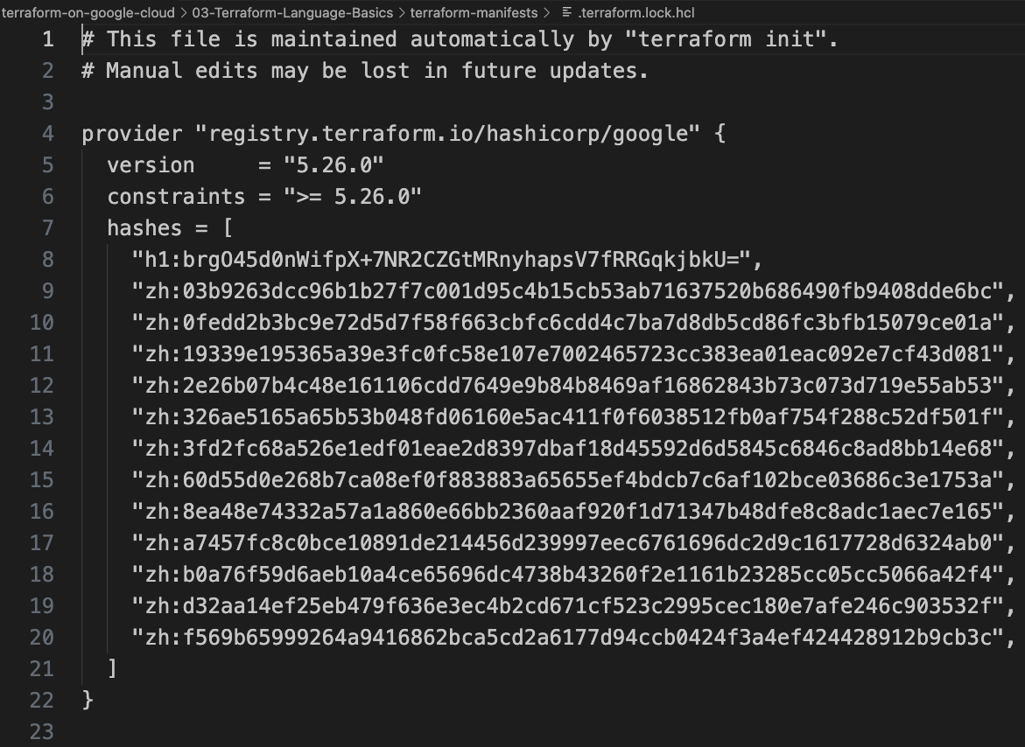
Dependency Lock File

Slide 56
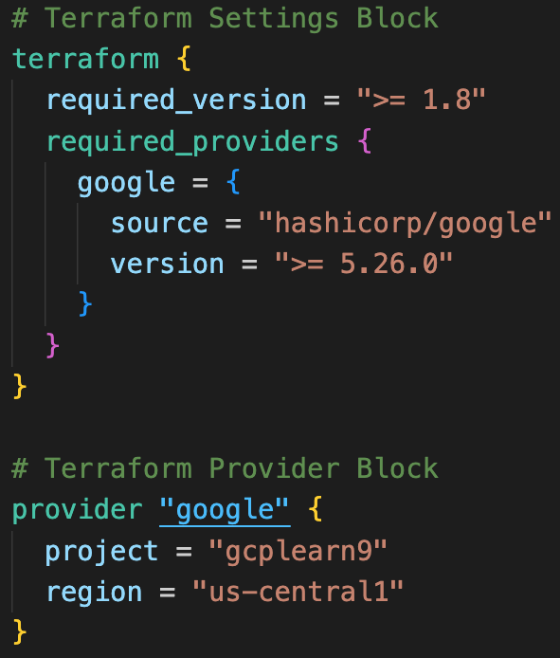
Required Providers
Local Names
Local Names are Module specific and should be unique per-module
Terraform configurations always refer to local name of provider outside required_provider block
Users of a provider can choose any local name for it (mygoogle, google1).
Recommended way of choosing local name is to use preferred local name of that provider (For Google Provider: hashicorp/google, preferred local name is google)
Source
It is the primary location where we can download the Terraform Provider
Source addresses consist of three parts delimited by slashes (/)
[<HOSTNAME>/]<NAMESPACE>/<TYPE>
registry.terraform.io/hashicorp/google
Registry Name is optional as default is going to be Terraform Public Registry

Slide 57
Terraform Registry
Terraform Providers
Terraform Modules
Terraform Registry
registry.terraform.io
Terraform Policy Libraries
Terraform Run Tasks

Slide 58
Demo
Terraform
State

Slide 59

Terraform State
Terraform must store state about your managed infrastructure and configuration
Terraform
Admin
This state is used by Terraform to map real world resources to your configuration (.tf files), keep track of metadata, and to improve performance for large infrastructures.
Local Desktop
This state is stored by default in a local file named "terraform.tfstate", but it can also be stored remotely, which works better in a team environment.
1
terraform init
Google Cloud
Terraform CLI
Download Provider
Terraform Registry
Terraform AWS
Provider
4
terraform apply
GCP
APIs
VM Instance
5
terraform destroy
2
terraform validate
3
terraform plan
Terraform State
File : terraform.tfstate

Slide 60
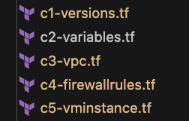

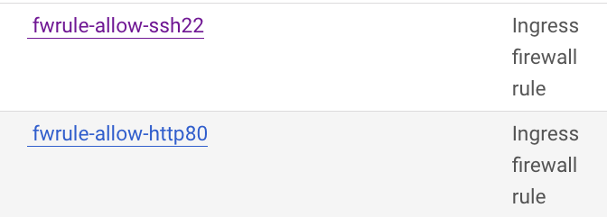
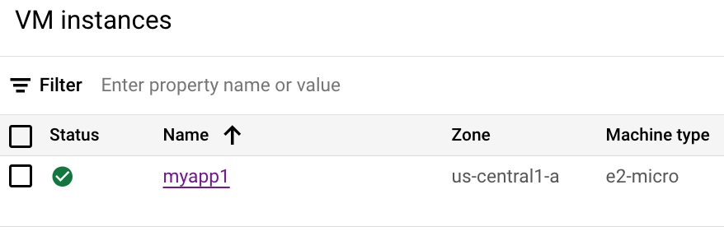
Desired & Current Terraform States
Terraform Configuration Files
Real World Resource
VM Instance, VPC, Subnet,
Firewall Rules
terraform.tfstate
Desired State
Current State

Slide 61
Demo-4
Terraform
Multiple Providers
Meta-Argument: provider

Slide 62
Resource Meta-Arguments
depends_on
count
Terraform Resources
Meta-Arguments
for_each
provider
Meta-Arguments can be used with any resource type to change the behavior of resources.
lifecycle

Slide 63
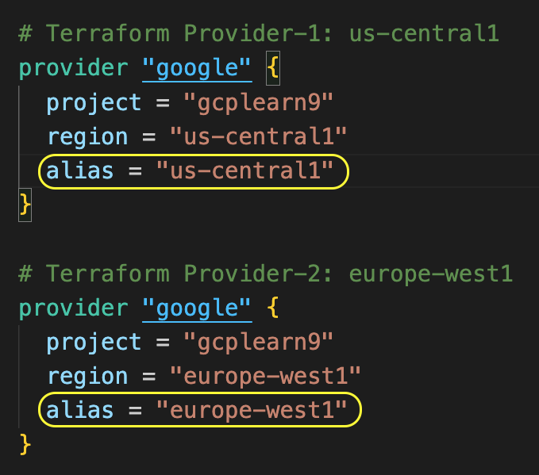
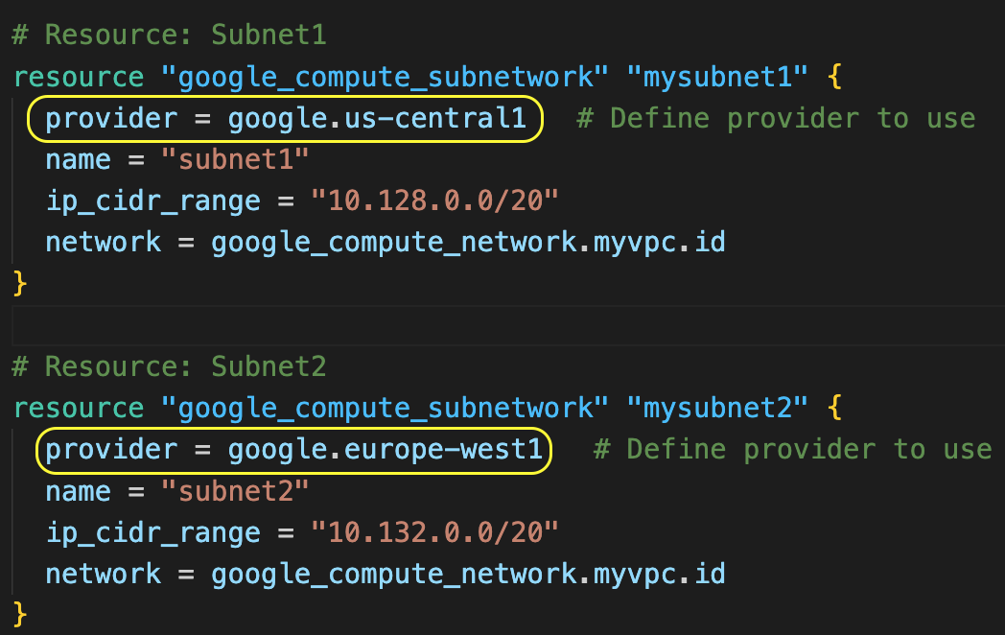
Terraform Multiple Providers
We can define multiple configurations for the same provider (Ex: google) and select which one to use on a per-resource or per-module basis.
The primary reason for this is to support multiple regions for a cloud platform, additionally for multiple environments (dev, prod) considering each environment has different provider configurations (Example: different authentication credentials for dev and prod)
We can use the alternate provider in a resource, data or module by referencing it as <PROVIDER NAME>.<ALIAS>

Slide 64
Terraform Multiple Providers
We can define multiple configurations for the same provider (Ex: google) and select which one to use on a per-resource or per-module basis.
Usage
To support multiple regions for a cloud platform (we will practically implement this)
For supporting multiple environments (dev, prod) considering each environment has different provider configurations
Example: Different authentication credentials for dev and prod configured in their respective provider blocks
We can use the alternate provider in a resource, data or module by referencing it as <PROVIDER NAME>.<ALIAS>

Slide 65
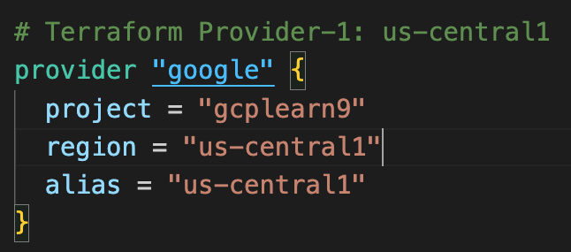
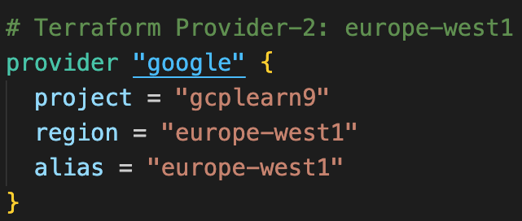
Terraform Multiple Providers
Customer Project: gcplearn9
VPC: vpc1
Automated by Terraform
Region: us-central1
Subnet: us-centra1-subnet
Region: europe-west1
Subnet: europe-west1-subnet

Slide 66
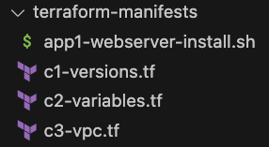
What are we going to learn?
Demo: Terraform Concept: Multiple Providers
C1
Update multiple providers
C2
Use provider alias in subnet Terraform resources

Slide 67
Demo-5
Terraform
Input Variables
Output Values
Demo: Terraform Concept: Input Variables and Output Values

Slide 68
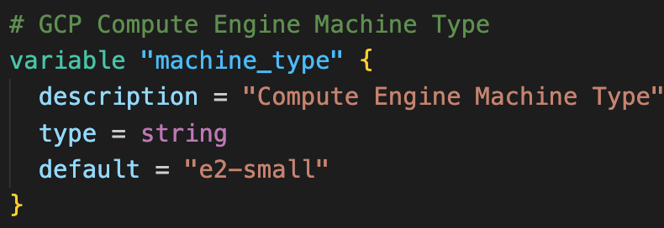
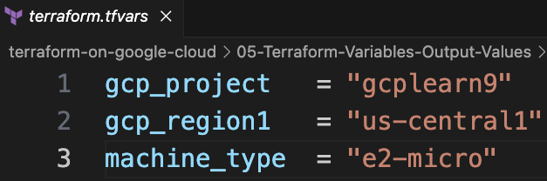
Terraform Input Variables
Input variables allow us to customize the Terraform Resources or modules without altering the source code.
Key Benefit: Allows us to make the code reusable by just changing variables
We have multiple options to declare variables
varibales.tf (Default value)
terraform.tfvars
vm.auto.tfvars
vm.tfvars
Environment Variables
--var-file flag
--var flag
variables.tf
terraform.tfvars

Slide 69
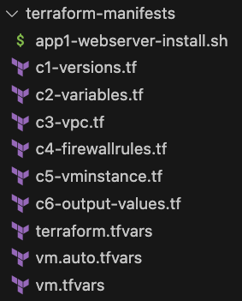
What are we going to learn?
Demo: Terraform Concept: Input Variables
C2
Understand and define Terraform Input Variables
C1
Update Provider block with Terraform input variables
C3
Update subnet region with input variable
C5
Update VM Instance machine type using input variable
TF
VARS
Play with terraform.tfvars, vm.auto.tfvars and vm.tfvars

Slide 70
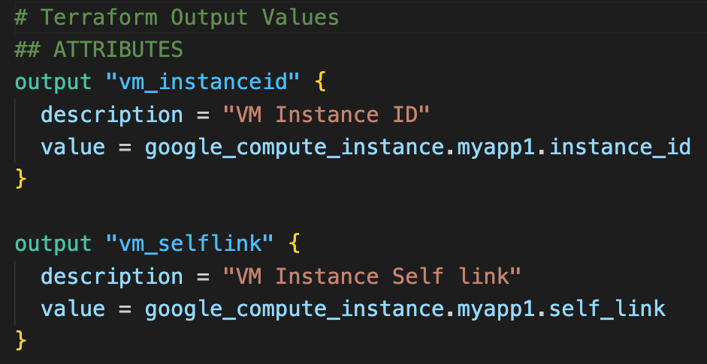
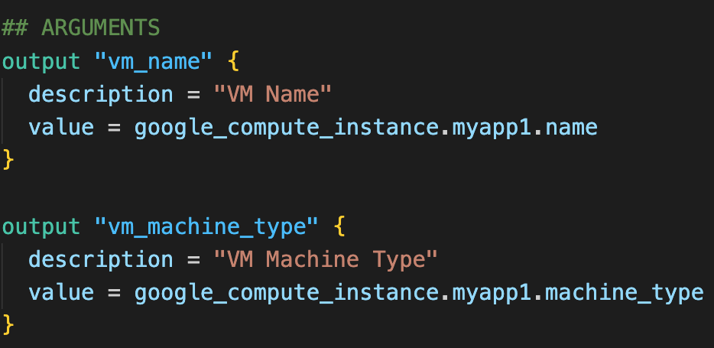
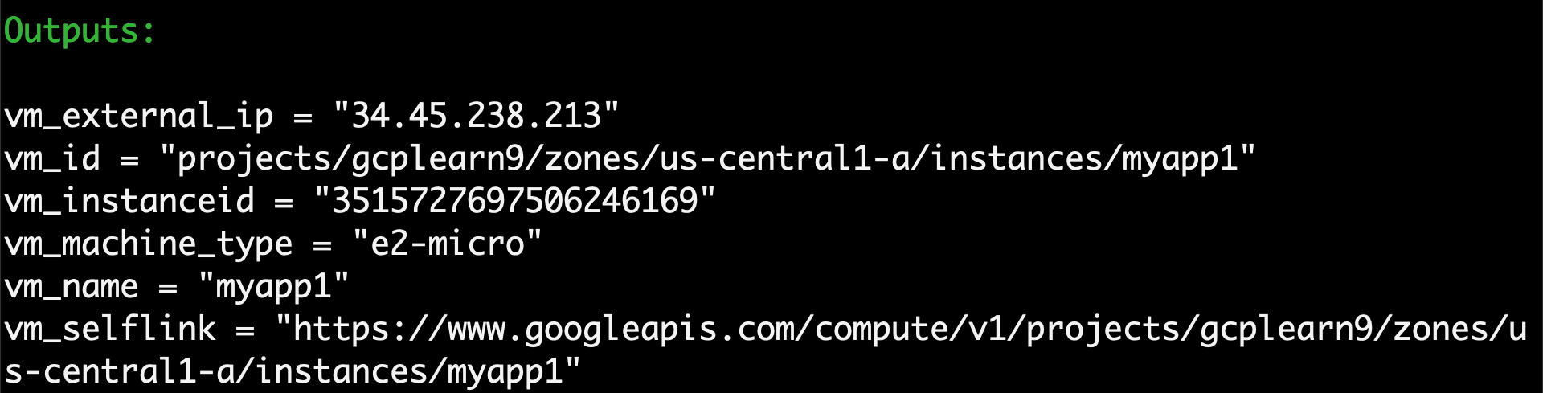
Terraform Output Values
Output Values - Attributes
Output values are like return values in programming languages.
Output values provide about your infrastructure available on the command line
With output values we can expose information for other Terraform configurations to use
Output Values - Arguments
Output Values

Slide 71
What are we going to learn?
Demo: Terraform Concept: Output Values
C6
Understand and define Terraform Output values

Slide 72
Demo-6
Terraform
Meta-Argument
count
Demo: Terraform Concept: Meta-argument count

Slide 73
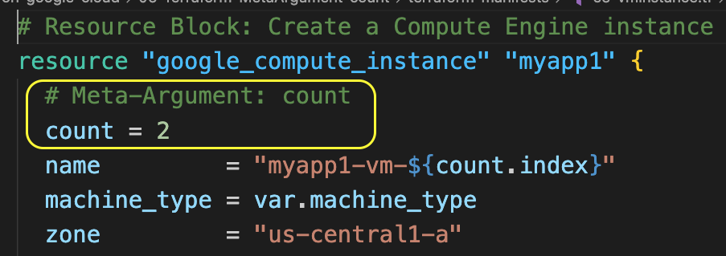
Terraform Meta-Argument: count
By default, resource block creates a single instance of a resource
For example: 1 VM Instance
With the meta-argument count we can create specified number of similar instances of a resource
For example: count = 2 (will create 2 VM instances from the same defined resource block)
count.index: The distinct index number (starting with 0) corresponding to this instance.
Resource Meta-Argument: count

Slide 74
Terraform Meta-argument: count
Customer Project: gcplearn9
VPC: vpc1
Automated by Terraform
Region: us-central1
Subnet: us-centra1-subnet
Zone: us-central1-a
fw_ssh22
http://<VM0-External-IP:80>
VM0
http://<VM1-External-IP:80>
User
VM1
fw_http80

Slide 75
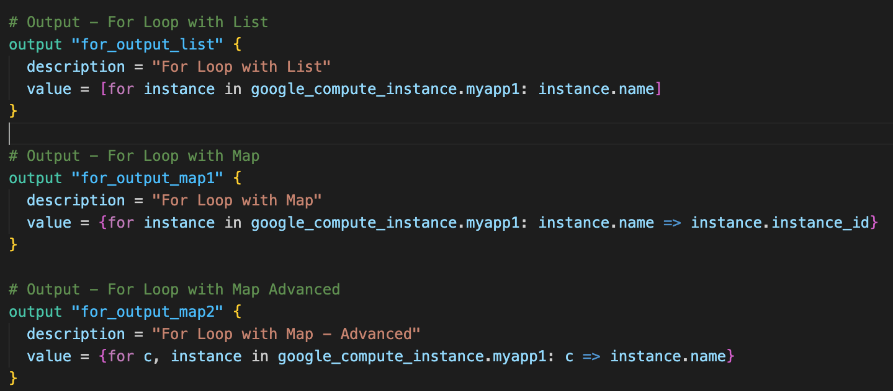
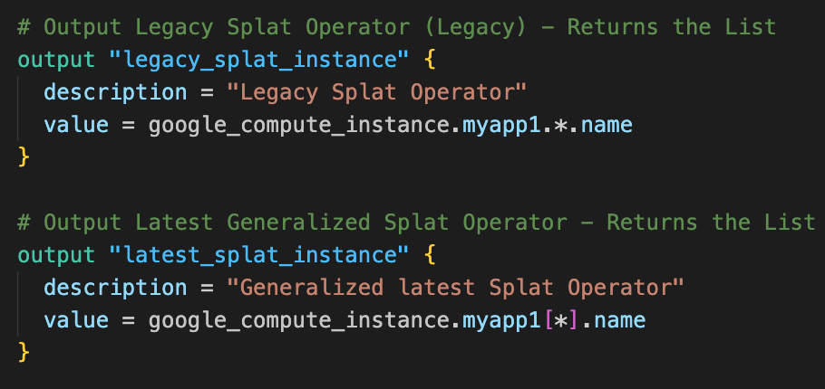
Terraform: For expression
For expression
For Expression: Enables efficient management of multiple resources by looping through lists, maps, or sets
Examples:
For loop with list
For loop with map
For loop with map advanced
Legacy splat operator
Latest generalized splat operator

Slide 76
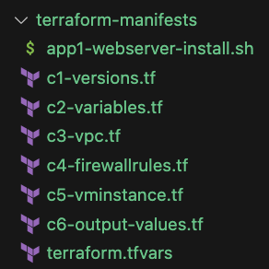
What are we going to learn?
Demo: Terraform Concept: Meta-argument count
NC
No Changes from C1 to C4
C5
Define VM Instance with Meta-argument count
C6
Define Terraform output values with Terraform for expression and also learn about Splat operator

Slide 77
Demo-7
Terraform
Data sources
Demo: Terraform Concept: Datasources

Slide 78
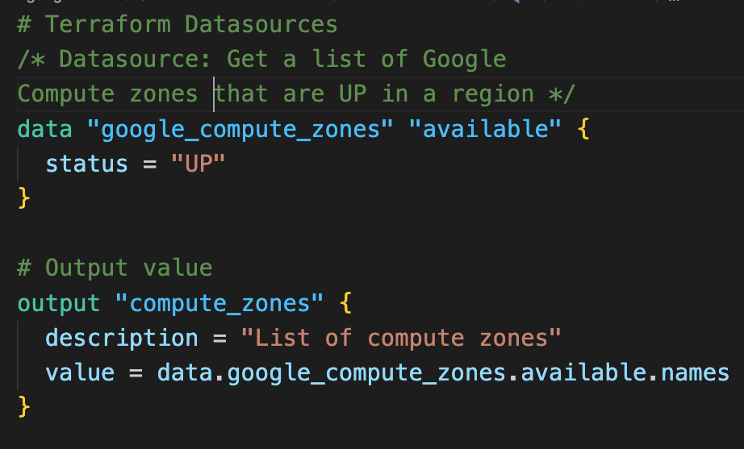
Terraform Data sources
Data sources: allow Terraform to use information defined outside of Terraform
A data source is accessed via a special kind of resource known as a data resource, declared using a data block:
Use case:
Step-01: Get the available compute zones in that respective region using google_compute_zone datasource
Step-02: Create two VM Instances in two available compute zones using the Meta-argument count
Terraform Data source

Slide 79
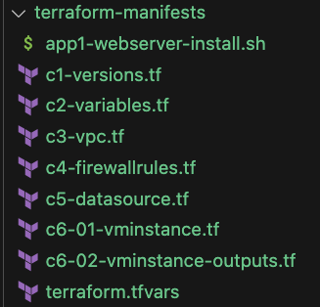
What are we going to learn?
Demo: Terraform Concept: Datasources
NC
No Changes from C1 to C4
C5
Define a data source to get a list of all available zones in that region
C6-01
Update VM Instance with zone value updated from Terraform data source

Slide 80
Demo-8
Terraform
Meta-Argument
for_each
Demo: Terraform Concept: Meta-Argument for_each

Slide 81
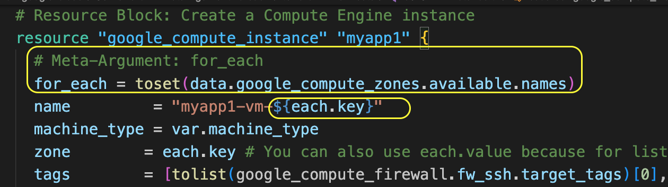
Terraform Meta-Argument: for_each
Resource Meta-Argument: for_each
By default, resource block creates a single instance of a resource
For example: 1 VM Instance
The for_each meta-argument accepts a map or a set of strings and creates an instance for each item in that map or set
For example: Creates 1 VM instance for each compute zone
Each instance has a
distinct infrastructure object associated with it
each is separately created, updated, or destroyed when the configuration is applied
each.key: The map key (or set member) corresponding to this instance.
each.value: The map value corresponding to this instance (If a set was provided, each.key == each.value)

Slide 82
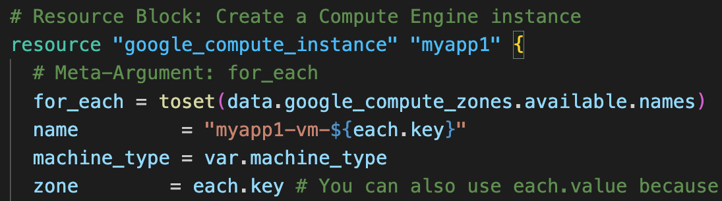
Terraform Meta-argument: for_each
Demo-1: for_each with Set values
Customer Project: gcplearn9
Creates VM instance for each available compute zone in a region
VPC: vpc1
Automated by Terraform
Region: us-central1
Subnet: us-centra1-subnet
Zone: us-central1-a
Zone: us-central1-b
fw_ssh22
VM1
VM2
Zone: us-central1-c
Zone: us-central1-f
fw_http80
VM3
VM4

Slide 83
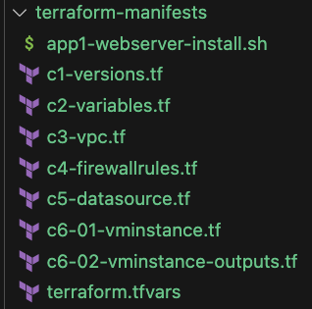
What are we going to learn?
Demo-01: Terraform Concept: Meta-argument for_each
NC
No Changes from C1 to C5
C6-01
VM Instance with for_each Meta-argument with Set Values
C6-02
Terraform outputs for VM Instance

Slide 84
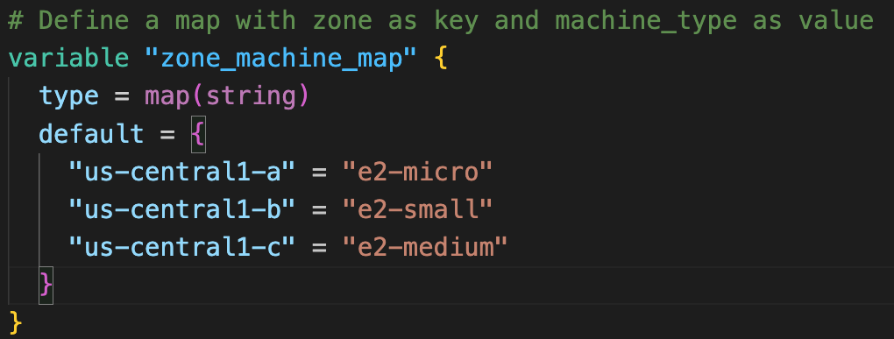
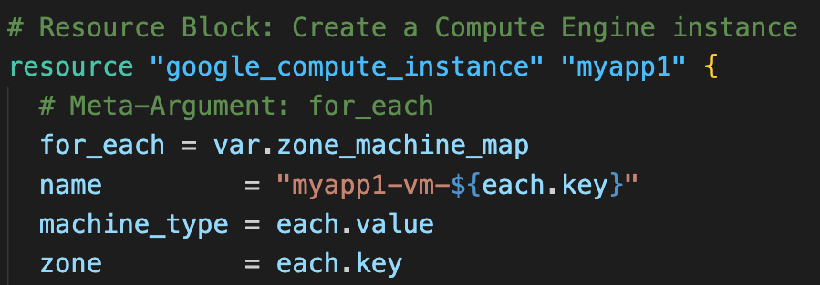
Terraform Meta-argument: for_each
Demo-2: for_each with Map values
Customer Project: gcplearn9
Creates VM instance with different machine type in each compute zone
VPC: vpc1
Automated by Terraform
Region: us-central1
Subnet: us-centra1-subnet
Zone: us-central1-a
Zone: us-central1-b
fw_ssh22
VM1
VM2
e2-micro
e2-small
Zone: us-central1-c
VM3
fw_http80
e2-medium

Slide 85
What are we going to learn?
Demo-02: Terraform Concept: Meta-argument for_each
NC
No Changes from C1 to C5
C6-01
VM Instance with for_each Meta-argument with Map Values

Slide 86
Demo-9
Terraform
Local Values
GCP Instance Templates
Demo: Custom VPC + Instance Template + VM Instance

Slide 87
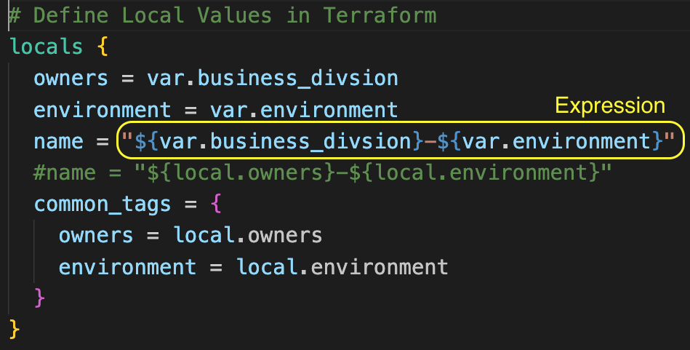
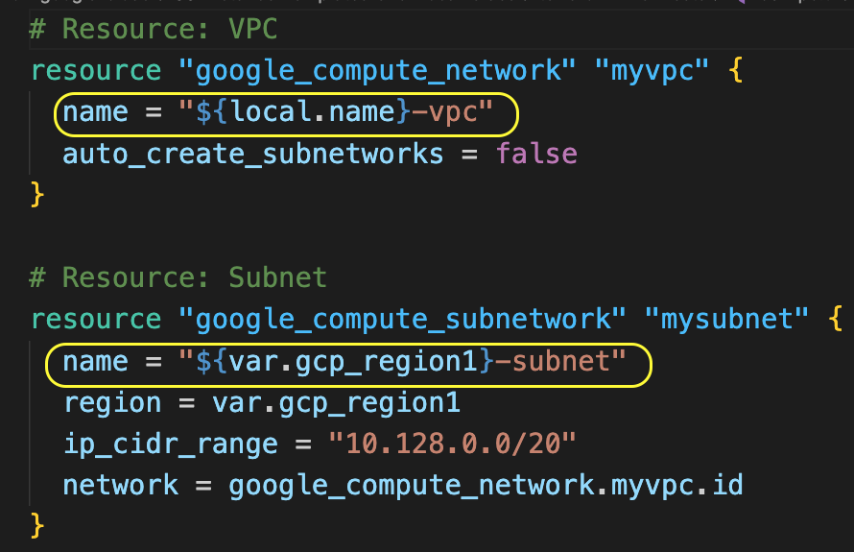
Terraform Local Values
Local Values
Local Values: Assigns a name to an expression, so you can use the name multiple times within a module instead of repeating the expression
Local values are like a function's temporary local variables
Usage:
local.name
local.owners
Important Note: Overusing local values can make the configuration hard to read for future maintainers by hiding the actual values used (use it wisely based on need)
Using Local values in Resources

Slide 88
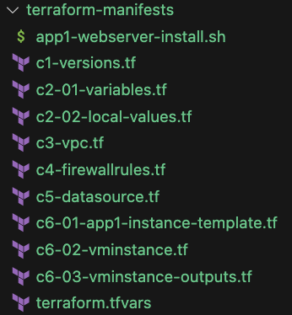
What are we going to learn?
Demo: Custom VPC + Instance Template + VM Instance
NC
No Changes in C1
C2-01
Update Variables required for local values (environment, business division) and also tfvars file
C2-02
Terraform Local Values concept + Update local values for all applicable terraform resources
C5
Add new data source google_compute_image to get image name dynamically (NO HARD CODING)
C6-01
Regional Instance Template
C6-02
VM Instance using Regional Instance Template
C6-03
Terraform outputs for VM Instance

Slide 89
Demo-10
Terraform
GCP
Managed Instance Groups
Demo: Custom VPC + Regional MIG Public IP

Slide 90
Managed Instance Groups
What is an Instance Group ?
Group of VM Instances managed as a single entity is called Instance Group
How many types of Instance Groups available in GCP ?
Unmanaged Instance Groups
Managed Instance Groups(MIG) - Stateless
Managed Instance Groups(MIG) - Stateful
What is a Zonal MIG ?
VM Instances created by MIG will be restricted to specific SINGLE ZONE
What is a Regional MIG?
VM Instances created by MIG will be distributed across selected Zones
Regional MIG gives HIGH AVAILABILITY (RECOMMENDED)
Customer Project: gcplearn9
VPC: vpc1
fw_ssh22
fw_http80
Region: us-central1
Subnet: us-centra1-subnet
Zone:
us-central1-a
Zone:
us-central1-b
Zone:
us-central1-c
VM1
VM2
VM3
Zone:
us-central1-f
Zone:
us-central1-a
Zone:
us-central1-a
VM4
VM5
VM6
Instance Group: MIG1
Automated by Terraform

Slide 91
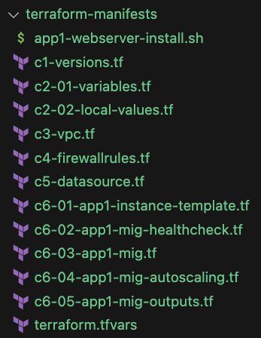
What are we going to learn?
Demo: Custom VPC + Regional MIG Public IP
NC
No Changes from C1 to C6-01
C6-02
Regional Health Check for Managed Instance Group
C6-03
Managed Instance Group Terraform Resource
C6-04
MIG Autoscaling Terraform Resource
C6-05
Terraform Outputs for MIG

Slide 92
Demo-11
Terraform
GCP
Regional Application Lod Balancer
Demo: Custom VPC + Regional MIG Public IP +
Regional Application Load Balancer HTTP

Slide 93
GCP Cloud Load Balancing
Users
Cloud Load Balancing: Distributes user traffic across multiple instances of your applications
Primarily used for providing HIGH AVAILABILITY for your applications
Fully distributed managed service
Global: load balance across regions
Regional: load balancer across zones in a region
Layer7 Load Balancer
Application load balancer
HTTP or HTTPS
Layer4 Load Balancer
Network Load Balancers - Proxy
TCP (TCP Proxy)
TCP with optional SSL offload (SSL Proxy)
Network Load Balancers - Pass-through
TCP, UDP, ICMP, ICMPv6, SCTP, ESP, AH, and GRE
Customer Project: gcplearn9
VPC: vpc1
Cloud
Load Balancing
fw_ssh22
fw_http80
Region: us-central1
Subnet: us-centra1-subnet
Zone:
us-central1-a
Zone:
us-central1-b
Zone:
us-central1-c
VM1
VM2
VM3
Zone:
us-central1-f
Zone:
us-central1-a
Zone:
us-central1-a
VM4
VM5
VM6
Instance Group: MIG1
Automated by Terraform

Slide 94

Google Cloud Load Balancing - Types
Reference: https://cloud.google.com/static/load-balancing/images/lb-product-tree.svg
We can create approximately 10 types of Load Balancers
On a very high-level, these are categorized as
Application Load Balancers
Network Load Balancers - Proxy
Network Load Balancers - Pass-through

Slide 95

Google Cloud Load Balancing - Terminology
Backend
Google Cloud services that receive traffic from Load Balancer
Instance Groups
Cloud Storage
App Engine
Cloud Run
GKE
Cloud Functions
Backends external to Google Cloud
Frontend
Define Load Balancer IP address, port, protocol (HTTP, HTTPS, TCP, UDP, SSL etc)
We will use this IP address to access the load balancer
Reference: https://cloud.google.com/static/load-balancing/images/application-load-balancer.svg

Slide 96
GCP External Regional Application Load Balancer
Users
Customer Project: gcplearn9
VPC: vpc1
fw_ssh22
fw_http80
Region: us-central1
Subnet: us-centra1-subnet-proxyonly
Proxy-Only Subnet (Regional)
Load Balancer
Forwarding Rule
(Regional)
Subnet: us-centra1-subnet
Zone:
us-central1-a
Zone:
us-central1-b
Zone:
us-central1-c
Target HTTP Proxy
(Regional)
VM1
VM2
VM3
URL Map
(Regional)
Zone:
us-central1-f
Zone:
us-central1-a
Zone:
us-central1-a
Backend Service
(Regional)
VM4
VM5
VM6
Instance Group: MIG1
Automated by Terraform

Slide 97


Google Cloud Load Balancing - Terminology
Proxy-Only Subnet
Uses Envoy proxies which manage traffic routing and security
Provides dedicated IP Address pool
Routing: These proxies terminate connections from clients and handle traffic routing based on factors like URL Maps
HTTP Path routing
Host header routing
Custom Header routing and many more
SSL: Proxy layer can perform advanced security functions like
SSL Termination
Scalability: Can be automatically scaled by GCP to meet traffic demands

Slide 98
Google Cloud Load Balancing - Terminology
Forwarding Rule:
Routes incoming traffic based on pre-defined criteria like IP address, port, and protocol.
It directs traffic to a specific load balancing configuration.
Benefits:
Provides a single, easy-to-manage IP address for your application in DNS records.
Target HTTP(S) Proxy:
Terminates client connections and acts as an intermediary between clients and backend services.
It routes traffic based on forwarding rule configuration and URL map rules.
Benefits:
Can perform security functions like SSL termination (especially with Envoy proxies in regional external ALBs).

Slide 99
Google Cloud Load Balancing - Terminology
URL Map:
Based on pre-defined rules (url path, host header, custom header) it determines the most suitable backend service to handle the request.
Benefits:
Enables intelligent traffic routing based on specific URL patterns.
Path based Routing
Domain based Routing
Custom Header Routing
Backend Service:
Represents a group of backend instances (VMs, containers) that handle incoming requests routed by the load balancer.
It distributes traffic across healthy instances based on the chosen load balancing algorithm.
Benefits:
Provides high availability and scalability for your application by ensuring requests reach healthy instances.
Simplifies backend management by hiding individual instances from the load balancer configuration (you manage the backend service, not individual VMs).

Slide 100

Google Cloud Load Balancing - Terminology
Routing Rules (Application LBs)
Path based Routing
App1: stacksimplify.com/app1
App2: stacksimplify.com/app2
Host based Routing
App1: app1.stacksimplify.com
App2: app2.stacksimplify.com
Rewrite the Requested URL
Host Rewrite: app1.stacksimplify.com to app1.terraformguru.com
Path Rewrite: stacksimplify.com/app1 to stacksimplify.com/app1new
Add and remove request and response headers
Configure a URL redirect
Many many more things we can do
/app1
App1
Application Load Balancer
Users
/app2
App2
Path-based Routing
app1.stacksimplify.com
App1
Application Load Balancer
Users
app2.stacksimplify.com
App2
Host-based Routing

Slide 101

What are we going to learn?
Demo: Custom VPC + Regional MIG Public IP +
Regional Application Load Balancer HTTP
NC
No Changes from C1 to C6-05
C7-01
Create Regional Static IP Address and Regional Health check for Load Balancers
C7-01
Create Regional backend service and Regional URL Map
C7-01
Create Regional HTTP Proxy and Regional forwarding rule
C7-02
Terraform Outputs for Regional Application Load Balancer
C3
Create Regional Proxy-only subnet required for External Regional ALB

Slide 102
Demo-12
Terraform
GCP
MIG Private IP
(Cloud NAT + Cloud Router)
Demo: Custom VPC + Regional MIG Private IP +
Regional Application Load Balancer HTTP

Slide 103
GCP Cloud Router + Cloud NAT
Users
What are we going to implement?
Remove External IPs or public Ips to VM Instances
Have only private IPs for VM instances
Enable outbound communication to internet for VM instances using Cloud Router and Cloud NAT
Create allow health check firewall rule from Google Health check systems CIDR IP ranges
Customer Project: gcplearn9
VPC: vpc1
Cloud
Load Balancing
fw_ssh22
fw_http80
fw_health
check
Region: us-central1
Subnet: us-centra1-subnet
Zone:
us-central1-a
Zone:
us-central1-b
Instance Group:
MIG1
VM1
VM2
Cloud NAT
Cloud Router
Download
Webserver software
Internet
Automated by Terraform

Slide 104

What are we going to learn?
Demo: Custom VPC + Regional MIG Private IP +
Regional Application Load Balancer HTTP
NC
No Changes from C1 to C3, C5, C6-02 to C7-02
C4
Firewall rule to allow health check for private VMs from GCP Health Check CIDR ranges
C6-01
Update health check firewall rule tag, also update VMs to have only private Ips (Disable Public IP to VMs)
C8
Create Cloud Router and Cloud NAT for opening outbound communication to internet from GCP VMs

Slide 105
Demo-13
Terraform
GCP
MIG Update Policy
Demo: Custom VPC + Regional MIG Private IP +
Regional Application Load Balancer HTTP + MIG Update Policy

Slide 106
GCP MIG Update Policy
Users
What are we going to implement?
Step-01: Add update_policy block with required settings in MIG
Step-02: Create new VM instance template with new V2 version of startup-script
Step-03: Update MIG with v2 version of instance template in version block
Customer Project: gcplearn9
VPC: vpc1
Cloud
Load Balancing
fw_ssh22
fw_http80
fw_health
check
Region: us-central1
Subnet: us-centra1-subnet
Zone:
us-central1-a
Instance Group:
MIG1
Zone:
us-central1-b
Update
Policy
VM1
VM2
Internet
Cloud NAT
Cloud Router
Automated by Terraform

Slide 107

What are we going to learn?
Demo: Custom VPC + Regional MIG Private IP +
Regional Application Load Balancer HTTP + MIG Update Policy
NC
No Changes from C1 to C6-02, C6-04 to C8
v2
V2 version of application: v2-app1-webserver-install.sh
C9-01
Create new VM Instance template with v2-app1-webserver-install.sh
C6-03
Update version block in mig with v2 version of instance template
C6-03
Add update_policy block for MIG

Slide 108
Demo-14
Terraform
GCP Load Balancer
Self-Signed SSL using
GCP Certificate Manager
Demo: Custom VPC + Regional MIG Private IP +
Regional Application Load Balancer HTTPS + Self-signed SSL

Slide 109
GCP Load Balancer Self-signed SSL
Users
HTTP -> HTTPS Redirect
HTTPS
What are we going to implement?
Create a HTTPS load balancer using self-signed SSL certificates with GCP certificate manager
Implement HTTP to HTTPS redirect
Customer Project: gcplearn9
VPC: vpc1
Cloud
Load Balancing
fw_ssh22
fw_http80
fw_health
check
Region: us-central1
Subnet: us-centra1-subnet
Zone:
us-central1-a
Instance Group:
MIG1
Zone:
us-central1-b
Update
Policy
VM1
VM2
Certificate
Manager
Internet
Cloud NAT
Cloud Router
Self-signed SSL Certificates
Automated by Terraform

Slide 110

What are we going to learn?
Demo: Custom VPC + Regional MIG Private IP +
Regional Application Load Balancer HTTPS + Self-signed SSL
NC
No Changes from C1 to C6-05, C8
SSL
Create self signed SSL private key and certificate
C9
Create self-signed SSL certificate object using certificate manager
C7-01
Comment HTTP proxy, create HTTPS proxy, Update regional forwarding rule with port 443
C7-02
Implement HTTP to HTTPS redirect with URL Map, HTTP Proxy, Forwarding rule
C7-03
Update HTTPS proxy output

Slide 111
Demo-15
Terraform
GCP Load Balancer
Cloud Domains + Cloud DNS

Slide 112

Demo
Google Cloud
Networking
Cloud Domains

Slide 113

Google Cloud Domains
Cloud Domains: Primarily used for Domain Registration and management
Key Benefits
Register new domains
Bills for purchasing/renewing domains will use the same Cloud Billing account
Automatic renewal of registered domains
Let's you manage domain registrations per project, not per user
Supports DNSSEC which protects your domains from spoofing and cache poisoning attacks
Tightly integrated with Google Cloud DNS (Domain Name system) for creating and managing DNS records
Cloud Domains

Slide 114
Google Cloud Domains
Important Note: From September 7, 2023 onwards Squarespace acquired all domain registrations and related customer accounts from Google Domains
Cloud Domains uses Google Domains as underlying domain registrar
Now after squarespace acquisition, Cloud Domains uses Squarespace Domains as underlying registrar
How does this impact Cloud Domains in Google Cloud ?
Complete Faq: https://cloud.google.com/domains/docs/faq
In a shorter note, google supports Cloud Domains even after this acquisition
Following features in Cloud Domain will work as-is
Searching and registering new domains
Renewing existing domains
Update your contact details and DNS settings
Transfer a registered domain to another registrar (GoDaddy, Namecheap, AWS Route53)
Transfer domain from another registrar to Cloud Domain - NOT POSSIBLE
Cloud Domains
Additional Reference: https://cloud.google.com/domains/docs/deprecations/feature-deprecations

Slide 115
Demo
Google Cloud
Networking
Cloud DNS

Slide 116

Google Cloud DNS
Cloud DNS: High-performance, resilient, global Domain Name System (DNS) service
Cloud DNS translates requests for domain names like stacksimplify.com into IP addresses like 13.224.249.31
Cloud DNS

Slide 117

Google Cloud DNS - Terminology
DNS Zones: It is a container of DNS records for the same DNS name suffix (Example suffix: stacksimplify.com)
Public Zone
Visible to the internet
Primarily used for DNS management of your internet facing applications
DNSSEC (DNS Security) protects your domains from spoofing and cache poisoning attacks
Private Zone
Contains DNS records that are only visible internally within your Google Cloud networks
Easy to manage internal DNS solution for all our internal needs (For Internal applications, VM Instances etc)
Users
http://mydnsdemo.kalyanreddydaida.com
Customer Project: gcplearn9
VPC: default
Cloud
Domains
Cloud
DNS
Region: us-central1
Subnet: us-centra1-subnet
Zone:
us-central1-a
VM1

Slide 118


Google Cloud DNS - Terminology
Record Sets: actual DNS records
DNS Name to IP Address mapping
We have different record types, but primarily we use Address record (A) type which maps hostnames to IPv4 address
Users
http://mydnsdemo.kalyanreddydaida.com
Customer Project: gcplearn9
VPC: default
DNS Record Set
DNS Record Type
Cloud
Domains
Cloud
DNS
Region: us-central1
Subnet: us-centra1-subnet
Zone:
us-central1-a
VM1
https://cloud.google.com/dns/docs/records-overview#supported_dns_record_types

Slide 119
Google Cloud DNS - Features
Cloud DNS
Integration with Cloud IAM
Provides secure domains management with full control and visibility for domain resources
Integration with Cloud Logging
Private DNS logs a record for every DNS query in Cloud Logging
We can view and export logs to supported destinations
Fast anycast Nameservers
Anycast: Uses the nearest nameserver to users for DNS lookup and resolution
Provides very high availability across globe and low latency
DNS registration and management
Cloud DNS is tightly integrated with Cloud Domains which takes care of DNS registration and management
Users
http://mydnsdemo.kalyanreddydaida.com
Customer Project: gcplearn9
VPC: default
Cloud
Domains
Cloud
DNS
Region: us-central1
Subnet: us-centra1-subnet
Zone:
us-central1-a
VM1

Slide 120
Google Cloud DNS - Features
Cloud DNS
Container-native Cloud DNS
Natively integrated with Google Kubernetes Engine (GKE)
Provides in-cluster Service DNS resolution
Provides high-throughput, scalable DNS resolution for every GKE node
DNS Peering
Sharing DNS data
All or a portion of DNS namespace can be configured to be sent from one network to another
Will respect all DNS configurations defined in peered network
DNS Forwarding
Primarily used for hybrid-cloud architecture
Forward DNS queries from Cloud DNS to on-premise DNS servers where actual DNS resolution takes place
Users
http://mydnsdemo.kalyanreddydaida.com
Customer Project: gcplearn9
VPC: default
Cloud
Domains
Cloud
DNS
Region: us-central1
Subnet: us-centra1-subnet
Zone:
us-central1-a
VM1

Slide 121
Pre-requisite: Registered Domain is required to implement this demo
Demo-16
Terraform
GCP Load Balancer
Cloud Domains + Cloud DNS
Production grade SSL Certificates
Demo: Custom VPC + Regional MIG Private IP +
Regional Application Load Balancer HTTPS + Cloud DNS + Cloud Domians

Slide 122
GCP Cloud DNS + Cloud Domains as Domain Registrar
Users
HTTP -> HTTPS Redirect
HTTPS
What are we going to implement?
Pre-requisite:
Registered domain using Cloud Domains
Cloud DNS zone pre-created and ready to use
Create production grade SSL certificate using Certificate Manager with DNS Authorization
Create a HTTPS load balancer
Create DNS record in Cloud DNS for myapp1 application
Customer Project: gcplearn9
VPC: vpc1
Cloud
Load Balancing
fw_ssh22
fw_http80
fw_health
check
Region: us-central1
Subnet: us-centra1-subnet
Zone:
us-central1-a
Instance Group:
MIG1
Zone:
us-central1-b
D1
Update
Policy
VM1
VM2
Internet
Cloud NAT
Cloud Router
Certificate
Manager
Production grade SSL certificates
Cloud Domains
Cloud DNS
Automated by Terraform

Slide 123

What are we going to learn?
Demo: Custom VPC + Regional MIG Private IP +
Regional Application Load Balancer HTTPS + Cloud Domains + Cloud DNS
NC
No Changes from C1 to C8
C9
Create a Cloud DNS record set
C10
Create SSL certificate using certificate manager
C10
Create certificate manager DNS authorization
C10
Create Cloud DNS record set for DNS authorization

Slide 124
GCP Cloud DNS + AWS Route53 as Domain Registrar
Users
HTTP -> HTTPS Redirect
HTTPS
What are we going to implement?
Pre-requisite:
Registered domain using any domain provider like GoDaddy, namecheap, AWS Route53
Create Cloud DNS zone
Update AWS Route53 with Google Cloud DNS Nameservers
Create production grade SSL certificate using Certificate Manager with DNS Authorization
Create a HTTPS load balancer
Create DNS record in Cloud DNS for myapp1 application
Customer Project: gcplearn9
VPC: vpc1
Cloud
Load Balancing
fw_ssh22
fw_http80
fw_health
check
Region: us-central1
Subnet: us-centra1-subnet
Zone:
us-central1-a
Instance Group:
MIG1
Zone:
us-central1-b
Update
Policy
D2
VM1
VM2
Cloud NAT
Cloud Router
Certificate
Manager
Internet
Production grade SSL certificates
AWS
Route53
Cloud DNS
Automated by Terraform

Slide 125

What are we going to learn?
Demo: Custom VPC + Regional MIG Private IP +
Regional Application Load Balancer HTTPS + Cloud Domains + Cloud DNS
NC
No Changes from C1 to C8
C9
Update locals block with DNS Name and Cloud DNS Zone

Slide 126
Demo-17
Terraform
GCP Load Balancer
HTTP Context Path Routing
Demo: Custom VPC + Regional MIG Private IP +
Regional Application Load Balancer HTTP + Context Path Routing

Slide 127
GCP Load Balancer + Context Path Routing
Customer Project: gcplearn9
VPC: vpc1
fw_ssh22
fw_http80
fw_health
check
Region: us-central1
Subnet: us-centra1-subnet
Zone:
us-central1-a
MIG: APP1
Zone:
us-central1-b
/app1
HTTP
Cloud
Load Balancing
Internet
Default
VM1
VM2
Users
Cloud NAT
Download Nginx Binary
/app2
URL Map
Zone:
us-central1-a
MIG: APP2
Zone:
us-central1-b
Load Balancer Resources
Cloud Router
http://LB-IP/app1/index.html
http://LB-IP/app2/index.html
VM1
VM2
http://LB-IP/
Automated by Terraform

Slide 128

What are we going to learn?
Demo: Custom VPC + Regional MIG Private IP +
Regional Application Load Balancer HTTP + Context Path Routing
NC
No Changes from C1 to C6-05, C7-02, C8
APP2
Create App2 from C6-06 to C6-10
C7-01
Create App2 Backend Service
C7-01
Create URL Map with context path-based routing

Slide 129
Demo-18
Terraform
GCP Load Balancer
Domain Name based Routing
Demo: Custom VPC + Regional MIG Private IP +
Regional Application Load Balancer HTTP + Domain Name based Routing

Slide 130
GCP Load Balancer + Domain Name based Routing
Customer Project: gcplearn9
VPC: vpc1
fw_ssh22
fw_http80
fw_health
check
Region: us-central1
Subnet: us-centra1-subnet
Zone:
us-central1-a
MIG: APP1
Zone:
us-central1-b
app1.stacksimplify.com
HTTP
Cloud
Load Balancing
Internet
default.stacksimplify.com
VM1
VM2
Users
Cloud NAT
Download Nginx Binary
app2.stacksimplify.com
URL Map
Zone:
us-central1-a
MIG: APP2
Zone:
us-central1-b
Load Balancer Resources
Cloud Router
http://app1.stacksimplify.com/
http://app2.stacksimplify.com/
VM1
VM2
http://default.stacksimplify.com/
Automated by Terraform

Slide 131
What are we going to learn?
Demo: Custom VPC + Regional MIG Private IP +
Regional Application Load Balancer HTTP + Domain Name based Routing
NC
No Changes from C1 to C6-10, C7-02, C8
C7-01
Create URL Map for domain name-based routing

Slide 132
Demo-19
Terraform
GCP Load Balancer
Header based Routing
Demo: Custom VPC + Regional MIG Private IP +
Regional Application Load Balancer HTTP + Header based Routing

Slide 133
GCP Load Balancer + Header based Routing
Customer Project: gcplearn9
VPC: vpc1
fw_ssh22
fw_http80
fw_health
check
Region: us-central1
Subnet: us-centra1-subnet
Zone:
us-central1-a
MIG: APP1
Zone:
us-central1-b
appname: myapp1
HTTP
Cloud
Load Balancing
Internet
Default (Any header)
VM1
VM2
Users
Cloud NAT
Download Nginx Binary
appname: myapp2
URL Map
Zone:
us-central1-a
MIG: APP2
Zone:
us-central1-b
Load Balancer Resources
Cloud Router
http://LB-IP/ + Header appname: myapp1
http://LB-IP/ + Header appname: myapp3, any value
VM1
VM2
http://LB-IP/ + Header appname: myapp2
Automated by Terraform

Slide 134
What are we going to learn?
Demo: Custom VPC + Regional MIG Private IP +
Regional Application Load Balancer HTTP + Header based Routing
NC
No Changes from C1 to C6-10, C7-02, C8
C7-01
Create URL Map for Header based routing

Slide 135
Demo-20
Terraform
Application Logging
Cloud Logging
Demo: Custom VPC + Regional MIG Private IP +
Regional Application Load Balancer HTTPS (Self-signed SSL) + LOGGING

Slide 136
GCP Cloud Logging
Customer Project: gcplearn9
VPC: vpc1
Cloud
Logging
fw_ssh22
fw_http80
fw_health
check
Region: us-central1
Subnet: us-centra1-subnet
HTTP -> HTTPS Redirect
Zone:
us-central1-a
Zone:
us-central1-b
HTTPS
Cloud
Load Balancing
Internet
Default
VM1
VM2
Users
URL Map
Ops Agent
Ops Agent
Cloud NAT
Self-signed SSL
Download Nginx Binary
https://LB-IP/
config.yaml for Nginx
config.yaml for Nginx
Certificate
Manager
Update
Policy
Cloud Router
Load Balancer Resources
MIG: APP1
Automated by Terraform

Slide 137

What are we going to learn?
Demo: Custom VPC + Regional MIG Private IP +
Regional Application Load Balancer HTTPS (Self-signed SSL) + Logging
NC
No Changes from C1 to C5, C6-02 to C6-05, C7-01 to C9
Ops Agent
Install Ops Agent install-opsagent-webserver.sh
C6-06
Create Service Account for Logging with Log writer and metric writer roles
C6-01
Update instance template with service_account block

Slide 138
Demo-21
Terraform
Application Monitoring
Cloud Monitoring
Demo: Custom VPC + Regional MIG Private IP +
Regional Application Load Balancer HTTPS (Self-signed SSL) + Logging + Monitoring

Slide 139
Cloud Logging + Cloud Monitoring
Customer Project: gcplearn9
VPC: vpc1
Cloud
Monitoring
Notification Channels
Cloud
Logging
Uptime Checks
Alert Policy
fw_ssh22
fw_http80
fw_health
check
Nginx Metrics
Region: us-central1
Subnet: us-centra1-subnet
HTTP -> HTTPS Redirect
Zone:
us-central1-a
Zone:
us-central1-b
HTTPS
Cloud
Load Balancing
Internet
Default
VM1
VM2
Users
URL Map
Ops Agent
Ops Agent
Cloud NAT
Self-signed SSL
Download Nginx Binary
https://LB-IP/
config.yaml for Nginx
config.yaml for Nginx
Certificate
Manager
Update
Policy
Cloud Router
Load Balancer Resources
MIG: APP1
Automated by Terraform

Slide 140

What are we going to learn?
Demo: Custom VPC + Regional MIG Private IP +
Regional Application Load Balancer HTTPS (Self-signed SSL) + Logging + Monitoring
NC
No Changes from C1, C3 to C9
C2-01
Create new input variable for GCP Notification channel
TF
VARS
Update terraform.tfvars with GCP Notification channel input variable
C10-1
Create GCP Notification channel to send monitoring alerts
C10-1
Create Uptime check resource for myapp1 application with LB IP
C10-1
Create Monitoring alert policy if uptime check fails

Slide 141
Demo-22
Terraform
GCP Cloud SQL
MySQL Database with Public Endpoint
Demo: Cloud SQL MySQL Database with Public Endpoint

Slide 142

Terraform Remote Backends
Backend: Place where terraform state files are stored
Terraform uses persisted state data to keep track of the resources it manages
Backend Types
Local Backend: Terraform working directory
Remote Backend: Stores state in remote location
AWS S3
Google Cloud Storage (GCS)
Azure Blob Storage
Google Cloud Storage Bucket (GCS)
Bucket should be pre-created and ready to use
Recommended to enable Object versioning
Cloud Storage

Slide 143
GCP Cloud SQL Public IP
Service Producer Project for Customer
Service Producer VPC Network
Subnet: UNKNOWN
C
L
O
U
D
SQL
PUB
L
IC
IP
Zone:
us-central1-a
Cloud SQL
(MySQL)
Users
Communication
is via Internet
Cloud Shell
Zone:
us-central1-b
Cloud SQL
(MySQL)
Automated by Terraform

Slide 144

What are we going to learn?
Demo: Cloud SQL MySQL Database with Public Endpoint
C1
Define Remote backend as Cloud Storage Bucket
C2-01
Define Input Variables for Cloud SQL MySQL Database
C2-02
Define Local values
C3-01
Define Cloud SQL Database, Schema and User Terraform resources
C3-02
Define Cloud SQL Outputs

Slide 145
Terraform Remote State Data source
Terraform Template Functions
Demo-23
Terraform
DNS to DB
Cloud SQL Public IP
Demo: Custom VPC + Regional MIG Private IP +
Regional Application Load Balancer HTTPS (Self-signed SSL) + Logging + Monitoring + Cloud SQL (Public IP)

Slide 146
Terraform Remote State Datasource
The terraform_remote_state data source retrieves the root module output values from project-1 Terraform configuration, using the latest state snapshot from the remote backend.
Project-1
Project-2
Terraform Resources
1. Cloud SQL Database
Terraform Resources
VPC, Subnets
Instance Templates, MIG
Service Account
Load Balancer
Cloud NAT, Cloud Router
Certificate Manager
Uptime Checks
terraform_remote_state data source
Outputs from Project-1
1. Cloud SQL Public IP
cloudsql/publicdb/default.tfstate
myapp1/httpslb-selfsigned-publicdb/default.tfstate

Slide 147
GCP DNS TO DB + LB (self-signed SSL) + Cloud SQL Public IP
Download
UMS Binary
Internet
Customer Project: gcplearn9
Service Producer Project for Customer
VPC: vpc1
Service Producer VPC Network
Cloud
Monitoring
Cloud
Logging
Subnet: UNKNOWN
fw_ssh22
fw_http80
fw_health
check
C
L
O
U
D
SQL
PUB
L
IC
IP
Zone:
us-central1-a
Region: us-central1
Subnet: us-centra1-subnet
Zone:
us-central1-a
Zone:
us-central1-b
Communication
is via Internet
HTTP -> HTTPS Redirect
Cloud NAT
Cloud SQL
(MySQL)
HTTPS
Cloud
Load Balancing
Default
VM1
VM2
Cloud Router
URL Map
User
Management
Web
Application
Ops Agent
Ops Agent
Self-signed SSL
Zone:
us-central1-b
config.yaml
config.yaml
Users
Certificate
Manager
https://LB-IP/
Load Balancer Resources
Update
Policy
Cloud SQL
(MySQL)
MIG: App1
Automated by Terraform

Slide 148

What are we going to learn?
Demo: Custom VPC + Regional MIG Private IP +
Regional Application Load Balancer HTTPS (Self-signed SSL) + Logging + Monitoring + Cloud SQL (Public IP)
NC
No Changes from C2 to C3, C6-04 to C6-06, C7-02 to C9
C1
Define remote backend as Cloud Storage Bucket
C11
Define Remote State Data source to access Cloud SQL Database from Project-1
C4
Define firewall rules for UMS Application (Port 8080)
UMS
Install
Review ums-install.tmpl to install UMS Application using startup-script + Terraform Template Functions
C6-01
Update instance template with startup-script and implement Terraform Template functions

Slide 149
What are we going to learn?
Demo: Custom VPC + Regional MIG Private IP +
Regional Application Load Balancer HTTPS (Self-signed SSL) + Logging + Monitoring + Cloud SQL (Public IP)
C6-02
Update health check with UMS Port 8080 and Path as /login
C6-03
Update named port to appserver with port as 8080
C7-01
Update Load balancer health check with port 8080 and Path as /login
C7-01
Update backend service with session affinity, and port name as appserver
C10
Update uptime checks with path as “/login” and content as “Username”

Slide 150
Pre-requisite: Registered Domain is required to implement this demo
Demo-24
Terraform
DNS to DB
Cloud SQL Public IP + Cloud Domains + Cloud DNS
Demo: Custom VPC + Regional MIG Private IP +
Regional Application Load Balancer HTTPS (Prod grade SSL, Cloud DNS) + Logging + Monitoring + Cloud SQL (Public IP)

Slide 151
GCP DNS TO DB + LB (Prod-grade SSL, Cloud DNS) + Cloud SQL Public IP
Download
UMS Binary
Internet
Customer Project: gcplearn9
Service Producer Project for Customer
VPC: vpc1
Service Producer VPC Network
Cloud
Monitoring
Cloud
Logging
Subnet: UNKNOWN
fw_ssh22
fw_http80
fw_health
check
C
L
O
U
D
SQL
PUB
L
IC
IP
Zone:
us-central1-a
Region: us-central1
Subnet: us-centra1-subnet
https://myapp29.kalyanreddydaida.com
Zone:
us-central1-a
Zone:
us-central1-b
Communication
is via Internet
HTTP -> HTTPS Redirect
Cloud NAT
Cloud SQL
(MySQL)
HTTPS
Cloud
Load Balancing
Default
VM1
VM2
Cloud Router
URL Map
User
Management
Web
Application
Ops Agent
Ops Agent
Prod grade SSL
Zone:
us-central1-b
config.yaml
config.yaml
Users
Certificate
Manager
Load Balancer Resources
Update
Policy
Cloud SQL
(MySQL)
MIG: APP1
Cloud Domains
Cloud DNS
Automated by Terraform

Slide 152

What are we going to learn?
Demo: Custom VPC + Regional MIG Private IP +
Regional Application Load Balancer HTTPS (Prod grade SSL, Cloud DNS) + Logging + Monitoring + Cloud SQL (Public IP)
NC
No Changes from C2 to C3, C6-04 to C6-06, C7-02 to C10
C1
Define remote backend as Cloud Storage Bucket
C12
Define Remote State Data source to access Cloud SQL Database from Project-1
C4
Define firewall rules for UMS Application (Port 8080)
UMS
Install
Review ums-install.tmpl to install UMS Application using startup-script + Terraform Template Functions
C6-01
Update instance template with startup-script and implement Terraform Template functions
C9, C10
Files related to Cloud DNS and Prod grade ssl certificates with DNS Auth from Demo-16

Slide 153
What are we going to learn?
Demo: Custom VPC + Regional MIG Private IP +
Regional Application Load Balancer HTTPS (Prod grade SSL, Cloud DNS) + Logging + Monitoring + Cloud SQL (Public IP)
C6-02
Update health check with UMS Port 8080 and Path as /login
C6-03
Update named port to appserver with port as 8080
C7-01
Update Load balancer health check with port 8080 and Path as /login
C7-01
Update backend service with session affinity, and port name as appserver
C11
Update uptime checks with path as “/login” and content as “Username”

Slide 154
Demo-24
Terraform
GCP Cloud SQL
Cloud SQL with Private Service Connection
Demo: Cloud SQL MySQL with Private Service Connection

Slide 155
GCP Cloud SQL Private IP
Customer Project: gcplearn9
Service Producer Project for Customer
Customer VPC: VPC1
VPC Network Peering
Service Producer VPC Network
Region: us-central1
Private Service Connection
(10.240.0.0/16)
C
L
O
U
D
SQL
P
R
I
V
A
T
E
I
P
Subnet: UNKNOWN
Subnet: us-centra1-subnet
Zone:
us-central1-a
Zone: us-central1-a
MySQL Client
Users
VM1
Cloud SQL
(MySQL)
Communication is Private
(Internal to Google Cloud)
Zone:
us-central1-b
Cloud SQL
(MySQL)
Automated by Terraform

Slide 156

What are we going to learn?
Demo: Cloud SQL MySQL with Private Service Connection
C2
Added Variable related to MySQL DB version, updated in terraform.tfvars
C3-01
VPC, Subnet and Regional Proxy Subnet for Regional Load Balancer (Same as previous demos)
C3-02
NEW: Two resources(1. Reserve Private IP Range for PSC, 2. Private Service Connection Resource)
C3-03
No changes in VPC Outputs from previous demos
C4-01
Create Cloud SQL Database with private network enabled.
C4-02
Define private IP in Cloud SQL Outputs
C5
Create a VM Instance in VPC with mysql client installed to test private connection to Cloud SQL DB

Slide 157
Demo-26
Terraform
DNS to DB
Cloud SQL with Private Service Connection
Demo: Custom VPC + Regional MIG Private IP +
Regional Application Load Balancer HTTPS (Self-signed SSL) + Logging + Monitoring + Cloud SQL (Private IP)

Slide 158
GCP DNS TO DB + LB (self-signed SSL) + Cloud SQL Private IP
Download
UMS Binary
Internet
Customer Project: gcplearn9
Service Producer Project for Customer
VPC: vpc1
VPC Network Peering
Service Producer VPC Network
Cloud
Monitoring
Cloud
Logging
Private Service Connection
(10.240.0.0/16)
C
L
O
U
D
SQL
P
R
I
V A
T
E
I
P
Subnet: UNKNOWN
fw_ssh22
fw_http80
fw_health
check
Zone:
us-central1-a
Region: us-central1
Subnet: us-centra1-subnet
Zone:
us-central1-a
Zone:
us-central1-b
HTTP -> HTTPS Redirect
Cloud NAT
Cloud SQL
(MySQL)
HTTPS
Cloud
Load Balancing
Default
VM1
VM2
Cloud Router
URL Map
User
Management
Web
Application
Ops Agent
Ops Agent
Self-signed SSL
Zone:
us-central1-b
config.yaml
config.yaml
Users
Certificate
Manager
https://LB-IP/
Load Balancer Resources
Update
Policy
Communication is Private
(Internal to Google Cloud)
Cloud SQL
(MySQL)
MIG: APP1
Automated by Terraform

Slide 159

What are we going to learn?
Demo: Custom VPC + Regional MIG Private IP +
Regional Application Load Balancer HTTPS (Self-signed SSL) + Logging + Monitoring + Cloud SQL (Private IP)
NC
No Changes from C2 to C3, C6-04 to C6-06, C7-02 to C9
C1
Define remote backend as Cloud Storage Bucket
C3
Define Remote State Data source to access Cloud SQL Database from Project-1
C4
Define firewall rules for UMS Application (Port 8080)
UMS
Install
Review ums-install.tmpl to install UMS Application using startup-script + Terraform Template Functions
C6-01
Update instance template with startup-script and implement Terraform Template functions

Slide 160
What are we going to learn?
Demo: Custom VPC + Regional MIG Private IP +
Regional Application Load Balancer HTTPS (Self-signed SSL) + Logging + Monitoring + Cloud SQL (Private IP)
C6-02
Update health check with UMS Port 8080 and Path as /login
C6-03
Update named port to appserver with port as 8080
C7-01
Update Load balancer health check with port 8080 and Path as /login
C7-01
Update backend service with session affinity, and port name as appserver
C10
Update uptime checks with path as “/login” and content as “Username”

Slide 161
Pre-requisite: Registered Domain is required to implement this demo
Demo-27
Terraform
DNS to DB
Cloud SQL with Private Service Connection
Demo: Custom VPC + Regional MIG Private IP +
Regional Application Load Balancer HTTPS (Prod grade SSL, Cloud DNS) + Logging + Monitoring +
Cloud SQL (Private IP)

Slide 162
GCP DNS TO DB + LB (Prod-grade SSL, Cloud DNS) + Cloud SQL Private IP
Download
UMS Binary
Internet
Customer Project: gcplearn9
Service Producer Project for Customer
VPC: vpc1
VPC Network Peering
Service Producer VPC Network
Cloud
Monitoring
Cloud
Logging
Private Service Connection
(10.240.0.0/16)
C
L
O
U
D
SQL
P
R
I
V A
T
E
I
P
Subnet: UNKNOWN
fw_ssh22
fw_http80
fw_health
check
Zone:
us-central1-a
Region: us-central1
Subnet: us-centra1-subnet
https://app1.kalyanreddydaida.com
Zone:
us-central1-a
Zone:
us-central1-b
HTTP -> HTTPS Redirect
Cloud NAT
Cloud SQL
(MySQL)
HTTPS
Cloud
Load Balancing
Default
VM1
VM2
Cloud Router
URL Map
User
Management
Web
Application
Ops Agent
Ops Agent
Prod
Grade
SSL
Zone:
us-central1-b
config.yaml
config.yaml
Users
Certificate
Manager
Communication is Private
(Internal to Google Cloud)
Load Balancer Resources
Update
Policy
Cloud SQL
(MySQL)
MIG: APP1
Cloud Domains
Cloud DNS
Automated by Terraform

Slide 163

What are we going to learn?
Demo: Custom VPC + Regional MIG Private IP +
Regional Application Load Balancer HTTPS (Prod grade SSL, Cloud DNS) + Logging + Monitoring + Cloud SQL (Private IP)
NC
No Changes from C2 to C3, C6-04 to C6-06, C7-02 to C9
C1
Define remote backend as Cloud Storage Bucket
C3
Define Remote State Data source to access Cloud SQL Database from Project-1
C4
Define firewall rules for UMS Application (Port 8080)
UMS
Install
Review ums-install.tmpl to install UMS Application using startup-script + Terraform Template Functions
C6-01
Update instance template with startup-script and implement Terraform Template functions

Slide 164
What are we going to learn?
Demo: Custom VPC + Regional MIG Private IP +
Regional Application Load Balancer HTTPS (Prod grade SSL, Cloud DNS) + Logging + Monitoring + Cloud SQL (Private IP)
C6-02
Update health check with UMS Port 8080 and Path as /login
C6-03
Update named port to appserver with port as 8080
C7-01
Update Load balancer health check with port 8080 and Path as /login
C7-01
Update backend service with session affinity, and port name as appserver
C10
Update uptime checks with path as “/login” and content as “Username”

Slide 165
Demo-28
Terraform
Modules
Use pre-built Modules from Terraform Registry
Demo: Custom VPC (Uses Terraform Module from Terraform Public Registry) + Firewall Rules + VM Instance

Slide 166

Terraform Modules
A module consists of a collection of .tf files kept together in a directory.
Modules are the main way to package and reuse resource configurations with Terraform.
We can compare modules to functions in our standard programming languages (define once and reuse wherever needed)
Example:
Define a VPC Module once, publish it to a Terraform registry
Call the VPC module wherever needed (reuse it)
Public Module on Terraform Registry
Custom Module

Slide 167
Terraform Modules
Root Module
Root Module: Every Terraform configuration has at least one module, known as its root module, which consists of the resources defined in the .tf files in the main working directory
A Terraform module (usually the root module of a configuration) can call other modules to include their resources into the configuration.
Child Module: A module that has been called by another module is often referred to as a child module.
Child modules can be called multiple times within the same configuration, and multiple configurations can use the same child module.
Call VM Instance child module in
Root Module
Child Module

Slide 168
Terraform Modules
Module Types
Local Modules (Local Paths)
Accessible using folder path locally
Accessible locally in that desktop or for others via shared drives
Public Modules
Modules published to Terraform Registry
Publicly accessible to anyone (Open source)
Free to use, use with caution, will contain continuous upgrades and might break our current code
If used, need to follow strong version constraints or fixed module versions to avoid major outages during upgrades
Private Modules
Modules developed and published to private registry in their respective organizations
Terraform Registry also supports private registry concept
Accessible only to that respective organization users (Highly secure, internal to that organization)

Slide 169






Terraform Modules
Local paths
Module Storage and Access: The module installer supports installation from several different source types.
Local Paths
Terraform Registry
GitHub
HTTP URLs
S3 Buckets
GCS Buckets
and many more
TF Registry
GitHub
HTTP
URL
S3
Bucket
GCS
Bucket

Slide 170
Terraform Registry - Use Publicly Available Modules
The Terraform Registry hosts a broad collection of publicly available Terraform modules for configuring many kinds of common infrastructure.
ModulesDemo 1
These modules are free to use, and Terraform can download them automatically if you specify the appropriate source and version in a module call block.

Slide 171

What are we going to learn?
Demo: Custom VPC (Uses Terraform Module from Terraform Public Registry) + Firewall Rules + VM Instance
NC
No Changes from C1, C2, C3
C4
Create VPC Module using Terraform public registry
C5
Update firewall rules with VPC ID from VPC Module
C6
Update Subnet with Subnet ID from VPC Module
C7
Update VPC ID and Subnet ID from VPC Module

Slide 172
Demo-29
Terraform
Modules
Create Custom or Local Terraform Module for VM Instance Resource
Demo: Custom VPC + Firewall Rules + VM Instance (Custom or Local Terraform Module)

Slide 173
Build a Local Terraform Module
Root Module
Modules
Demo 2
Call VM Instance child module in
Root Module
Build a Local Terraform Module and call it from Root Module and Test
Child Module

Slide 174

What are we going to learn?
Demo: Custom VPC + Firewall Rules + VM Instance (Custom or Local Terraform Module)
Terraform Child Module: VM Instance
versions
Define Terraform Settings block for child or local module
variables
Define Input variables for child or local module
main
Define VM Instance resource for child or local module
outputs
Define outputs for child or local module
App1 Install
Reuse the app1-webserver-install.sh from previous demos

Slide 175
What are we going to learn?
Demo: Custom VPC + Firewall Rules + VM Instance (Custom or Local Terraform Module)
Terraform Root Module
NC
No Changes from C1, C2, C3, C5, C5
C6
Define VM Instance module by calling child or local module
C7
Update VM Instance External IP output using VM Instance Module

Slide 176
Demo-30
Terraform
GCP DevOps
GCP Cloud Build, GitHub GCP Cloud Build App and GitHub
Demo: Custom VPC + Firewall Rules + VM Instance (Custom or Local Terraform Module)
Implement DevOps Pipelines for Terraform Configs on GCP

Slide 177

GCP DevOps for Terraform Configs
The following resources are used for this implementation
GitHub Repositories
GitHub Branches
Main branch
Dev branch
Prod branch
Feature branch
GitHub Pull Request and Merge concepts
GCP Cloud Build App from GitHub Marketplace
GCP Cloud Build
Connections
Link Repositories
Triggers
GCP Resources
GCP VPC
GCP Firewall Rules
GCP VM Instances
Terraform Concepts
Terraform Resources
Terraform custom modules
Terraform Remote Backend using Google Cloud Storage Bucket
GIT Repo

Slide 178
GCP DevOps for Terraform Configs
+
Cloud Build
App
MAIN Branch
GIT Repo
GitHub
Developer

Slide 179
GCP DevOps for Terraform Configs
Customer Project: gcplearn9
+
VPC: vpc1
fw_ssh22
fw_http80
Cloud Build
App
Region: us-central1
Connection
Link Repo
Cloud Build
Trigger
Cloud Build Key Concepts
Subnet: us-centra1-subnet
Zone: us-central1-a
MAIN Branch
GIT Repo
GitHub
Developer

Slide 180
GCP DevOps for Terraform Configs
Customer Project: gcplearn9
+
VPC: vpc1
fw_ssh22
fw_http80
Cloud Build
App
Region: us-central1
Connection
Link Repo
Cloud Build
Trigger
Cloud Build Key Concepts
Subnet: us-centra1-subnet
Zone: us-central1-a
MAIN Branch
GIT Repo
GitHub
Developer

Slide 181
GCP DevOps for Terraform Configs
Customer Project: gcplearn9
+
VPC: vpc1
fw_ssh22
fw_http80
Cloud Build
App
Region: us-central1
Connection
Link Repo
DEV Branch
Cloud Build
Trigger
Build
Approver
Cloud Build Key Concepts
Subnet: us-centra1-subnet
Zone: us-central1-a
MAIN Branch
Disk
10GB
GIT Repo
dev-vm
GitHub
Dev Environment
Developer

Slide 182
GCP DevOps for Terraform Configs
Customer Project: gcplearn9
+
VPC: vpc1
fw_ssh22
fw_http80
Cloud Build
App
Region: us-central1
Connection
Link Repo
DEV Branch
Cloud Build
Trigger
Build
Approver
Build
Approver
Cloud Build Key Concepts
Subnet: us-centra1-subnet
PROD Branch
Zone: us-central1-a
MAIN Branch
Disk
10GB
Disk
10GB
GIT Repo
dev-vm
prod-vm
GitHub
Dev Environment
Prod Environment
Developer

Slide 183
GCP DevOps for Terraform Configs
Customer Project: gcplearn9
+
VPC: vpc1
fw_ssh22
fw_http80
Cloud Build
App
Region: us-central1
Connection
Link Repo
DEV Branch
Cloud Build
Create
Pull Request
Trigger
Merge
Build
Approver
Feature Branch-1
Cloud Build Key Concepts
Subnet: us-centra1-subnet
PROD Branch
Zone: us-central1-a
MAIN Branch
Disk
20GB
Disk
10GB
GIT Repo
dev-vm
prod-vm
GitHub
Dev Environment
Prod Environment
Developer

Slide 184
GCP DevOps for Terraform Configs
Customer Project: gcplearn9
+
VPC: vpc1
fw_ssh22
fw_http80
Cloud Build
App
Region: us-central1
Connection
Link Repo
DEV Branch
Cloud Build
Create
Pull Request
Trigger
Merge
Build
Approver
Build
Approver
Create
Pull Request
& Merge
Feature Branch-1
Cloud Build Key Concepts
Subnet: us-centra1-subnet
PROD Branch
Zone: us-central1-a
MAIN Branch
Disk
20GB
Disk
20GB
GIT Repo
dev-vm
prod-vm
GitHub
Dev Environment
Prod Environment
Developer

Slide 185

What are we going to learn?
Demo: Custom VPC + Firewall Rules + VM Instance (Custom or Local Terraform Module)
Implement DevOps Pipelines for Terraform Configs on GCP
All these TF Configs are copy from Root Module Demo-29 (terraform-manifests folder)
DEV
Development Environment
C1
Update GCS Bucket (your bucket name) and State file prefix as “env/dev”
TFVARS
Ensure (environment = "dev”) in terraform.tfvars file
PROD
Production Environment
C1
Update GCS Bucket (your bucket name) and State file prefix as “env/prod”
TFVARS
Ensure (environment = ”prod”) in terraform.tfvars file

Slide 186

What are we going to learn?
Demo: Custom VPC + Firewall Rules + VM Instance (Custom or Local Terraform Module)
Implement DevOps Pipelines for Terraform Configs on GCP
All these TF Configs are copy from Child Module Demo-29 (modules folder)
CHILD
MODULE
VM Instance Module we have created in Demo-29
cloudbuild
cloudbuild.yaml contains Terraform commands with DevOps pipeline code

Slide 187
Demo-31
Terraform
Global Application Load Balancer
Demo: Custom VPC + Firewall Rules + Managed Instance Groups + Global Application Load Balancer

Slide 188

GCP Global Application Load Balancer
Global Application Load Balancer: Load balances traffic between regions (multi-region load balancing)
Load Balancers Single anycast IP Address Feature
Cross-region load balancing
Automatic multi-region failover (sends traffic to failover backends if primary backends are unhealthy)
Directs traffic to the closest healthy backend
Seamless Autoscaling (No config needed - Inbuilt):
can scale as your users and traffic grow
It can divert traffic to other regions in the world that can take traffic (if one region is overloaded)
Autoscaling does not require pre-warming: you can scale from zero to full traffic in a matter of seconds.
In short, it is a FULLY MANAGED SERVICE

Slide 189
GCP Global Application Load Balancer
Users
from
us-central1 or nearest regions
Customer Project: gcplearn9
VPC: vpc1
fw_ssh22
fw_http80
fw_health
check
Region: us-central1
Subnet: us-centra1-subnet
http://LB-IP/
Zone:
us-central1-a
Zone:
us-central1-b
MIG:
US-CENTRAL1
APP1
Cloud NAT
Download Nginx Binary
Cloud
Load Balancing
VM1
VM2
HTTP
Cloud Router
Global Application
Load Balancer
Region: asia-south1
Internet
Subnet: asia-south1 -subnet
http://LB-IP/
Zone:
asia-south1-a
Zone:
asia-south1-b
MIG:
ASIA-SOUTH1
APP1
Cloud NAT
Download Nginx Binary
Users
from
asia-south1 or nearest regions
VM2
VM1
Cloud Router
Automated by Terraform

Slide 190

What are we going to learn?
Demo: Custom VPC + Firewall Rules + Managed Instance Groups + Global Application Load Balancer
C2
Define GCP Region-2 variable and update in terraform.tfvars
C3
Create Region-2 Subnet
C5
Create Region-2 Zones data source
C6-01
Create Region-2 Instance Template
C6-02
Create Region-2 MIG Health Check
C6-03
Create Region-2 MIG

Slide 191
What are we going to learn?
Demo: Custom VPC + Firewall Rules + Managed Instance Groups + Global Application Load Balancer
C6-04
Create Region-2 Autoscaling resource
C6-05
Create Region-2 MIG outputs
C7-01
Create Global Static IP Address for Load Balancer Forwarding Rule
C7-01
Create Global Health Check for Load Balancer
C7-01
Create Global Backend service for load balancer with two regional backends in it
C7-01
Create Global URL Map for Load Balancer

Slide 192
What are we going to learn?
Demo: Custom VPC + Firewall Rules + Managed Instance Groups + Global Application Load Balancer
C7-01
Create Global HTTP Proxy for Load Balancer
C7-01
Create Global Forwarding Rule for Load Balancer
C7-02
Create Load Balancer Outputs
C8
Create Region-2 Cloud Router and Cloud NAT

Slide 193
ANYTHING AFTER THIS SLIDE IS NON-LIVE SLIDES

