Slide 1
GCP GKE Terraform on Google Kubernetes Engine DevOps SRE IaC : 40 Real-World Demos
Kalyan Reddy Daida

Slide 2


Terraform on Google Kubernetes Engine
Terraform Fundamentals
40
Real-World Demos
GKE Clusters
Terraform CLI Install
1
01
GKE Public Standard Cluster
Terraform Commands
2
02
GKE Private Standard Cluster
Terraform Language Basics
3
03
GKE Private Standard Cluster
(Private Endpoint)
Meta-Argument Provider
4
04
GKE Private Autopilot Cluster
Input Variables &
Output Values
5
GKE Scaling
Meta-Argument count
6
Terraform
GKE Cluster
01
GKE Cluster Autoscaling
Terraform Data sources
7
Step by Step GitHub Documentation
02
Horizontal Pod Autoscaling
Meta-Argument for_each
8
03
Vertical Pod Autoscaling
Remote Backend
Remote State Data source
9

Slide 3
Terraform on Google Kubernetes Engine
GKE Storage
40
Real-World Demos
GKE Gateway API
GCP Compute Engine Persistent Disk CSI Driver
1
05
Gateway API SSL
(HTTP to HTTPS Redirect)
GCP Cloud SQL
2
06
Gateway API Routing
(Context Path Routing)
GCP Cloud Storage FUSE CSI Driver
3
07
Gateway API Routing
(Domain Name Routing)
GCP Filestore CSI Driver
4
08
Gateway API Routing
(Traffic Splitting)
09
Gateway API
(Health Checks + Session Affinity)
GKE Gateway API
Gateway API Basics
(Cloud Regional Application LB)
1
Terraform
GKE Cluster
10
Cloud Domains & Cloud DNS
Gateway API Static IP
(GCP External IP Address)
2
Step by Step GitHub Documentation
11
Gateway API Prod Grade SSL
(Certificate Manager + Cloud DNS + Cloud Domains)
Gateway API SSL
(Kubernetes Secrets)
3
12
Gateway API Prod Grade SSL
(Certificate Manager + Cloud DNS + AWS Route53)
Gateway API SSL
(GCP Certificate Manager)
4
13
Gateway API Global
(Cloud Global Application LB)

Slide 4
Terraform on Google Kubernetes Engine
GKE Infra DevOps
40
Real-World Demos
Terraform Modules
1
GKE Cluster
(Custom Terraform Module)
2
GKE Infra DevOps
(GitHub + Cloud Build)
3
GKE Workload DevOps
Kubernetes Deployment
(Custom Terraform Module)
1
GKE Workload DevOps
(GitHub + Cloud Build)
2
Terraform
GKE Cluster
GKE Continuous Integration
(GitHub + Cloud Build + Artifact Registry)
3
Step by Step GitHub Documentation
GKE Continuous Delivery
(GitHub + Cloud Build)
4

Slide 5
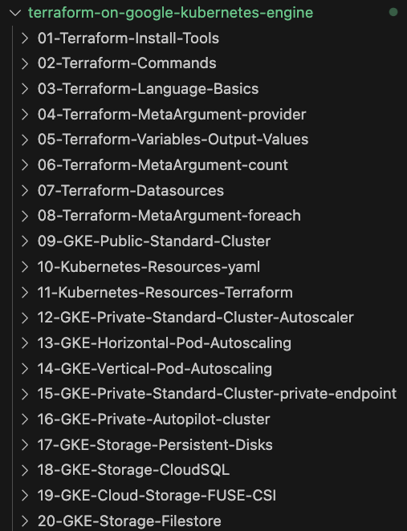
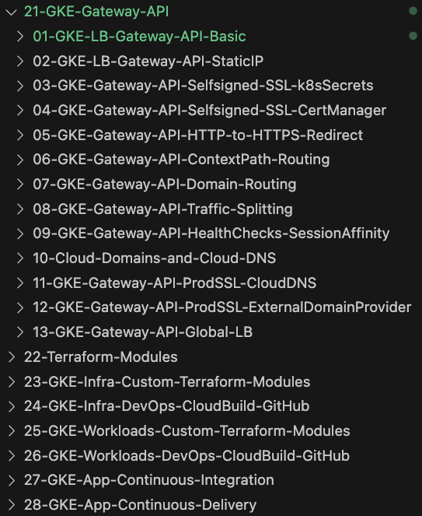
GitHub Step-by-Step Documentation
40
Real-World
Demos
GKE Cluster
Terraform

Slide 6
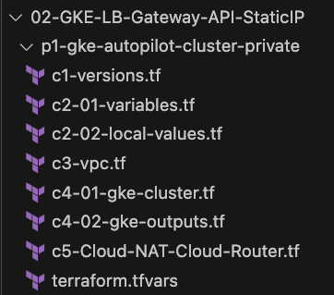
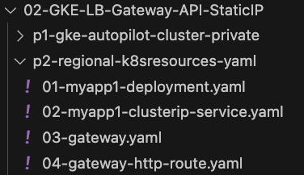
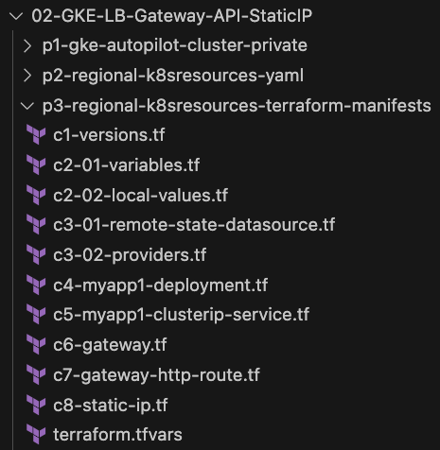
How are Terraform Configs organized ?
Project-1
Project-2
Project-3
GKE Cluster
Terraform Manifests
Kubernetes
YAML Manifests
Kubernetes Terraform Manifests

Slide 7

















Terraform on Google Cloud
Google
Compute Engine
Virtual
Private Cloud
Cloud
Monitoring
18+
GCP Services
Cloud SQL
(MySQL)
Cloud
Load Balancing
Cloud
Logging
Cloud
IAM
Google
Kubernetes Engine
Cloud
Firewalls
Many more
Sub-services under each service
Cloud
Domains
Cloud
DNS
Cloud
External IP
Cloud
Router
Cloud
NAT
Cloud
Build
Automated with
Terraform
Persistent
Disks
Certificate
Manager
Cloud
Storage

Slide 8
GitHub Repository
Repository Used For | Repository URL
Course Main Repository with step-by-step documentation | https://github.com/stacksimplify/terraform-on-google-kubernetes-engine
GCP GKE INFRA DevOps Repo | https://github.com/stacksimplify/terraform-gcp-gke-infra-devops
GCP GKE App DevOps Repo | https://github.com/stacksimplify/terraform-gcp-gke-app-devops
GCP GKE K8S WORKLOAD DevOps Repo | https://github.com/stacksimplify/terraform-gcp-gke-k8s-devops

Slide 9
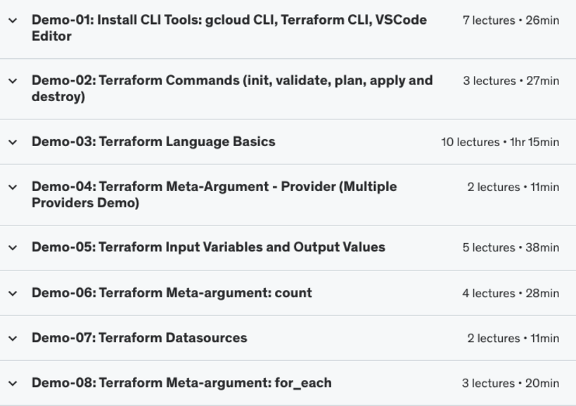
Terraform Fundamentals
Terraform Fundamentals
(4 Hours)

Slide 10
Terraform Workflow
init
validate
plan
apply
destroy
1
2
3
4
5
terraform init
terraform validate
terraform plan
terraform apply
terraform destroy

Slide 11
Terraform language uses a limited number of top-level block types, which are blocks that can appear outside of any other block in a TF configuration file.
Terraform
Top-Level
Blocks
Most of Terraform's features are implemented as top-level blocks.
Terraform Block
Input Variables Block
Data Sources Block
Providers Block
Output Values Block
Modules Block
Resources Block
Local Values Block
Calling / Referencing Blocks
Import Block
Fundamental Blocks
Variable Blocks
Moved Block
Removed Block
Check Block
NEW BLOCKS – Added Recently

Slide 12
Terraform Remote State Datasource
The terraform_remote_state data source retrieves the root module output values from project-1 Terraform configuration, using the latest state snapshot from the remote backend.
Project-1
Project-3
Terraform Resources
1. GKE Cluster
Terraform Resources
Kubernetes Provider
Kubernetes Deployment
Kubernetes Load Balancer Service
terraform_remote_state data source
Outputs from Project-1
GKE Cluster Name
GKE Cluster Location
dev/gke-cluster-public/default.tfstate
dev/k8s-demo1/default.tfstate

Slide 13
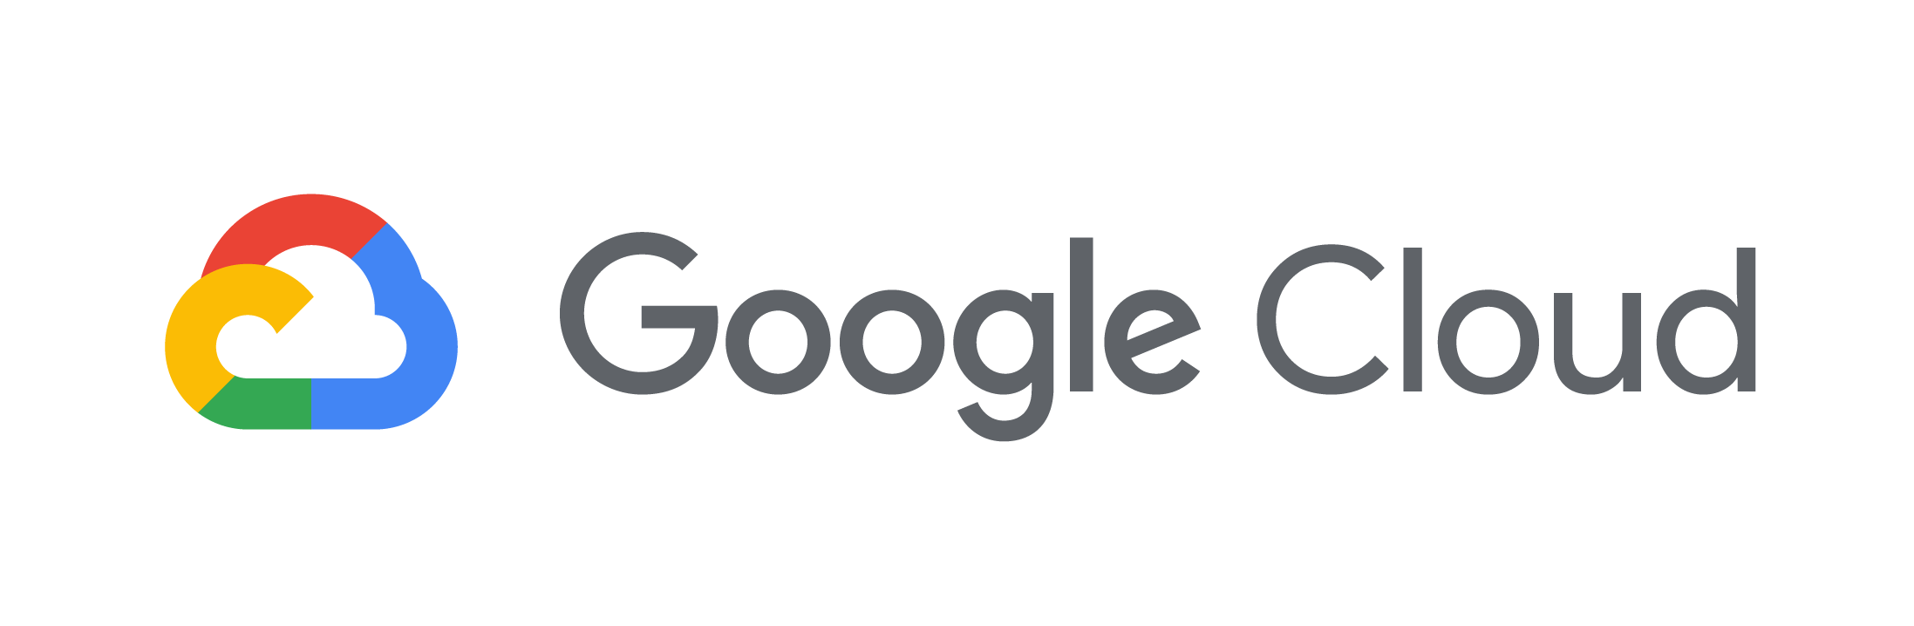








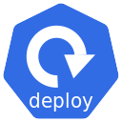


GKE Standard Public Cluster - Network Design
Customer Project: gcplearn9
Automated by Terraform
Google Managed Project
http://LB-IP
Customer VPC: myvpc
Google Managed VPC Network
Region: us-central1
Region: us-central1
Cloud
Load Balancing
GKE Control Plane
Users
GKE Cluster
Subnet: 10.128.0.0/20
Kube API Server Public IP
Zone: us-central1-a
Zone: us-central1-b
GKE Node-1
GKE Node-2
Admin
Load Balancer Service
Docker
Hub
Internet
Public IP
Private IP
Public IP
Private IP
Download Docker Image from Docker Hub
NETWORK
DESIGN

Slide 14
GKE Standard Private Cluster - Network Design
Customer Project: gcplearn9
Automated by Terraform
Google Managed Project
http://LB-IP
Customer VPC: myvpc
VPC Network Peering
Google Managed VPC Network
Private Connectivity
Region: us-central1
Region: us-central1
Cloud
Load Balancing
GKE Control Plane
Users
GKE Cluster
Cloud NAT
Cloud Router
Subnet: 10.128.0.0/20
Kube API Server Public IP
Private Connectivity
Kube API Server Private IP
Zone: us-central1-a
Zone: us-central1-b
GKE Node-1
GKE Node-2
Admin
Load Balancer Service
Docker
Hub
Internet
Private IP
Private IP
Cluster Autoscaler
Download Docker Image from Docker Hub
NETWORK
DESIGN

Slide 15
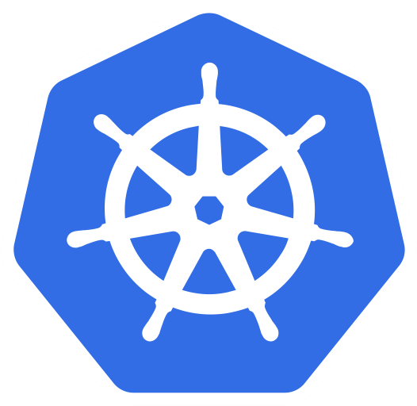
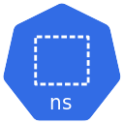
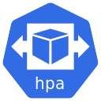
Kubernetes Horizontal Pod Autoscaling
GKE Cluster
default namespace
Calculate the Replica’s
2
kube-system namespace
15 secs
Metrics Server
1
Query for Metrics
This control loop is executed every 15 seconds
Horizontal
Pod Autoscaler
Service
Pod
Deployment
Scale the app to desired replicas
3
MyApp1
Horizontal Pod Autoscaling
Pod
Pod
Pod
Pod
Deployment
Pod
Pod
Pod
Pod
Service

Slide 16
Kubernetes Vertical Pod Autoscaling
default namespace
Deployment
Vertical Pod Autoscaling
Pod
Pod
CPU
CPU
Memory
Memory
Requests
Requests
CPU
CPU
Memory
Memory
Limits
Limits

Slide 17
GKE Standard Private Cluster with Private Endpoint
Customer Project: gcplearn9
Automated by Terraform
Google Managed Project
Customer VPC: myvpc
VPC Network Peering
Google Managed VPC Network
Private Connectivity
Region: us-central1
GKE Master Server IP Address CIDR Range (Reserved)
Region: us-central1
Subnet: 10.3.0.0/28
GKE Control Plane
GKE Cluster
k8s API Server ILB VIP
Kube API Server Private IP
Subnet: 10.128.0.0/20
Zone: us-central1-a
Zone: us-central1-b
GKE Node-1
GKE Node-2
Private IP
Private IP
Bastion VM
Connect to Bastion VM
Admin
NETWORK
DESIGN

Slide 18
GKE Autopilot Private Cluster - Network Design
Customer Project: gcplearn9
Automated by Terraform
Google Managed Project
http://LB-IP
Customer VPC: myvpc
VPC Network Peering
Google Managed VPC Network
Private Connectivity
Region: us-central1
Region: us-central1
Cloud
Load Balancing
GKE Control Plane
Users
GKE Cluster
Cloud NAT
Cloud Router
Subnet: 10.128.0.0/20
Kube API Server Public IP
Private Connectivity
Kube API Server Private IP
Zone: us-central1-a
Zone: us-central1-b
GKE Node-1
GKE Node-2
Admin
Load Balancer Service
Docker
Hub
Internet
Private IP
Private IP
Download Docker Image from Docker Hub
NETWORK
DESIGN

Slide 19



Kubernetes Storage
Kubernetes Cluster
default namespace
mypod1
Kubernetes
Storage Class
Kubernetes
Persistent Volume
Kubernetes
Persistent Volume Claim
k8s Persistent Volume Claim
k8s Storage Class
k8s Persistent Volume

Slide 20
User Management Web Application - Architecture
Java Spring Boot
Create User
schema: webappdb
List User
Table: User
Delete User
Default User: admin101
User Management
Web Application
MySQL DB

Slide 21

GKE Storage with Compute Engine Persistence Disks
GKE Cluster
http://<LB-IP>
UserMgmt - LB Service
REST API
Load Balancer Service
Users
POD
Deployment
ReplicaSet
Environment Variables
Deployment (UserMgmt)
MySQL – ClusterIP Service
YAML
Terraform
Compute Engine Persistent Disk
Storage Class
Environment Variables
GKE Storage Compute Engine Persistent Disk CSI Driver
Persistent Volume Claim
Volumes
MySql
Config Map
Volume Mounts
POD
ReplicaSet
Deployment
Deployment (mysql)
ClusterIP Service

Slide 22


GKE Storage with Compute Engine Persistence Disks
default namespace
GKE Cluster
http//<LB-IP>
UserMgmt Deployment
k8s Pods
k8s ReplicaSet
k8s Deployment
Load Balancer Service
MySQL k8s ClusterIP Service
MySQL Deployment
k8s Pods
k8s ReplicaSet
k8s Deployment
k8s Persistent Volume Claim
Note-3: PVC Status changes from Pending to Bound after MySQL Deployment
Compute Engine Persistent Disk
k8s Storage Class
k8s Persistent Volume

Slide 23
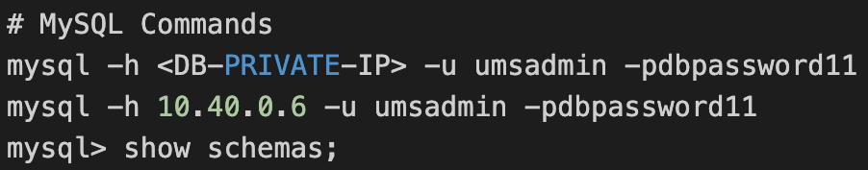
GCP Cloud SQL Private IP
Customer Project: gcplearn9
Service Producer Project for Customer
Customer VPC: VPC1
VPC Network Peering
Service Producer VPC Network
Region: us-central1
Private Service Connection
(10.240.0.0/16)
C
L
O
U
D
SQL
P
R
I
V
A
T
E
I
P
Subnet: UNKNOWN
Subnet: us-centra1-subnet
Zone:
us-central1-a
Zone: us-central1-a
MySQL Client
Users
VM1
Cloud SQL
(MySQL)
Communication is Private
(Internal to Google Cloud)
Zone:
us-central1-b
Cloud SQL
(MySQL)
Automated by Terraform

Slide 24
GCP Cloud SQL Private IP + GKE Autopilot Cluster + User Management Web Application
Customer Project: gcplearn9
Service Producer Project for Customer
Customer VPC: VPC1
VPC Network Peering
Service Producer VPC Network
Region: us-central1
Private Service Connection
(10.240.0.0/16)
GKE Autopilot Cluster
C
L
O
U
D
SQL
P
R
I
V
A
T
E
I
P
Subnet: UNKNOWN
Users
Subnet: 10.128.0.0/20
Zone:
us-central1-a
default namespace
UserMgmt Deployment
Cloud SQL
(MySQL)
http//<LB-IP>
Communication is Private
(Internal to Google Cloud)
Load Balancer
Service
Pods
ReplicaSet
Deployment
Zone:
us-central1-b
Docker
Hub
Cloud SQL
(MySQL)
Internet
Cloud NAT
Cloud Router
Automated by Terraform

Slide 25
GKE Autopilot Cluster + Cloud Storage Bucket as Volume Mount
Customer Project: gcplearn9
Customer VPC: VPC1
Region: us-central1
GKE Autopilot Cluster
Users
Subnet: 10.128.0.0/20
mydemo1ns namespace
Dummy Storage Class
MyApp1 Deployment
Cloud Storage
Bucket
http//<LB-IP>
Persistent
Volume
Claim
Persistent
Volume
Load Balancer
Service
Pods
ReplicaSet
Deployment
Docker
Hub
Internet
Cloud NAT
Cloud Router
Automated by Terraform

Slide 26

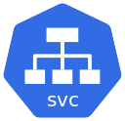



GKE Storage: FileStore Dynamic Provisioning
default namespace
GKE Cluster
myapp1
http://<LB-IP>/filestore/myapp1.txt
Load Balancer
Service
Pods
ReplicaSet
Deployment
We will create k8s Custom Storage Class
tier: standard-rwx
Writer POD
Persistent
Volume Claim
Pod
Dynamically Provisioned
File Store
Storage Class
Persistent Volume

Slide 27

Gateway API Basics - Regional Application Load Balancer
Customer Project: gcplearn9
Customer VPC: VPC1
Region: us-central1
GKE Autopilot Cluster
Users
Subnet: 10.128.0.0/20
default namespace
Gateway
(Regional LB)
HTTPRoute
http://<LB-IP>
HTTP Listener
Default Backend
MyApp1 Deployment
ClusterIP
Service
Pods
ReplicaSet
Deployment
Docker
Hub
Internet
Cloud NAT
Cloud Router
Automated by Terraform

Slide 28

Gateway API Basics + Static IP + Self-signed SSL with Kubernetes Secret
Customer Project: gcplearn9
Customer VPC: VPC1
Region: us-central1
GKE Autopilot Cluster
Subnet: 10.128.0.0/20
default namespace
Users
Gateway
(Regional LB)
HTTPRoute
SSL Certificates
Kubernetes Secret
MyApp1 Deployment
https://<LB-IP>
HTTPS Listener
Default Backend
Static IP
ClusterIP
Service
Pods
ReplicaSet
Deployment
Docker
Hub
Cloud
External IP Addresses
Internet
Cloud NAT
Cloud Router
Automated by Terraform

Slide 29
Gateway API Basics + Static IP + Self-signed SSL with Certificate Manager
Customer Project: gcplearn9
Customer VPC: VPC1
Region: us-central1
GKE Autopilot Cluster
Subnet: 10.128.0.0/20
default namespace
Users
Gateway
(Regional LB)
HTTPRoute
https://<LB-IP>
MyApp1 Deployment
HTTPS Listener
Default Backend
SSL Certificates
Static IP
ClusterIP
Service
Pods
ReplicaSet
Deployment
Docker
Hub
Cloud
External IP Addresses
Internet
Certificate
Manager
Cloud NAT
Cloud Router
Automated by Terraform

Slide 30
Gateway API Basics + Static IP + SSL Certificate Manager + HTTP to HTTPS
Customer Project: gcplearn9
Customer VPC: VPC1
Region: us-central1
GKE Autopilot Cluster
Subnet: 10.128.0.0/20
default namespace
Users
Gateway
(Regional LB)
HTTPRoute
HTTP to HTTPS Redirect
http://<LB-IP>
HTTP Listener
MyApp1 Deployment
HTTP to HTTPS
HTTPS Listener
HTTPRoute
SSL Certificates
Default Backend
Static IP
ClusterIP
Service
Pods
ReplicaSet
Deployment
Docker
Hub
Cloud
External IP Addresses
Internet
Certificate
Manager
Cloud NAT
Cloud Router
Automated by Terraform

Slide 31
Gateway API Basics + Static IP + SSL Certificate Manager + HTTP to HTTPS + Context Path based Routing
Customer Project: gcplearn9
Customer VPC: VPC1
Region: us-central1
GKE Autopilot Cluster
Subnet: 10.128.0.0/20
default namespace
Users
Gateway
(Regional LB)
HTTPRoute
MyApp1 Deployment
HTTP to HTTPS Redirect
MyApp1
Service
Pods
ReplicaSet
Deployment
HTTP Listener
HTTPRoute
MyApp2 Deployment
HTTP to HTTPS
HTTPS Listener
/app1/*
MyApp2
Service
Pods
ReplicaSet
Deployment
http://<LB-IP>/app1/
SSL Certificates
/app2/*
http://<LB-IP>/app2/
MyApp3 Deployment
Static IP
/*
http://<LB-IP>/
MyApp3
Service
Pods
ReplicaSet
Deployment
Docker
Hub
Cloud
External IP Addresses
Certificate
Manager
Cloud NAT
Cloud Router
Internet
Automated by Terraform

Slide 32
Gateway API Basics + Static IP + SSL Certificate Manager + HTTP to HTTPS + Domain name-based Routing
Customer Project: gcplearn9
Customer VPC: VPC1
Region: us-central1
GKE Autopilot Cluster
Subnet: 10.128.0.0/20
default namespace
Users
Gateway
(Regional LB)
HTTPRoute
MyApp1 Deployment
HTTP to HTTPS Redirect
MyApp1
Service
Pods
ReplicaSet
Deployment
HTTP Listener
HTTPRoute
MyApp2 Deployment
HTTP to HTTPS
http://app1.stacksimplify.com/app1/
HTTPS Listener
app1.stacksimplify.com
http://app2.stacksimplify.com/app2/
MyApp2
Service
Pods
ReplicaSet
Deployment
SSL Certificates
app2.stacksimplify.com
http://default.stacksimplify.com/
MyApp3 Deployment
Static IP
default.stacksimplify.com
MyApp3
Service
Pods
ReplicaSet
Deployment
Docker
Hub
Cloud
External IP Addresses
Certificate
Manager
Cloud NAT
Cloud Router
Internet
Automated by Terraform

Slide 33
Gateway API Basics + Static IP + SSL Certificate Manager + HTTP to HTTPS + Traffic Splitting
Customer Project: gcplearn9
Customer VPC: VPC1
Region: us-central1
GKE Autopilot Cluster
Subnet: 10.128.0.0/20
default namespace
Users
Gateway
(Regional LB)
HTTPRoute
50%
MyApp1 V1 Deployment
HTTP to HTTPS Redirect
MyApp1
Service
Pods
ReplicaSet
Deployment
HTTP Listener
HTTPRoute
MyApp1 V2 Deployment
HTTP to HTTPS
50%
http://<LB-URL>/
HTTPS Listener
V1: Weight: 50
MyApp2
Service
Pods
ReplicaSet
Deployment
SSL Certificates
V2: Weight: 50
Static IP
Docker
Hub
Cloud
External IP Addresses
Certificate
Manager
Cloud NAT
Cloud Router
Internet
Automated by Terraform

Slide 34
Gateway API + Static IP + SSL Certificate Manager + HTTP to HTTPS + Health Checks + Session Affinity
Customer Project: gcplearn9
Customer VPC: VPC1
GKE Custom Policies
Region: us-central1
GKE Autopilot Cluster
Subnet: 10.128.0.0/20
default namespace
Users
Gateway
(Regional LB)
HTTPRoute
HTTP to HTTPS Redirect
HTTP Listener
ClusterIP
Service
MyApp1 Deployment
http://<LB-IP>
HTTP to HTTPS
HTTPS Listener
HTTPRoute
Session Affinity
SSL Certificates
Default Backend
Health Checks
Static IP
Pods
ReplicaSet
Deployment
Docker
Hub
Cloud
External IP Addresses
Internet
Certificate
Manager
Cloud NAT
Cloud Router
Automated by Terraform

Slide 35
Gateway API + Static IP + SSL Certificate Manager + HTTP to HTTPS + Health Checks + Session Affinity + Cloud Domains + Cloud DNS
Customer Project: gcplearn9
Automated by Terraform
Customer VPC: VPC1
Region: us-central1
GKE Autopilot Cluster
Subnet: 10.128.0.0/20
default namespace
Users
Gateway
(Regional LB)
HTTPRoute
HTTP to HTTPS Redirect
http://<DNS-NAME>
HTTP Listener
ClusterIP
Service
MyApp1 Deployment
HTTP to HTTPS
HTTPS Listener
HTTPRoute
Session Affinity
SSL Certificates
Default Backend
Health Checks
Static IP
Pods
ReplicaSet
Deployment
Docker
Hub
Cloud
External IP Addresses
Production
grade
SSL certificates
Internet
Certificate
Manager
Cloud Domains
Cloud DNS
Cloud NAT
Cloud Router

Slide 36
Gateway API + Static IP + SSL Certificate Manager + HTTP to HTTPS + Health Checks + Session Affinity + AWS Route53 + Cloud DNS
Customer Project: gcplearn9
Automated by Terraform
Customer VPC: VPC1
Region: us-central1
GKE Autopilot Cluster
Subnet: 10.128.0.0/20
default namespace
Users
Gateway
(Regional LB)
HTTPRoute
HTTP to HTTPS Redirect
http://<DNS-NAME>
HTTP Listener
ClusterIP
Service
MyApp1 Deployment
HTTP to HTTPS
HTTPS Listener
HTTPRoute
Session Affinity
SSL Certificates
Default Backend
AWS
Route53
Health Checks
Static IP
Pods
ReplicaSet
Deployment
Docker
Hub
Cloud
External IP Addresses
Production
grade
SSL certificates
Internet
Certificate
Manager
Cloud DNS
Cloud NAT
Cloud Router

Slide 37
Gateway API – Global Application Load Balancer
Customer Project: gcplearn9
Customer VPC: VPC1
Region: us-central1
GKE Autopilot Cluster
Users
Subnet: 10.128.0.0/20
default namespace
Gateway
(Global LB)
HTTPRoute
http://<LB-IP>
HTTP Listener
Default Backend
MyApp1 Deployment
ClusterIP
Service
Pods
ReplicaSet
Deployment
Docker
Hub
Internet
Cloud NAT
Cloud Router
Automated by Terraform

Slide 38
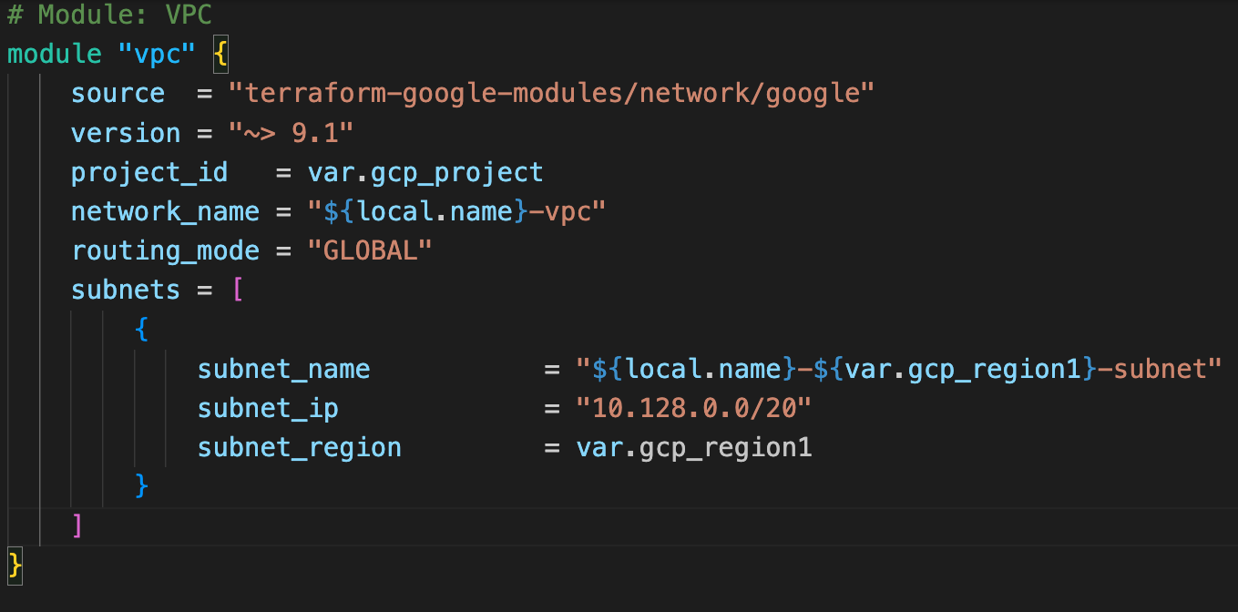
Terraform Registry - Use Publicly Available Modules
The Terraform Registry hosts a broad collection of publicly available Terraform modules for configuring many kinds of common infrastructure.
ModulesDemo 1
These modules are free to use, and Terraform can download them automatically if you specify the appropriate source and version in a module call block.

Slide 39
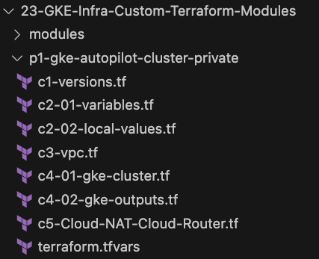
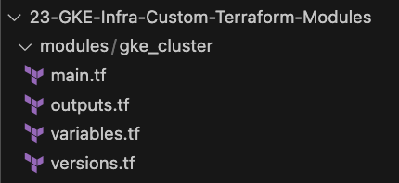
Build a Local Terraform Module
Root Module
GKE
Custom
Terraform Module
Call GKE Cluster child
module in Root Module
Child Module

Slide 40

GCP GKE INFRA DevOps for Terraform Configs
Customer Project: gcplearn9
+
VPC: vpc1
fw_ssh22
fw_http80
Cloud Build
App
Region: us-central1
Connection
Link Repo
DEV Branch
Cloud Build
Trigger
Build
Approver
Build
Approver
Cloud Build Key Concepts
Subnet: us-centra1-subnet
PROD Branch
MAIN Branch
GIT Repo
GKE Cluster
GKE Cluster
GitHub
Dev Environment
Prod Environment
Developer

Slide 41
GCP GKE INFRA DevOps for Terraform Configs
Customer Project: gcplearn9
+
VPC: vpc1
fw_ssh22
fw_http80
Cloud Build
App
Region: us-central1
Connection
Link Repo
DEV Branch
Cloud Build
Create
Pull Request
Trigger
Merge
Build
Approver
Build
Approver
Create
Pull Request
& Merge
Feature Branch-1
Cloud Build Key Concepts
Subnet: us-centra1-subnet
PROD Branch
MAIN Branch
Resource Labels
Resource Labels
GIT Repo
GKE Cluster
GKE Cluster
GitHub
Dev Environment
Prod Environment
Developer

Slide 42


Continuous Integration and Continuous Delivery
GitHub Repositories
Artifact
Registry
Cloud Build
App
Terraform
Configs
GKE
Cluster
Demo
25
Create Kubernetes Deployment Custom Terraform Module
Demo
26
Implement k8s workload DevOps pipelines
(Dev and Prod Environments)
Demo27
App: Implement Continuous Integration Pipeline with Artifact Registry
Demo28
App: Implement Continuous Integration and Continuous Delivery Pipeline (CI CD)

Slide 43
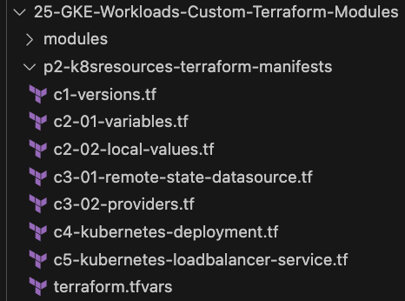
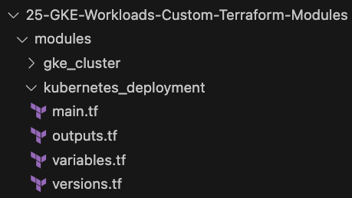
Build a Local Terraform Module
Root Module
Kubernetes Deployment
Custom
Terraform Module
Call GKE Cluster child
module in Root Module
Child Module

Slide 44
Kubernetes Deployment DevOps for Terraform Configs
Customer Project: gcplearn9
+
VPC: vpc1
fw_ssh22
fw_http80
Cloud Build
App
Region: us-central1
Connection
Link Repo
DEV Branch
Cloud Build
Trigger
Build
Approver
Build
Approver
Cloud Build Key Concepts
Subnet: us-centra1-subnet
PROD Branch
MAIN Branch
V1
V1
GIT Repo
GKE Cluster
GKE Cluster
GitHub
Dev Environment
Prod Environment
Developer

Slide 45
Kubernetes Deployment DevOps for Terraform Configs
Customer Project: gcplearn9
+
VPC: vpc1
fw_ssh22
fw_http80
Cloud Build
App
Region: us-central1
Connection
Link Repo
DEV Branch
Cloud Build
Create
Pull Request
Trigger
Merge
Build
Approver
Build
Approver
Create
Pull Request
& Merge
Feature Branch-1
Cloud Build Key Concepts
Subnet: us-centra1-subnet
PROD Branch
MAIN Branch
V2
V2
GIT Repo
GKE Cluster
GKE Cluster
GitHub
Dev Environment
Prod Environment
Developer

Slide 46
Continuous Integration
Continuous Integration Pipeline
GitHub
Google
Cloud Build
Google
Artifact Registry
To Store App Code
(Application Code + Docker Files)
To Build Packages
(Build Docker Image)
To Store Packages
(Store Docker Image)

Slide 47

Google Cloud Build: Continuous Integration
Check-in Code
GitHub
Admin
Customer Project: gcplearn9
Region: us-central1
Trigger the Code Build CI Pipeline
Google
Cloud Build
Build and push new Docker Image
Google
Artifact Registry
© Kalyan Reddy Daida

Slide 48
GKE CI CD Pipelines
1
Check-in App Code
Admin
Customer Project: gcplearn9
GitHub
(Application Code)
Push Kubernetes Terraform Manifests with Docker Image tag as COMMIT_SHA
4
GitHub
(k8s TERRAFORM Code) (main branch)
Region: us-central1
2
5
Trigger the Continuous Delivery Pipeline
Trigger the Continuous Integration Pipeline
Cloud Build
(myapp1-ci)
6
Pull Docker Image
Cloud Build
(myapp1-cd)
3
RUNS TERRAFORM PLAN
Build and push new Docker Image
7
Google
Artifact Registry
TF plan runs on Dev and Prod Env (latest code in main branch)
Continuous Integration
Continuous Deployment
© Kalyan Reddy Daida

Slide 49
Kubernetes Deployment DevOps for Terraform Configs
Customer Project: gcplearn9
+
VPC: vpc1
fw_ssh22
fw_http80
Cloud Build
App
Region: us-central1
Connection
Link Repo
DEV Branch
Cloud Build
Create
Pull Request
Trigger
Merge
Build
Approver
Build
Approver
Create
Pull Request
& Merge
MAIN Branch
Cloud Build Key Concepts
Subnet: us-centra1-subnet
PROD Branch
V3
V3
GIT Repo
GKE Cluster
GKE Cluster
GitHub
Dev Environment
Prod Environment
Developer

Slide 50
END OF INTRODUCTION

Slide 51
Terraform on Google Kubernetes Engine
Terraform Fundamentals
Terraform CLI Install
1
Terraform Commands
2
Terraform
GKE Cluster
Terraform Language Basics
3
Meta-Argument Provider
4
GCP Terraform on Google Cloud : DevOps SRE 30 Real-World Demos
Input Variables &
Output Values
5
Sections common
in both courses
Meta-Argument count
6
Terraform Data sources
7
GCP GKE Terraform on Google Kubernetes Engine DevOps SRE IaC
Meta-Argument for_each
8

Slide 52
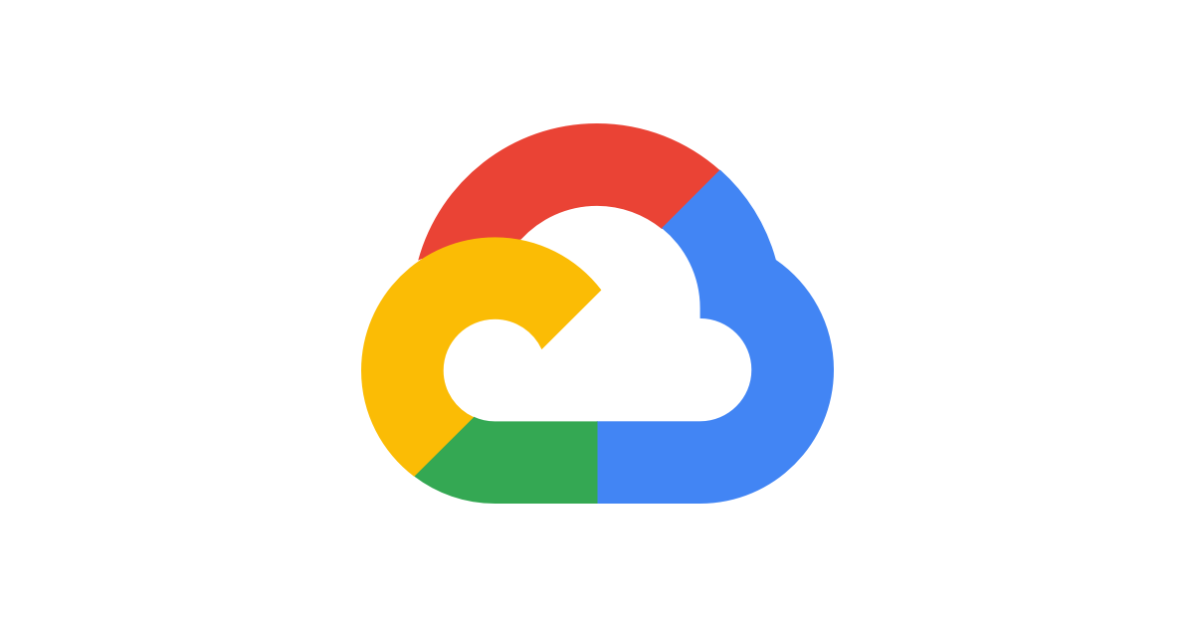
Demo
Terraform
Installation
CLI Tools

Slide 53
Terraform Installation
gcloud CLI
Terraform CLI
VS Code Editor
Terraform plugin for VS Code
Mac OS
Windows OS

Slide 54
Demo
Terraform
Command Basics

Slide 55
Terraform Workflow
init
validate
plan
apply
destroy
1
2
3
4
5
terraform init
terraform validate
terraform plan
terraform apply
terraform destroy

Slide 56
Terraform Workflow
init
validate
plan
apply
destroy
1
2
3
4
5
Used to Initialize a working directory containing terraform config files
This is the first command that should be run after writing a new Terraform configuration
Downloads Providers
Validates the terraform configurations files in that respective directory to ensure they are syntactically valid and internally consistent.
Creates an execution plan
Terraform performs a refresh and determines what actions are necessary to achieve the desired state specified in configuration files
Used to apply the changes required to reach the desired state of the configuration.
By default, apply scans the current directory for the configuration and applies the changes appropriately.
Used to destroy the Terraform-managed infrastructure
This will ask for confirmation before destroying.

Slide 57
Demo
Terraform What are we going
to automate as part of this demo
using
Terraform?

Slide 58
Terraform Language Basics
Customer Project: gcplearn9
VPC: vpc1
Automated by Terraform
Region: us-central1
Subnet: us-centra1-subnet
Zone: us-central1-a
http://<VM-External-IP:80>
fw_ssh22
User
fw_http80
VM1

Slide 59
Demo
Terraform
Language Basics

Slide 60
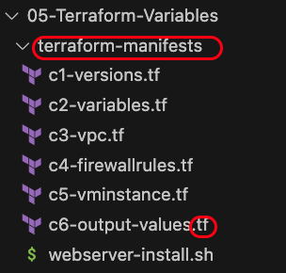
Terraform Language Basics - Files
Terraform Working Directory
Code in the Terraform language is stored in plain text files with the .tf file extension.
There is also a JSON-based variant of the language that is named with the .tf.json file extension.
We can call the files containing terraform code as Terraform Configuration Files or Terraform Manifests
Terraform files should be saved in a directory (Terraform Working Directory)
Terraform Configuration Files ending with .tf as extension

Slide 61
Terraform Language Basics - Configuration Syntax
Blocks
Arguments
HCL – HashiCorp Language
Terraform
Identifiers
Comments

Slide 62
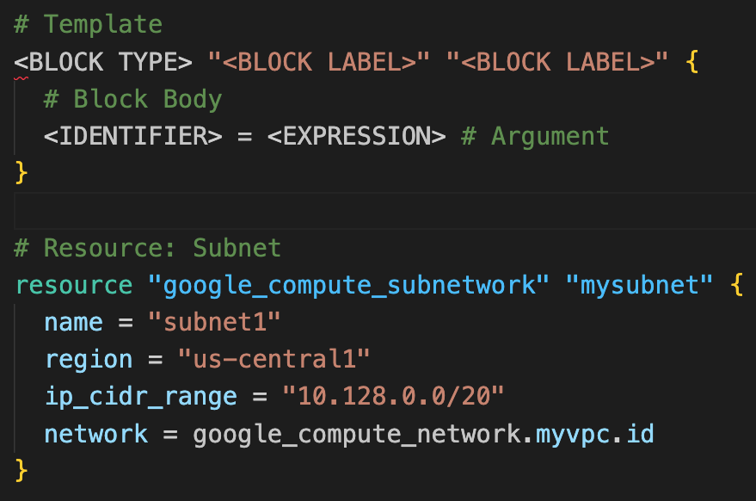
Terraform Language Basics - Configuration Syntax
Based on Block Type, block labels can be 1 or 2
Example:
Resources: 2 block labels
Variables: 1 block label
Block Labels
Block Type
Arguments
Top Level & Block inside Blocks
Top Level Blocks: resource, provider, terraform, variable, data, module, output
Block Inside Block: provisioners, resource specific blocks like tags

Slide 63
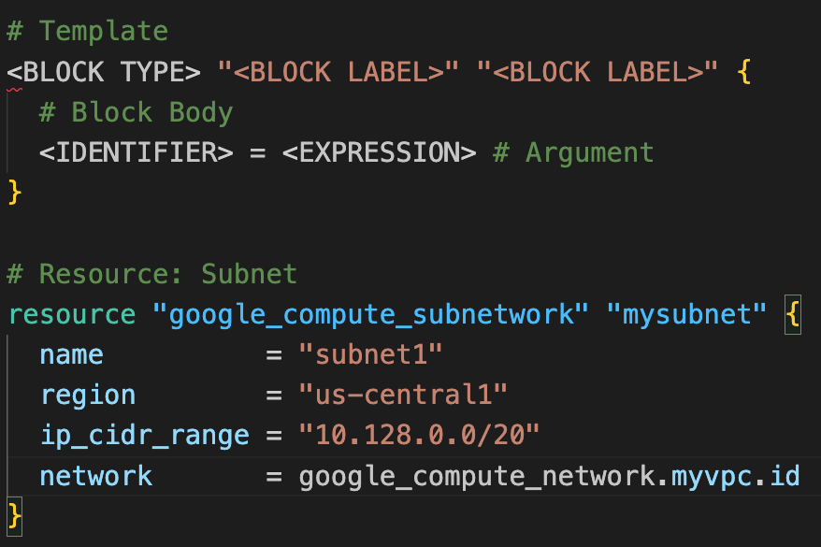
Terraform Language Basics - Configuration Syntax
Argument Name
[OR]
Identifier
Argument Value
[OR]
Expression

Slide 64
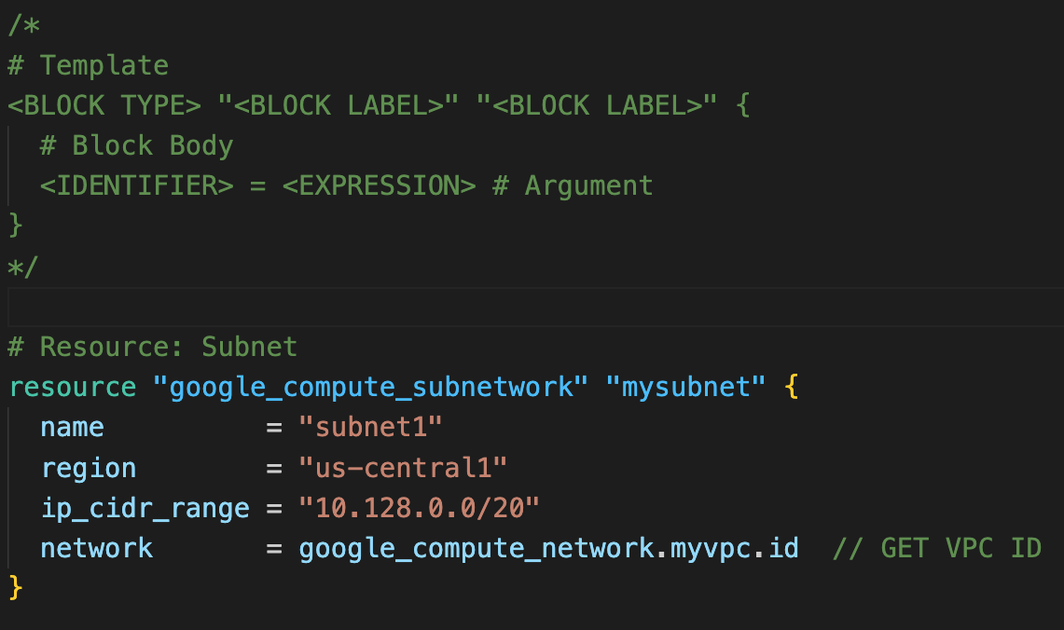
Terraform Language Basics - Configuration Syntax
Multi-line comment /* ….. */
Single Line Comments with # or //

Slide 65
Terraform language uses a limited number of top-level block types, which are blocks that can appear outside of any other block in a TF configuration file.
Terraform
Top-Level
Blocks
Most of Terraform's features are implemented as top-level blocks.
Terraform Block
Input Variables Block
Data Sources Block
Providers Block
Output Values Block
Modules Block
Resources Block
Local Values Block
Calling / Referencing Blocks
Import Block
Fundamental Blocks
Variable Blocks
Moved Block
Removed Block
Check Block
NEW BLOCKS – Added Recently

Slide 66
Demo
Terraform
Fundamental Blocks

Slide 67
Terraform Basic Blocks
Terraform
Block
Provider
Block
Resource
Block
Special block used to configure some behaviors
HEART of Terraform
Each Resource Block describes one or more Infrastructure Objects
Specifying a required Terraform Version
Terraform relies on providers to interact with Remote Systems
Resource Syntax:
How to declare Resources?
Specifying Provider Requirements
Declare providers for Terraform to install providers & use them
Resource Behavior: How Terraform handles resource declarations?
Configuring a Terraform Backend (Terraform State)
Provider configurations belong to Root Module
Provisioners: We can configure Resource post-creation actions

Slide 68
Demo
Terraform
Terraform Block

Slide 69
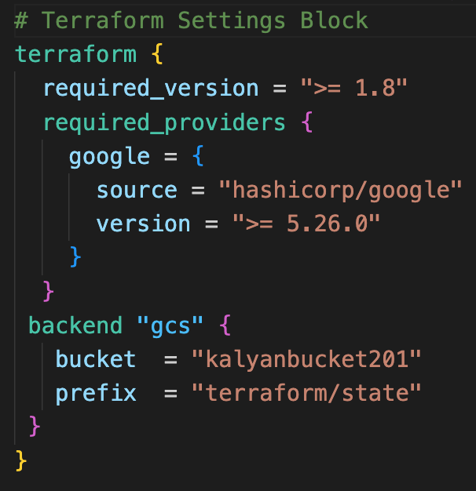
Terraform Block
This block can be called in 3 ways. All means the same.
Terraform Block
Terraform Settings Block
Terraform Configuration Block
Each terraform block can contain a number of settings related to Terraform's behavior.
Within a terraform block, only constant values can be used; arguments may not refer to named objects such as resources, input variables, etc, and may not use any of the Terraform language built-in functions.

Slide 70
Demo
Terraform
Providers

Slide 71



Terraform Providers
Providers are HEART of Terraform
Every Resource Type (example: VM Instance), is implemented by a Provider
Without Providers Terraform cannot manage any infrastructure.
Terraform Admin
Providers are distributed separately from Terraform and each provider has its own release cycles and Version Numbers
Terraform Registry is publicly available which contains many Terraform Providers for most major Infra Platforms
Local Desktop
1
Google Cloud
terraform init
Terraform CLI
Download Provider
Terraform Registry
Terraform GCP
Provider
4
terraform apply
GCP
APIs
5
terraform destroy
VM Instance
2
terraform validate
3
terraform plan

Slide 72
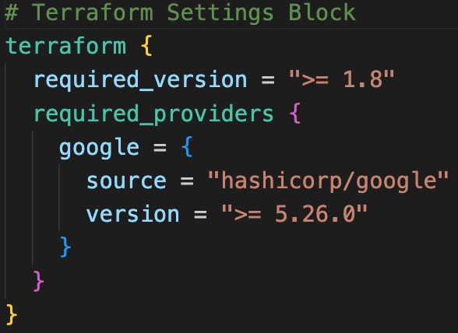
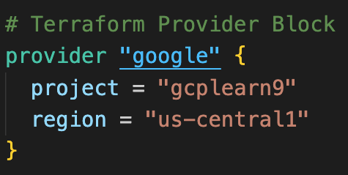
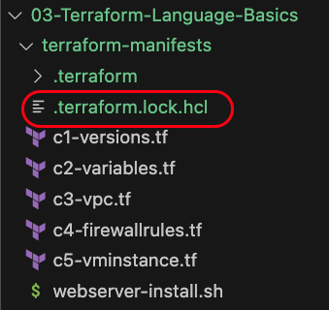
Terraform
Providers
Provider Requirements
Provider Configuration
Dependency Lock File

Slide 73
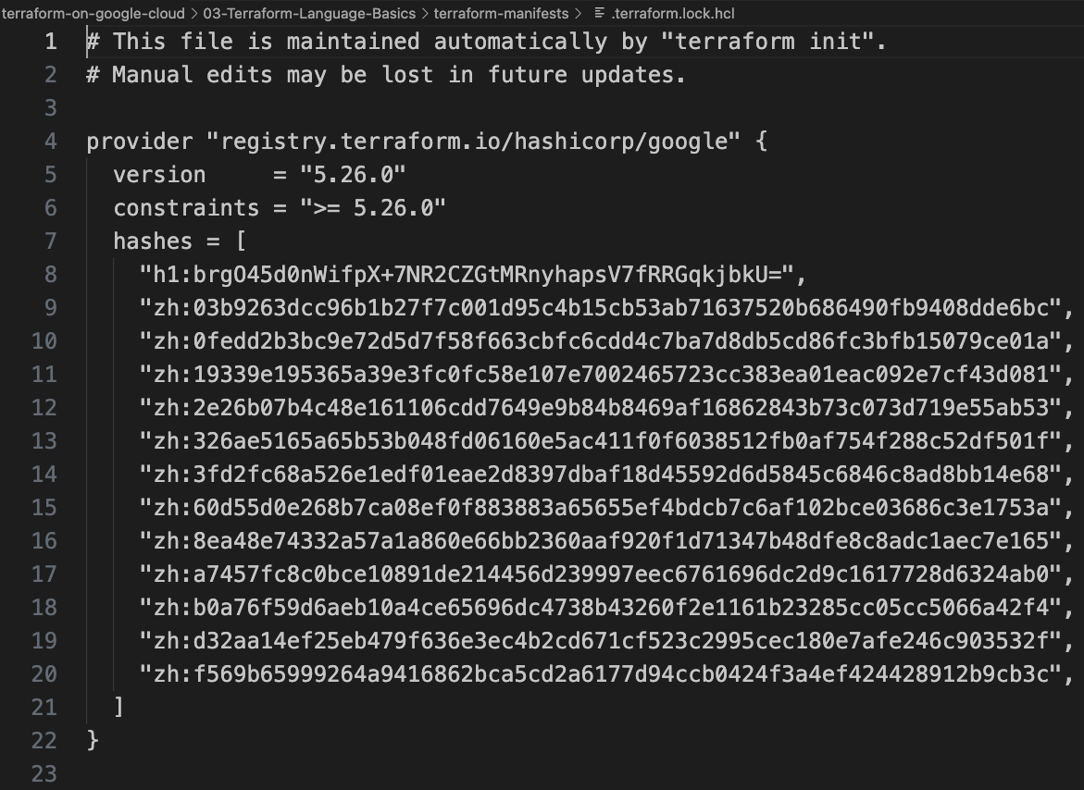
Dependency Lock File

Slide 74
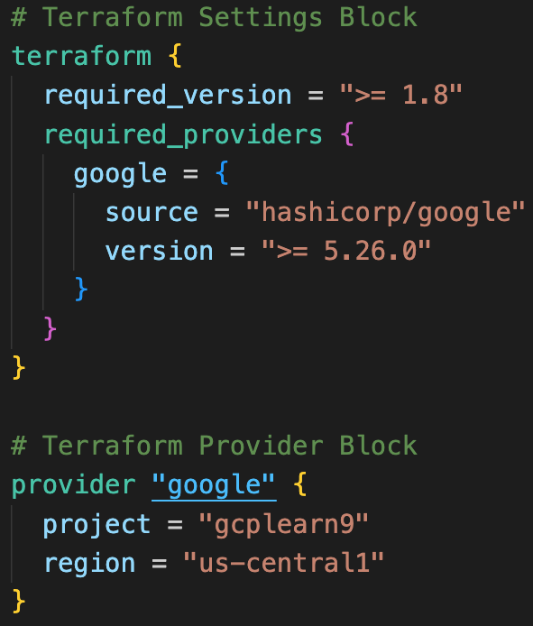
Required Providers
Local Names
Local Names are Module specific and should be unique per-module
Terraform configurations always refer to local name of provider outside required_provider block
Users of a provider can choose any local name for it (mygoogle, google1).
Recommended way of choosing local name is to use preferred local name of that provider (For Google Provider: hashicorp/google, preferred local name is google)
Source
It is the primary location where we can download the Terraform Provider
Source addresses consist of three parts delimited by slashes (/)
[<HOSTNAME>/]<NAMESPACE>/<TYPE>
registry.terraform.io/hashicorp/google
Registry Name is optional as default is going to be Terraform Public Registry

Slide 75
Terraform Registry
Terraform Providers
Terraform Modules
Terraform Registry
registry.terraform.io
Terraform Policy Libraries
Terraform Run Tasks

Slide 76
Demo
Terraform
State

Slide 77

Terraform State
Terraform must store state about your managed infrastructure and configuration
Terraform
Admin
This state is used by Terraform to map real world resources to your configuration (.tf files), keep track of metadata, and to improve performance for large infrastructures.
Local Desktop
This state is stored by default in a local file named "terraform.tfstate", but it can also be stored remotely, which works better in a team environment.
1
terraform init
Google Cloud
Terraform CLI
Download Provider
Terraform Registry
Terraform AWS
Provider
4
terraform apply
GCP
APIs
VM Instance
5
terraform destroy
2
terraform validate
3
terraform plan
Terraform State
File : terraform.tfstate

Slide 78
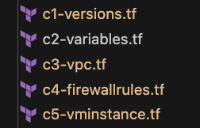

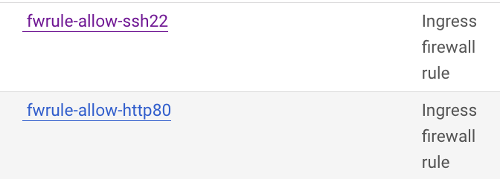
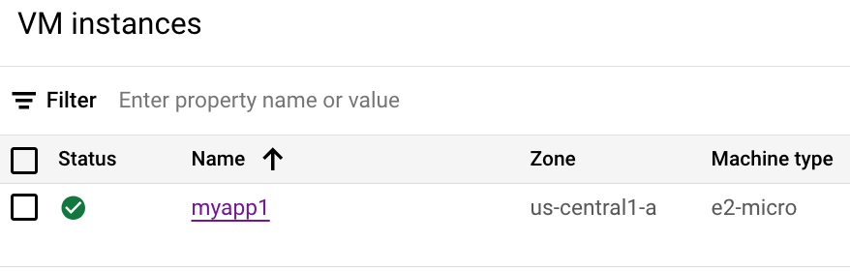
Desired & Current Terraform States
Terraform Configuration Files
Real World Resource
VM Instance, VPC, Subnet,
Firewall Rules
terraform.tfstate
Desired State
Current State

Slide 79
Demo-4
Terraform
Multiple Providers
Meta-Argument: provider

Slide 80
Resource Meta-Arguments
depends_on
count
Terraform Resources
Meta-Arguments
for_each
provider
Meta-Arguments can be used with any resource type to change the behavior of resources.
lifecycle

Slide 81
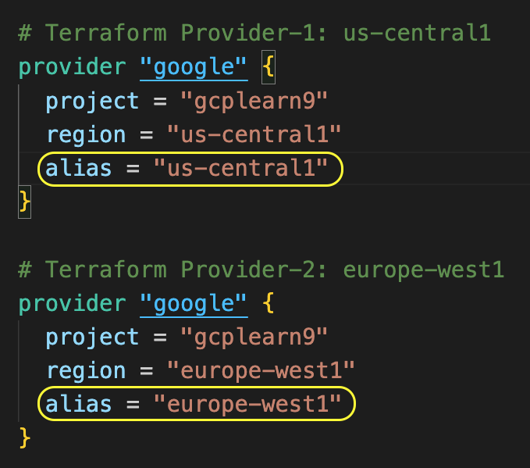
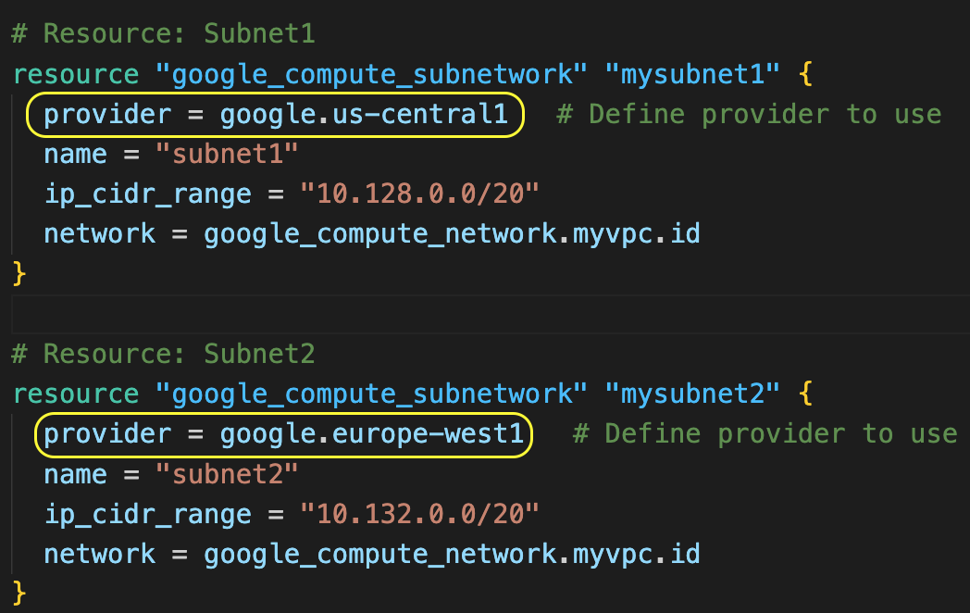
Terraform Multiple Providers
We can define multiple configurations for the same provider (Ex: google) and select which one to use on a per-resource or per-module basis.
The primary reason for this is to support multiple regions for a cloud platform, additionally for multiple environments (dev, prod) considering each environment has different provider configurations (Example: different authentication credentials for dev and prod)
We can use the alternate provider in a resource, data or module by referencing it as <PROVIDER NAME>.<ALIAS>

Slide 82
Terraform Multiple Providers
We can define multiple configurations for the same provider (Ex: google) and select which one to use on a per-resource or per-module basis.
Usage
To support multiple regions for a cloud platform (we will practically implement this)
For supporting multiple environments (dev, prod) considering each environment has different provider configurations
Example: Different authentication credentials for dev and prod configured in their respective provider blocks
We can use the alternate provider in a resource, data or module by referencing it as <PROVIDER NAME>.<ALIAS>

Slide 83
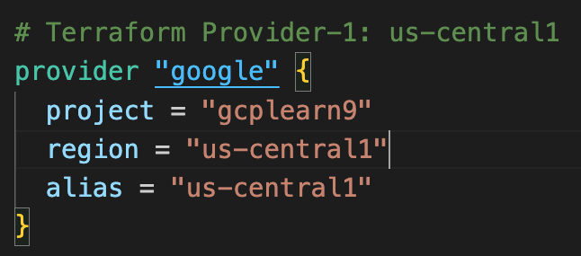
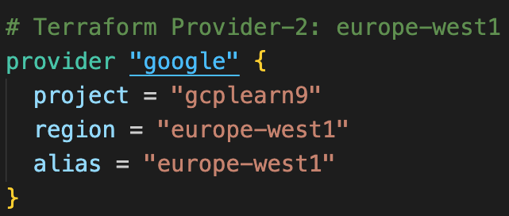
Terraform Multiple Providers
Customer Project: gcplearn9
VPC: vpc1
Automated by Terraform
Region: us-central1
Subnet: us-centra1-subnet
Region: europe-west1
Subnet: europe-west1-subnet

Slide 84
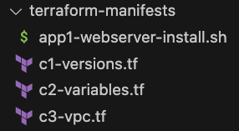
What are we going to learn?
Demo: Terraform Concept: Multiple Providers
C1
Update multiple providers
C2
Use provider alias in subnet Terraform resources

Slide 85
Demo-5
Terraform
Input Variables
Output Values
Demo: Terraform Concept: Input Variables and Output Values

Slide 86
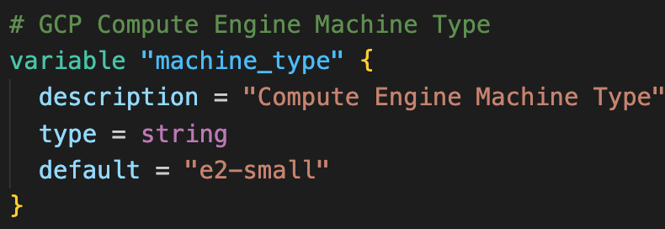
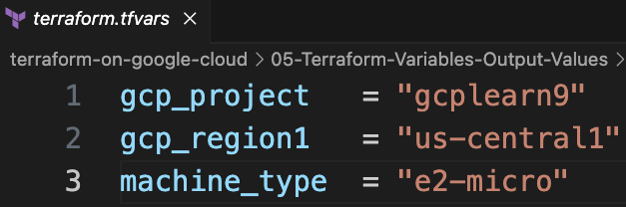
Terraform Input Variables
Input variables allow us to customize the Terraform Resources or modules without altering the source code.
Key Benefit: Allows us to make the code reusable by just changing variables
We have multiple options to declare variables
varibales.tf (Default value)
terraform.tfvars
vm.auto.tfvars
vm.tfvars
Environment Variables
--var-file flag
--var flag
variables.tf
terraform.tfvars

Slide 87
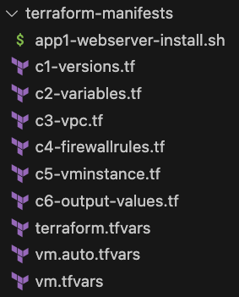
What are we going to learn?
Demo: Terraform Concept: Input Variables
C2
Understand and define Terraform Input Variables
C1
Update Provider block with Terraform input variables
C3
Update subnet region with input variable
C5
Update VM Instance machine type using input variable
TF
VARS
Play with terraform.tfvars, vm.auto.tfvars and vm.tfvars

Slide 88
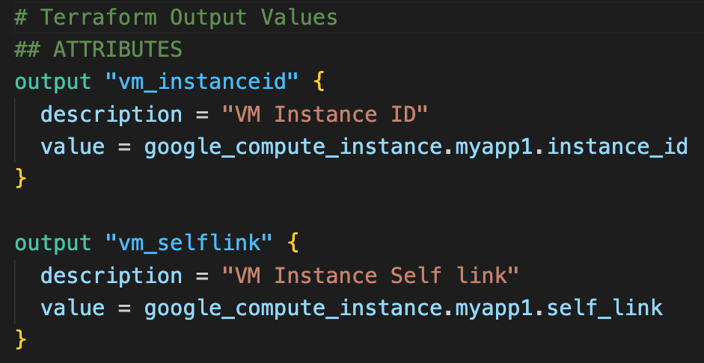
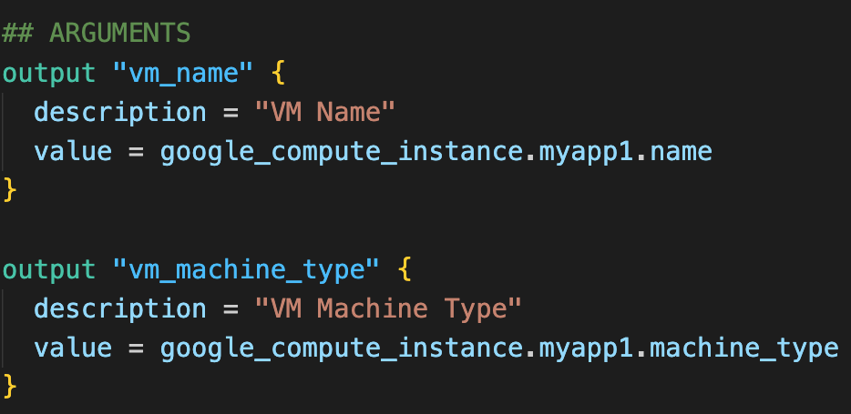
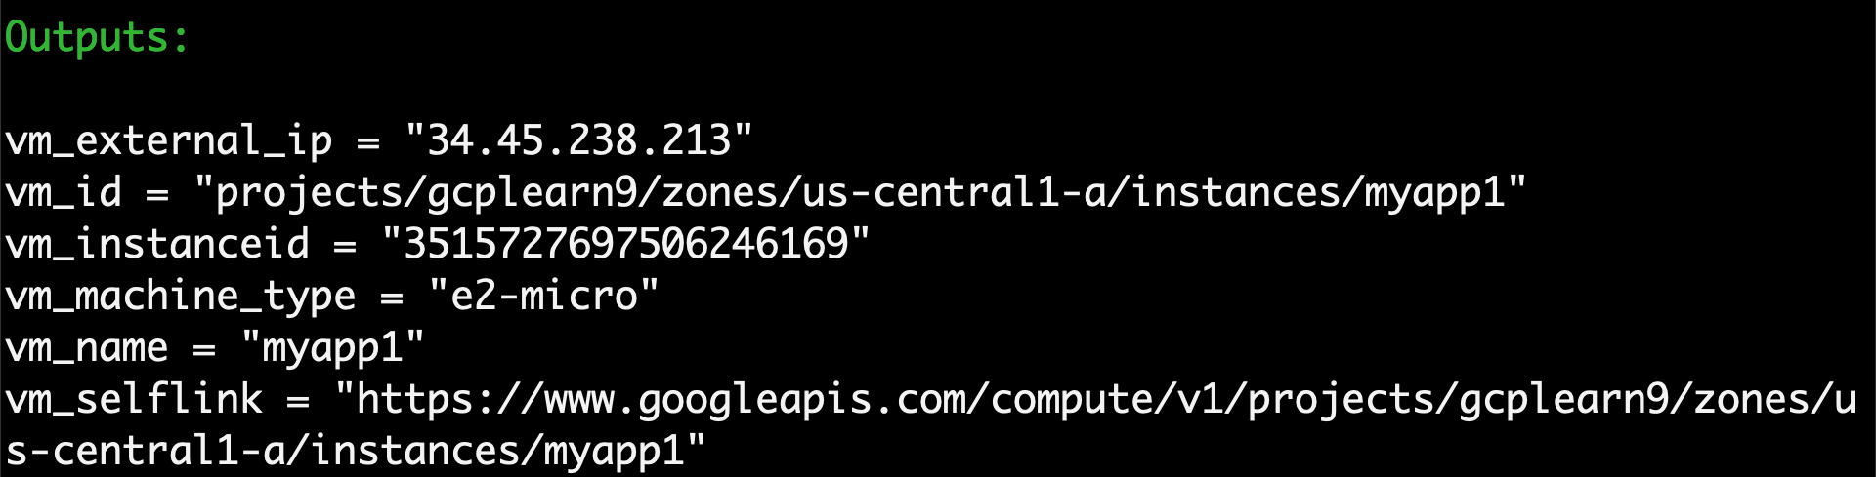
Terraform Output Values
Output Values - Attributes
Output values are like return values in programming languages.
Output values provide about your infrastructure available on the command line
With output values we can expose information for other Terraform configurations to use
Output Values - Arguments
Output Values

Slide 89
What are we going to learn?
Demo: Terraform Concept: Output Values
C6
Understand and define Terraform Output values

Slide 90
Demo-6
Terraform
Meta-Argument
count
Demo: Terraform Concept: Meta-argument count

Slide 91
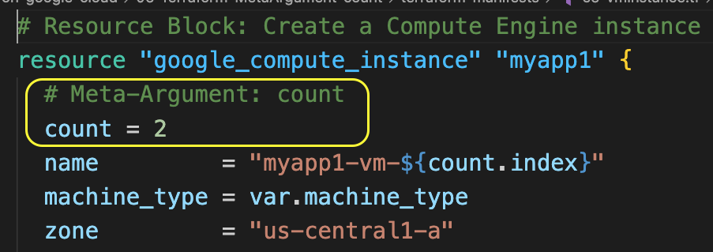
Terraform Meta-Argument: count
By default, resource block creates a single instance of a resource
For example: 1 VM Instance
With the meta-argument count we can create specified number of similar instances of a resource
For example: count = 2 (will create 2 VM instances from the same defined resource block)
count.index: The distinct index number (starting with 0) corresponding to this instance.
Resource Meta-Argument: count

Slide 92
Terraform Meta-argument: count
Customer Project: gcplearn9
VPC: vpc1
Automated by Terraform
Region: us-central1
Subnet: us-centra1-subnet
Zone: us-central1-a
fw_ssh22
http://<VM0-External-IP:80>
VM0
http://<VM1-External-IP:80>
User
VM1
fw_http80

Slide 93
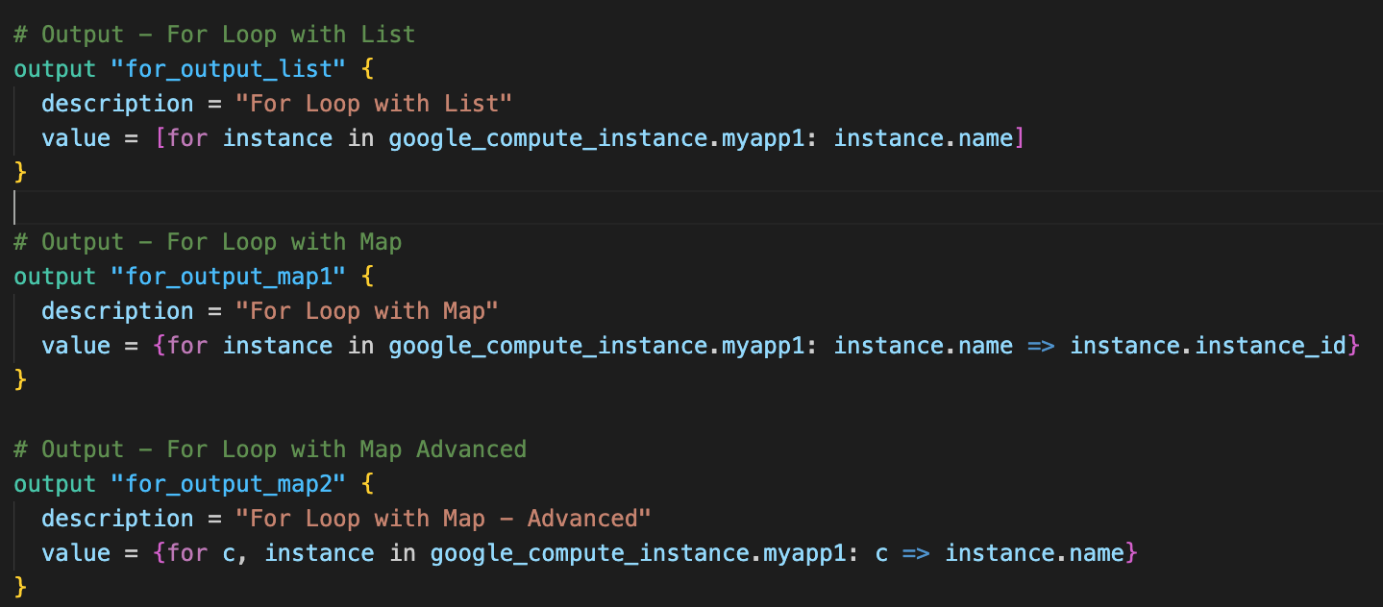
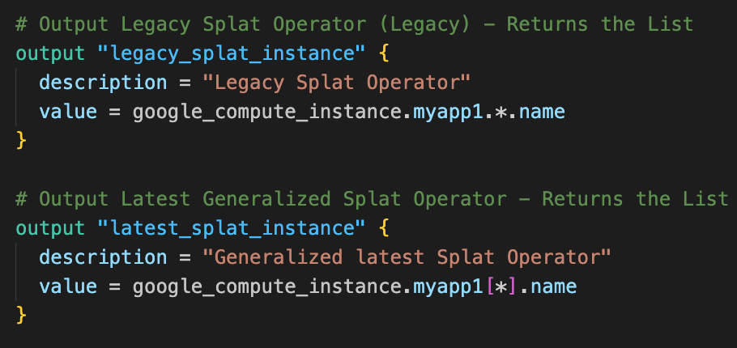
Terraform: For expression
For expression
For Expression: Enables efficient management of multiple resources by looping through lists, maps, or sets
Examples:
For loop with list
For loop with map
For loop with map advanced
Legacy splat operator
Latest generalized splat operator

Slide 94
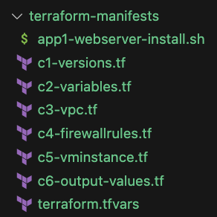
What are we going to learn?
Demo: Terraform Concept: Meta-argument count
NC
No Changes from C1 to C4
C5
Define VM Instance with Meta-argument count
C6
Define Terraform output values with Terraform for expression and also learn about Splat operator

Slide 95
Demo-7
Terraform
Data sources
Demo: Terraform Concept: Datasources

Slide 96
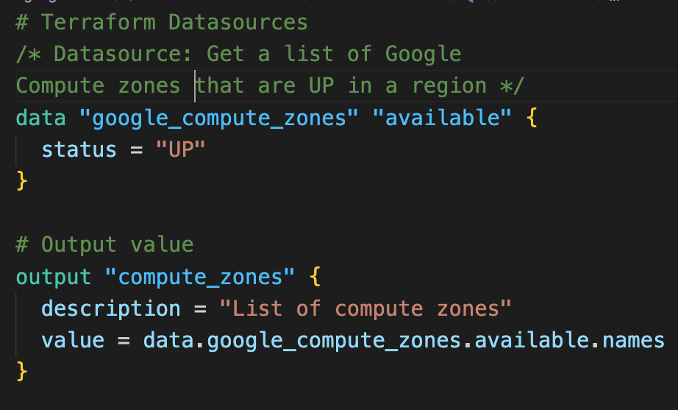
Terraform Data sources
Data sources: allow Terraform to use information defined outside of Terraform
A data source is accessed via a special kind of resource known as a data resource, declared using a data block:
Use case:
Step-01: Get the available compute zones in that respective region using google_compute_zone datasource
Step-02: Create two VM Instances in two available compute zones using the Meta-argument count
Terraform Data source

Slide 97
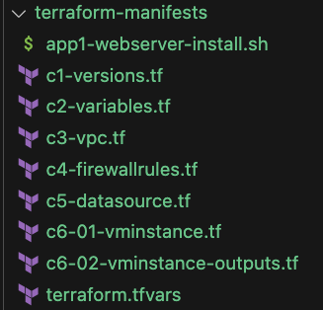
What are we going to learn?
Demo: Terraform Concept: Datasources
NC
No Changes from C1 to C4
C5
Define a data source to get a list of all available zones in that region
C6-01
Update VM Instance with zone value updated from Terraform data source

Slide 98
Demo-8
Terraform
Meta-Argument
for_each
Demo: Terraform Concept: Meta-Argument for_each

Slide 99
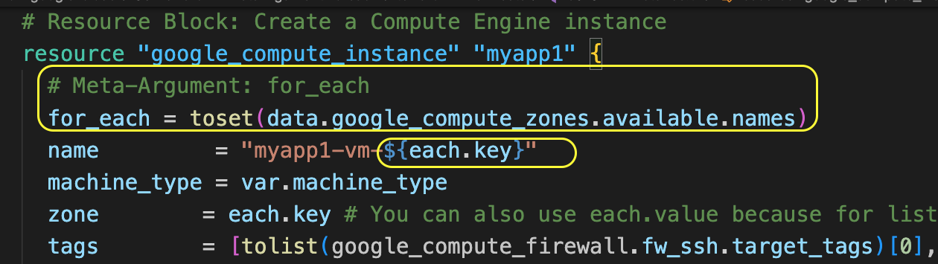
Terraform Meta-Argument: for_each
Resource Meta-Argument: for_each
By default, resource block creates a single instance of a resource
For example: 1 VM Instance
The for_each meta-argument accepts a map or a set of strings and creates an instance for each item in that map or set
For example: Creates 1 VM instance for each compute zone
Each instance has a
distinct infrastructure object associated with it
each is separately created, updated, or destroyed when the configuration is applied
each.key: The map key (or set member) corresponding to this instance.
each.value: The map value corresponding to this instance (If a set was provided, each.key == each.value)

Slide 100

Terraform Meta-argument: for_each
Demo-1: for_each with Set values
Customer Project: gcplearn9
Creates VM instance for each available compute zone in a region
VPC: vpc1
Automated by Terraform
Region: us-central1
Subnet: us-centra1-subnet
Zone: us-central1-a
Zone: us-central1-b
fw_ssh22
VM1
VM2
Zone: us-central1-c
Zone: us-central1-f
fw_http80
VM3
VM4

Slide 101

What are we going to learn?
Demo-01: Terraform Concept: Meta-argument for_each
NC
No Changes from C1 to C5
C6-01
VM Instance with for_each Meta-argument with Set Values
C6-02
Terraform outputs for VM Instance

Slide 102


Terraform Meta-argument: for_each
Demo-2: for_each with Map values
Customer Project: gcplearn9
Creates VM instance with different machine type in each compute zone
VPC: vpc1
Automated by Terraform
Region: us-central1
Subnet: us-centra1-subnet
Zone: us-central1-a
Zone: us-central1-b
fw_ssh22
VM1
VM2
e2-micro
e2-small
Zone: us-central1-c
VM3
fw_http80
e2-medium

Slide 103
What are we going to learn?
Demo-02: Terraform Concept: Meta-argument for_each
NC
No Changes from C1 to C5
C6-01
VM Instance with for_each Meta-argument with Map Values

Slide 104

Demo-9
Google
Kubernetes Engine
Create GKE
Standard Public Cluster
Terraform New Concept: Terraform Remote Backend

Slide 105
GKE Cluster Modes & Types
GKE Cluster Modes
GKE Cluster Types
GKE Zonal Cluster
GKE Regional Cluster
GKE Standard
GKE Public Cluster
GKE Private Cluster
GKE Autopilot
GKE Alpha Cluster
GKE Cluster using Windows Node Pools

Slide 106
GKE Standard Public Cluster - Network Design
Customer Project: gcplearn9
Automated by Terraform
Google Managed Project
Customer VPC: myvpc
Google Managed VPC Network
Region: us-central1
Region: us-central1
GKE Control Plane
GKE Cluster
Subnet: 10.128.0.0/20
Kube API Server Public IP
Zone: us-central1-a
Zone: us-central1-b
GKE Node-1
GKE Node-2
Admin
Public IP
Private IP
Public IP
Private IP
NETWORK
DESIGN

Slide 107
GKE Standard Public Cluster - Network Design
Customer Project: gcplearn9
Automated by Terraform
Google Managed Project
http://LB-IP
Customer VPC: myvpc
Google Managed VPC Network
Region: us-central1
Region: us-central1
Cloud
Load Balancing
GKE Control Plane
Users
GKE Cluster
Subnet: 10.128.0.0/20
Kube API Server Public IP
Zone: us-central1-a
Zone: us-central1-b
GKE Node-1
GKE Node-2
Admin
Load Balancer Service
Docker
Hub
Internet
Public IP
Private IP
Public IP
Private IP
Download Docker Image from Docker Hub
NETWORK
DESIGN

Slide 108
What is Terraform Backend ?
Backends are responsible for storing state and providing an API for state locking.
Local Backend
Remote Backend
Terraform
Local
State
Storage
Terraform
Remote
State
Storage
Inside Terraform Local Working Directory
Google Cloud Storage Buckets

Slide 109







Local State File
Remote State File
Multiple Team members
cannot update the infrastructure as they don’t have access to State File
Using Terraform Backend concept we can use GCP Cloud storage bucket as the shared storage for State Files
Admin1
Admin2
Admin3
Admin1
Admin2
Admin3
Admin1
Desktop
Admin2
Desktop
Admin3
Desktop
If two team members are running Terraform at the same time, you may run into race conditions as multiple Terraform processes make concurrent updates to the state files, leading to conflicts, data loss, and state file corruption.
Admin1
Desktop
terraform.tfstate
Cloud Storage
Bucket
terraform.tfstate
This means we need store the state file in a shared location.
VM Instance
VM Instance
Google Cloud
State Locking will not allow the above scenario
Google Cloud

Slide 110

What is Terraform State Storage and State Locking ?
Terraform State Storage
Terraform State Locking
GCP Cloud Storage Bucket
GCP Cloud Storage Bucket

Slide 111

Terraform Remote Backend for GCP Terraform Resources
Terraform Remote Backend as
GCP Cloud Storage Bucket

Slide 112

What are we going to learn?
Project-1: GKE Cluster
Demo: GKE Standard Public Cluster + Terraform Remote Backend
NC
No Changes from C2-01, C2-02, C4
C1
Add Remote Backend as Cloud Storage Bucket
C3
Standard VPC and Subnet, no major changes
C5-01
IAM Service Account
C5-02
GKE Cluster
C5-03
GKE Linux Node Pool
C5-04
GKE Outputs

Slide 113
Demo-10
Google
Kubernetes Engine
Kubernetes Deployment
Kubernetes Load Balancer Service
YAML
Manifests
Demo: Kubernetes YAML Manifests

Slide 114
GKE Standard Public Cluster - Network Design
Customer Project: gcplearn9
Automated by Terraform
Google Managed Project
http://LB-IP
Customer VPC: myvpc
Google Managed VPC Network
Region: us-central1
Region: us-central1
Cloud
Load Balancing
GKE Control Plane
Users
GKE Cluster
Subnet: 10.128.0.0/20
Kube API Server Public IP
Zone: us-central1-a
Zone: us-central1-b
GKE Node-1
GKE Node-2
Admin
Load Balancer Service
k8s
YAML
Manifests
Docker
Hub
Internet
Public IP
Private IP
Public IP
Private IP
Download Docker Image from Docker Hub
NETWORK
DESIGN

Slide 115


GKE- Kubernetes Load Balancer Service
GKE Cluster
default namespace
http//<LB-IP>
MyApp1 Deployment
http//34.27.64.117
Service
Port 80
Target
Port 80
Users
Load Balancer
Service
Pods
ReplicaSet
Deployment
YAML
Manifests

Slide 116

What are we going to learn?
Project-2: k8s YAML Manifests
Demo: Deploy Kubernetes Deployment and Service in GKE Standard Public Cluster
01
Kubernetes Deployment
02
Kubernetes Load Balancer Service

Slide 117
Demo-11
Google
Kubernetes Engine
Kubernetes Deployment
Kubernetes Load Balancer Service
k8s
Terraform
Manifests
Demo: Kubernetes Deployment and Service using Terraform + Terraform Remote State Data source concept

Slide 118
GKE Standard Public Cluster - Network Design
Customer Project: gcplearn9
Automated by Terraform
Google Managed Project
http://LB-IP
Customer VPC: default
Google Managed VPC Network
Region: us-central1
Region: us-central1
Cloud
Load Balancing
GKE Control Plane
Users
GKE Cluster
Subnet: 10.128.0.0/20
Kube API Server Public IP
Zone: us-central1-a
Zone: us-central1-b
GKE Node-1
GKE Node-2
Admin
Load Balancer Service
k8s
Terraform
Manifests
Docker
Hub
Internet
Public IP
Private IP
Public IP
Private IP
Download Docker Image from Docker Hub
NETWORK
DESIGN

Slide 119
GKE- Kubernetes Load Balancer Service
GKE Cluster
default namespace
http//<LB-IP>
MyApp1 Deployment
http//34.27.64.117
Service
Port 80
Target
Port 80
Users
Load Balancer
Service
Pods
ReplicaSet
Deployment
k8s
Terraform
Manifests
Automated by Terraform

Slide 120
Terraform Remote State Datasource
The terraform_remote_state data source retrieves the root module output values from project-1 Terraform configuration, using the latest state snapshot from the remote backend.
Project-1
Project-3
Terraform Resources
1. GKE Cluster
Terraform Resources
Kubernetes Provider
Kubernetes Deployment
Kubernetes Load Balancer Service
terraform_remote_state data source
Outputs from Project-1
GKE Cluster Name
GKE Cluster Location
dev/gke-cluster-public/default.tfstate
dev/k8s-demo1/default.tfstate

Slide 121

What are we going to learn?
Project-3: k8s Terraform Manifests
Demo: Kubernetes Deployment and Service using Terraform + Terraform Remote State Data source concept
C1
Add Remote Backend as Cloud Storage Bucket
C2-01
Standard Input Variables as project-1
C2-02
Standard Local values as project-1
C3-01
Terraform Remote State Data source concept to access outputs from Project-1
C3-02
Kubernetes Provider to connect to GKE Cluster created using Project-1
C4
Kubernetes Deployment using Terraform
C5
Kubernetes Load Balancer Service using Terraform

Slide 122
Demo-12
Google
Kubernetes Engine
Create GKE
Standard Private Cluster
Demo: GKE Standard Private Cluster with
Public Kubernetes API Server Endpoint + Cluster Autoscaler

Slide 123

GKE Private Cluster - Network Design
Private Clusters: Control Plane VPC network is connected to customer (our) VPC network using VPC Network peering
Our VPC network contains GKE nodes
Google managed VPC network contains GKE cluster Control plane
Traffic between nodes and control plane is routed using internal IP addresses only
Customer Project: gcplearn9
Google Managed Project
Customer VPC: myvpc
VPC Network Peering
Google Managed VPC Network
Private Connectivity
Region: us-central1
Region: us-central1
Cloud NAT
GKE Control Plane
GKE Cluster
Subnet: 10.128.0.0/20
Zone: us-central1-a
Zone: us-central1-b
GKE Node-1
GKE Node-2

Slide 124
GKE Private Clusters
You can create and configure private clusters in Standard or Autopilot.
Private clusters will have nodes that do not have external IP addresses
If you want to provide outbound internet access for certain private nodes, you can use Cloud NAT and Cloud Router
Customer Project: gcplearn9
Google Managed Project
Customer VPC: myvpc
VPC Network Peering
Google Managed VPC Network
Private Connectivity
Region: us-central1
Region: us-central1
Cloud NAT
GKE Control Plane
GKE Cluster
Subnet: 10.128.0.0/20
Zone: us-central1-a
Zone: us-central1-b
GKE Node-1
GKE Node-2
https://cloud.google.com/kubernetes-engine/docs/concepts/alias-ips#benefits

Slide 125
GKE Private Clusters
In private clusters, private google access enabled by default on VPC subnet to access other Google cloud APIs and services using private network
Example-1: To access container images from Artifact Registry
Example-2: To send logs to Cloud Logging
Customer Project: gcplearn9
Google Managed Project
Customer VPC: myvpc
VPC Network Peering
Google Managed VPC Network
Private Connectivity
Region: us-central1
Region: us-central1
Cloud NAT
GKE Control Plane
GKE Cluster
Subnet: 10.128.0.0/20
Zone: us-central1-a
Zone: us-central1-b
GKE Node-1
GKE Node-2

Slide 126
GKE Standard Private Cluster - Network Design
Customer Project: gcplearn9
Automated by Terraform
Google Managed Project
http://LB-IP
Customer VPC: myvpc
VPC Network Peering
Google Managed VPC Network
Private Connectivity
Region: us-central1
Region: us-central1
Cloud
Load Balancing
GKE Control Plane
Users
GKE Cluster
Cloud NAT
Cloud Router
Subnet: 10.128.0.0/20
Kube API Server Public IP
Private Connectivity
Kube API Server Private IP
Zone: us-central1-a
Zone: us-central1-b
GKE Node-1
GKE Node-2
Admin
Load Balancer Service
Docker
Hub
Internet
Private IP
Private IP
Download Docker Image from Docker Hub
NETWORK
DESIGN

Slide 127

GKE Private Cluster - Access using kubectl
Least secure Option
Public endpoint access: Enabled
Authorized Networks: Disabled
Accessible via Internet
Medium secure option: Demo-12
Public endpoint access: Enabled
Authorized Networks: Enabled
Accessible via authorized internet IP ranges (Example: CloudShell, local desktop, from specified network in authorized network)
High secure option: Demo-15
Public endpoint access: Disabled
Accessible via
VM in google cloud VPC network
On-premise network provided Cloud VPN or Cloud Interconnect is configured

Slide 128

Kubernetes Cluster Autoscaler
Cluster Autoscaler: Automatically resizes the number of nodes in a node pool, based on the demands of your workloads.
Minimum Size: 3
Maximum Size: 12
Scale-Out: Gradually increases nodes to maximum size based on need (When pods are unschedulable)
Scale-In: Decreases nodes to minimum size when nodes are idle (no workloads scheduled on them)
Customer Project: gcplearn9
Customer VPC: myvpc
Region: us-central1
GKE Cluster
Subnet: 10.128.0.0/20
Zone: us-central1-a
Zone: us-central1-b
GKE Node
GKE Node
GKE Node
GKE Node
Default Node Pool
GKE Node
GKE Node
GKE Node
GKE Node
Production Node Pool

Slide 129
Kubernetes Cluster Autoscaler
Benefits
Increases the availability of your workloads
Control the costs
Effective use of system resources (CPU, memory)
Standard vs Autopilot Clusters
Standard Cluster uses Cluster Autoscaler
Autopilot cluster uses Node auto-provisioning
GKE automatically takes care of nodes and manage node pools.
Customer Project: gcplearn9
Customer VPC: myvpc
Region: us-central1
GKE Cluster
Subnet: 10.128.0.0/20
Zone: us-central1-a
Zone: us-central1-b
GKE Node
GKE Node
GKE Node
GKE Node
Default Node Pool
GKE Node
GKE Node
GKE Node
GKE Node
Production Node Pool

Slide 130

What are we going to learn?
Project-1: GKE Cluster
Demo: GKE Standard Private Cluster + k8s API Server Public Endpoint + Cluster Autoscaler
NC
No Changes from C2-02, C6-01
C1
Add Remote Backend as Cloud Storage Bucket
C2-01
Add new variables related to Private Cluster IP ranges
C3
Create a subnet with secondary IP ranges
C6-02
GKE Private cluster
C6-03
GKE Linux Node Pool + Cluster Autoscaler
C6-04
GKE Outputs

Slide 131
What are we going to learn?
Project-1: GKE Cluster
Demo: GKE Standard Private Cluster + k8s API Server Public Endpoint
C7
Cloud NAT and Cloud Router Resources
TFVARS
Update Input variable values: terraform.tfvars related to Private Cluster CIDR Ranges

Slide 132
What are we going to learn?
Project-3: k8s Terraform Manifests
Demo: Kubernetes Deployment and Service using Terraform + Terraform Remote State Data source concept
NC
No Changes: c1, c2-01, c2-02, c3-02, c4, c5
C3-01
Update project-1 Terraform state file bucket prefix in Remote State Data source

Slide 133
Demo-13
Google
Kubernetes Engine
Horizontal
Pod Autoscaler
Demo: GKE Horizontal Pod Autoscaler

Slide 134
Kubernetes Horizontal Pod Autoscaling
Automatically increase or decrease number of pods in response to
Workloads CPU and Memory Utilization
Custom metrics reported from within Kubernetes Cluster
External metrics (Load Balancers, Messaging Services …)
Custom metrics using Managed Service for Prometheus
HPA automatically scales the pods in workload types
Kubernetes ReplicaSet
Kubernetes Replication Controller
Kubernetes Deployment
Kubernetes StatefulSet
This can help our applications
Scale out to meet increased demand or
Scale in when resources are not needed, thus freeing up your worker nodes for other applications
HPA Imperative Command: kubectl autoscale deployment my-app --max 6 --min 4 --cpu-percent 50

Slide 135
Kubernetes Metrics Server
Metrics Server collects resource metrics from Kubelets and exposes them in Kubernetes apiserver through Metrics API
Metrics API can also be accessed by kubectl top, making it easier to debug autoscaling pipelines.
Fast Autoscaling solution, collecting metrics every 15 seconds
Metrics Server is not meant for non-autoscaling purposes. For example, don't use it to forward metrics to monitoring solutions.
Resource efficiency, using 1 mili core of CPU and 2 MB of memory for each node in a cluster
Metrics Server used for CPU/Memory based horizontal autoscaling
Metrics Server used for automatically adjusting/suggesting resources needed by containers (Vertical Autoscaling)
kube-system namespace
Metrics Server
Service
Pod
Deployment
kubectl top pods

Slide 136
Kubernetes Horizontal Pod Autoscaling
GKE Cluster
default namespace
Calculate the Replica’s
2
kube-system namespace
15 secs
Metrics Server
1
Query for Metrics
This control loop is executed every 15 seconds
Horizontal
Pod Autoscaler
Service
Pod
Deployment
Scale the app to desired replicas
3
MyApp1
Pod
Pod
Pod
Pod
Deployment
Pod
Pod
Pod
Pod
Service

Slide 137


Kubernetes Horizontal Pod Autoscaling
Autoscaling v1
Autoscaling v2
Horizontal
Pod Autoscaler

Slide 138


What are we going to learn?
Project-2: HPA V1
Demo: HPA using Autoscaler V1 API Version
01
Kubernetes Deployment
02
Kubernetes ClusterIP Service
03
Kubernetes HPA Autoscaler V1 API Version
Project-3: HPA V2
Demo: HPA using Autoscaler V1 API Version
01
Kubernetes Deployment
02
Kubernetes ClusterIP Service
03
Kubernetes HPA Autoscaler V2 API Version

Slide 139

What are we going to learn?
Project-4: HPA V2 Terraform Manifests
Demo: GKE Standard Private Cluster + HPA V2
NC
No Changes from C1 to C4
C5
Kubernetes ClusterIP Service
C6
Kubernetes HPA Autoscaler V2 API Version

Slide 140
Demo-14
Google
Kubernetes Engine
Vertical
Pod Autoscaler
Demo: GKE Vertical Pod Autoscaler

Slide 141
Kubernetes Vertical Pod Autoscaling
Vertical Pod autoscaling: Lets you analyze and set CPU and memory resources required by Pods
Manual
VPA recommends cpu and memory requests and limits
We can review the recommendation and update the values manually
Automatic
VPA recommends and automatically updates the cpu and memory requests and limits
VPA evicts and recreates the pod during the resource request updates
default namespace
Deployment
Pod
Pod
CPU
CPU
Memory
Memory
Requests
Requests
CPU
CPU
Memory
Memory
Limits
Limits

Slide 142
Kubernetes Vertical Pod Autoscaling
Standard vs Autopilot clusters
VPA need to be enabled at workload level for standard clusters
VPA is by default enabled in Autopilot clusters
Benefits
Cluster nodes are used efficiently because Pods use exactly what they need
You don't have to run time-consuming benchmarking tasks to determine the correct values for CPU and memory requests
Pods are scheduled onto nodes that have the appropriate resources available
Runs Vertical Pod Autoscaler Pods as control plane processes instead of Deployment on worker nodes (GKE special feature)
Important Note:
Enable Cluster Autoscaler before enabling VPA
VPA can talk to Cluster Autoscaler to increase the number of nodes if needed for the VPA enabled workloads
default namespace
Deployment
Pod
Pod
CPU
CPU
Memory
Memory
Requests
Requests
CPU
CPU
Memory
Memory
Limits
Limits

Slide 143

What are we going to learn?
Project-2 & 3: VPA YAML & Terraform Manifests
Demo: Project-2: VPA YAML Manifests
NC
No Changes – 01, 02
03
Kubernetes Vertical Pod Autoscaler
Demo: Project-3: VPA Terraform Manifests
NC
No Changes from C1 to C5
C6
Kubernetes Vertical Pod Autoscaler

Slide 144
Demo-15
Google
Kubernetes Engine
Create GKE Standard Private Cluster
with k8s API Server Private Endpoint
Demo: GKE Standard Private Cluster with
Private Kubernetes API Server Endpoint

Slide 145
GKE Private Cluster - Access using kubectl
Least secure Option
Public endpoint access: Enabled
Authorized Networks: Disabled
Accessible via Internet
Medium secure option: Demo-12
Public endpoint access: Enabled
Authorized Networks: Enabled
Accessible via authorized internet IP ranges (Example: CloudShell, local desktop, from specified network in authorized network)
High secure option: Demo-15
Public endpoint access: Disabled
Accessible via
VM in google cloud VPC network
On-premise network provided Cloud VPN or Cloud Interconnect is configured

Slide 146
GKE Standard Private Cluster - Network Design
Customer Project: gcplearn9
Automated by Terraform
Google Managed Project
http://LB-IP
Customer VPC: myvpc
VPC Network Peering
Google Managed VPC Network
Private Connectivity
Region: us-central1
Region: us-central1
Cloud
Load Balancing
GKE Control Plane
Users
GKE Cluster
Cloud NAT
Cloud Router
Subnet: 10.128.0.0/20
Kube API Server Public IP
Private Connectivity
Kube API Server Private IP
Zone: us-central1-a
Zone: us-central1-b
GKE Node-1
GKE Node-2
Admin
Load Balancer Service
Docker
Hub
Internet
Private IP
Private IP
Download Docker Image from Docker Hub
NETWORK
DESIGN

Slide 147
GKE Standard Private Cluster with Private Endpoint
Customer Project: gcplearn9
Automated by Terraform
Google Managed Project
Customer VPC: myvpc
VPC Network Peering
Google Managed VPC Network
Private Connectivity
Region: us-central1
GKE Master Server IP Address CIDR Range (Reserved)
Region: us-central1
Subnet: 10.3.0.0/28
GKE Control Plane
GKE Cluster
k8s API Server ILB VIP
Kube API Server Private IP
Subnet: 10.128.0.0/20
Zone: us-central1-a
Zone: us-central1-b
GKE Node-1
GKE Node-2
Private IP
Private IP
Bastion VM
Connect to Bastion VM
Admin
NETWORK
DESIGN

Slide 148

What are we going to learn?
Project-1: GKE Private Cluster + Private Endpoint
Demo: GKE Standard Private Cluster + Private k8s API Server EnpPoint
NC
No Changes from C1 to C3
C4
Create Firewall rule with source as IAP IP Range (Bastion VM accessible using IAP only)
C6-02
GKE cluster – Enable Private Endpoint setting
C6-03
Comment Tags where earlier SSH firewall referenced
C8
Bastion VM Instance

Slide 149
Demo-16
Google
Kubernetes Engine
Create GKE Autopilot Private cluster
with k8s API Server Public endpoint
Demo: GKE Autopilot Private Cluster + k8s API Server Public API endpoint

Slide 150

GKE Autopilot Cluster
Complete Comparison: https://cloud.google.com/kubernetes-engine/docs/resources/autopilot-standard-feature-comparison

Slide 151
GKE Autopilot Cluster
Pricing: Pay per pod, Pay for the CPU, memory and storage used by our workloads
Scaling: When high load, GKE provisions new nodes for those pods (Node Autoprovisioning)
Pricing: Not charged for system workloads, unused capacity on nodes, Operating System Costs
Resource Management: If we don’t specify resource values in workloads, Autopilot sets pre-configured default values
GKE
Autopilot
Cluster
Security: Clusters have a super hardened configs with many security settings enabled by default.
Release Management: All Autopilot clusters are enrolled in GKE release channel which ensures control plane and nodes run on latest versions in that channel
Security: GKE automatically applies the security patches.
Managed Flexibility: Autopilot supports specific hardware requirements (Compute Classes: General Purpose, Balanced, Scale-Out)
Node Management: Google manages Worker Nodes (Creation, Upgrades, Repairs)
Reduced Operational Complexity: Autopilot reduces platform administration overhead by removing need to continuously monitor nodes, scaling and scheduling operations
Networking: very advanced. All pod traffic passes through VPC Firewalls.

Slide 152

Autopilot Cluster
Observation: Once the Autopilot cluster is created, if we don’t deploy any workloads, after some time Number of nodes, Total vCPUs and Total Memory all will come to zero.

Slide 153

What are we going to learn?
Project-1: GKE Autopilot Private Cluster
Demo: GKE Autopilot Private Cluster + k8s API Server Public Endpoint
NC
No Changes from C1 to C3, C5, C4-02
C4-01
Create GKE Autopilot private cluster with enable_autopilot = true

Slide 154

What are we going to learn?
Project-2 & 3: YAML & Terraform Manifests
Demo: Project-2: YAML Manifests
NC
No Changes in 02
01
Kubernetes Deployment: Add Container Resource Request and Limits (Optional but recommended)
Demo: Project-3: Terraform Manifests
NC
No Changes from C1 to C3-02 and C5
C4
Kubernetes Deployment: Add Container Resource Request and Limits (Optional but recommended)

Slide 155
Demo-17
Google
Kubernetes Engine
Kubernetes Storage
Compute Engine Persistent Disks
Demo: GKE Autopilot cluster + Compute Engine persistent disks as storage

Slide 156
Kubernetes Storage - Key Resources
Kubernetes
Storage Class
Kubernetes
Persistent Volume
Kubernetes
Persistent Volume Claim

Slide 157

Kubernetes Storage Class
Storage Class: Provides a way for administrators to define the classes of storage they offer
standard-rwo: Provides balanced disks
premium-rwo: Provides SSD disks
Kubernetes Cluster
default namespace
mypod1
k8s Persistent Volume Claim
k8s Storage Class
k8s Persistent Volume

Slide 158

Kubernetes Persistent Volume Claim
Persistent Volume Claim (PVC): PVC objects request a specific size, access mode, and StorageClass for the PersistentVolume
If a PersistentVolume that satisfies the request exists or can be provisioned, the PVC is bound to that PersistentVolume.
Access Modes
ReadWriteOnce: The volume can be mounted as read-write by a single node.
ReadOnlyMany: The volume can be mounted read-only by many nodes.
ReadWriteMany: The volume can be mounted as read-write by many nodes.
PersistentVolume resources that are backed by Compute Engine persistent disks don't support this access mode.

Slide 159
Kubernetes Persistent Volume
Persistent Volume: In GKE, a PersistentVolume is typically backed by a Google persistent disk
A PersistentVolume can be dynamically provisioned, we do not have to manually create and delete the backing storage
PersistentVolume resources are cluster resources that exist independently of Pods.
Doesn’t impact due to cluster changes
Doesn’t impact due to pods deleted or recreated
Persistent Volume will be provisioned based on configurations defined in Storage Class and Persistent Volume Claim
Storage Class: Storage type (pd-balanced, pd-ssd)
PVC:
Size: 1GB, 2GB
Access Modes: ReadWriteOnce, ReadOnlyMany, ReadWriteMany
Kubernetes Cluster
default namespace
mypod1
k8s Persistent Volume Claim
k8s Storage Class
k8s Persistent Volume

Slide 160
Kubernetes Persistent Volume
Resource Types [IMPORTANT]
Storage Class and Persistent Volume or cluster level resources
Persistent Volume Claim (PVC) is a namespace level resource
Kubernetes Cluster
default namespace
mypod1
k8s Persistent Volume Claim
k8s Storage Class
k8s Persistent Volume

Slide 161
GKE Cluster - Default Kubernetes Storage Classes
Persistent Disks
Default Storage Class
standard
kubernetes.io/gce-pd
standard-rwo
(Balanced Disk)
premium-rwo
(SSD Disk)
Uses In-Tree Provisioner - Old
Uses CSI Provisioner (Container Storage Interface – GKE PD CSI) – LATEST & GREATEST
NOT RECOMMENDED
RECOMMENDED TO USE
Cluster Feature should be enabled

Slide 162
User Management Web Application - Architecture
Java Spring Boot
Create User
schema: webappdb
List User
Table: User
Delete User
Default User: admin101
User Management
Web Application
MySQL DB

Slide 163
GKE Storage Compute Engine Persistent Disk CSI Driver
GKE Storage with Compute Engine Persistence Disks
GKE Cluster
MySQL – ClusterIP Service
YAML
Terraform
Compute Engine Persistent Disk
Storage Class
Environment Variables
Persistent Volume Claim
Volumes
MySql
Config Map
Volume Mounts
POD
ReplicaSet
Deployment
Deployment (mysql)
ClusterIP Service

Slide 164
GKE Storage with Compute Engine Persistence Disks
GKE Cluster
http://<LB-IP>
UserMgmt - LB Service
REST API
Load Balancer Service
Users
POD
Deployment
ReplicaSet
Environment Variables
Deployment (UserMgmt)
MySQL – ClusterIP Service
YAML
Terraform
Compute Engine Persistent Disk
Storage Class
Environment Variables
GKE Storage Compute Engine Persistent Disk CSI Driver
Persistent Volume Claim
Volumes
MySql
Config Map
Volume Mounts
POD
ReplicaSet
Deployment
Deployment (mysql)
ClusterIP Service

Slide 165
GKE Storage with Compute Engine Persistence Disks
default namespace
GKE Cluster
http//<LB-IP>
UserMgmt Deployment
Note-1: PVC Claims must exist in the same namespace as the Pod using the claim. The cluster finds the claim in the Pod's namespace and uses it to get the PersistentVolume backing the claim
k8s Pods
k8s ReplicaSet
k8s Deployment
Load Balancer Service
MySQL k8s ClusterIP Service
Note-2: A PersistentVolume (PV) is a piece of storage in the cluster that has been provisioned by an administrator or dynamically provisioned using Storage Classes. It is a resource in the cluster just like a node is a cluster resource
MySQL Deployment
k8s Pods
k8s ReplicaSet
k8s Deployment
k8s Persistent Volume Claim
Note-3: PVC Status changes from Pending to Bound after MySQL Deployment
Compute Engine Persistent Disk
k8s Storage Class
k8s Persistent Volume

Slide 166

What are we going to learn?
Project-2: YAML Manifests
Demo: Project-2: YAML Manifests
00
Custom Kubernetes Storage Class
01
Kubernetes Persistent Volume Claim
02
Kubernetes ConfigMap
03
Kubernetes Deployment for MySQL Database
04
Kubernetes ClusterIP Service with clusterIP:None
05
User Management Web Application Kubernetes Deployment
06
User Management Web Application Kubernetes Load Balancer Service

Slide 167

What are we going to learn?
Project-3: Terraform Manifests
Demo: Project-3: Terraform Manifests
NC
No Changes from C1 to C3-02
c4-01
Custom Kubernetes Storage Class
c4-02
Kubernetes Persistent Volume Claim
c4-03
Kubernetes ConfigMap
c4-04
Kubernetes Deployment for MySQL Database
c4-05
Kubernetes ClusterIP Service with clusterIP:None
c4-06
User Management Web Application Kubernetes Deployment

Slide 168
What are we going to learn?
Project-3: Terraform Manifests
Demo: Project-3: Terraform Manifests
NC
No Changes from C1 to C3-02
c4-07
User Management Web Application Kubernetes Load Balancer Service
SQL
webappdb.sql file to create base database schema

Slide 169
Demo-18
Google
Kubernetes Engine
Cloud SQL MySQL Database
as Storage for Applications Deployed on
GKE Cluster
Demo: GKE Autopilot cluster + Cloud SQL MySQL DB

Slide 170
GCP Cloud SQL Private IP
Customer Project: gcplearn9
Service Producer Project for Customer
Customer VPC: VPC1
VPC Network Peering
Service Producer VPC Network
Region: us-central1
Private Service Connection
(10.240.0.0/16)
C
L
O
U
D
SQL
P
R
I
V
A
T
E
I
P
Subnet: UNKNOWN
Subnet: us-centra1-subnet
Zone:
us-central1-a
Zone: us-central1-a
MySQL Client
Users
VM1
Cloud SQL
(MySQL)
Communication is Private
(Internal to Google Cloud)
Zone:
us-central1-b
Cloud SQL
(MySQL)
Automated by Terraform

Slide 171

What are we going to learn?
Project-2: Terraform Manifests
Demo: Project-2: Cloud SQL Private Database
c1
Define Remote Backend in Cloud Storage Bucket for this demo
c2-01
Define Cloud SQL MySQL Database version variable
c3-01
Define Remote State data source to access GKE cluster from Project-1
c3-02
Create VPC Network peering between our VPC and Google Managed Project VPC
c4-01
Create Cloud SQL Terraform Resources
c4-02
Define Cloud SQL Outputs mainly Database IP, so that it can accessed in Project-3 UMS Web App
C5
VM Instance to test the DB created is accessible privately from our customer VPC

Slide 172
GCP Cloud SQL Private IP + GKE Autopilot Cluster + User Management Web Application
Customer Project: gcplearn9
Service Producer Project for Customer
Customer VPC: VPC1
VPC Network Peering
Service Producer VPC Network
Region: us-central1
Private Service Connection
(10.240.0.0/16)
GKE Autopilot Cluster
C
L
O
U
D
SQL
P
R
I
V
A
T
E
I
P
Subnet: UNKNOWN
Users
Subnet: 10.128.0.0/20
Zone:
us-central1-a
default namespace
UserMgmt Deployment
Cloud SQL
(MySQL)
http//<LB-IP>
Communication is Private
(Internal to Google Cloud)
Load Balancer
Service
Pods
ReplicaSet
Deployment
Zone:
us-central1-b
Docker
Hub
Cloud SQL
(MySQL)
Internet
Cloud NAT
Cloud Router
Automated by Terraform

Slide 173

What are we going to learn?
Project-3: Terraform Manifests
Demo: Project-3: UMS Web Application using Cloud SQL MySQL Database
c1
Define Remote Backend in Cloud Storage Bucket for this demo
c2-01
Define Input variable
c3-01
Define Remote State data source to access GKE cluster from Project-1 and Cloud SQL IP from Project-2
c3-02
Define Kubernetes Provider
c4-06
UMS WebApp k8s Deployment pointing to Cloud SQL MySQL Database
c4-07
UMS WebApp Load Balancer Service

Slide 174
Demo-19
Google
Kubernetes Engine
Cloud Storage FUSE CSI Driver
Demo: GKE Autopilot cluster + Cloud Storage Buckets

Slide 175
Cloud Storage FUSE CSI Driver
FUSE: Filesystem in Userspace
Fuse is an interface primarily used to export a filesystem to the Linux kernel
Cloud Storage FUSE CSI Driver
Allow you to mount Cloud Storage Buckets as a file system
Applications can access the objects in a bucket using common File IO operations (e.g. open, read, write, close) rather than using cloud-specific APIs
In short, it lets you use the Kubernetes API to consume pre-existing Cloud Storage buckets as volumes
Driver can be deployed automatically just using enable/disable options
Supports GKE Standard and Auto-pilot clusters
Cloud Storage
Bucket
Persistent
Volume
Dummy
Storage Class
Persistent
Volume
Claim
Kubernetes
Pod
Reference: https://cloud.google.com/kubernetes-engine/docs/how-to/persistent-volumes/cloud-storage-fuse-csi-driver

Slide 176
GKE Autopilot Cluster + Cloud Storage Bucket as Volume Mount
Customer Project: gcplearn9
Customer VPC: VPC1
Region: us-central1
GKE Autopilot Cluster
Users
Subnet: 10.128.0.0/20
mydemo1ns namespace
Dummy Storage Class
MyApp1 Deployment
Cloud Storage
Bucket
http//<LB-IP>
Persistent
Volume
Claim
Persistent
Volume
Load Balancer
Service
Pods
ReplicaSet
Deployment
Docker
Hub
Internet
Cloud NAT
Cloud Router
Automated by Terraform

Slide 177

What are we going to learn?
Project-2: YAML Manifests
Demo: Project-2: GKE Autopilot cluster + Cloud Storage Buckets (GCS FUSE CSI)
c1
Kubernetes Namespace
c2
Kubernetes Service Account
c3
Kubernetes Persistent Volume using Cloud Storage Bucket
Manual Steps (Required)
c4
Kubernetes Persistent Volume Claim
c5
Kubernetes Deployment mounted with Cloud Storage bucket as volume
Cloud Storage Bucket
c6
Kubernetes Load Balancer Service
IAM Policy Binding

Slide 178

What are we going to learn?
Project-3: Terraform Manifests
Demo: Project-3: GKE Autopilot cluster + Cloud Storage Buckets (GCS FUSE CSI)
NC
No changes c1 to c3
c4-01
Create Cloud Storage Bucket
c4-02
Cloud Storage Bucket IAM Binding
c5-01
Kubernetes Persistent Volume using Cloud Storage Bucket
c5-02
Kubernetes Namespace
c5-03
Kubernetes Persistent Volume Claim
c5-04
Kubernetes Service Account

Slide 179
What are we going to learn?
Project-3: Terraform Manifests
Demo: Project-3: GKE Autopilot cluster + Cloud Storage Buckets (GCS FUSE CSI)
c5-05
Kubernetes Deployment mounted with Cloud Storage bucket as volume
c5-06
Kubernetes Load Balancer Service

Slide 180
Demo-20
Google
Kubernetes Engine
File Store CSI Driver
Demo: GKE Autopilot cluster + File Store

Slide 181

File Store CSI Driver - Storage Classes
Standard
Premium
Enterprise
Enterprise
Reference: https://cloud.google.com/filestore/docs/multishares#storageclasses_and_dynamic_volume_provisioning

Slide 182
GKE Storage: FileStore Dynamic Provisioning
default namespace
GKE Cluster
myapp1
http://<LB-IP>/filestore/myapp1.txt
Load Balancer
Service
Pods
ReplicaSet
Deployment
We will create k8s Custom Storage Class
tier: standard-rwx
Writer POD
Persistent
Volume Claim
Pod
Dynamically Provisioned
File Store
Storage Class
Persistent Volume

Slide 183

What are we going to learn?
Project-2: YAML Manifests
Demo: Project-2: GKE Autopilot cluster + File Store
00
Kubernetes Custom Storage Class
01
Kubernetes Persistent Volume Claim
02
Kubernetes Pod - Write to File store
03
Kubernetes MyApp1 Deployment (Read content from file store by mounting it)
04
Kubernetes Load Balancer Service

Slide 184

What are we going to learn?
Project-3: Terraform Manifests
Demo: Project-3: GKE Autopilot cluster + File Store
NC
No changes c1 to c3
c4-01
Create Custom Storage Class
c4-02
Kubernetes Persistent Volume Claim
c5-01
Kubernetes Pod – Write to File Store instance
c5-02
Kubernetes MyApp1 Deployment (Read content from file store by mounting)
c5-03
Kubernetes Load Balancer Service

Slide 185
Kubernetes Gateway API
Introduction

Slide 186

Kubernetes Gateway API
Why do we need to use Gateway API ?
Kubernetes Ingress is frozen and new features are being added to the Gateway API
Gateway API is going to be the replacement for Ingress going forward
What is Gateway API ?
Gateway API is an advanced version of Ingress
Ingress supports only Layer7 protocols (HTTP, HTTPS)
Gateway API supports
Layer7 Protocols: HTTP and HTTPS
Layer4 Protocols: TCP and UDP
gRPC Protocol
Reference: https://gateway-api.sigs.k8s.io/

Slide 187
Kubernetes Gateway API
Role-oriented Design: The Gateway API is a role-oriented resource model
Users with specific roles can manage those specific Gateway API Resources
Example:
Infrastructure Providers can manage GatewayClass
Cluster Operators can manage Gateways
Application Developers can define TLSRoute, HTTPRoute
Reference: https://gateway-api.sigs.k8s.io/

Slide 188
Kubernetes Gateway API Terminology
GatewayClass
Template for creating load balancers in a cluster.
It's a cluster-scoped resource
Gateway
Defines where and how the load balancers listen for traffic.
Cluster operators create Gateways in their clusters based on a GatewayClass.
HTTPRoute
Defines protocol-specific rules for routing requests from a Gateway to Kubernetes services.
Application developers create HTTPRoutes to expose their HTTP applications using Gateways.
Reference: https://gateway-api.sigs.k8s.io/

Slide 189
Demo-01
Google
Kubernetes Engine
Gateway API Basics
Cloud Application Load Balancer
Demo: GKE Autopilot cluster + Gateway API
(Cloud Application Load Balancer)

Slide 190
Kubernetes Gateway API
In GKE, Gateway API is implemented using GKE Gateway controller
GKE Gateway classes
Gatewayclass | GCP Load Balancer | Load Balancer Scope
gke-l7-global-external-managed | Global External Application Load Balancer | Global
gke-l7-regional-external-managed | Regional External Application Load Balancer | Regional
gke-l7-rilb | Internal Application Load Balancer | Regional
gke-l7-gxlb-mc | Classic Application Load Balancer | Global
Reference: https://cloud.google.com/kubernetes-engine/docs/concepts/gateway-api

Slide 191
Gateway API Basics
Customer Project: gcplearn9
Customer VPC: VPC1
Region: us-central1
GKE Autopilot Cluster
Users
Subnet: 10.128.0.0/20
default namespace
Gateway
(Regional LB)
HTTPRoute
http://<LB-IP>
HTTP Listener
Default Backend
MyApp1 Deployment
ClusterIP
Service
Pods
ReplicaSet
Deployment
Docker
Hub
Internet
Cloud NAT
Cloud Router
Automated by Terraform

Slide 192

What are we going to learn?
Project-2: YAML Manifests
Demo: Project-2: GKE Autopilot cluster + Gateway API + basic scenario
NC
No changes 01 and 02
03
Gateway Manifest
04
Gateway HTTPRoute Manifest

Slide 193

What are we going to learn?
Project-3: Terraform Manifests
Demo: Project-3: GKE Autopilot cluster + Gateway API + basic scenario
NC
No changes c1 to c5
c6
Create Gateway Manifest which should create Regional Application Load Balancer
c7
Create Gateway HTTPRoute

Slide 194
Demo-02
Google
Kubernetes Engine
Gateway API
Cloud Application Load Balancer
Demo: GKE Autopilot cluster + Gateway + Static IP

Slide 195
Gateway API Basics + Static IP
Customer Project: gcplearn9
Customer VPC: VPC1
Region: us-central1
GKE Autopilot Cluster
Users
Subnet: 10.128.0.0/20
default namespace
Gateway
(Regional LB)
HTTPRoute
HTTP Listener
Default Backend
MyApp1 Deployment
http://<LB-IP>
ClusterIP
Service
Pods
ReplicaSet
Deployment
Static IP
Docker
Hub
Cloud
External IP Addresses
Internet
Cloud NAT
Cloud Router
Automated by Terraform

Slide 196
What are we going to learn?
Project-2: YAML Manifests
Demo: Project-2: GKE Autopilot cluster + Gateway + Regional Static IP
NC
No changes 01, 02 and 04
03
Create Static IP using gcloud and Update Gateway Manifest with Static IP

Slide 197

What are we going to learn?
Project-3: Terraform Manifests
Demo: Project-3: GKE Autopilot cluster + Gateway + Regional Static IP
NC
No changes c1 to c5, c7
c8
Create Regional Static IP
c6
Update Gateway manifest with Static IP

Slide 198
Demo-03
Google
Kubernetes Engine
Gateway API
Cloud Application Load Balancer
Demo: GKE Autopilot cluster + Gateway + Static IP + Self-signed SSL with k8s Secret

Slide 199
Gateway API Basics + Static IP + Self-signed SSL with Kubernetes Secret
Customer Project: gcplearn9
Customer VPC: VPC1
Region: us-central1
GKE Autopilot Cluster
Subnet: 10.128.0.0/20
default namespace
Users
Gateway
(Regional LB)
HTTPRoute
SSL Certificates
Kubernetes Secret
MyApp1 Deployment
https://<LB-IP>
HTTPS Listener
Default Backend
Static IP
ClusterIP
Service
Pods
ReplicaSet
Deployment
Docker
Hub
Cloud
External IP Addresses
Internet
Cloud NAT
Cloud Router
Automated by Terraform

Slide 200

What are we going to learn?
Project-2: YAML Manifests
Demo: Project-2: GKE Autopilot cluster + Gateway + Regional Static IP + Self-signed SSL k8s secret
NC
No changes 01, 02 and 04
03
Create SSL Cert, Kubernetes secret and map the k8s secret in Gateway manifest
03
Update Listener to HTTPS and Port to 443

Slide 201

What are we going to learn?
Project-3: Terraform Manifests
Demo: Project-3: GKE Autopilot cluster + Gateway API + Regional Static IP + Self-signed SSL k8s secret
NC
No changes c1 to c5, c7, c8
c9
Create Kubernetes Secret with cert and key
c6
Update Gateway manifest with Kubernetes secret
c6
Update Listener to HTTPS and Port to 443

Slide 202
Demo-04
Google
Kubernetes Engine
Gateway API
Cloud Application Load Balancer
Demo: GKE Autopilot cluster + Gateway + Static IP + Self-signed SSL with Certificate Manager

Slide 203
Gateway API Basics + Static IP + Self-signed SSL with Certificate Manager
Customer Project: gcplearn9
Customer VPC: VPC1
Region: us-central1
GKE Autopilot Cluster
Subnet: 10.128.0.0/20
default namespace
Users
Gateway
(Regional LB)
HTTPRoute
https://<LB-IP>
MyApp1 Deployment
HTTPS Listener
Default Backend
SSL Certificates
Static IP
ClusterIP
Service
Pods
ReplicaSet
Deployment
Docker
Hub
Cloud
External IP Addresses
Internet
Certificate
Manager
Cloud NAT
Cloud Router
Automated by Terraform

Slide 204
What are we going to learn?
Project-2: YAML Manifests
Demo: Project-2: GKE Autopilot cluster + Gateway + Regional Static IP + Self-signed SSL Certificate Manager
NC
No changes 01, 02 and 04
03
Create SSL Cert, Certificate Manager Object and reference it in Gateway Manifest

Slide 205

What are we going to learn?
Project-3: Terraform Manifests
Demo: Project-3: GKE Autopilot cluster + Gateway + Regional Static IP + Self-signed SSL Certificate Manager
NC
No changes c1 to c5, c7, c8
c9
Create Self-signed SSL certificate using Certificate Manager
c6
Update Gateway manifest with Certificate Manager object

Slide 206
Demo-05
Google
Kubernetes Engine
Gateway API
Cloud Application Load Balancer
Demo: GKE Autopilot cluster + Gateway + Static IP + Self-signed SSL with Certificate Manager + HTTP to HTTPS Redirect

Slide 207
Gateway API Basics + Static IP + SSL Certificate Manager + HTTP to HTTPS
Customer Project: gcplearn9
Customer VPC: VPC1
Region: us-central1
GKE Autopilot Cluster
Subnet: 10.128.0.0/20
default namespace
Users
Gateway
(Regional LB)
HTTPRoute
HTTP to HTTPS Redirect
http://<LB-IP>
HTTP Listener
MyApp1 Deployment
HTTP to HTTPS
HTTPS Listener
HTTPRoute
SSL Certificates
Default Backend
Static IP
ClusterIP
Service
Pods
ReplicaSet
Deployment
Docker
Hub
Cloud
External IP Addresses
Internet
Certificate
Manager
Cloud NAT
Cloud Router
Automated by Terraform

Slide 208

What are we going to learn?
Project-2: YAML Manifests
Demo: Project-2: Gateway + Regional Static IP + Self-signed SSL Certificate Manager + HTTP to HTTPS Redirect
NC
No changes 01, 02 and 04
03
Add both HTTP and HTTPS listeners
04
Update route with “sectionName: https”, in short map this route to HTTPS listener in gateway
05
Create new HTTP to HTTPS redirect Route

Slide 209

What are we going to learn?
Project-3: Terraform Manifests
Demo: Project-3: Gateway + Regional Static IP + Self-signed SSL Certificate Manager + HTTP to HTTPS Redirect
NC
No changes c1 to c5, c7, c8
C6-01
Create both HTTP and HTTPS Listeners in Gateway manifest
C6-02
Update route with “sectionName: https”, in short map this route to HTTPS listener in gateway
C6-03
Create new HTTP to HTTPS redirect Route

Slide 210
Demo-06
Google
Kubernetes Engine
Gateway API
Cloud Application Load Balancer
Demo: GKE Autopilot cluster + Gateway + Static IP + Self-signed SSL with Certificate Manager + HTTP to HTTPS Redirect + Context Path based Routing

Slide 211
Gateway API Basics + Static IP + SSL Certificate Manager + HTTP to HTTPS + Context Path based Routing
Customer Project: gcplearn9
Customer VPC: VPC1
Region: us-central1
GKE Autopilot Cluster
Subnet: 10.128.0.0/20
default namespace
Users
Gateway
(Regional LB)
HTTPRoute
MyApp1 Deployment
HTTP to HTTPS Redirect
MyApp1
Service
Pods
ReplicaSet
Deployment
HTTP Listener
HTTPRoute
MyApp2 Deployment
HTTP to HTTPS
HTTPS Listener
/app1/*
MyApp2
Service
Pods
ReplicaSet
Deployment
http://<LB-IP>/app1/
SSL Certificates
/app2/*
http://<LB-IP>/app2/
MyApp3 Deployment
Static IP
/*
http://<LB-IP>/
MyApp3
Service
Pods
ReplicaSet
Deployment
Docker
Hub
Cloud
External IP Addresses
Certificate
Manager
Cloud NAT
Cloud Router
Internet
Automated by Terraform

Slide 212

What are we going to learn?
Project-2: YAML Manifests
Demo: Project-2: Gateway + Regional Static IP + Self-signed SSL Certificate Manager + HTTP to HTTPS + Context Path Routing
01 to 06
MyApp1, 2, 3 Deployments and Cluster IP Services
07
Gateway – No changes
09
HTTP to HTTPS redirect – No changes
08
Define Context path-based routing

Slide 213

What are we going to learn?
Project-3: Terraform Manifests
Demo: Project-3: Gateway + Regional Static IP + Self-signed SSL Certificate Manager + HTTP to HTTPS + Context Path Routing
NC
No changes c1 to c3-02, c6, c7
C4
MyApp1, 2, 3 Deployments and Cluster IP Services
C5-01
No changes in Gateway manifest
C5-03
No changes in HTTP to HTTPS redirect
C5-02
Define Context path-based routing

Slide 214
Demo-07
Google
Kubernetes Engine
Gateway API
Cloud Application Load Balancer
Demo: GKE Autopilot cluster + Gateway + Static IP + Self-signed SSL with Certificate Manager + HTTP to HTTPS Redirect + Domain name based Routing

Slide 215
Gateway API Basics + Static IP + SSL Certificate Manager + HTTP to HTTPS + Domain name-based Routing
Customer Project: gcplearn9
Customer VPC: VPC1
Region: us-central1
GKE Autopilot Cluster
Subnet: 10.128.0.0/20
default namespace
Users
Gateway
(Regional LB)
HTTPRoute
MyApp1 Deployment
HTTP to HTTPS Redirect
MyApp1
Service
Pods
ReplicaSet
Deployment
HTTP Listener
HTTPRoute
MyApp2 Deployment
HTTP to HTTPS
http://app1.stacksimplify.com/app1/
HTTPS Listener
app1.stacksimplify.com
http://app2.stacksimplify.com/app2/
MyApp2
Service
Pods
ReplicaSet
Deployment
SSL Certificates
app2.stacksimplify.com
http://default.stacksimplify.com/
MyApp3 Deployment
Static IP
default.stacksimplify.com
MyApp3
Service
Pods
ReplicaSet
Deployment
Docker
Hub
Cloud
External IP Addresses
Certificate
Manager
Cloud NAT
Cloud Router
Internet
Automated by Terraform

Slide 216

What are we going to learn?
Project-2: YAML Manifests
Demo: Project-2: Gateway + Regional Static IP + Self-signed SSL Certificate Manager + HTTP to HTTPS + Domain Name Routing
C1 to C4-02
MyApp1, 2, 3 Deployments and Cluster IP Services
c4-01
Gateway – No changes
c4-02
HTTP to HTTPS redirect – No changes
c4-03
App1 HTTP Route with domain name as app1.stacksimplify.com
c4-04
App2 HTTP Route with domain name as app2.stacksimplify.com
c4-05
App3 HTTP Route with domain name as default.stacksimplify.com

Slide 217

What are we going to learn?
Project-3: Terraform Manifests
Demo: Project-3: Gateway + Regional Static IP + Self-signed SSL Certificate Manager + HTTP to HTTPS + Domain Name Routing
NC
No changes c1 to c5-02, c6, c7
c5-03
App1 HTTP Route with domain name as app1.stacksimplify.com
c5-04
App2 HTTP Route with domain name as app2.stacksimplify.com
c5-05
App3 HTTP Route with domain name as default.stacksimplify.com

Slide 218
Demo-08
Google
Kubernetes Engine
Gateway API
Cloud Application Load Balancer
Demo: GKE Autopilot cluster + Gateway + Static IP + Self-signed SSL with Certificate Manager + HTTP to HTTPS Redirect + Traffic Splitting

Slide 219
Gateway API Basics + Static IP + SSL Certificate Manager + HTTP to HTTPS + Traffic Splitting
Customer Project: gcplearn9
Customer VPC: VPC1
Region: us-central1
GKE Autopilot Cluster
Subnet: 10.128.0.0/20
default namespace
Users
Gateway
(Regional LB)
HTTPRoute
50%
MyApp1 V1 Deployment
HTTP to HTTPS Redirect
MyApp1
Service
Pods
ReplicaSet
Deployment
HTTP Listener
HTTPRoute
MyApp1 V2 Deployment
HTTP to HTTPS
50%
http://<LB-URL>/
HTTPS Listener
V1: Weight: 50
MyApp2
Service
Pods
ReplicaSet
Deployment
SSL Certificates
V2: Weight: 50
Static IP
Docker
Hub
Cloud
External IP Addresses
Certificate
Manager
Cloud NAT
Cloud Router
Internet
Automated by Terraform

Slide 220

What are we going to learn?
Project-2: YAML Manifests
Demo: Project-2: Gateway + Regional Static IP + Self-signed SSL Certificate Manager + HTTP to HTTPS + Traffic Splitting
NC
NO Changes c4-01, c4-02,
c1-01
MyApp1 V1 Kubernetes Deployment
c1-02
MyApp1 V1 Cluster IP Service
c2-01
MyApp1 V2 Kubernetes Deployment
c2-02
MyApp1 V2 Cluster IP Service
c4-03
HTTP Route: V1 and V2 Traffic Splitting

Slide 221

What are we going to learn?
Project-3: Terraform Manifests
Demo: Project-3: Gateway + Regional Static IP + Self-signed SSL Certificate Manager + HTTP to HTTPS + Traffic Splitting
NC
No changes c1 to c5-02, c6, c7
c4-01
MyApp1 V1 Kubernetes Deployment
c4-02
MyApp1 V1 Cluster IP Service
c4-03
MyApp1 V2 Kubernetes Deployment
c4-04
MyApp1 V2 Cluster IP Service
c5-03
HTTP Route: V1 and V2 Traffic Splitting

Slide 222
Demo-09
Google
Kubernetes Engine
Gateway API
Cloud Application Load Balancer
Demo: GKE Autopilot cluster + Gateway + Static IP + Self-signed SSL with Certificate Manager + HTTP to HTTPS Redirect + Health Checks + Session Affinity

Slide 223
Gateway API + Static IP + SSL Certificate Manager + HTTP to HTTPS + Health Checks + Session Affinity
Customer Project: gcplearn9
Customer VPC: VPC1
GKE Custom Policies
Region: us-central1
GKE Autopilot Cluster
Subnet: 10.128.0.0/20
default namespace
Users
Gateway
(Regional LB)
HTTPRoute
HTTP to HTTPS Redirect
HTTP Listener
ClusterIP
Service
MyApp1 Deployment
http://<LB-IP>
HTTP to HTTPS
HTTPS Listener
HTTPRoute
Session Affinity
SSL Certificates
Default Backend
Health Checks
Static IP
Pods
ReplicaSet
Deployment
Docker
Hub
Cloud
External IP Addresses
Internet
Certificate
Manager
Cloud NAT
Cloud Router
Automated by Terraform

Slide 224

What are we going to learn?
Project-2: YAML Manifests
Demo: Project-2: Gateway + Regional Static IP + Self-signed SSL Certificate Manager + HTTP to HTTPS + Health Checks + Session Affinity
NC
NO Changes c1-01, c1-02, c2-01, c2-02, c2-04
c1-03
MyApp1 Health Check Policy
c1-05
MyApp1 Session Affinity Policy

Slide 225

What are we going to learn?
Project-3: Terraform Manifests
Demo: Project-3: Gateway + Regional Static IP + Self-signed SSL Certificate Manager + HTTP to HTTPS + Health Checks + Session Affinity
NC
No changes c1 to c4-02, c5-01 to c7
c4-03
MyApp1 Health Check Policy
c4-04
MyApp1 Session Affinity Policy

Slide 226
Demo-10
Google
Kubernetes Engine
Gateway API
Cloud Domains + Cloud DNS

Slide 227

Demo
Google Cloud
Networking
Cloud Domains

Slide 228

Google Cloud Domains
Cloud Domains: Primarily used for Domain Registration and management
Key Benefits
Register new domains
Bills for purchasing/renewing domains will use the same Cloud Billing account
Automatic renewal of registered domains
Let's you manage domain registrations per project, not per user
Supports DNSSEC which protects your domains from spoofing and cache poisoning attacks
Tightly integrated with Google Cloud DNS (Domain Name system) for creating and managing DNS records
Cloud Domains

Slide 229
Google Cloud Domains
Important Note: From September 7, 2023 onwards Squarespace acquired all domain registrations and related customer accounts from Google Domains
Cloud Domains uses Google Domains as underlying domain registrar
Now after squarespace acquisition, Cloud Domains uses Squarespace Domains as underlying registrar
How does this impact Cloud Domains in Google Cloud ?
Complete Faq: https://cloud.google.com/domains/docs/faq
In a shorter note, google supports Cloud Domains even after this acquisition
Following features in Cloud Domain will work as-is
Searching and registering new domains
Renewing existing domains
Update your contact details and DNS settings
Transfer a registered domain to another registrar (GoDaddy, Namecheap, AWS Route53)
Transfer domain from another registrar to Cloud Domain - NOT POSSIBLE
Cloud Domains
Additional Reference: https://cloud.google.com/domains/docs/deprecations/feature-deprecations

Slide 230
Demo
Google Cloud
Networking
Cloud DNS

Slide 231

Google Cloud DNS
Cloud DNS: High-performance, resilient, global Domain Name System (DNS) service
Cloud DNS translates requests for domain names like stacksimplify.com into IP addresses like 13.224.249.31
Cloud DNS

Slide 232

Google Cloud DNS - Terminology
DNS Zones: It is a container of DNS records for the same DNS name suffix (Example suffix: stacksimplify.com)
Public Zone
Visible to the internet
Primarily used for DNS management of your internet facing applications
DNSSEC (DNS Security) protects your domains from spoofing and cache poisoning attacks
Private Zone
Contains DNS records that are only visible internally within your Google Cloud networks
Easy to manage internal DNS solution for all our internal needs (For Internal applications, VM Instances etc)
Users
http://mydnsdemo.kalyanreddydaida.com
Customer Project: gcplearn9
VPC: default
Cloud
Domains
Cloud
DNS
Region: us-central1
Subnet: us-centra1-subnet
Zone:
us-central1-a
VM1

Slide 233


Google Cloud DNS - Terminology
Record Sets: actual DNS records
DNS Name to IP Address mapping
We have different record types, but primarily we use Address record (A) type which maps hostnames to IPv4 address
Users
http://mydnsdemo.kalyanreddydaida.com
Customer Project: gcplearn9
VPC: default
DNS Record Set
DNS Record Type
Cloud
Domains
Cloud
DNS
Region: us-central1
Subnet: us-centra1-subnet
Zone:
us-central1-a
VM1
https://cloud.google.com/dns/docs/records-overview#supported_dns_record_types

Slide 234
Google Cloud DNS - Features
Cloud DNS
Integration with Cloud IAM
Provides secure domains management with full control and visibility for domain resources
Integration with Cloud Logging
Private DNS logs a record for every DNS query in Cloud Logging
We can view and export logs to supported destinations
Fast anycast Nameservers
Anycast: Uses the nearest nameserver to users for DNS lookup and resolution
Provides very high availability across globe and low latency
DNS registration and management
Cloud DNS is tightly integrated with Cloud Domains which takes care of DNS registration and management
Users
http://mydnsdemo.kalyanreddydaida.com
Customer Project: gcplearn9
VPC: default
Cloud
Domains
Cloud
DNS
Region: us-central1
Subnet: us-centra1-subnet
Zone:
us-central1-a
VM1

Slide 235
Google Cloud DNS - Features
Cloud DNS
Container-native Cloud DNS
Natively integrated with Google Kubernetes Engine (GKE)
Provides in-cluster Service DNS resolution
Provides high-throughput, scalable DNS resolution for every GKE node
DNS Peering
Sharing DNS data
All or a portion of DNS namespace can be configured to be sent from one network to another
Will respect all DNS configurations defined in peered network
DNS Forwarding
Primarily used for hybrid-cloud architecture
Forward DNS queries from Cloud DNS to on-premise DNS servers where actual DNS resolution takes place
Users
http://mydnsdemo.kalyanreddydaida.com
Customer Project: gcplearn9
VPC: default
Cloud
Domains
Cloud
DNS
Region: us-central1
Subnet: us-centra1-subnet
Zone:
us-central1-a
VM1

Slide 236
Demo-11
Google
Kubernetes Engine
Gateway API
Cloud Domains + Cloud DNS
Demo: GKE Autopilot cluster + Gateway + Static IP + PROD GRADE SSL with Certificate Manager + HTTP to HTTPS Redirect + Health Checks + Session Affinity + Cloud Domains + Cloud DNS

Slide 237
Gateway API + Static IP + SSL Certificate Manager + HTTP to HTTPS + Health Checks + Session Affinity + Cloud Domains + Cloud DNS
Customer Project: gcplearn9
Automated by Terraform
Customer VPC: VPC1
Region: us-central1
GKE Autopilot Cluster
Subnet: 10.128.0.0/20
default namespace
Users
Gateway
(Regional LB)
HTTPRoute
HTTP to HTTPS Redirect
http://<DNS-NAME>
HTTP Listener
ClusterIP
Service
MyApp1 Deployment
HTTP to HTTPS
HTTPS Listener
HTTPRoute
Session Affinity
SSL Certificates
Default Backend
Health Checks
Static IP
Pods
ReplicaSet
Deployment
Docker
Hub
Cloud
External IP Addresses
Production
grade
SSL certificates
Internet
Certificate
Manager
Cloud Domains
Cloud DNS
Cloud NAT
Cloud Router

Slide 238

What are we going to learn?
Project-2: Terraform Manifests
Demo: Project-2: Gateway + Static IP + Prod grade SSL Certificate Manager + HTTP to HTTPS + Health Checks + Session Affinity + Cloud DNS + Cloud Domains
NC
No changes c1 to c6
C7
Create production grade SSL certificates using Certificate Manager with DNS Authorization
C8
Create record sets in Cloud DNS

Slide 239
Demo-12
Google
Kubernetes Engine
Gateway API
AWS Route53 + Cloud DNS
Demo: GKE Autopilot cluster + Gateway + Static IP + PROD GRADE SSL with Certificate Manager + HTTP to HTTPS Redirect + Health Checks + Session Affinity + AWS Route53 + Cloud DNS

Slide 240
Gateway API + Static IP + SSL Certificate Manager + HTTP to HTTPS + Health Checks + Session Affinity + AWS Route53 + Cloud DNS
Customer Project: gcplearn9
Automated by Terraform
Customer VPC: VPC1
Region: us-central1
GKE Autopilot Cluster
Subnet: 10.128.0.0/20
default namespace
Users
Gateway
(Regional LB)
HTTPRoute
HTTP to HTTPS Redirect
http://<DNS-NAME>
HTTP Listener
ClusterIP
Service
MyApp1 Deployment
HTTP to HTTPS
HTTPS Listener
HTTPRoute
Session Affinity
SSL Certificates
Default Backend
AWS
Route53
Health Checks
Static IP
Pods
ReplicaSet
Deployment
Docker
Hub
Cloud
External IP Addresses
Production
grade
SSL certificates
Internet
Certificate
Manager
Cloud DNS
Cloud NAT
Cloud Router

Slide 241
What are we going to learn?
Project-2: Terraform Manifests
Demo: Project-2: Gateway + Static IP + Prod Grade SSL Certificate Manager + HTTP to HTTPS + Health Checks + Session Affinity + Cloud DNS + AWS Route53
NC
No changes c1 to c6
C7
Create production grade SSL certificates using Certificate Manager with DNS Authorization
C8
Create record sets in Cloud DNS

Slide 242
Demo-13
Google
Kubernetes Engine
Gateway API
Cloud Application Load Balancer
Demo: GKE Autopilot cluster + Gateway (Global Application Load Balancer)

Slide 243
Gateway API – Global Application Load Balancer
Customer Project: gcplearn9
Customer VPC: VPC1
Region: us-central1
GKE Autopilot Cluster
Users
Subnet: 10.128.0.0/20
default namespace
Gateway
(Global LB)
HTTPRoute
http://<LB-IP>
HTTP Listener
Default Backend
MyApp1 Deployment
ClusterIP
Service
Pods
ReplicaSet
Deployment
Docker
Hub
Internet
Cloud NAT
Cloud Router
Automated by Terraform

Slide 244

What are we going to learn?
Project-2: YAML Manifests
Demo: Project-2: Gateway (Global Application Load Balancer)
NC
NO Changes 01, 02
03
Gateway with gatewayClassName: gke-l7-global-external-managed
04
Gateway HTTPRoute

Slide 245

What are we going to learn?
Project-3: Terraform Manifests
Demo: Project-3: Gateway (Global Application Load Balancer)
NC
No changes c1 to c5
c6
Gateway with gatewayClassName: gke-l7-global-external-managed
c7
Gateway HTTPRoute

Slide 246
Demo-22
Terraform
Modules
Use pre-built Modules from Terraform Registry
Demo: Custom VPC (Uses Terraform Module from Terraform Public Registry) + Firewall Rules + VM Instance

Slide 247


Terraform Modules
A module consists of a collection of .tf files kept together in a directory.
Modules are the main way to package and reuse resource configurations with Terraform.
We can compare modules to functions in our standard programming languages (define once and reuse wherever needed)
Example:
Define a VPC Module once, publish it to a Terraform registry
Call the VPC module wherever needed (reuse it)
Public Module on Terraform Registry
Custom Module

Slide 248

Terraform Modules
Root Module
Root Module: Every Terraform configuration has at least one module, known as its root module, which consists of the resources defined in the .tf files in the main working directory
A Terraform module (usually the root module of a configuration) can call other modules to include their resources into the configuration.
Child Module: A module that has been called by another module is often referred to as a child module.
Child modules can be called multiple times within the same configuration, and multiple configurations can use the same child module.
Call VM Instance child module in
Root Module
Child Module

Slide 249
Terraform Modules
Module Types
Local Modules (Local Paths)
Accessible using folder path locally
Accessible locally in that desktop or for others via shared drives
Public Modules
Modules published to Terraform Registry
Publicly accessible to anyone (Open source)
Free to use, use with caution, will contain continuous upgrades and might break our current code
If used, need to follow strong version constraints or fixed module versions to avoid major outages during upgrades
Private Modules
Modules developed and published to private registry in their respective organizations
Terraform Registry also supports private registry concept
Accessible only to that respective organization users (Highly secure, internal to that organization)

Slide 250






Terraform Modules
Local paths
Module Storage and Access: The module installer supports installation from several different source types.
Local Paths
Terraform Registry
GitHub
HTTP URLs
S3 Buckets
GCS Buckets
and many more
TF Registry
GitHub
HTTP
URL
S3
Bucket
GCS
Bucket

Slide 251
Terraform Registry - Use Publicly Available Modules
The Terraform Registry hosts a broad collection of publicly available Terraform modules for configuring many kinds of common infrastructure.
ModulesDemo 1
These modules are free to use, and Terraform can download them automatically if you specify the appropriate source and version in a module call block.

Slide 252

What are we going to learn?
Demo: Custom VPC (Uses Terraform Module from Terraform Public Registry) + Firewall Rules + VM Instance
NC
No Changes from C1, C2, C3
C4
Create VPC Module using Terraform public registry
C5
Update firewall rules with VPC ID from VPC Module
C6
Update Subnet with Subnet ID from VPC Module
C7
Update VPC ID and Subnet ID from VPC Module

Slide 253
Demo-23
Google
Kubernetes Engine
Terraform Custom Module
Demo: Create GKE Autopilot Cluster by building a custom Terraform Module

Slide 254
Build a Local Terraform Module
Root Module
Modules
Demo 2
Call GKE Cluster child
module in Root Module
Build a Local Terraform Module and call it from Root Module and Test
Child Module

Slide 255

What are we going to learn?
Modules: GKE Cluster Custom Module
Demo: Create GKE Cluster Custom Module
versions
Define Terraform Provider versions
variables
Define Terraform Input Variables
main
Create GKE Cluster Terraform resource
outputs
Define Terraform Outputs

Slide 256

What are we going to learn?
Project-1: Terraform Manifests
Demo: Project-1: Create GKE Autopilot Cluster by calling a custom Terraform Module
NC
No changes c1 to c3, c5
c4-01
Create GKE cluster by calling custom gke_cluster Terraform module
c4-02
Define GKE Terraform outputs

Slide 257
Demo-24
Google
Kubernetes Engine
GKE Infra DevOps
GCP Cloud Build, GitHub GCP Cloud Build App and GitHub
Demo: Custom VPC + + GKE Cluster (Custom or Local Terraform Module)
Implement DevOps Pipelines for Terraform Configs on GCP GKE

Slide 258

GCP GKE DevOps for Terraform Configs
The following resources are used for this implementation
GitHub Repositories
GitHub Branches
Main branch
Dev branch
Prod branch
Feature branch
GitHub Pull Request and Merge concepts
GCP Cloud Build App from GitHub Marketplace
GCP Cloud Build
Connections
Link Repositories
Triggers
GCP Resources
GCP VPC
GCP Firewall Rules
GCP GKE Autopilot cluster
Terraform Concepts
Terraform Resources
Terraform custom modules
Terraform Remote Backend using Google Cloud Storage Bucket
GIT Repo

Slide 259
GCP GKE DevOps for Terraform Configs
+
Cloud Build
App
MAIN Branch
GIT Repo
GitHub
Developer

Slide 260
GCP GKE DevOps for Terraform Configs
Customer Project: gcplearn9
+
VPC: vpc1
Cloud Build
App
Region: us-central1
Connection
Link Repo
Cloud Build
Trigger
Cloud Build Key Concepts
Subnet: us-centra1-subnet
MAIN Branch
GIT Repo
GitHub
Developer

Slide 261
GCP GKE DevOps for Terraform Configs
Customer Project: gcplearn9
+
VPC: vpc1
fw_ssh22
fw_http80
Cloud Build
App
Region: us-central1
Connection
Link Repo
DEV Branch
Cloud Build
Trigger
Build
Approver
Cloud Build Key Concepts
Subnet: us-centra1-subnet
MAIN Branch
GIT Repo
GKE Cluster
GitHub
Dev Environment
Developer

Slide 262
GCP GKE DevOps for Terraform Configs
Customer Project: gcplearn9
+
VPC: vpc1
fw_ssh22
fw_http80
Cloud Build
App
Region: us-central1
Connection
Link Repo
DEV Branch
Cloud Build
Trigger
Build
Approver
Build
Approver
Cloud Build Key Concepts
Subnet: us-centra1-subnet
PROD Branch
MAIN Branch
GIT Repo
GKE Cluster
GKE Cluster
GitHub
Dev Environment
Prod Environment
Developer

Slide 263
GCP GKE DevOps for Terraform Configs
Customer Project: gcplearn9
+
VPC: vpc1
fw_ssh22
fw_http80
Cloud Build
App
Region: us-central1
Connection
Link Repo
DEV Branch
Cloud Build
Create
Pull Request
Trigger
Merge
Build
Approver
Feature Branch-1
Cloud Build Key Concepts
Subnet: us-centra1-subnet
PROD Branch
MAIN Branch
Resource Labels
GIT Repo
GKE Cluster
GKE Cluster
GitHub
Dev Environment
Prod Environment
Developer

Slide 264
GCP GKE DevOps for Terraform Configs
Customer Project: gcplearn9
+
VPC: vpc1
fw_ssh22
fw_http80
Cloud Build
App
Region: us-central1
Connection
Link Repo
DEV Branch
Cloud Build
Create
Pull Request
Trigger
Merge
Build
Approver
Build
Approver
Create
Pull Request
& Merge
Feature Branch-1
Cloud Build Key Concepts
Subnet: us-centra1-subnet
PROD Branch
MAIN Branch
Resource Labels
Resource Labels
GIT Repo
GKE Cluster
GKE Cluster
GitHub
Dev Environment
Prod Environment
Developer

Slide 265

What are we going to learn?
Demo: Custom VPC + GKE Cluster(Custom or Local Terraform Module)
Implement DevOps Pipelines for Terraform Configs on GCP GKE
All these TF Configs are copy from Root Module Demo-23 (p1-gke-autopilot-cluster-private folder)
DEV
Development Environment
C1
Update GCS Bucket (your bucket name) and State file prefix as “dev/gke-cluster”
TFVARS
Ensure (environment = "dev”) in terraform.tfvars file
PROD
Production Environment
C1
Update GCS Bucket (your bucket name) and State file prefix as “prod/gke-cluster”
TFVARS
Ensure (environment = ”prod”) in terraform.tfvars file

Slide 266
What are we going to learn?
Demo: Custom VPC + GKE Cluster(Custom or Local Terraform Module)
Implement DevOps Pipelines for Terraform Configs on GCP GKE
All these TF Configs are copy from Root Module Demo-23 (p1-gke-autopilot-cluster-private folder)
DEV
Development Environment
TFVARS
Update all CIDR ranges by ensuring it doesn’t overlap with other environments
PROD
Production Environment
TFVARS
Update all CIDR ranges by ensuring it doesn’t overlap with other environments

Slide 267

What are we going to learn?
Demo: Custom VPC + GKE Cluster(Custom or Local Terraform Module)
Implement DevOps Pipelines for Terraform Configs on GCP GKE
All these TF Configs are copy from Child Module Demo-23 (modules folder)
CHILD
MODULE
GKE Cluster Module we have created in Demo-23
cloudbuild
cloudbuild.yaml contains Terraform commands with DevOps pipeline code

Slide 268
Demo-25, 26, 27, 28
Google
Kubernetes Engine
Continuous Integration Continuous Delivery

Slide 269
Continuous Integration and Continuous Delivery
GitHub Repositories
Artifact
Registry
Cloud Build
App
Terraform
Configs
GKE
Cluster
Demo
25
Create Kubernetes Deployment Custom Terraform Module
Demo
26
Implement k8s workload DevOps pipelines
(Dev and Prod Environments)
Demo27
App: Implement Continuous Integration Pipeline with Artifact Registry
Demo28
App: Implement Continuous Integration and Continuous Delivery Pipeline (CI CD)

Slide 270
Demo-25
Google
Kubernetes Engine
Terraform Custom Module
Kubernetes Deployment
Demo: Create Kubernetes Deployment by building a custom Terraform Module

Slide 271
Build a Local Terraform Module
Root Module
Modules
Demo
Call GKE Cluster child
module in Root Module
Build a Local Terraform Module and call it from Root Module and Test
Child Module

Slide 272
What are we going to learn?
Modules: Kubernetes Deployment Custom Module
Child Module
Demo: Create GKE Cluster Custom Module
versions
Define Terraform Provider versions
variables
Define Terraform Input Variables
main
Create Kubernetes Deployment Terraform resource
outputs
Define Terraform Outputs

Slide 273
What are we going to learn?
Project-1: Terraform Manifests
Root Module
Demo: Project-2: Deploy Kubernetes Deployment and Load Balancer Service by calling Terraform Module
NC
No changes c1 to c3, c5
c4
Create Kubernetes Deployment by calling custom Kubernetes Deployment Terraform module

Slide 274
Demo-26
Google
Kubernetes Engine
GKE Workload DevOps
GCP Cloud Build, GitHub GCP Cloud Build App and GitHub
Demo: Implement DevOps Pipelines for Kubernetes Deployment Terraform Configs on GCP GKE

Slide 275

Kubernetes Deployment DevOps for Terraform Configs
The following resources are used for this implementation
GitHub Repositories
GitHub Branches
Main branch
Dev branch
Prod branch
Feature branch
GitHub Pull Request and Merge concepts
GCP Cloud Build App from GitHub Marketplace
GCP Cloud Build
Connections
Link Repositories
Triggers
Kubernetes Resources
Kubernetes Deployments
Kubernetes Load Balancer Services
Terraform Concepts
Terraform Resources
Terraform custom modules
Terraform Remote Backend using Google Cloud Storage Bucket
GIT Repo

Slide 276
Kubernetes Deployment DevOps for Terraform Configs
+
Cloud Build
App
MAIN Branch
GIT Repo
GitHub
Developer

Slide 277
Kubernetes Deployment DevOps for Terraform Configs
Customer Project: gcplearn9
+
VPC: vpc1
Cloud Build
App
Region: us-central1
Connection
Link Repo
Cloud Build
Trigger
Cloud Build Key Concepts
Subnet: us-centra1-subnet
MAIN Branch
GIT Repo
GitHub
Developer

Slide 278
Kubernetes Deployment DevOps for Terraform Configs
Customer Project: gcplearn9
+
VPC: vpc1
fw_ssh22
fw_http80
Cloud Build
App
Region: us-central1
Connection
Link Repo
DEV Branch
Cloud Build
Trigger
Build
Approver
Cloud Build Key Concepts
Subnet: us-centra1-subnet
MAIN Branch
V1
GIT Repo
GKE Cluster
GitHub
Dev Environment
Developer

Slide 279
Kubernetes Deployment DevOps for Terraform Configs
Customer Project: gcplearn9
+
VPC: vpc1
fw_ssh22
fw_http80
Cloud Build
App
Region: us-central1
Connection
Link Repo
DEV Branch
Cloud Build
Trigger
Build
Approver
Build
Approver
Cloud Build Key Concepts
Subnet: us-centra1-subnet
PROD Branch
MAIN Branch
V1
V1
GIT Repo
GKE Cluster
GKE Cluster
GitHub
Dev Environment
Prod Environment
Developer

Slide 280
Kubernetes Deployment DevOps for Terraform Configs
Customer Project: gcplearn9
+
VPC: vpc1
fw_ssh22
fw_http80
Cloud Build
App
Region: us-central1
Connection
Link Repo
DEV Branch
Cloud Build
Create
Pull Request
Trigger
Merge
Build
Approver
Feature Branch-1
Cloud Build Key Concepts
Subnet: us-centra1-subnet
PROD Branch
MAIN Branch
V2
V1
GIT Repo
GKE Cluster
GKE Cluster
GitHub
Dev Environment
Prod Environment
Developer

Slide 281
Kubernetes Deployment DevOps for Terraform Configs
Customer Project: gcplearn9
+
VPC: vpc1
fw_ssh22
fw_http80
Cloud Build
App
Region: us-central1
Connection
Link Repo
DEV Branch
Cloud Build
Create
Pull Request
Trigger
Merge
Build
Approver
Build
Approver
Create
Pull Request
& Merge
Feature Branch-1
Cloud Build Key Concepts
Subnet: us-centra1-subnet
PROD Branch
MAIN Branch
V2
V2
GIT Repo
GKE Cluster
GKE Cluster
GitHub
Dev Environment
Prod Environment
Developer

Slide 282

What are we going to learn?
Demo: Implement DevOps Pipelines for
Kubernetes Deployment Terraform Configs on GCP GKE
DEV
Development Environment
C1
Update GCS Bucket (your bucket name) and State file prefix as “workloads/dev/k8s-myapp1”
c3-01
Remote State Data source: Access GKE Dev Cluster Outputs “dev/gke-cluster”
TFVARS
Ensure (environment = "dev”) in terraform.tfvars file
PROD
Production Environment
C1
Update GCS Bucket (your bucket name) and State file prefix as “workloads/prod/k8s-myapp1”
c3-01
Remote State Data source: Access GKE Dev Cluster Outputs “prod/gke-cluster”
TFVARS
Ensure (environment = ”prod”) in terraform.tfvars file

Slide 283

What are we going to learn?
Demo: Implement DevOps Pipelines for
Kubernetes Deployment Terraform Configs on GCP GKE
All these TF Configs are copy from Child Module Demo-25 (modules folder)
CHILD
MODULE
Kubernetes Deployment Module we have created in Demo-25
cloudbuild
cloudbuild.yaml contains Terraform commands with DevOps pipeline code

Slide 284
Demo-27
Google
Kubernetes Engine
Continuous Integration
GitHub
Artifact Registry
Cloud Build
Demo: App on GKE Cluster - Continuous Integration

Slide 285
Continuous Integration
Continuous Integration Pipeline
GitHub
Google
Cloud Build
Google
Artifact Registry
To Store App Code
(Application Code + Docker Files)
To Build Packages
(Build Docker Image)
To Store Packages
(Store Docker Image)

Slide 286
Google Cloud Build: Continuous Integration
Check-in Code
GitHub
Admin
Customer Project: gcplearn9
Region: us-central1
Trigger the Code Build CI Pipeline
Google
Cloud Build
Build and push new Docker Image
Google
Artifact Registry
© Kalyan Reddy Daida

Slide 287
Customer Project: gcplearn9
Automated by Terraform
http://<Load-Balancer-IP-Address>
Customer VPC: myvpc
Users
Region: us-central1
Cloud
Load Balancing
Subnet: 10.128.0.0/20
Zone: us-central1-a
Zone: us-central1-b
GKE Node-1
GKE Node-2
NETWORK
DESIGN
GKE Cluster
Kubernetes
Load Balancer Service
Google
Artifact
Registry
Google
Artifact Registry
Pull Docker Image
Kubernetes Deployment

Slide 288

What are we going to learn?
Git Repo Files
Demo: App on GKE Cluster - Continuous Integration
index.html
Sample Application - index.html page
Dockerfile
Dockerfile to create Docker Image for our sample application
cloudbuild
cloudbuild.yaml used for implementing CI Pipeline in GCP Cloud Build

Slide 289
Demo-28
Google
Kubernetes Engine
Continuous Integration & Delivery
GCP Cloud Build, GitHub GCP Cloud Build App and GitHub
Demo: Implement Continuous Integration & Continuous Delivery for GKE Workloads (MyApp1)

Slide 290
GKE CI CD Pipelines
1
Check-in App Code
Admin
Customer Project: gcplearn9
GitHub
(Application Code)
Push Kubernetes Terraform Manifests with Docker Image tag as COMMIT_SHA
4
GitHub
(k8s TERRAFORM Code) (main branch)
Region: us-central1
2
5
Trigger the Continuous Delivery Pipeline
Trigger the Continuous Integration Pipeline
Cloud Build
(myapp1-ci)
6
Pull Docker Image
Cloud Build
(myapp1-cd)
3
RUNS TERRAFORM PLAN
Build and push new Docker Image
7
Google
Artifact Registry
TF plan runs on Dev and Prod Env (latest code in main branch)
Continuous Integration
Continuous Deployment
© Kalyan Reddy Daida

Slide 291
Kubernetes Deployment DevOps for Terraform Configs
Customer Project: gcplearn9
+
VPC: vpc1
fw_ssh22
fw_http80
Cloud Build
App
Region: us-central1
Connection
Link Repo
DEV Branch
Cloud Build
Trigger
Build
Approver
Build
Approver
MAIN Branch
Cloud Build Key Concepts
Subnet: us-centra1-subnet
PROD Branch
V2
V2
GIT Repo
GKE Cluster
GKE Cluster
GitHub
Dev Environment
Prod Environment
Developer

Slide 292
Kubernetes Deployment DevOps for Terraform Configs
Customer Project: gcplearn9
+
VPC: vpc1
fw_ssh22
fw_http80
Cloud Build
App
Region: us-central1
Connection
Link Repo
DEV Branch
Cloud Build
Create
Pull Request
Trigger
Merge
Build
Approver
MAIN Branch
Cloud Build Key Concepts
Subnet: us-centra1-subnet
PROD Branch
V3
V2
GIT Repo
GKE Cluster
GKE Cluster
GitHub
Dev Environment
Prod Environment
Developer

Slide 293
Kubernetes Deployment DevOps for Terraform Configs
Customer Project: gcplearn9
+
VPC: vpc1
fw_ssh22
fw_http80
Cloud Build
App
Region: us-central1
Connection
Link Repo
DEV Branch
Cloud Build
Create
Pull Request
Trigger
Merge
Build
Approver
Build
Approver
Create
Pull Request
& Merge
MAIN Branch
Cloud Build Key Concepts
Subnet: us-centra1-subnet
PROD Branch
V3
V3
GIT Repo
GKE Cluster
GKE Cluster
GitHub
Dev Environment
Prod Environment
Developer

Slide 294

What are we going to learn?
Git Repo Files: App, k8s
Demo: Implement Continuous Integration & Continuous Delivery for GKE Workloads (MyApp1)
App
App: GitRepoFiles
SSH Keys
Configure SSH Authentication from Cloud Build (From build run container) to K8S Repository
cloudbuild
Add cloudbuild.yaml with Continuous Delivery Code
Known hosts
Get the github.com public certificate to store in known_hosts file where build is run (In build run container)
main.tf.tpl
K8S Deployment template file used for updating latest Docker Image Tag
K8S
K8S: GitRepoFiles
NC
NO CHANGES in k8s repo from Demo-26 onwards

Slide 295
ANYTHING AFTER THIS SLIDE IS NON-LIVE SLIDES

