Slide 1
How do you deploy one pod on every node?

Slide 2
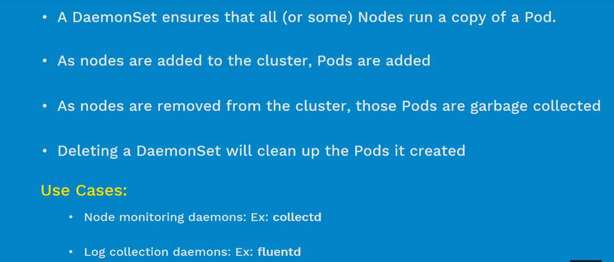

Slide 3
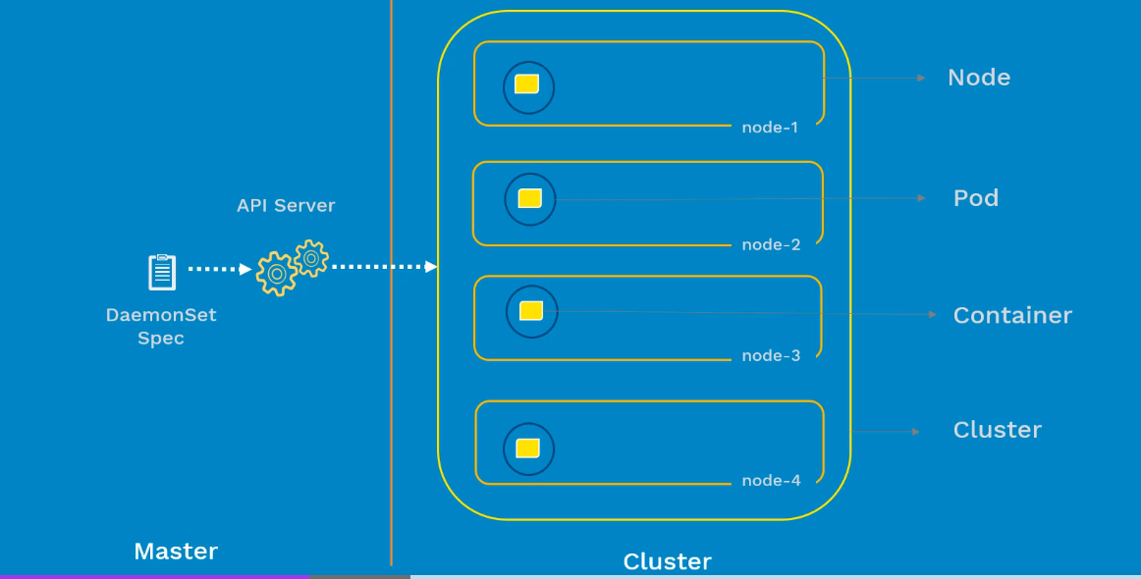

Slide 4
How do you run pod till taks completion? & At scheduled times

Slide 5
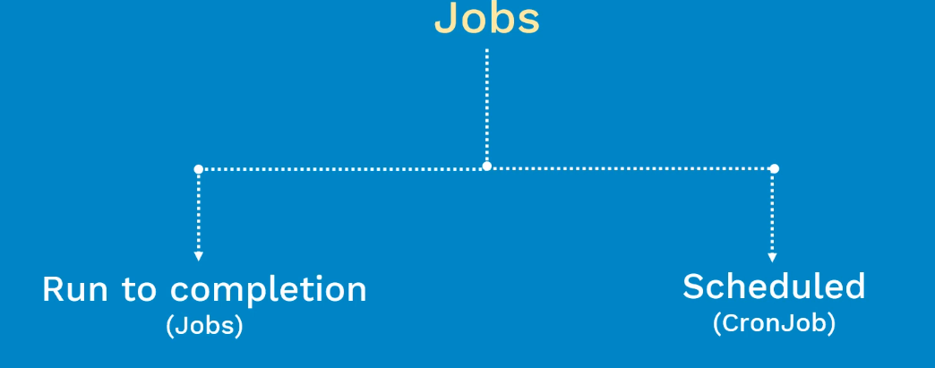

Slide 6
