Slide 1
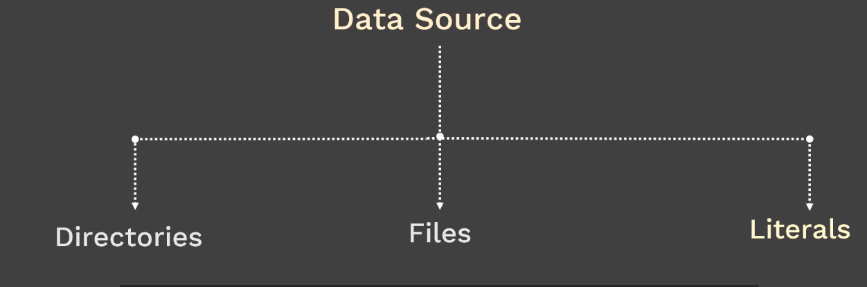
Configmaps → Configuring Containerized Application:
When you build any container image, we need to make sure that image is portable.
Container image are build to be portable.
container expect configuration from
configuration files
command line arguments
environment variables
configuration formats can be json or ini or xml - custom format

Slide 2
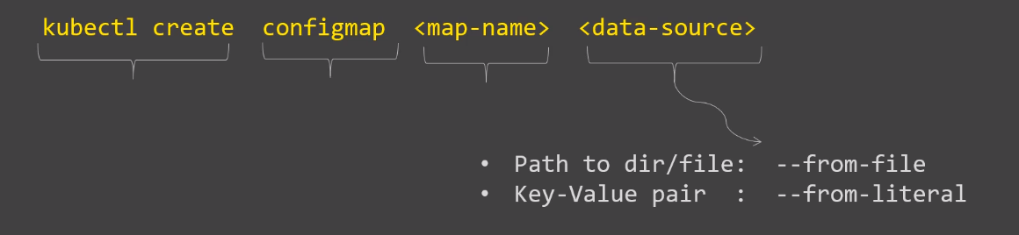
Decouples configration from pods and components --> prevents the hard coding configration data
Stores configuration data as key-value pairs.
Similar to secrets but don't contain sensitive information.
you must create a configmap before referencing it in a pod spec

Slide 3
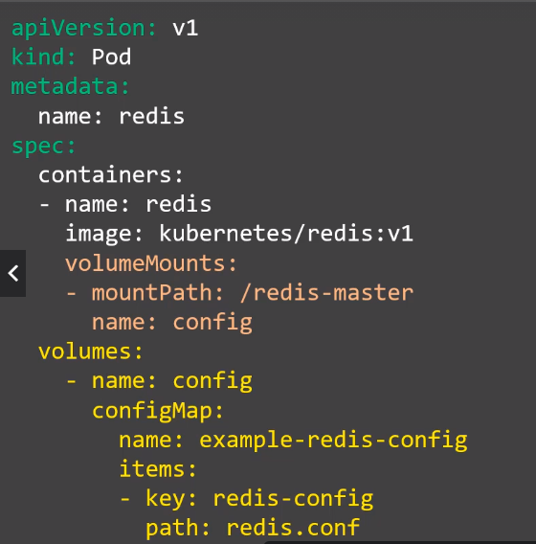
#vim redis-config
Maxmemory 2mb
#kubectl create configmap example-redis-config –from-file=redis-config

Slide 4
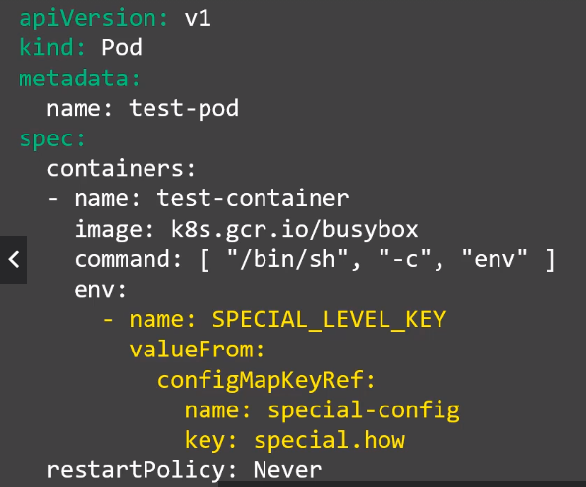
kubectl create configmap special-config –from-literal=special.how=2GB

