Slide 1
Welcome to www.sundakkai.com

Slide 2
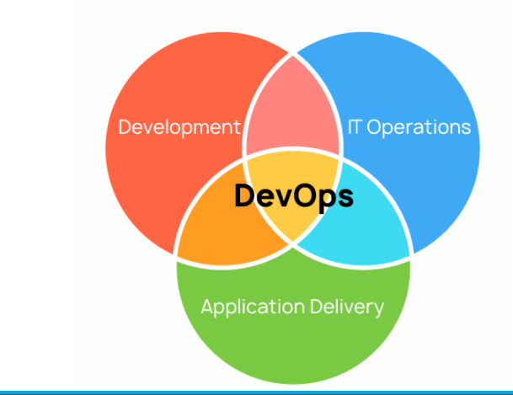
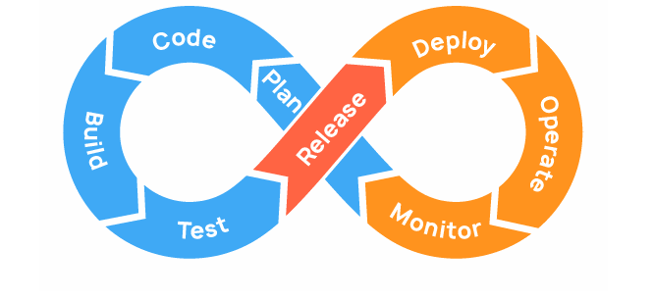
DevOps -> combines software development and IT operations.
Version control systems --> Github
CI & cd --> Jenkins.
Docker or Vagrant.
Framework automation tools --> Shell scripting, Python
Cloud services --> AWS
Testing --> quality of their software testing

Slide 3
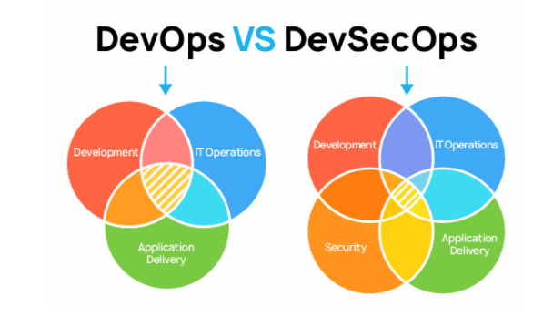
DevSecOps emphasizes that developers should create code with security in mind and aims to solve the issues with security that DevOps doesn’t address.
level of security during the CI and CD phases.
Automated security testing.
Incident management.

Slide 4
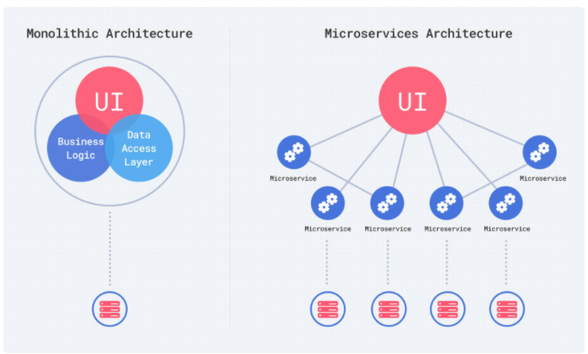
Monolithic vs Microservice Architecture
Self contained --> Packaged & deployed as single unit.

Slide 5
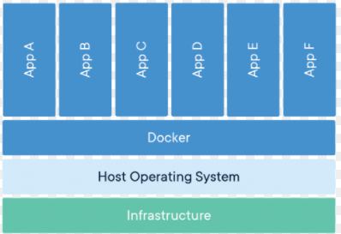
Container
Container virtualize at the OS level
Benefits:
very light weight
boots up in seconds
Take fraction of disk and memory space
Container Engines
1.Docker
2.Rocket (rts)
Adv:
Portability
Resource Efficiency
Isolation
speed
Scaling

