Slide 1
Welcome to www.sundakkai.com

Slide 2
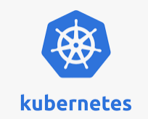
What is kubernetes?
“Kubernetes, or k8s, is an open source platform that automates Linux container operations.
Why kubernetes is best?
Manages containerized apps at large scale
Google donated kubernetes to cncf.
Symbol

Slide 3
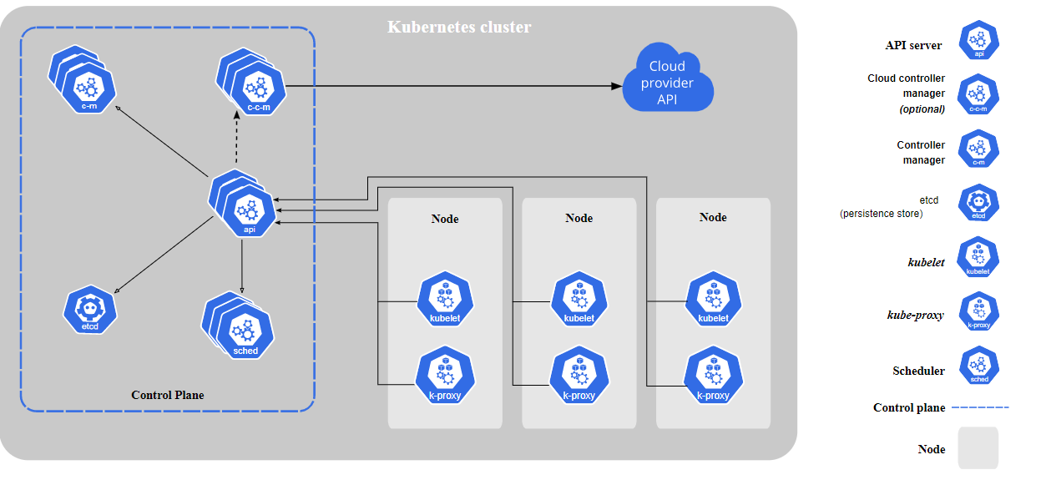

Slide 4
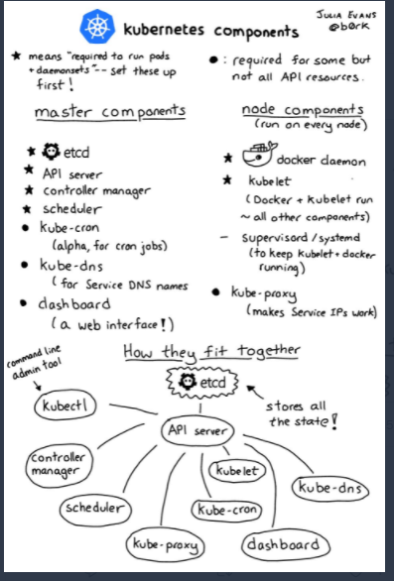

Slide 5
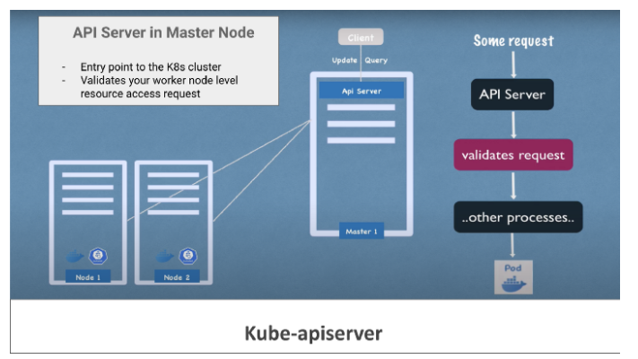
kube-apiserver is designed to scale horizontally — that is, it scales by deploying more instances. You can run several instances of kube-apiserver and balance traffic between those instances

Slide 6
kube-scheduler
The key Control plane component that keep a watch for newly created Pods with no assigned worker node, and selects a worker node for them to be scheduled and run on.
Key deciding factors regarding pod schedule include:
Individual and collective resource requirements
Hardware/Software/Policy constraints
Node affinity and anti-affinity specifications,
Data locality, inter-workload interference, and deadlines.
kube-controller-manager(Kubelet):
It is one of the critical processes in a master node that monitors the status of any worker node level failures. It keeps a close watch over the event like Crashing of any pods in the worker node and, requests the scheduler to restart or reschedule any dead /failed pods, after detecting such event.

Slide 7
Node controller: Responsible to respond when any worker node goes down
Replication controller: It ensures that the request to maintain the correct replica count of any pod deployment is always taken care
Endpoints controller: Populates the Endpoints object viz. Joins, Services & Pods
etcd in K8s Master Node:
etcd in the master control plane is responsible to store every kind of cluster-level change in the form of key-value pairs.
Some Of The Key K8s components Are :
Pods: Smallest unit of k8s, which is an abstraction of the container application
Services & Ingress: To manage external communication between nodes and internal pod level communication
ConfigMaps: used to store non-confidential data in key-value pairs.
Secrets: To keep app-level passwords and secret keys securely using based64 encoding
Volume: For Persistent data storage
Deployments: To deploy create replicas & manage stateless apps
Statefulsets: For stateful apps and databases.

