Slide 1

ANIL NEEERUKONDA INSTITUTE OF TECHNOLOGY & SCIENCES
Dept. of Computer Science and Engineering
STUDENT RECORD MANAGEMENT SYSTEM
USING SINGLY LINKED LIST
Team Members
A25126510015 | GORLE HARSHA VARDHAN
A25126510021 | KANDUKURI LOHITH
A25126510044 | RAYUDU HARSHA VARDHANA GANESH
A25126510051 | SIRASAPALLI BHAVAN
Guidance by: Dr. Bhagavathula Meena, Associate Professor , Dept. of Computer Science and Engineering

Slide 2
PROBLEM STATEMENT
Managing student records manually can be time-consuming and difficult, especially when the number of students increases.
A system is required to efficiently store, manage, search, update, and delete student information without using a fixed-size data structure.
The Student Record Management System aims to develop a menu-driven application using a singly linked list in C. Each student record contains details such as Roll Number, Name, and Marks.
The linked list allows student records to be dynamically added or removed during program execution without requiring a fixed amount of memory in advance.
MANUAL / FIXED STORAGE
SINGLY LINKED LIST
Difficult to manage as
records increase
Dynamic addition/removal
of records
Student Record Management System — DSA Project
2

Slide 3
OBJECTIVES
• Develop a Student Record Management System using a singly linked list in C.
• Store student details dynamically using structures and dynamic memory allocation.
• Add new student records dynamically.
• Search and update student records using the roll number.
• Delete and display student records easily.
• Demonstrate structures, pointers, insertion, deletion, searching, and traversal.
Student Record Management System — DSA Project
3

Slide 4
FEATURES
1. ADD STUDENT
Add a new student record with Roll Number, Name, and Marks.
2. DISPLAY RECORDS
Display all student records stored in the linked list.
3. SEARCH STUDENT
Find a student using the Roll Number.
4. UPDATE STUDENT
Modify the Name or Marks of an existing student.
5. DELETE STUDENT
Remove a student record from the system.
6. DUPLICATE ROLL NUMBER HANDLING
Prevent multiple records from being created with the same Roll Number.
Dynamic Memory Allocation
Linked List Implementation
Student Record Management System — DSA Project
4

Slide 5
SINGLY LINKED LIST STRUCTURE
Generic Node Structure:
Roll No
Name
Marks
Next
Example — Linked List with 3 Student Records:
HEAD
101
Ravi
85
Next
102
Rahul
91
Next
103
Anil
78
NULL
"Each node stores student information and a pointer to the next node."
• Structure stores student data.
• Pointer connects one node to the next node.
• NULL marks the end of the list.
• Nodes are dynamically allocated as required.
Student Record Management System — DSA Project
5

Slide 6
LINKED LIST OPERATIONS
ADD
DISPLAY
SEARCH
UPDATE
DELETE
Create a new node and insert the student record.
Traverse the list from HEAD to NULL.
Traverse the list and compare Roll Number.
Search for the Roll Number and modify the required information.
Find the required node and adjust the links to remove it.
Student Record Management System — DSA Project
6

Slide 7
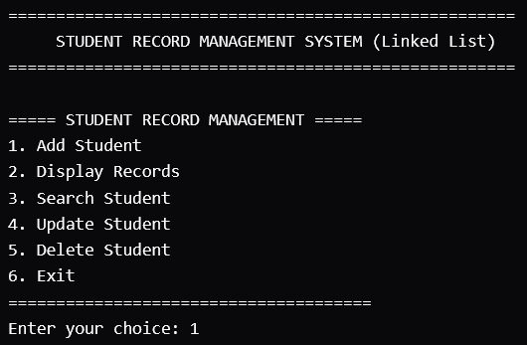
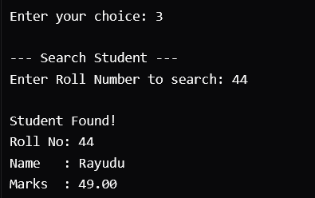
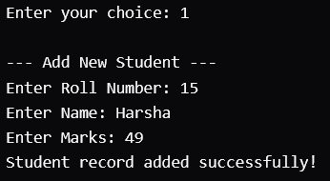
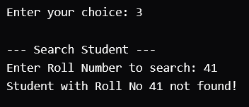
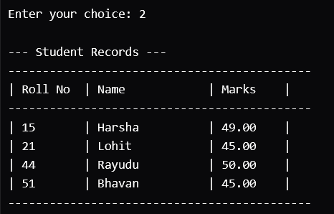
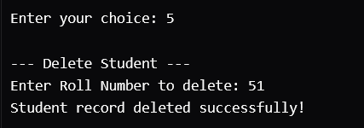
PROGRAM WORKFLOW
START
Display Menu
Choose Operation
1. Add Student
2. Display Records
3. Search Student
4. Update Student
5. Delete Student
6. Exit
Perform Selected Operation
Return to Menu
STOP
Student Record Management System — DSA Project
7

Slide 8
CONCLUSION
The Student Record Management System provides a simple way to store, manage, search, update, and delete student records.
By implementing the system using a singly linked list in C, the project demonstrates structures, pointers, dynamic memory allocation, insertion, deletion, searching, and traversal.
The linked-list approach allows student records to be added or removed dynamically without relying on a fixed-size data structure.
The project provides a foundation for developing more advanced student management systems in the future.
Student Record Management System — DSA Project
8

Slide 9
THANK YOU

