Slide 1
QuickMPay
Secure Mobile Payments
Forget credit cards

Slide 2
Agenda
QuickMPay Overview
Without sending customer's card details to vendor's mobile
With customer's card details sent to vendor's mobile
Solution Details
Comparison with today's technologies
Use Cases
Monetization Models
Questions

Slide 3
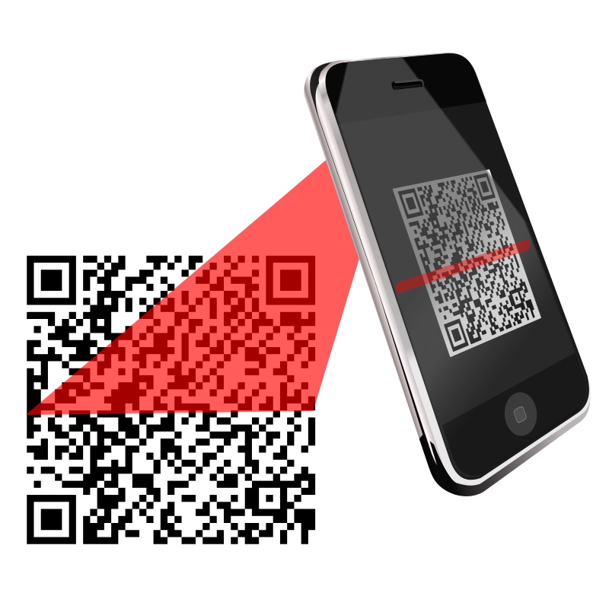

Overview
Secure Option: Customer's Card Details not sent to Vendor's Mobile (Demo at QuickMPay and QuickMPay-POS)
Bill Amount
Order Id
Select Credit Card
Pay Bill
Bill Amount
Order Id
Vendor-POS
Customer

Slide 4
Overview
Regular Option: Customer's Card Details sent to Vendor's Mobile: Today's Swiping machine
Credit Card
Expiry Date
Bill Amount
Customer PIN
Credit Card
Expiry Date
Customer
Vendor-POS

Slide 5
Solution Details
Credit cards info stored in encrypted form: Even the app does not know your card details
Decrypted only at the time of transaction using user's password
App secure's card, payment details using password
Rich payment analytics for consumer and vendor:
Keeps track of payment locations using GPS
No need to look into SMS, emails
Works with vendor's payment gateway
Device Loss: Customer's can invalidate app installation from website

Slide 6
Today's technonogies
Square
NFC
ApplePay

Slide 7
Use Cases
Home Delivery: Flipkart, Snapdeal, Vegetables, Grocery, Pizza, …
Taxi: Ola, Taxi For Sure, …
Shops: Compromised Swiping Machines (EFT POS)
Restaurants: They can just print the QR code containing bill details and the customer's QuickMPay app can scan it and make payment. No need to hand over credit card to staff.

Slide 8
Monetization Models
Paid App for Vendors
Charging a percentage per transaction
Discount coupons by coupon vendors after spending some amounts
Working with major vendors to integrate with their apps
Flipkart, Snapdeal, Ola, Taxi for sure: Rich mobile apps.
Vendor apps to work with QuickMPay customer app

