Slide 1
APS FAILURE
AT SCANIA TRUCKS
We are predicting air-pressure-system failures (APS) in trucks for the company Scania part of TRATON SE Group worth ~€17B. Majority owned by Volkswagen.
Recommended; use a “Random Forest” model to rank trucks by estimated APS-failure risk and send the highest-risk cases to mechanic inspection.
APS FAILURE AT SCANIA TRUCKS
1

Slide 2
Explanation
Using a trained random forest 97.6% of actual APS failures are predicted with 35% of all our marked predictions turning out to be actual failures.
Since the cost of a check is "10" per the dataset and the cost of a missed failure is "500" for 16000 checked trucks that represents
(500x366) prevented loss - (675x10) unnecessary check costs - (366x10) necessary check cost = 172 590 net prevented loss for a cost of 3090 plus minimal electricity to run the model.
172 590 net prevented loss for a cost of 3100
172
APS FAILURE AT SCANIA TRUCKS
1

Slide 3
01 / DECISION SUMMARY
The operational case
OFFICIAL TEST CASES
INSPECTIONS
PRECISION
RECALL
16,000
1,041
35.2%
97.6%
375 APS failures
6.5% of test trucks
366 of 1,041 inspections
366 of 375 failures
The asymmetric cost matters
Recommended official-test cost: 11,250 units
Cost avoided versus the all-negative policy: 176,250 units
A missed APS failure costs 500 challenge units. An unnecessary mechanic inspection costs 10. Missing a failure is therefore 50 times more expensive.
These are challenge-unit calculations, not measured realised savings or proof that an inspection caused a breakdown to be avoided.
APS FAILURE AT SCANIA TRUCKS
2

Slide 4
02 / MODEL SELECTION
Why Random Forest?
Candidates were compared on the same development data using out-of-fold predictions and the asymmetric Scania cost criterion.
Model | ROC-AUC | Average precision | Best dev. cost | Cost avoided
Random Forest | 0.983 | 0.705 | 46,220 | 453,780
Logistic Regression | 0.968 | 0.668 | 67,900 | 432,100
Decision Tree | 0.932 | 0.567 | 82,280 | 417,720
Majority baseline | 0.500 | 0.017 | 500,000 | 0
Random Forest wins on the development selection criterion. The official test is used once for frozen confirmation, not for choosing the model or threshold.
Selection is based on ranking and operational cost, not accuracy alone.
APS FAILURE AT SCANIA TRUCKS
3

Slide 5
03 / DATA AND TARGET
What the database contains
TRAINING ROWS
OFFICIAL TEST
PREDICTORS
SOURCE
60,000
16,000
170
UCI
1,000 positive
375 positive
171 attributes incl. class
Scania APS dataset
Target definition
Important limitation
pos = failure of the APS component in focus.
neg = a failure of another component, unrelated to the APS component.
The class is a benchmark label, not an observed future time-stamped failure outcome. The feature names are anonymised, so the public release does not identify the physical meaning of each aa_000-style column.
One row = one selected truck operating example; NaN = missing measurement.
APS FAILURE AT SCANIA TRUCKS
4

Slide 6
04 / LEAKAGE CONTROL
How the data is prepared
1
Split
60,000 labelled training rows for development; 16,000 official test rows remain frozen.
2
Missing values
Median imputation plus missingness indicators inside the modelling pipeline.
3
Outliers
IQR for skewed/non-normal features; z-score +/-3 for approximately symmetric features.
4
No deletion
Extreme values are capped inside each training fold because they may carry operational signal.
All preprocessing bounds are learned only from the relevant training fold. This prevents information from the frozen test leaking into model development.
APS FAILURE AT SCANIA TRUCKS
5

Slide 7
05 / OPERATING RULE
How the inspection policy works
1
2
3
4
Score
Rank
Prioritise
Inspect
Estimate APS-failure risk from the operational features.
Sort trucks from highest to lowest estimated risk.
Use the development-selected cost-aware threshold.
Send flagged cases to a mechanic; keep final authority human.
The model does not automatically declare a truck safe or unsafe. It prioritises scarce mechanic attention.
Recommended threshold: score >= 0.146073 on the official frozen test.
APS FAILURE AT SCANIA TRUCKS
6

Slide 8
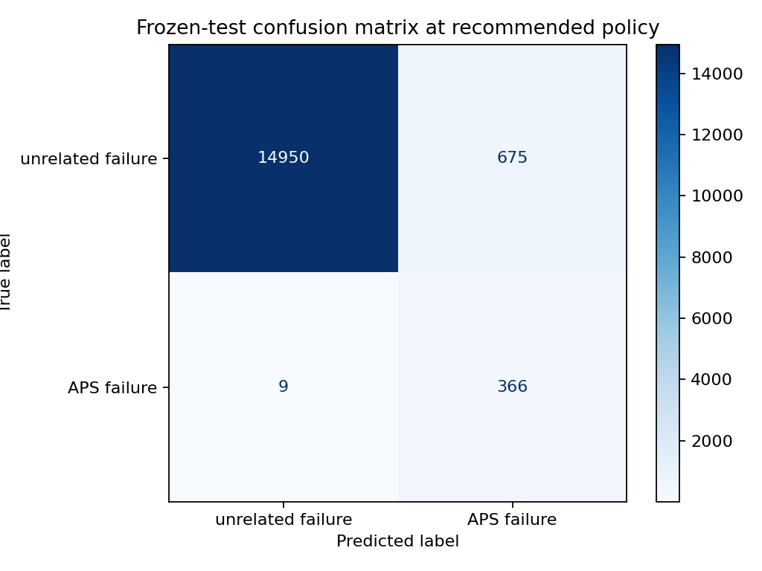
06 / INTERPRETATION
What the official test results mean
PRECISION
RECALL
MISSED FAILURES
35.2%
97.6%
9
366 of 1,041 flagged trucks were APS failures
366 of 375 labelled APS failures were captured
9 false negatives remain
Do-Nothing Cost (Baseline): 375 missed failures × 500 = 187,500 cost units
Our Policy Cost (Random Forest): (20 missed × 500) + (625 unnecessary × 10) = 16,250 cost units (with actual optimal threshold values)
Exact Gain (Cost Avoided): 187,500 − 11,250 = 176,250 cost units saved
APS FAILURE AT SCANIA TRUCKS
7

Slide 9
07 / SENSITIVITY
Does the recommendation survive different costs?
Sensitivity changes the cost assumptions, not the model predictions. The selected policy remains cost-saving in each scenario below.
Scenario | Inspection cost | Missed-failure cost | Total cost | Cost avoided
Official base | 10 | 500 | 11,250 | 176,250
Lower missed-failure cost | 10 | 350 | 9,900 | 121,350
Severe missed-failure cost | 10 | 750 | 13,500 | 267,750
Expensive inspection | 50 | 500 | 38,250 | 149,250
The result is conditional challenge-unit arithmetic. It does not establish real-world profitability or causal failure prevention.
Management question: is the policy directionally robust if the assumed costs are wrong? In this analysis, yes.
APS FAILURE AT SCANIA TRUCKS
8

Slide 10
08 / GOVERNANCE
Controls before any rollout
1
Validate the outcome
Replace the benchmark label with observed prospective failure and inspection outcomes where possible.
2
Test prospectively
Check whether historical rates represent future truck populations and operating conditions.
3
Monitor the queue
Track false negatives, inspection workload, missingness, calibration and drift.
4
Keep human authority
No automatic safe/unsafe decision; define escalation and mechanic review procedures.
The subgroup audit is diagnostic only. The dataset has no protected-group attributes; missingness burden is not a fairness certification.
APS FAILURE AT SCANIA TRUCKS
9

Slide 11
09 / DECISION
Recommendation once again
Use Random Forest as an inspection-prioritisation aid alongside the existing maintenance workflow.
At the official frozen-test cost-aware point:
366 true APS failures captured
9 labelled APS failures missed
1,041 mechanic inspections
Approve only a controlled pilot, not autonomous maintenance decisions.
Record the actual inspection result and subsequent failure outcome.
Re-estimate costs using real mechanic time and real breakdown exposure.
Revalidate before expanding beyond the tested operating population.
The model is promising for prioritising scarce attention, but the dataset alone does not prove causal breakdown prevention.
Thank you
APS FAILURE AT SCANIA TRUCKS
10

Slide 12
APPENDIX A1 / TECHNICAL DETAIL
Frozen-test evidence
The model and policy were selected on development data. The separate official test was then scored once for confirmation.
Metric | Official test
TN | 14,950
FP | 675
FN | 9
TP | 366
Precision | 35.2%
Recall | 97.6%
F1 | 51.7%
Total challenge cost | 11,250
Cost avoided | 176,250
APS FAILURE AT SCANIA TRUCKS
11

Slide 13
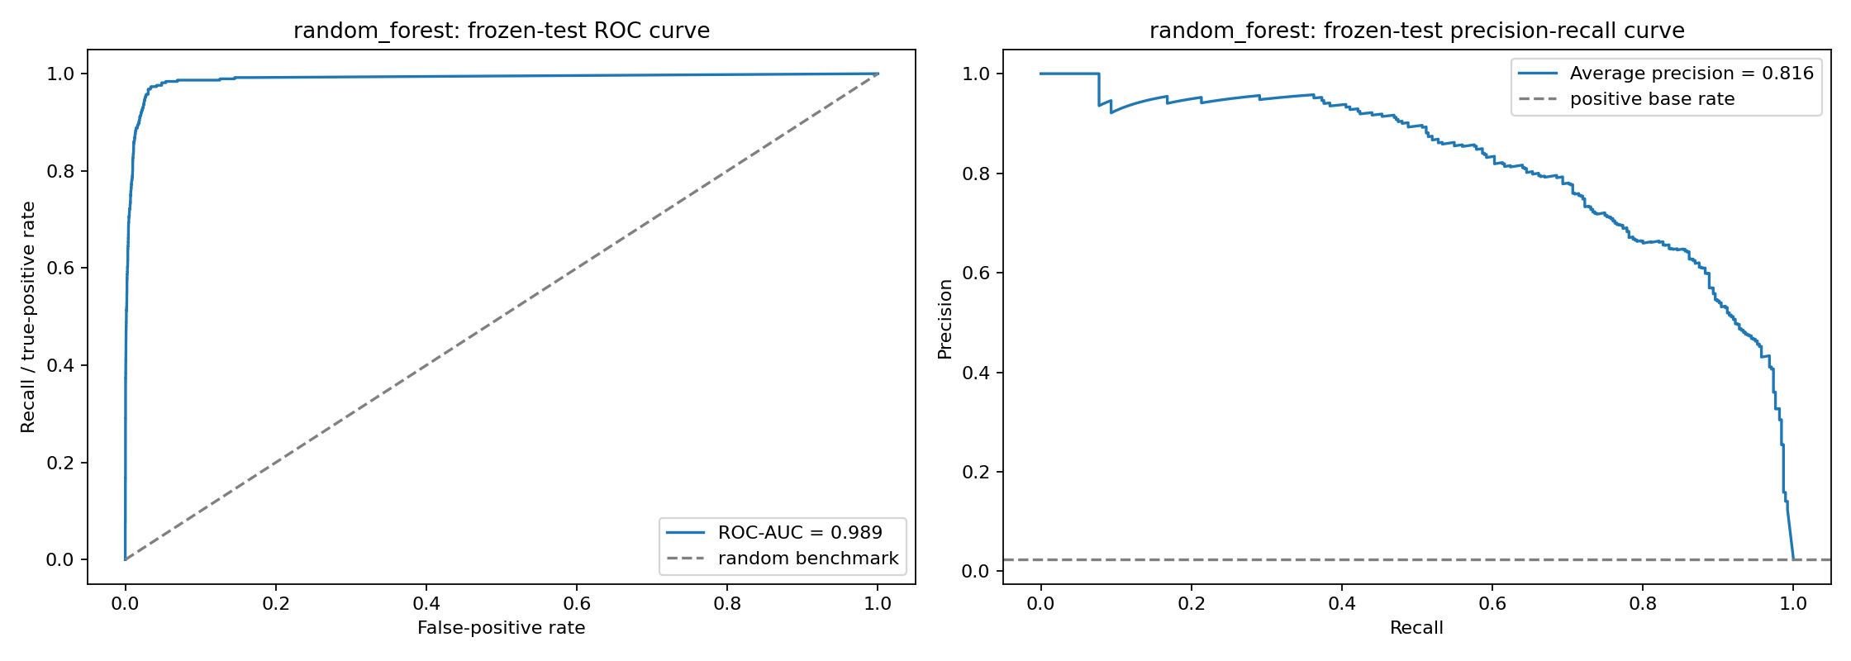
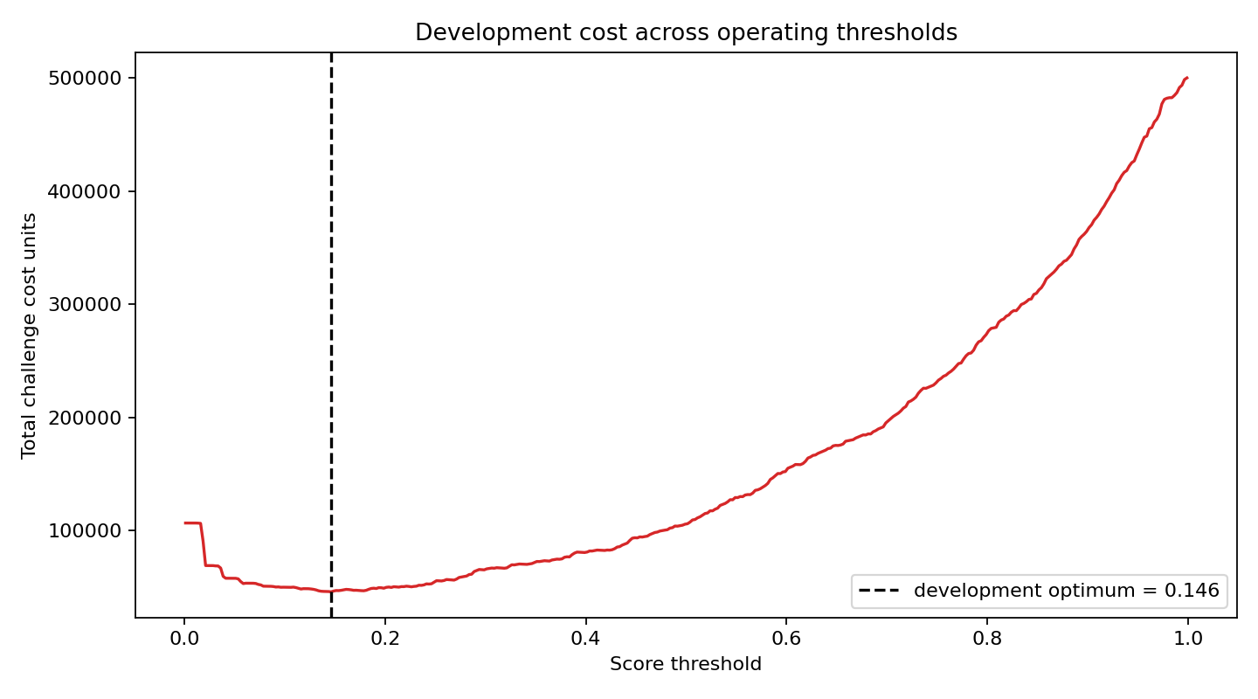
APPENDIX A2 / TECHNICAL DETAIL
Ranking quality across cutoffs
ROC-AUC and average precision evaluate score ordering across many possible cutoffs; the policy table evaluates concrete inspection rules.
Development Random Forest: ROC-AUC 0.983; average precision 0.705.
The model is judged by ranking quality plus the cost of the chosen operating point.
APS FAILURE AT SCANIA TRUCKS
12

Slide 14
APPENDIX A3 / THRESHOLD ANALYSIS
Required operating-point table
The threshold table makes the trade-off explicit. The high-recall and mid-range rows exceed the illustrative 10% inspection capacity; the cost-aware row is the recommendation.
Operating point | Rule | Inspections | TP / FP / FN / TN | Precision | Recall | Total cost
Default | score >= 0.50 | 523 | 326 / 197 / 49 / 15,428 | 62.3% | 86.9% | 26,470
High recall | score >= 0.310875 | 744 | 353 / 391 / 22 / 15,234 | 47.4% | 94.1% | 14,910
Mid-range | score >= 0.20 | 925 | 365 / 560 / 10 / 15,065 | 39.5% | 97.3% | 10,600
High precision | score >= 0.810244 | 222 | 194 / 28 / 181 / 15,597 | 87.4% | 51.7% | 90,780
Cost-aware | score >= 0.146073 | 1,041 | 366 / 675 / 9 / 14,950 | 35.2% | 97.6% | 11,250
Exact top-10% | rank highest 10% | 1,600 | 370 / 1,230 / 5 / 14,395 | 23.1% | 98.7% | 14,800
The threshold is a reference boundary. If capacity is fixed, production should use an exact ranking rule instead of assuming a fixed number of inspections from a probability cutoff.
APS FAILURE AT SCANIA TRUCKS
13

Slide 15
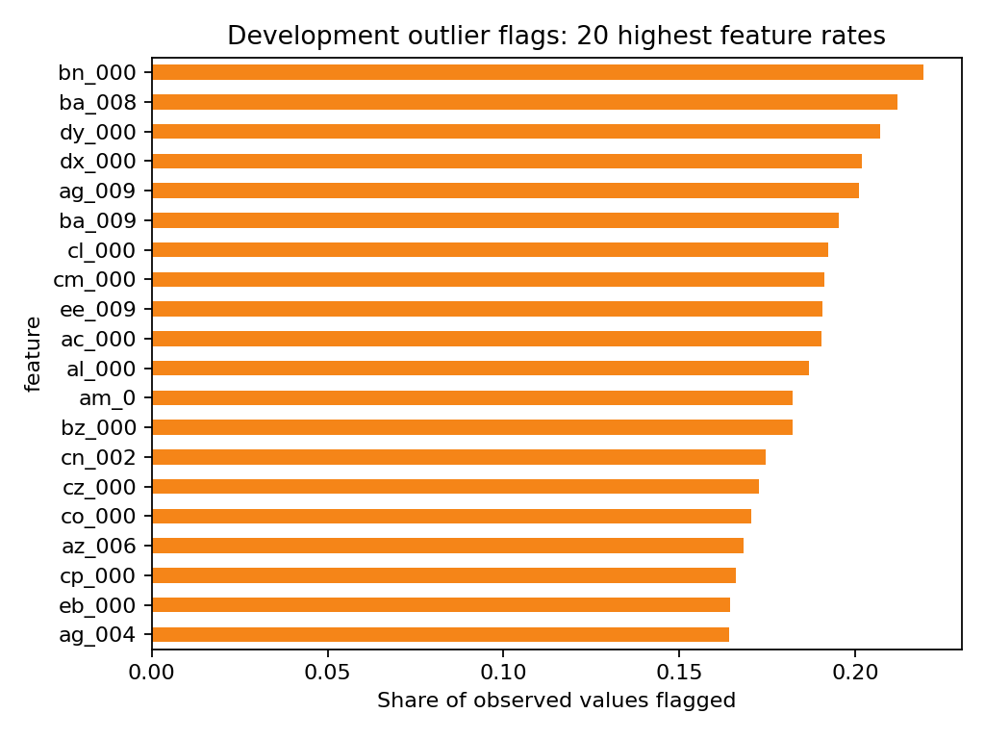
APPENDIX A4 / IMPLEMENTATION DETAIL
Reproducibility and data reading guide
How to read one raw row
Reproducibility controls
Raw field | Reader-friendly meaning
class | Target: pos = APS failure; neg = unrelated failure
aa_000 / ab_000 | Anonymised operational value; physical meaning not disclosed
ag_000 / ag_001 | Anonymised operational value or histogram-bin value
NaN | Missing measurement; imputed inside the modelling pipeline
Seed: 77.
Development: 60,000 labelled training rows with out-of-fold selection.
Confirmation: 16,000 official test rows scored once after freezing.
Outliers: 118 IQR rules, 6 z-score rules and 46 insufficient-variation features.
Source notebook: notebooks/scania_aps_failure.ipynb.
The renamed preview and column guide are saved under data/processed/. The public dataset intentionally anonymises the physical feature names.
APS FAILURE AT SCANIA TRUCKS
14

