Slide 1


USPAS – Simulation of Beam and Plasma Systems
Lecture: Computational Reproducibility
Instructor: David L. Bruhwiler
Contributors: R. Nagler and P. Moeller
U.S. Particle Accelerator School sponsored by Old Dominion University
http://uspas.fnal.gov/programs/2018/odu/courses/beam-plasma-systems.shtml
January 15-26, 2018 – Hampton, Virginia
This material is based upon work supported by the U.S. Department of Energy, Office of Science, Offices of High Energy Physics and Basic Energy Sciences, under Award Number(s) DE-SC0011237 and DE-SC0011340.

Slide 2
Motivation
Scientific research should be reproducible
every scientist agrees in principle
There are three primary branches of scientific inquiry
theory: logic, physics & mathematics must be clear and correct
essentially no problem, assuming rigorous peer review
experiment: descriptions of apparatus, methods, data collection & analysis
producing and/or collecting data is beyond the scope considered here
data archival, post-processing, analysis and viz should all be reproducible
computation: similar to experiments, but it’s possible to do much better
this is the focus of today’s lecture
software is inherently replicable
Funding agencies (i.e. the community) is asking for reproducibility
US Department of Energy requires a Digital Management Plan
https://science.energy.gov/funding-opportunities/digital-data-management
Sharing and preserving data are central to protecting the integrity of science by facilitating validation of results and to advancing science by broadening the value of research data to disciplines other than the originating one and to society at large. To the greatest extent and with the fewest constraints possible, and consistent with the requirements and other principles of this Statement, data sharing should make digital research data available to and useful for the scientific community, industry, and the public.

Slide 3
What is meant by Reproducibility?
Our intuition comes from the long history of experimental science
other scientists try to reproduce an experimental result with their own equipment
this attitude has carried over to computational science
However, software and computation are inherently replicable
two scientists should be able to get identical results from the same code
Reproducibility implies something more:
two scientists should be able to get identical results from different codes
this implies the two codes have been successfully benchmarked
For this lecture, “computational reproducibility” means “replicability”
replicability is the essential first step (but more difficult to say…)
Some links to discussion of the differences in meaning:
M. Liberman (2015), http://languagelog.ldc.upenn.edu/nll/?p=21956
Replicability Research Group, http://www.replicability.tau.ac.il/index.php/replicability-in-science/replicability-vs-reproducibility.html
Wikipedia, https://en.wikipedia.org/wiki/Reproducibility
The Replication Network, https://replicationnetwork.com/2016/04/03/the-national-academy-of-sciences-weighs-in-on-reproducibility
Workshop: “Statistical Challenges in Assessing and Fostering the Reproducibility of Scientific Results” (2016), https://www.nap.edu/catalog/21915/statistical-challenges-in-assessing-and-fostering-the-reproducibility-of-scientific-results

Slide 4
Barriers to Reproducibility
The first step would be to share simulations with a single code
Not just the plots: the full simulation, generating identical results
Why don’t we share our simulations directly?
It can be very difficult to reproduce computational results
Close collaborators do, of course, but even this can be difficult and error prone
different hardware, different versions of the source code, many input files, etc.
Political and social reasons
don’t want to share years of effort with others, who would directly benefit
software can be used incorrectly
this might generate confusing results that are incorrectly published
this could hurt the reputation of the original developers
Technical reasons
it can be very difficult to build/install the software
the software may be very difficult to use
the simulations may require many processors
the post-processing tools may be sophisticated

Slide 5
Class discussion:
Have you successfully shared a simulation with a colleague?
How positive was the experience?
Did you every try and fail?
Briefly describe a code benchmarking exercise.
Which codes? Were others involved? Did you have access to all codes?
How positive was the experience?
Under what circumstances should a code (or simulation) be made public
Do scientists have a right to protect their computational tools from competitors?
Does scientific ethics require sharing? If so, then how much?
Is it appropriate for funding agencies to require reproducibility?

Slide 6
Validity – this is essential to the issue of reproducibility
Computational science requires validated software
we want our results to be correct
we want confidence that published/presented results are correct
Build environment and computing platform:
software is validated on a particular platform, compiler, etc.
supporting multiple platforms is possible, but expensive
what if the software is built, installed, executed on another platform?
can one be sure that it is still valid?
Versioning:
a particular version of software is validated
regular use of regression tests can help maintain validity across versions
however: tests are never complete, features are added/removed, etc.
for multiple dependencies, versioning becomes an N² problem
how can one be sure of the validity of a particular software version?
how can one communicate full versioning information to others?
Sharing:
difficult to share identical build & version(s), including dependencies

Slide 7
Usability – without it, reproducibility loses a lot of its value
Many physics codes are difficult to use
Particle accelerator codes are a case in point
they focus on specific design aspects (not fully general)
most rely on complicated command-line interfaces (CLI)
multiple input and configuration files
multiple output files (text, data, images) in different formats
they typically require computational experts to use correctly
even so, the assistance of an expert and/or much experience is often required
collaboration is difficult and error prone
required exchange of input and output files
independent installation of codes (different versions on different hardware)
use of different post-processing and visualization tools
If a code is very difficult to use, what does reproducibility really mean?
if you are given a replicated environment to work in, what do you do next?
suppose a single script is provided to execute all other scripts and render plots
does this black box experience enable understanding of what is being replicated?
Reproducibility should enable understanding, comparison & further work
the various steps required should each be clear and replicable
it should be possible to modify each step and see the results

Slide 8
Usability via Python – an example of problems encountered
Python wrapping of scientific applications is popular
This approach can be very powerful:
extend capabilities with a powerful, expressive language
develop convenient GUIs and CLIs
develop a common interface to multiple codes
It also creates serious challenges:
Python 2.7.x is not compatible with Python 3.x
32 bit and 64 bit versions of Python are incompatible
also true of many other software libraries
open source library projects issue frequent releases
breaks compatibility with previous versions of other libraries
Python is amazingly cross-platform; however…
C/C++ and Fortran libraries and compilers are not
one frequently has multiple versions of installed Python
this creates confusion

Slide 9
Class discussion:
When you run a simulation how confident are you in the results?
Are you skeptical of results presented by others in talks or papers?
have you ever wanted to rerun someone else’s simulation?
How do you validate your own results?
compare with your physical intuition?
compare with your previous work?
compare with publicly available papers and presentations?
rerun the same case with a different code (or ask a colleague to do it…)?
discuss the plots with a colleague…?
Maybe revisit previous discussion points –
Have you successfully shared a simulation with a colleague?
How positive was the experience?
Did you every try and fail?
Briefly describe a code benchmarking exercise.
Which codes? Were others involved? Did you have access to all codes?
How positive was the experience?

Slide 10
The reproducibility literature (pt. 1)
The topic cannot be covered completely in a single lecture…
so we provide some pointers for further study
note that this is an active area of research
Best practices, tips, tools and techniques:
Reproducibility, reusability, etc. – what is it? …why do it?
V. Stodden (2017), https://codeocean.com/workshops/computational-reproducibility
V. Stodden & S. Miguez (2014), https://openresearchsoftware.metajnl.com/articles/10.5334/jors.ay/
S.R. Piccolo & M.B. Frampton (2016), https://gigascience.biomedcentral.com/articles/10.1186/s13742-016-0135-4
G.K. Sandve et al. (2013), http://journals.plos.org/ploscompbiol/article?id=10.1371/journal.pcbi.1003285
J. Freire, P. Bonnet & D. Shasha (2012), https://pdfs.semanticscholar.org/57ee/c0917fc84716e5748c2e94139ab156db3ada.pdf
O. Guest & N.P. Rougier (2016), https://hal.inria.fr/hal-01358082/file/guest_rougier_2016.pdf
G. Varoquaux (2017), http://gael-varoquaux.info/programming/beyond-computational-reproducibility-let-us-aim-for-reusability.html
rOpenSci Project, http://ropensci.github.io/reproducibility-guide/sections/introduction/
L.A. Barba (2017), https://speakerdeck.com/labarba/introduction-to-computational-reproducibility-and-why-we-care

Slide 11
The reproducibility literature (pt. 2)
The topic cannot be covered completely in a single lecture…
so we provide some pointers for further study
note that this is an active area of research
Biology and health sciences:
How can journals (or funding agencies) incentivize scientists…?
L. Hatton & G. Warr (2016), https://arxiv.org/abs/1608.06897
B. Grüning et al. (2017), https://www.biorxiv.org/content/early/2017/10/10/200683
S. Cohen-Boulakia et al. (2017), https://www.sciencedirect.com/science/article/pii/S0167739X17300316
B.K. Beaulieu-Jones & C.S. Greene (2017), https://www.nature.com/articles/nbt.3780
P. Montagano & S. Green (2018), https://codeocean.com/webinar/editor
R. Nagler & D.L. Bruhwiler (2018), submitted to arXiv…

Slide 12
Heads up – today’s homework
Read at least one of the above references, and…
Write 3 paragraphs on computational reproducibility:
e.g. How could improved computational reproducibility benefit your science?
e.g. How could it improve your institution?
e.g. Describe an experience with computational reproducibility (or the opposite).
e.g. Discuss what you think would be most effective for improving reproducibility.
e.g. Discuss pros/cons, trade-offs or how to address cost-benefit concerns.
…or choose your own theme
Be sure to make a connection with at least one of the above references
The rest of the lecture is relevant to this assignment
Just giving you a heads up…

Slide 13
Near-term goals – let’s walk before trying to run…
Enable reproducible simulations with a single code (i.e. replicability)
two scientists will get identical results from the same code
more than two – as many scientists as are interested
and it can be easy
What is required?
make community codes portable, easy to install, publicly available
simple, easy sharing of code & full environment across users and systems
And how is that done?
with application containers
Docker, https://www.docker.com/what-docker
Shifter, http://www.nersc.gov/users/software/using-shifter-and-docker/using-shifter-at-nersc
What about usability?
IPython notebooks (on a Jupyter server) can get you part of the way
Intuitive, browser-based GUIs show greater promise
Cloud-based approach minimizes the cost of reproducibility

Slide 14
What do containers do? How are they used?
Application containers provide OS-level virtualization
deploy and run distributed applications
most use cases involve small, serial apps and very short run-times
no need for an entire virtual machine (VM) for each app
Multiple isolated applications or services run on a single host
each accesses the same OS kernel
multiple containers compete for available resources
Containers can be deployed on any computer system
bare-metal; cloud instances; virtual machines
Containers are available on every OS
multiple flavors of Linux, with essentially no run-time overhead
MacOS and Windows (limited, with some computational overhead)
HPC presents a fundamentally different use case
large apps: physics code, dependencies, viz & post-processing tools...
highly variable run-times (seconds to days) on multiple processors
data generation
subdirs can be mounted to write files outside of the container

Slide 15
Partial History of Containerization
1979: the chroot system call is added to Unix V7
changes root directory of a process and its children
the beginning of process isolation:
segregating file access for each process
chroot was added to BSD in 1982
2006: process containers (Google)
limits and isolates resource usage of a collection of processes
renamed “Control Groups” or cgroups in 2007
merged into Linux kernel 2.6.24
2008: LXC (LinuX Containers)
first, most complete implementation of a Linux container manager
uses cgroups and Linux namespaces
works on a single Linux kernel with no patches
2013: Docker
used LXC originally, but now uses its own libcontainer
offers an entire ecosystem for container management
resulted in widespread adoption of containerization
developers can create and run application containers quickly
DockerHub enables rapid distribution of containers
Material taken from R. Osnat (2016), https://blog.aquasec.com/a-brief-history-of-containers-from-1970s-chroot-to-docker-2016

Slide 16
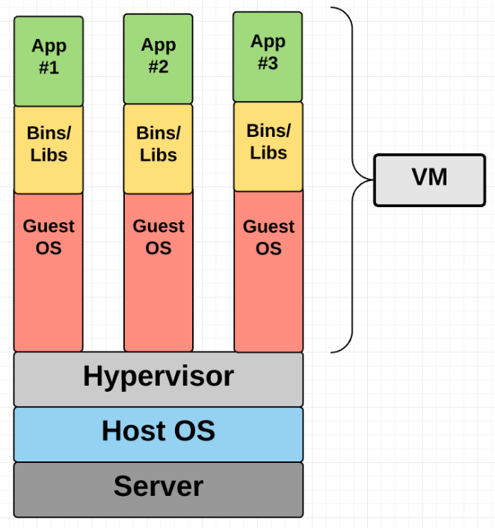
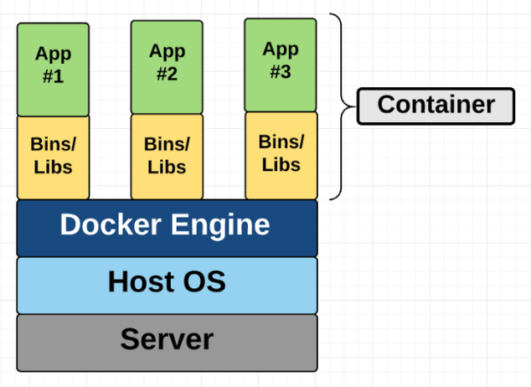
Container vs. Virtual Machine (VM)
Containers and VMs are similar in their goal:
to isolate an application and its dependencies
in a self-contained unit that can run anywhere
The differences are important
Schematics taken from https://medium.freecodecamp.org/a-beginner-friendly-introduction-to-containers-vms-and-docker-79a9e3e119b

Slide 17
Application Containers for Reproducibility
Containerization has become a key technology for reproducibility
it is the only practical approach for replicating a simulation result in the future
the colleague you are sharing with could by yourself in 6 months or 6 years
an application container can be archived indefinitely and then reused
assuming Docker or a compatible technology is still supported
The topic cannot be covered completely in a single lecture…
so we provide some pointers for further study
Docker Containers for Reproducible Research Workshop (2017), https://www.software.ac.uk/c4rr
D. Nüst & M. Hinz (2017), http://o2r.info/2017/05/30/containerit-package/
J. Cito, V. Ferme and H.C. Gall (2016), https://link.springer.com/chapter/10.1007/978-3-319-38791-8_58
D.L. Bruhwiler, R. Nagler et al. (2015), http://accelconf.web.cern.ch/AccelConf/IPAC2015/papers/mopmn009.pdf
R. Nagler, D.L. Bruhwiler et al. (2015), https://arxiv.org/abs/1509.08789
C. Boettiger (2014), https://arxiv.org/abs/1410.0846

Slide 18
Class discussion:
Do you have experience working with VMs?
If so, what are the advantages and disadvantages?
Explain at least one difference between VMs and containers
A VM is to a house as a container is to an apartment: explain the analogy
Reproducibility vs Replication: which is more difficult? …more important?
How does Docker help with replicating a physics simulation?
Maybe revisit previous discussion points –
When you run a simulation how confident are you in the results?
Are you skeptical of results presented by others in talks or papers?
have you ever wanted to rerun someone else’s simulation?
How do you validate your own results?
compare with your physical intuition?
compare with your previous work?
compare with publicly available papers and presentations?
rerun the same case with a different code (or ask a colleague to do it…)?
discuss the plots with a colleague…?

Slide 19
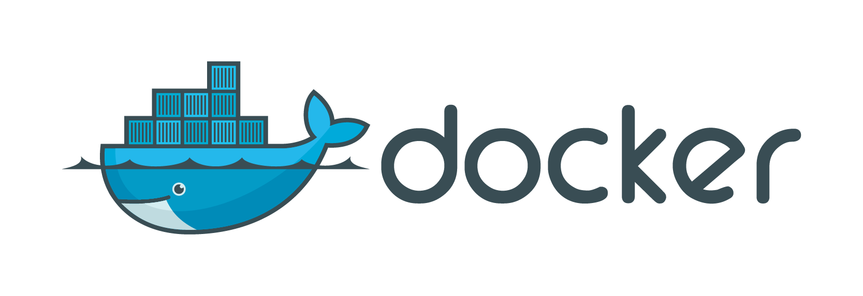
HPC Application Containers
Executable, portable archive of code and all dependencies
except the OS kernel
most popular container platform for Linux, Windows, and Mac
Linux – containers run at native speeds
Mac OS X and Windows:
containers can run at near-native speed for CPU-intensive codes
a couple of good examples on Mac; more testing required on Windows
large-scale I/O can be slow (similar to NFS, more testing required)
MPI works well
seems to work well on Mac; more testing required on Windows
Shifter – a recent initiative at the NERSC supercomputing center
optimized for Linux on the compute nodes
compatible with Docker

Slide 20
Delivering Codes via Docker Images
https://hub.docker.com/r/radiasoft/
Seven particle accelerator codes are available (more on the way)
X-ray: SRW, Shadow3
Beams: Synergia, Warp, Elegant/SDDS, Hellweg
coming soon: MAD-X, PTC
FELs: Genesis v.2
Three user interface (UI) modes are supported:
Sirepo (GUI); Jupyter (IPython notebooks); command-line (CLI)
Automated build/test/release to Docker Hub and to PyPI
One command to download/install/run:
> docker run –p 8000:8000 radiasoft/sirepo
RadiaSoft code on GitHub: http://sirepo.com (primary repo)
https://github.com/radiasoft (all)
Try it yourself on RadiaSoft servers: https://beta.sirepo.com
https://jupyter.radiasoft.org

Slide 21
…more on version management
We also implemented automatic and uniform version management through a channel update mechanism similar to CoreOS[ ]. Instead of the usual system of having major version numbers, we deliver the entire application atomically on a channel. Each software release (embedded in a Docker image) is given a chronological version, and enters the staging pipeline. Only those releases which pass the development and alpha channels reach public beta, and those that pass beta become available generally.
The Sirepo platform implements three containers running separate services to provide web-based access to Warp. On Linux, the container components are run as independent services. This enables scaling the web service over multiple computers, thus allowing multiple jobs to run simultaneously on independent compute nodes. Within a single instance of one container, Warp runs in parallel using MPI. The job queue is managed by a different container running RabbitMQ [ ].

Slide 22
Version Management
Images are identified by chronological version
does not interfere with systems used by the code developers
provides meaningful versioning, as necessary for reproducibility
Channels are declared for the main git branch:
dev (latest, specified by default)
alpha (internal testing)
beta (external testing)
prod (ready for production release)
Each container image includes a ‘manifest’
describes the image & codes, rsmanifest.json
Source code for each application is stored in the image
Code versions/commits can be queried by simulations

Slide 23
What is an application container?
Essential technology for cloud computing
enables automated distribution of applications to remote servers
An abstraction of relevant resources used by a code
LXC (LinuX Container) [ ] isolates kernel resources for a collection of processes
it is a lightweight, hosted hypervisor without the need for emulation
Vagrant [ ] is a program for configuring headless VMs and containers.
Like Vagrant, Docker [ ] is a productivity enhancer for LXC.
It’s native on Linux
It provides a lightweight VM on Mac and Windows

