Slide 1


Computational Reproducibility
D.L. Bruhwiler, R. Nagler and P. Moeller
presented at the HSC Section Meeting, CERN
(Hadron Synchrotron Collective effects)
24 April 2017 – Geneva
This material is based upon work supported by the U.S. Department of Energy, Office of Science, Offices of High Energy Physics and Basic Energy Sciences, under Award Number(s) DE-SC0006284 and DE-SC0017161.

Slide 2
Motivation
Scientific research should be reproducible
Peer review partially addresses the issue by requiring –
theory: logic, physics & mathematics are clear and correct
essentially no problem, assuming rigorous peer review
experiment: descriptions of apparatus, methods, data collection & analysis
producing and/or collecting data is beyond the scope considered here
data archival, post-processing, analysis and viz should all be reproducible
computation: similar to experiments, but it’s possible to do much better

Slide 3
Goals
Reproducible simulations
Simple sharing across users and systems
Portable, easy-to-install legacy codes
Accessible, browser-compatible UI
Outcome
Many particle and X-ray codes in the cloud:
https://beta.sirepo.com
SRW, Shadow3
Elegant, Hellweg, Warp
Instantaneous collaboration
Computational reproducibility is now possible

Slide 4

HPC Application Containers
Executable, portable archive of code and all dependencies
except the OS kernel
most popular container platform for Linux, Windows, and Mac
Linux – containers run at native speeds
Mac OS X and Windows:
containers can run at near-native speed for CPU-intensive codes
a couple of good examples on Mac; more testing required on Windows
I/O can be slow (similar to NFS)
MPI works
seems to work well on Mac; more testing required on Windows

Slide 5
Delivering Codes via Docker Images
https://hub.docker.com/r/radiasoft/
Seven particle accelerator codes are available (more on the way)
X-ray: SRW, Shadow3
Beams: Synergia, Warp, Elegant/SDDS, Hellweg
coming soon: MAD-X, PTC
FELs: Genesis v.2
Three user interface (UI) modes are supported:
Sirepo (GUI); Jupyter (IPython notebooks); command-line (CLI)
Automated build/test/release to Docker Hub and to PyPI
One command to download/install/run:
> docker run –p 8000:8000 radiasoft/sirepo
RadiaSoft code on GitHub: http://sirepo.com (primary repo)
https://github.com/radiasoft (all)
Try it yourself on RadiaSoft servers: https://beta.sirepo.com
https://jupyter.radiasoft.org

Slide 6
Version Management
Images are identified by chronological version
does not interfere with systems used by the code developers
provides meaningful versioning, as necessary for reproducibility
Channels are declared for the main git branch:
dev (latest, specified by default)
alpha (internal testing)
beta (external testing)
prod (ready for production release)
Each container image includes a ‘manifest’
describes the image & codes, rsmanifest.json
Source code for each application is stored in the image
Code versions/commits can be queried by simulations

Slide 7



The Browser is the Scientific UI
Easy sharing via links (& many other ways)
Nothing to compile or build or install
Work from either your tablet & desktop
Fast, interactive scientific plotting
Modern JavaScript:
Angular, Bootstrap, D3.js

Slide 8
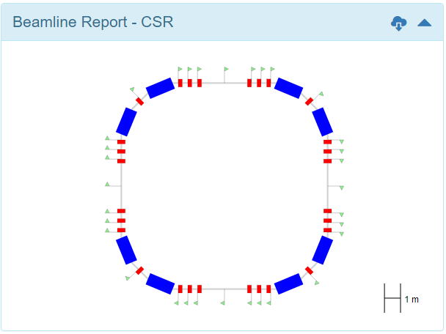
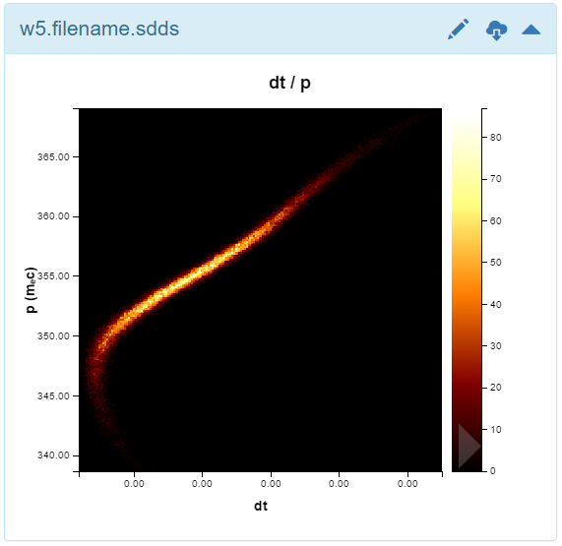
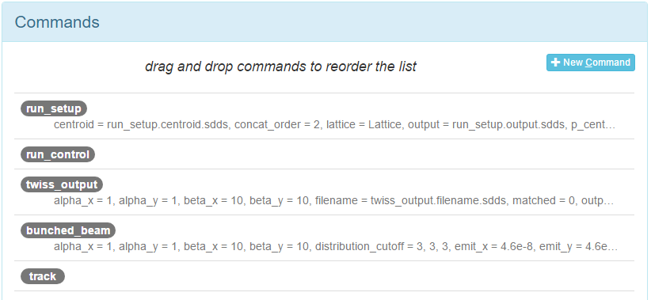
Begin demo: Elegant in the cloud

Slide 9
Number of users is growing
Brookhaven National Lab (BNL) – mostly SRW
multiple independent Sirepo servers at NSLS-II
RadiaSoft will assist users in standing up independent servers
M. Rakitin is an active Sirepo developer
we welcome new contributors to this open source project
SLAC, European XFEL, ESRF, Elletra – using SRW
ANL/APS & LBL/ALS – testing Shadow3 and SRW
Fermilab – using Jupyter/IPython for IOTA simulations
UCLA & LBL/ATAP – using Elegant
commercial client – using Jupyter/IPython for Warp
We have 50+ active users
Sirepo: 25+ Jupyter: 30+
We are looking for more!

Slide 10
Conclusion: many ways to share
Simple web link to run on the same server
email or IM a URL to your colleague
Self-extracting simulations
alternative to URL when colleague uses different server
put (potentially large) HTML file on Dropbox (for example)
colleague double-clicks and specifies Sirepo server to use
Zipped archive (used for self-extracting feature)
Python source for CLI
the Sirepo GUI never constrains power users
easy interaction between new users and expert
IPython/Jupyter compatible
manual now, but will be automated in the future

