Slide 1




USPAS – Simulation of Beam and Plasma Systems Steven M. Lund, Jean-Luc Vay, Remi Lehe, Daniel Winklehner and David L. Bruhwiler
Lecture: Slice Energy Spread
Instructor: David L. Bruhwiler
Contributors: G. Andonian, UCLA / RadiaBeam Tech
G. Andonian, UCLA / RadiaBeam Tech
U.S. Particle Accelerator School sponsored by Old Dominion University
http://uspas.fnal.gov/programs/2018/odu/courses/beam-plasma-systems.shtml
January 15-26, 2018 – Hampton, Virginia
This material is based upon work supported by the U.S. Department of Energy, Office of Science, Offices of High Energy Physics and Basic Energy Sciences, under Award Number(s) DE-SC0011237 and DE-SC0011340.

Slide 2
Goals
TBD

Slide 3
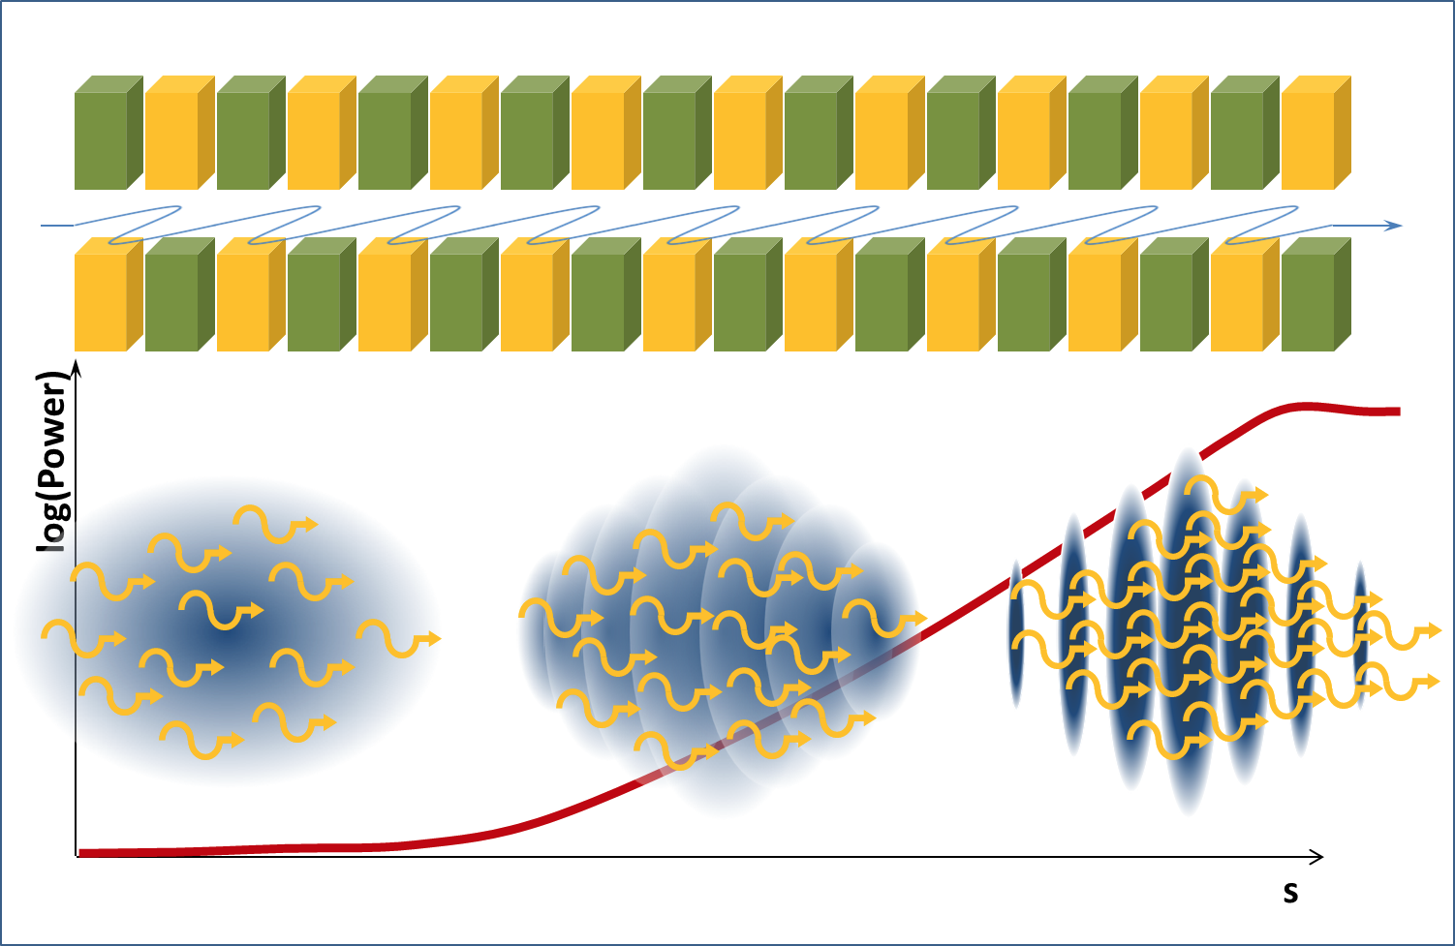


High-quality electron beams (high charge, short duration, low emittance) can drive Free Electron Laser
https://www.helmholtz-berlin.de/projects/berlinpro/erl-intro/linac-fel_en.html
Free Electron Laser:
Interaction undulator radiation & dense e-beam → micro-bunching → coherent undulator emission
Small gain length favorable
E-beam quality → Pierce parameter ρ
Large ρ favorable (ρ typically of order 10⁻³-10⁻²)
Energy spread washes out micro-bunching
1D gain length corrected with 3D effects Λ (energy spread, emittance, etc.)
Gain length
Charge / duration
Pierce parameter
3D Gain length
E-beam size (emittance)
E-beam energy
This slide courtesy of J. van Tilborg (LBL)
Huang & Kim PRSTAB 10, 034801 (2007)

Slide 4
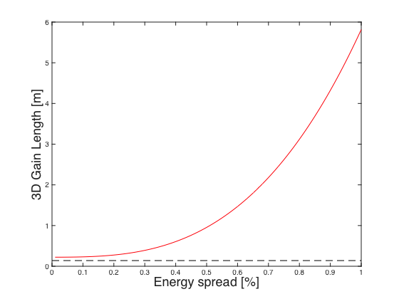
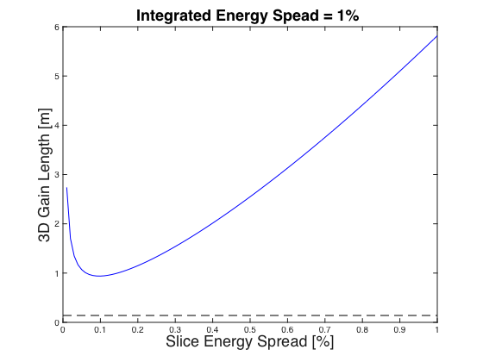
Each time slice can develop micro-bunching: Not integrated but slice energy spread critical to FEL: σ_{γ,slice}<ρ
3D Gain Length as a function of energy spread in a correlation-free beam:
Adding correlation through chicane de-compression:
D=1
De-compression D>1
This slide courtesy of J. van Tilborg (LBL)
3D Gain Length
Chicane de-compression:
Maier et al. PRX 2012, Schroeder et al. FEL2013
1D Gain Length
Beam parameters:
5 pC in 10 fs
250 MeV
Emittance 0.5 μm
Beam size 25 μm
Undulator:
Period 2.18 cm
Strength K=1.26
Pierce ρ=0.007
σ_{z0}
No correlation
D×σ_{z0}
Same beam, with correlation
γ
γ
σ_{γ}
σ_{γ}
Instantaneous energy spread of slice: σ_{γ}/D
z
z
Slippage of chirped e-beam through photon pulse is detrimental
Length of relevant slice is several radiation wavelengths long (~5 fs)

Slide 5
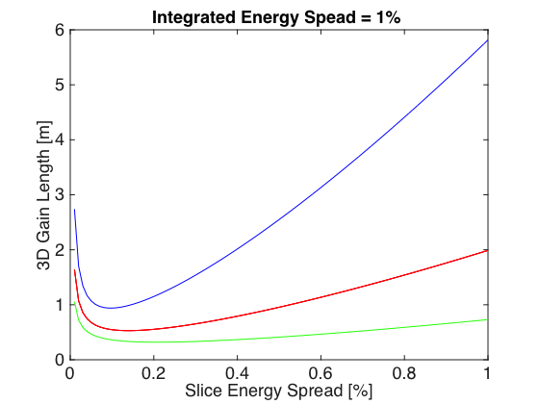
Bunch length and energy spread known, but correlation not known (longitudinal phase phase not known)
Bunch duration: 5 pC in 10 fs
Correlation unknown
This slide courtesy of J. van Tilborg (LBL)
Chicane scan

Slide 6
Class discussion:
Any questions at this point?
Have

Slide 7
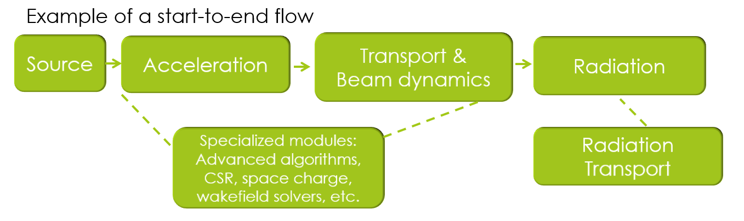
The accelerator design workflow

Slide 8
Wrap up
Any final questions regarding the material in this lecture?
Have

