Slide 1




USPAS – Simulation of Beam and Plasma Systems Steven M. Lund, Jean-Luc Vay, Remi Lehe, Daniel Winklehner and David L. Bruhwiler
Lecture: Graphical User Interfaces
Instructor: David L. Bruhwiler
Contributors: P. Moeller, R. Nagler and G. Andonian
U.S. Particle Accelerator School sponsored by Old Dominion University
http://uspas.fnal.gov/programs/2018/odu/courses/beam-plasma-systems.shtml
January 15-26, 2018 – Hampton, Virginia
This material is based upon work supported by the U.S. Department of Energy, Office of Science, Offices of High Energy Physics and Basic Energy Sciences, under Award Number(s) DE-SC0011237 and DE-SC0011340.

Slide 2
Goals
Graphical User Interfaces (GUI)
understand some principles of user interface (UI) design
appreciate the difficulties associated with desktop GUIs
consider some aspects of “software sustainability”
Understand what’s meant by “cloud computing”
Why this is helpful for “computational reproducibility”
Other benefits it can provide, like easy collaboration
Learn a little about the elegant code from ANL
M. Borland, “elegant: A Flexible SDDS-Compliant Code for Accelerator Simulation,” Advanced Photon Source LS-287 (2000).
Y. Wang and M. Borland, “Pelegant: A Parallel Accelerator Simulation Code for Electron Generation and Tracking,” AIP Conf. Proc. 877, 241 (2006).
https://ops.aps.anl.gov/manuals/elegant_latest/elegant.html
Become familiar with Sirepo/elegant
a browser-based GUI

Slide 3
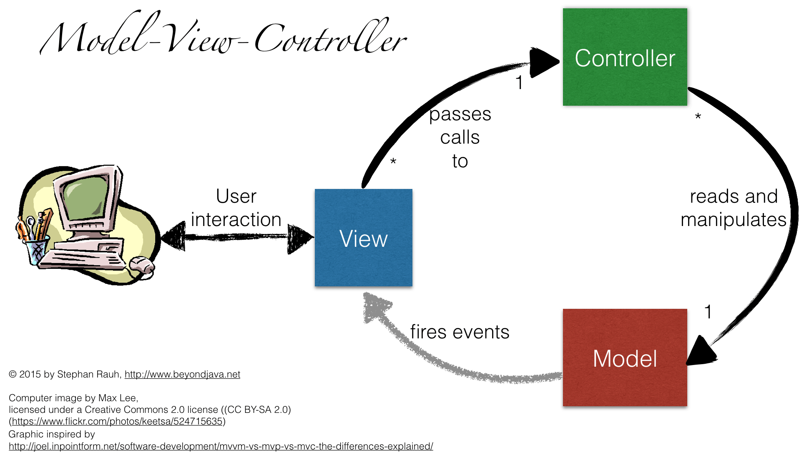
Separate Physics from UI from Control logic
Commonly referred to as model-view-controller (MVC)

Slide 4
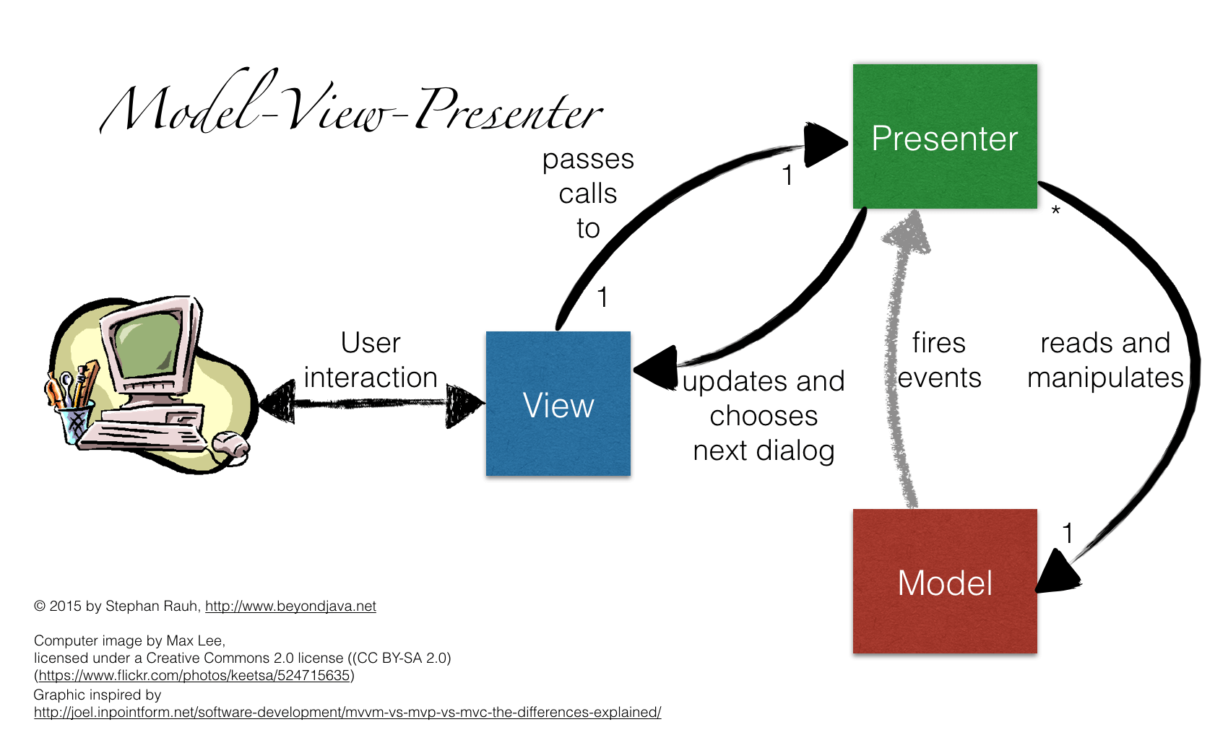
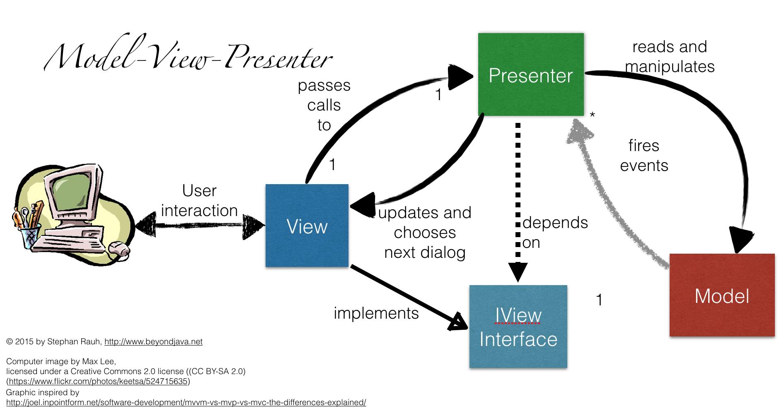
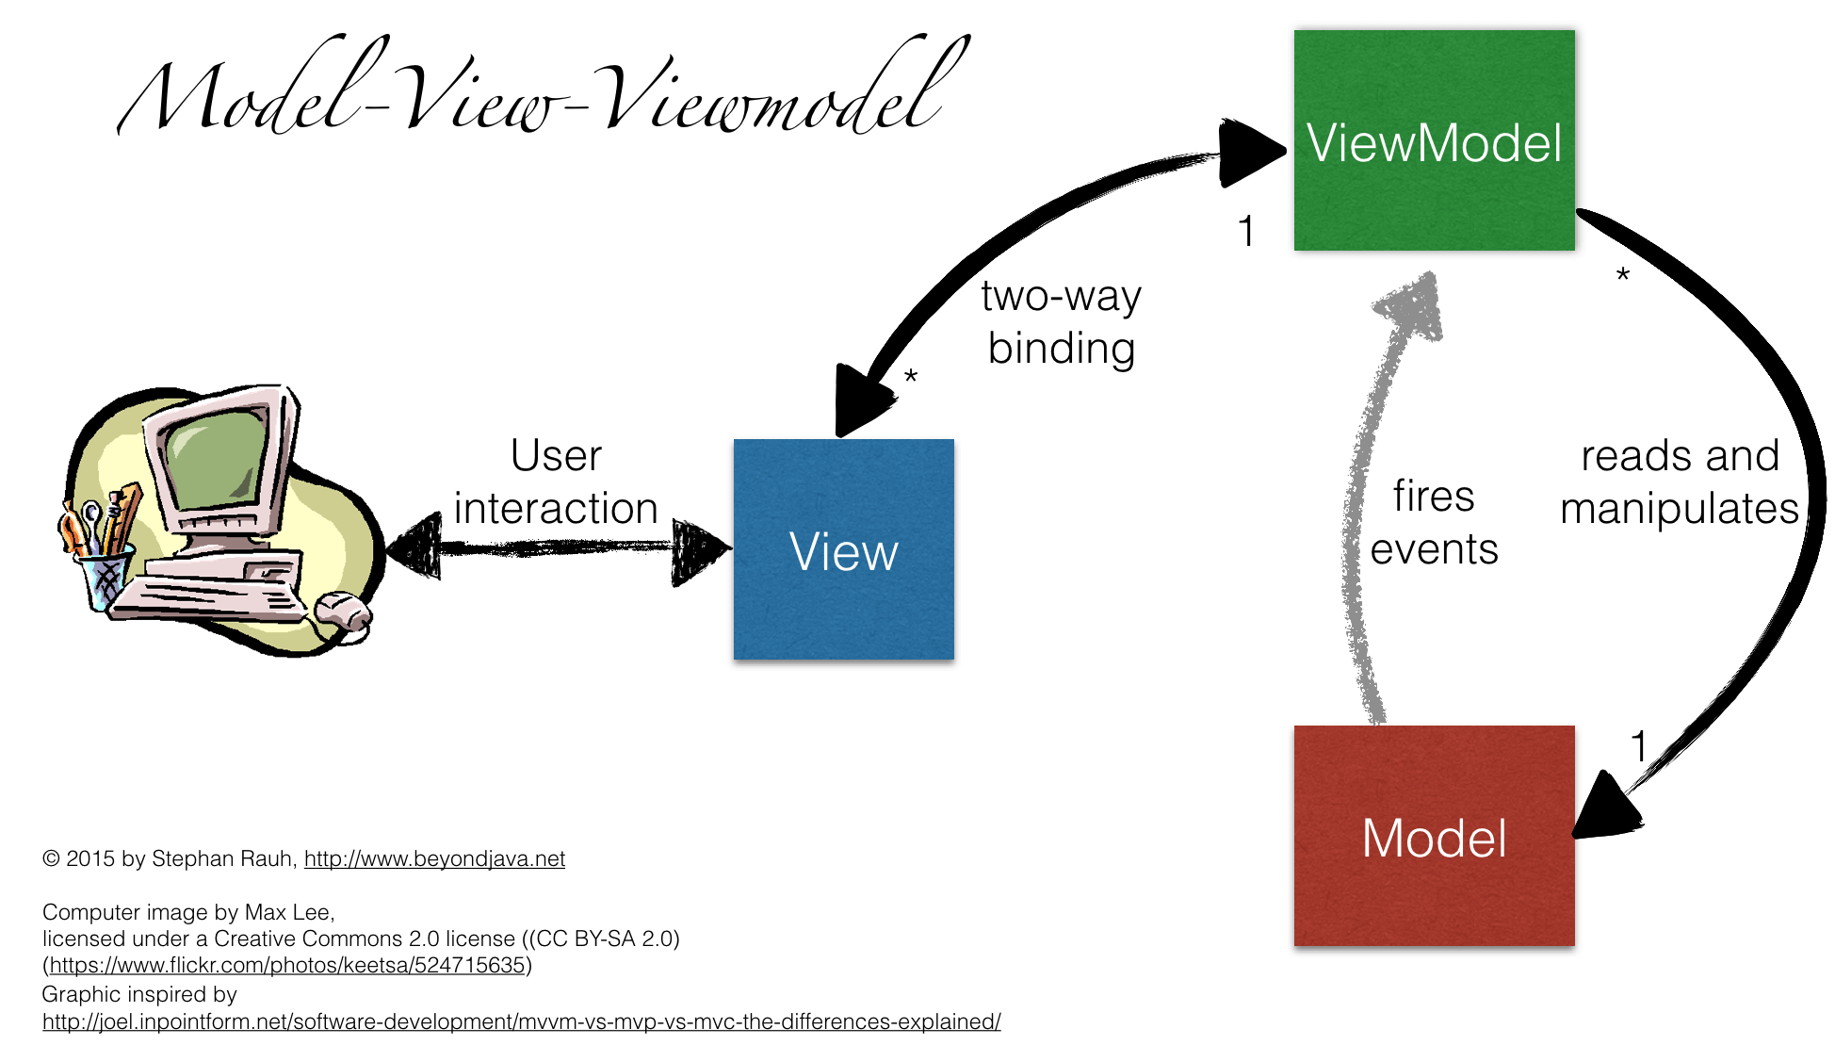
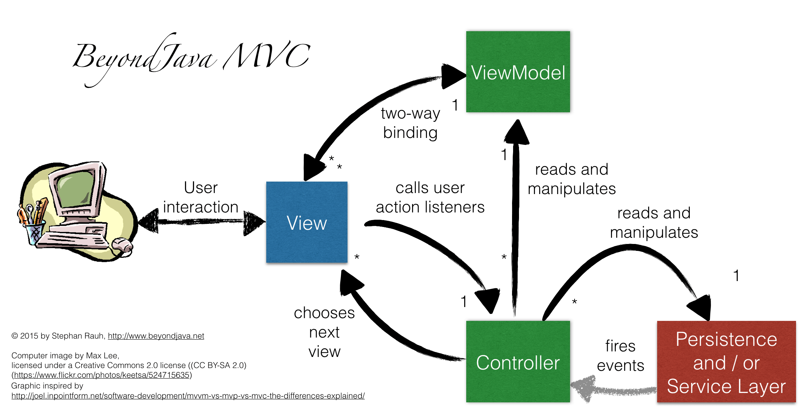
MVC has become Model – View – Whatever
The reality of modern UI’s is complicated
JavaScript library AngularJS is advances the MV* concept
https://angularjs.org

Slide 5
Why do we end up with Cross-platform GUIs?
GUI used to imply “desktop application”
still does in for some people
Windows-only vs Linux-only vs Linux & MacOS vs Mac-only
there is immediate frustration from users
strong pressure to support multiple platforms
The Qt application and UI framework is a popular solution
cross-platform C/C++ GUI toolkit, http://www.qt.io
Python bindings, http://riverbankcomputing.com/software/pyqt
there are a number of competing open source options
It’s expensive to develop & maintain a cross-platform application
Qt / Python help a lot, but do not solve the problem
see slide #8 of the “computational reproducibility” lecture
Python 2.7.x code is not always compatible with Python 3.x code
32 bit and 64 bit versions of Python are incompatible
open source library projects issue frequent releases
underlying physics application may not be robustly cross-platform

Slide 6
Why so few GUIs for particle accelerator codes?
There are definitely some, but…
how many particle accelerator codes are there? Many
how many users are there for each code? Not so many
how many OS’s are used by each subset? Probably 3
Too expensive to support M GUIs on 3 platforms
only of order N_{total} / (3 * M) users for each instance
even if you get someone else to pay the cost, is it worth it?
question of software sustainability
Also, code development teams are busy and under-funded
they will not modify their code to support GUI development efforts
any code/GUI coupling must be very loose
all burden is on the GUI developer to support file formats, etc.
An approach was proposed and developed by RadiaBeam Tech
a Python/Qt cross-platform GUI for multiple physics codes
very loose coupling between GUI and code
GUI enables easy interchange between different codes
the project is called RadTrack
D.L. Bruhwiler, R. Nagler, S.D. Webb, G. Andonian, M.A. Harrison, S. Seung, T. Shaftan and P. Moeller, “Cross-platform and cloud-based access to multiple particle accelerator codes via application containers,” Proc. Int. Part. Accel. Conf., MOPMN009 (2015).

Slide 7
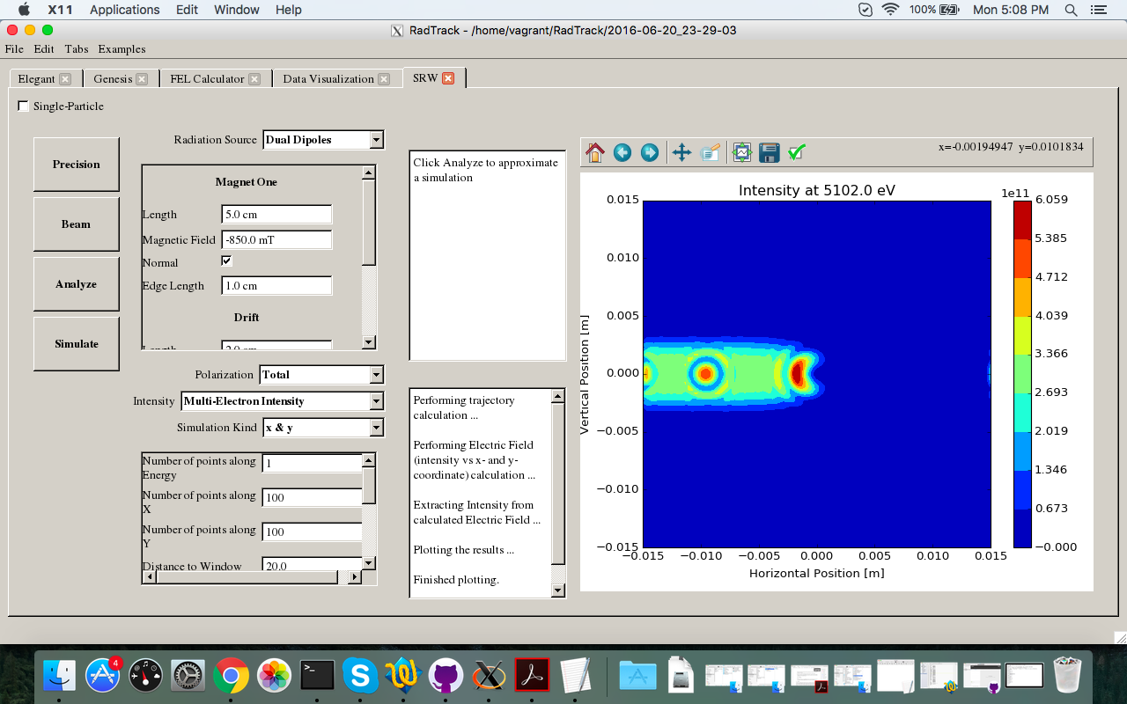
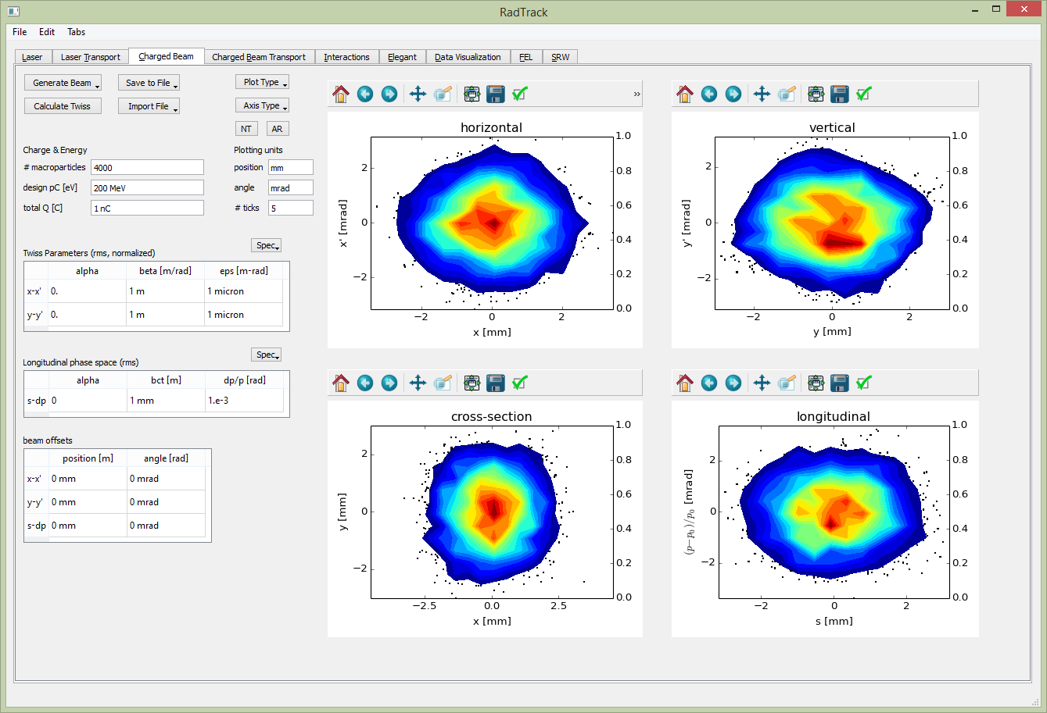
RadTrack – a cross-platform GUI for accelerator codes
Available on GitHub, https://github.com/radiasoft/radtrack
good place to start if you’re interested in PyQt, with lots of good code
but it’s no longer supported – a question of software sustainability
development was supported by US DOE/BES, Award # DE-SC0006284
RadTrack simulation, showing 2D phase space projections plots: horizontal x-x’ phase space (upper left); vertical y-y’ phase space (upper right); x-y configuration space (lower left); and s-dp longitudinal phase space (lower right).
A Synchrotron Radiation Workshop (SRW) simulation showing the interference of synchrotron radiation from two nearby dipoles – an important e- beam diagnostic.

Slide 8
Class discussion:
Any questions at this point?
Have you used an accelerator physics code with a GUI?
If yes, how was the GUI helpful (or not)?
If no, have you ever wished there was a GUI for codes you use?
Have you ever used a GUI-based code and been frustrated?
do you consider it a point of honor to work from the command line?
What is meant by “software sustainability”?

Slide 9
What does it mean to execute a code “in the cloud”
Cloud computing is a buzzword, and will probably fade in time
used to be called “client-server”
then it was called “software as a service” or SaaS
for a short while, everyone talked about “grid computing”
The physics code is running on a remote “server”
probably running on Linux, possibly on a cluster or supercomputer
might be on “bare metal”, such as your institution’s cluster down the hall
might be running on a commercial cloud provider, like AWS
The UI is your computer browser
whether you are banking, shopping, or designing a linac
This wasn’t practical 5+ years ago, so what changed?
the HTML5 standard was adopted by all modern browsers
the same GUI can now function well in any modern browser on any OS
the JavaScript language (nothing like Java) emerged as a standard
many powerful JavaScript libraries and frameworks became available
browsers have become powerful precompilers for executing code

Slide 10
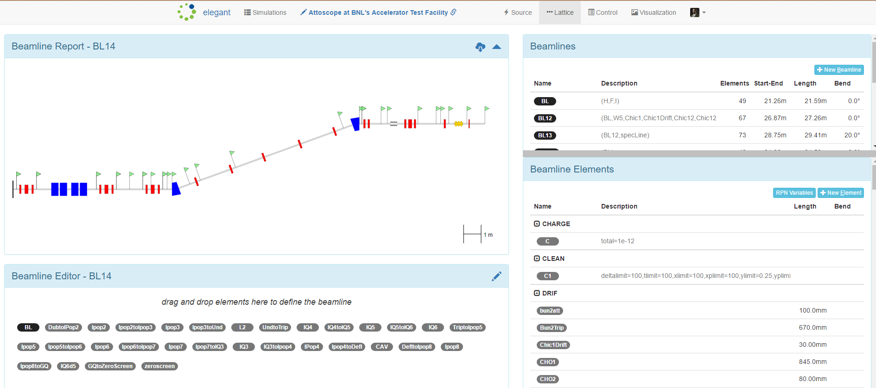
The Sirepo cloud computing framework
Open source, https://github.com/radiasoft/sirepo
Freely available in open beta, https://sirepo.com
Growing number of codes
X-ray optics: SRW, Shadow
Particle accelerators: elegant, Warp (special cases), more on the way
Growing number of users
independent servers at BNL/NSLS-II, LBNL/ALS and PSI/ETH Zurich
about 100 users visit the open beta site

Slide 11
Sirepo: in-browser technologies
HTML5 (including JavaScript, CSS3, SVG, etc.)
https://en.wikipedia.org/wiki/HTML5
Bootstrap, http://getbootstrap.com
fundamental for cross-platform web applications
AngularJS, https://angularjs.org
model–view–whatever (MV *) architecture, components
D3.js, http://d3js.org
interactive plots, data-driven transformations
Karma, http://karma-runner.github.io
testing framework for browser-based applications
JSON, https://www.w3schools.com/js/js_json.asp
JavaScript Object Notation – lightweight data-interchange format

Slide 12
Sirepo: server-side technologies
Docker https://www.docker.com
enables rapid deployment of applications to the cloud
Flask http://flask.pocoo.org
lightweight framework for web development with Python
Celery http://docs.celeryproject.org
task manager
RabbitMQ https://www.rabbitmq.com
message broker
Jinja http://jinja.pocoo.org/docs/dev
secure and widely used templating language for Python
Werkzeug http://werkzeug.pocoo.org/docs/0.10
Python utility library, compliant with the WSGI standard
Nginx https://www.nginx.com/resources/wiki
HTTP server & proxy; scalable event-driven architecture
Pyenv https://github.com/yyuu/pyenv
Python version management, multiple versions

Slide 13
Class discussion:
Any questions at this point?
How does cloud computing help with ease of use?
How does cloud computing help with software sustainability?

Slide 14
The elegant code
G

Slide 15
Wrap up
Any final questions regarding the material in this lecture?
In the Computer Lab this afternoon, you will…

