Slide 1



USPAS – Simulation of Beam and Plasma Systems Steven M. Lund, Jean-Luc Vay, Remi Lehe, Daniel Winklehner and David L. Bruhwiler
Computer Lab: Computational Reproducibility
Instructor: David L. Bruhwiler
Contributors: R. Nagler and P. Moeller
U.S. Particle Accelerator School sponsored by Old Dominion University
http://uspas.fnal.gov/programs/2018/odu/courses/beam-plasma-systems.shtml
January 15-26, 2018 – Hampton, Virginia
This material is based upon work supported by the U.S. Department of Energy, Office of Science, Offices of High Energy Physics and Basic Energy Sciences, under Award Number(s) DE-SC0011237 and DE-SC0011340.

Slide 2
Goals
Familiarize yourself with the Jupyter hub server
browser-based terminal window with bash
many particle accelerator codes pre-installed (on RadiaSoft server)
supports Jupyter (aka IPython) notebooks
Explore use of a Jupyter notebook for particle accelerator simulations
assume you are asked to do space charge simulations with Synergia
https://web.fnal.gov/sites/Synergia/SitePages/Synergia%20Home.aspx
http://compacc.fnal.gov/~amundson/html/ (draft user manual)
typically, you must do the following:
find the source repository, download, install
learn how to run the code, then visualize the output
if someone provides you with a well-written Jupyter notebook…
then you can start working immediately
Consider expansion of a 2D (i.e. very long) proton beam in a drift
this is an important exercise with any particle tracking code

Slide 3
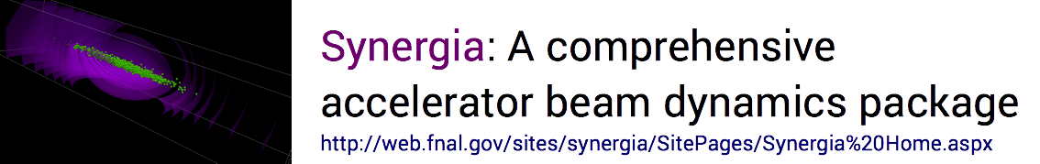


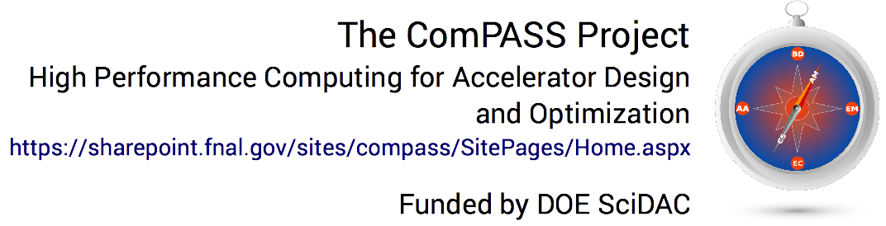

Beam dynamics with space charge via Synergia 2.1
James Amundson, Qiming Lu,
Alexandru Macridin, Leo Michelotti,
Chong Shik Park, (Panagiotis Spentzouris), Eric Stern and Timofey Zolkin
Accelerator Simulation Group
Computer time from INCITE
Funded by DOE
Slide courtesy of James Amundson | Advancing Particle Accelerator Science with High Performance Computing
11/12/15

Slide 4

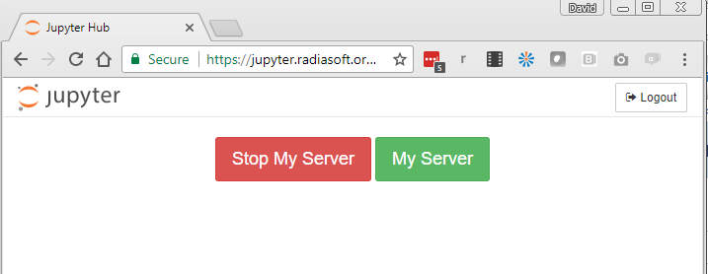
JupyterHub (Part 1)
Jupyter & JupyterHub, http://jupyter.org
RadiaSoft, https://uspas-jupyter.radiasoft.org
also try: jupyter-1, -2, -3, -4, -5, -6, -7
Create a GitHub account (if necessary), https://github.com
Go to the RadiaSoft server, https://uspas-jupyter.radiasoft.org
Authorize the server with your GitHub credentials
it can verify your identity and provide a persistent simulation workspace
the server saves your GitHub username, but never sees your password
RadiaSoft only uses your username to identify you on the Jupyter server
Upon first login, you might see:
If so, just select 'My Server’
activates your instance

Slide 5
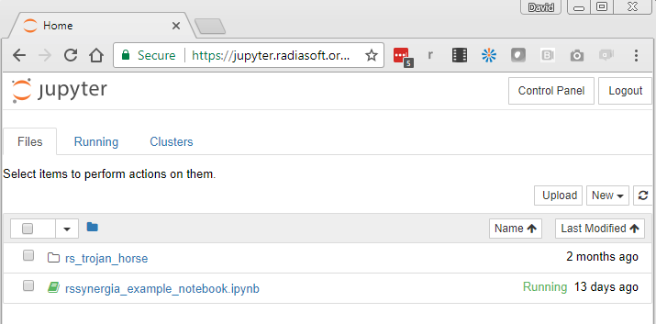
JupyterHub (Part 2)
Next you’ll see something like the following, but with no files:
To upload a Jupyter notebook, or any file, click on the 'Upload' button.
To create a subdirectory, click on the 'New' button, then select 'Folder’.
To rename, delete or move a file or folder, select the box to its left
causes necessary buttons to appear in the upper-left region of your browser

Slide 6
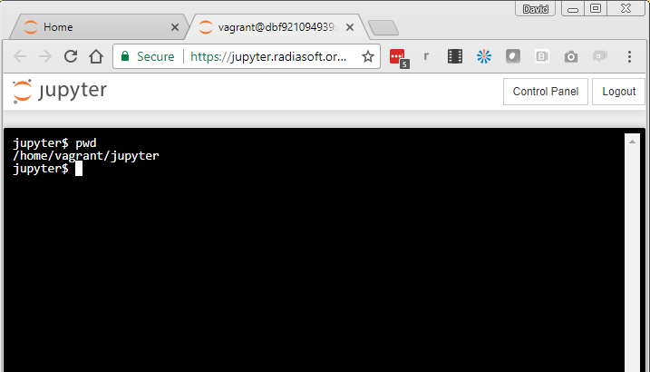
JupyterHub (Part 3)
For a bash terminal, click on the 'New' button and select 'Terminal’
the terminal window will open in a new tab of your browser
it will looking something like this:
it’s like any bash terminal
but you don't have X11
The working directory is /home/vagrant/jupyter/
everything uploaded via the JupyterHub interface appear in that directory
you are free to 'cd' upward and create other directories
you can also 'scp' files to/from other computers
you can ‘git pull’ repos from wherever you like

Slide 7
Pull a Jupyter notebook from GitHub
Type the following in your terminal window:
jupyter$ cd /home/vagrant/jupyter
jupyter$ git clone \
> https://github.com/radiasoft/rssynergia.git
jupyter$ mkdir uspas
jupyter$ cp \
> rssynergia/examples/drift_expansion/sc_drift_expansion.ipynb \
> uspas/
jupyter$ cp \
> rssynergia/examples/drift_expansion/myGaussianBunch.txt \
> uspas/

Slide 8
Run Synergia from a Jupyter notebook
Go back to the main browser tab for the JupyterHub server
click on the directory named ‘uspas’
click on the file named ‘sc_drift_expansion.ipynb’
this opens a Jupyter notebook in a new browser tab
Type ‘shift enter’ repeatedly to advance through the notebook
pause at each cell to read the docs or look over the code
if you see an asterisk in the square brackets to the left…
that means the Python kernel is working
wait until a number replaces the asterisk; look for any output
Once you understand what’s happening, scroll back to the top
click on ‘Kernel’ and then select ‘Restart & Clear Output’
this prevents a lot of problems, when starting a new Synergia simulation
Find the discussion of drift length in the 4th cell
in the cell above, modify this Python code
opts.add("turns",30,"Number of turns", int)
to specify 60 “turns”, so that the drift length is increased to 6 m
Click on ‘Cell’ and then select ‘Run All’
wait for the simulation to complete, then observe the results

Slide 9
Your Tasks for this afternoon
Save the final plot for at least 3 different propagation distances
put these plots into a form (or location) that can be shared later
For one choice of propagation distance, choose two new currents
put these 3 plots into a file (or location) that can be shared later
make sure the curve labels and plot title are correct for each plot
For one choice of current and propagation distance
increase the Synergia step size repeatedly (keep distance constant)
look for signs of problems due to poor resolution
make at least 3 plots, with meaningful titles
Homework for this evening:
Write a paragraph for each of your 3 sets of plots
Explain what you did and/or what you learned
Feel free to comment on the Jupyter notebook experience
Make plots and text available to instructors (print, PDF, web…)

