Slide 1



USPAS – Simulation of Beam and Plasma Systems Steven M. Lund, Jean-Luc Vay, Remi Lehe, Daniel Winklehner and David L. Bruhwiler
Lecture: Software Version Control
Instructor: David L. Bruhwiler
Contributors: R. Nagler, P. Barbe and P. Moeller
U.S. Particle Accelerator School sponsored by Old Dominion University
http://uspas.fnal.gov/programs/2018/odu/courses/beam-plasma-systems.shtml
January 15-26, 2018 – Hampton, Virginia
This material is based upon work supported by the U.S. Department of Energy, Office of Science, Offices of High Energy Physics and Basic Energy Sciences, under Award Number(s) DE-SC0011237 and DE-SC0011340.

Slide 2
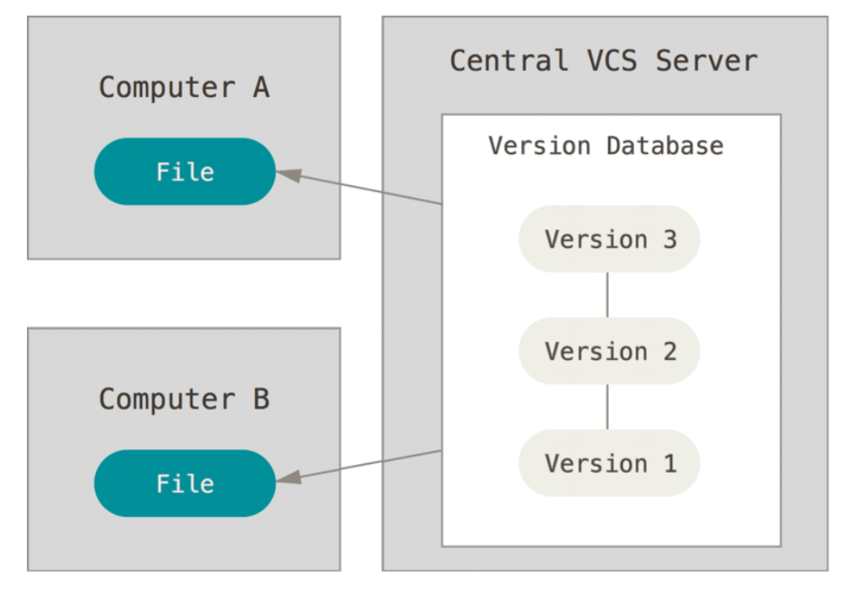
Centralized version control systems (VCS)
A version control system (VCS) records changes to a set of files
Manual version control (ad hoc, error prone)
copy file versions with some convention for naming, location, etc.
ad hoc, error prone, difficult to collaborate
Centralized software version control
enables collaboration
reliable recovery of previous states
CVS, Subversion (SVN), many others
Criticisms of centralized systems
server is a single point of failure
if server goes down for an hour
nobody has access
if database becomes corrupted
all recent work is lost (since backup)
except for individual snapshots
all these criticisms are addressed by a well-managed system

Slide 3
Distributed vs Central models
Centralized version control systems
focuses on synchronizing, tracking, and backing up files
recording/downloading is simultaneous with applying a change
primary repo is a database on a central server
the entire change history, including branches, is part of the central database
user repositories are snapshots that get synched with the central database
Distributed version control systems
focuses on sharing changes; every change has a unique guid
recording/downloading is separate from applying a change
the hierarchical structure is not required
one can create a centrally administered location, if it is convenient
alternatively, one can treat all repositories as equal peers
this results in new concepts and associated terminology
push: send a change to another repository
pull: grab a change from a repository
the change history, including branches, are distributed
every user repo is self-contained

Slide 4
git – Getting Started
It is assumed you are working on the Linux command line
Establish your git identity (name & email) for the local client
every git commit uses this information
it’s immutably baked into the commits you start creating
$ git config --global user.name "My Name"
$ git config --global user.email my_name@example.com
you need do this only once if you pass the --global option
many GUI tools will help you do this when you first run them
Configure the default text editor
$ git config --global core.editor emacs
used when git needs you to type a message
if not configured, git uses your system’s default editor

Slide 5
Class discussion:
Any questions at this point?
Any concerns about using git from the command line (CL)?
git is a distributed VCS implementation
the classroom computers provide git on Linux
2 students per computer, but only one Linux login
this means you’ll have to share a single git identity
Work from your laptop…
if it has a good CL environment, with git installed
PyCharm supports interaction with git, GitHub and other VCS options
You can download/install the GitHub desktop application
https://desktop.github.com
it installs git on your Windows or MacOS laptop
it provides an optional command-line terminal for using git
Today’s computer lab exercises will provide some practical experience

Slide 6
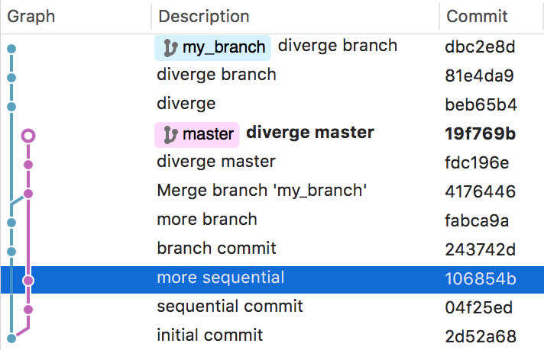
git – Underlying Concepts (Part 1)
The git CLI is not intuitive, compared to central model applications (e.g. svn)
it helps if you understand the underlying concepts
The git commit tree
information is representable as a graph
each node results from an operation
database is immutable and append-only
an example git Tree (see figure)
each node is associated with…
the developer’s commit message
a unique hash (guid)
Git references
a reference (ref) is a human readable label, pointing to a commit hash
branches, tags, remotes are all forms of refs
refs facilitate interaction with the commit tree
refs do not hold the information in the git database
all such info is held within the commit tree, which is immutable
suppose the git repository is in a bad state, and we want to back track
all previous states are still present inside the tree
we need only change the references to the desired commit address
git provides a special reference named HEAD
current address for the state that is checked out in the working directory

Slide 7
git – Underlying Concepts (Part 2)
The state of a git repository has three components
Working Directory
result of cloning a git repository
a directory with everything contained within the git repository
Staging Index
an intermediate space to add changes from the working directory
(without adding them to the commit tree)
Commit Tree
changes in the staging index are (when ready) added to the commit tree
each change is given a hash address
Cloning a repository
Create a local copy
this is complete and independent from the source
git supports various protocols:
$ git clone [<options>] <repo> [<dir>]
If no [<dir>], git creates a new directory with the same name as the repo
local filesystem clone
$ git clone /Path/To/Git/Repo/Dir
remote HTTPS clone from GitHub
$ git clone https://github.com/radiasoft/devops.git
Docs for ‘git clone’, https://git-scm.com/docs/git-clone

Slide 8
git – the Checkout command
It changes the HEAD reference, making it point to a new address
affects only the working directory
secondary use: undo changes in the working directory
$ git checkout [<options>] <branch>
Useful examples:
get latest commit from the master branch for use in currently active branch
$ git checkout master
get an address (e.g. 2d52a68) and label it as branch new_branch_name
$ git checkout -b new_branch_name 2d52a68
force a checkout from master branch, throwing away local modifications
$ git checkout -f master
revert changes in file my_file.py
$ git checkout path/to/my_file.py
revert file my_file.py to its state in the branch my_branch
$ git checkout my_branch -- path/to/my_file.py
Docs for ‘git checkout’, https://git-scm.com/docs/git-checkout

Slide 9
git – how to Stage and Commit
Staging – add changes from the working directory to staging index
add new (untracked) file to staging index (or new changes to a tracked file)
$ git add path/to/file
add all changes of tracked files to the staging index
$ git add –u
Commit – store changes within the commit tree
changes may come from the staging index or directly from the working directory
each commit requires a message to document the changes being recorded
Some examples:
commit the staging index, and document with a message
if don’t specify an inline message, an editor will be invoked
$ git commit –m ‘this is my commit message’
commit all changes in tracked files
$ git add –a
commit changes within a specific file
$ git commit /path/to/file –m ‘file is better now’
Docs for ‘git add’, https://git-scm.com/docs/git-add
Docs for ‘git commit’, https://git-scm.com/docs/git-commit

Slide 10
git – Push & Pull
Pull – performs a ‘fetch’ and ‘merge’ in one step
pull the remote tracking branch into the current working directory
if you clone a repo, it’s ‘master’ is your ‘remote tracking branch’
we do not discuss ‘fetch’ and ‘merge’ here
$ git pull
Push – send changes from the local branch to a remote repo
push to the remote tracking branch
$ git push
There are many sophisticated uses of push & pull
e.g. one can push to (or pull from) arbitrary branches in remote repos
Docs for ‘git pull’, https://git-scm.com/docs/git-pull
Docs for ‘git push’, https://git-scm.com/docs/git-push

Slide 11
git – Creating a Branch
A branch tracks a set of (logically connected) changes
no conflicts with concurrent modifications to the same part of the repo
conflicts can manifest when merging two branches with overlapping changes
a branch is a ref
points to latest commit in corresponding ‘branch’ of the commit tree
In our example repo (see figure on slide #6), we start with two branches
my_branch & master
both initially point to the same address, 2d52a68
after changes in each branch occur separately, we see they have diverged
addresses 243742d & 04d25ed respectively.
Examples of using the branch command:
Create new branch branch_name pointing to same address as HEAD
$ git branch branch_name
List local branches
$ git branch
Delete branch named 'branch_name'
$ git branch -d branch_name
Rename the branch branch_name to new name: new_branch_name
$ git branch -m branch_name new_branch_name
Docs for ‘git branch’, https://git-scm.com/docs/git-branch

Slide 12
git workflow – create, then merge a branch
Create a new branch, named ‘issue03’
perhaps the goal is to address issue #3 from GitHub repo
$ git checkout –b issue03
the above is shorthand for the following two commands:
$ git branch issue03
$ git checkout issue03
Add a new file to the branch (trivial example)
$ touch dummy.txt
$ git add dummy.txt
$ git commit –m ‘this file is empty’
$ git push –set-upstream origin issue03
Merge this branch into the ‘master’ branch
$ git checkout master
$ git merge issue03
$ git push origin master
Docs for ‘git merge’, https://git-scm.com/docs/git-merge
More workflow details here, https://git-scm.com/book/en/v2/Git-Branching-Basic-Branching-and-Merging

Slide 13
Class discussion:
Any questions at this point?
Why would you want to create a branch?
What is a ‘ref’ in the world of git?
Today’s computer lab exercises will provide some practical experience

Slide 14
GitHub overview
GitHub & Bitbucket are two of the largest web-based hosting services
they are targeted towards software development projects
can be used for proposals, papers or any collection of documents
neither supports Subversion (SVN)
GitHub exclusively supports git; Bitbucket supports git and mercurial
GitHub provides the following features (and more):
an integrated issue tracker
branch comparison views
native applications for Windows and Mac desktops
https://desktop.github.com/
support for over 200 programming languages and data formats
GitHub pages, a feature for publishing and hosting
SSL, SSH & https for data transmission; two-factor authentication for login
API integration for 3rd-party tool and other platforms
partial support is provided for SVN
import SVN repos into git
GitHub repos can be cloned directly via the SVN client.
for a comparison, see https://www.upguard.com/articles/github-vs-bitbucket

Slide 15
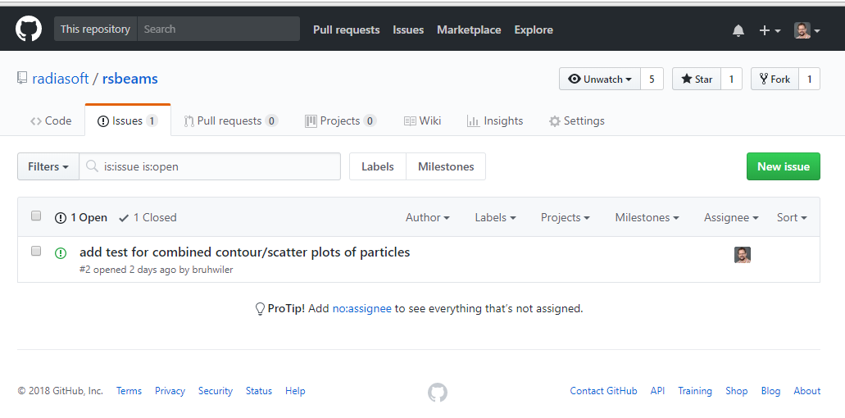
The GitHub ‘issues’ feature
Creating issues is a good thing
most other tracking systems call them ‘tickets’
every GitHub repo has it’s own set of issues
Issues help you (or a team) keep track of
tasks, enhancements and bugs
They are a very good alternative to email
they can be shared and discussed with the team
individuals can turn notifications on/off
they can be closed and later re-opened
provides a searchable archive
Docs for GitHub issues, https://guides.github.com/features/issues/

Slide 16
An example GitHub code repository
rsbeams is a python library for 3D particle beams
rsbeams: https://github.com/radiasoft/rsbeams
not specific to any particular tracking code
rsbeams is used by other Python libraries, which are code specific
rswarp: https://github.com/radiasoft/rswarp
rssynergia: https://github.com/radiasoft/rssynergia
In the Computer Lab this afternoon & tomorrow, you will
fork this repo to your own GitHub account
clone this forked repo to your laptop or desktop
decide what part of the code you would like to test
create an ‘issue’ in the original repo regarding your plan to create a test
create a branch in your working directory
create/add/commit the test in your branch
merge your branch into the ‘master’ branch of your forked repo on GitHub
Issue a ‘pull request’ to the original repository
We won’t cover all this material today

Slide 17
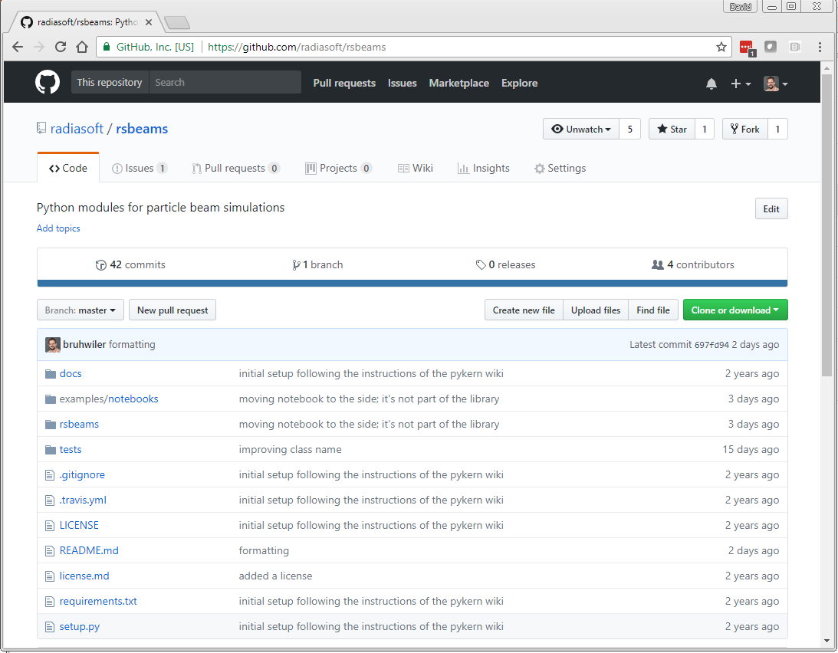
An overview of the rsbeams repository

Slide 18
Wrap up
Any final questions regarding the material in this lecture?
In the Computer Lab this afternoon, you will
fork this repo to your own GitHub account
clone this forked repo to your laptop or desktop
document each of the following with an issue:
run the existing tests
create a branch
create a new example, based on one of the existing tests
merge the branch back into ‘master’
decide what part of the code you would like to test
create an ‘issue’ in the original repo regarding your plan to create a test

