Slide 1



USPAS – Simulation of Beam and Plasma Systems Steven M. Lund, Jean-Luc Vay, Remi Lehe, Daniel Winklehner and David L. Bruhwiler
Lecture: Software Version Control
Instructor: David L. Bruhwiler
Contributors: R. Nagler, P. Barbe and P. Moeller
U.S. Particle Accelerator School sponsored by Old Dominion University
http://uspas.fnal.gov/programs/2018/odu/courses/beam-plasma-systems.shtml
January 15-26, 2018 – Hampton, Virginia
This material is based upon work supported by the U.S. Department of Energy, Office of Science, Offices of High Energy Physics and Basic Energy Sciences, under Award Number(s) DE-SC0011237 and DE-SC0011340.

Slide 2
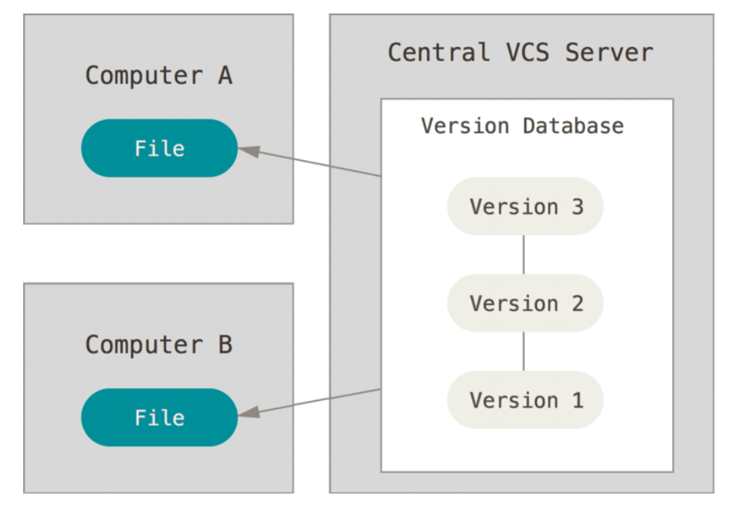
Centralized software version control
Version control is a system that records changes to a set of files
Manual version control (ad hoc, error prone)
copy file versions with some convention for naming, location, etc.
ad hoc, error prone, difficult to collaborate
Centralized software version control
enables collaboration
reliable recovery of previous states
CVS, Subversion (SVN), many others
Criticisms of centralized systems
server is a single point of failure
if server goes down for an hour
nobody has access
if database becomes corrupted
all recent work is lost (since backup)
except for individual snapshots
all these criticisms are addressed by a well-managed system

Slide 3
Distributed vs Central models
Centralized version control
focuses on synchronizing, tracking, and backing up files
recording/downloading is simultaneous with applying a change
primary repo is a database on a central server
the entire change history, including branches, is part of the central database
user repositories are snapshots that get synched with the central database
Distributed version control
focuses on sharing changes; every change has a unique guid
recording/downloading is separate from applying a change
the hierarchical structure is not required
one can create a centrally administered location, if it is convenient
alternatively, one can treat all repositories as equal peers
this results in new concepts and associated terminology
push: send a change to another repository
pull: grab a change from a repository
the change history, including branches, are distributed
every user repo is self-contained

Slide 4
git
tbd

Slide 5
Using GitHub
GitHub & Bitbucket are two of the largest web-based hosting services
they are targeted towards software development projects
can be used for proposals, papers or any collection of documents
neither supports Subversion (SVN)
GitHub exclusively supports git; Bitbucket supports git and mercurial
GitHub provides the following features (and more):
an integrated issue tracker
branch comparison views
native applications for Windows and Mac desktops
https://desktop.github.com/
support for over 200 programming languages and data formats
GitHub pages, a feature for publishing and hosting
SSL, SSH & https for data transmission; two-factor authentication for login
API integration for 3rd-party tool and other platforms
partial support is provided for SVN
import SVN repos into git
GitHub repos can be cloned directly via the SVN client.
for a comparison, see https://www.upguard.com/articles/github-vs-bitbucket

Slide 6
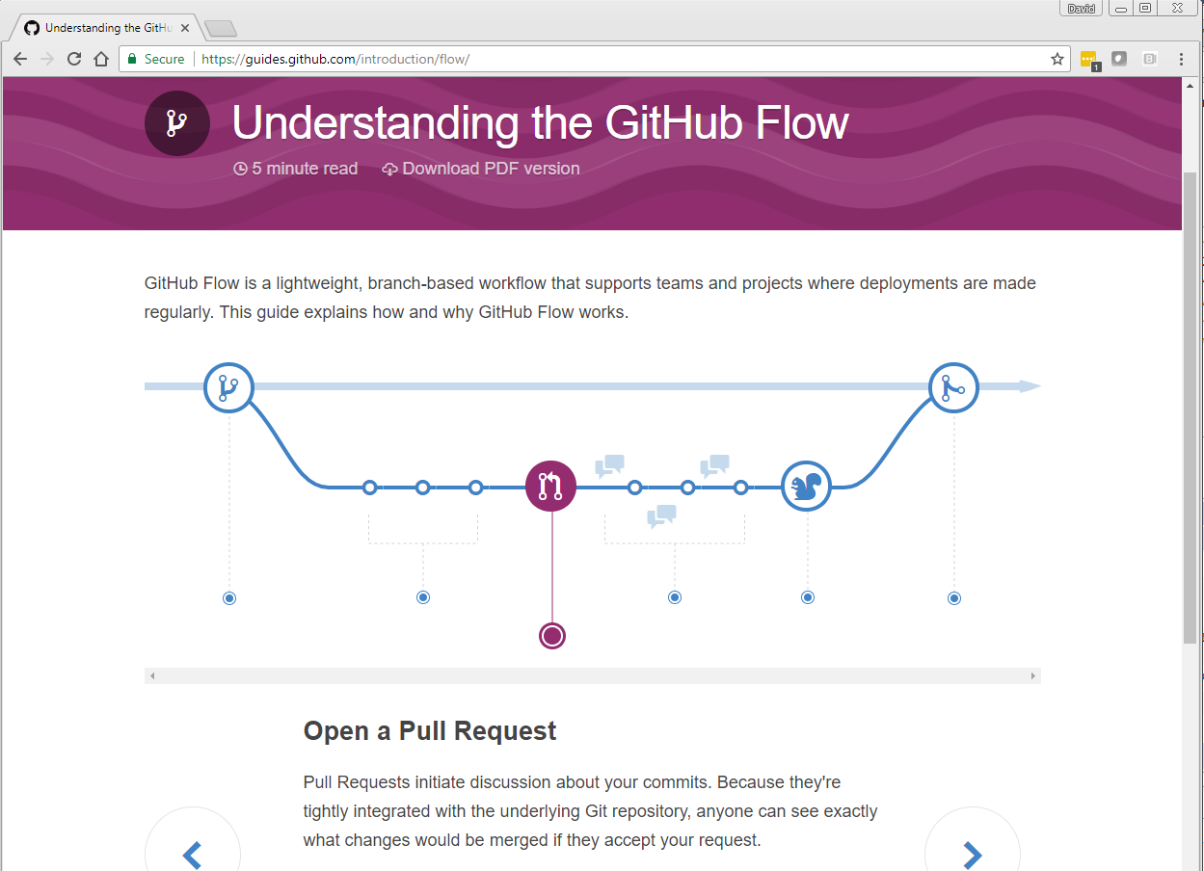
Go to GitHub docs for interactive explanation, https://guides.github.com/introduction/flow

Slide 7
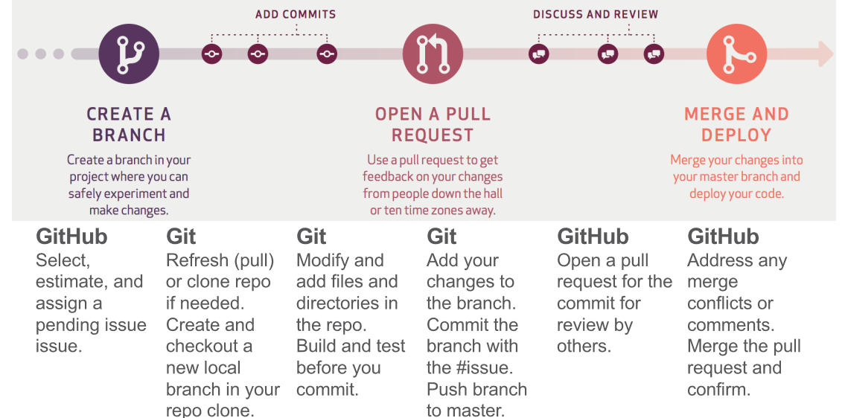
Using git via GitHub
TBD…
GitHub docs, https://guides.github.com/introduction/flow

Slide 8
Class discussion:
TBD…

Slide 9
Wrap up
TBD…
Any final questions regarding the material in this lecture?
Computer Lab this afternoon –
TBD…

