Slide 1





USPAS – Simulation of Beam and Plasma Systems Steven M. Lund, Jean-Luc Vay, Remi Lehe, Daniel Winklehner and David L. Bruhwiler
Computer Lab: Slice Energy Spread
Instructor: David L. Bruhwiler
Contributors: G. Andonian, UCLA / RadiaBeam Tech
J. van Tilborg, Lawrence Berkeley Lab
U.S. Particle Accelerator School sponsored by Old Dominion University
http://uspas.fnal.gov/programs/2018/odu/courses/beam-plasma-systems.shtml
January 15-26, 2018 – Hampton, Virginia
This material is based upon work supported by the U.S. Department of Energy, Office of Science, Offices of High Energy Physics and Basic Energy Sciences, under Award Number(s) DE-SC0011237 and DE-SC0011340.

Slide 2
Goals
Learn how to control the longitudinal phase space of a beam.
Motivation and background will be provided during the lecture, after lunch

Slide 3
The Elegant Simulation Workflow
Typical work flow for Elegant using sirepo interface
Source
Transport
Lattice
Simulation
Control
Output & Visualization
Define beam parameters:
Energy
Energy spread Twiss
Chirp
Distribution
Offsets
Etc.
Construct transport:
Drifts
Quads
Dipoles
Screens
Etc.
Setup simulation:
Output control
Higher order
Optimization
Etc.
Graphic output:
Phase spaces
Beam Trajectory
Twiss evolution
Etc.
OR
Import existing
OR
Import existing
OR
Import existing
THEN
Conduct experiment,
Publish paper, etc.

Slide 4
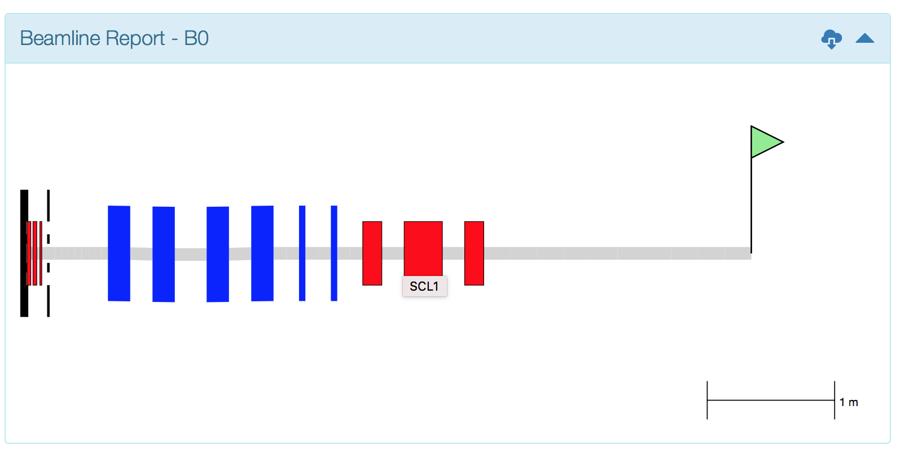
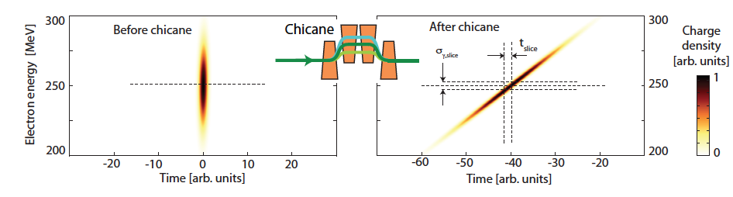
User case: Chicane for LPA-FEL
LPA source brightness is good for FEL, slice energy spread is not
Use chicane to stretch beam, reduce slice energy spread
Find balance between reduction in beam current and slice energy spread
Optimal R₅₆ depends on initial beam parameters
Modeled with Sirepo/elegant
Courtesy S. Barber (LBNL)

