Slide 1





USPAS – Simulation of Beam and Plasma Systems Steven M. Lund, Jean-Luc Vay, Remi Lehe, Daniel Winklehner and David L. Bruhwiler
Lecture: Use case: sub-fs diagnostic
Instructor: David L. Bruhwiler
Contributors: G. Andonian, UCLA / RadiaBeam Tech
N. Sudar, UCLA
U.S. Particle Accelerator School sponsored by Old Dominion University
http://uspas.fnal.gov/programs/2018/odu/courses/beam-plasma-systems.shtml
January 15-26, 2018 – Hampton, Virginia
This material is based upon work supported by the U.S. Department of Energy, Office of Science, Offices of High Energy Physics and Basic Energy Sciences, under Award Number(s) DE-SC0011237 and DE-SC0011340.

Slide 2
Goals
Learn a little about the Accelerator Test Facility (ATF) at BNL
bright electron beams, lasers, plasmas
Consider an experiment to demonstrate fs diagnostics of e- beams
simulation and planning of the experiment using Sirepo/elegant

Slide 3
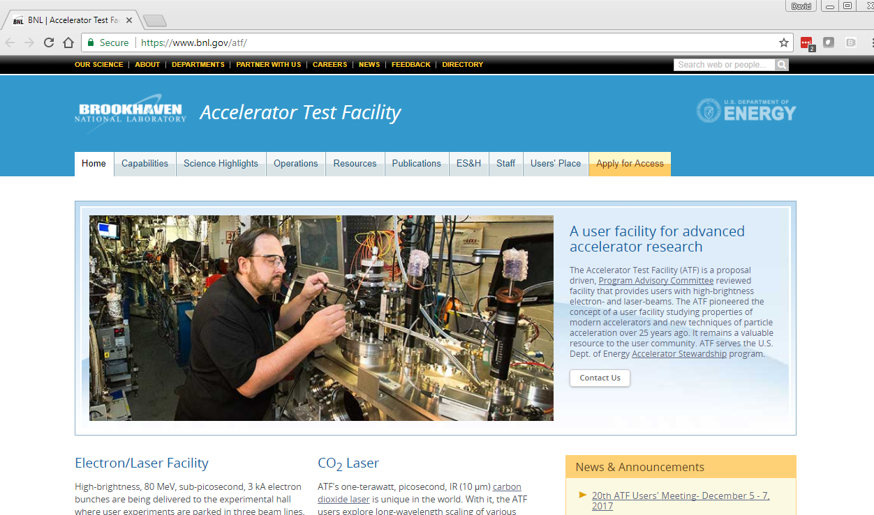
The Accelerator Test Facility at BNL
https://www.bnl.gov/atf

Slide 4
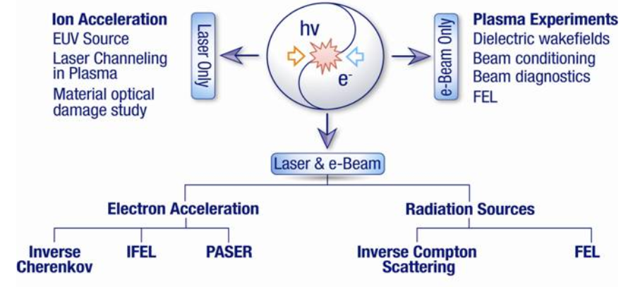
ATF – Overview
Proposal-driven user facility, enables R&D into the physics of beams
Unique experimental capabilities:
high-brightness e gun, 85 MeV Linac
high-power lasers, beam-synchronized at the ps level
high-brightness X ray source

Slide 5
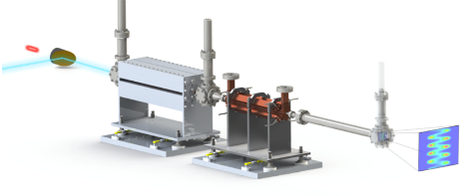
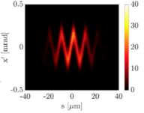
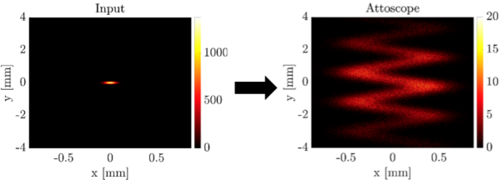
Use case: sub-fs diagnostic at ATF
Slide courtesy of
G. Andonian & N. Sudar
beam
Undulator
Deflector
laser
Screen
High-resolution bunch length diagnostic
Laser modulator (TEM10 mode)
RF deflecting cavity
Potential for sub-fs resolution
Experiment at BNL ATF
Images with Sirepo/elegant
Phase space correlation after interaction
Distribution after deflector

Slide 6
Class discussion:
Any questions at this point?
The rest of this lecture is a Sirepo/elegant simulation
we’ll consider the full “Attoscope” beamline
courtesy of G. Andonian (UCLA, RadiaBeam Technologies) and N. Sudar (UCLA)
multiple beamline definitions
use of diagnostics
export / import of simulations via zip files
Begin the demo…

