Slide 1





USPAS – Simulation of Beam and Plasma Systems Steven M. Lund, Jean-Luc Vay, Remi Lehe, Daniel Winklehner and David L. Bruhwiler
Lecture: Slice Energy Spread
Instructor: David L. Bruhwiler
Contributors: G. Andonian, UCLA / RadiaBeam Tech
J. van Tilborg, Lawrence Berkeley Lab
U.S. Particle Accelerator School sponsored by Old Dominion University
http://uspas.fnal.gov/programs/2018/odu/courses/beam-plasma-systems.shtml
January 15-26, 2018 – Hampton, Virginia
This material is based upon work supported by the U.S. Department of Energy, Office of Science, Offices of High Energy Physics and Basic Energy Sciences, under Award Number(s) DE-SC0011237 and DE-SC0011340.

Slide 2
Goals
Understand slice energy spread
why is it important for free electron lasers (FEL)
what is the relevance to laser-plasma accelerators?
Explore a real world example, using Elegant

Slide 3
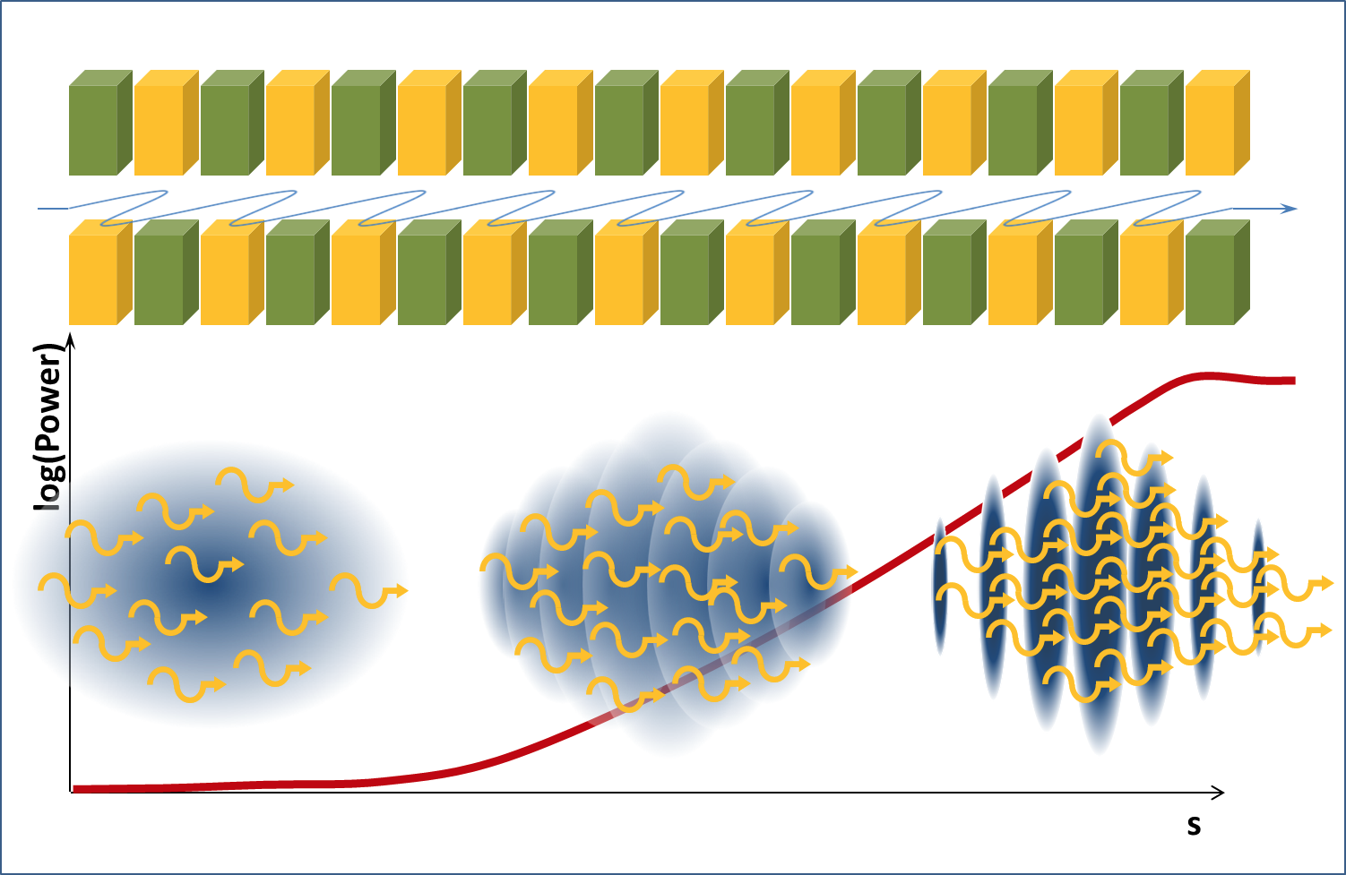


High-quality electron beams (high charge, short duration, low emittance) can drive Free Electron Laser
https://www.helmholtz-berlin.de/projects/berlinpro/erl-intro/linac-fel_en.html
Free Electron Laser:
Interaction undulator radiation & dense e-beam → micro-bunching → coherent undulator emission
Small gain length favorable
E-beam quality → Pierce parameter ρ
Large ρ favorable (ρ typically of order 10⁻³-10⁻²)
Energy spread washes out micro-bunching
1D gain length corrected with 3D effects Λ (energy spread, emittance, etc.)
Gain length
Charge / duration
Pierce parameter
3D Gain length
E-beam size (emittance)
E-beam energy
This slide courtesy of J. van Tilborg (LBL)
Huang & Kim PRSTAB 10, 034801 (2007)

Slide 4
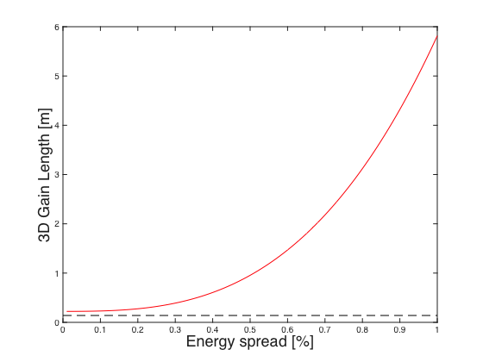
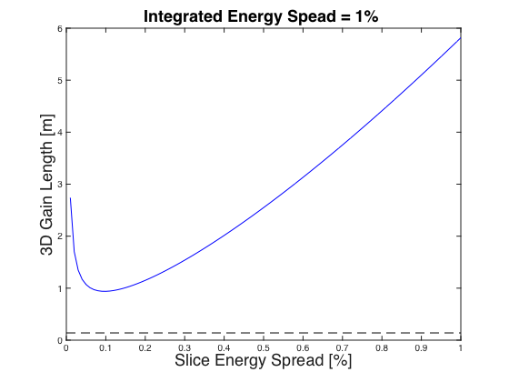
Each time slice can develop micro-bunching: Not integrated but slice energy spread critical to FEL: σ_{γ,slice}<ρ
3D Gain Length as a function of energy spread in a correlation-free beam:
Adding correlation through chicane de-compression:
D=1
De-compression D>1
This slide courtesy of J. van Tilborg (LBL)
3D Gain Length
Chicane de-compression:
Maier et al. PRX 2012, Schroeder et al. FEL2013
1D Gain Length
Beam parameters:
5 pC in 10 fs
250 MeV
Emittance 0.5 μm
Beam size 25 μm
Undulator:
Period 2.18 cm
Strength K=1.26
Pierce ρ=0.007
σ_{z0}
No correlation
D×σ_{z0}
Same beam, with correlation
γ
γ
σ_{γ}
σ_{γ}
Instantaneous energy spread of slice: σ_{γ}/D
z
z
Slippage of chirped e-beam through photon pulse is detrimental
Length of relevant slice is several radiation wavelengths long (~5 fs)

Slide 5
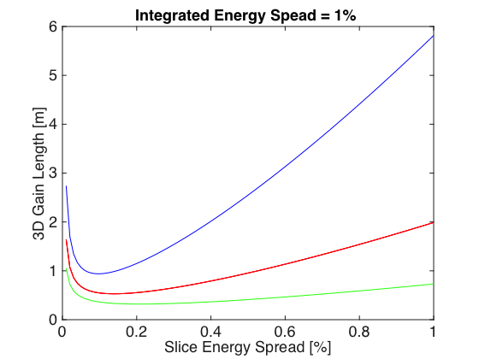
Bunch length and energy spread known, but correlation not known (longitudinal phase phase not known)
Bunch duration: 5 pC in 10 fs
Correlation unknown
This slide courtesy of J. van Tilborg (LBL)
Chicane scan

Slide 6
How can one quickly stretch the longitudinal phase space?
Use a chicane (a sequence of dipoles)
typically used to compress bunches
here, it is being used to longitudinally stretch the bunch
Explore a real world example
from the ATF (Accelerator Test Facility) at Brookhaven National Lab

Slide 7
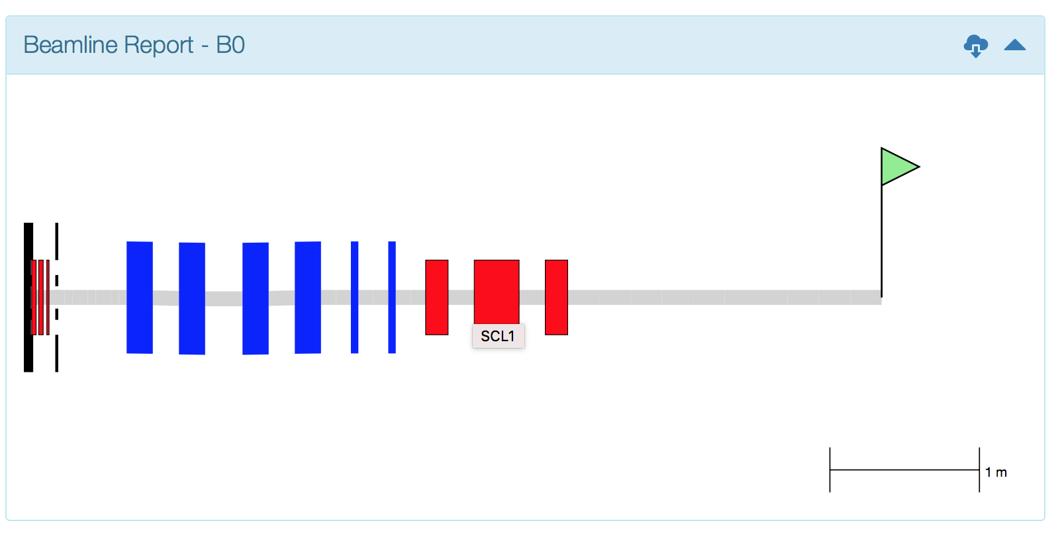
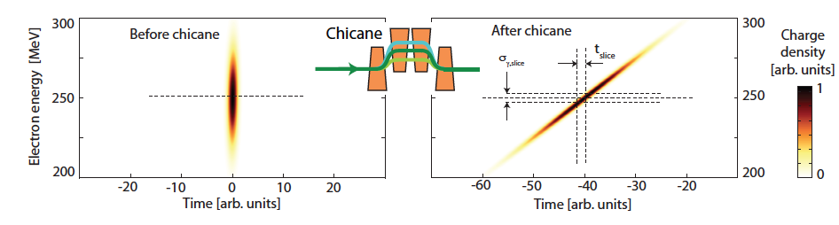
User case: Chicane for LPA-FEL
LPA source brightness is good for FEL, slice energy spread is not
Use chicane to stretch beam, reduce slice energy spread
Find balance between reduction in beam current and slice energy spread
Optimal R₅₆ depends on initial beam parameters
Modeled with sirepo.elegant
Courtesy S. Barber (LBNL)

