Slide 1
Plugfest summary in Bundang, 30/6-1/7/2018
2/7/2018 rev.3
Capturing TD into NodeRED
-> NEXT slide
NodeRED
(Hitachi)
NodeRED/
Scripting API
(Panasonic)
Node-WoT
application
(Oracle)
Application
(Fujitsu)
mashup.jp
(TUM)
Oracle IF
(td2dm conv.)
Oracle IF
lookup
http://192.168.1.163:8080
TD directory
(Fujitsu)
IoT Cloud Service
(Oracle)
TD directory
(Siemens)
Remote proxy
(Fujitsu)
Long Polling
Oracle IF
TD directory IF (trying)
WebSocket
Oracle IF
http://192.168.1.99:18081
WebSocket (trying)
Oracle-WoT
bridge
(Siemens)
TD directory
(Fujitsu)
Oracle-WoT
bridge
(Fujitsu)
Node-WoT proxy
(Siemens)
Local proxy
(Fujitsu)
Local proxy
(Fujitsu)
WoT-EtherCAT
bridge
(Fujitsu)
Long Polling
Register
Oracle IF
WebSocket
Blind
(Fujitsu)
Sensors
(Fujitsu)
Rotating Light
(Fujitsu)
Device sim.
(Panasonic)
Motion sensor
(Intel)
sensor
(KETI)
IoT Dev. Sim.
(Oracle)
Event Source
(Siemens)
Nabaztag
(Siemens)
Festo Live
(Siemens)
WoT-OCF bridge
(Intel)
Google home
(Panasonic)
HVAC sim.
(Oracle)
Air conditioner
sim.
(Panasonic)
BMW X5
(Eurecom)
Web Camera
(Intel)
OCF devs
(Intel)
LED light
(Panasonic)
Festo sim
(Oracle)
Connected Car sim
(Oracle)
Sensor sim
(KETI)
OCF devs
(Intel)
These simulated devices are generated by TDs for this Plugfest on Github.

Slide 2
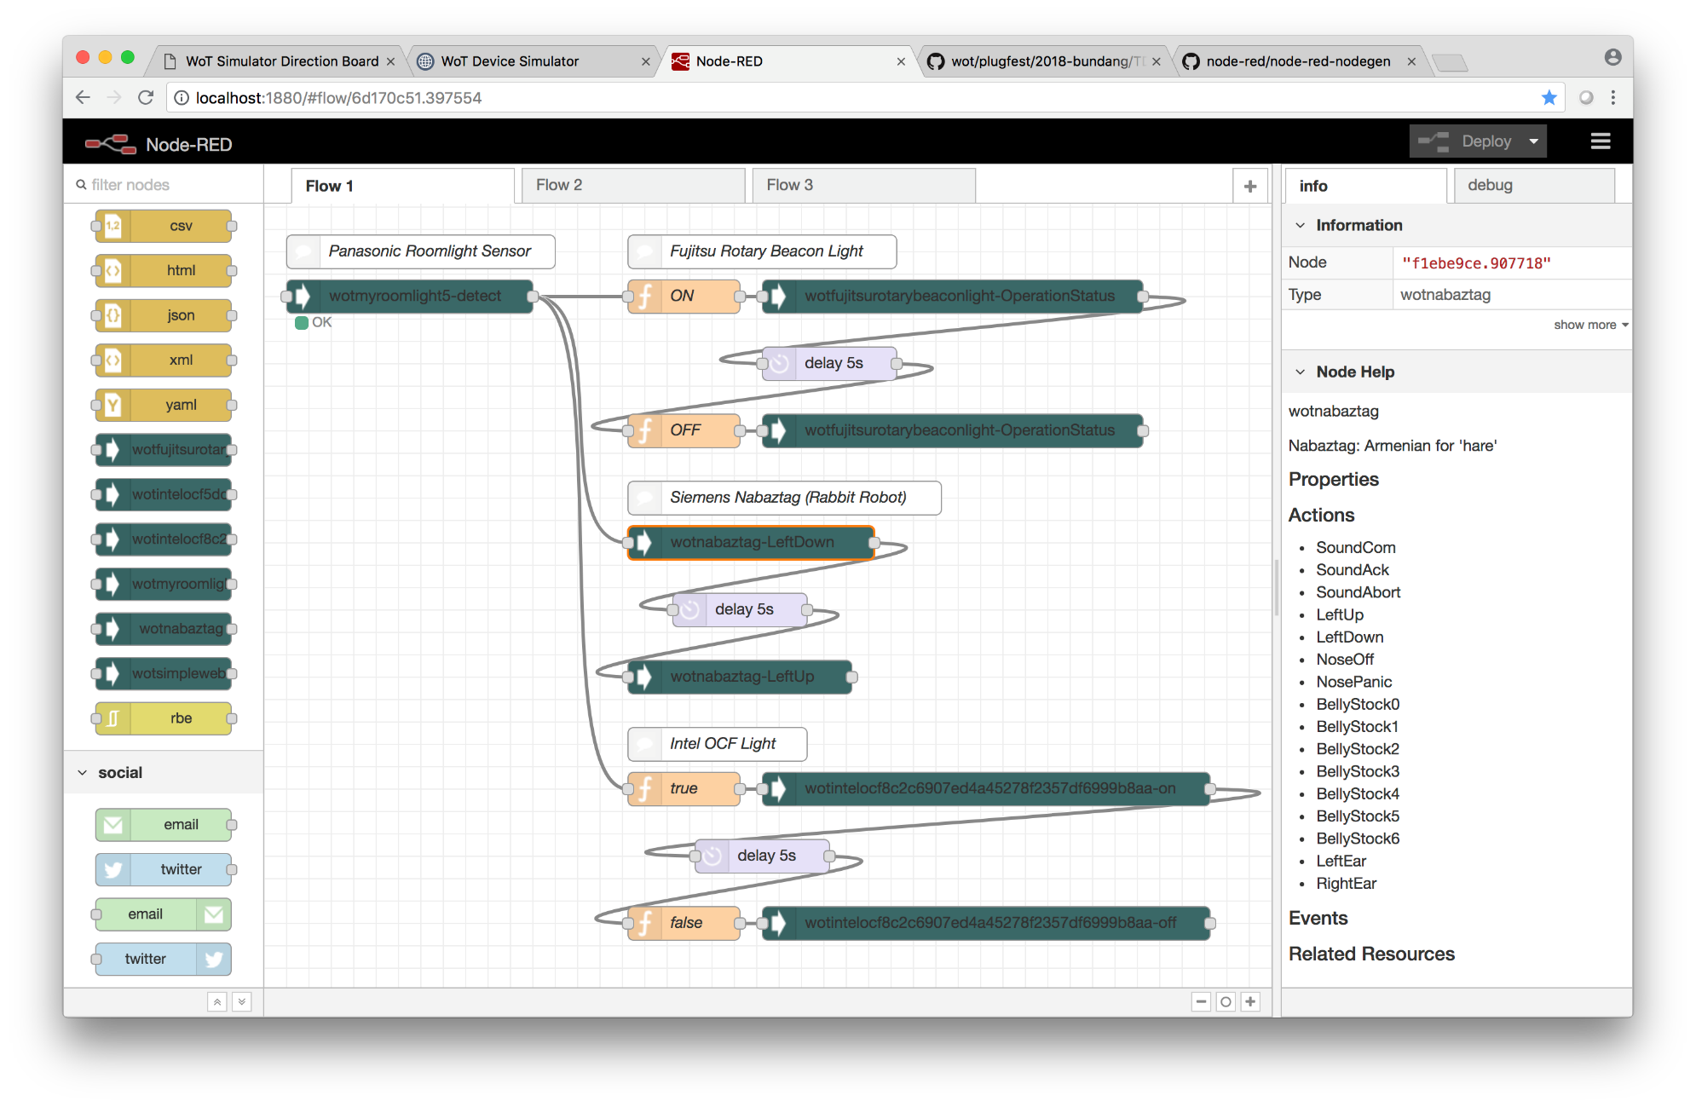
Capturing TDs into NodeRED (Hitachi)
These are generated from TDs

