Slide 1
Internal
IQC Rotor gear sleeve 2 x ID scan
IQC
Rev. A
Date : 20.06.2018

Slide 2
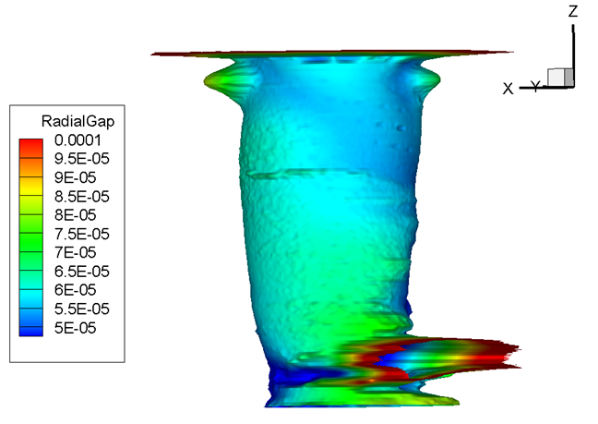
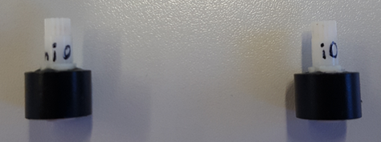
Audi rotor gear i.O Part
20.06.2017 Ali DOGAN
IQC / Internal

Slide 3
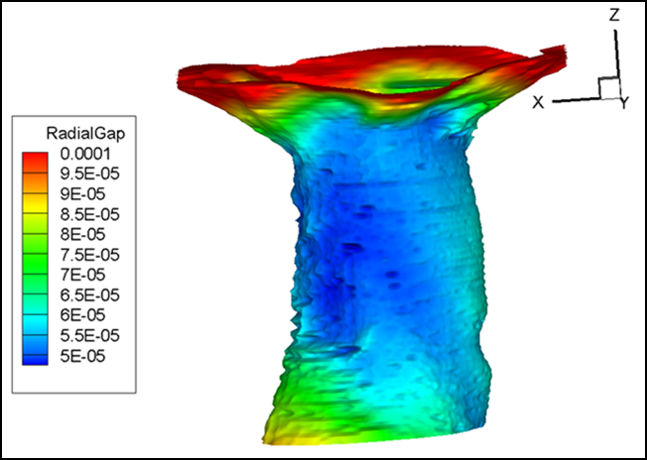
Audi rotor gear n.i.O Part
20.06.2017 Ali DOGAN
IQC / Internal

