Slide 1
Airbnb Data Extraction and Automation Workshop
The World Bank
Day 1 | Advanced Analytics Series

Slide 2
Agenda
Setup & environment preparation
Airbnb grid-based data architecture and recursive tiling
Dynamic listing extraction
Pagination & image handling
Google Maps + Lens integration
Graceful shutdowns & resumable scraping

Slide 3


WARNING!
“Airbnb’s terms prohibit commercial scraping, so this is purely for educational and capacity building purposes”

Slide 4
GitHub link
https://github.com/arindammisra/IndonesiaPoC

Slide 5
Tools and Environment
Python 3.x
Selenium + ChromeDriver
Requests + BeautifulSoup + Regex
Pandas / NumPy
Webdriver-manager for auto driver setup
PowerShell / Terminal for execution:
Use of Selenium instead of requests to avoid blocking and capturing rendered content
pip install selenium pandas numpy requests webdriver-manager

Slide 6
Tools and Environment
Selenium + ChromeDriver
  Automates browser actions (clicks, form filling, scrolling)
  Used for scraping dynamic websites (JavaScript-loaded content)
  ChromeDriver acts as the bridge between Selenium and Chrome browser
BeautifulSoup
  Parses and extracts data from static HTML pages
  Lightweight and fast for structured HTML data extraction
Webdriver-Manager
  Automatically downloads & manages browser drivers (like ChromeDriver)
  Eliminates manual setup hassles for Selenium

Slide 7
Two Stage Approach
First stage – Extract the listings
Second stage - Enrichment

Slide 8
Airbnb URL structure
https://www.airbnb.co.in/s/Sukawati-Bali-ID/homes?omni_page_id=36021&map_toggle=true&dynamic_product_ids%5B%5D=1451927421944172451&room_types%5B%5D=Entire%20home%2Fapt&checkin=2025-11-06&checkout=2025-11-11&date_picker_type=calendar&place_id=ChIJoQ8Q6NNB0S0RkOYkS7EPkSQ&guest_favorite=true&refinement_paths%5B%5D=%2Fhomes&flexible_trip_lengths%5B%5D=one_week&monthly_start_date=2025-12-01&monthly_length=3&monthly_end_date=2026-03-01&search_mode=regular_search&price_filter_input_type=2&price_filter_num_nights=5&channel=EXPLORE&selected_filter_order%5B%5D=room_types%3AEntire%20home%2Fapt&selected_filter_order%5B%5D=guest_favorite%3Atrue&ne_lat=-8.476627153321408&ne_lng=115.28227877636652&sw_lat=-8.585085777507018&sw_lng=115.20886181395713&zoom=12.637687468170414&zoom_level=12.637687468170414&search_by_map=true&search_type=user_map_move&query=Sukawati%20Bali%20ID

Slide 9
Airbnb URL structure
https://www.airbnb.com/s/Bali/homes?flexible_trip_lengths%5B%5D=one_week&monthly_start_date=2025-12-01&monthly_length=3&monthly_end_date=2026-02-01&ne_lat=-8.528780842415433&ne_lng=115.25013632031563&sw_lat=-8.537853723685433&sw_lng=115.24059924469563&zoom=21.7895&zoom_level=21.7895

Slide 10
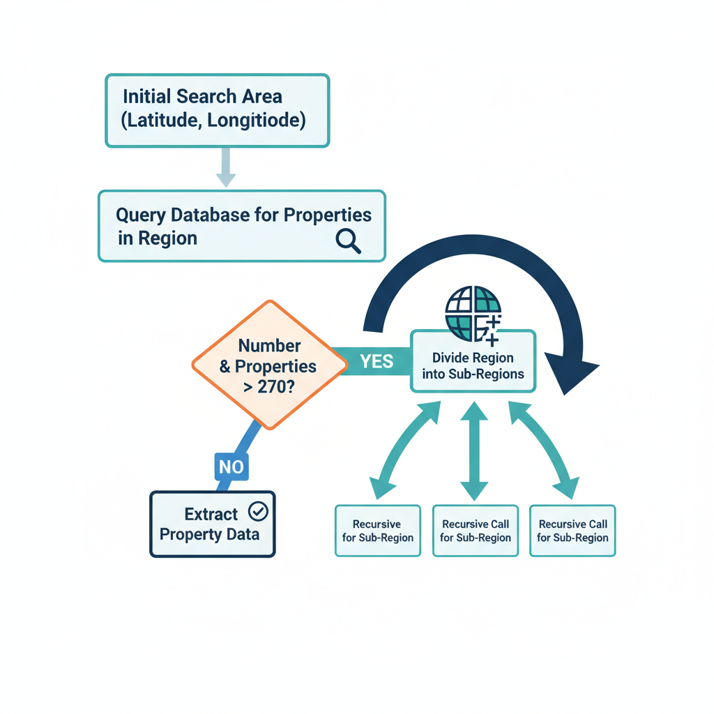
Understanding Airbnb’s Dynamic Structure
Airbnb content is JavaScript-rendered
Listings load dynamically as you pan/zoom the map
Each map view bounded by:
  ne_lat, ne_lng (North-East)
  sw_lat, sw_lng (South-West)
URLs change when moving the map → these parameters drive our scraping

Slide 11
URL Generation Logic
Airbnb interprets these bounds to return listings inside the box
url = f"https://www.airbnb.com/s/Bali/homes?"
url += f"&monthly_start_date={start_date}&monthly_length={monthly_length}"
url += f"&monthly_end_date={end_date}"
url += f"&ne_lat={ne_lat_new}&ne_lng={ne_lng_new}"
url += f"&sw_lat={sw_lat_new}&sw_lng={sw_lng_new}"
url += f"&zoom={zoom_level}"

Slide 12
Recursive Grid Function
Airbnb interprets these bounds to return listings inside the box
def process_grid(sw_lat, sw_lng, ne_lat, ne_lng, lat_pitch, lng_pitch):
driver.get(url)
html = driver.page_source
match = re.search(r'(\d+)\s+home[s]?\s+within map area', html)
if match:
count = int(match.group(1))
if count > 270:
# subdivide into 4
new_lat_pitch = lat_pitch / 2
new_lng_pitch = lng_pitch / 2
mid_lat = (sw_lat + ne_lat) / 2
mid_lng = (sw_lng + ne_lng) / 2
subcells = [
(sw_lat, sw_lng, mid_lat, mid_lng),
(sw_lat, mid_lng, mid_lat, ne_lng),
(mid_lat, sw_lng, ne_lat, mid_lng),
(mid_lat, mid_lng, ne_lat, ne_lng)
]
for cell in subcells:
process_grid(*cell, new_lat_pitch, new_lng_pitch)

Slide 13
Looping Through Grid
Raster scanning across the region. Each loop tile acts like a recursive node
latitudes = np.arange(sw_lat, ne_lat, lat_pitch)
longitudes = np.arange(sw_lng, ne_lng, lng_pitch)
for lat in latitudes:
for lng in longitudes:
process_grid(lat, lng, lat+lat_pitch, lng+lng_pitch, lat_pitch, lng_pitch)
Define Grid
Generate URL
Fetch URL
Count Listings
If >270
Subdivide
Else
Extract Listings

Slide 14
Handling Large Areas and Performance
Controlled subdivision prevents overload
Reuse ChromeDriver across calls
Sleep intervals allow JS to render
KeyboardInterrupt captured for safe exit
try:
# main loop
except KeyboardInterrupt:
driver.quit()

Slide 15
Dynamic Scraping with Selenium, XPath, and Pagination
Selenium Setup and ChromeDriver Initialization
from selenium import webdriver
from selenium.webdriver.chrome.service import Service
from webdriver_manager.chrome import ChromeDriverManager
driver = webdriver.Chrome(service=Service(ChromeDriverManager().install()))
driver.maximize_window()

Slide 16
Waiting for JavaScript-Rendered Content
Airbnb uses lazy-loading; content appears after scripts execute.
Waits ensure full Document Object Model availability before locating elements.
from selenium.webdriver.common.by import By
import time
driver.get(url)
time.sleep(5) # allow dynamic elements to load

Slide 17
Locating Listing Cards with XPath
each listing card is wrapped in a div[itemprop=itemListElement]
find_elements returns a list of web elements — iterated for extraction
listings = driver.find_elements(By.XPATH, "//div[@itemprop='itemListElement']")
print(f"Found {len(listings)} listings.")

Slide 18
Extracting Data Elements
Airbnb uses localized currency text (“Rp” for Indonesian rupiah)
.text and .get_attribute() differ
“.” in XPath means relative search
name = listing.find_element(By.XPATH, ".//div[@data-testid='listing-card-title']").text
price = listing.find_element(By.XPATH, ".//span[contains(text(), 'Rp')]").text
url = listing.find_element(By.TAG_NAME, 'a').get_attribute('href')
img = listing.find_element(By.XPATH, ".//img[@aria-hidden='true']").get_attribute('src’)
For Example for listing in listings:
title = listing.find_element(By.XPATH, “.//h2").text
<div class="listing">
<h2 class="title">Cozy Apartment</h2>
<span class="price">Rp 500.000</span>
</div>
<div class="listing">
<h2 class="title">Luxury Villa</h2>
<span class="price">Rp 2.000.000</span>
</div>

Slide 19
Extracting Rating and Reviews
Airbnb concatenates rating + review count in one string
string manipulation cleans the numeric data
exceptions — try/except protect continuity
rating_el = listing.find_element(By.XPATH, ".//span[contains(text(), 'out of 5 average rating')]")
rating_text = rating_el.text.strip()
rating = rating_text.split(' out of ')[0]
reviews = rating_text.split('reviews')[0].split(',')[-1].strip()

Slide 20
Image Download Function
Uses requests library
SSL disabled for speed – displays warning, but no confidential data involved
Name ensures traceability to listing ID
def download_image(image_url, listing_id):
os.makedirs("Airbnb", exist_ok=True)
img_data = requests.get(image_url, verify=False).content
image_path = f"Airbnb/Property{listing_id}.jpeg"
with open(image_path, "wb") as f:
f.write(img_data)
return image_path

Slide 21
Pagination Logic
Airbnb’s “Next” pagination — identified via aria-label
Loop terminates when the button is missing or number of listings reached
Extract → Find Next → If URL exists and number of pages not reached→ Load next page → Extract again → Repeat
while current_page < num_pages:
next_button = driver.find_element(By.XPATH, "//a[@aria-label='Next']")
next_url = next_button.get_attribute("href")
if next_url:
driver.get(next_url)
time.sleep(5)
current_page += 1
extract_listings()
else:
break

Slide 22
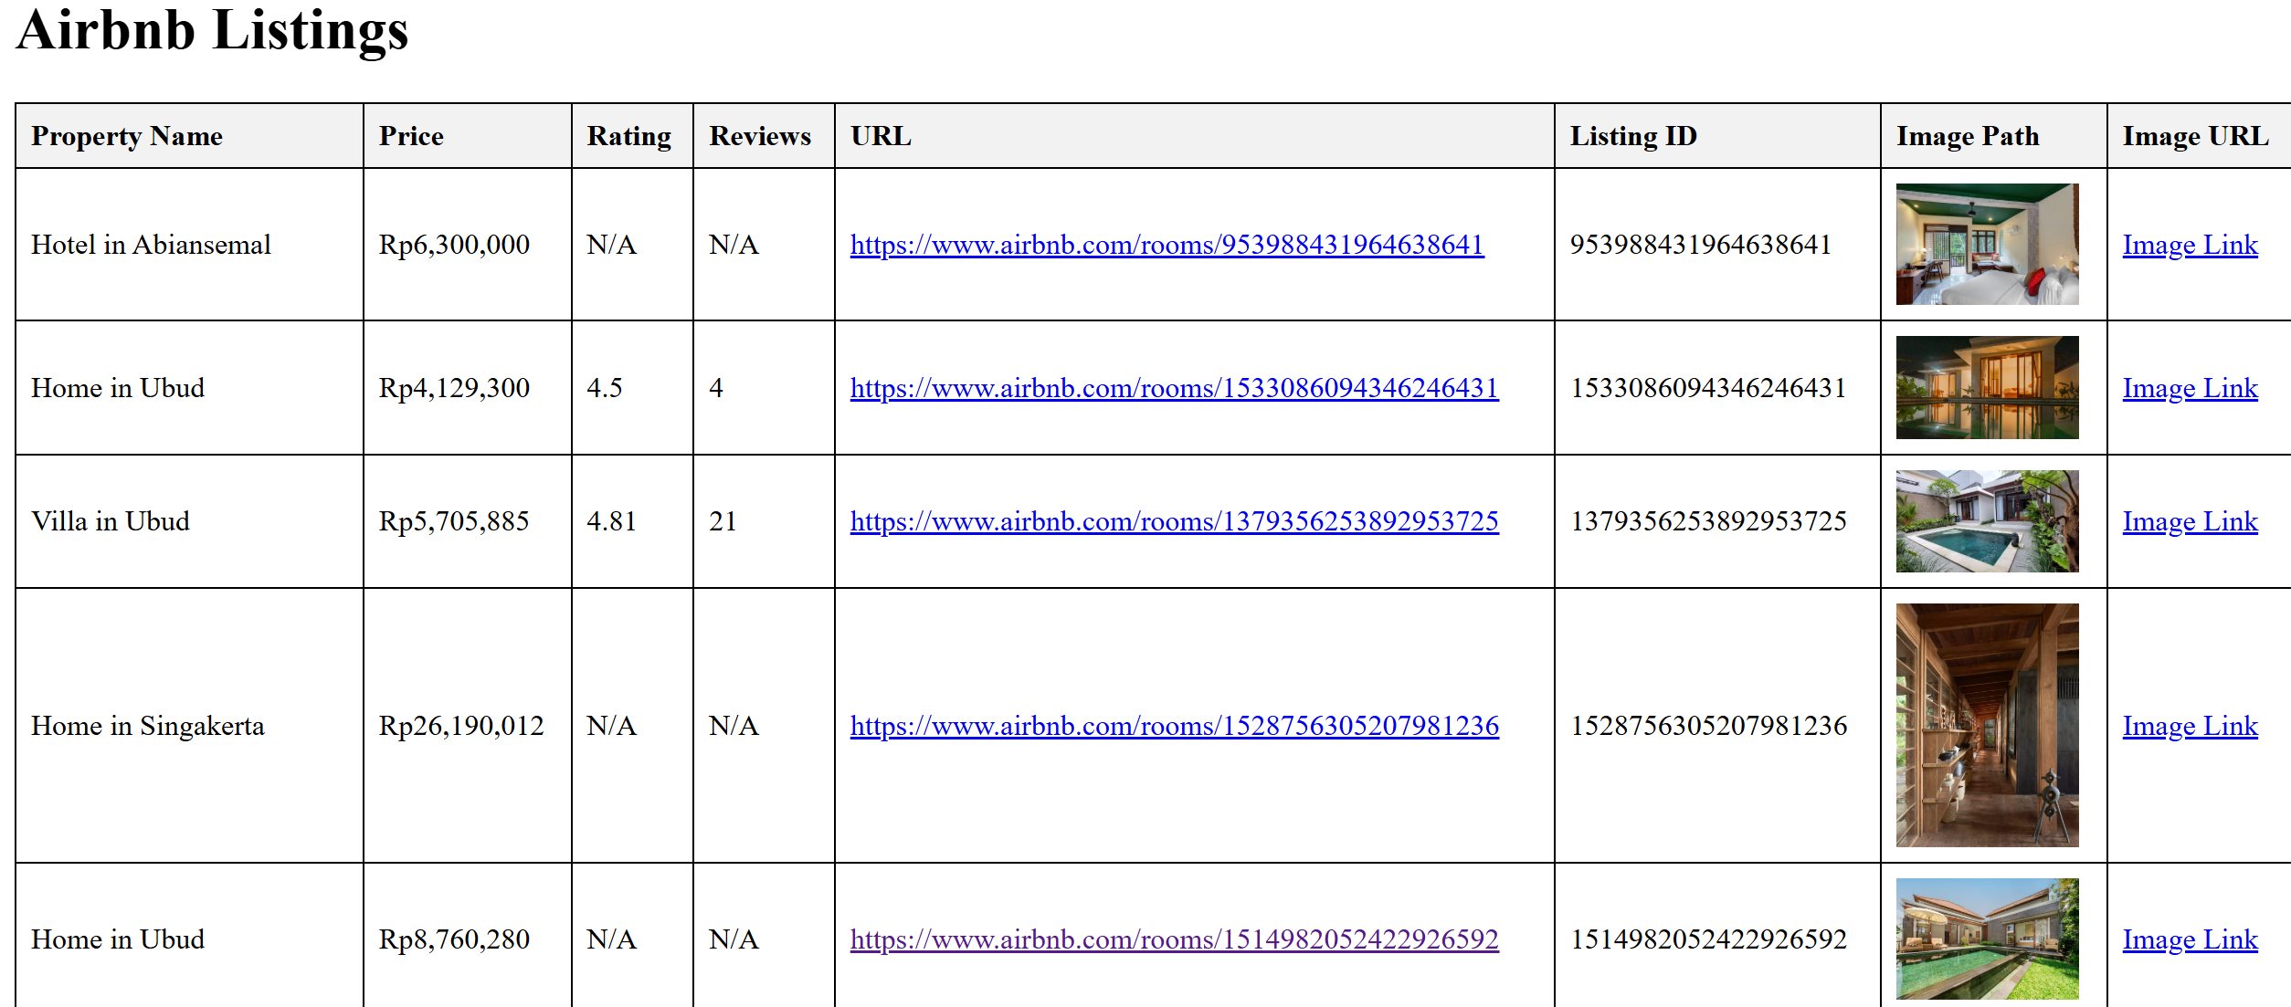
Deduplication and HTML Finalization (Stage 1 Output)
Deduplication performed to ensure that no listing is listed twice
Stage 1 ends with a deduped CSV + HTML preview

Slide 23
Data Augmentation and HTML Enhancement (Stage 2)
Read deduplicated CSV
Visit each listing URL
Extract coordinates and host metadata
Save images locally
Append Google Maps & Lens links
Output augmented CSV and HTML
INPUT_CSV = "Airbnb_listings_deduped.csv"
WORKING_CSV = "Airbnb_listings_augmented.csv"
FINAL_HTML = "Airbnb_listings_final_augmented.html"
DOWNLOAD_FOLDER = "images"
SAVE_INTERVAL = 10
MAX_RETRIES = 3

Slide 24
Core Function – get_listing_data()
function responsible for individual listing extraction
open URL → retrieve HTML → regex parse for required attributes
def get_listing_data(listing_url, property_id):
data = {"lat": "", "lng": "", "host_duration": "", "host_image_path": ""}
driver.get(listing_url)
time.sleep(3)
html = driver.page_source

Slide 25
Extracting Latitude and Longitude and host duration
Airbnb embeds geolocation values inside JSON snippets in the HTML source
Regex captures floating-point numbers following "lat": and "lng":
Regex also captures the hosting duration
lat_match = re.search(r'"lat":([\-0-9.]+)', html)
lng_match = re.search(r'"lng":([\-0-9.]+)', html)
if lat_match and lng_match:
data["lat"] = lat_match.group(1)
data["lng"] = lng_match.group(1)
hosting_match = re.search(r'([0-9]+)\s+(year|month)s?\s+hosting', html)
if hosting_match:
data["host_duration"] = hosting_match.group(0)

Slide 26
Extracting and saving host images
Regex locates user profile image URLs following consistent Airbnb CDN pattern
host_image_match = re.search(
r'https://a0\.muscache\.com/im/pictures/user/[A-Za-z0-9\-/]+?\.(?:jpe?g)',
html
)
if host_image_match:
host_image_url = host_image_match.group(0)
os.makedirs(download_folder, exist_ok=True)
local_path = os.path.join(download_folder, f"Host{property_id}.jpeg")
img_data = requests.get(host_image_url, verify=False, timeout=10).content
with open(local_path, "wb") as f:
f.write(img_data)
data["host_image_path"] = local_path

Slide 27
Adding Google Lens and Google Map Links
Creating URLs for a single-click location and reverse image search
Based on latitude and longitude data
URL of image used with English as language and region as Indonesia
if data["lat"] and data["lng"]:
df.at[idx, "Google Maps Link"] = f"https://www.google.com/maps?q={data['lat']},{data['lng']}"
if image_url.startswith("http"):
df.at[idx, "Lens Link"] = (
f"https://lens.google.com/uploadbyurl?url={image_url}&hl=en&gl=id&q=what+is+the+address+and+map+location+of+this"
)

Slide 28
Creating and Updating an HTML Report
Function – generate_html_from_csv()
HTML Header Template creation
Iterating over rows of the CSV with handling of missing data
Embedding of Images and links
Final HTML Assembly

Slide 29
Using the HTML Report
Use by field officers or DG Tax Staff for determination of properties in a geographical area
Price for 5 nights available for EVERY property
Listing duration available for many properties
Address and precise location can be obtained using the Lens link
Location needs to be matched and correlated with the Airbnb latitude and longitude
Next Step by DG Tax/Local Government – Development of an estimation model for Revenue of the listings depending on the price fluctuations and occupancy

Slide 30
Thank You

