Slide 1
C# Coding Standards And Best Programming Practices
Compiled Version of Coding Best Practices Articles on Web + my experience
- Kiran Patil

Slide 2





Who am I?
Having more than 4 years of experience Working on MS technologies Especially .NET.
Holding MCP,
MCTS,
MCTS-Windows,
MCTS-Web,
MCPD,
MCPD-Web Certifications.
INETA APAC Content Manager and Publisher.
Active on MS Forums.
Passionate C#.NET Programmer.
A “student” strive to learn anything new ☺

Slide 3
Inception
Anybody can write a ‘working code’. But to write ‘Efficient Code’ it requires more work.
To write ‘Efficient Code’ you have to read loads of books and have some years of experience.
I’ve just compiled this document from books I’ve read and years of experience I have. (following Don’t repeat yourself principle).
You might be thinking why PPT not document? Initially I also thought to create a document. But document sounds bit boring and PPT sounds bit interesting and fun!. That’s what I think “Coding should be fun!“
(following Keep it simple and stupid principle)
The coding standard presented next has best practices which should be followed.
This document is not Bible. We will keep updating it as we keep learning.
Efficient code should be
  Easily understandable
  Easily Maintainable
  Efficient
Notes:
#3 – The DRY principle is stated as "Every piece of knowledge must have a single, unambiguous, authoritative representation within a system.“. For More information visit : http://en.wikipedia.org/wiki/Don%27t_repeat_yourself
#4 - The KISS principle states that simplicity should be a key goal in design, and that unnecessary complexity should be avoided. For More information visit : http://en.wikipedia.org/wiki/KISS_principle

Slide 4
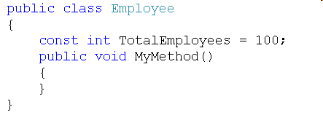
Naming Conventions and Standards
Why?
Use Pascal Casing for Class/Type names, Constants, and Method names.
Notes:
This Capitalization Styles has been suggested by Microsoft for more information have a look at : http://msdn.microsoft.com/en-us/library/x2dbyw72(VS.71).aspx

Slide 5
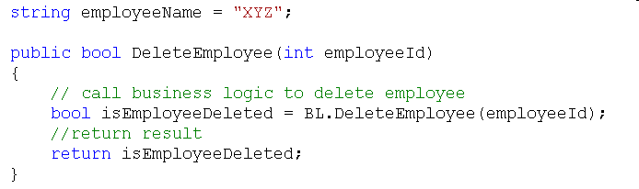
Naming Conventions and Standards – Contd..
Use camel casing for local variable names, and method parameters.
Notes:
This Capitalization Styles has been suggested by Microsoft for more information have a look at : http://msdn.microsoft.com/en-us/library/x2dbyw72(VS.71).aspx

Slide 6

Naming Conventions and Standards – Contd..
Interface names should be prefix with “I” and follow Pascal Casing
Notes:
This Capitalization Styles has been suggested by Microsoft for more information have a look at : http://msdn.microsoft.com/en-us/library/x2dbyw72(VS.71).aspx

Slide 7
Naming Conventions and Standards – Contd..
Do not use Hungarian notation to name variables. For example:
  string strEmployeeName;
  int nEmployeeAge;
To identify member variables follow camel casing as shown earlier.
Use Meaningful, descriptive words to name variables.
  Do not use abbreviations or contractions as parts of identifier names. For example, use OnButtonClick rather than OnBtnClick.
Name method names using verb-object pair, such as ShowEmployee().
Notes:
#1 - Hungarian notation is the practice of including a prefix in identifiers to encode some metadata about the parameter, such as the data type of the identifier. More information : http://msdn.microsoft.com/en-us/library/ms229045.aspx.
If you are thinking why someone should not use Hungarian here are my views :
Readability
You have one variable which can be declared as double/float/Decimal. Then it might confuse other one who is using it e.g. dSalary/fSalary/dSalary. But if you are following camel casing then it will be simple salary. Simple right?

Slide 8

Naming Conventions and Standards – Contd..
Do not use single character variable names, such as i , j, k etc. instead of that use Index or Counter for example:
for (int counter = 0; counter < count; counter ++)
{
……..
}
Methods with return values should have a describing name the value it returns. E.g. GetEmployee().
Suffix custom exception classes with Exception.
Suffix custom attribute classes with Attribute.

Slide 9

Naming Conventions and Standards – Contd..
Prefix boolean variables with “is”. E.g. isEmployeeDeleted.
While naming Namespace follow the standard:
  <company name>.<product name>.<top level module>.<bottom level module> e.g. MyCompany.CMS.Web.Controls
Avoid fully qualified namespace for Type. Good to use Using Statement.
Using Statements should be sort by framework namespaces and then other namespaces.

Slide 10
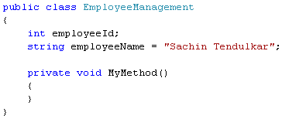
Naming Conventions and Standards – Contd..
File name and class name should be same.
Use Pascal Casing for file name. Keep related Class files in single Class Library.
Declare local variable as close as possible for its first use.
All Member variables should be declared at the top, with one line separating them from Properties and Methods.
Notes:
#1 If file name and class name will be same then maintainability will be easy.
#2 Readability, Maintenance and consistency

Slide 11
Naming Conventions and Standards – Contd..
UI elements (Whether it is under Windows/ASP.NET) should use appropriate prefix so that you can identify them easily.
  Brief list given here – you can create your own!
Control | Prefix
Form | frm
Label | lbl
TextBox | txt
DataGrid | dtg
Button | btn
ImageButton | imb
HyperLink | hlk
DropDownList | ddl
ListBox | lst
DataList | dtl
GridView | gvw
Control | Prefix
Repeater | rep
Checkbox | chk
CheckBoxList | cbl
RadioButton | rdo
RadioButtonList | rbl
Image | img
Panel | pnl
PlaceHolder | phd
Table | tbl
Validators | val

Slide 12
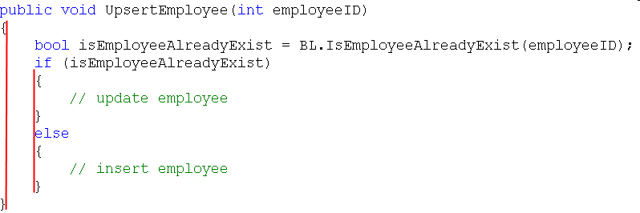
Indentation, spacing and comments
Curly braces should be at the same level.
Use one blank line to separate logical groups of code.
There should be one and only one single blank line between each method inside the class.

Slide 13
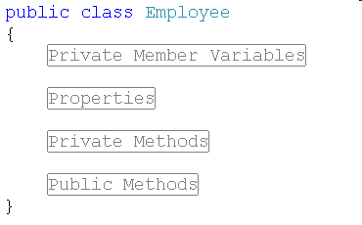
Indentation, spacing and comments – Contd..
Use #region to group related pieces of code together. (To Collapse region – CTRL + M + O and To Expand region – CTRL + M + P)

Slide 14




Indentation, spacing and comments – Contd..
Use TAB for Spaces and Do not use SPACES. Define the Tab Size as 4 (Tools | Options | Text Editor | <language> | Tabs)
Comments should be in the same level as the code (use the same level of indentation).

Slide 15
Indentation, spacing and comments – Contd..
Comments are great piece of document. It makes code more maintainable.
All Comments should pass spell checking.
Use // or /// for comments. Avoid using /* … */ -- Xml Documentation
Write comments whenever required. But if you have followed naming standards and best practices which makes your code more readable requires less comments.
Do not write the comment if code is easily understandable. Because if you update the code and forgot to update the comments it will lead to confusion.
If you have to write some complex logic, document it very well with sufficient comments.
For all special implementation in your code. Do comment it!
While writing comments make sure proper grammar and punctuation has been used.
Notes:
#3 – Xml Documentation is a great feature using which you can produce professional, indexed, and searchable source documentation. for more on it visit : http://www.codeproject.com/KB/XML/csharpcodedocumentation.aspx

Slide 16



Coding Best Practices
Class file and Class/namespace should have a one-to-one relationship.
Avoid long methods. Define some limit(e.g. 200 lines) if method goes beyond the limit then it’s time to refactor it!
Method should not have more than 5 arguments. Use structures for passing multiple arguments.
Method name should tell what it does. Do not use mis-leading names. If the method name is obvious, there is no need of documentation explaining what the method does.
Avoid comments that explain the obvious. Code should be self-explanatory. Good code with readable variable and method names should not require comments.
Document only operational assumptions, algorithm insights and so on.
Notes:
#1 – Maintainability!
#2 – If your method is becoming too long like 200 lines then it’s time to refactor it because today you are working on that method and you know all the things but tomorrow some one else might need to work on it and if method is 200 lines long the person will go mad in spite of that if you do refactor and create individual methods based on functionality the piece of code does. E.g. If you have a method SaveEmployee which does following tasks:
Input data is valid or not – why not put this code in one method called “IsValidEmployee()”.
Do some Business Logic – why not put this code in one method called “ApplyBusinessLogicOnEmployee()”.
#3 – Readability and Maintainability. For example today you have method with 5 arguments and tomorrow you need to add one more argument then if you do so then all callers should have to change their code.
#4 – It is possible to split the definition of a class or a struct, or an interface over two or more source files. Each source file contains a section of the class definition, and all parts are combined when the application is compiled. There are several situations when splitting a class definition is desirable:
When working on large projects, spreading a class over separate files allows multiple programmers to work on it simultaneously.
When working with automatically generated source, code can be added to the class without having to recreate the source file. Visual Studio uses this approach when creating Windows Forms, Web Service wrapper code, and so on. You can create code that uses these classes without having to edit the file created by Visual Studio.
See more on partial at : http://msdn.microsoft.com/en-us/library/wa80x488(VS.80).aspx

Slide 17
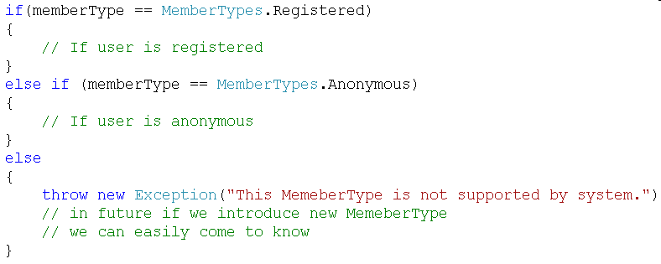
Coding Best Practices – Contd..
A method should have only ‘single responsibility'. Do not combine more than one responsibility in a single method, even if those responsibilities are very small. - Example
Always watch for unexpected values. For example, if you are using a parameter with 2 possible values, never assume that if one is not matching then the only possibility is the other value.

Slide 18


Coding Best Practices – Contd..
Do not hardcode number. Use constants instead. Are you sure value should be declared as constant/config? - Example
Convert strings to lowercase or upper case before comparing. This will ensure the string will match even if the string being compared has a different case.
Use string.Empty instead of “”

Slide 19
Coding Best Practices – Contd..
Avoid sharing member variables amongst methods. Better to declare local variables and pass it to other methods. Sharing member variables may lead to confusion. - Example
Use enum wherever required. Do not use numbers or strings to indicate discrete values. – Example
  For Readability and Maintainability.
  Better error-checking and compiler warnings.

Slide 20
Coding Best Practices – Contd..
Do not make the member variables public or protected. Keep them private and expose public/protected Properties.
Never hardcode a path or drive name in code. Get the application path programmatically and use relative path.
In the application start up, do some kind of "self check" and ensure all required files and dependencies are available in the expected locations. Check for database connection in start up, if required. Give a friendly message to the user in case of any problems.
If a wrong value found in the configuration file, application should throw an error or give a message and also should tell the user what are the correct values.
Error messages should help the user to solve the problem. Never give error messages like "Error in Application", “object reference not set to an instance of an object" etc. Instead give specific messages like “Failed to connect to database. Please ensure that database server is on." - Example
Show short and friendly message to the user. But log the actual error with all possible information. This will help a lot in diagnosing problems.
Notes:
#1 – Using properties we can put some Business logic/any validation logic in our properties to ensure that users provide the values which we are expecting!

Slide 21
Coding Best Practices – Contd..
Avoid having very large files. If a single file has more than 1000 lines of code, it is a good candidate for refactoring. Split them logically into two or more files using Partial. – Example
Method which returns collection object. If no data found then it should always return empty collection -- To reduce chance of error. – Example
Use the AssemblyInfo file to fill information like version number, description, company name, copyright notice etc. – Example
Use Powerful, configurable and flexible Logging class heavily! - Log4Net fits in this picture. – Example
Notes:
#1 – If you split files logically then maintainability will be easy and on different functionality working will be easy when you are working in Subversion environment where single check in only allowed.

Slide 22




Coding Best Practices – Contd..
If your code opens database connection/socket/file/stream then close them in finally block.– Example
When manipulating string use StringBuilder instead of String – for better performance.
Avoid ToString() and use Convert.ToString() Method.
Before using any instance method/properties always check that object is not null.
Notes:
#2 – StringBuilder is mutable and String Is Immutable. Means if you have string variable and you are appending anything to that string variable then it will destroy current instance of string and create new one while String Builder will use the same string object reference on Append operation. – This can improve performance.
#3 – If you use

Slide 23
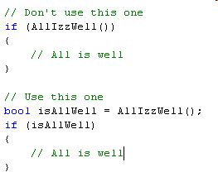

Coding Best Practices – Contd..
Every line of code should be tested in a “white box” testing matter.
Avoid function calls in Boolean conditional statements. Assign in to local variables and check them.
Always Mark public and protected methods as virtual in a non-sealed class.
Notes:
#1 – Means each and every line of code should passed from debug point. Because sometimes we write the code which may create problem in some specific scenarios and White Box Testing can reduce chance of this kind of errors. For more : http://en.wikipedia.org/wiki/White-box_testing
#2 – For Readability, Maintainability – Using Quick watch another developer can see local variables value before and after method call.
#3 – As the methods are public anyone can access them and if some one would like to redefine the behavior then if method has been declared as virtual can be redefined using Overridden keyword without changing code of base class. http://en.wikipedia.org/wiki/Virtual_function

Slide 24




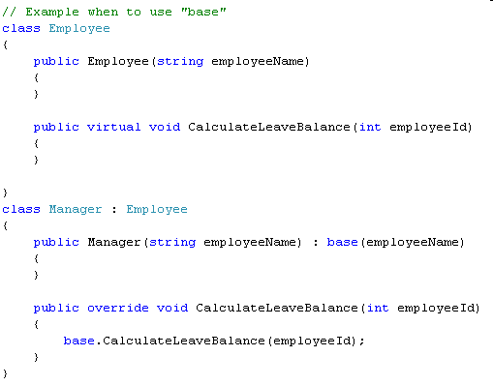
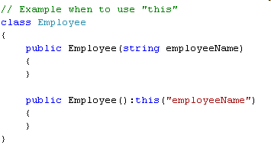
Coding Best Practices – Contd..
Avoid Explicit casting. Use the as operator to defensively cast to a type.
Use the base and this wisely.
Notes:
#1 - The as operator is like a cast operation. However, if the conversion is not possible, as returns null instead of raising an exception. Consider the following expression: expression as type
It is equivalent to the following expression except that expression is evaluated only one time.
expression is type ? (type)expression : (type)null
Fo more info : http://msdn.microsoft.com/en-us/library/cscsdfbt.aspx

Slide 25
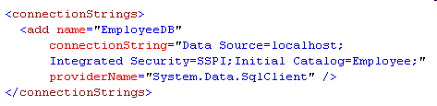
Database Best Practices
Never hard-code connection string. Always declare connection string in configuration file [app.config/web.config] and use it from there only.
Avoid SQL Server authentication. Use Windows Authentication instead.
Always use Stored procedures and avoid to use SQL Statements in the code. -- SQL Statements eats your network bandwidth.
Batch operation should be atomic. So, always use Transaction for this type of operations. [If either task fails, the both operations should be rolled back.]
Notes:
#2 - Microsoft’s best practice recommendation is that you use Windows authentication mode whenever possible. The main benefit is that the use of this mode allows you to centralize account administration for your entire enterprise in a single place: Active Directory. This dramatically reduces the chances of error or oversight.
For example, consider the scenario where a trusted database administrator leaves your organization on unfriendly terms. If you use Windows authentication mode, revoking that user’s access takes place automatically when you disable or remove the DBA’s Active Directory account. If you use mixed authentication mode, you not only need to disable the DBA’s Windows account, but you also need to comb through the local user listings on each database server to ensure that no local accounts exist where the DBA may know the password. That’s a lot of work!
In conclusion, I suggest that you heed Microsoft’s advice and implement Windows authentication mode for your SQL Server databases whenever possible.

Slide 26
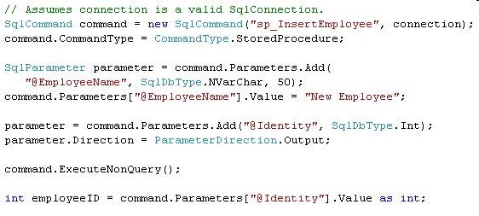
Database Best Practices – Contd..
Don’t put complex business logic inside the stored procedure. It should go under Business Logic Layer.
For installing database on client machine create installer scripts using sqlcmd.
To avoid SQL Injection never write direct SQL statements in the code. Instead of that use SQL Parameters and stored procedures.
Notes:
#1 – Because if it is under SP then it will be difficult to Debug and If it is under Business Logic then you can easily achieve the functionality using .NET framework’s Classes and Visual Studio has a nice debugger! – Which will make your application easily maintainable.
#2 - The sqlcmd utility lets you enter Transact-SQL statements, system procedures, and script files at the command prompt, in Query Editor in SQLCMD mode, in a Windows script file or in an operating system (Cmd.exe) job step of a SQL Server Agent job. This utility uses OLE DB to execute Transact-SQL batches.
#3 - http://en.wikipedia.org/wiki/SQL_injection, http://unixwiz.net/techtips/sql-injection.html

Slide 27
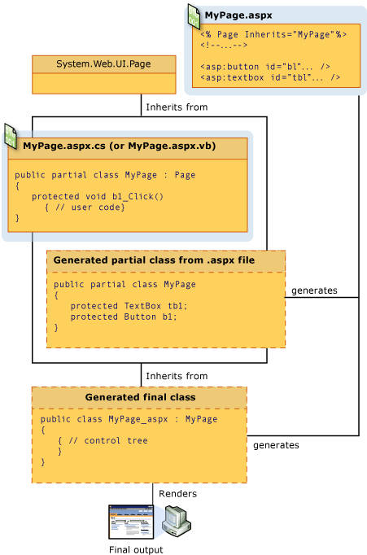
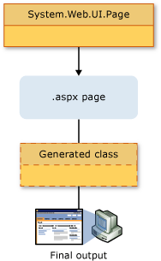
ASP.NET Best Practices
Avoid single file model(.aspx) and follow code-behind model(.aspx|.aspx.cs).
Notes:
#1 – Maintainability and take benefit of Partial class

Slide 28
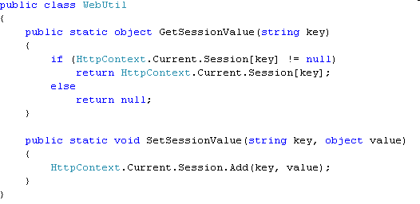

ASP.NET Best Practices – Contd..
Do not use session variables throughout the code. Use session variables only within the classes and expose methods to access the value stored in the session variables. A class can access the session using System.Web.HttpContext.Current.Session
Notes:
#1 – Maintainability

Slide 29
ASP.NET Best Practices – Contd..
Do not store large objects in session. Storing large objects in session may consume lot of server memory depending on the number of users.
Do not store large objects in View State. It will increase page load time.
ASP.NET Code should not contain any business logic. It should call a business logic component.
Use Style sheet for providing consistent look and feel to an application.
Handle exceptions gracefully use global exception handling [Page_Error Or Application_Error].– Example
Don’t use absolute paths – until and unless you have strong reason to do so. Prefer to use Server.MapPath(“~/…..”);
Avoid Copy – Pasting same code everywhere. Better to put them in Base Class or create new utility class.
Notes:
#4 - Always use style sheet to control the look and feel of the pages. Never specify font name and font size in any of the pages. Use appropriate style class. This will help you to change the UI of your application easily in future. Also, if you like to support customizing the UI for each customer, it is just a matter of developing another style sheet for them.
#6 – If you use static absolute paths then when you deploy application on other machine it will be headache to make it working.
#7 – Maintenance and Reusability.

Slide 30
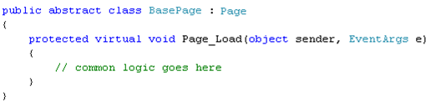
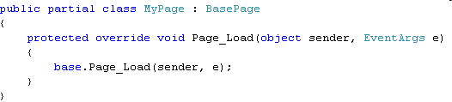
ASP.NET Best Practices – Contd..
Create Base Page for your application and all your pages/web forms should be derived from your Base Page.
If possible, follow the same concept while using ASP.NET Web Server Controls. E.g. TextBox, DropDownList etc.
Always have the mock-up screens of all forms before your eyes. And do brainstorming session in team to make reusable components out of them. [ WebControl(.dll) / UserControl(.ascx)]

Slide 31

ASP.NET Best Practices – Contd..
If you are going to render some value on page from un trusted source then you should use HtmlEncode method. – This is called XSS attack.
Avoid writing complex logic in JavaScript. JS Should be used to provide rich experience to an end user. And always keep in mind “JS is Disabled scenario”.
Cookies should not store large values[Limit – 4096 bytes] And always keep in mind “Cookies are Disabled scenario”.
Always keep in mind your deployment plan. And your deployment should be easy (Precompiled,Xcopy,WebSetup).

Slide 32
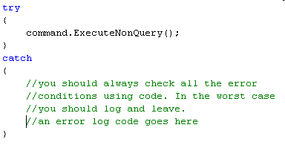
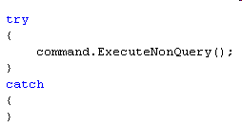

Exception Handling and Logging
Always “Expect the unexpected”. We all developers think that my code has no exception. But when it goes live something comes up and we spend our whole day figuring out what went wrong. So, always catch and log the exception.
Never put empty try…catch.
In case of exceptions, give a friendly message to the user, but log the actual error with all possible details about the error, including the time it occurred, method and class name etc.
Don’t catch generic exceptions. To handle them use Global Error Handling

Slide 33



Exception Handling and Logging – Contd..
Always catch exceptions from specific to generic. - Example
While re throwing an exception use throw statement which will preserve original stack trace.
Always log the exceptions[Log4Net!] and critical business operations[Database/Any other data source].
Avoid very large try-catch blocks. Put each task in one try—catch block. This will help you find which piece of code generated the exception and you can give specific error message to the user.

Slide 34
Visual Studio IDE Tips and Tricks
Editing
  Collapses existing regions to provide a high-level view of the types and members (CTRL + M + O)
  Removes all outlining information from the whole document. (CTRL + M + P)
  Toggles the currently selected collapsed region. (CTRL + M + M)
  Inserts // at the beginning of the current line or every line of the current selection. (CTRL + K + C)
  Removes the // at the beginning of the current line or every line of the current selection. (CTRL + K + U)
  Formats the current document according to the indentation and code formatting settings specified on the Formatting pane under Tools | Options | Text Editor | C#. (CTRL + K + D)

Slide 35
Visual Studio IDE Tips and Tricks
Editing – Contd..
  Pastes text from the Clipboard ring to the cursor location in the file. Subsequent use of the shortcut key iterates through the items in the Clipboard ring. (CTRL + SHIFT + V)
  Displays the available options on the smart tag menu.(CTRL + .)
Intellisense
  Displays the available options on the smart tag menu. (CTRL + K + I)
  Causes a visible completion list to become transparent. (CTRL)
Debugging
  Conditional Debug
  Launch in Debug Mode (F5)
  Launch without Debug Mode (CTRL + F5)
  Sets or removes a breakpoint at the current line (F9)
  To Remove all breakpoints (CTRL + SHIFT + F9)

Slide 36
Visual Studio IDE Tips and Tricks – Contd..
Navigation
  Displays a list of all references for the symbol selected (CTRL + K + R)
  Moves the cursor location to the matching brace in the source file (CTRL + ])
  Navigates to the declaration for the selected symbol in code (F12)
  Moves to the previously browsed line of code (CTRL + -)
  Displays the selected item in Code view of the editor (F7)
  Switches to Design view for the current document. Available only in Source view (SHIFT + F7)
  Switches to Source view for the current document. Available only in Design view (SHIFT + F7)
  Displays the Quick tab of the Find and Replace dialog box (CTRL + F)
  Displays the Go To Line dialog box (CTRL + G)

Slide 37
Visual Studio IDE Tips and Tricks – Contd..
Window
  Displays the Class View window (CTRL + W + C)
  Displays the Class Definition window (CTRL + W + D)
  Displays the Error List window (CTRL + W + E)
  Displays the Object Browser (CTRL + W + J)
  Displays Solution Explorer, which lists the projects and files in the current solution (CTRL + W + S)
  Displays the Task List window (CTRL + W + T)
  Closes the current tool window (SHIFT + ESC)
  Closes the current tab (CTRL + F4)
  Displays the IDE Navigator, with the first document window selected (CTRL + TAB)

Slide 38
Visual Studio IDE Tips and Tricks – Contd..
Refactoring
  Displays the Encapsulate Field dialog box, which allows creation of a property from an existing field and updates all references to use the new property (CTRL + R + E)
  Displays the Extract Method dialog box, which allows creation of a new method from the selected code (CTRL + R + M)
  Displays the Remove Parameters dialog box, which allows removal of parameters from methods, indexers, or delegates by changing the declaration at any locations where the member is called (CTRL + R + V)
  Displays the Rename dialog box, allows renaming all references for an identifier (CTRL + R + R/F2)
  Displays the Reorder Parameters dialog box, which allows changes to the order of the parameters for methods, indexers, and delegates (CTRL + R + O)

Slide 39
Visual Studio IDE Tips and Tricks – Contd..
Snippets
  Class (class | TAB | TAB)
  Constructor (ctor | TAB | TAB)
  Windows - Message Box (mbox | TAB |TAB)
  Console – WriteLine (cw | TAB | TAB)
  Property – (prop | TAB | TAB)
  For more snippets ( CTRL + K + X)
Build
  Builds all the projects in the solution (F6 / CTRL + SHIFT + B)
  Builds the selected project and its dependencies (SHIFT + F6)
My Favorites
  Enum and Switch case

Slide 40
Revision History
As I said earlier this document is not Hard-Coded. Anyone can amend his/her changes anytime. If you are going to do so (Really great idea!) then please update the revision history with following details. So, anybody can distinguish between your changes
Sr. No. | Date Time | Changed By | Description
1 | 11/19/2009 2:32:20 PM | Kiran Patil | Initial Draft

Slide 41

Q and A
The important thing is not to stop questioning. - Albert Einstein

Slide 42
Resources
C# Coding Standards and Best Programming Practices from http://www.dotnetspider.com
IDesign C# Coding Standard 2.32 By Juval Lowy(www.idesign.net)
http://msdn.microsoft.com/en-us/library/xzf533w0(VS.71).aspx
My Experience

Slide 43



Thank you!
http://kiranpatils.wordpress.com – for new stuff
http://twitter.com/kiranpatils
Provide your invaluable feedback here : http://www.surveymonkey.com/s/SX2RJKD
Happy Coding! ☺
-Kiran Patil
klpatil@hotmail.com
http://kiranpatils.wordpress.com/

Slide 44
Glossary
It contains all the Key Terms which has been used across the document.

Slide 45


Pascal Casing
First character of all words are Upper Case and other characters are lower case. Example EmployeeName

Slide 46

Camel Casing
First character of all words, except the first word are Upper Case and other characters are lower case. Example employeeName

Slide 47
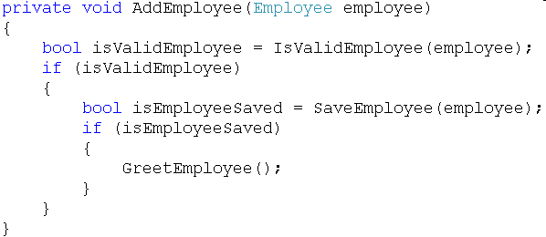
Example : Single Responsibility
Notes:
In object-oriented programming, the single responsibility principle states that every object should have a single responsibility, and that responsibility should be entirely encapsulated by the class. All its services should be narrowly aligned with that responsibility. Src :http://en.wikipedia.org/wiki/Single_responsibility_principle
If you assign single responsibility to each method then it will be easy to debug and find out the bug. If you put everything under one method and for some change if you do code change it will increase the chance of bug.
It also allows peoples to work on independently for example AddEmployee method does following things:
ValidateEmployee
SaveEmployee
GreetEmployee
three guys can work on different piece of code at a time – Remembered Partial class?

Slide 48

Example : Constant/Config
Notes:
Do not hardcode numbers. Use constants instead. Declare constant in the top of the file and use it in your code.
However, using constants are also not recommended. You should use the constants in the config file or database so that you can change it later. Declare them as constants only if you are sure this value will never need to be changed (e.g. Days of the week).

Slide 49
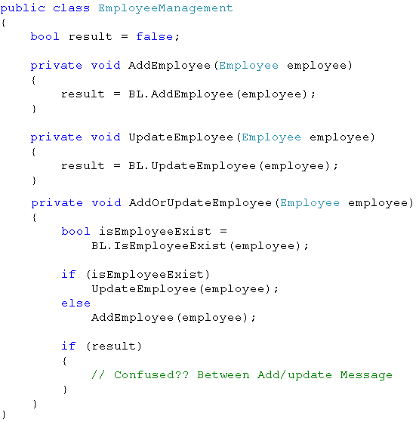
Example : Passing Variables
Notes:
Now if you see result flag is updated by two methods AddEmployee and UpdateEmployee. Now, suppose you have one caller method
Which calls either of this method based on employee exist or not if you check the “result” flag then you can’t identify which method got
Executed. So, it’s better to declare local variables.

Slide 50
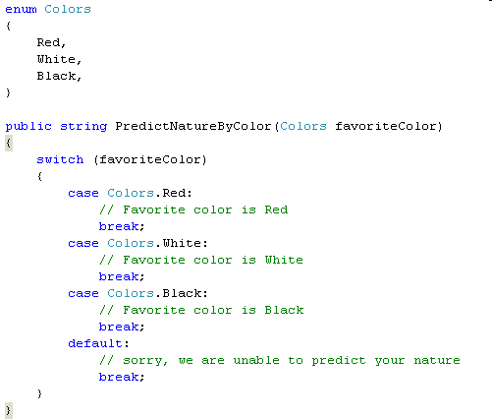
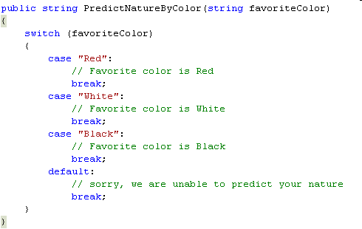
Example : Enum

Slide 51
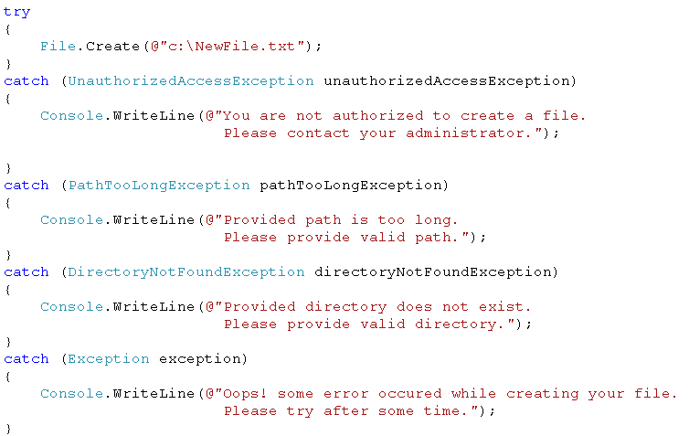
Example : Exception Handling

Slide 52
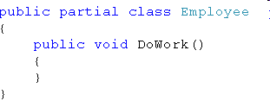
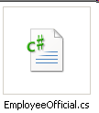
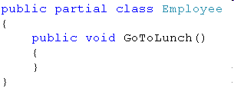
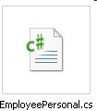
Example : Group Logical Files

Slide 53
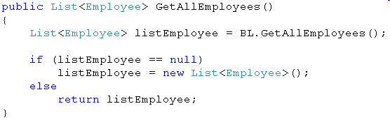
Example : Collection Method
Notes:
If you have a method returning a collection, return an empty collection instead of null, if you have no data to return. For example, if you have a method returning an List<Employee>, always return a valid List. If you have no items to return, then return a valid List<Employee> with 0 items. This will make it easy for the calling application to just check for the “count” rather than doing an additional check for “null”.

Slide 54
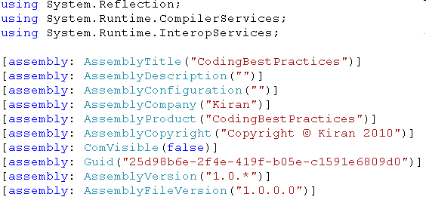
Example : AssemblyInfo

Slide 55
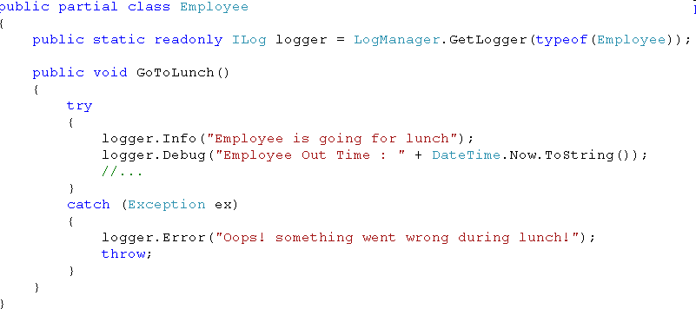
Example : Log4Net

Slide 56
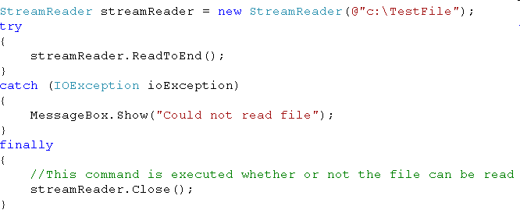
Example : try-catch-finally
Notes:
A Finally statement can be used within a Try block to ensure allocated resources are clean. The code in a Finally block runs after the exception-handling code, but before control returns to the calling procedure. The code in a Finally block will run even if your code throws an exception, and even if you add an explicit return statement within a catch block.
If you do not need to catch specific exceptions, the Using statement behaves like a Try…Finally block, and guarantees disposal of the resources, no matter how you exit the block. This is true even in the case of an unhandled exception.

Slide 57


Example : SQL Injection
SELECT * FROM userinfo WHERE id = 1;DROP TABLE userinfo;
Notes:
Visit : http://en.wikipedia.org/wiki/SQL_injection, http://unixwiz.net/techtips/sql-injection.html

Slide 58
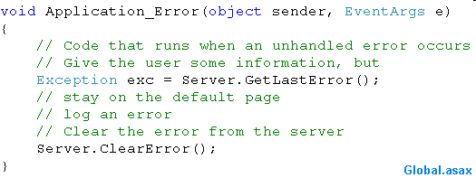
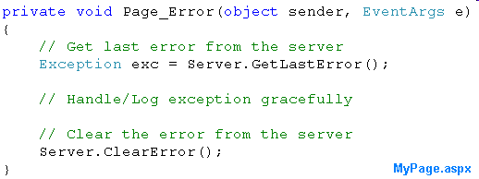
Example : Global Error Handling

