Slide 1
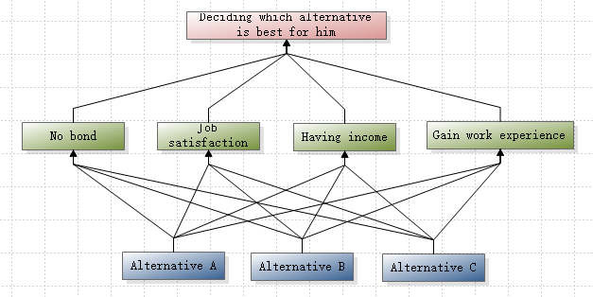
TIE4203 Decision Analysis in Industrial Operations & Management (2023) Name 1 Name 2
Problem Description
<Header>
Text minimum font size = 14pt.
<Header>
<Header>
Conclusion
<Header>
Text minimum font size = 14pt.

