Slide 1
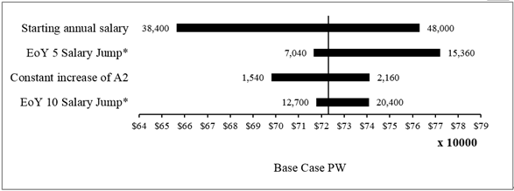
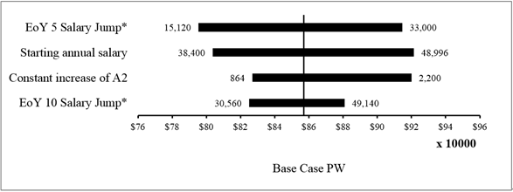
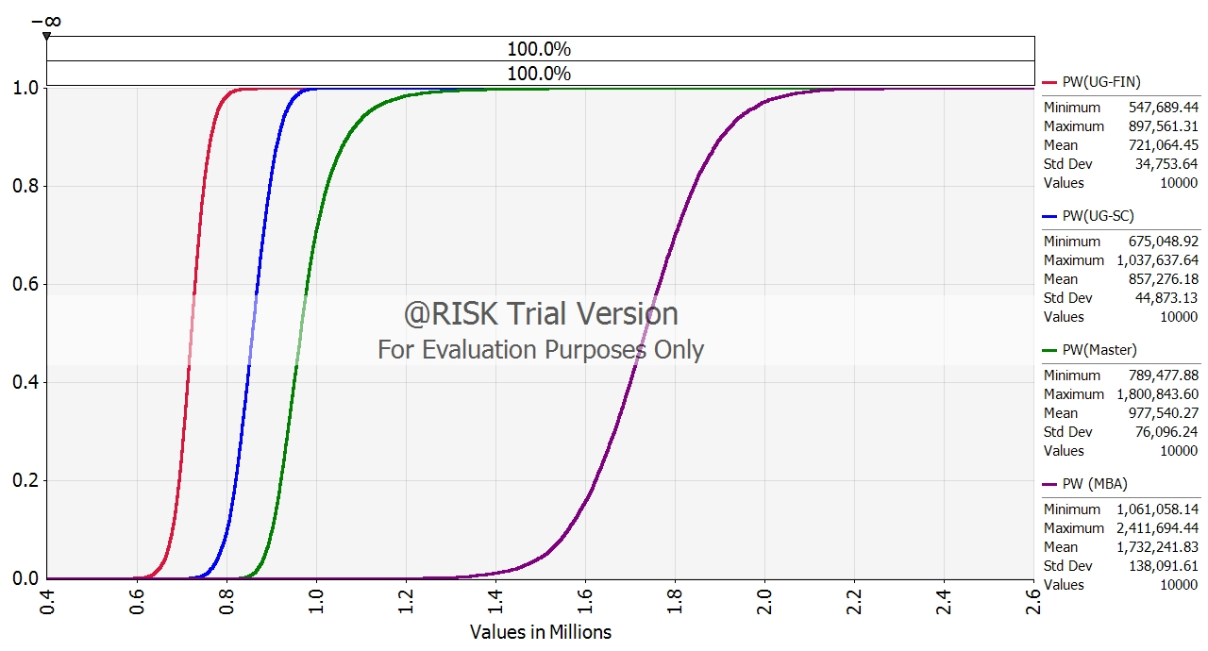
TIE2140 Engineering Economy (2024) Project Project Title Name 1 Name 2
Problem Description
<Header>
Text minimum font size = 14pt.
<Header>
<Header>
<Conclusion>
<Header>
Text minimum font size = 14pt.

