Slide 1
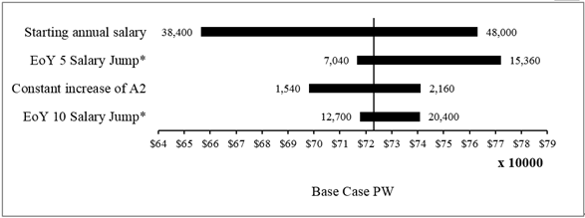
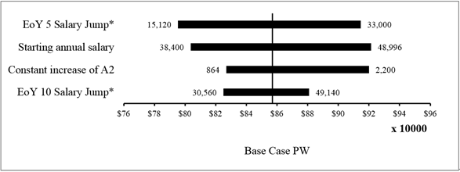
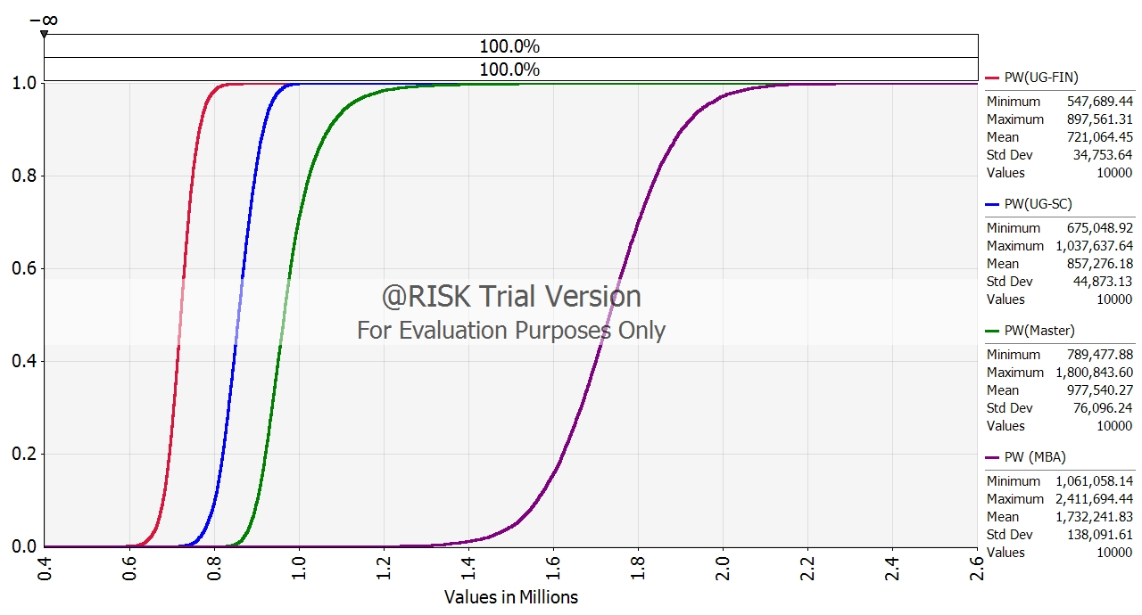
IE2111 ISE Principles & Practice II (2024) Project Project Title Name 1 Name 2 Name 3 Name 4 Name 5 Name 6
Problem Description
<Header>
Text minimum font size = 14pt.
<Header>
<Header>
<Conclusion>
<Header>
Text minimum font size = 14pt.

