Slide 1
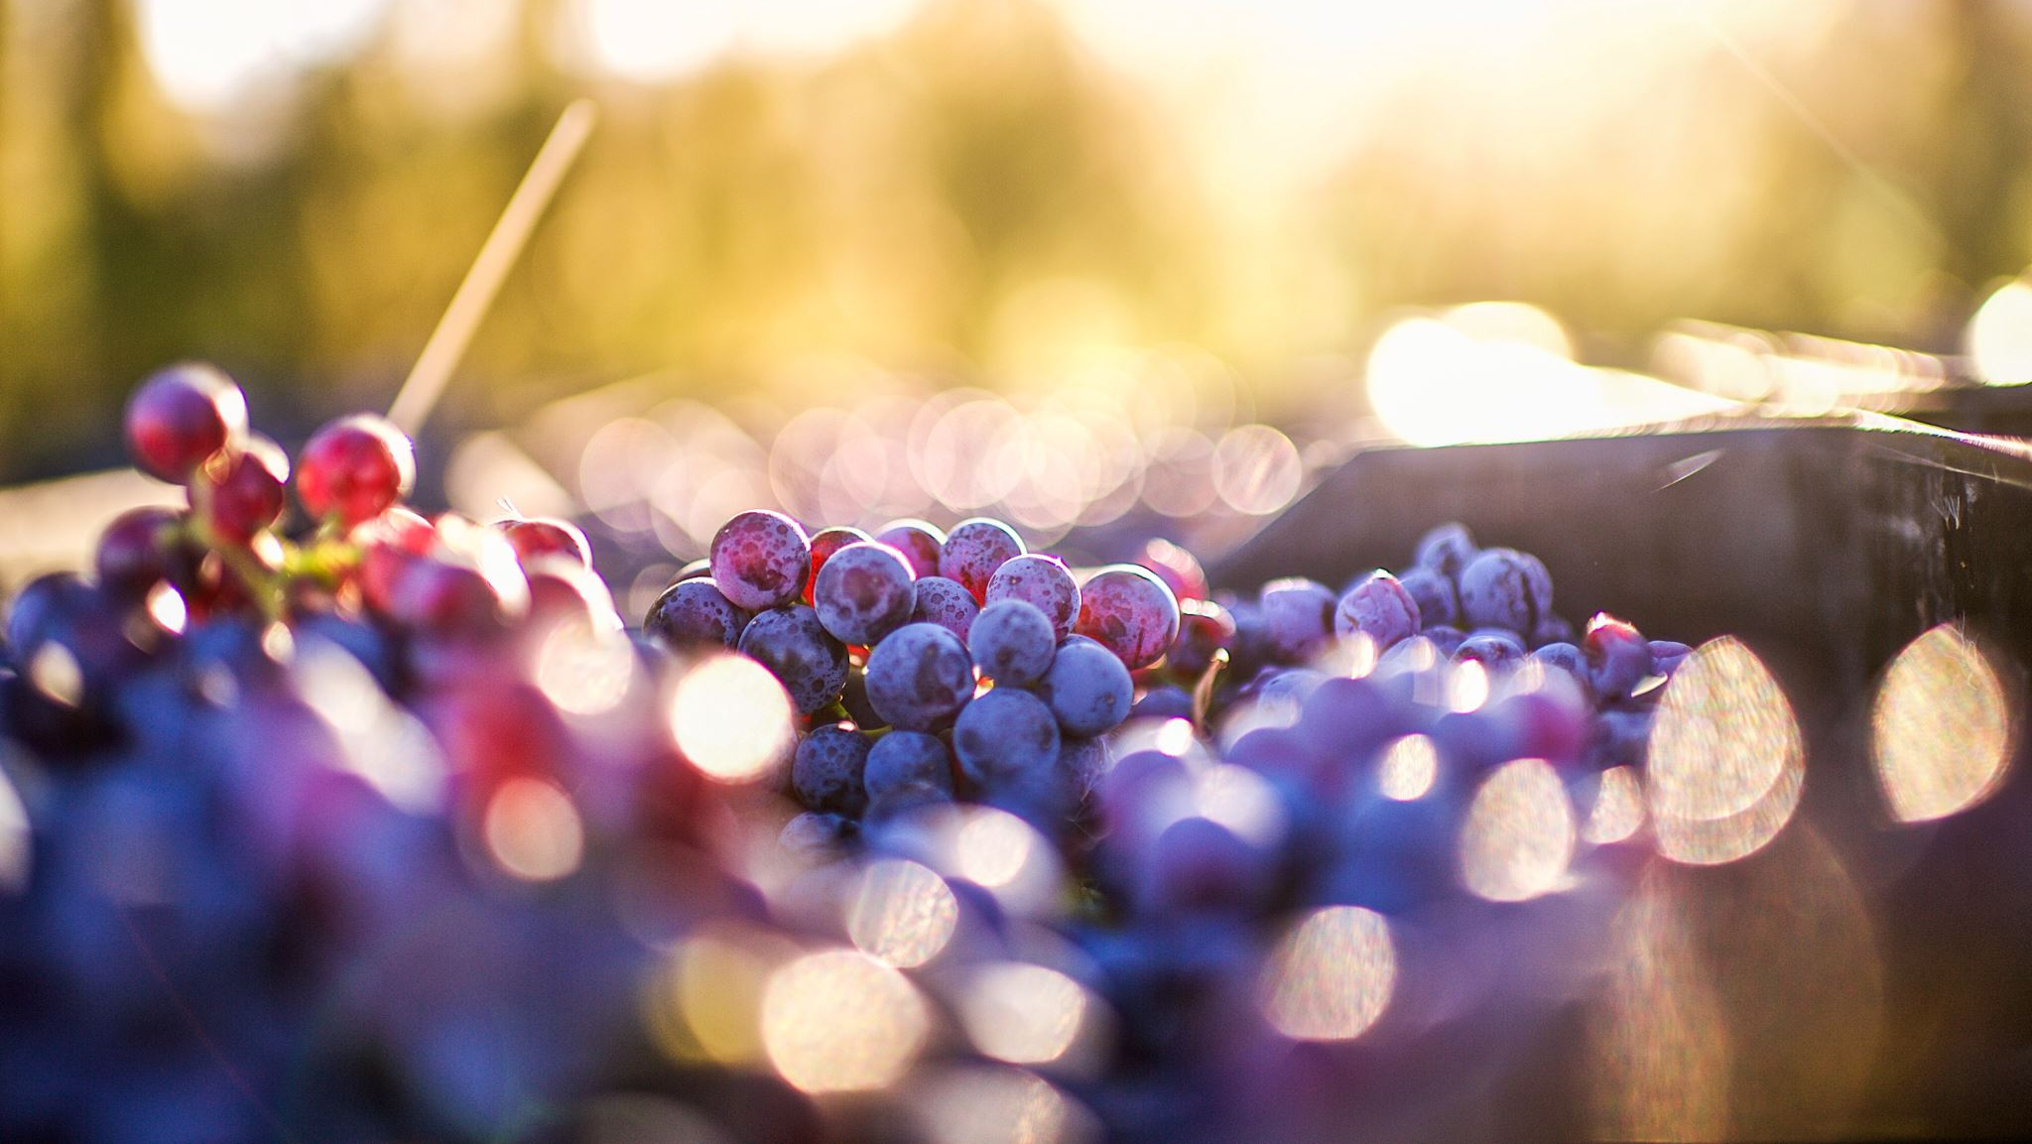
Predicting Wine Quality
Noelle Ferrari and Katarina Salcedo

Slide 2
Project Overview
Predict wine quality to give the Washington winegrower’s association a model for choosing wines to send to competitions

Slide 3
Data Overview
Data collected by UCI and sourced from Kaggle: https://www.kaggle.com/huseyinelci/wne-qualty-by-uci
Contains 11 different chemical features of each wine
Each wine is scored for quality on a scale of 1-10

Slide 4
EDA
any visualizations that will be relevant to your analysis/modeling
annotate if needed!

Slide 5
modeling (1-2 slides)
present your final model (or an intermediate one if you think it adds to your presentation)
briefly talk about any feature selection/feature engineering that you did
eliminated variables based on p-values, removed collinear variables
interaction terms, scaling, transforming, etc.
evaluate your model and interpret some of the more important coefficients
interpret your R2 with the correct definition
show RMSE

Slide 6
summary/conclusions/recommendations
summarize all your insights in a single slide and (if applicable) add any overall recommendations

Slide 7
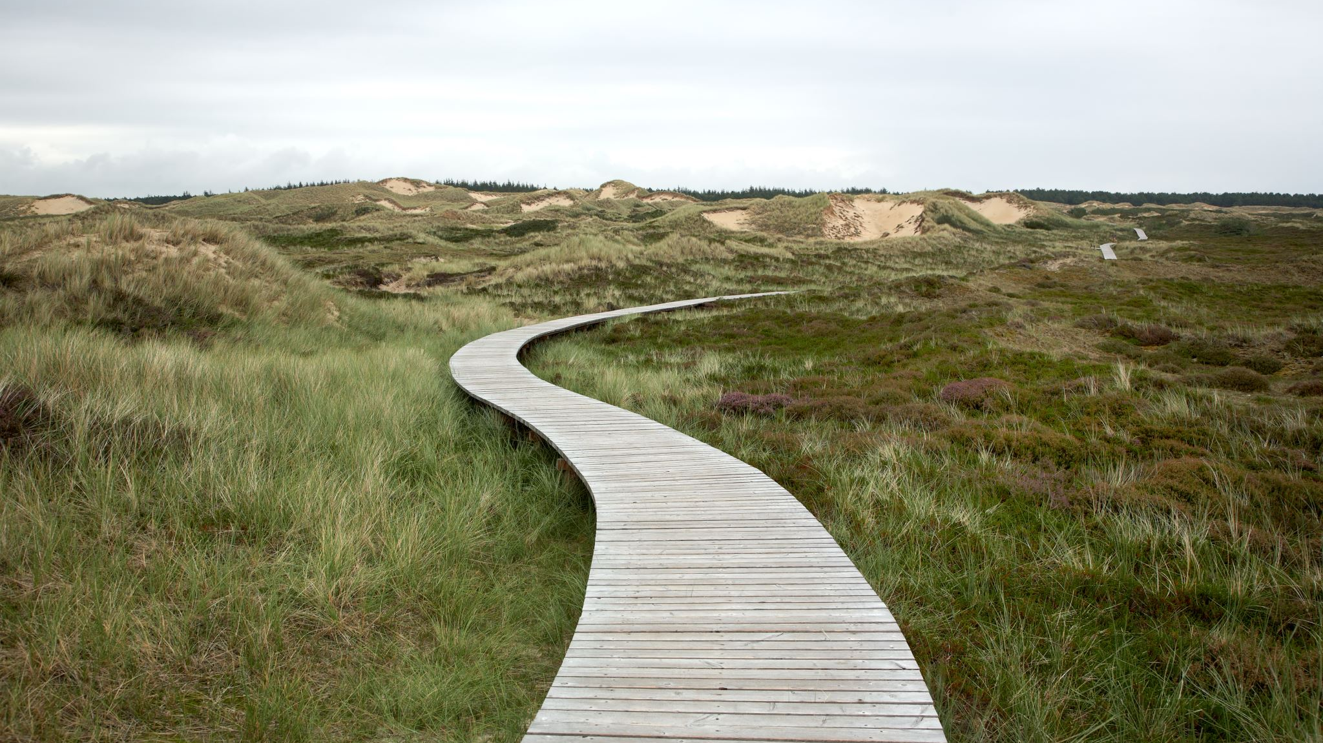
next steps
Missing data points:
Varietal
Label

Slide 8
the “thank you” slide
possible to link to resources used, your github repo, any acknowledgements
for more professional purposes, you might link your contact info (linkedin, email, etc.)

