Slide 1
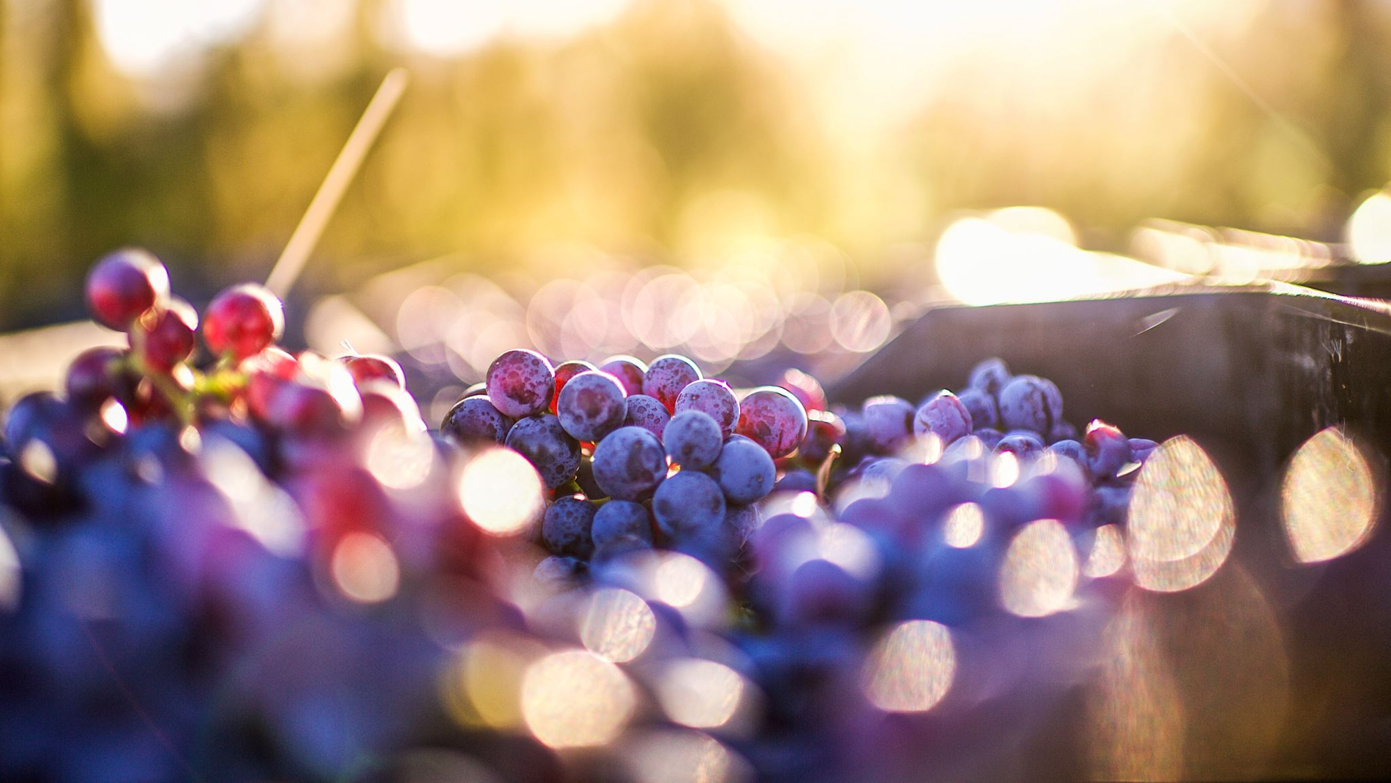
Predicting Wine Quality
Noelle Ferrari and Katarina Salcedo

Slide 2
Project Overview
Predict wine quality to give the Washington Winegrower’s Association a model for choosing wines to send to competitions

Slide 3
Data Overview
Data collected by UCI and sourced from Kaggle
Contains 11 different chemical features and 6497 wines
Each wine is scored for quality on a scale of 1-10

Slide 4
Variable Definitions
Fixed acidity: non-volatile acids
Volatile acidity: Acetic acid content. High amounts are associated with a vinegary taste
Residual sugar: Amount of sugar remaining after fermentation, more than 45g/liter is considered a “sweet” wine
Chlorides: Amount of salt
Free sulfur dioxide: protects against oxidation
Total sulfur dioxide: Both free and bound forms of SO₂, flavor becomes detectable above 50ppm
Sulphates: an additive that acts as a preservative and can influence sulfur dioxide levels
Other variables: citric acid, density, pH, alcohol

Slide 5
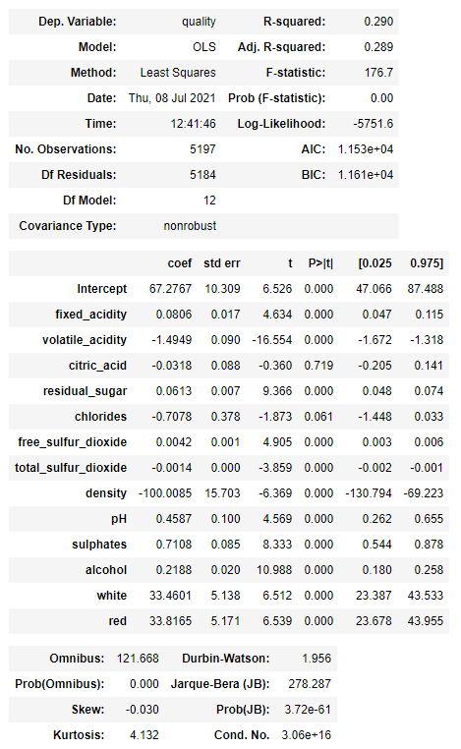
Initial model
Model RMSE: 0.732
Prediction RMSE: 0.735

Slide 6
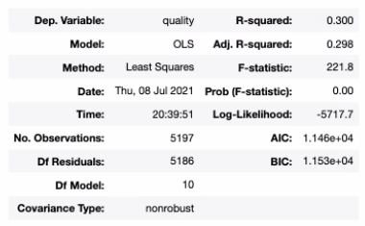
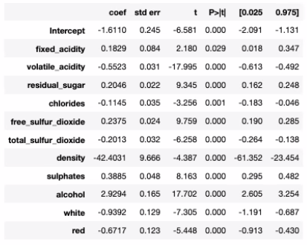
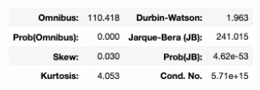
Final model
Model RMSE: 0.727
Prediction RMSE: 0.730

Slide 7
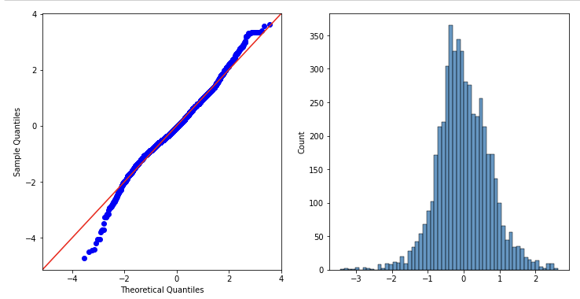
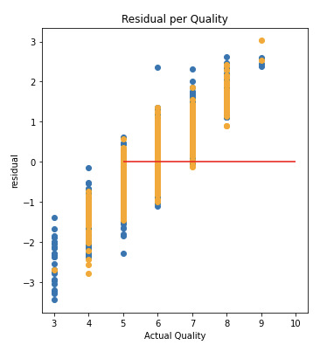
Final model

Slide 8
Summary and next steps
30% of the variations in quality are explained by the chemical qualities of wine in our model.
Next steps:
Consider additional transformations to improve R-squared
Gather data on wine varietal and/or brand to better account for variance within quality rankings

Slide 9
Thank you!
Data source: https://www.kaggle.com/huseyinelci/wne-qualty-by-uci
Project repo: https://github.com/klsalcedo/wine_analysis/tree/main

