Slide 1
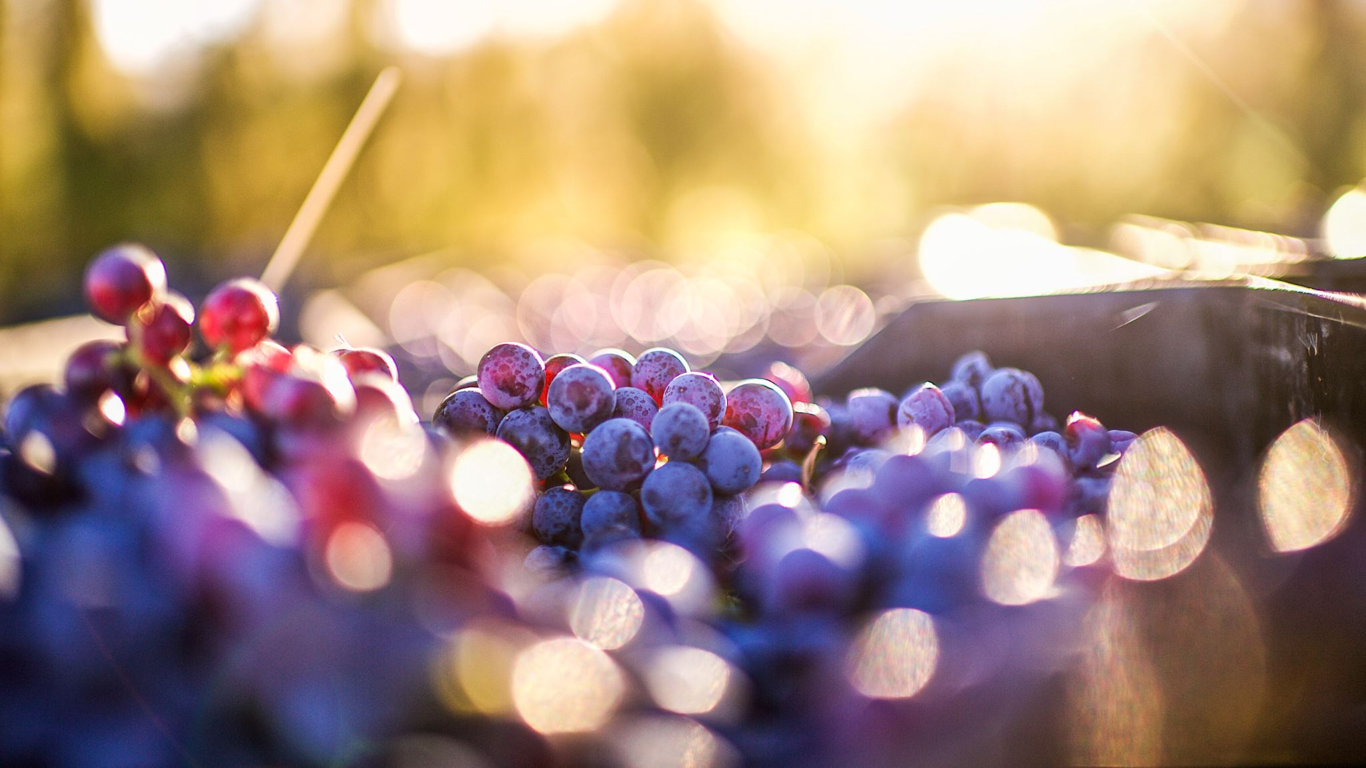
Predicting Wine Quality
Noelle Ferrari and Katarina Salcedo

Slide 2
Project Overview
Predict wine quality to give the Washington winegrower’s association a model for choosing wines to send to competitions

Slide 3
Data Overview
Data collected by UCI and sourced from Kaggle
Contains 11 different chemical features of each wine
Each wine is scored for quality on a scale of 1-10

Slide 4
EDA
Variable definitions:
Fixed acidity: non-volatile acids
Volatile acidity: Acetic acid content. High amounts are associated with a vinegary taste
Residual sugar: Amount of sugar remaining after fermentation, more than 45g/liter is considered a “sweet” wine
Chlorides: Amount of salt
Free sulfur dioxide: protects against oxidation
Total sulfur dioxide: Both free and bound forms of SO2, flavor becomes detectable above 50ppm
Sulphates: an additive that acts as a preservative and can influence sulfur dioxide levels

Slide 5
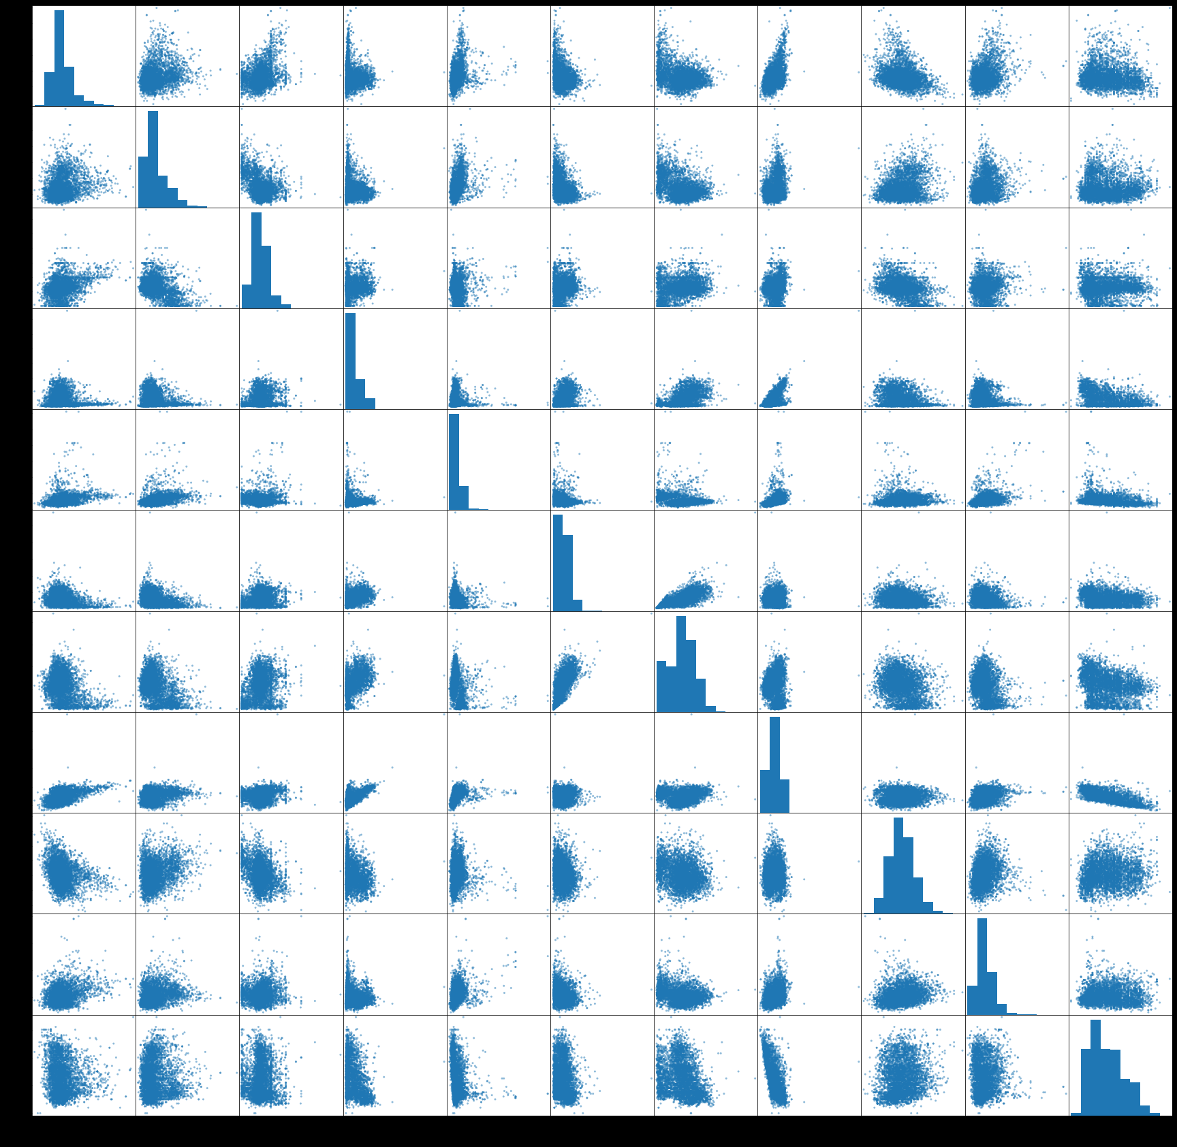
EDA

Slide 6
modeling (1-2 slides)
present your final model (or an intermediate one if you think it adds to your presentation)
briefly talk about any feature selection/feature engineering that you did
eliminated variables based on p-values, removed collinear variables
interaction terms, scaling, transforming, etc.
evaluate your model and interpret some of the more important coefficients
interpret your R2 with the correct definition
show RMSE

Slide 7
summary/conclusions/recommendations
summarize all your insights in a single slide and (if applicable) add any overall recommendations

Slide 8
next steps
Missing data points:
Varietal
Label

Slide 9
Thank you!
Data source: https://www.kaggle.com/huseyinelci/wne-qualty-by-uci
Project repo: https://github.com/klsalcedo/wine_analysis/tree/main

