Slide 1
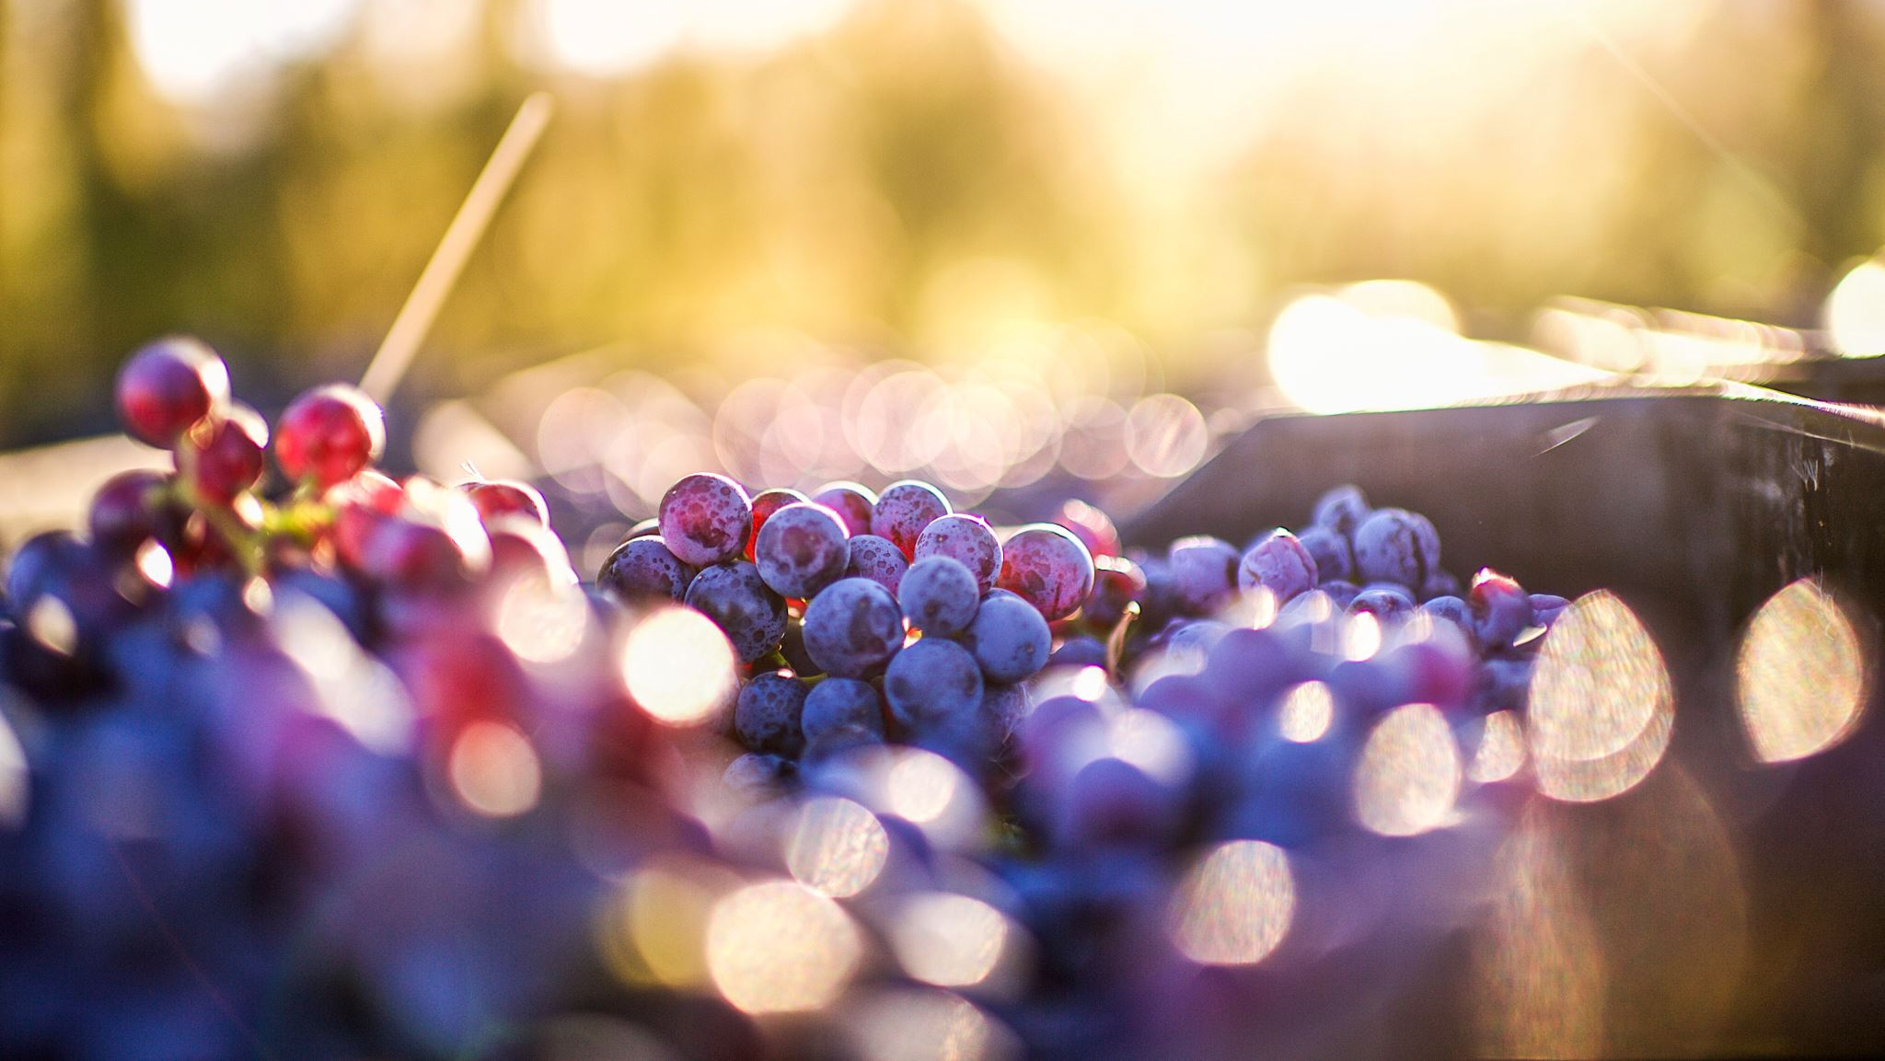
Predicting Wine Quality
Noelle Ferrari and Katarina Salcedo

Slide 2
Project Overview
Predict wine quality to give the Washington winegrower’s association a model for choosing wines to send to competitions

Slide 3
Data Overview
Data collected by UCI and sourced from Kaggle
Contains 11 different chemical features of each wine
Each wine is scored for quality on a scale of 1-10

Slide 4
EDA
Variable definitions:
Fixed acidity: non-volatile acids
Volatile acidity: Acetic acid content. High amounts are associated with a vinegary taste
Residual sugar: Amount of sugar remaining after fermentation, more than 45g/liter is considered a “sweet” wine
Chlorides: Amount of salt
Free sulfur dioxide: protects against oxidation
Total sulfur dioxide: Both free and bound forms of SO2, flavor becomes detectable above 50ppm
Sulphates: an additive that acts as a preservative and can influence sulfur dioxide levels

Slide 5
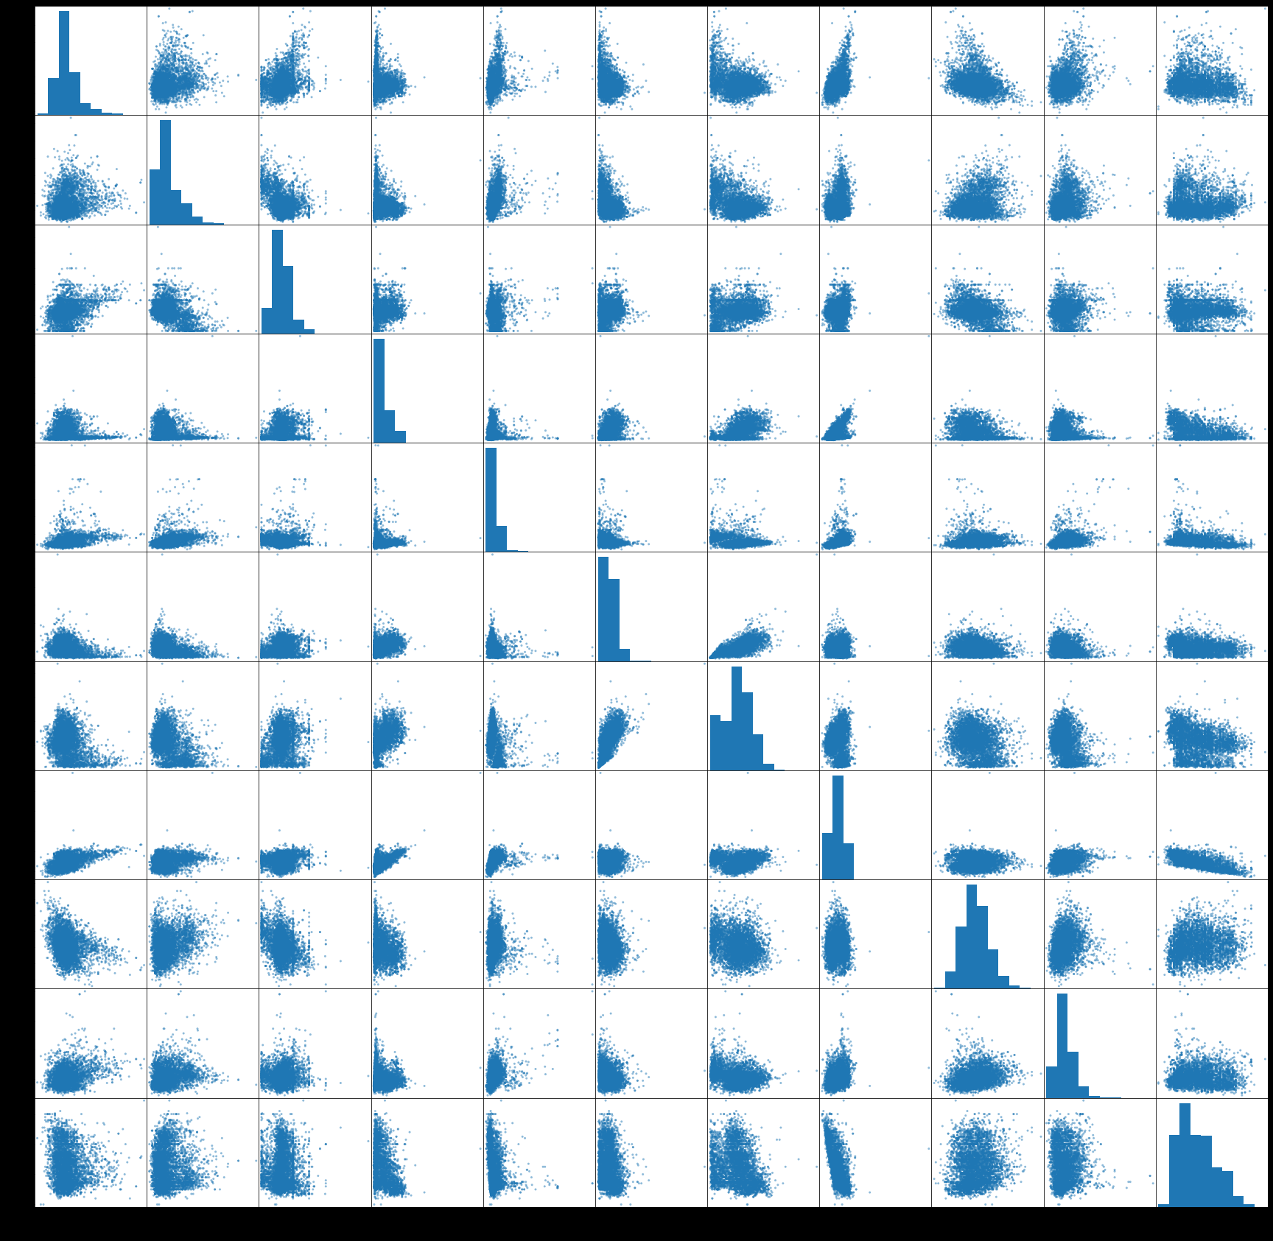
EDA

Slide 6
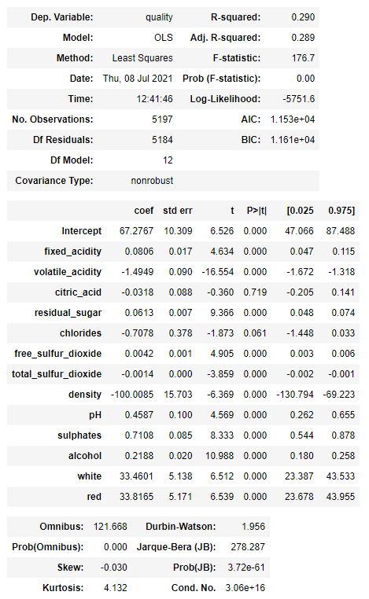
Initial model
Model RMSE: 0.732
Prediction RMSE: 0.735

Slide 7
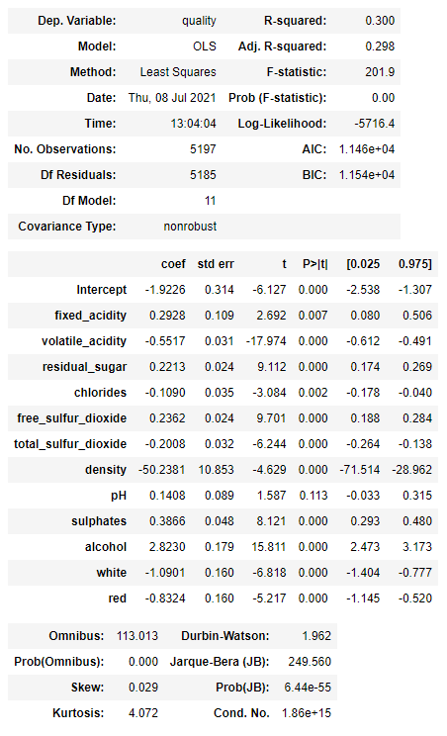
Final model
Model RMSE: 0.727
Prediction RMSE: 0.730

Slide 8
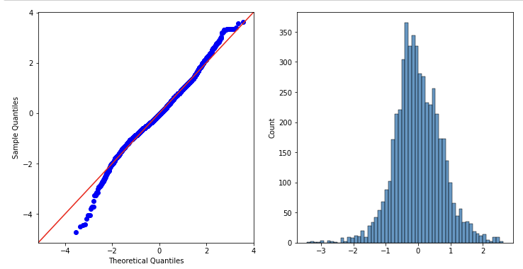
Final model

Slide 9
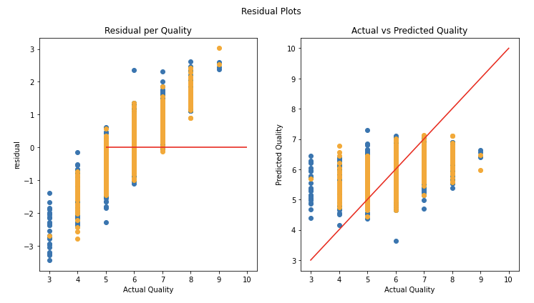
Final model

Slide 10
Summary and next steps
Missing data points:
Varietal
Label

Slide 11
Thank you!
Data source: https://www.kaggle.com/huseyinelci/wne-qualty-by-uci
Project repo: https://github.com/klsalcedo/wine_analysis/tree/main

