Slide 1
Dabble Sports Betting
Analytics Dashboard
A Power BI portfolio project built to demonstrate BI analyst skills
Dataset · Simulated sports betting data (100,000 bets, 5,000 customers)
Tools · Power BI Desktop | DAX | Python (data generation)
Author · Kudzai Shava

Slide 2
Project Overview & Data Model
Objective
Star Schema Model
A multi page Power BI report that mirrors the analytics a BI analyst at Dabble would produce day to day covering commercial performance and customer intelligence.
fact_bets
user_id
Datasets Used
bet_date
fact_bets.csv: 100,000 bets with dates, odds, stake, GGR, win/loss
dim_users.csv: 5,000 customers with country, age, gender, tier
dim_date.csv : Full calendar table (2022–2024) for time intelligence
dim_users
dim_date
user_id · country age_group · gender customer_tier
bet_id | bet_date user_id | sport stake | GGR | odds
date · year · month quarter · week day_of_week
Tools & Skills Demonstrated
Relationships:
Power BI Desktop: report design, slicers, cross:filtering
DAX: SUM, DIVIDE, CALCULATE, DISTINCTCOUNT measures
Data modelling: star schema with active relationships
Python: synthetic data generation (pandas, numpy)
dim_users[user_id] → fact_bets[user_id] (Many:to:One)
dim_date[date] → fact_bets[bet_date] (Many:to:One)

Slide 3
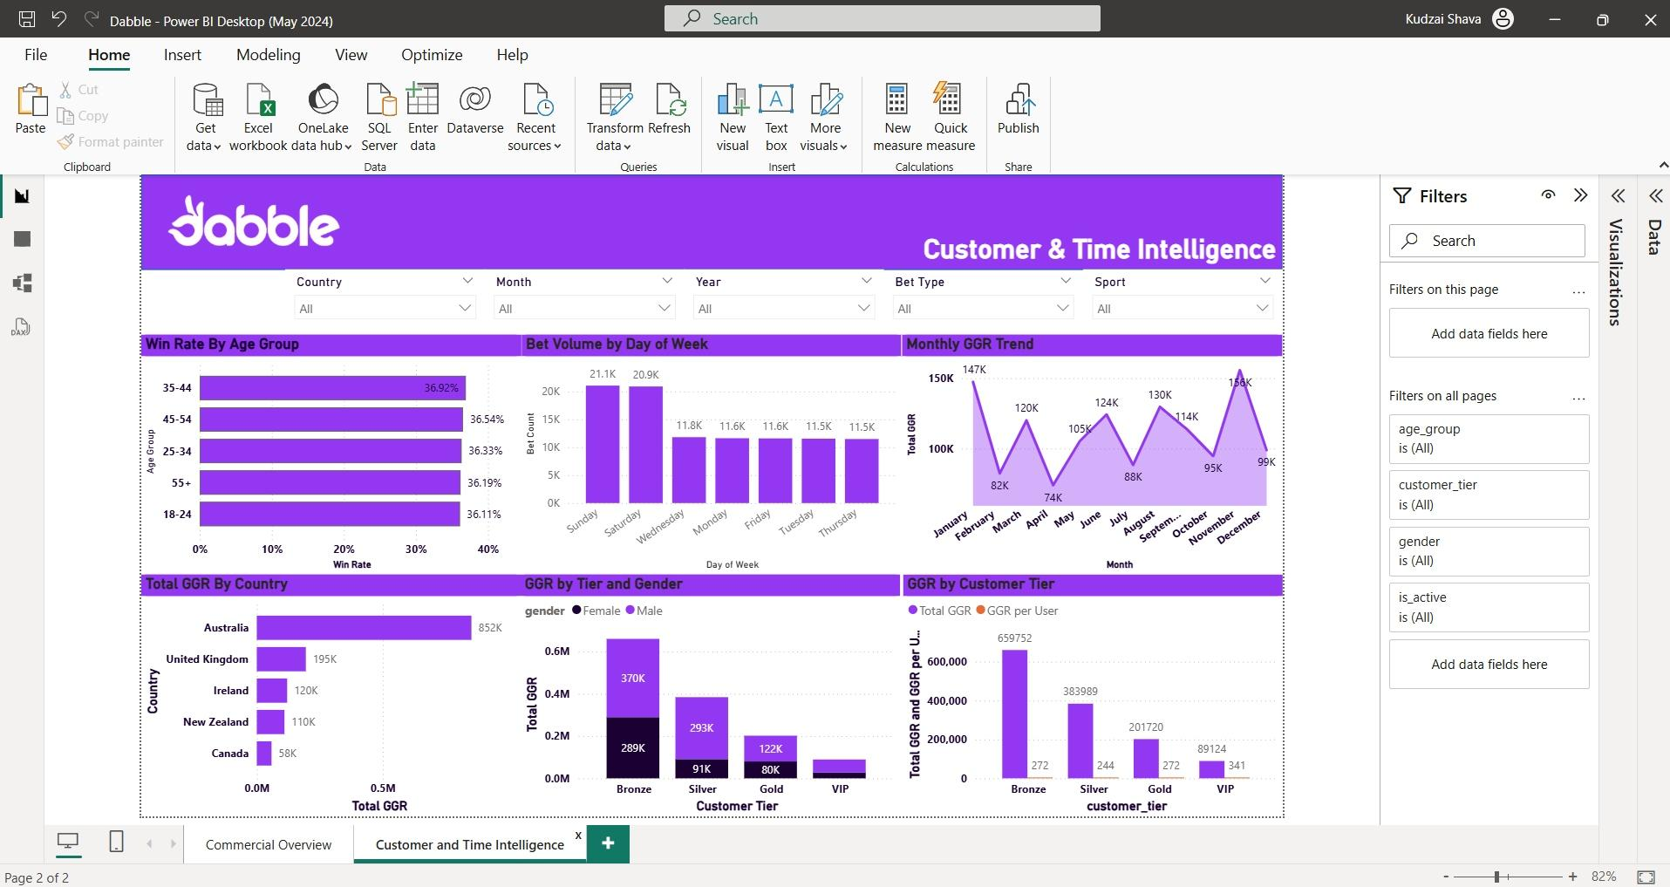
Report Page 1 · Commercial Overview
Dabble Analytics Portfolio · Kudzai Shava · 2026

Slide 4
Key Insights · Commercial Overview
Total GGR
Top Sport
$1.33M
Football
across 100,000 bets: Football drives $573K (43%) of total revenue
49% of all bets placed; Tennis second at 18%. Core product focus confirmed
Formula 1
Top Customer
–$3.6K GGR
User 2813
Only loss:making sport: revealed through waterfall chart analysis
Highest total stake at $23K: colour:coded by GGR contribution
Bet Type
Avg Odds
Singles win more
4.7x
Single bets have consistently higher win rates than multiples across all sports
Multiples attract higher odds which drives bigger GGR variance for the operator
Dabble Analytics Portfolio · Kudzai Shava · 2026

Slide 5
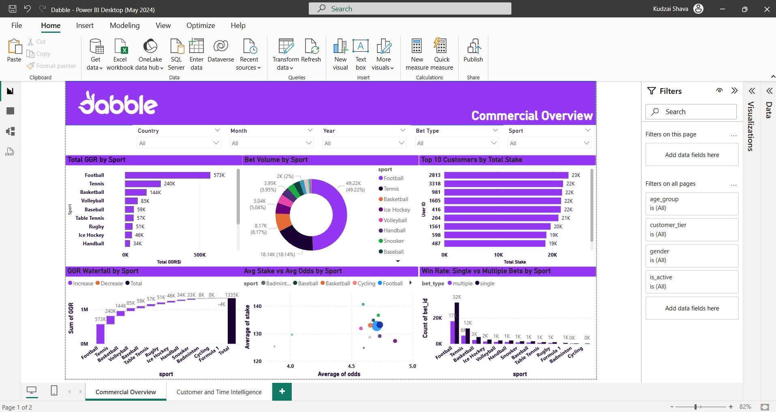
Report Page 2 · Customer & Time Intelligence
Dabble Analytics Portfolio · Kudzai Shava · 2026

Slide 6
Key Insights · Customer & Time Intelligence
Core Market
Top Tier Value
Australia (64%)
VIP = $341/user
$852K GGR from Australian customers: validates Dabble's market focus
VIP customers generate 25% more GGR per head than Bronze tier customers
Weekend Effect
Age Insight
+80% bets Sat/Sun
35–44 win most
Weekend volume spikes to 21K bets/day vs 11.5K on weekdays: key for promotions
35–44 age group has the highest win rate at 36.9%: valuable for risk modelling
Gender Split
GGR Growth
Male = 75% GGR
3:year uptrend
Male customers drive 75% of GGR across all tiers: demographic targeting opportunity
Monthly GGR grew consistently from 2022 to 2024 across all customer segments
Dabble Analytics Portfolio · Kudzai Shava · 2026

Slide 7
Dabble Sports Betting
THANK YOU

