Slide 1
21CS2109RA
Operating Systems
Deadlocks
© 2022 KL University – The contents of this presentation are an intellectual and copyrighted property of KL University. ALL RIGHTS RESERVED

Slide 2
Deadlocks
If two or more processes are waiting for happening of some event which never happens then we say these processes are involved in deadlock and the state will be the deadlock state.
If all of the following four conditions fulfill the current situation then deadlock will be occur if any one condition false then there will be no deadlock.
The four necessary conditions for Deadlocks are:
Mutual Exclusion (Never Share Resource)
No Pre-emptive
Hold and Wait
Circular Wait
Cooperative processes cannot use the critical section at the same time.
© 2022 KL University – The contents of this presentation are an intellectual and copyrighted property of KL University. ALL RIGHTS RESERVED

Slide 3
Deadlocks
1) Mutual Exclusion (Never Share Resource)
Only one process can use any resource at a time. If there are two processes P1, and P2.
When a resource R1 is allocated to P1 and P2 request for R1 at the same time. Then P1 never share the resource R1 with process P2 because condition of mutual exclusion is that only one processes can use one resource at a time
2) No Pre-emptive
If a process P1 holds a resource then it will never release it for upcoming process P2 which also demand for the same resource which is already allocated to P1.
© 2022 KL University – The contents of this presentation are an intellectual and copyrighted property of KL University. ALL RIGHTS RESERVED

Slide 4
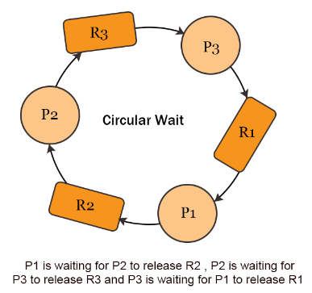
Deadlocks
3) Hold And Wait
If a process P1 holds a resource and upcoming process P2 also demand for the same resource which is already allocated to P1. Then P2 have to wait until P1 release the resource.
4) Circular Wait
There exist a set of processes (P1, P2, P3……PN). Where P1 is waiting for P2 and P2 is waiting for P3 and so on until PN. And PN is waiting for P1 in the last.
© 2022 KL University – The contents of this presentation are an intellectual and copyrighted property of KL University. ALL RIGHTS RESERVED

Slide 5
Deadlocks
Deadlock Vs. Starvation
SNo. | Deadlock | Starvation
1. | In deadlock situation, no further process block and no process execute. | In Starvation all the low priority processes are blocked and the all high priority processes are executed.
2. | Deadlock is infinite time waiting. | Starvation is long time waiting but not infinite.
3. | Every Deadlock is always a starvation. | Every starvation may not be deadlock.
4. | The requested resource is blocked by the other process. | The requested resource is continuously used by the higher priority processes.
5. | Deadlock occur when following four conditions fulfill at the same time. Mutual exclusion. No preemption, hold and wait circular wait. | It may occurs due to resource management and having no control on priority of processes etc.
© 2022 KL University – The contents of this presentation are an intellectual and copyrighted property of KL University. ALL RIGHTS RESERVED

Slide 6
Deadlocks
Deadlock can be Handled by following Methods.
1).Deadlock Ignorance
2).Deadlock Prevention
3).Deadlock Avoidance
4).Deadlock detection
5).Deadlock Recovery
1). Deadlock Ignorance
Deadlock ignorance technique is mostly used nowadays In both cases i.e. system and real life scenario.
The performance of the system decreases if it uses deadlock handling mechanism all the time if deadlock happens 1 out of 100 times then it is completely unnecessary to use the deadlock handling mechanism all the time.
© 2022 KL University – The contents of this presentation are an intellectual and copyrighted property of KL University. ALL RIGHTS RESERVED

Slide 7
Deadlocks
Lets Explain with Example: If deadlock occur then we restart the computer. Operating system has no particular code for it.
We don’t want to affect the performance. Because, if we add particular code for deadlock ignorance then functionality of OS will be increased.
As a result, performance of operating system (speed) will be reduced. As deadlock never occur daily so it is a rare case that’s why we have no need to increase the functionality of OS
2). Deadlock Prevention
Deadlock prevention can be achieved by making any one condition false from the following four conditions. Because for the deadlock these four conditions are compulsory.
1. Mutual exclusion 2. No preemptive 3. Hold and wait 4. Circular wait
© 2022 KL University – The contents of this presentation are an intellectual and copyrighted property of KL University. ALL RIGHTS RESERVED

Slide 8
Deadlocks
1. Eliminate Mutual exclusion
If all the resources are shareable then deadlock will never occur but it is not possible.
However, if we can be able to violate resources behaving in the mutually exclusive manner then the deadlock can be prevented.
To make all resources shareable like CPU is shareable for all resources. But printer and tape drive is not shareable for all resources. So to make resources shareable like printer leads toward incorrect results.
As process 1 was printing some document and process P2 came for printing then we cannot start the printing of P2 at the same time.
© 2022 KL University – The contents of this presentation are an intellectual and copyrighted property of KL University. ALL RIGHTS RESERVED

Slide 9
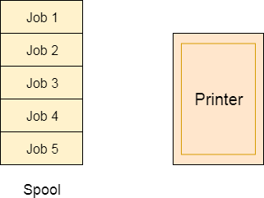
Deadlocks
Spooling
Although, Spooling can be an effective approach to violate mutual exclusion but it suffers from two kinds of problems.
This cannot be applied to every resource.
After some point of time, there may arise a race condition between the processes to get space in that spool.
© 2022 KL University – The contents of this presentation are an intellectual and copyrighted property of KL University. ALL RIGHTS RESERVED

Slide 10
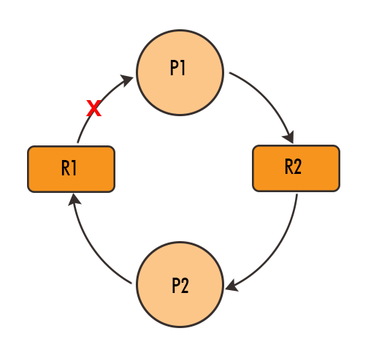
Deadlocks
2). Eliminate No Pre-emptive
In simple words make the resources preemptive to prevent deadlock situation.
If process P2 request for resource R1 and R1 is hold by Process P1 and P1 release R1 for P2 as request came then deadlock can be removed.
But it is also not a good solution in all the cases like printing but might be suitable for CPU utilization.
If a resource is 90% used by a process then it preempted then it will be very Costly.
© 2022 KL University – The contents of this presentation are an intellectual and copyrighted property of KL University. ALL RIGHTS RESERVED

Slide 11
Deadlocks
3). Eliminate Hold and wait
As new process demand for allocated resource then that allocated resource given to demanding process.
For example, process P1 came and it request for resource R1, R2 and R3. These resources are allocated to some other process. Then other process will release the R1, R2, R3 process at the same time for P1. It is called No hold and wait. If they don’t release then it will be hold and wait.
4). Eliminate Circular wait
If last process is demanding for first resource and that resource is allocated to first process. Loop kind situation is created there is called circular wait.
© 2022 KL University – The contents of this presentation are an intellectual and copyrighted property of KL University. ALL RIGHTS RESERVED

Slide 12
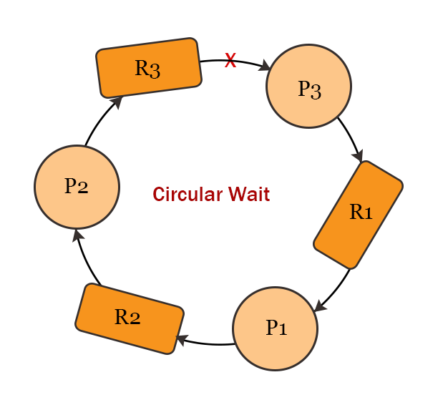
Deadlocks
Solution of circular wait is explained under
Process can only request for high order resource. Process cannot request for low order resource to remove circular wait.
In the diagram P3 cannot request for R1 or R2 because P3 previous request was R3 and next request will be greater than R3.
So next request for resource must be greater than previous request for resource to remove circular wait. In this way, by removing circular wait deadlock can be prevented.
Note: If we make false any one condition or more from above 4 conditions then deadlock can be prevented. Because, condition of deadlock is to fulfill above four conditions. In this way deadlock is removed.
© 2022 KL University – The contents of this presentation are an intellectual and copyrighted property of KL University. ALL RIGHTS RESERVED

Slide 13
Resource Allocation Graph (RAG)
The Resource Allocation Graph, also known as RAG is a graphical representation of the state of a system.
It has all the information about the resource allocation to each process and the request of each process.
In some cases, we can determine there is a deadlock in the system or not, just after looking at the Resource Allocation Graph or (RAG), but it is not possible by just looking at the table.
This is one of the advantages of the Resource Allocation Graph.
Like all other graphs, it also has vertices and edges, where the vertices of the RAG represent the process or the resource, and the edges represent the allocation or request of any resource.
As both the process and resource are the vertices of the graph, generally, the process vertex will be represented using the circle and the resource vertex using the rectangle.
© 2022 KL University – The contents of this presentation are an intellectual and copyrighted property of KL University. ALL RIGHTS RESERVED

Slide 14
Resource Allocation Graph (RAG)
The resource can be of two types:
Single Instance - It contains the single instance of the resource, and is represented by a single dot inside the rectangle which is the resource vertex.
Multiple Instance - It contains the multiple instances of the resource, and is represented by multiple (more than one) dots inside the rectangle.
Edges also can be of two types:
Assign Edge - This edge directing from the resource towards the process represents the allocation of the resource to the process.
Request Edge - This edge directing from the process towards the resource represents the request of the resource by the process.
© 2022 KL University – The contents of this presentation are an intellectual and copyrighted property of KL University. ALL RIGHTS RESERVED

Slide 15
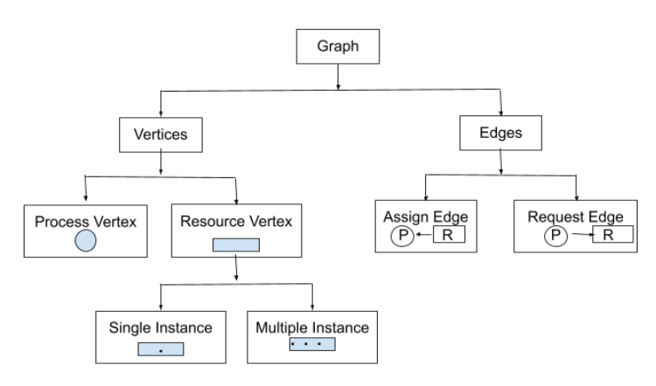
Resource Allocation Graph (RAG)
© 2022 KL University – The contents of this presentation are an intellectual and copyrighted property of KL University. ALL RIGHTS RESERVED

Slide 16
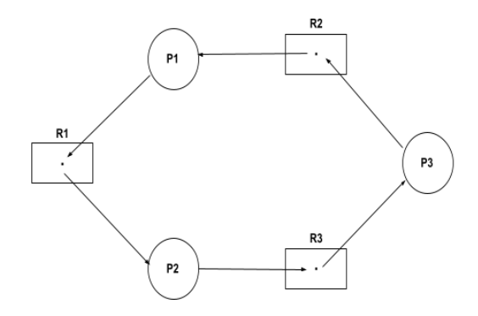
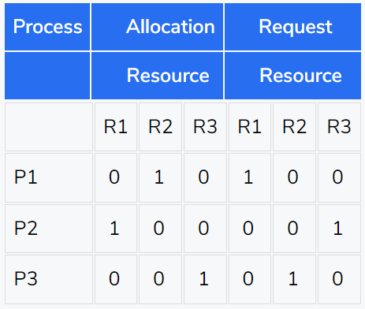
Resource Allocation Graph (RAG)
In the above single instances RAG example, it can be seen that P2 is holding the R1 and waiting for R3. P1 is waiting for R1 and holding R2 and, P3 is holding the R3 and waiting for R2. So, it can be concluded that none of the processes will get executed.
Note: If there is a cycle in a single instance RAG then the processes will be in a deadlock.
© 2022 KL University – The contents of this presentation are an intellectual and copyrighted property of KL University. ALL RIGHTS RESERVED

Slide 17
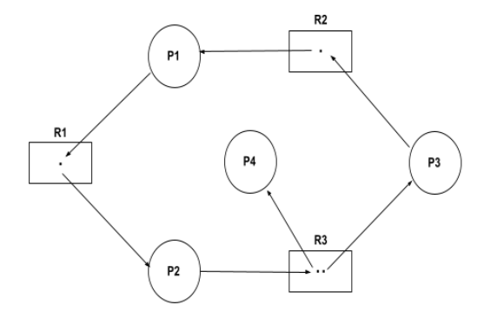
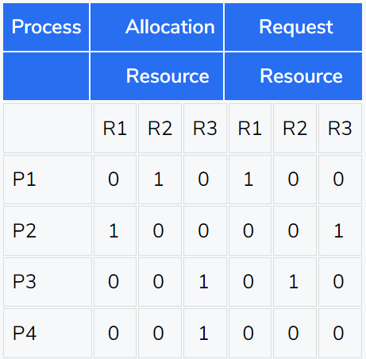
Resource Allocation Graph (RAG)
Example of Multiple Instances RAG.
In the case of Multiple Instances RAG, it becomes difficult to analyze from the RAG that the system is in a safe state or not.
To determine the state of the system we will write it in the form of an allocation and request matrix.
© 2022 KL University – The contents of this presentation are an intellectual and copyrighted property of KL University. ALL RIGHTS RESERVED

Slide 18
Resource Allocation Graph (RAG)
Algorithm to check deadlock
First, find the currently available instances of each resource.
Check for each process which can be executed using the allocated + available resource.
Add the allocated resource of the executable process to the available resources and terminate it.
Repeat the 2nd and 3rd steps until the execution of each process.
If at any step, none of the processes can be executed then there is a deadlock in the system.
Using the above algorithm, we will get that there is no deadlock in the above-given example, and their sequence of execution can be P4 → P2 → P1 → P3.
Note: Unlike Singles Instances RAG, a cycle in a Multiple Instances RAG does not guarantee that the processes are in deadlock.
© 2022 KL University – The contents of this presentation are an intellectual and copyrighted property of KL University. ALL RIGHTS RESERVED

Slide 19
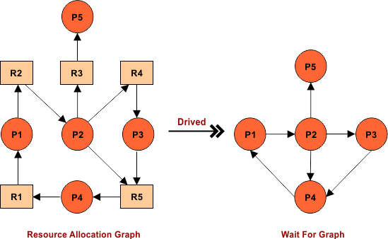
Resource Allocation Graph (RAG)
How Wait for Graph is Derived?
If there is a cycle in wait for graph then there must be deadlock but if there is cycle in resource allocation graph then there may or may not be a deadlock.
© 2022 KL University – The contents of this presentation are an intellectual and copyrighted property of KL University. ALL RIGHTS RESERVED

Slide 20
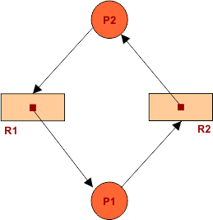
Resource Allocation Graph (RAG)
Question 01: Look at Resource allocation graph given below and find weather a deadlock present or not?
Solution: To find the deadlock in resource allocation graph there is a best way called resource allocation table.
Processes | Allocated |  | Request
 | R1 | R2 | R1 | R2
P1 | 1 | 0 | 0 | 1
P2 | 0 | 1 | 1 | 0
Availability |  | Execution
R1 | R2
0 | 0
So, Deadlock is confirmed because P1 is dependent on P2 and vice versa. But no resource is available. There were two resources and both of these are used.
© 2022 KL University – The contents of this presentation are an intellectual and copyrighted property of KL University. ALL RIGHTS RESERVED

Slide 21
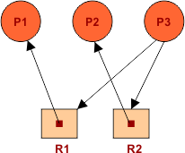
Resource Allocation Graph (RAG)
Question 02: Look at Resource allocation graph in the diagram. And find whether the deadlock is there or not? and if there is no deadlock then find the safe sequence??
Solution: To find the deadlock in resource allocation graph there is a best way called resource allocation table.
Processes | Allocated |  | Request
 | R1 | R2 | R1 | R2
P1 | 1 | 0 | 0 | 0
P2 | 0 | 1 | 0 | 0
P3 | 0 | 0 | 1 | 1
© 2022 KL University – The contents of this presentation are an intellectual and copyrighted property of KL University. ALL RIGHTS RESERVED

Slide 22
Resource Allocation Graph (RAG)
Safe Sequence will be P1 -> P2 -> P3. No deadlock because all processes executed successfully.
Availability |  | Execution
R1 | R2
0 | 0 | Before execution of any Process
1 | 0 | P1 executed
1 | 1 | P2 Executed
1 | 1 | P3 Executed
© 2022 KL University – The contents of this presentation are an intellectual and copyrighted property of KL University. ALL RIGHTS RESERVED

Slide 23
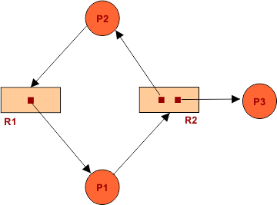
Resource Allocation Graph (RAG)
Question No: 03. Find whether the deadlock is there or not? and if there is no deadlock then find the safe sequence? Resource allocation graph for this question is given below
Solution: To find the deadlock in resource allocation graph there is a best way called resource allocation table.
Processes | Allocated |  | Request
 | R1 | R2 | R1 | R2
P1 | 1 | 0 | 0 | 1
P2 | 0 | 1 | 1 | 0
P3 | 0 | 1 | 0 | 0
© 2022 KL University – The contents of this presentation are an intellectual and copyrighted property of KL University. ALL RIGHTS RESERVED

Slide 24
Resource Allocation Graph (RAG)
Safe Sequence will be P3 -> P1 -> P2. No deadlock because all processes executed successfully.
Availability |  | Execution
R1 | R2
0 | 0 | Before execution of any Process
0 | 1 | P3 executed
1 | 1 | P1 Executed
1 | 2 | P2 Executed
© 2022 KL University – The contents of this presentation are an intellectual and copyrighted property of KL University. ALL RIGHTS RESERVED

Slide 25
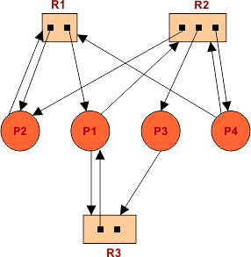
Resource Allocation Graph (RAG)
Question No: 04. Resource allocation graph is given in diagram. Find deadlock is there or not? and if there is no deadlock then find the safe sequence?
Solution:
Processes | Allocated |  |  | Request
 | R1 | R2 | R3 | R1 | R2 | R3
P1 | 1 | 0 | 1 | 0 | 1 | 1
P2 | 1 | 1 | 0 | 1 | 0 | 0
P3 | 0 | 1 | 0 | 0 | 0 | 1
P4 | 0 | 1 | 0 | 1 | 1 | 0
© 2022 KL University – The contents of this presentation are an intellectual and copyrighted property of KL University. ALL RIGHTS RESERVED

Slide 26
Resource Allocation Graph (RAG)
The safe sequence will be P3 -> P1 -> P2 -> P4. After execution all resources will get free.
Availability |  |  | Execution
R1 | R2 | R3
0 | 0 | 1 | Before execution of any Process
0 | 1 | 1 | P3 Executed
1 | 1 | 2 | P1 Executed
2 | 2 | 2 | P2 Executed
2 | 3 | 2 | P4 Executed
© 2022 KL University – The contents of this presentation are an intellectual and copyrighted property of KL University. ALL RIGHTS RESERVED

Slide 27
Resource-Allocation Graph
A set of vertices V and a set of edges E.
V is partitioned into two types:
  P = {P₁, P₂, …, P_{n}}, the set consisting of all the processes in the system
  R = {R₁, R₂, …, R_{m}}, the set consisting of all resource types in the system
request edge – directed edge P_{i} → R_{j}
assignment edge – directed edge R_{j} → P_{i}
© 2022 KL University – The contents of this presentation are an intellectual and copyrighted property of KL University. ALL RIGHTS RESERVED

Slide 28



Process
Resource Type with 4 instances
P_{i} requests instance of R_{j}
P_{i} is holding an instance of R_{j}
P_{i}
R_{j}
P_{i}
R_{j}
© 2022 KL University – The contents of this presentation are an intellectual and copyrighted property of KL University. ALL RIGHTS RESERVED

Slide 29

Resource Allocation Graph
© 2022 KL University – The contents of this presentation are an intellectual and copyrighted property of KL University. ALL RIGHTS RESERVED

Slide 30

Resource Allocation Graph With A Deadlock
© 2022 KL University – The contents of this presentation are an intellectual and copyrighted property of KL University. ALL RIGHTS RESERVED

Slide 31

Graph With A Cycle But No Deadlock
© 2022 KL University – The contents of this presentation are an intellectual and copyrighted property of KL University. ALL RIGHTS RESERVED

Slide 32
If graph contains no cycles ⇒ no deadlock
If graph contains a cycle ⇒
  if only one instance per resource type, then deadlock
  if several instances per resource type, possibility of deadlock
© 2022 KL University – The contents of this presentation are an intellectual and copyrighted property of KL University. ALL RIGHTS RESERVED

Slide 33
Deadlocks…
Deadlock avoidance
In deadlock avoidance, the request for any resource will be granted if the resulting state of the system doesn't cause deadlock in the system.
The state of the system will continuously be checked for safe and unsafe states.
In order to avoid deadlocks, the process must tell OS, the maximum number of resources a process can request to complete its execution.
The simplest and most useful approach states that the process should declare the maximum number of resources of each type it may ever need.
The Deadlock avoidance algorithm examines the resource allocations so that there can never be a circular wait condition.
© 2022 KL University – The contents of this presentation are an intellectual and copyrighted property of KL University. ALL RIGHTS RESERVED

Slide 34
Deadlocks…
Deadlock avoidance is achieved through Banker’s Algorithm. It cannot implement in real-life.
What is Banker Algorithm?
Banker’s Algorithm is also known as deadlock avoidance algorithm. It looks at all request made by processes to get resources.
It checks for the safe state, If the request given by the process is less than equal to (<=) freely available resource in the system, then it is a safe state and request is granted otherwise it is a unsafe state, deadlock will be there.
Inputs to Banker’s Algorithm:
Currently allocated resources by each process.
Max need of resources by each process.
Max free available resources in the system.
© 2022 KL University – The contents of this presentation are an intellectual and copyrighted property of KL University. ALL RIGHTS RESERVED

Slide 35
Deadlocks…
The request will only be granted under the below condition:
If the request made by the process is less than equal to the freely available resource in the system.
Safe State: A state is safe if the system can allocate resources to each process (up to its maximum) in some order and still avoid a deadlock.
We can say also a system is in a safe state only if there exists a safe sequence.
Unsafe State: If there is no safe sequence, then the system will be in an unsafe state, which may leads toward deadlock.
Why Banker’s algorithm is called banker?
The Banker’s Algorithm derives its name from bank, in a banking system it is ensure that the bank does not run out of resources, because the bank would never allocate its all money in such a way that it can no longer satisfy the needs of all its customers.
© 2022 KL University – The contents of this presentation are an intellectual and copyrighted property of KL University. ALL RIGHTS RESERVED

Slide 36
Banker’s Algorithm
Multiple instances
Each process must a priori claim maximum use
When a process requests a resource it may have to wait
When a process gets all its resources it must return them in a finite amount of time
© 2022 KL University – The contents of this presentation are an intellectual and copyrighted property of KL University. ALL RIGHTS RESERVED

Slide 37
Data Structures for the Banker’s Algorithm
Let n = number of processes, and m = number of resources types
Available: Vector of length m. If available [j] = k, there are k instances of resource type R_{j} available
Max: n x m matrix. If Max [i,j] = k, then process P_{i} may request at most k instances of resource type R_{j}
Allocation: n x m matrix. If Allocation[i,j] = k then P_{i} is currently allocated k instances of R_{j}
Need: n x m matrix. If Need[i,j] = k, then P_{i} may need k more instances of R_{j} to complete its task
    Need [i,j] = Max[i,j] – Allocation [i,j]
© 2022 KL University – The contents of this presentation are an intellectual and copyrighted property of KL University. ALL RIGHTS RESERVED

Slide 38
Safety Algorithm
1. Let Work and Finish be vectors of length m and n, respectively. Initialize:
      Work = Available
      Finish [i] = false for i = 0, 1, …, n- 1
2. Find an i such that both:
  (a) Finish [i] = false
  (b) Need_{i} ≤ Work
  If no such i exists, go to step 4
3. Work = Work + Allocation_{i}
Finish[i] = true
go to step 2
4. If Finish [i] == true for all i, then the system is in a safe state
© 2022 KL University – The contents of this presentation are an intellectual and copyrighted property of KL University. ALL RIGHTS RESERVED

Slide 39
Resource-Request Algorithm for Process P_{i}
Request_{i} = request vector for process P_{i}. If Request_{i} [j] = k then process P_{i} wants k instances of resource type R_{j}
  1. If Request_{i} ≤ Need_{i} go to step 2. Otherwise, raise error condition, since process has exceeded its maximum claim
  2. If Request_{i} ≤ Available, go to step 3. Otherwise P_{i} must wait, since resources are not available
  3. Pretend to allocate requested resources to P_{i} by modifying the state as follows:
      Available = Available – Request_{i};
      Allocation_{i} = Allocation_{i} + Request_{i};
      Need_{i} = Need_{i} – Request_{i};
    If safe ⇒ the resources are allocated to P_{i}
    If unsafe ⇒ P_{i} must wait, and the old resource-allocation state is restored
© 2022 KL University – The contents of this presentation are an intellectual and copyrighted property of KL University. ALL RIGHTS RESERVED

Slide 40
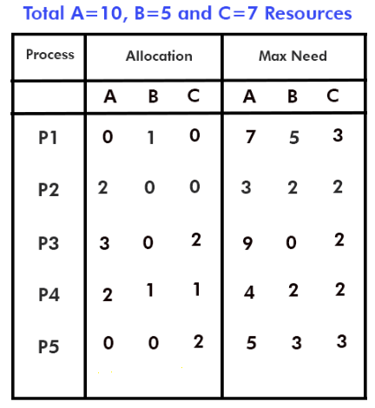
Deadlocks…
Let us consider an example
Find the safe sequence?
© 2022 KL University – The contents of this presentation are an intellectual and copyrighted property of KL University. ALL RIGHTS RESERVED

Slide 41
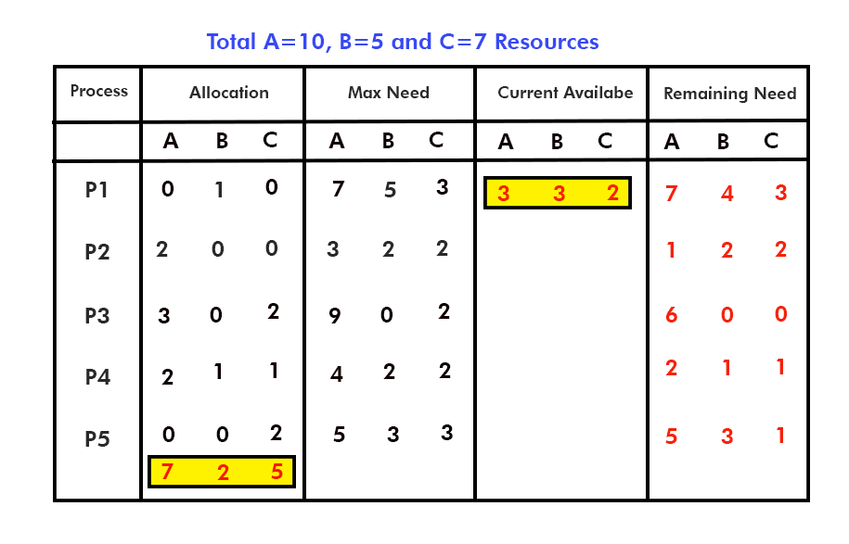
Deadlocks…
In the above question, there are 5 processes (P1…..P5) are requesting for 3 resources (A, B, C). P1 says gives me a 7 instance of A, 5 instances of B and 3 instances of C to execute itself successfully. In the same way P2, P3….P5 requesting for some instances given in the question.
In the end, banker algorithm tells us whether the deadlock happens or not, that’s why it’s called deadlock deduction algorithm
© 2022 KL University – The contents of this presentation are an intellectual and copyrighted property of KL University. ALL RIGHTS RESERVED

Slide 42
Deadlocks…
Solution:
To find whether the deadlock is happen or not through Banker Algorithm, we have to follow the four basic steps.
Step 1: Find the Total Allocation Resources of A, B and C?
Step 2: Find the Remaining Need?
Remaining need of R = MAX Need of R – Allocation of R, where resource R=(A, B, C).
Step3: Find Current Available?
Current available Resource R = Total Resources R – Total Allocation Resources R.
Step 4: Compare the current available resources with remaining need of all resources. If Current availability is greater or equal to remaining need then that process will get executed and our safe state will start from that process and that process will release its Allocation resources after execution for other processes.
Then Safe sequence will be P2 → P4 → P5 → P1 → P3 and current available resources will be A= 10, B=5, C=7.
© 2022 KL University – The contents of this presentation are an intellectual and copyrighted property of KL University. ALL RIGHTS RESERVED

Slide 43
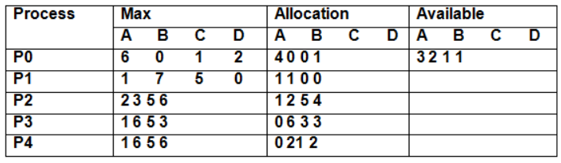
Deadlocks…
Question. Consider the following system snapshot using data structure in the Banker’s algorithm, with resource A,B,C,D and Process P0 to P4.
a.)Is the system is safe state?
b.) If a request from process P4 arrived for additional resources of (1,2,0,0) can Banker’s Algorithm grant the request immediately? Show the new system state and other criteria.
© 2022 KL University – The contents of this presentation are an intellectual and copyrighted property of KL University. ALL RIGHTS RESERVED

Slide 44
Deadlocks…
Deadlock Detection
Allow system to enter deadlock state
Detection algorithm
Recovery scheme
Deadlock detection can be explained in two terms:
1. When resources have single instance 2. And When resources have multiple instances
© 2022 KL University – The contents of this presentation are an intellectual and copyrighted property of KL University. ALL RIGHTS RESERVED

Slide 45
Single Instance of Each Resource Type
Maintain wait-for graph
  Nodes are processes
  P_{i} → P_{j} if P_{i} is waiting for P_{j}
Periodically invoke an algorithm that searches for a cycle in the graph. If there is a cycle, there exists a deadlock
An algorithm to detect a cycle in a graph requires an order of n² operations, where n is the number of vertices in the graph
© 2022 KL University – The contents of this presentation are an intellectual and copyrighted property of KL University. ALL RIGHTS RESERVED

Slide 46

Resource-Allocation Graph and Wait-for Graph
Resource-Allocation Graph
Corresponding wait-for graph
© 2022 KL University – The contents of this presentation are an intellectual and copyrighted property of KL University. ALL RIGHTS RESERVED

Slide 47
Several Instances of a Resource Type
Available: A vector of length m indicates the number of available resources of each type
Allocation: An n x m matrix defines the number of resources of each type currently allocated to each process
Request: An n x m matrix indicates the current request of each process. If Request [i][j] = k, then process P_{i} is requesting k more instances of resource type R_{j}.
© 2022 KL University – The contents of this presentation are an intellectual and copyrighted property of KL University. ALL RIGHTS RESERVED

Slide 48
Detection Algorithm
1. Let Work and Finish be vectors of length m and n, respectively Initialize:
  (a) Work = Available
  For i = 1,2, …, n, if Allocation_{i} ≠ 0, then
  Finish[i] = false; otherwise, Finish[i] = true
2. Find an index i such that both:
  (a) Finish[i] == false
  (b) Request_{i} ≤ Work
  If no such i exists, go to step 4
3. Work = Work + Allocation_{i}
Finish[i] = true
go to step 2
If Finish[i] == false, for some i, 1 ≤ i ≤ n, then the system is in deadlock state. Moreover, if Finish[i] == false, then P_{i} is deadlocked.
Algorithm requires an order of O(m x n²) operations to detect whether the system is in deadlock state
© 2022 KL University – The contents of this presentation are an intellectual and copyrighted property of KL University. ALL RIGHTS RESERVED

Slide 49
Example of Detection Algorithm
Five processes P₀ through P₄; three resource types
A (7 instances), B (2 instances), and C (6 instances)
Snapshot at time T₀:
Allocation Request Available
A B C A B C A B C
P₀ 0 1 0 0 0 0 0 0 0
P₁ 2 0 0 2 0 2
P₂ 3 0 3 0 0 0
P₃ 2 1 1 1 0 0
P₄ 0 0 2 0 0 2
Sequence <P₀, P₂, P₃, P₁, P₄> will result in Finish[i] = true for all i
© 2022 KL University – The contents of this presentation are an intellectual and copyrighted property of KL University. ALL RIGHTS RESERVED

Slide 50
P₂ requests an additional instance of type C
Request
A B C
P₀ 0 0 0
P₁ 2 0 2
P₂ 0 0 1
P₃ 1 0 0
P₄ 0 0 2
State of system?
  Can reclaim resources held by process P₀, but insufficient resources to fulfill other processes; requests
  Deadlock exists, consisting of processes P₁, P₂, P₃, and P₄
© 2022 KL University – The contents of this presentation are an intellectual and copyrighted property of KL University. ALL RIGHTS RESERVED

Slide 51
Detection-Algorithm Usage
When, and how often, to invoke depends on:
  How often a deadlock is likely to occur?
  How many processes will need to be rolled back?
    one for each disjoint cycle
If detection algorithm is invoked arbitrarily, there may be many cycles in the resource graph and so we would not be able to tell which of the many deadlocked processes “caused” the deadlock.
© 2022 KL University – The contents of this presentation are an intellectual and copyrighted property of KL University. ALL RIGHTS RESERVED

Slide 52
Recovery from Deadlock: Process Termination
Abort all deadlocked processes
Abort one process at a time until the deadlock cycle is eliminated
In which order should we choose to abort?
  Priority of the process
  How long process has computed, and how much longer to completion
  Resources the process has used
  Resources process needs to complete
  How many processes will need to be terminated
  Is process interactive or batch?
© 2022 KL University – The contents of this presentation are an intellectual and copyrighted property of KL University. ALL RIGHTS RESERVED

Slide 53
Recovery from Deadlock: Resource Preemption
First, we detect the deadlock through Resource allocation graph method. if there is no deadlock in the graph then there is no problem.
Otherwise we follow, one of the following deadlock recovery method to remove the deadlock.
1. Kill One/All Deadlocked Processes
Kill one process and check deadlock status. If deadlock is removed then the system is deadlock free otherwise kill one more process and so on, continues killing the other processes until the deadlock is removed.
In simple words, kill all those processes which are involved in deadlock situation. Definitely it hampers the performance of the system.
© 2022 KL University – The contents of this presentation are an intellectual and copyrighted property of KL University. ALL RIGHTS RESERVED

Slide 54
Recovery from Deadlock: Resource Preemption
2. Preempt Resources
Preempt the resources from those processes which are involved in the deadlock and assign these resources to other processes which are not involved in deadlock.
So that, system can be recovered from deadlock. But starvation increase in the system.
3. Roll Back Resource
Roll back the resource until the elimination of deadlock.
© 2022 KL University – The contents of this presentation are an intellectual and copyrighted property of KL University. ALL RIGHTS RESERVED

Slide 55
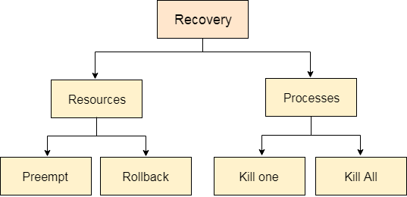
Recovery from Deadlock: Resource Preemption
© 2022 KL University – The contents of this presentation are an intellectual and copyrighted property of KL University. ALL RIGHTS RESERVED

