Slide 1


AtliQ Hospitality Analysis
-Sai Maneesha Gudimetla

Slide 2
Introduction
Atliq Grands owns multiple five-star hotels across India. They have been in the hospitality industry for the past 20 years.
Due to strategic moves from other competitors and ineffective decision-making in management, Atliq Grands are losing its market share and revenue in the luxury/business hotels category.
As a strategic move, the managing director of Atliq Grands wanted to incorporate “Business and Data Intelligence” in order to regain their market share and revenue.

Slide 3
AtliQ
Bangalore
Delhi
Atliq Bay
Atliq Blu
Atliq City
Atliq Exotica
Atliq Grands
Atliq Palace
Mumbai
Hyderabad
Atliq Bay
Atliq Blu
Atliq City
Atliq Grands
Atliq Palace
Atliq Bay
Atliq Blu
Atliq City
Atliq Exotica
Atliq Grands
Atliq Palace
Atliq Seasons
Atliq Bay
Atliq Blu
Atliq City
Atliq Exotica
Atliq Grands
Atliq Palace

Slide 4
Dataset Details
We are provided 3 moths booking details data of all the atliq hotels.
Dataset contains 5 excel files.
i)Dim_date
ii)Dim_hotels
iii)Dim_rooms
iv)Fact_aggregated_bookings
v)Fact_bookings
Metric list excel file
Mock-up Dashboard

Slide 5
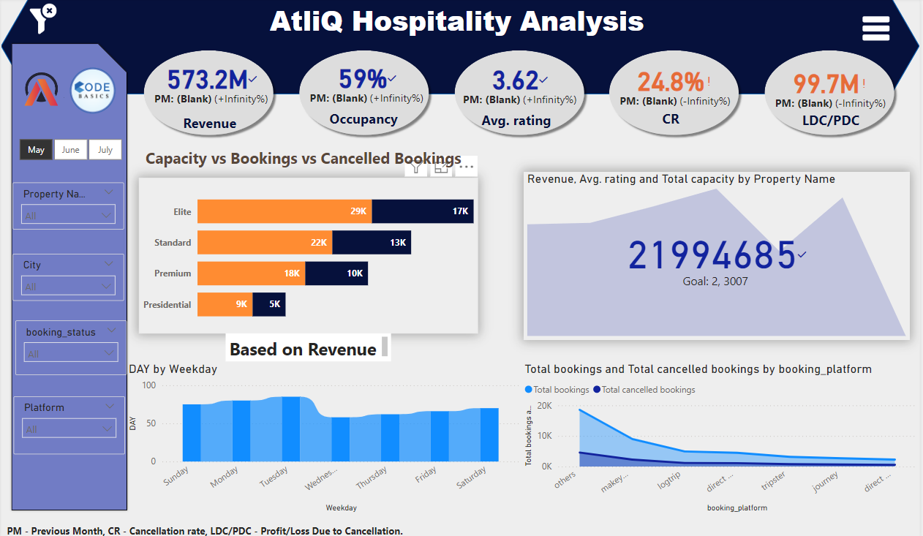
Mock-up Dashboard

Slide 6
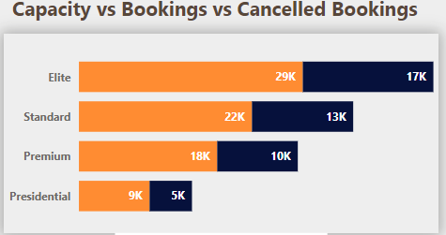
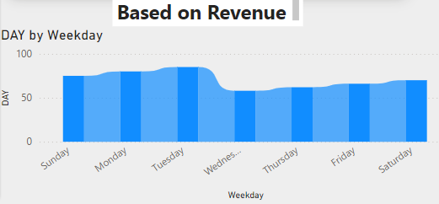
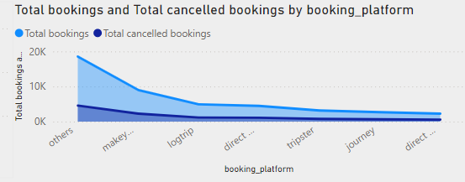
Insights

Slide 7
Thank You

