Slide 1

Data Visualization of Bird Strikes between 2000-2011
Sai Maneesha Gudimetla

Slide 2
Introduction:
A bird strike is strictly defined as a collision between a bird and an aircraft which is in flight or on a take-off or landing roll.
Bird strikes may occur during any phase of flight, but are most likely during the take-off, initial climb, approach and landing phases due to the greater numbers of birds in flight at lower levels.
To have a closer look the following document visually depicts the data collected on Bird Strikes by FAA between 2000-2011.

Slide 3
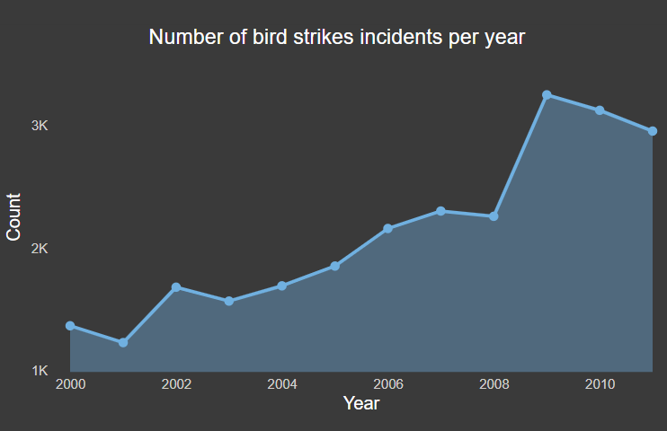
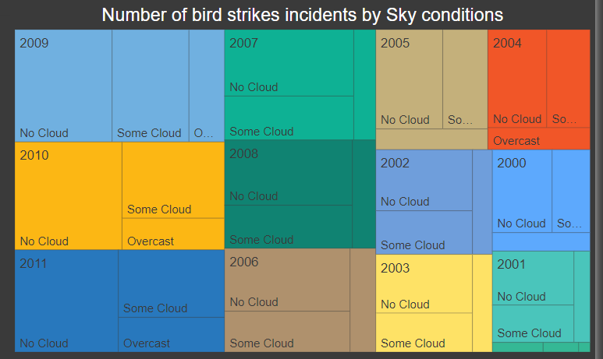
Insights:

Slide 4
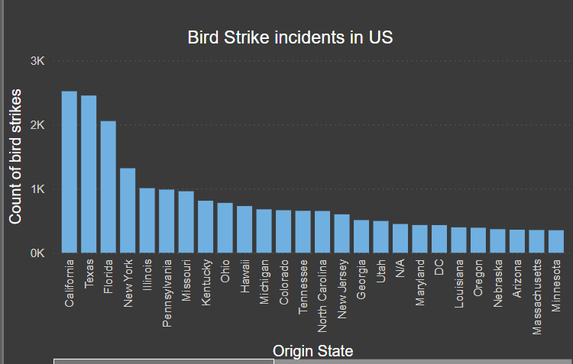
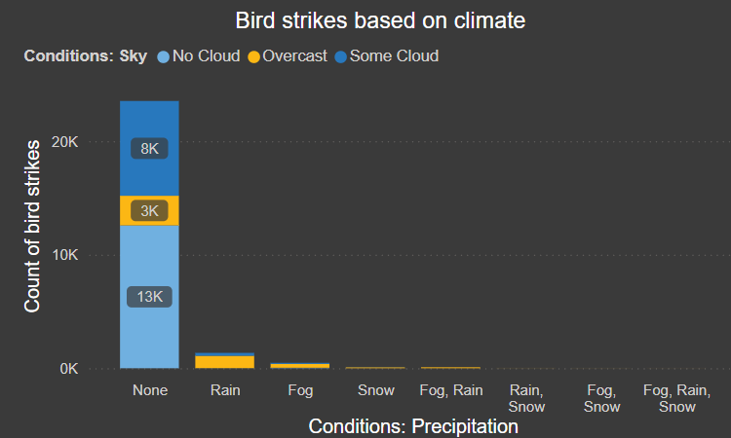
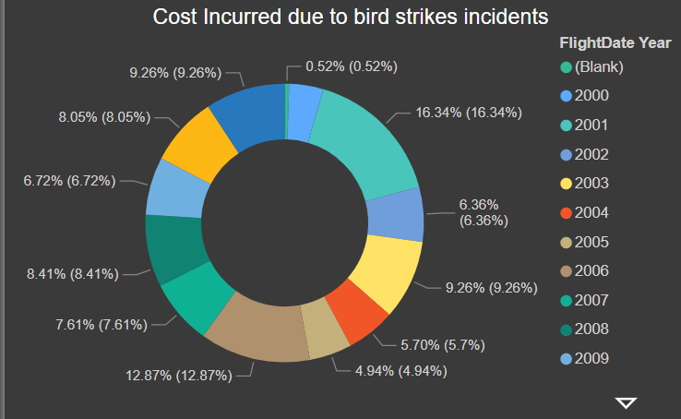
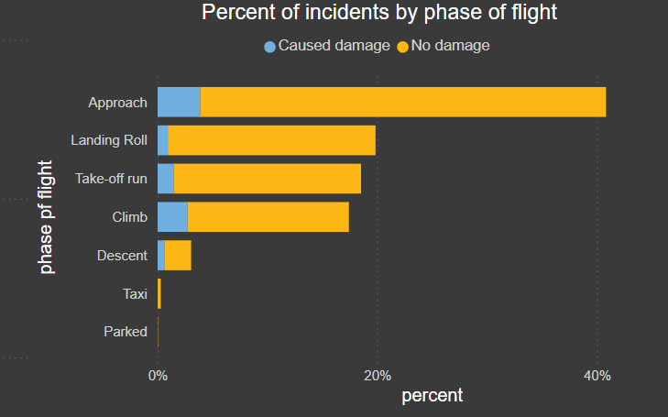

Slide 5
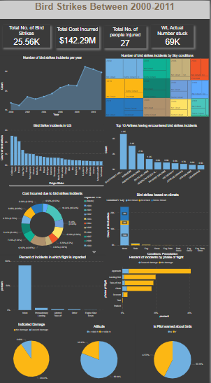
My Dashboard Design:

Slide 6
Thank You

