Slide 1
Lithe: Enabling Efficient Composition of Parallel Libraries
Heidi Pan, Benjamin Hindman, Krste Asanović
xoxo@mit.edu • {benh, krste}@eecs.berkeley.edu
Massachusetts Institute of Technology • UC Berkeley
HotPar • Berkeley, CA • March 31, 2009

Slide 2


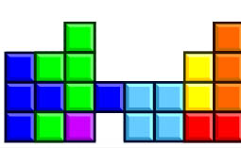

How to Build Parallel Apps?
Functionality:
or
or
or
App
Resource Management:
OS
Core 0
Core 1
Core 2
Core 3
Core 4
Core 5
Core 6
Core 7
Hardware
Need both programmer productivity and performance!

Slide 3
Composability is Key to Productivity
App 1
App 2
App
sort
sort
bubble
sort
quick
sort
code reuse
modularity
same library implementation, different apps
same app, different library implementations
Functional Composability

Slide 4
Composability is Key to Productivity
fast
+
fast
fast
fast
+
faster
fast(er)
Performance Composability

Slide 5
Talk Roadmap
Problem: Efficient parallel composability is hard!
Solution:
  Harts
  Lithe
Evaluation

Slide 6
Motivational Example
Sparse QR Factorization
(Tim Davis, Univ of Florida)
Column
Elimination Tree
SPQR
Frontal Matrix
Factorization
TBB
MKL
OpenMP
OS
Hardware
System Stack
Software Architecture

Slide 7
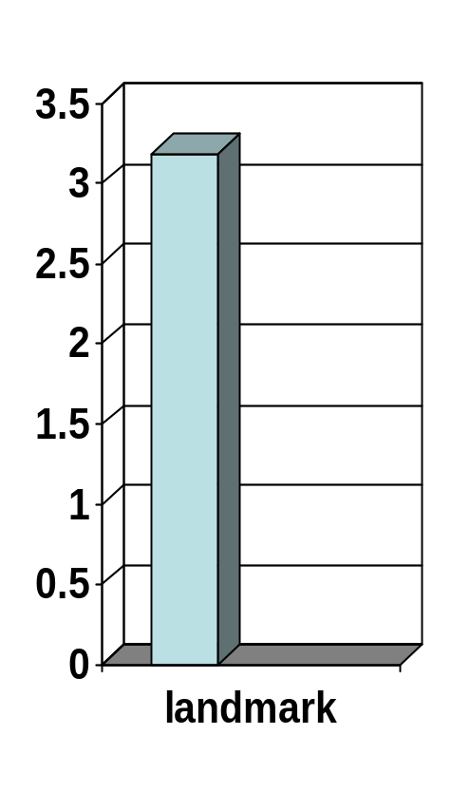
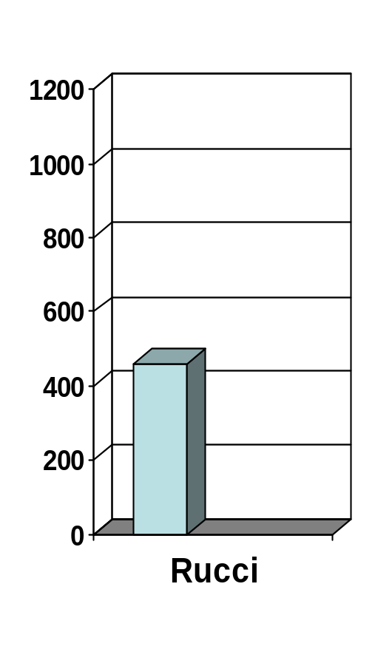
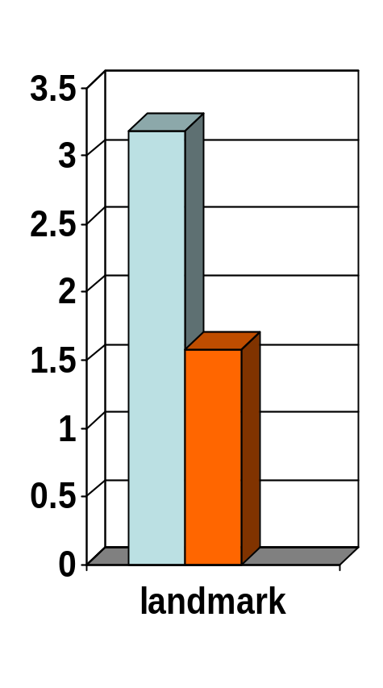
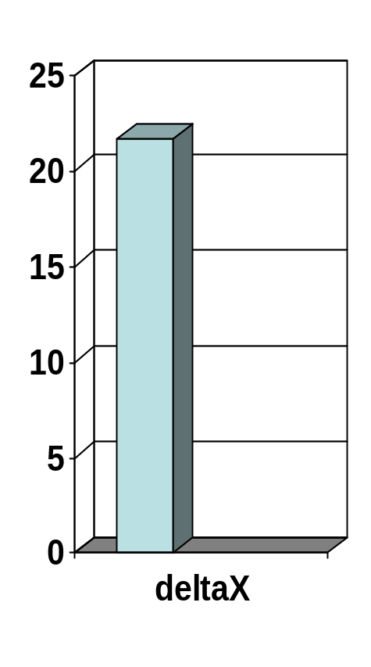
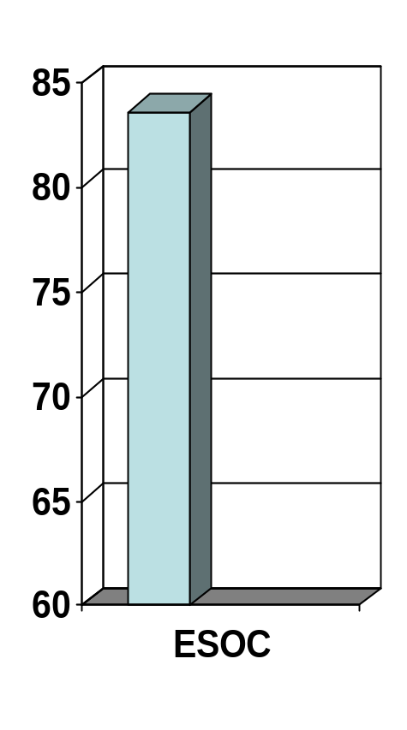
Out-of-the-Box Performance
Performance of SPQR on 16-core Machine
Out-of-the-Box
sequential
Time (sec)
Input Matrix

Slide 8
Out-of-the-Box Libraries Oversubscribe the Resources
A[0]
A[0]
A[0]
A[0]
A[0]
A[0]
TX
TY
TX
A[0]
A[0]
TY
TX
TY
TX
TY
TX
TY
TX
TY
+Z
+Z
+Z
TX
TY
TX
TY
+Z
+Z
+Z
+Z
+Z
A[1]
A[1]
A[1]
A[1]
A[1]
A[1]
A[1]
A[2]
A[1]
A[2]
A[2]
A[2]
A[2]
A[2]
CZ
A[2]
A[2]
CZ
CZ
CZ
CZ
CZ
NZ
NZ
NZ
NZ
NZ
NZ
CZ
+Y
NZ
CZ
NZ
+Y
+Y
+Y
+Y
+Y
+Y
+Y
Prefetch
Prefetch
Prefetch
Prefetch
Prefetch
Prefetch
NY
+X
(unit stride)
+X
(unit stride)
+X
(unit stride)
+X
(unit stride)
+X
(unit stride)
+X
(unit stride)
+X
(unit stride)
+X
(unit stride)
Prefetch
Prefetch
NY
NY
NY
CY
NY
CY
NY
CY
NY
NY
CY
CY
CY
CY
CY
A[10]
A[10]
A[10]
A[10]
A[10]
A[10]
NX
NX
NX
NX
A[10]
A[10]
CX
NX
CX
NX
CX
NX
NX
CX
CX
CX
CX
CX
A[11]
A[11]
A[11]
A[11]
A[11]
A[11]
Cache Blocking
A[11]
A[11]
Cache Blocking
Cache Blocking
Cache Blocking
Cache Blocking
Cache Blocking
Cache Blocking
Cache Blocking
A[12]
A[12]
A[12]
A[12]
A[12]
A[12]
A[12]
A[12]
Core
0
Core
1
Core
2
Core
3
TBB
OpenMP
OS
virtualized kernel threads
Hardware

Slide 9
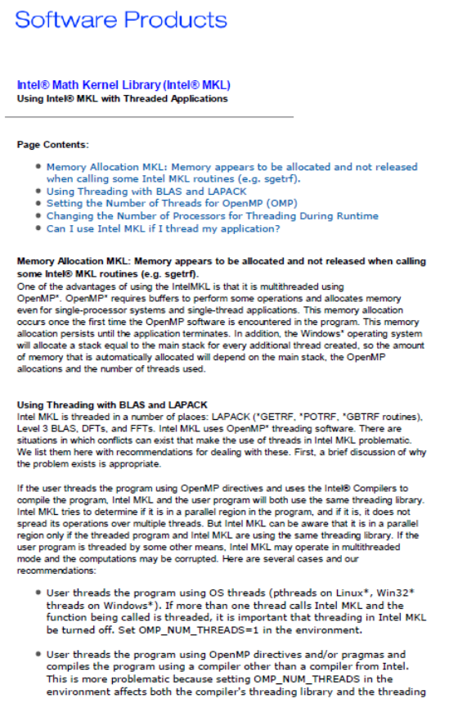
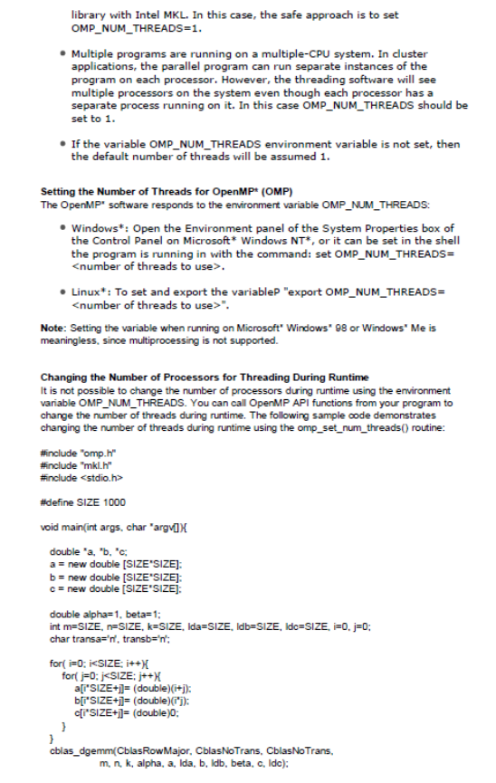
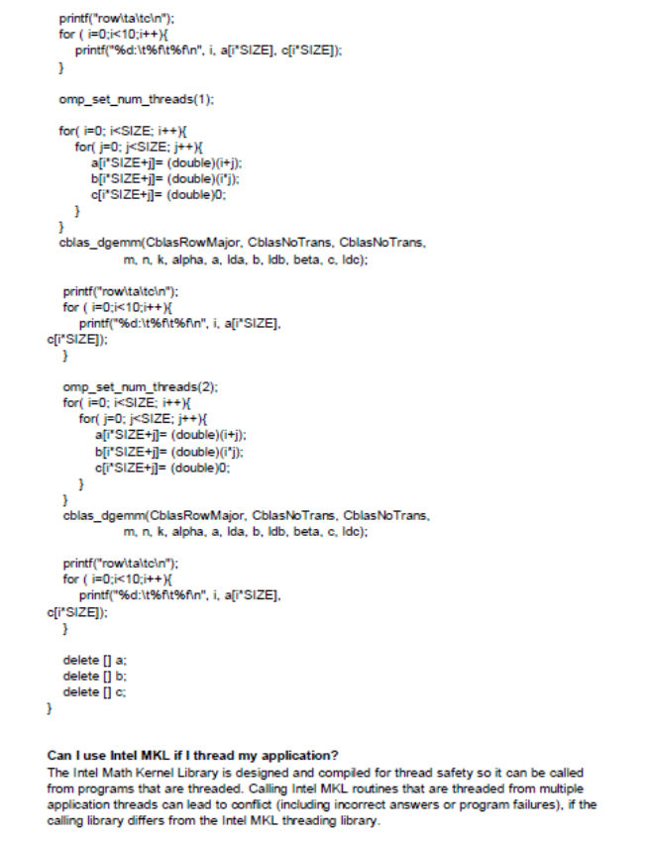
MKL Quick Fix
Using Intel MKL with Threaded Applications
http://www.intel.com/support/performancetools/libraries/mkl/sb/CS-017177.htm
• If more than one thread calls Intel MKL and the
function being called is threaded, it is important
that threading in Intel MKL be turned off.
Set OMP_NUM_THREADS=1 in the environment.

Slide 10
Sequential MKL in SPQR
Core
0
Core
1
Core
2
Core
3
TBB
OpenMP
OS
Hardware

Slide 11
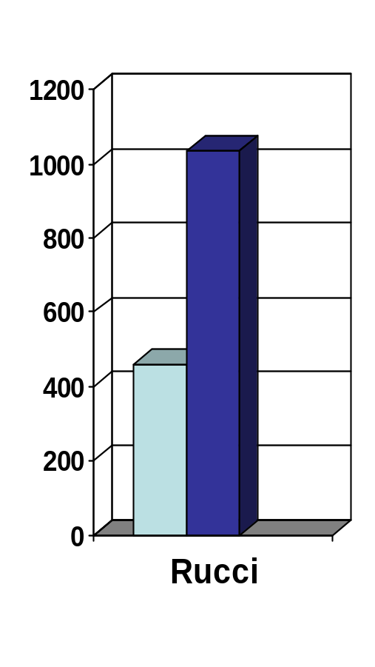
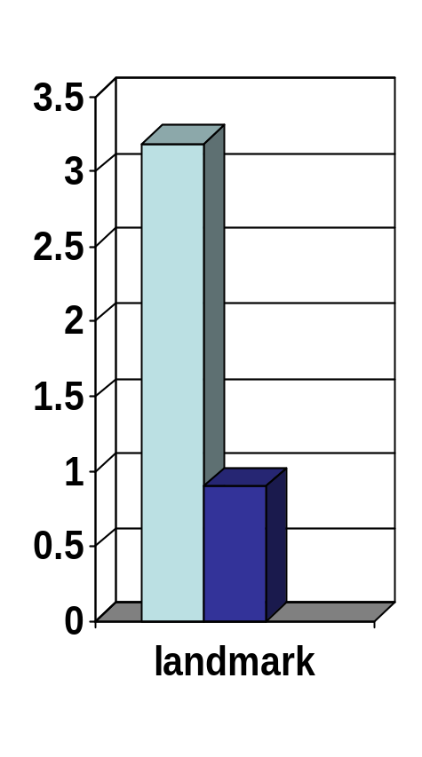
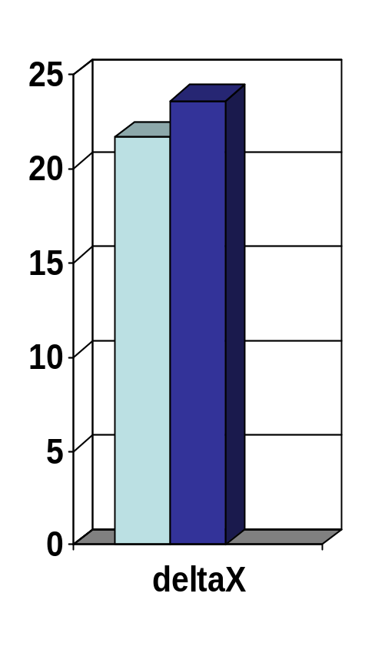
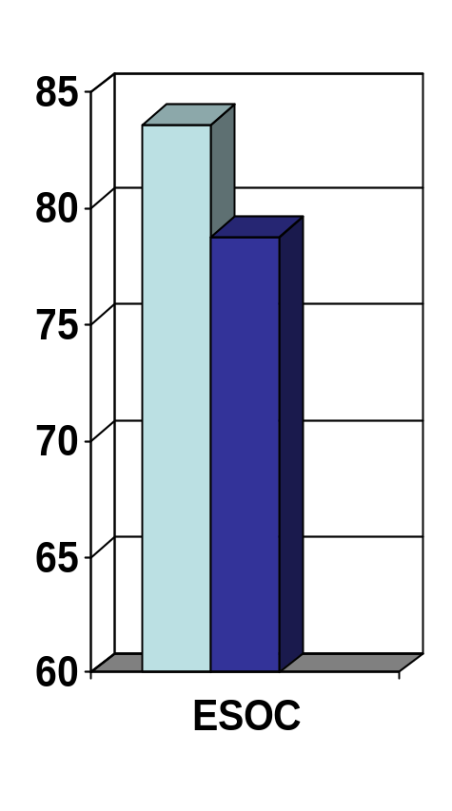
Sequential MKL Performance
Performance of SPQR on 16-core Machine
Out-of-the-Box
Sequential MKL
Time (sec)
Input Matrix

Slide 12
SPQR Wants to Use Parallel MKL
No task-level parallelism!
Want to exploit
matrix-level parallelism.

Slide 13
Share Resources Cooperatively
Core
0
Core
1
Core
2
Core
3
TBB_NUM_THREADS = 2
OMP_NUM_THREADS = 2
TBB
OpenMP
OS
Hardware
Tim Davis manually tunes libraries to effectively partition the resources.

Slide 14
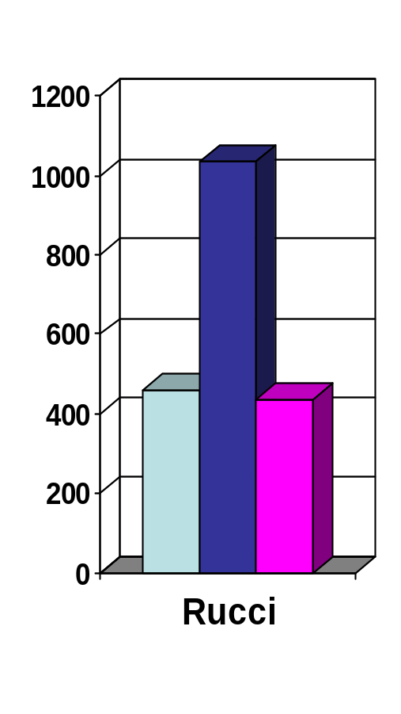
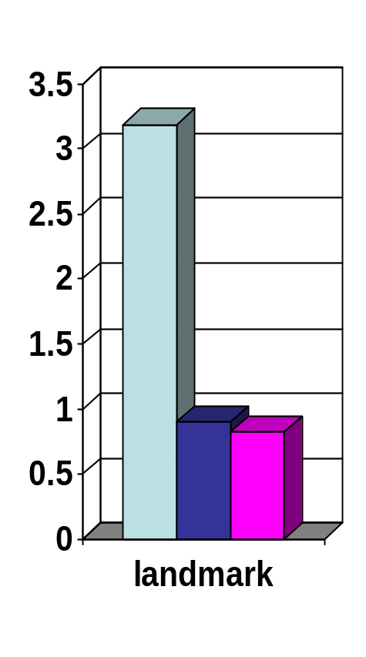
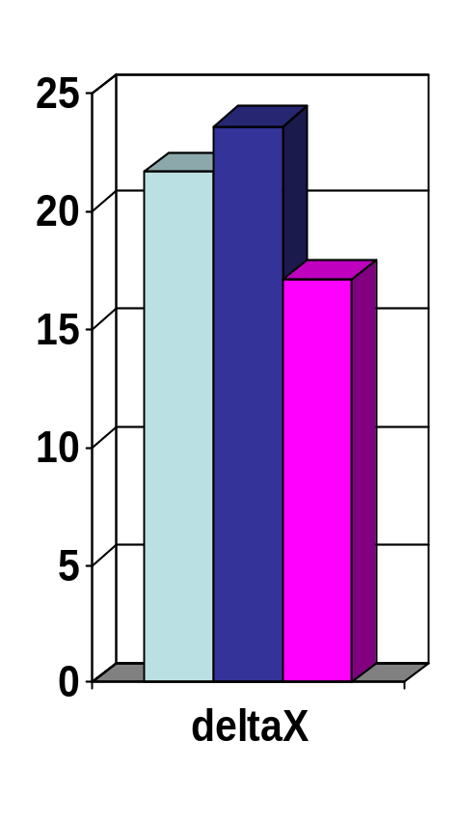
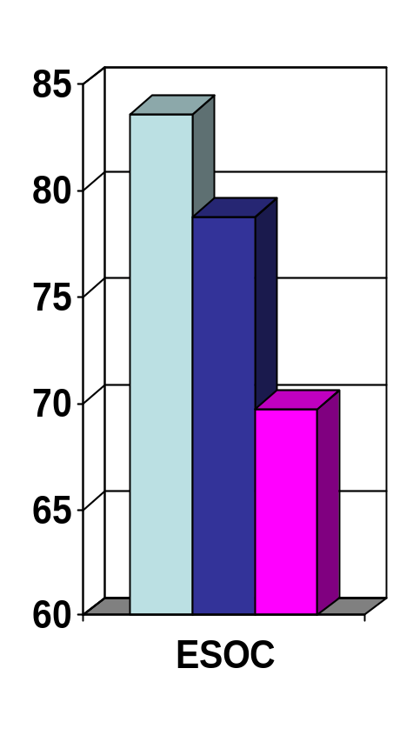
Manually Tuned Performance
Performance of SPQR on 16-core Machine
Out-of-the-Box
Sequential MKL
Manually Tuned
Time (sec)
Input Matrix

Slide 15
Manual Tuning Cannot Share Resources Effectively
Give resources to OpenMP
Give resources to TBB

Slide 16

Manual Tuning Destroys
Functional Composability
Tim Davis
OMP_NUM_THREADS = 4
MKL
OpenMP
LAPACK
Ax=b

Slide 17
Manual Tuning Destroys Performance Composability
SPQR
MKL
v1
MKL
v2
MKL
v3
App
SPQR
0
0
1
2
3

Slide 18
Talk Roadmap
Problem: Efficient parallel composability is hard!
Solution:
  Harts: better resource abstraction
  Lithe: framework for sharing resources
Evaluation

Slide 19
Virtualized Threads are Bad
App 1 (TBB)
App 1 (OpenMP)
App 2
OS
Core 0
Core 1
Core 2
Core 3
Core 4
Core 5
Core 6
Core 7
Different codes compete unproductively for resources.

Slide 20
Space-Time Partitions aren’t Enough
Partition 1
Partition 2
SPQR
App 2
TBB
MKL
OpenMP
OS
Core 0
Core 1
Core 2
Core 3
Core 4
Core 5
Core 6
Core 7
Space-time partitions isolate diff apps.
What to do within an app?

Slide 21
Harts: Hardware Thread Contexts
SPQR
TBB
MKL
OpenMP
Harts
Represent real hw resources.
Requested, not created.
OS doesn’t manage harts for app.
OS
Core 0
Core 1
Core 2
Core 3
Core 4
Core 5
Core 6
Core 7

Slide 22
Sharing Harts
Hart 0
Hart 1
Hart 2
Hart 3
time
TBB
OpenMP
OS
Hardware
Partition

Slide 23
Cooperative Hierarchical Schedulers
application call graph
library (scheduler) hierarchy
Cilk
Cilk
TBB
Ct
TBB
Ct
OpenMP
OMP
Modular: Each piece of the app scheduled independently.
Hierarchical: Caller gives resources to callee to execute on its behalf.
Cooperative: Callee gives resources back to caller when done.

Slide 24
A Day in the Life of a Hart
Cilk
TBB Sched: next?
executeTBB task
TBB
Ct
TBB
Tasks
TBB Sched: next?
OpenMP
execute TBB task
TBB Sched: next?
nothing left to do, give hart back to parent
Cilk Sched: next?
don‘t start new task, finish existing one first
Ct Sched: next?
time

Slide 25
Standard Lithe ABI
TBB_{Lithe} Scheduler
Parent Scheduler
Cilk_{Lithe} Scheduler
Caller
enter
yield
request
register
unregister
call
return
interface for sharing harts
interface for exchanging values
OpenMP_{Lithe} Scheduler
Child Scheduler
TBB_{Lithe} Scheduler
enter
yield
request
register
unregister
Callee
call
return
Analogous to function call ABI for enabling interoperable codes.
Mechanism for sharing harts, not policy.

Slide 26
Lithe Runtime
current
scheduler
current
scheduler
TBB_{Lithe}
yield
enter
yield
request
register
unregister
OpenMP_{Lithe}
enter
yield
request
register
unregister
harts
scheduler hierarchy
TBB_{Lithe}
OpenMP_{Lithe}
TBB
OpenMP
Lithe
OS
OS
Hardware
Hardware

Slide 27
Register / Unregister
TBB_{Lithe} Scheduler
matmult(){
register
unregister
register(OpenMP_{Lithe});
enter
yield
request
register
unregister
:
:
OpenMP_{Lithe} Scheduler
unregister(OpenMP_{Lithe});
enter
yield
request
register
unregister
}
time
Register dynamically adds the new scheduler to the hierarchy.

Slide 28
Request
TBB_{Lithe} Scheduler
matmult(){
request
register(OpenMP_{Lithe});
enter
yield
request
register
unregister
request(n);
OpenMP_{Lithe} Scheduler
:
unregister(OpenMP_{Lithe});
enter
yield
request
register
unregister
}
time
Request asks for more harts from the parent scheduler.

Slide 29
Enter / Yield
TBB_{Lithe} Scheduler
yield
enter(OpenMP_{Lithe});
enter
yield
request
register
unregister
:
:
OpenMP_{Lithe} Scheduler
yield();
enter
enter
yield
request
register
unregister
time
Enter/Yield transfers additional harts between the parent and child.

Slide 30
SPQR with Lithe
SPQR
TBB_{Lithe}
MKL
OpenMP_{Lithe}
matmult
reg
req
enter
enter
enter
yield
yield
yield
unreg
time

Slide 31
SPQR with Lithe
SPQR
TBB_{Lithe}
MKL
OpenMP_{Lithe}
matmult
matmult
matmult
matmult
reg
reg
reg
reg
req
req
req
req
unreg
unreg
unreg
unreg
time

Slide 32
Talk Roadmap
Problem: Efficient parallel composability is hard!
Solution:
  Harts
  Lithe
Evaluation

Slide 33
Implementation
Harts: simulated using pinned Pthreads on x86-Linux
Lithe: user-level library (register, unregister, request, enter, yield, ...)
TBB_{Lithe}
OpenMP_{Lithe} (GCC4.4)
~600 lines of C & assembly
~2000 lines of C, C++, assembly
~1500 / ~8000 relevant lines added/removed/modified
~1000 / ~6000 relevant lines added/removed/modified
TBB_{Lithe}
OpenMP_{Lithe}
Lithe
Harts

Slide 34
No Lithe Overhead w/o Composing
All results on Linux 2.6.18, 8-core Intel Clovertown.
TBB_{Lithe} Performance (µbench included with release)
 | tree sum | preorder | fibonacci
TBB_{Lithe} | 54.80ms | 228.20ms | 8.42ms
TBB | 54.80ms | 242.51ms | 8.72ms
OpenMP_{Lithe} Performance (NAS parallel benchmarks)
 | conjugate gradient (cg) | LU solver (lu) | multigrid (mg)
OpenMP_{Lithe} | 57.06s | 122.15s | 9.23s
OpenMP | 57.00s | 123.68s | 9.54s

Slide 35
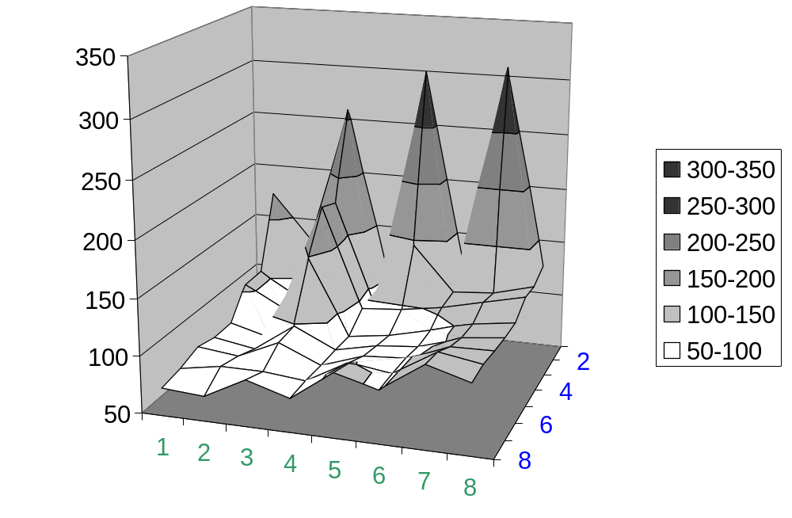
Performance Characteristics of SPQR (Input = ESOC)
Time (sec)
NUM_TBB_THREADS
NUM_OMP_THREADS

Slide 36
Performance Characteristics of SPQR (Input = ESOC)
Sequential
TBB=1, OMP=1
172.1 sec
Time (sec)
NUM_TBB_THREADS
NUM_OMP_THREADS

Slide 37
Performance Characteristics of SPQR (Input = ESOC)
Time (sec)
Out-of-the-Box
TBB=8, OMP=8
111.8 sec
NUM_TBB_THREADS
NUM_OMP_THREADS

Slide 38
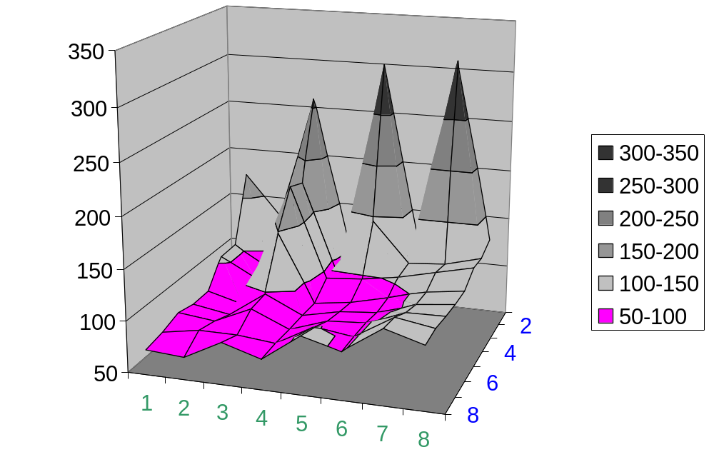
Performance Characteristics of SPQR (Input = ESOC)
Manually Tuned
70.8 sec
Time (sec)
Out-of-the-Box
NUM_TBB_THREADS
NUM_OMP_THREADS

Slide 39
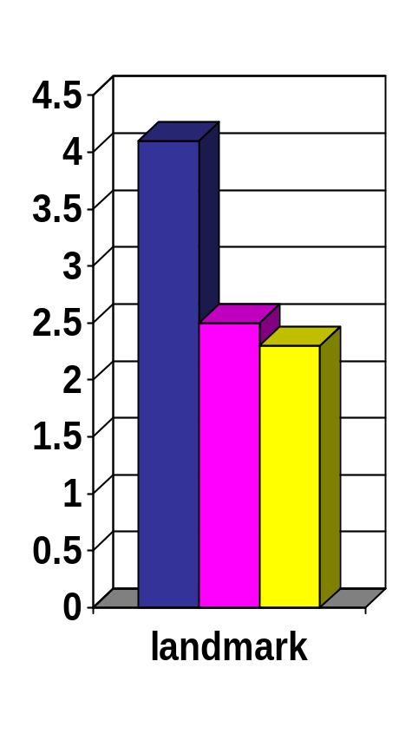
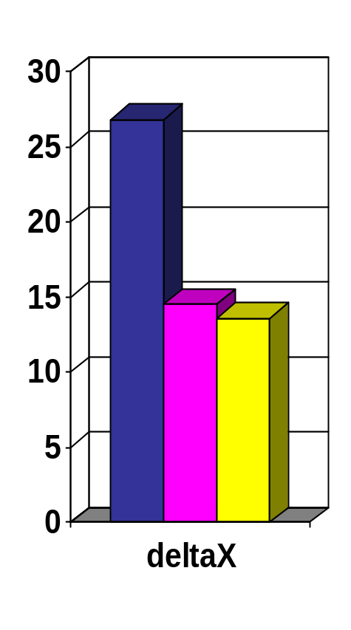
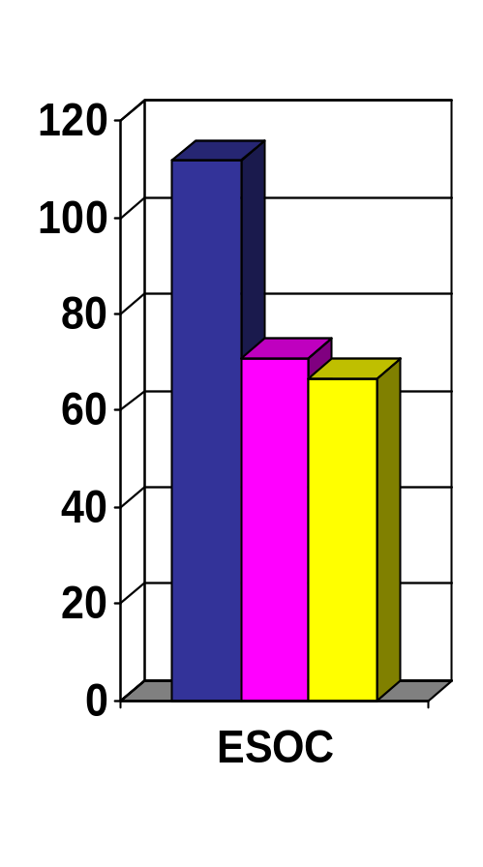
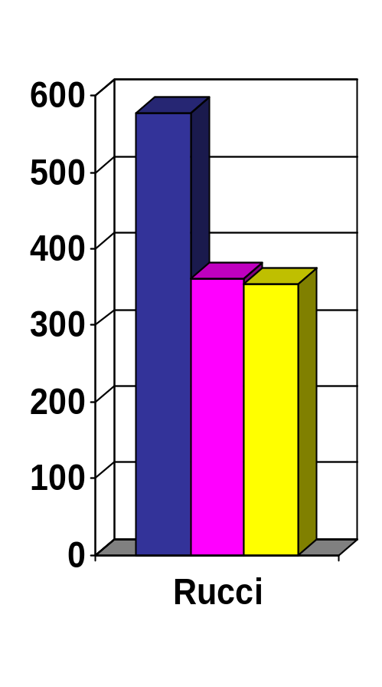
Performance of SPQR with Lithe
Out-of-the-Box
Manually Tuned
Lithe
Time (sec)
Input Matrix

Slide 40


Future Work
SPQR
TBB_{Lithe}
OpenMP_{Lithe}
Ct_{Lithe}
Cilk_{Lithe}
• • •
enter
yield
req
reg
unreg
enter
yield
req
reg
unreg
enter
yield
req
reg
unreg
enter
yield
req
reg
unreg

Slide 41

Conclusion
Composability essential for parallel programming to become widely adopted.
SPQR
functionality
TBB
MKL
OpenMP
resource management
Parallel libraries need to share resources cooperatively.
0
1
2
3
Lithe project contributions
  Harts: better resource model for parallel programming
  Lithe: enables parallel codes to interoperate by standardizing the sharing of harts

Slide 42




Acknowledgements
We would like to thank George Necula and the rest of Berkeley
Par Lab for their feedback on this work.
Research supported by Microsoft (Award #024263 ) and Intel
(Award #024894) funding and by matching funding by U.C.
Discovery (Award #DIG07-10227). This work has also been
in part supported by a National Science Foundation Graduate
Research Fellowship. Any opinions, findings, conclusions, or
recommendations expressed in this publication are those of the
authors and do not necessarily reflect the views of the National
Science Foundation. The authors also acknowledge the support
of the Gigascale Systems Research Focus Center, one of five research centers funded under the Focus Center Research Program, a Semiconductor Research Corporation program.

