Slide 1
Lithe
Composing Parallel Software Efficiently
Heidi Pan, Benjamin Hindman, Krste Asanovic
xoxo@mit.edu • {benh, krste}@eecs.berkeley.edu
Massachusetts Institute of Technology • UC Berkeley
PLDI • June 09, 2010

Slide 2
Composition is King
game() {
forall frames:
AI.compute() ;
}
Graphics
AI
||
||
Audio.play() ;
Physics
{
Graphics.render();
Physics.calc ();
:
}
Audio
Productivity: Don’t want to implement & understand everything.
Performance: Leverage language & runtime optimizations within components.
Diversity: Components may want to use different abstractions & languages.

Slide 3
Multiple Components Oversubscribe the Resources
tbb::task() {
matmult();
:
matmult() {
#pragma omp parallel
:
matmult {
#pragma omp parallel
:
Core
0
Core
1
Core
2
Core
3
App
TBB
OpenMP
OS
Hardware

Slide 4
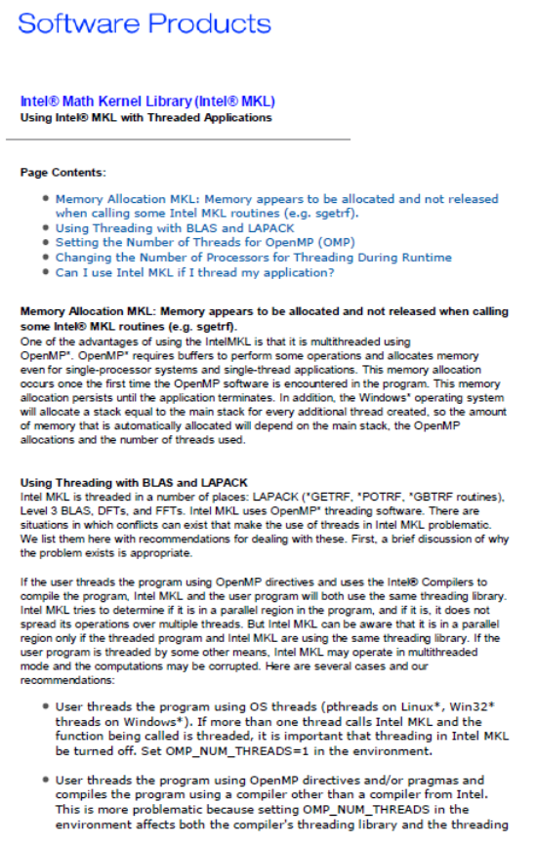
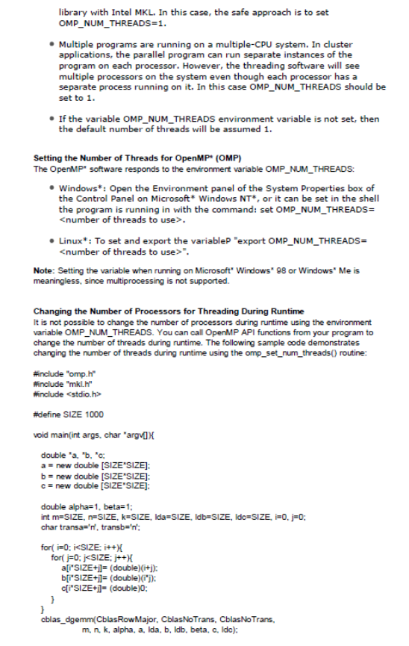
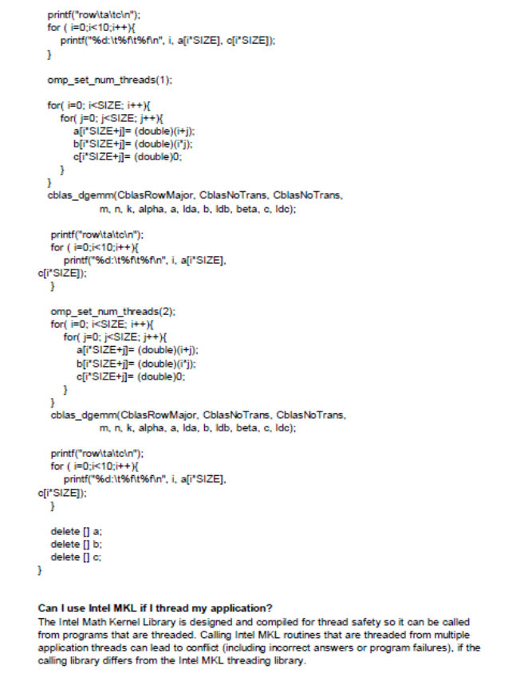
MKL Quick Fix
Using Intel MKL with Threaded Applications
http://www.intel.com/support/performancetools/libraries/mkl/sb/CS-017177.htm
• If more than one thread calls Intel MKL and the
function being called is threaded, it is important
that threading in Intel MKL be turned off.
Set OMP_NUM_THREADS=1 in the environment.

Slide 5

Breaks Black-Box Abstraction
Programmer
OMP_NUM_THREADS = 1
MKL
OpenMP
Ax = b

Slide 6


Exports Problem to User
Game
AI
Graphics
Audio
Physics
MKL
Cilk
TBB
OpenMP
Custom
Need Systemic Solution! Lithe
Core
0
Core
1
Core
2
Core
3

Slide 7
Better Resource Abstraction: Harts
Application
Application
Library A
Library B
Library C
Library A
Library B
Library C
OS Threads
Harts
= Hardware Thread Contexts
Core 0
Core 1
Core 2
Core 3
Core 0
Core 1
Core 2
Core 3
Hardware
Hardware
Create as many threads as wanted.
Allocated a finite amount of harts.
Threads = Resource + Programming Abstraction
Harts = Resource Abstraction

Slide 8
Cooperative Hierarchical Resource Sharing
Parent (Caller)
tbb::task() {
matmult() {
#pragma omp parallel
:
}
:
}
task() {
matmult() {
:
}
:
}
tbb::
task
#pragma omp parallel
TBB Runtime Scheduler
TBB
TBB
Call
Return
matmult
Application
Call Graph
Hierarchy
OpenMP Runtime Scheduler
OpenMP
OpenMP
Child (Callee)
Transfer of control coupled with transfer of resources.

Slide 9
Confluence of Related Work
Hierarchical Scheduling
Cooperative Scheduling
Parent
Lottery Scheduling (Waldspurger 94)
Continuation-Based
CPU Inheritance (Ford 96)
Multiprocessing
(Wand 80)
Tasks
(Threads)
Converse (Kale 96)
Manticore (Fluet 08)
HLS (Regehr 01)
GHC (Li 07)
:
:
Unstructured
Transfer of Control
Child
Structured
Transfer of
Control
Parent
Resources
(Harts)
Lithe
Child

Slide 10
Standard Callback Interface
task
cilk
tbb::
task() {
matmult() {
:
}
:
}
Cilk_{Lithe}
Parent
TBB_{Lithe}
#pragma OMP parallel
enter
yield
request
register
unregister
matmult
OpenMP_{Lithe}
Child
enter
yield
request
register
unregister
Separation of Interface and Implementation

Slide 11
Sharing Harts via Lithe
Hart
0
Hart
1
Hart
2
Hart
3
Time
Game
AI
Graphics
Audio
Physics
MKL
call
matmult
Cilk
TBB
OMP
Custom
request
enter
tbb::task() {
matmult() {
#pragma omp parallel
:
}
:
}
yield
return
Core
0
Core
1
Core
2
Core
3

Slide 12
Sparse QR Factorization (SPQR)
Column
Elimination Tree
SPQR
Frontal Matrix
Factorization
TBB
MKL
OpenMP
OS
Hardware
System Stack
Software Architecture

Slide 13
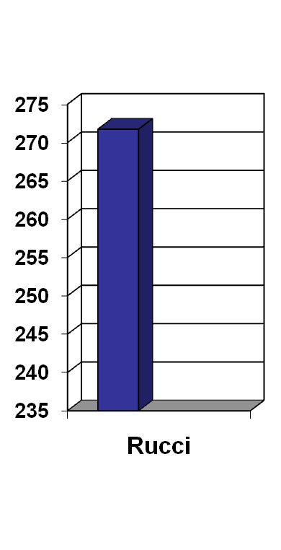
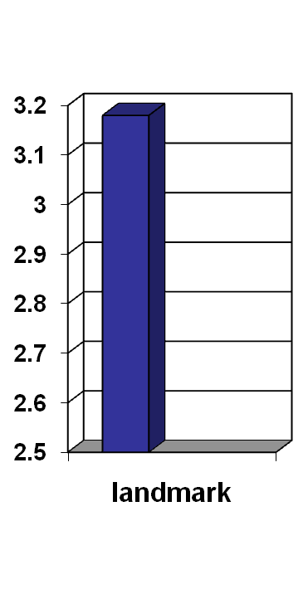
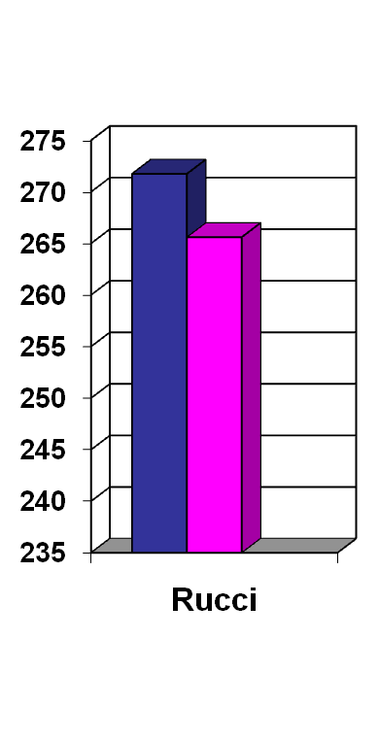
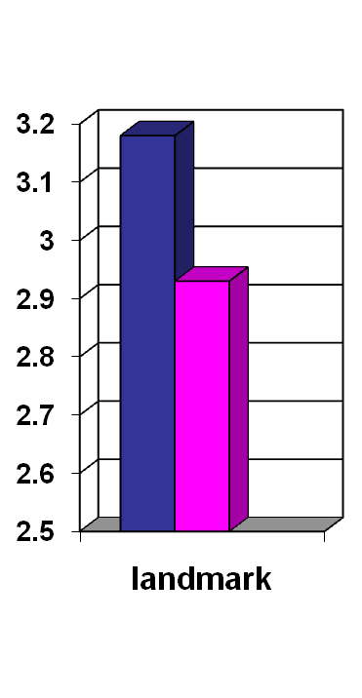
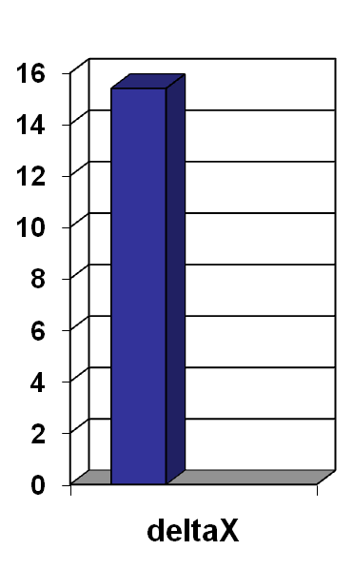
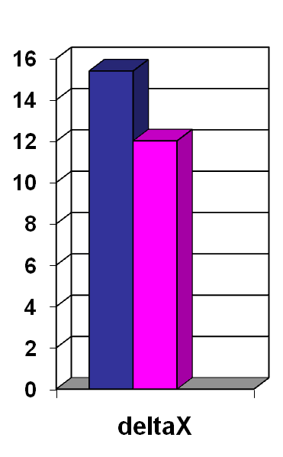
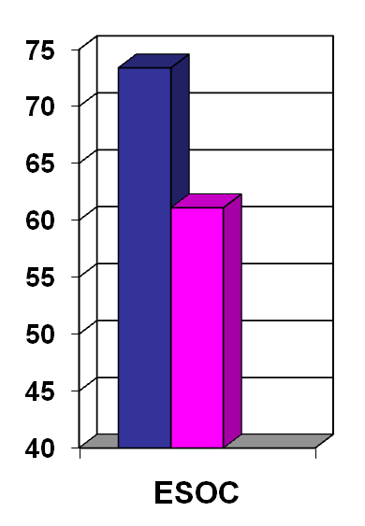
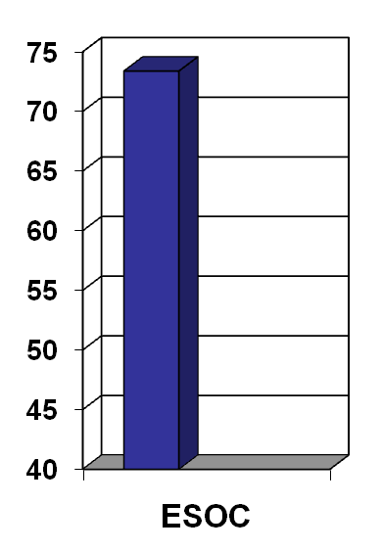
Performance of SPQR on 16-Core Machine
Out-of-the-Box
Manually Tuned
TBB=16 • OMP=16
Time (sec)
TBB=11• OMP=8
TBB=3 • OMP=5
TBB=16 • OMP=5
TBB=16 • OMP=8
Input Matrix

Slide 14
SPQR with Lithe
SPQR
SPQR
TBB
MKL
TBB_{Lithe}
OpenMP
TBB
MKL
OpenMP
OMP _{Lithe}
Lithe
OS
Hardware
Library interfaces remain the same.
Zero lines of high-level codes changed (SPQR, MKL).
Just link in Lithe runtime + Lithe versions of libraries (TBB, OpenMP).

Slide 15
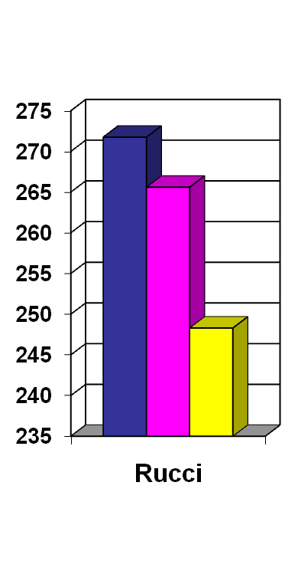
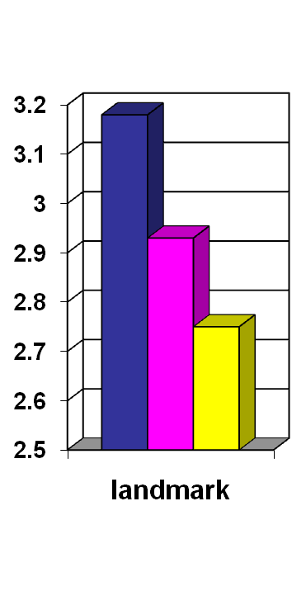
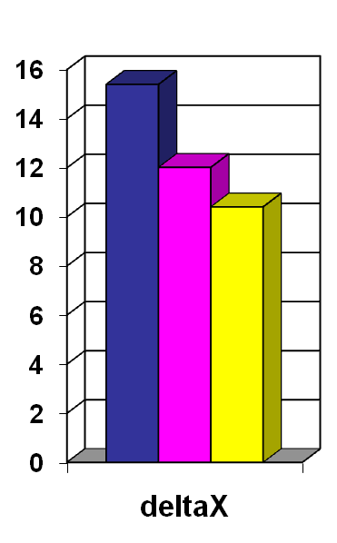
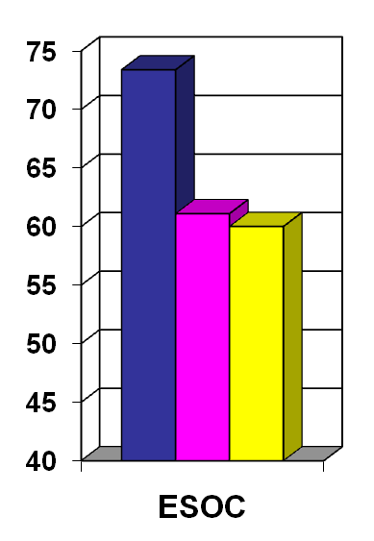
Performance of SPQR with Lithe
Out-of-the-Box
Manually Tuned
Lithe
TBB=16 • OMP=16
Time (sec)
TBB=11• OMP=8
TBB=3 • OMP=5
TBB=16 • OMP=5
TBB=16 • OMP=8
Input Matrix

Slide 16
Lithe Enables Flexible Sharing of Resources
Give resources to OpenMP
Give resources to TBB
Manual tuning is stuck with 1 TBB/OMP config throughout run.

Slide 17





Flickr-Like Image Processing App Server
`
App Server
`
Graphics
Libprocess
OpenMP
Magick
Image
Resizing
OS
Hardware
Requests
System Stack

Slide 18
Performance of App Server
6
(16-Core Machine)
5
# OMP Threads = 1
4
# OMP Threads = 2
# OMP Threads = 4
Latency (Seconds)
3
# OMP Threads = 8
2
# OMP Threads = 16
1
Lithe
0
0
0.5
1
1.5
2
2.5
3
Throughput (Requests / Second)

Slide 19

Conclusion
Composability essential for parallel programming to become widely adopted.
App
functionality
TBB
MKL
OpenMP
resource management
Parallel libraries need to share resources cooperatively.
0
1
2
3
Main contributions:
  Harts: better resource model for parallel programming
  Lithe: framework for using and sharing harts

Slide 20
Questions?
App
MKL
TBB_{Lithe}
OMP
Lithe
Lithe
OS
Hardware
Composing Parallel Software Efficiently with Lithe
Code release at http://parlab.eecs.berkeley.edu/lithe
See paper on how I/O and synchronization work with Lithe

