Slide 1
REVIEW-2 Patient Database Management System Using BlockChain
Presented by:
2010030526 – D.Dedeepya
2010030530 – K.SriTeja
Guided by
Lalitha Surya Kumari ma’am

Slide 2
Table of contents
Implementation (flow chart)
Github commits
Work progress
Alpha testing

Slide 3
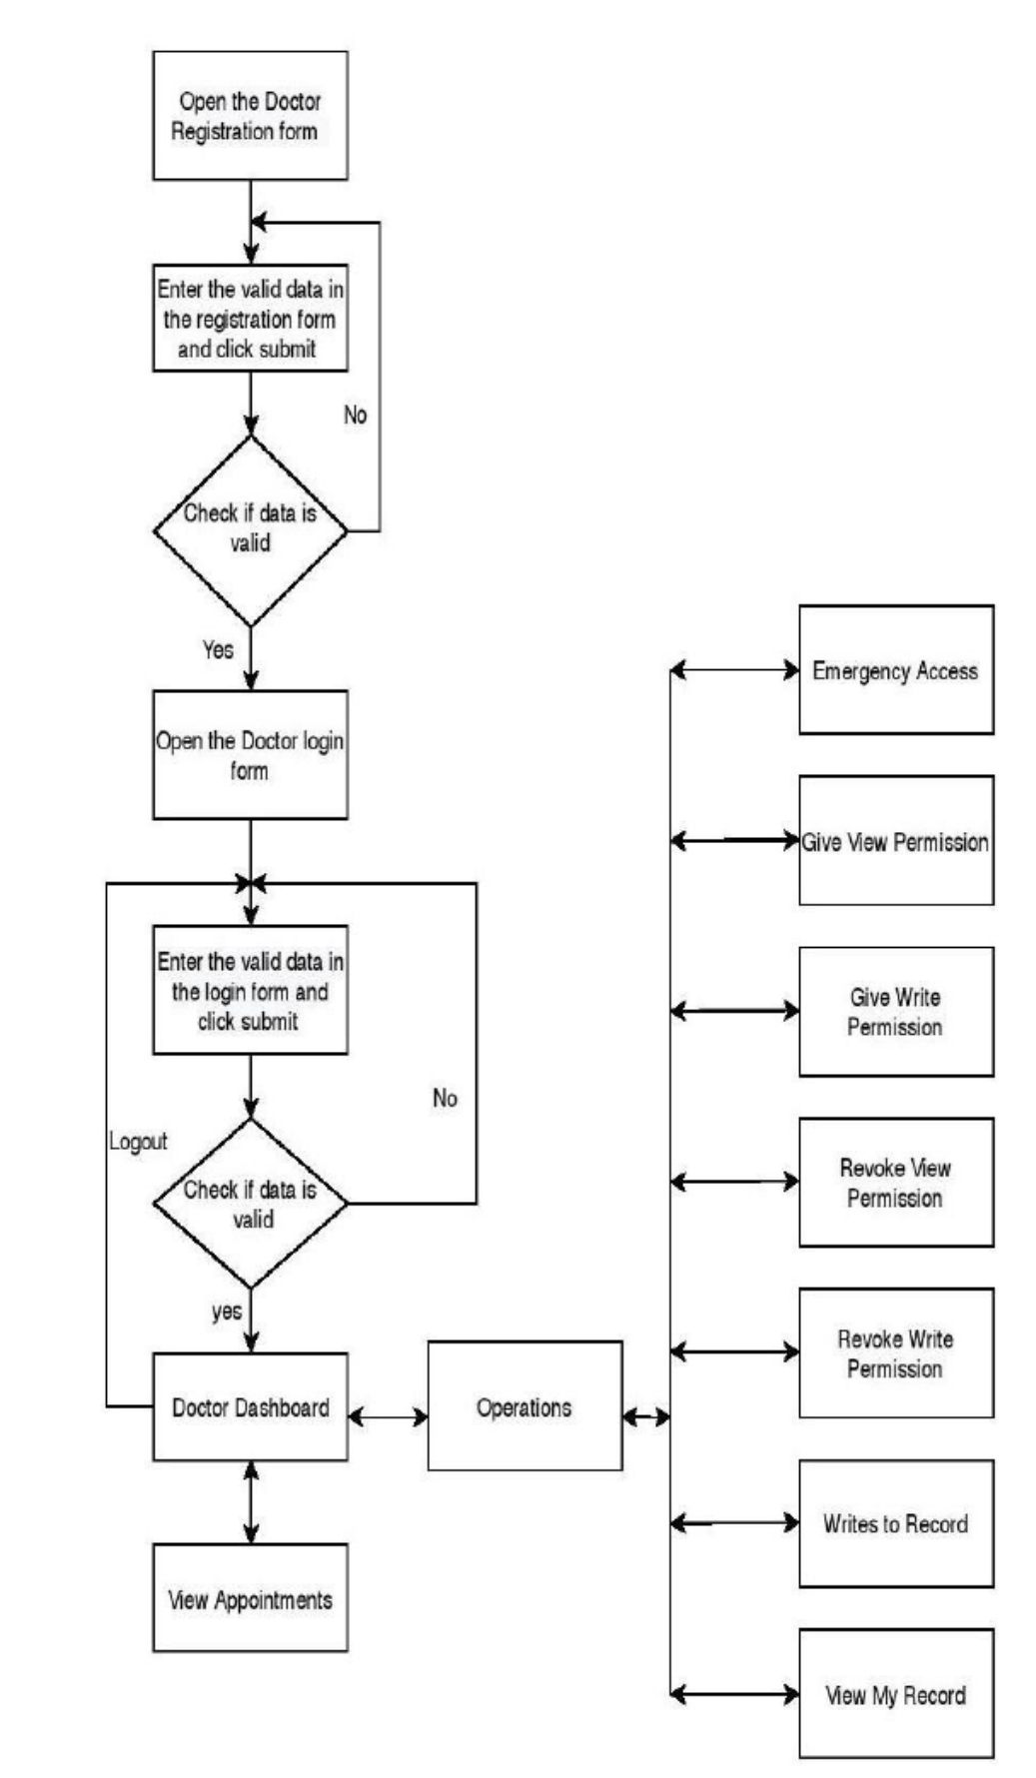
Implementation (flow chart)

Slide 4
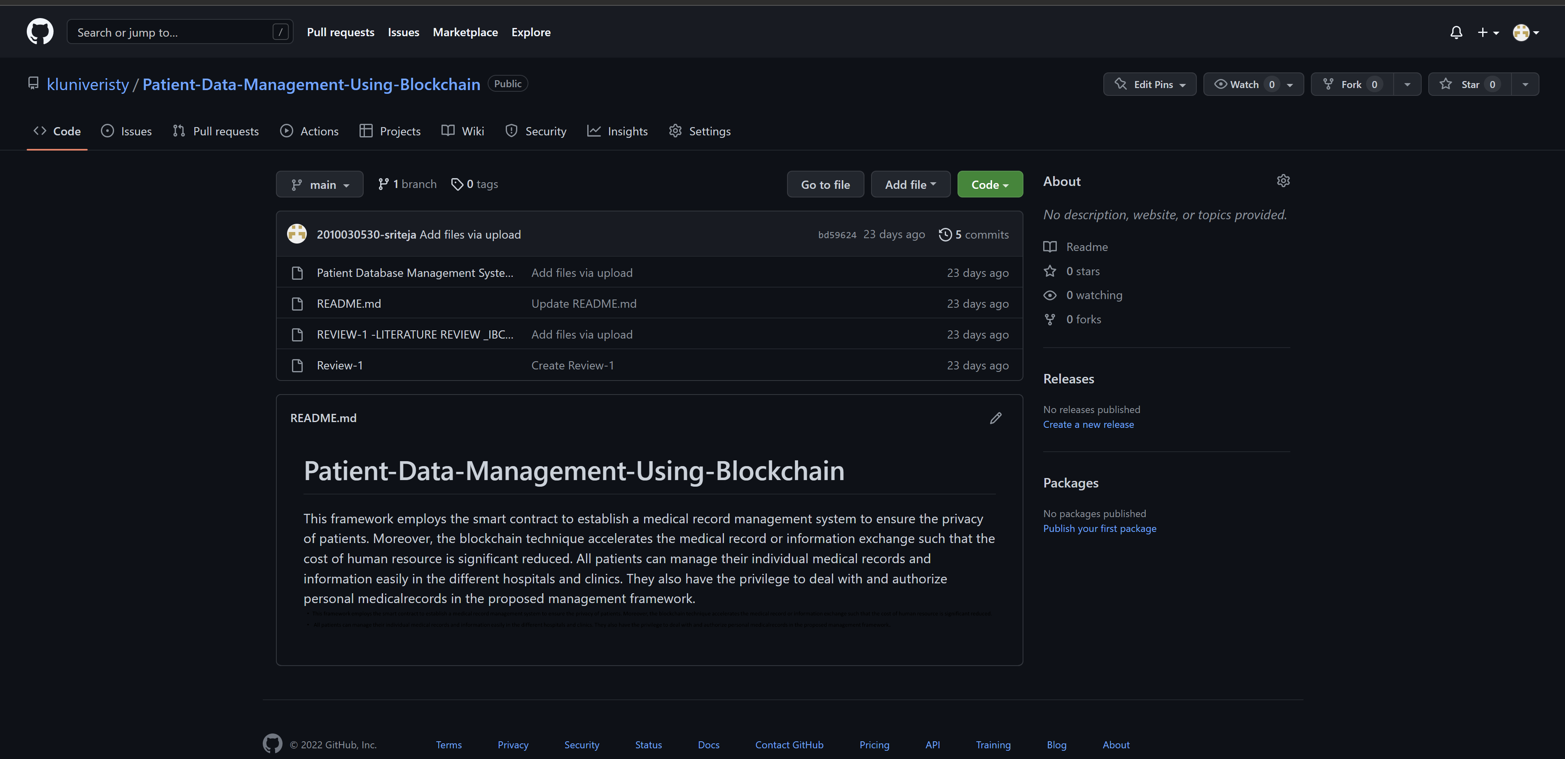
Github commits

Slide 5
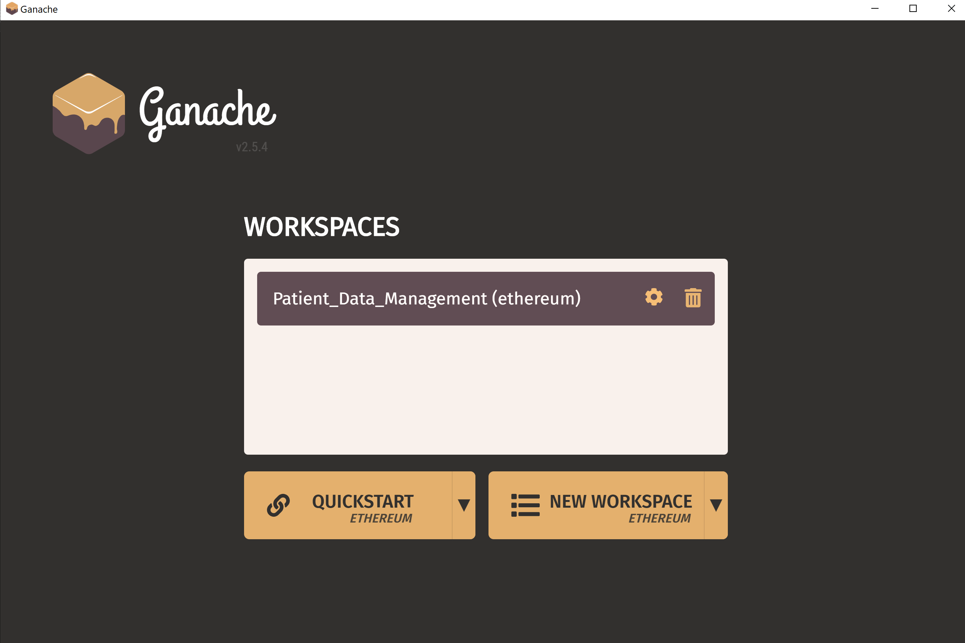
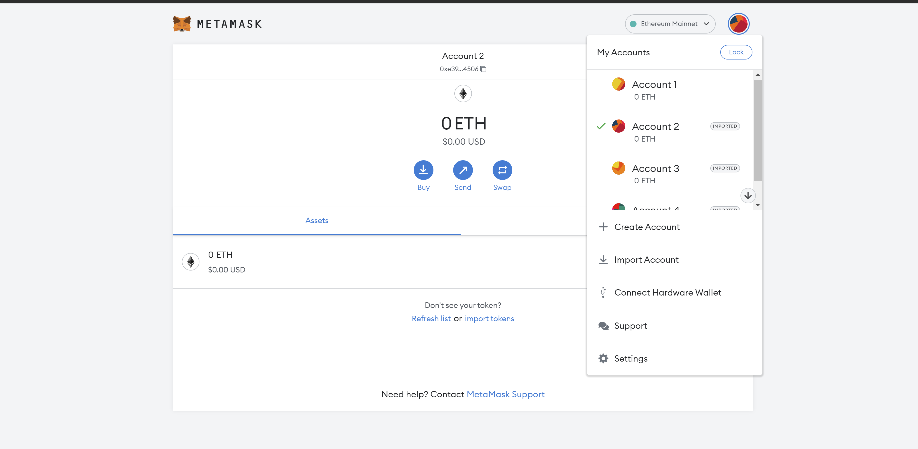
Work progress

Slide 6
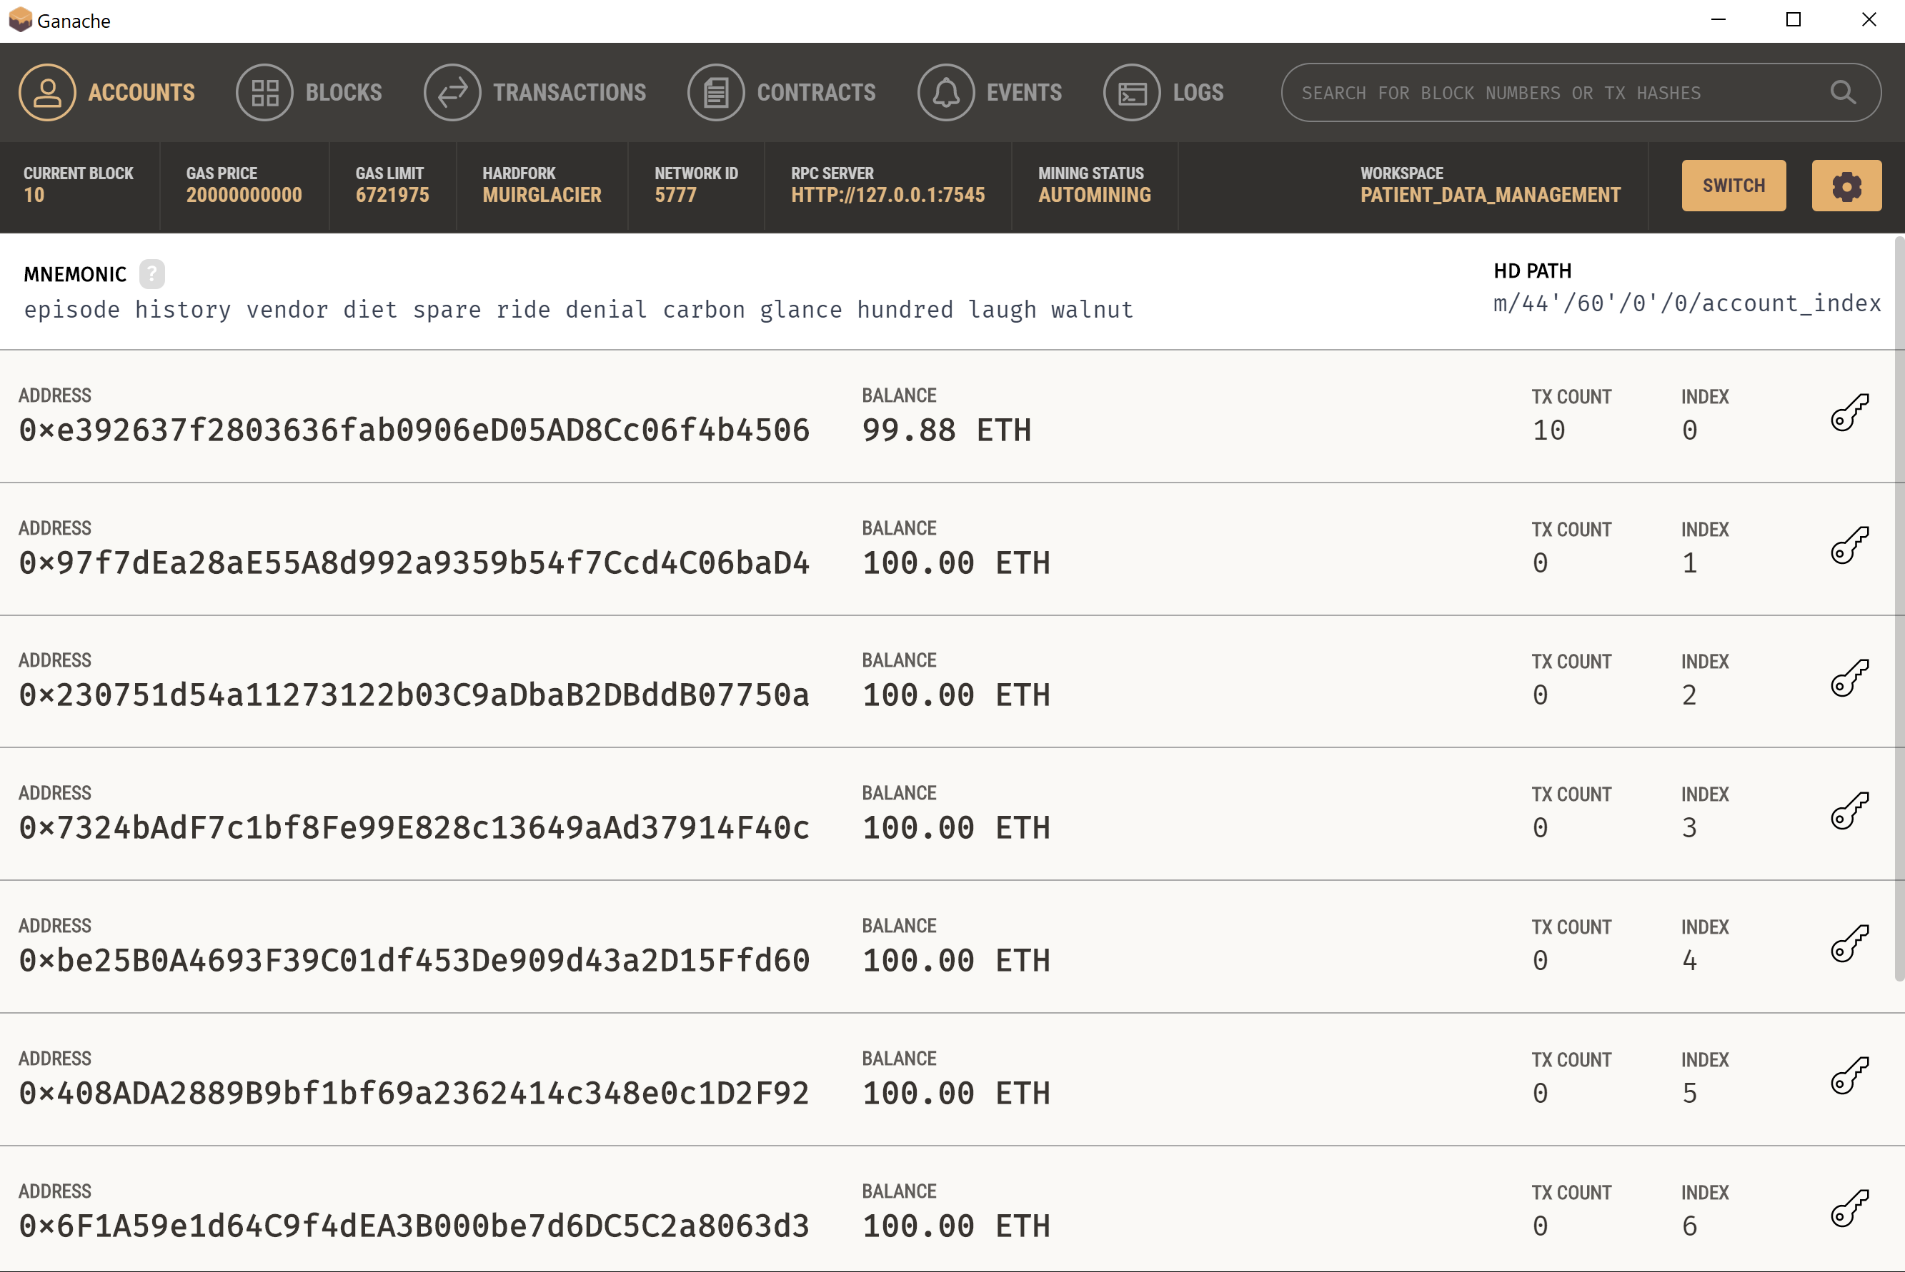
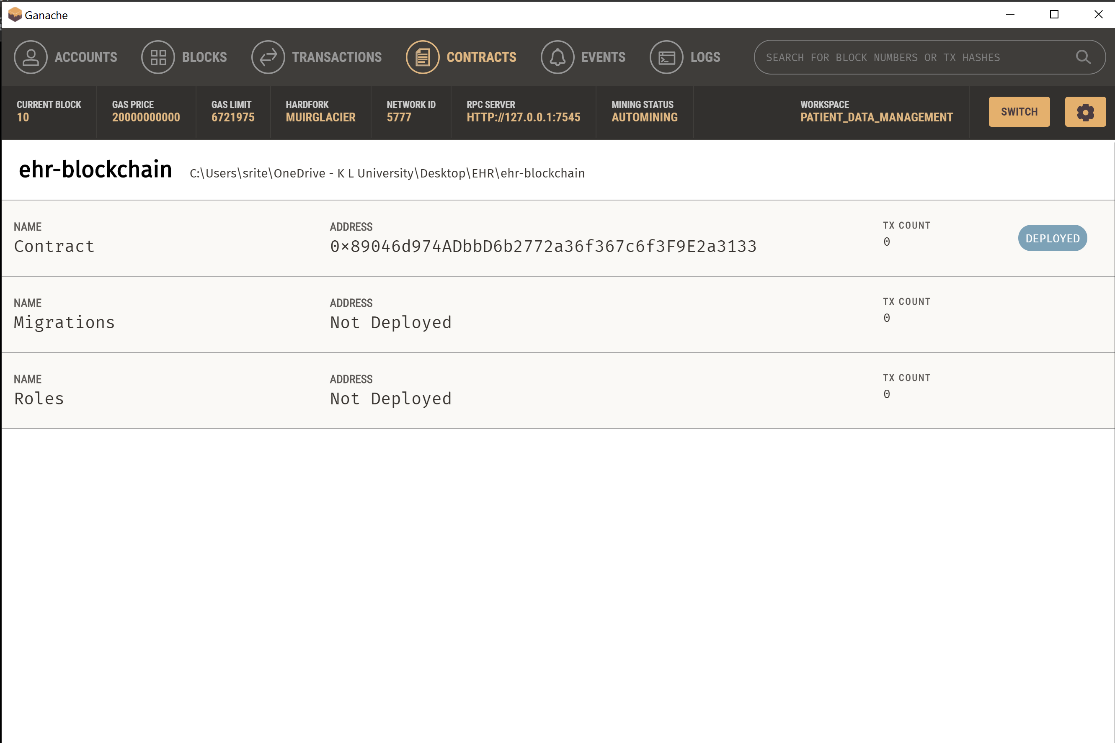
Alpha testing

Slide 7
