Slide 1
REVIEW-3 Patient Database Management System Using BlockChain
Presented by:
2010030526 – D.Dedeepya
2010030530 – K.SriTeja
Guided by
Lalitha Surya Kumari ma’am

Slide 2
Table of contents
Documentation
Github commits
Work progress
Beta testing

Slide 3
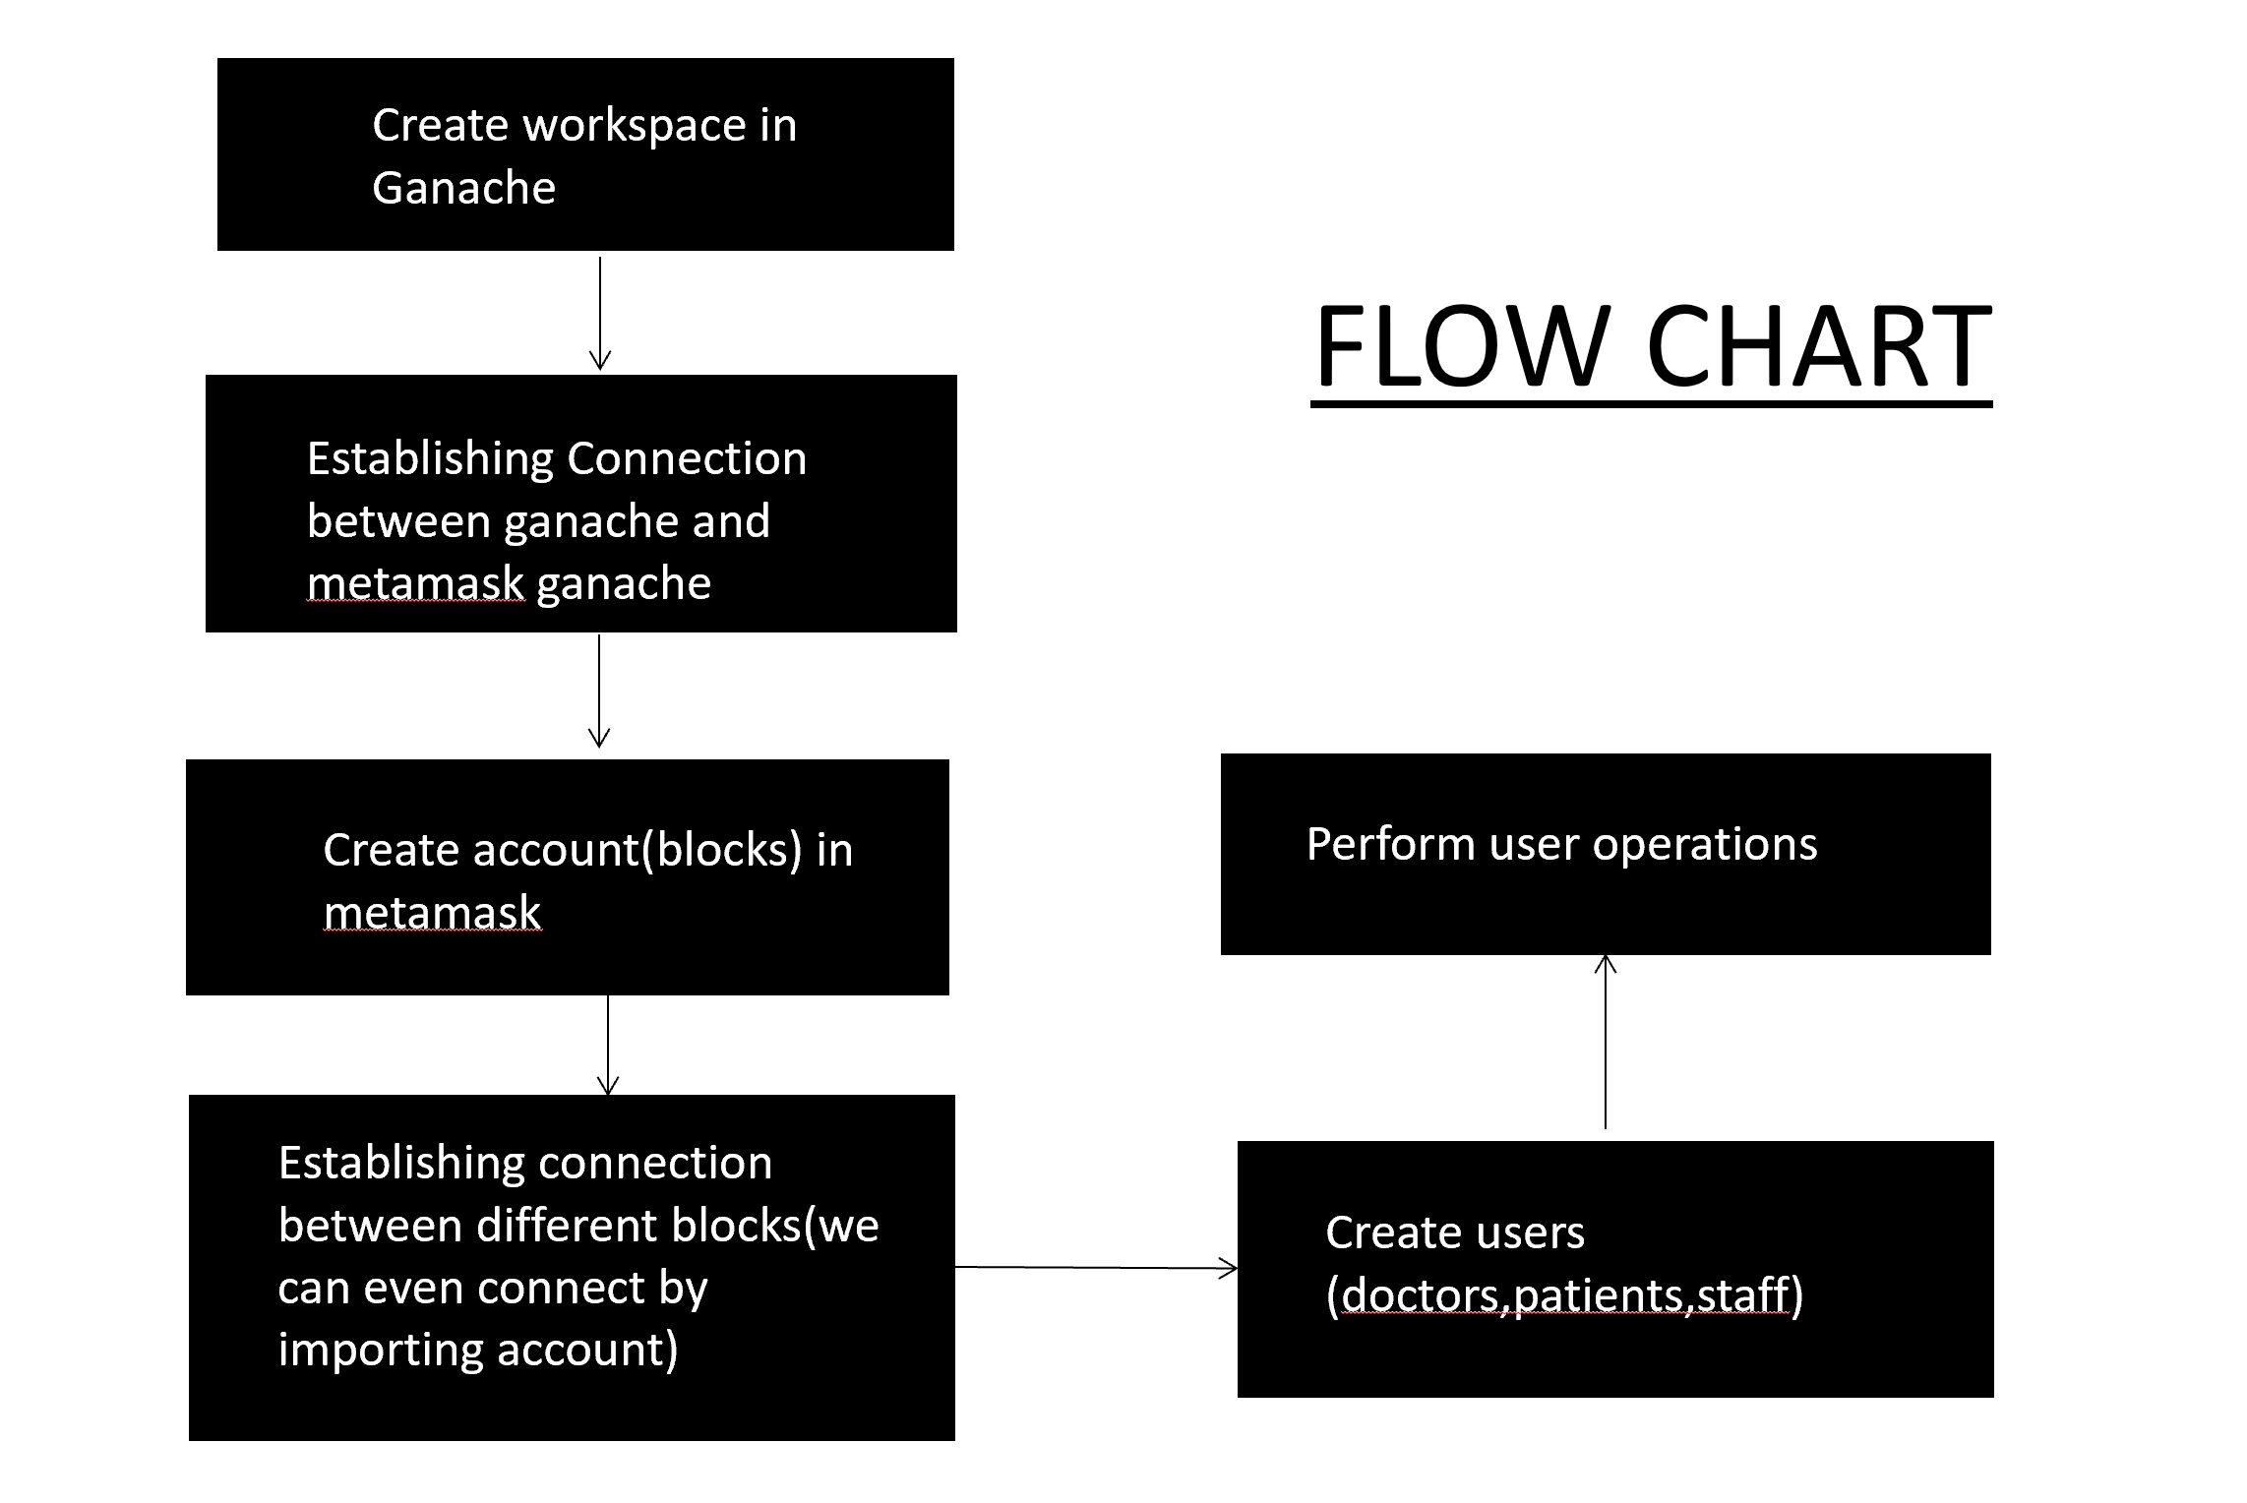

Slide 4
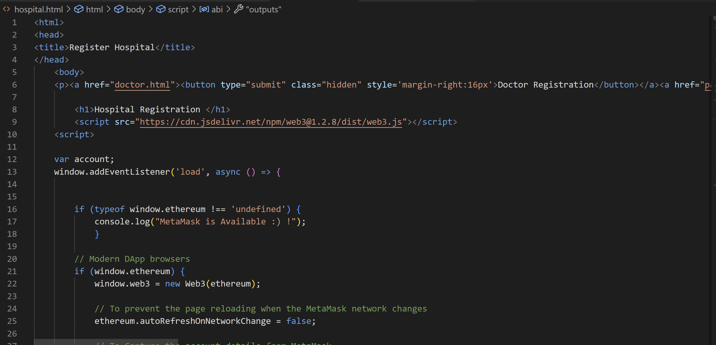
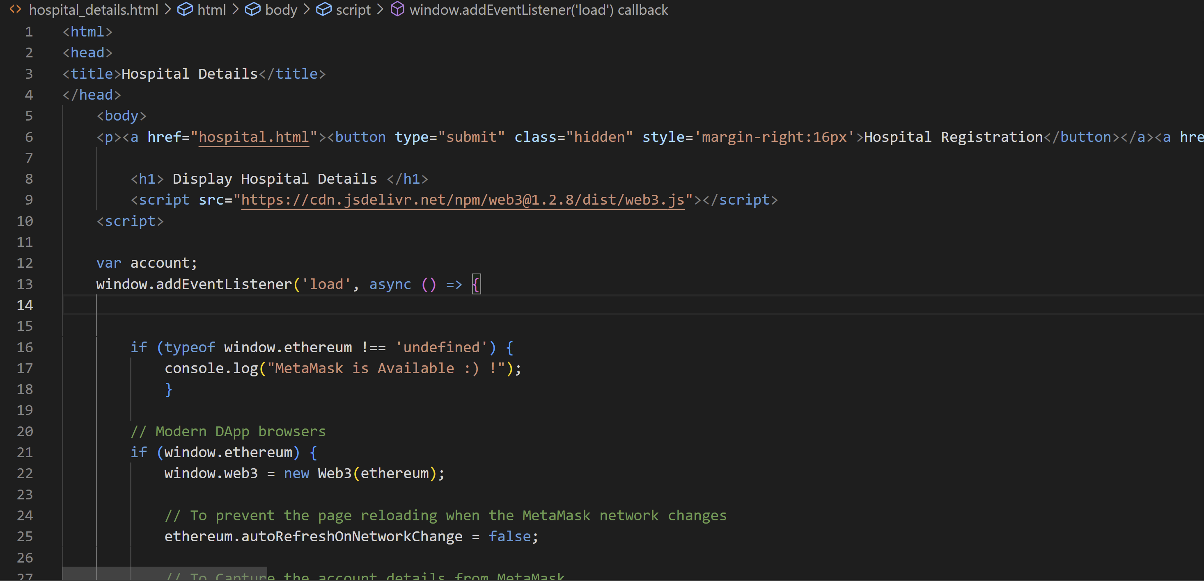
CODE
Create workspace in Ganache
Hospital.html
Hospital_details

Slide 5
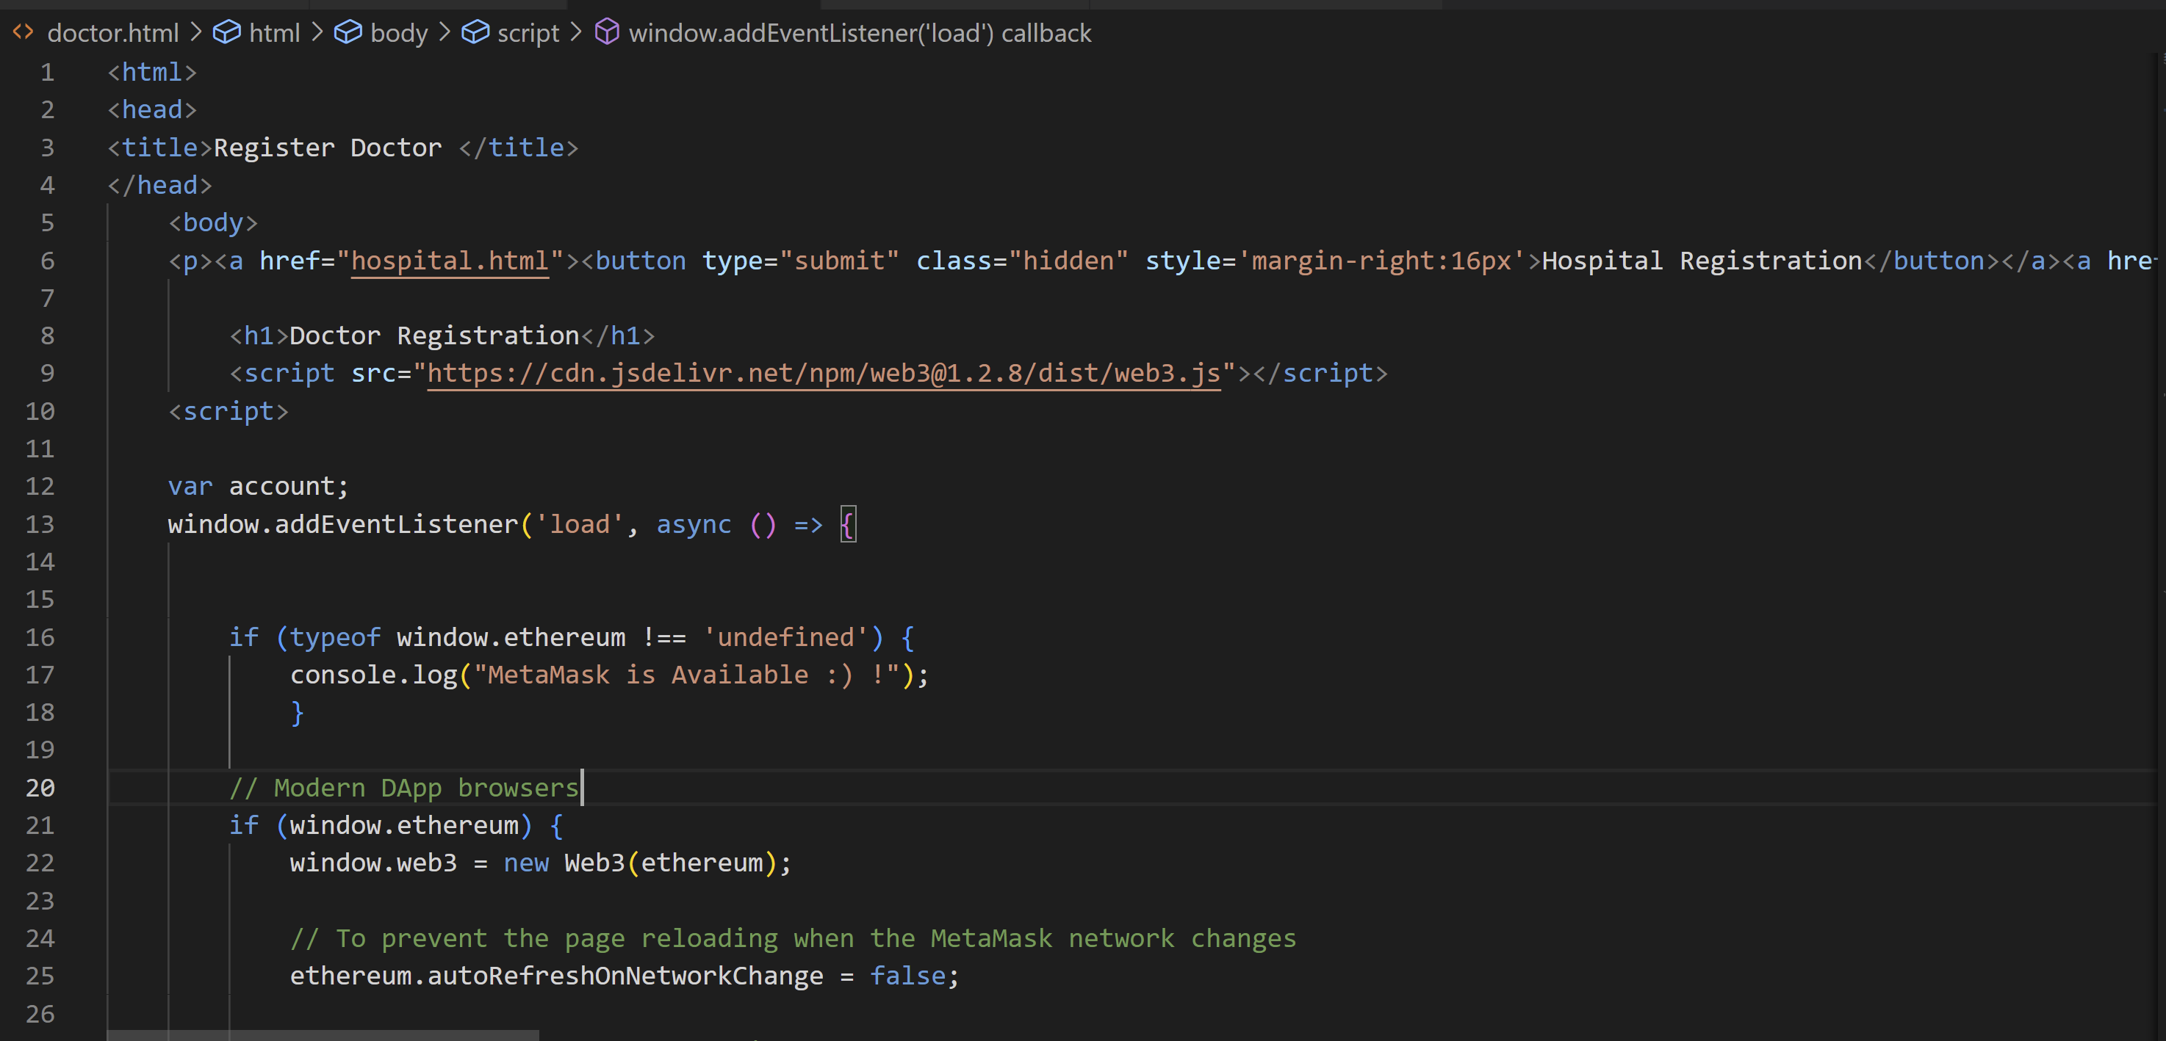
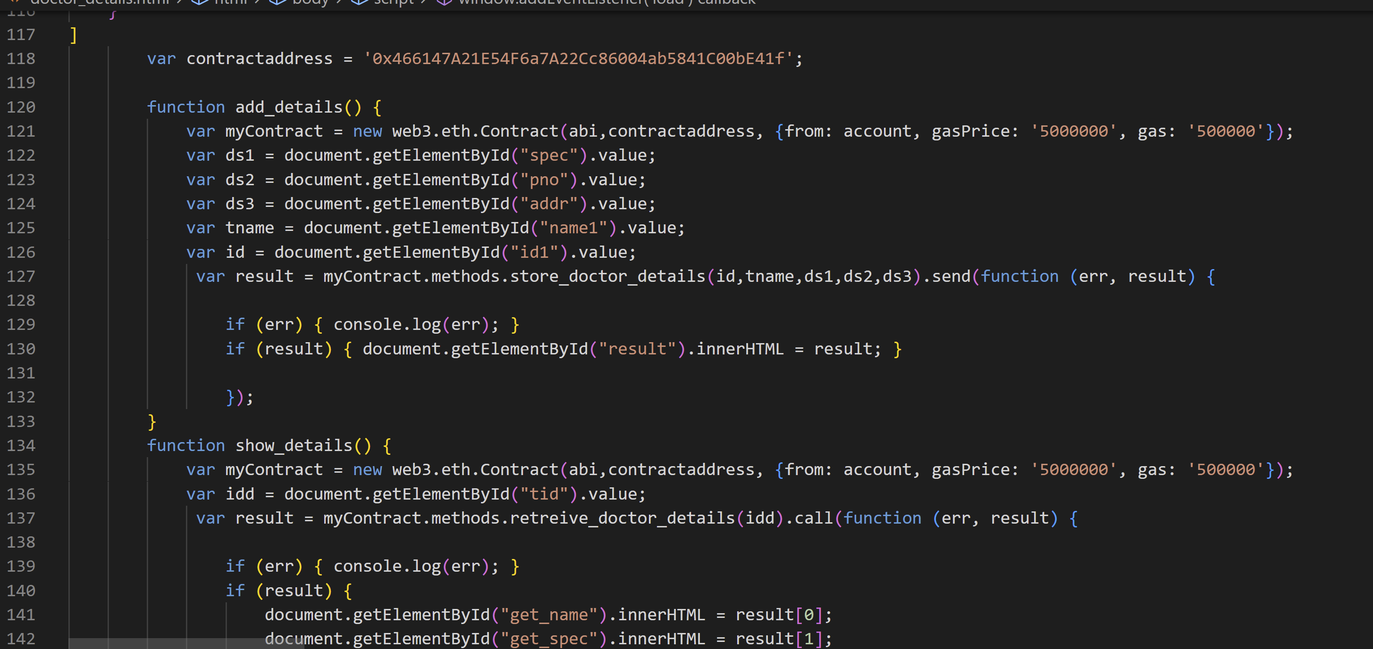
Doctor.html
Doctor_details.html

Slide 6
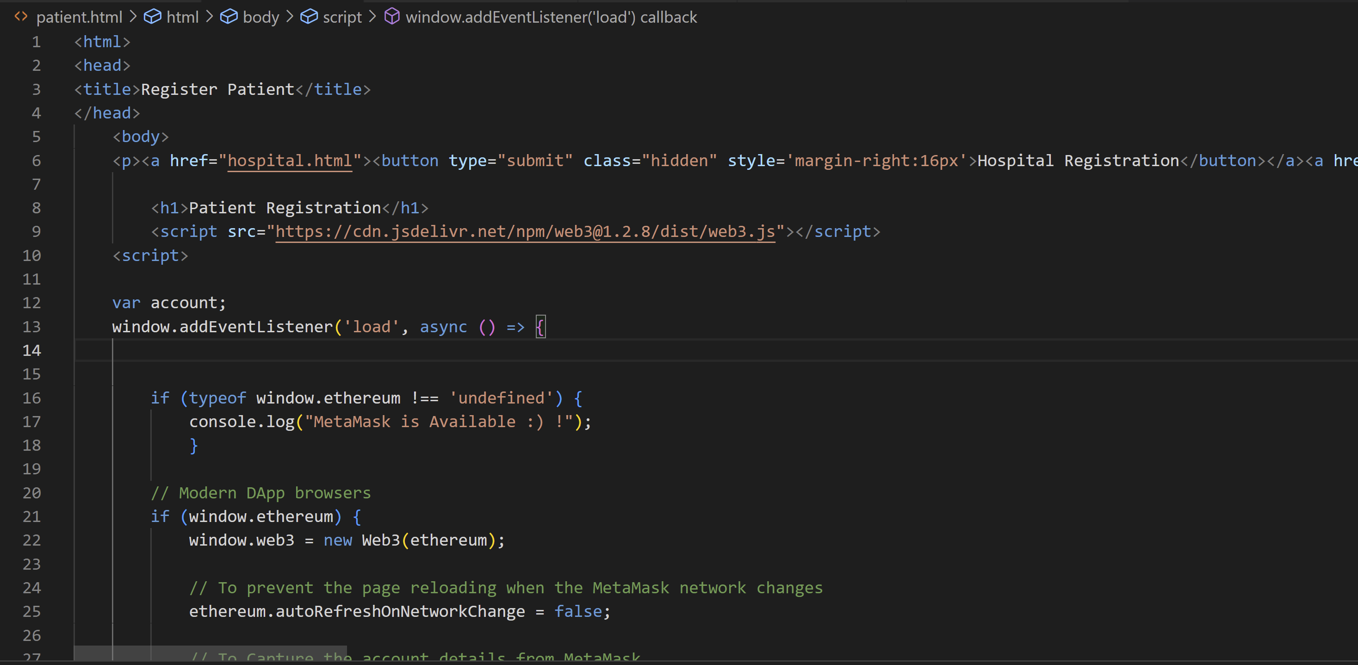
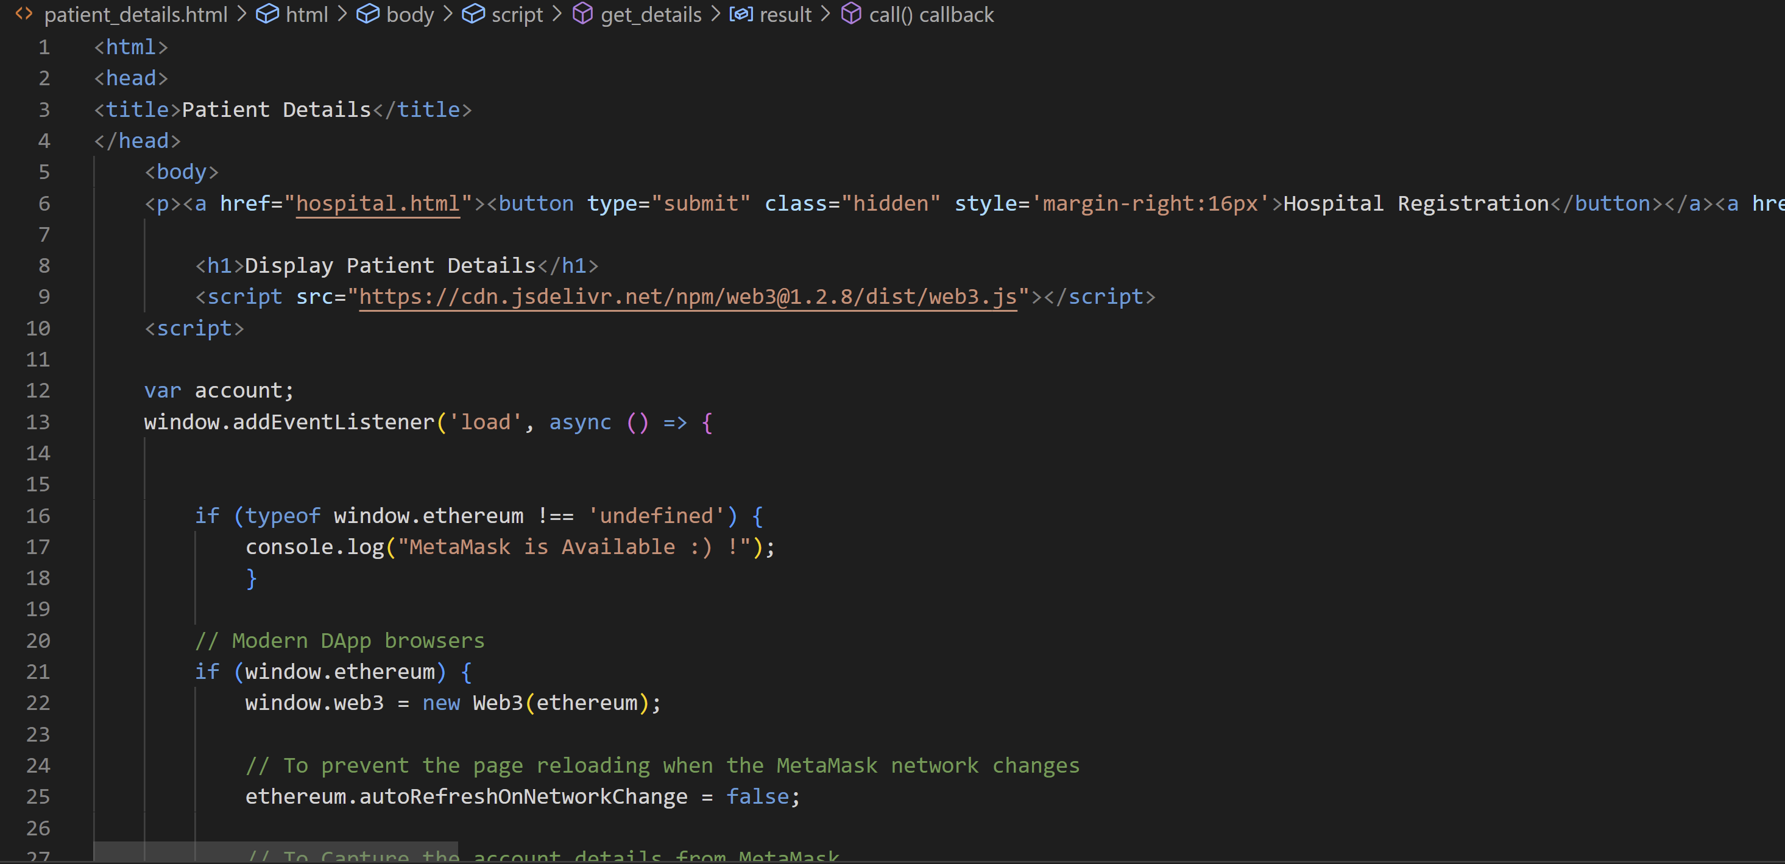
Patient.html
Patient_details.html

Slide 7
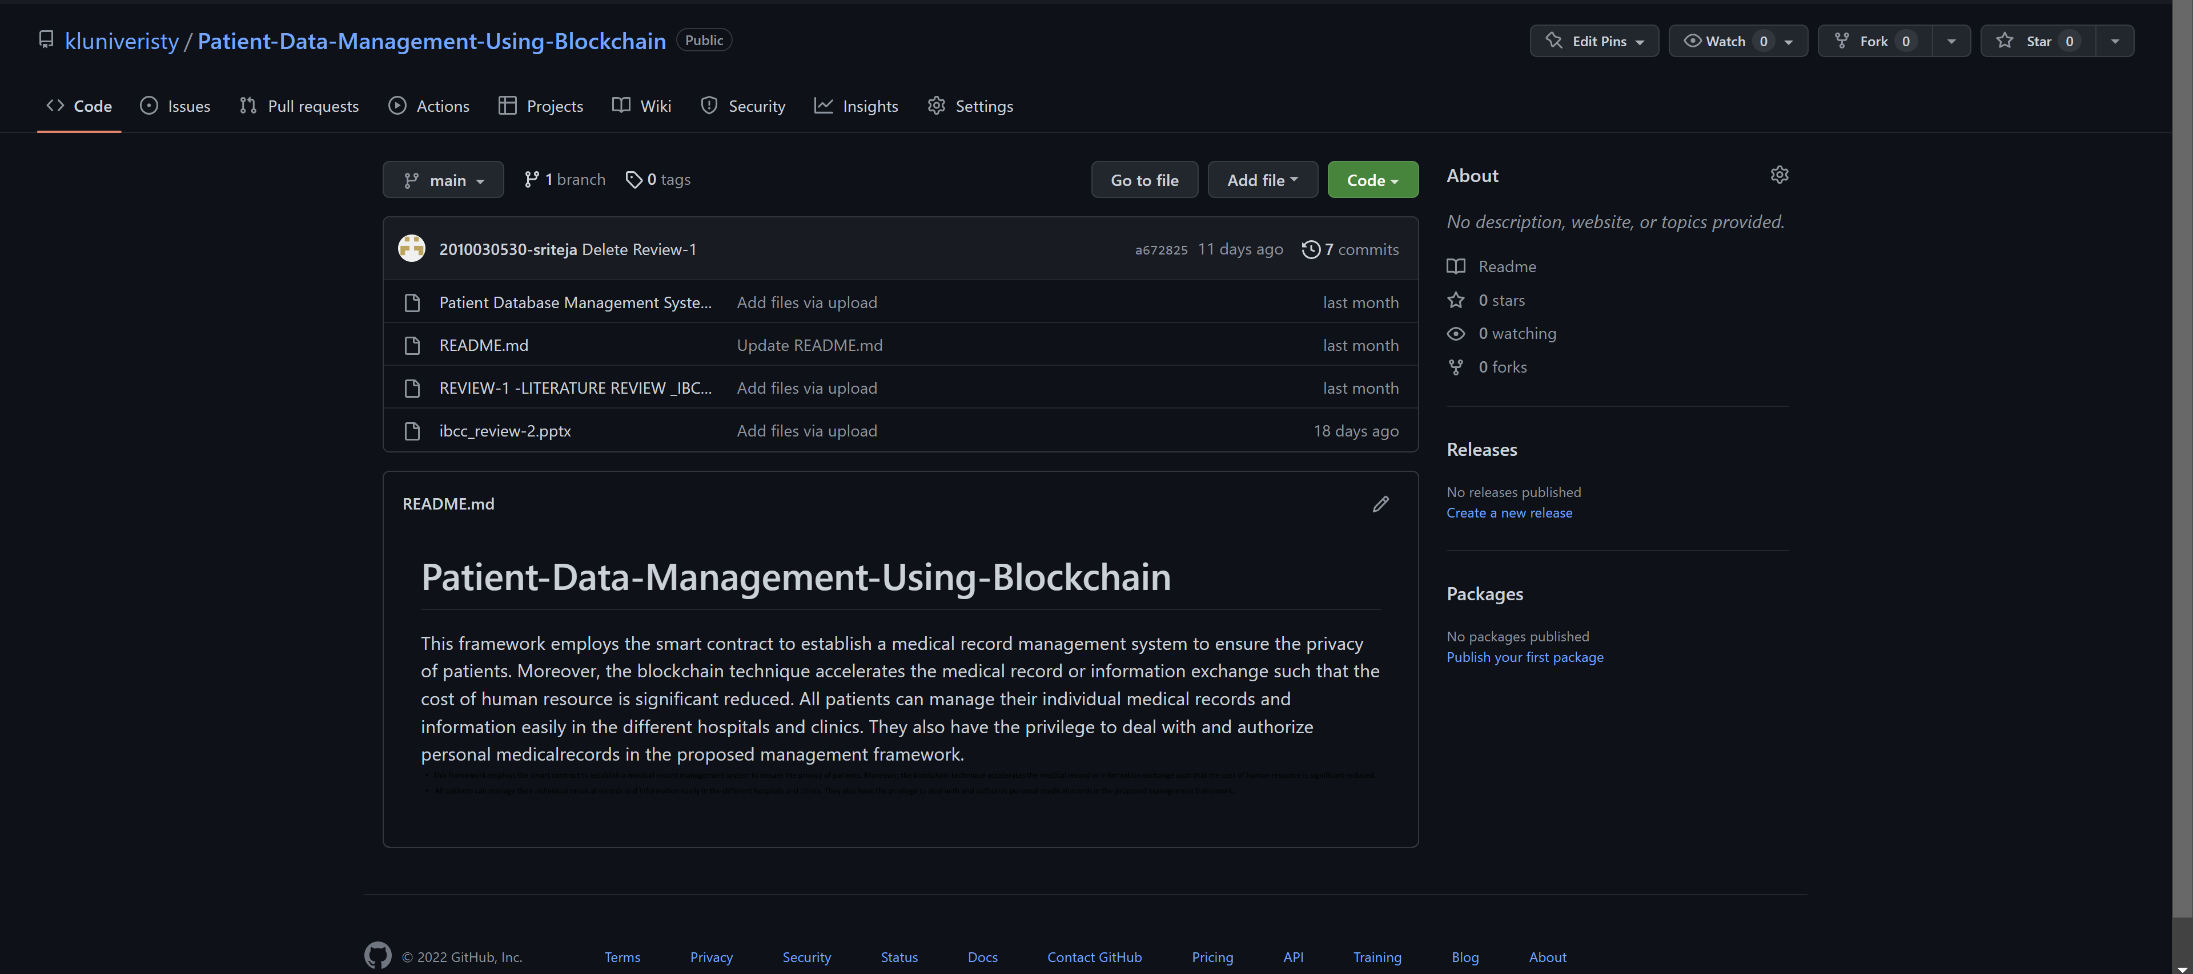
Github commits

Slide 8
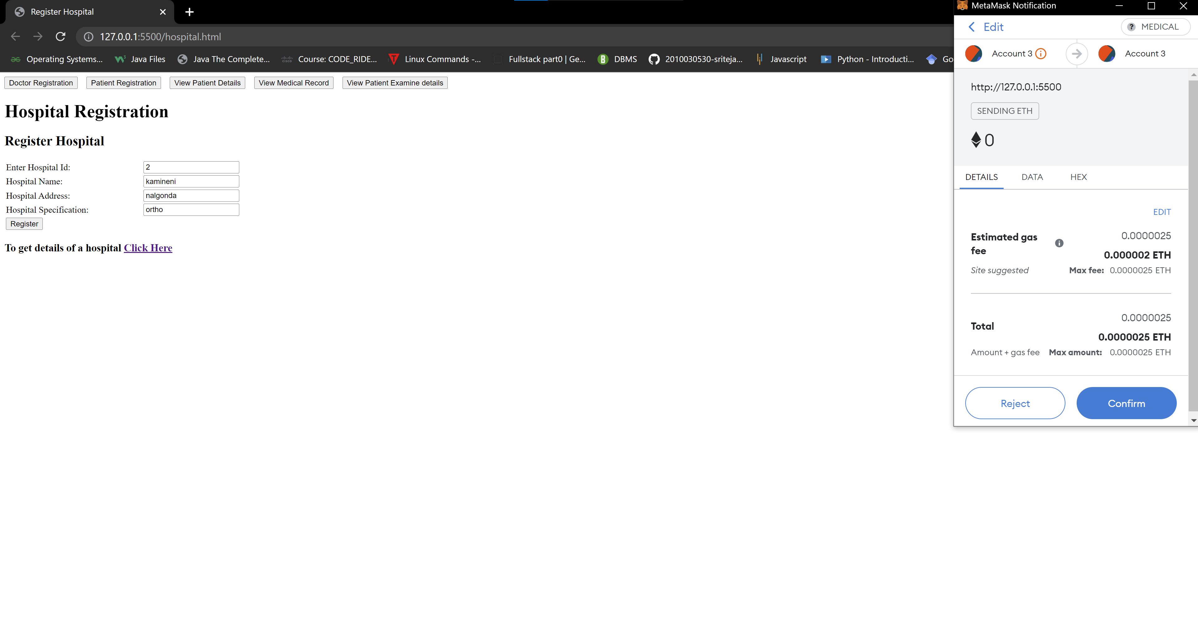
Work progress

Slide 9
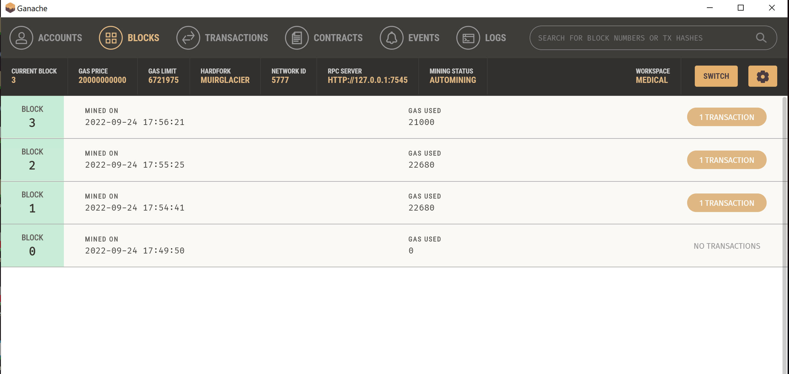
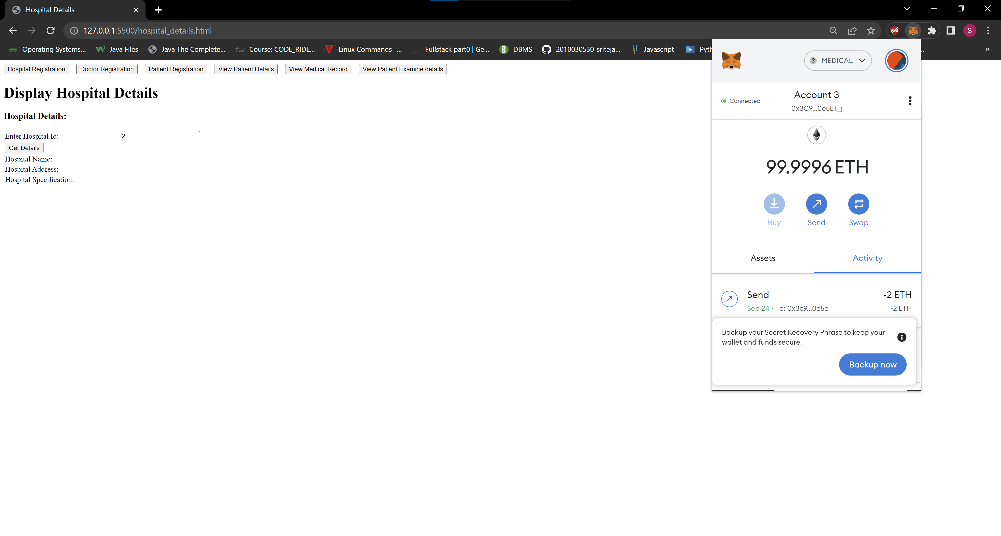
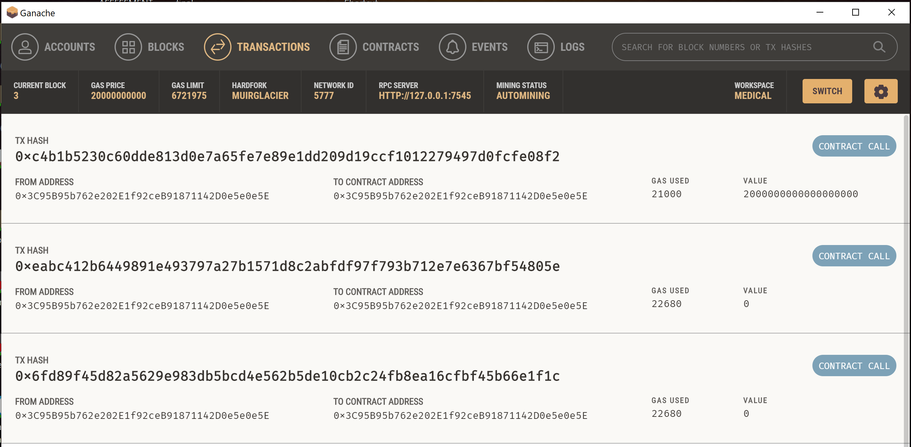

Slide 10
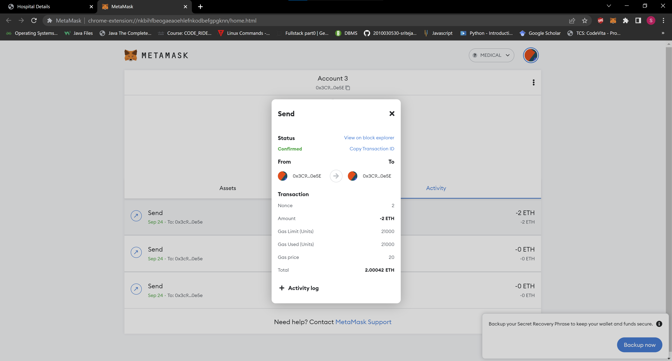
Beta testing

