Slide 1
HD Creation

Slide 2
What is it?
Healthy Diet Creation

Slide 3

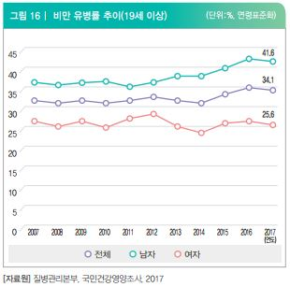

Why do you need it?
HD Creation
Increase in adult diseases

Slide 4
What kind of game?
1. Creating a healthy diet
2. With “Diet Man”
3. To protect one`s own health

Slide 5
Research Basis

Slide 6
Research Basis
1. Smart Phone based Personalized Menu Management System for Diabetes Patient
The system proposed in this study provides the menu for diabetes patients according to season, weather, time, and personal preferences.
In particular, the recipe and personalized menu for patients can be provided without limiting any time and location based on smart phone services, and its menu can easily be changed or selected by the phone.

Slide 7
Research Basis
2. A Diet Prescription System for U-Healthcare Personalized Services
This system changes the personal preference by monitoring the diet selection behavior of users.

Slide 8

What is it made of?

Slide 9
Game Flow
Start
Mode Selection
Round Selection
Game Play
Results occur
Initial Screen
Exit
Program Termination

Slide 10
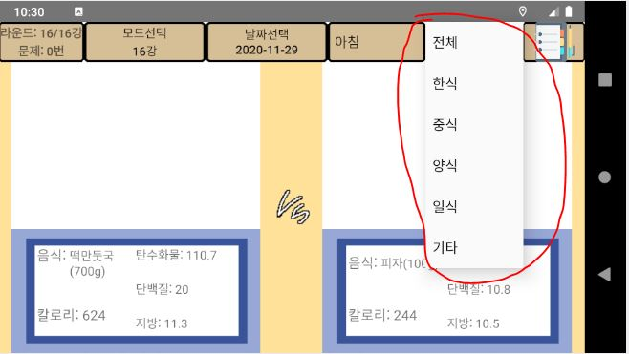
Game Flow
Mode Selection
Start
Mode Selection
Round Selection
Game Play
Results occur
Initial Screen
Exit
Program Termination

Slide 11
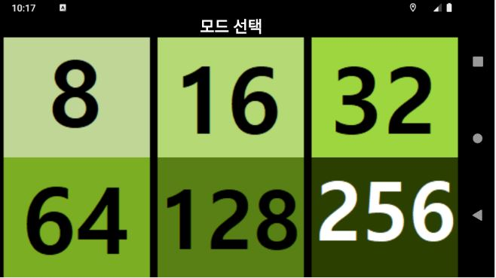
Game Flow
Round Selection
Start
Mode Selection
Round Selection
Game Play
Results occur
Initial Screen
Exit
Program Termination

Slide 12
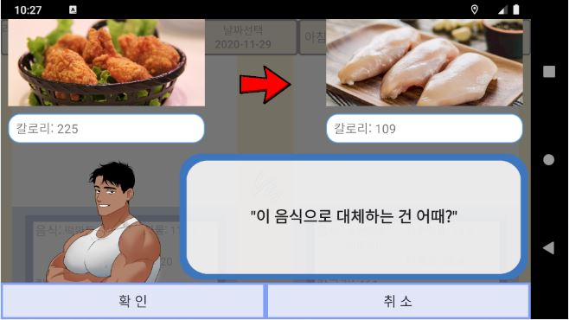
Game Flow
Results Occur
Start
Mode Selection
Round Selection
Game Play
Results occur
Initial Screen
Exit
Program Termination

Slide 13
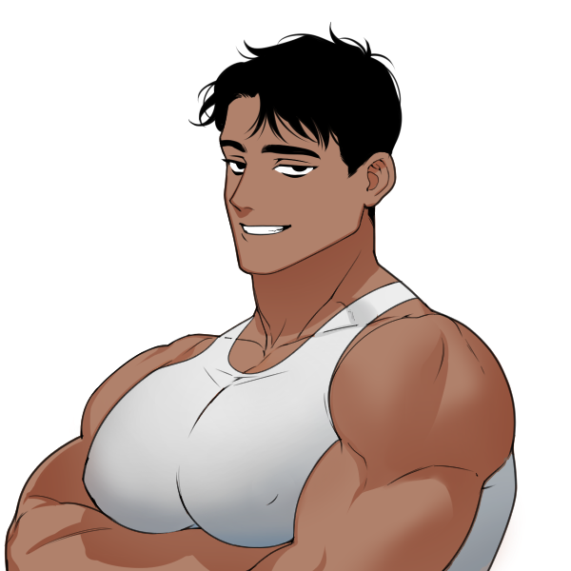
What is different?
1. The Diet Man
The Diet Man
2. Alternative proposal

Slide 14
What is different?
1. The Diet Man
2. Alternative proposal

Slide 15
HD Creation

Slide 16


