Slide 1
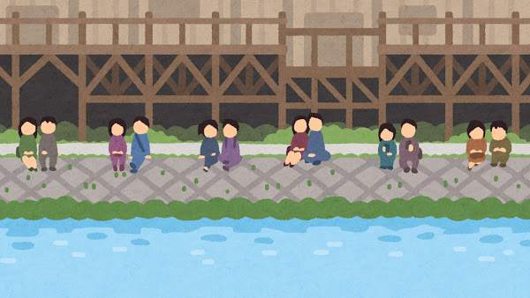



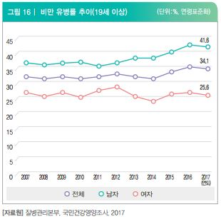
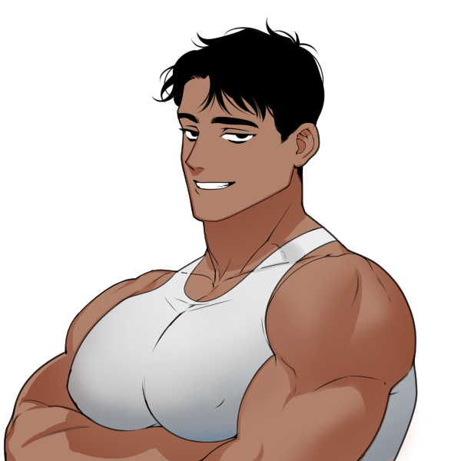
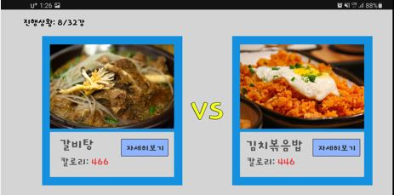
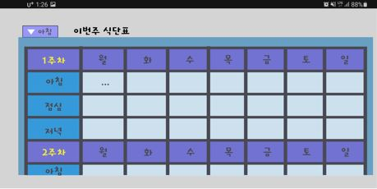
Input & Preprocessing
Input RGB image
Extract hand
Motion image
Smartphone application to create a healthy diet
Ahn Ilki, Kim Gyeongho, Park Sion
Chungbuk National University Computer Engineering
Background & Purpose
Design & Functions
Modern society has increased intellectual activity and developed various
means of transportation. As a result, the physical activity of modern people
has decreased compared to the past. In addition, various adult diseases
that did not occur in the past have emerged as social problems due to
changes in eating habits. There is a growing interest in keeping healthy, but
voluntary diets have problems with lack of information and interest.
As for the algorithm for selecting alternative food, we use the Food and
Nutrition Information API provided by the "Ministry of Food and Drug
Safety." Using this data, the total nutritional information for the combined
diet is quantified based on the nutritional information contained in the
food. The quantified data will be compensated for the recommended
amount of nutrition according to the user's physical condition and
weighted against important nutrients according to the mode chosen by the
user. Modes are divided to prevent various adult diseases.
To solve the problems mentioned above, we planned an application with
game elements. Game is appropriate as a source of interest.
The design of our application is designed as an environment where we can see as much visual material as possible, such as pictures. This is because I thought it was important to look at the photo data because it was planned as a "food World Cup" game.
Concept & Idea
Our application considers the physical condition of the user.
Information about body condition can be entered in 'Settings’.
Also, our application helps prevent and solve various adult
diseases. For example, as a precaution against high blood pressure,
it is advised to avoid foods high in sodium and to eat foods
containing potassium together.
Attached is an example of design for our application. The image
on the left shows the game progress screen. The image on the
right shows the configured diet daily and weekly.
Because of the nature of our application, it is very important to select an interesting factor. So, we used a game called "Food World Cup." This allows users to get advice on alternative foods based on their favorite foods.
Future works
The problems our application has are as follows. First, is it made with the design preferred by people in their 30s, the main customer base? Second, the nutritional information data we used was based on the recommended amount once, so we can't calculate how much food the user eats. Finally, we cannot introduce medically beneficial drugs for certain adult diseases.
Through the game, the selected foods are sent to the data store to
form a single daily diet table. In addition, the user is alerted if they
eat more than the recommended amount by organizing the total
amount of nutrients taken during the day, and if they eat less than
the recommended amount, alternative food is advised considering
the selection of alternative foods.
Due to these problems, our applications need to develop more sophisticated logic about nutritional information of food, and a more user-friendly application environment should be developed.

