Slide 1
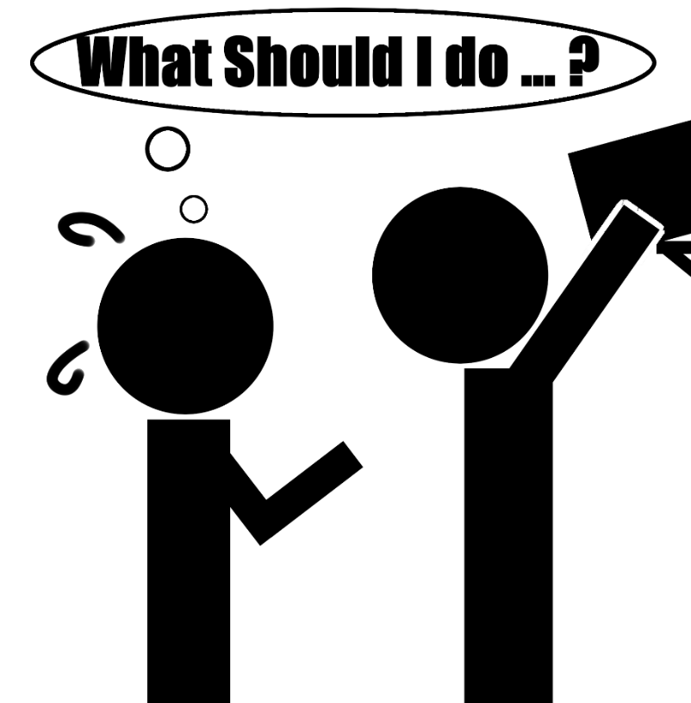
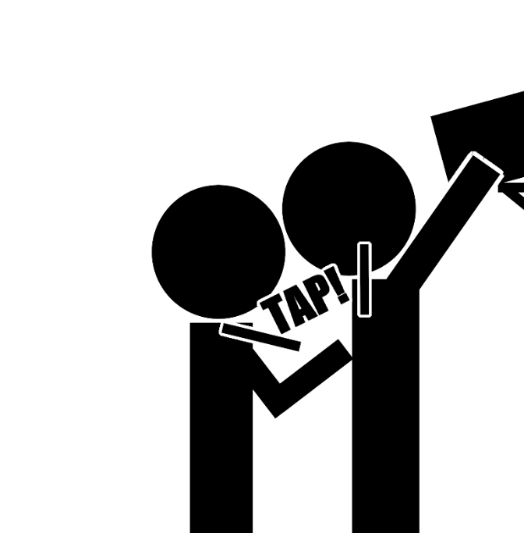
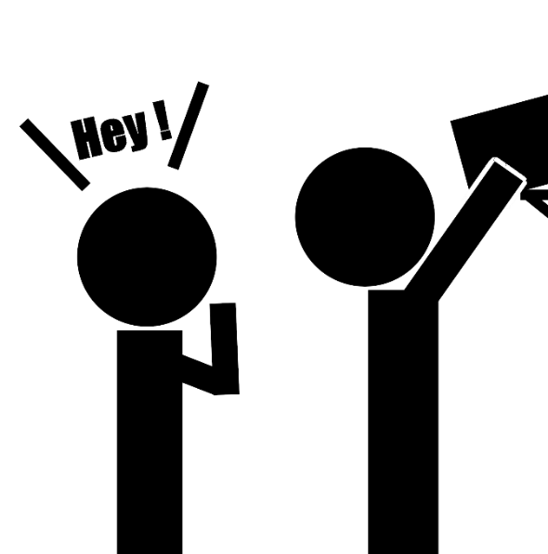

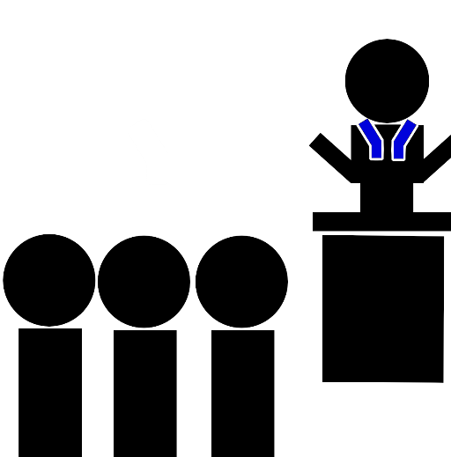
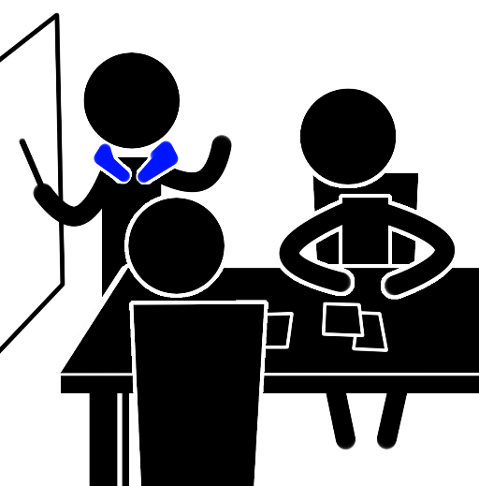
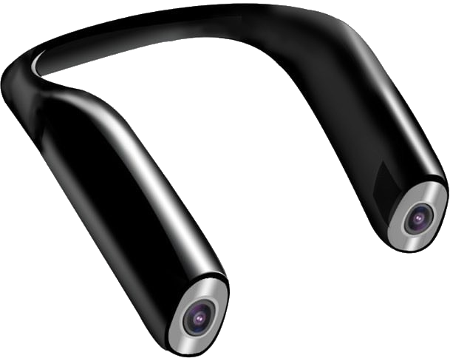
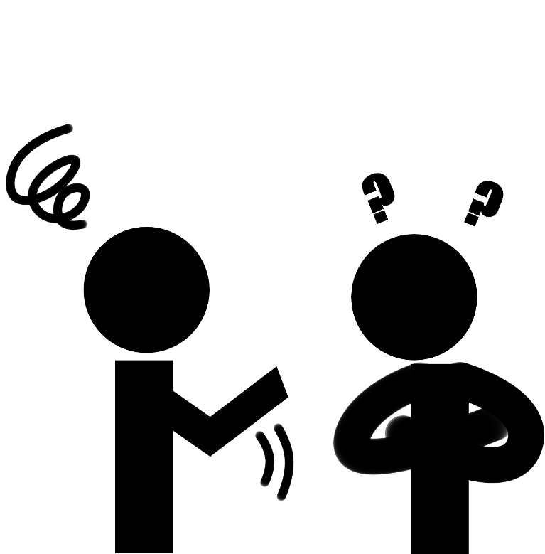

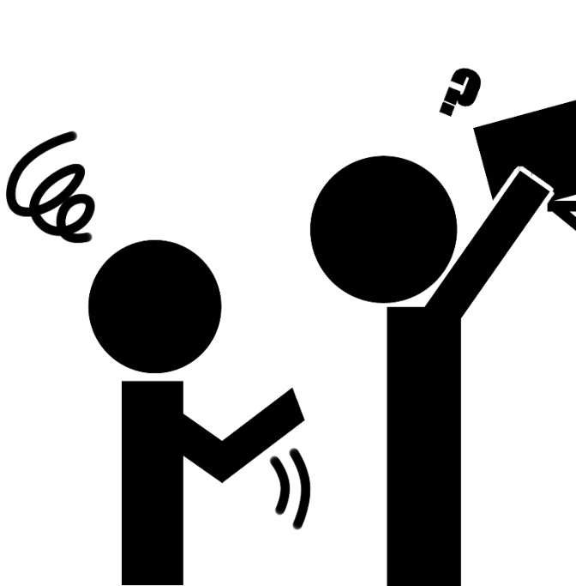




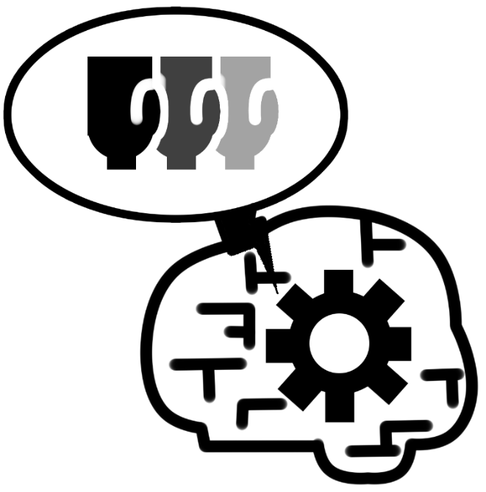


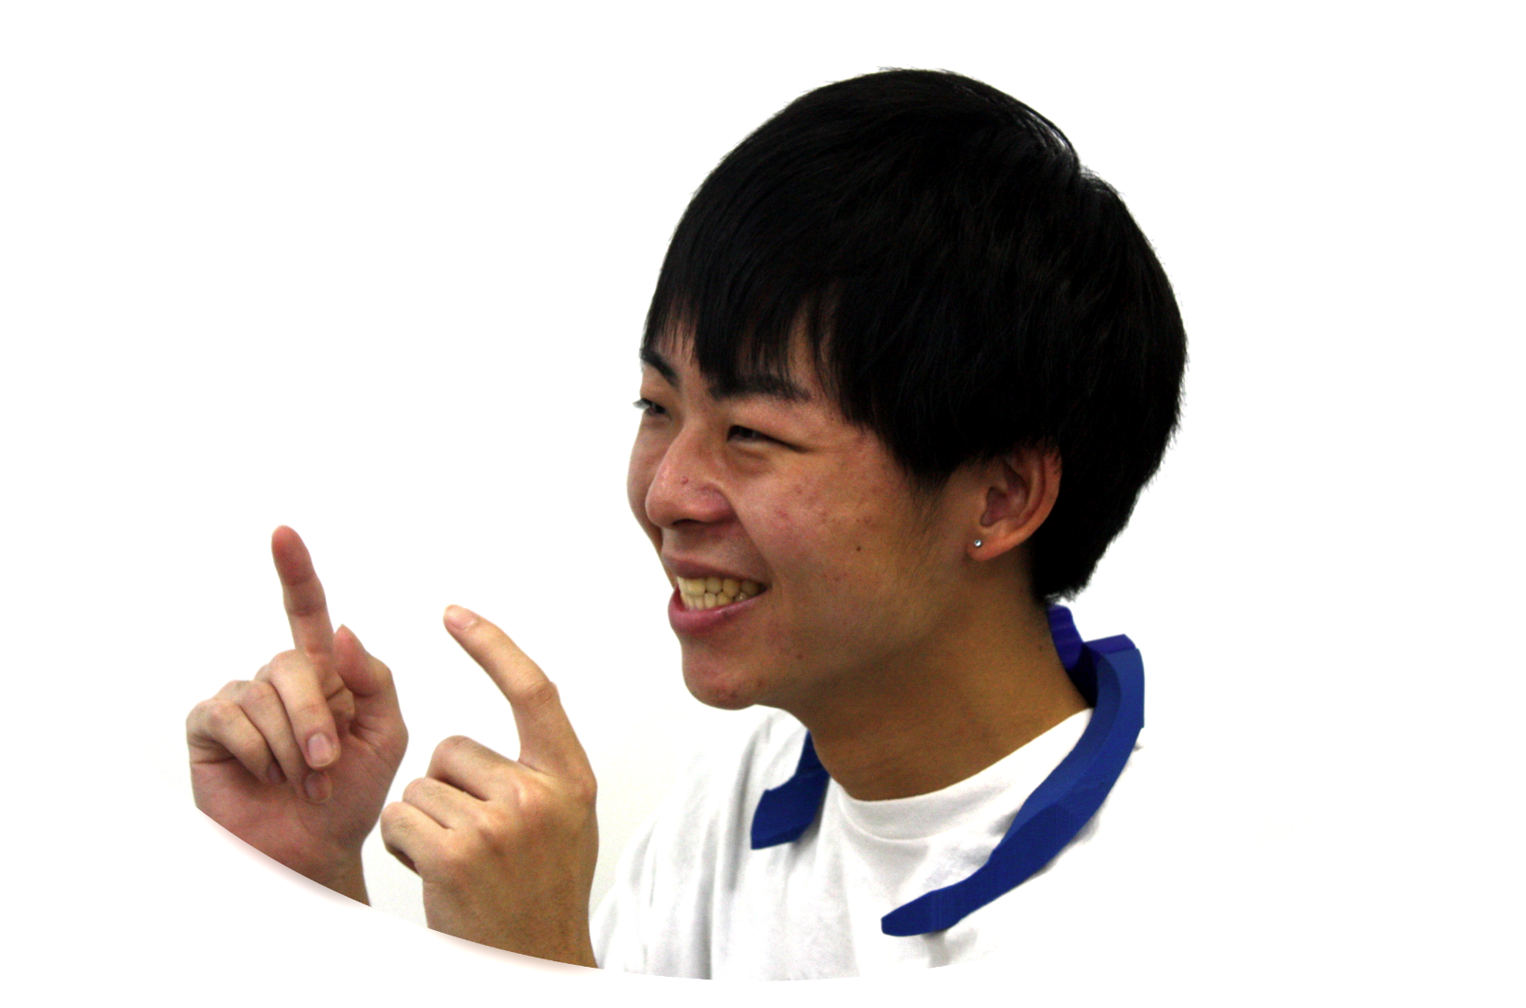
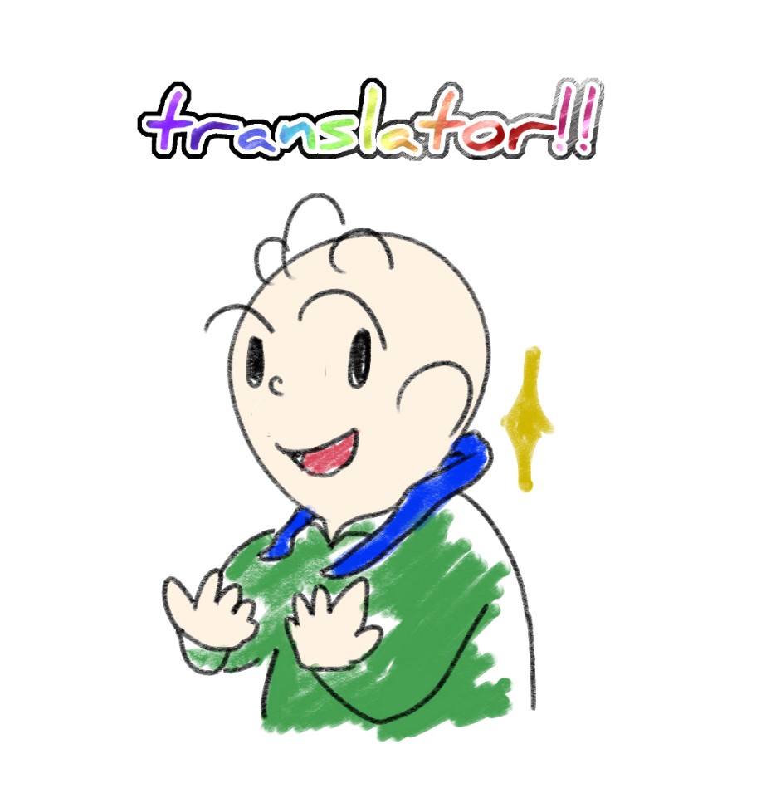

Paper Title With 60pt Bold font
Author1 Name, Author2 Name, Author3 Name with 40pt Bold font
Author Affiliations
Background & Purpose
Concept & Idea
In the picture, there are you who are a customer and the shop assistant. You want to speak to the clerk, but the clerk doesn't notice you. Then what do you do?
Our idea is a sign language speaker (SLS) that translates sign language to spoken language and outputs it as speech. And the concept is “Turn sign language into voice.”
If deaf people use our product, they will be able to do barrier-free communication. SLS will be used not only in daily life but also in business scenes and speeches.
You can use “SLS”
in these situations.
?
or
Just put it on your neck!
"Slap your shoulder ?" —— Not bad, but a little impatient..
"Call out ?" —— Yes, many people will do..
But there are people who can't speak. Some of the deaf people. They refrain from speaking out.
1.Everyday life!
2.Speech!
3.business!
Design & Functions
Translation from sign language to language goes through following three steps below.
Our model can classify 10 times as far as some famous models, and, it realize real time classification.
But…
1.Input
2.Classification
3.Output
Input & Preprocessing
I couldn’t get to understand me …
Sign language is as expressive as sound language. A great language.
However, it is not transmitted to healthy people. Few people can use and understand sign language.
What if sign language could be translated into speech? They can use sign language for conversation.
Playing
corresponding voice.
Input RGB image
Extract hand
Motion image
Extract hand motion
from natural images.
Classify hand motion images in real time.
Future works
Turn sign language
into voice.
Supports conversion from voice to sign language.
Miniaturization.
Translation taking into account the unique grammar of sign language.
I can do it !!

