Slide 1
The Biology Concept Inventory (BCI)
Developing Tools to Identify
Misconceptions
Kathy Garvin-Doxas
Alliance for Technology, Learning & Society Institute Michael Klymkowsky
Molecular, Cellular & Developmental Biology Dept.
University of Colorado, Boulder
Notes:
How many of you out there teach in K-12? How many of you teach college?

Slide 2
Conceptual Understanding
Understanding beyond the ability to name, list, define, etc.
Higher order learning
Fundamental principles in a field
Notes:
Transferrence
Application
Go beyond current knowledge and understanding

Slide 3

Misconceptions
Types of misconceptions:
  Preconceived notions
  Nonscientific beliefs
  Conceptual misunderstanding
  Vernacular misconceptions
  Factual misconceptions
Our focus:
  Conceptual misunderstanding
  Preconceived notions

Slide 4
Why focus on misconceptions?
The story of physics education and the Force Concept Inventory
  Eric Mazur at Harvard
  Hake (1998) meta-study on interactive engagement
Innovative teaching techniques
The assessment and evaluation dilemma

Slide 5
What are we building?
3-pronged approach:
Biology Concept List (BCL)
Latent Semantic Analysis (LSA)
Biology Concept Inventory (BCI)
http://www.bioliteracy.net

Slide 6
Biology Concept List
Interactive web space
  Check list to identify what you emphasize
Generate quick, mostly factual “tests” customized to your course/class
Visual comparison tool
  Compare what you think you’re emphasizing with what your TA’s, students, etc. perceive you are teaching
  Compare what you’re covering with what others cover

Slide 7
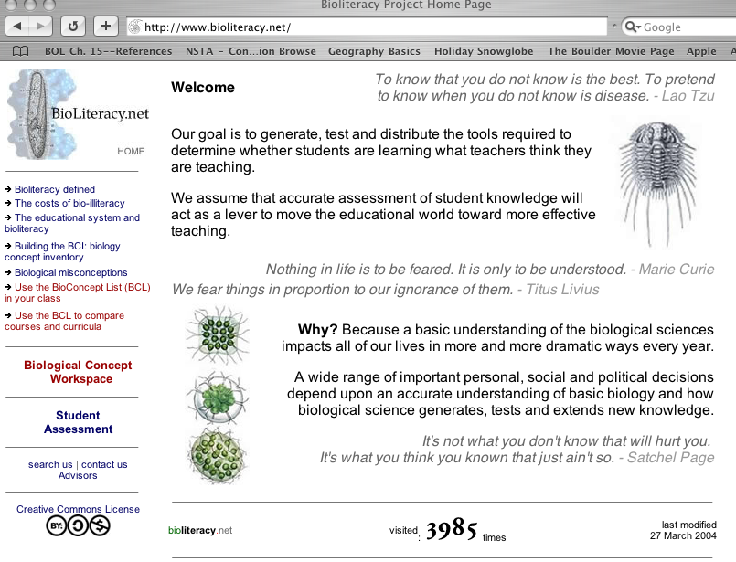
Bioliteracy Home Page

Slide 8
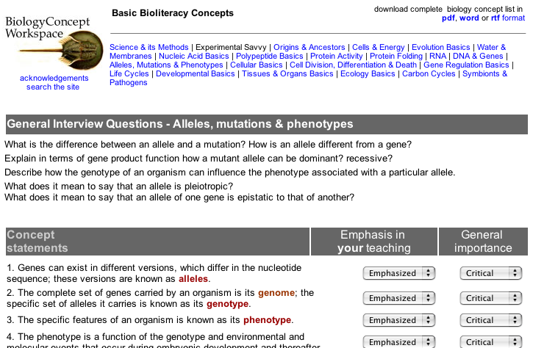
BCL Space: Step 1

Slide 9
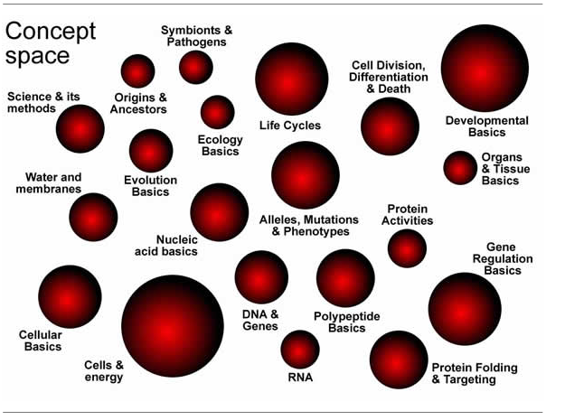
Visualization Tool
Notes:
Size is a function of how many questions currently available in each group.

Slide 10
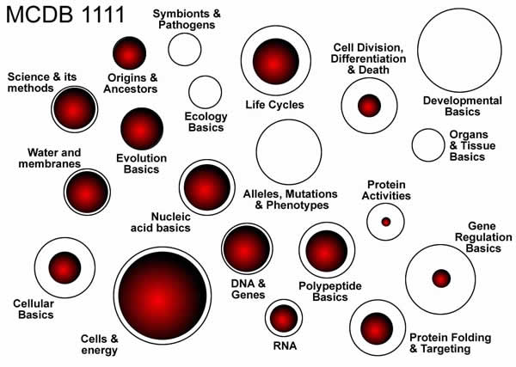
BCL: Step 2

Slide 11
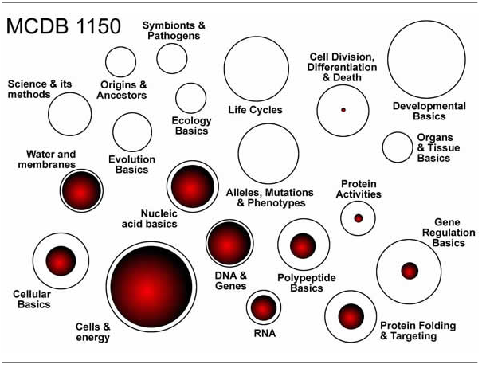
BCL: Step 3

Slide 12
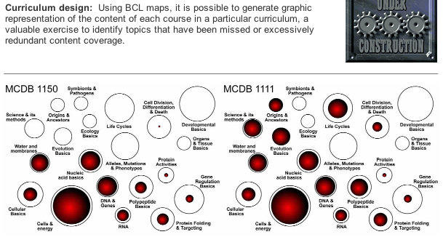
Compare

Slide 13
Latent Semantic Analysis
Scaleable way to identify your students’ misconceptions
“Bag of words” method
Natural language
Student essays
  60-100 words
Kintsch, Landauer, Doxas, Dennis

Slide 14
Biology Concept Inventory
Review of literature
Review and content analysis of course syllabi
  Intro biology courses
Analysis of student essays
Interviews with students

Slide 15
Biology Concept Inventory
Develop initial multiple-choice style instrument
Conduct student “think alouds”
Refine instrument
Pilot instrument and compare responses with student interviews
Validate, validate, validate!

Slide 16
Our Partners
Biology teaching community

Slide 17
Pool of Students
University of Colorado
  Non-majors in variety of science courses
  Intro MCD Biology
Penn State University (Cyr)
  1,000 non-majors per semester
University of Michigan (Klionsky)
  Introductory Course
University of Northern Colorado (Willis)
  Future teachers

Slide 18
Challenges
Question development
  Examples of student responses
‘sexual selection’: According to Darwin survival of the fittest is a component of evolution. Here sexual selection refers to individuals selecting a mate that possesses preferable genes; mating with such a mate would result in offspring with a higher chance of survival
“In molecular terms, describe how genetic informtion is stored and how it is used”
Genetic information is stored in DNA. DNA is located in the nucleus of the cell. Genetic information is the blueprint for everything in the organism. It is translated and transcribed to create amino acids and proteins.

Slide 19
Challenges
Question development
  Multi-disciplinary team
  Wording that forces students to reveal their underlying assumptions rather than learned “correct” responses
Persuading students to write at least 60 words
Conducting and analyzing interviews and essay data

