Slide 1
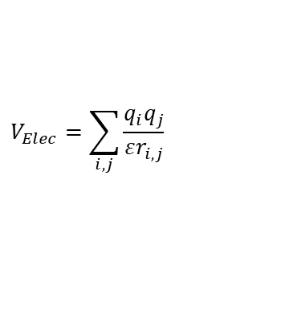
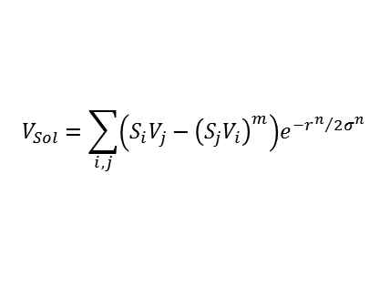

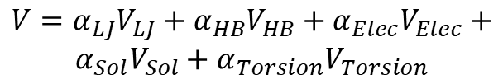


$$V_{LJ}=−\sum_{i,j}{\left(\frac{\frac{m}{n−m}ℰ_{i,j}r_{eqm,i,j}^{n}}{r_{i,j}^{n}}−\frac{\frac{n}{n−m}ℰ_{i,j}r_{eqm,i,j}^{m}}{r_{i,j}^{m}}\right)}$$
$$V_{Elec}=\sum_{i,j}{\frac{q_{i}q_{j}}{εr_{i,j}}}$$
where V_{Elec} is the electrostatic potential;
q_{i} and q_{j} are the partial atomic charges assigned to the macromolecule and ligand;
r_{i,j} is the interatomic distance;
ε is the dielectric function is used to model solvent screening as follows.
where ε₀ = 78.4 (dielectric constant of bulk water at 25˚C); B = ε₀ – A; A = -8.5525; λ = 0.003627 and k = 7.7839.
where V_{LJ} is the Lennard-Jones potential used to model the van der Waals’ interactions involving two dipoles;
m and n are the Lennard Jones parameters (n=12, m=6) used to model the van der Waals’ interactions;
r_{i,j} is the interatomic distance;
r_{eqm,I,j} is the equilibrium separation between the nuclei of two atoms i an j;
ε_{I,j} is the pairwise potential energy or well depth, and
the summation is taken over all pair of atoms, being i from the ligand and j from the macromolecule.
$$ε\left(r\right)=A+\frac{B}{\left(1+{ke}^{−λBr}\right)}$$
$$V=α_{LJ}V_{LJ}+α_{HB}V_{HB}+α_{Elec}V_{Elec}+$$
$$α_{Sol}V_{Sol}+α_{Torsion}V_{Torsion}$$
where the α’s indicate the relative weight of each energy term.
$$V_{HB}=−\sum_{i,j}{\left(\frac{\frac{m}{n−m}ℰ_{i,j}r_{eqm,i,j}^{n}}{r_{i,j}^{n}}−\frac{\frac{n}{n−m}ℰ_{i,j}r_{eqm,i,j}^{m}}{r_{i,j}^{m}}\right)}$$
$$V_{Sol}=\sum_{i,j}{\left(S_{i}V_{j}−{\left(S_{j}V_{i}\right)}^{m}\right)e^{−{r^{n}}/{2σ^{n}}}}$$
where V_{HB} is the hydrogen-bond potential used to model the intermolecular hydrogen bond interactions;
m and n are the parameters (n=12, m=10) used to model the hydrogem-bond interactions;
r_{i,j} is the interatomic distance;
R_{eqm,i,i} is the equilibrium separation between the nuclei of two atoms i and j;
ε_{I,j} is the pairwise potential energy or well depth, and
the summation is taken over all pair of atoms, being i from the ligand and j from the macromolecule
where V_{i} and V_{j} are the volumes of atoms I and j that surround a given atom and shelter it from solvent;
S_{i} and S_{j} are the solvation parameters for atom i and j;
m and n are the parameters used to model solvent effects ( m=n=2);
r_{i,j} is the interatomic distance, and
σ Is a distance-weighting factor σ=3.5Å.

Slide 2
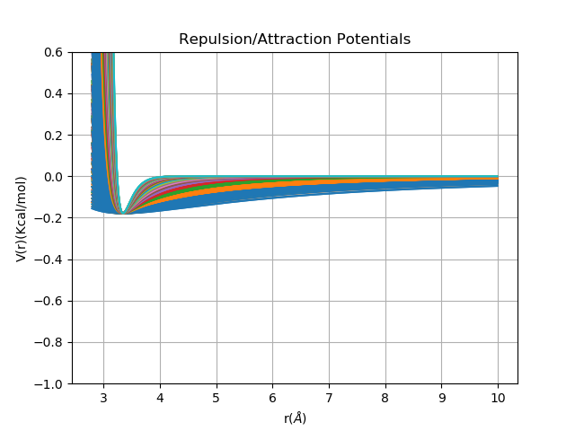
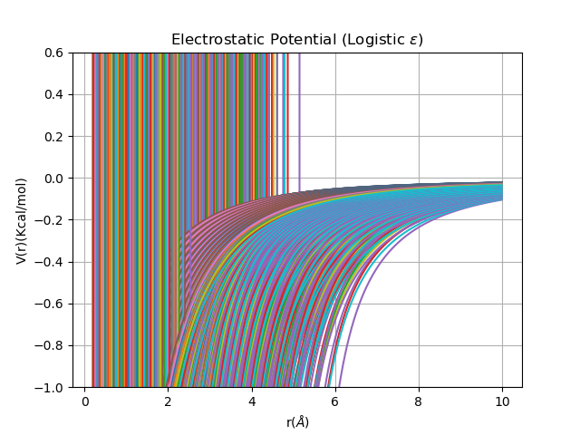
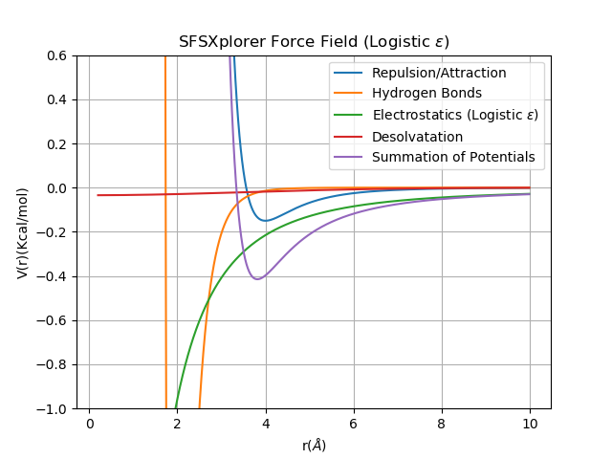
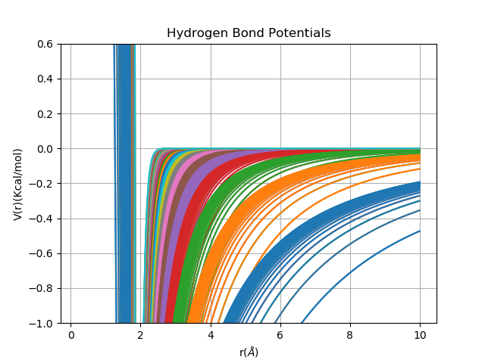
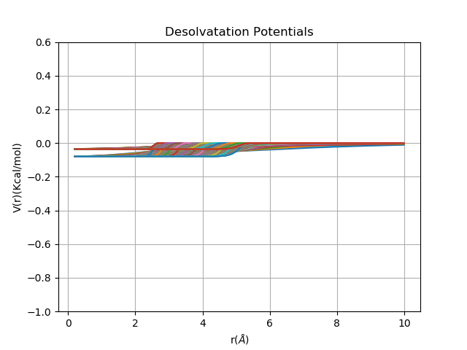
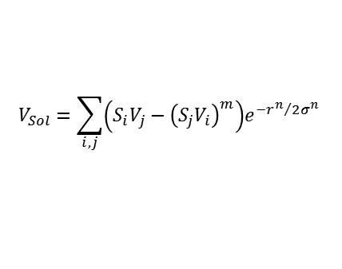
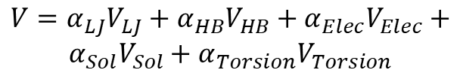

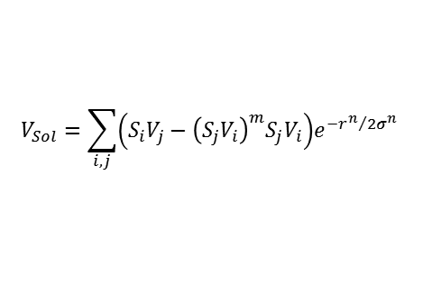
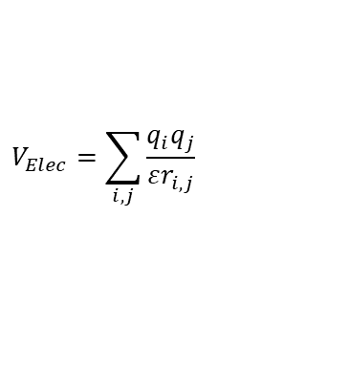


$$V_{LJ}=−\sum_{i,j}{\left(\frac{\frac{m}{n−m}ℰ_{i,j}r_{eqm,i,j}^{n}}{r_{i,j}^{n}}−\frac{\frac{n}{n−m}ℰ_{i,j}r_{eqm,i,j}^{m}}{r_{i,j}^{m}}\right)}$$
$$V_{Elec}=\sum_{i,j}{\frac{q_{i}q_{j}}{εr_{i,j}}}$$
$$V=α_{LJ}V_{LJ}+α_{HB}V_{HB}+α_{Elec}V_{Elec}+$$
$$α_{Sol}V_{Sol}+α_{Torsion}V_{Torsion}$$
where V_{Elec} is the electrostatic potential;
q_{i} and q_{j} are the partial atomic charges assigned to the macromolecule and ligand;
r_{i,j} is the interatomic distance;
ε is the dielectric function is used to model solvent screening as follows.
where ε₀ = 78.4 (dielectric constant of bulk water at 25˚C); B = ε₀ – A; A = -8.5525; λ = 0.003627 and k = 7.7839.
where V_{LJ} is the Lennard-Jones potential used to model the van der Waals’ interactions involving two dipoles;
m and n are the Lennard Jones parameters (n=12, m=6) used to model the van der Waals’ interactions;
r_{i,j} is the interatomic distance;
r_{eqm,I,j} is the equilibrium separation between the nuclei of two atoms i an j;
ε_{I,j} is the pairwise potential energy or well depth, and
the summation is taken over all pair of atoms, being i from the ligand and j from the macromolecule.
$$ε\left(r\right)=A+\frac{B}{\left(1+{ke}^{−λBr}\right)}$$
$$V_{LJ}=−\sum_{i,j}{\left(\frac{\frac{m}{n−m}ℰ_{i,j}r_{eqm,i,j}^{n}}{r_{i,j}^{n}}−\frac{\frac{n}{n−m}ℰ_{i,j}r_{eqm,i,j}^{m}}{r_{i,j}^{m}}\right)}$$
$$V_{Elec}=\sum_{i,j}{\frac{q_{i}q_{j}}{εr_{i,j}}}$$
$$ε\left(r\right)=A+\frac{B}{\left(1+{ke}^{−λBr}\right)}$$
$$V_{Sol}=\sum_{i,j}{\left(S_{i}V_{j}−{\left(S_{j}V_{i}\right)}^{m}\right)e^{−{r^{n}}/{2σ^{n}}}}$$
where the α’s indicate the relative weight of each energy term.
$$V_{HB}=−\sum_{i,j}{\left(\frac{\frac{m}{n−m}ℰ_{i,j}r_{eqm,i,j}^{n}}{r_{i,j}^{n}}−\frac{\frac{n}{n−m}ℰ_{i,j}r_{eqm,i,j}^{m}}{r_{i,j}^{m}}\right)}$$
$$V_{Sol}=\sum_{i,j}{\left(S_{i}V_{j}−{\left(S_{j}V_{i}\right)}^{m}S_{j}V_{i}\right)e^{−{r^{n}}/{2σ^{n}}}}$$
where V_{HB} is the hydrogen-bond potential used to model the intermolecular hydrogen bond interactions;
m and n are the parameters (n=12, m=10) used to model the hydrogem-bond interactions;
r_{i,j} is the interatomic distance;
R_{eqm,i,i} is the equilibrium separation between the nuclei of two atoms i and j;
ε_{I,j} is the pairwise potential energy or well depth, and
the summation is taken over all pair of atoms, being i from the ligand and j from the macromolecule
where V_{i} and V_{j} are the volumes of atoms I and j that surround a given atom and shelter it from solvent;
S_{i} and S_{j} are the solvation parameters for atom i and j;
r_{i,j} is the interatomic distance, and
σ Is a distance-weighting factor σ=3.5Å.
$$V_{HB}=−\sum_{i,j}{\left(\frac{\frac{m}{n−m}ℰ_{i,j}r_{eqm,i,j}^{n}}{r_{i,j}^{n}}−\frac{\frac{n}{n−m}ℰ_{i,j}r_{eqm,i,j}^{m}}{r_{i,j}^{m}}\right)}$$

Slide 3
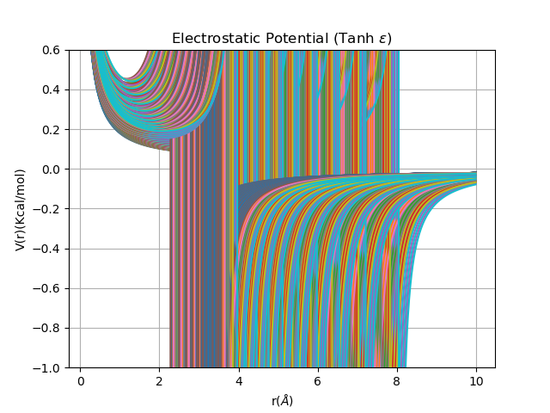
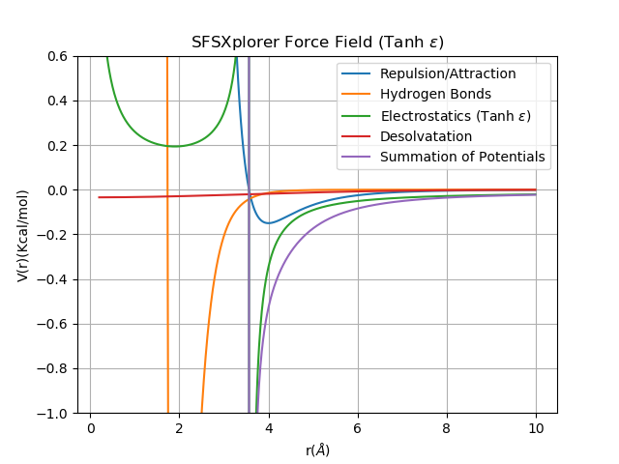

$$V=α_{LJ}V_{LJ}+α_{HB}V_{HB}+α_{Elec}V_{Elec}+$$
$$α_{Sol}V_{Sol}+α_{Torsion}V_{Torsion}$$
$$V_{LJ}=−\sum_{i,j}{\left(\frac{\frac{m}{n−m}ℰ_{i,j}r_{eqm,i,j}^{n}}{r_{i,j}^{n}}−\frac{\frac{n}{n−m}ℰ_{i,j}r_{eqm,i,j}^{m}}{r_{i,j}^{m}}\right)}$$
$$V_{Elec}=\sum_{i,j}{\frac{q_{i}q_{j}}{εr_{i,j}}}$$
$$ε\left(r\right)=A+\frac{B\left(e^{lBr}−ke^{−lBr}\right)}{\left(e^{lBr}+ke^{−lBr}\right)}$$
$$V_{Sol}=\sum_{i,j}{\left(S_{i}V_{j}−{\left(S_{j}V_{i}\right)}^{m}\right)e^{−{r^{n}}/{2σ^{n}}}}$$
$$V_{HB}=−\sum_{i,j}{\left(\frac{\frac{m}{n−m}ℰ_{i,j}r_{eqm,i,j}^{n}}{r_{i,j}^{n}}−\frac{\frac{n}{n−m}ℰ_{i,j}r_{eqm,i,j}^{m}}{r_{i,j}^{m}}\right)}$$

Slide 4
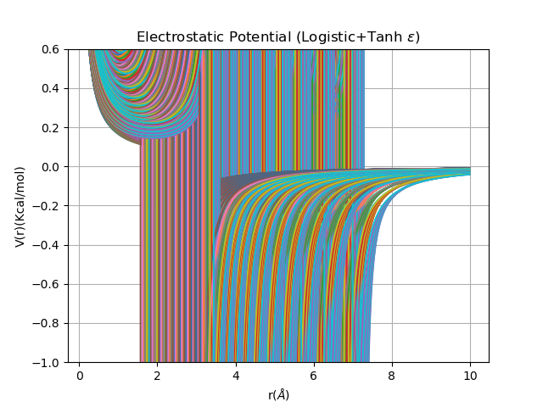
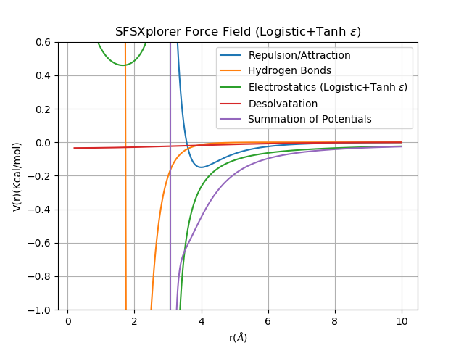
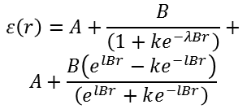
$$V=α_{LJ}V_{LJ}+α_{HB}V_{HB}+α_{Elec}V_{Elec}+$$
$$α_{Sol}V_{Sol}+α_{Torsion}V_{Torsion}$$
$$V_{LJ}=−\sum_{i,j}{\left(\frac{\frac{m}{n−m}ℰ_{i,j}r_{eqm,i,j}^{n}}{r_{i,j}^{n}}−\frac{\frac{n}{n−m}ℰ_{i,j}r_{eqm,i,j}^{m}}{r_{i,j}^{m}}\right)}$$
$$V_{Elec}=\sum_{i,j}{\frac{q_{i}q_{j}}{εr_{i,j}}}$$
$$ε\left(r\right)=A+\frac{B}{\left(1+{ke}^{−λBr}\right)}+$$
$$A+\frac{B\left(e^{lBr}−ke^{−lBr}\right)}{\left(e^{lBr}+ke^{−lBr}\right)}$$
$$V_{Sol}=\sum_{i,j}{\left(S_{i}V_{j}−{\left(S_{j}V_{i}\right)}^{m}\right)e^{−{r^{n}}/{2σ^{n}}}}$$
$$V_{HB}=−\sum_{i,j}{\left(\frac{\frac{m}{n−m}ℰ_{i,j}r_{eqm,i,j}^{n}}{r_{i,j}^{n}}−\frac{\frac{n}{n−m}ℰ_{i,j}r_{eqm,i,j}^{m}}{r_{i,j}^{m}}\right)}$$

Slide 5
