Slide 1
PROJECT PROPOSAL PRESENTATION
Our Project Team Members
Introducing the development team presenting the eLMS architecture, core modules, and system implementation:
eLMS
Scalable E-Learning
Management System
Full-Stack Web Development Project
Software Development Management Lab
Course Code: 0613-307
• React 18 + Vite
• Django REST Framework
• HLS Video Streaming
• Docker Containerized
SUDIP KUMER
Roll: 12 • Frontend React Architecture
Khalid Muhammad
Roll: 09 • Backend Database & Data Modeling
Your Name
Roll: 31 • UI/UX Design
Your Name
Roll: 13 •
Your Name
Roll: 23 •
Your Name
Roll: 30 •

Slide 2
Abstract & Project Objectives
EXECUTIVE SUMMARY
What is eLMS?
An E-Learning Management System (eLMS) provides an integrated digital environment for delivering, tracking, and managing educational courses, multimedia content, and academic evaluations online.
Project Overview
This project aims to develop a robust, cloud-native full-stack e-Learning platform designed to support 500–1000 concurrent active learners.
Built with React 18, Vite, and Tailwind CSS on the frontend, and Django REST Framework, Daphne ASGI, Celery, and PostgreSQL on the backend, eLMS features adaptive HLS video streaming, per-user course enrollment isolation, an administrative CMS, real-time notifications, and full Docker containerization.
User Authentication & RBAC
Secure JWT authentication with refresh token rotation. Distinct roles: Student, Teacher, and Administrator with strict data isolation.
Adaptive HLS Video Streaming
Background video transcoding using Celery and FFmpeg to deliver buffer-free HTTP Live Streaming (HLS) tailored to student bandwidth.
Academics, Assignments & Live Classes
Comprehensive curriculum organization (Departments, Semesters, Courses, Modules, Lectures), downloadable slides/PDFs, and submission evaluation.
Centralized Admin CMS & Analytics
DRF-style administrative dashboard providing complete control over users, courses, module sequences, student enrollments, and platform health.

Slide 3
Technologies Used & Platform Features
STACK & CAPABILITIES
Frontend Layer
• React 18 (Vite SPA)
• Tailwind CSS + Forms
• Zustand State Store
• HLS.js Video Player
• Lucide Modern Icons
Backend API Layer
• Django 4.2 + DRF
• Daphne (ASGI Server)
• Django Channels (WS)
• SimpleJWT Auth
• drf-spectacular (OpenAPI)
Database & Caching
• PostgreSQL 15 (Prod)
• SQLite (Zero-dep Dev)
• Redis 7 (Broker & WS)
• Celery 5 (Async Queue)
• Celery Beat & Flower
DevOps & Media
• Docker & Docker Compose
• Nginx Reverse Proxy
• DigitalOcean Spaces (S3)
• FFmpeg HLS Transcoding
• Whitenoise Static Server
Student / Learner Features
• Course Discovery: Search, browse, and filter courses by category and department
• Isolated Enrollment: Independent enrollment state isolated per user account
• Adaptive Video Player: Pre-recorded lectures with quality switching via HLS.js
• Learning Materials: Download lecture slides, reference PDFs, and resources
• Assignments & Notes: Submit assignments and take contextual lecture notes
• Real-Time Alerts: WebSocket notifications for new grades, live classes, and announcements
Teacher & Administrator Features
• Curriculum Builder: Organize courses into modules, lectures, and resources
• Asynchronous Video Pipeline: Upload raw MP4/MOV videos transcoded automatically to HLS
• Grading & Evaluation: Review submissions, assign marks, and provide feedback
• Live Session Scheduling: Schedule Zoom/Google Meet/Jitsi sessions with calendar sync
• DRF-Style Admin CMS: High-speed dashboard to manage users, enrollments, and courses
• Analytics Dashboard: Monitor total enrollments, active students, and course completions

Slide 4
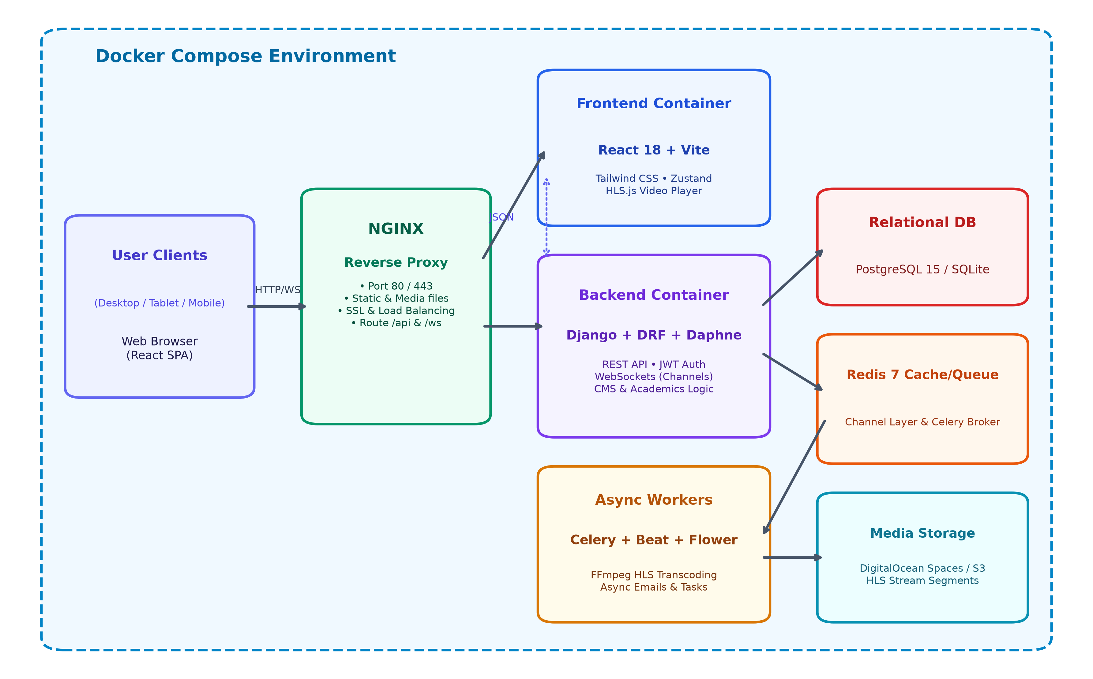
Project Scope & System Architecture
BOUNDARIES & IMPLEMENTATION
Included in Scope
• Full JWT auth & role-based access control
• Course catalog with isolated enrollment
• Adaptive HLS video streaming pipeline
• Material distribution (PDFs, slide decks)
• Assignment submission and teacher grading
• Live class scheduling & real-time WS notifications
• Dedicated DRF CMS & administrative analytics
Excluded from Scope
• Real commercial payment gateway integration (Stripe/PayPal)
• AI automated exam proctoring / eye tracking
• Native iOS/Android compiled applications
• In-browser sandboxed code execution engine
• Custom WebRTC SFU video conferencing cluster

Slide 5
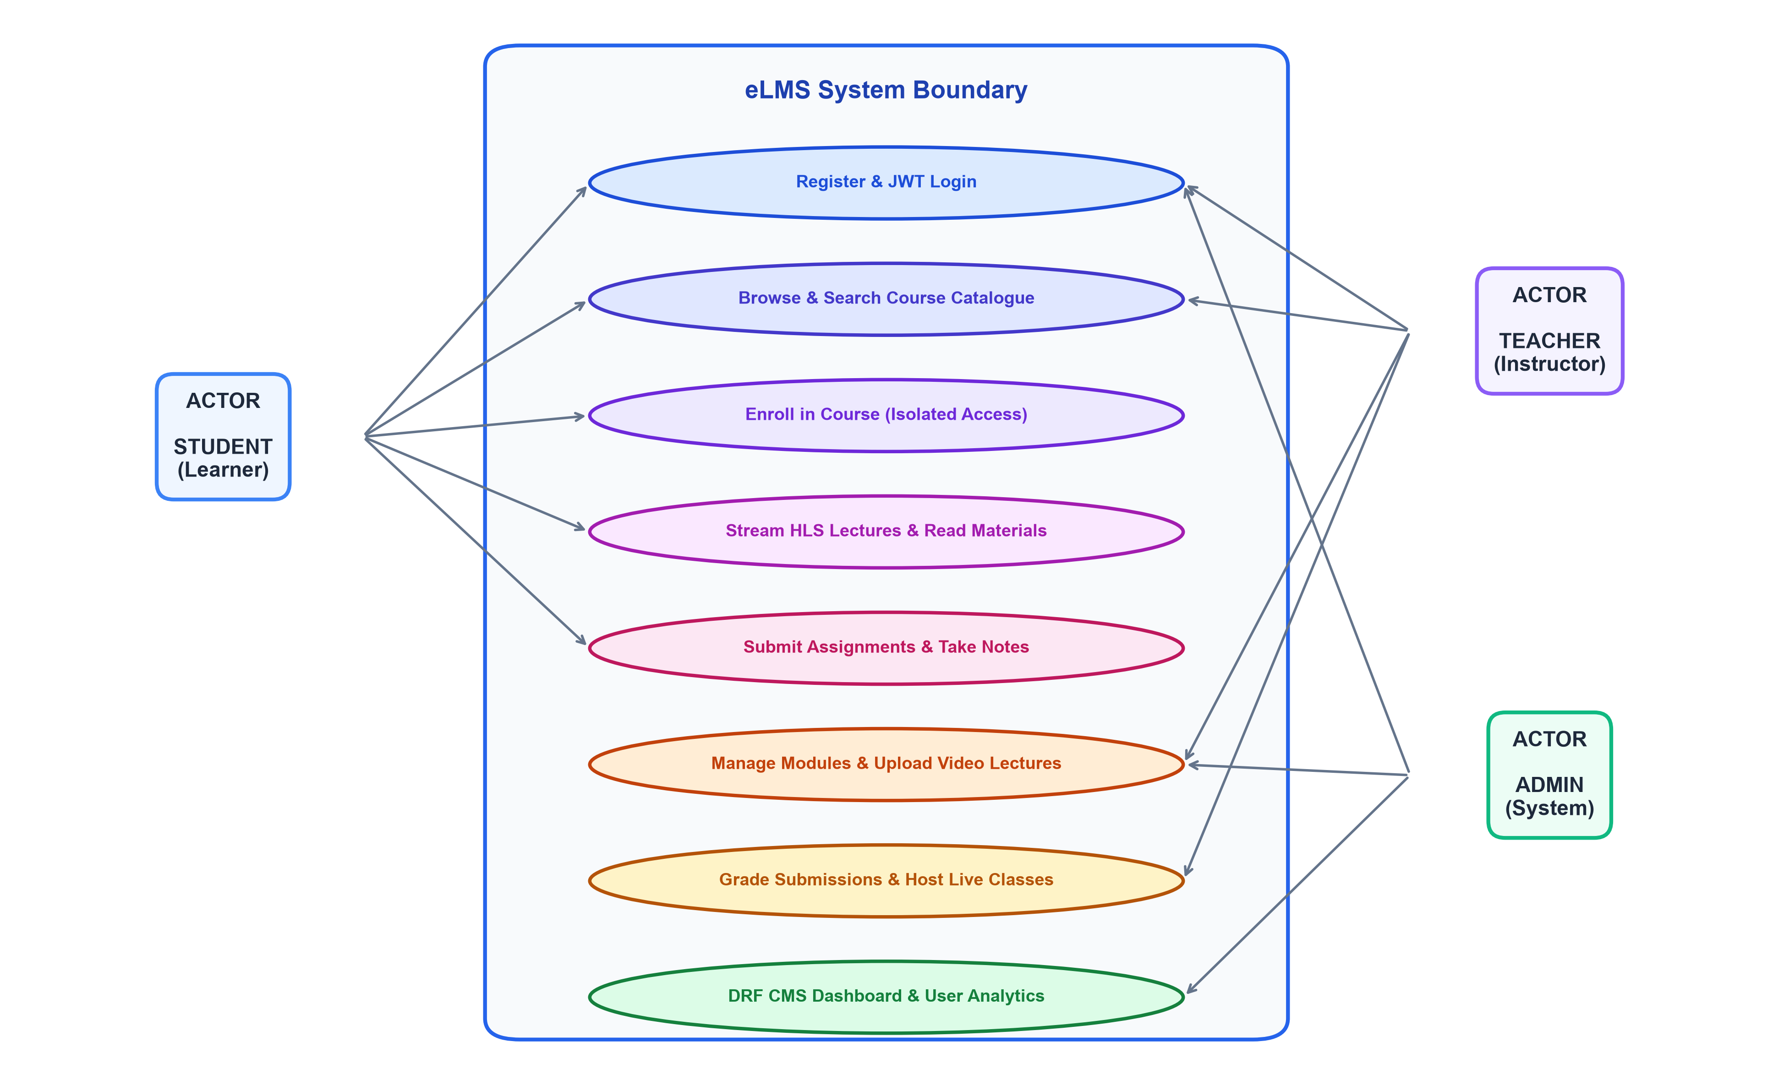
Scaling Architecture & Use Case Diagram
SYSTEM DESIGN & ACTORS
Containerized Micro-Services
Docker & Docker Compose encapsulate Frontend, Backend, Celery, Redis, and Database for predictable deployment.
Asynchronous Worker Offloading
Resource-heavy video encoding (FFmpeg) and email dispatching are offloaded to Celery background workers, ensuring zero API blocking.
ASGI & WebSocket Scalability
Daphne ASGI combined with Redis channel layers handles persistent WebSocket connections for live notifications and class updates.
Cloud Storage & CDN Ready
Media assets and HLS segments are streamed via S3-compatible DigitalOcean Spaces, offloading storage and bandwidth from web servers.

Slide 6
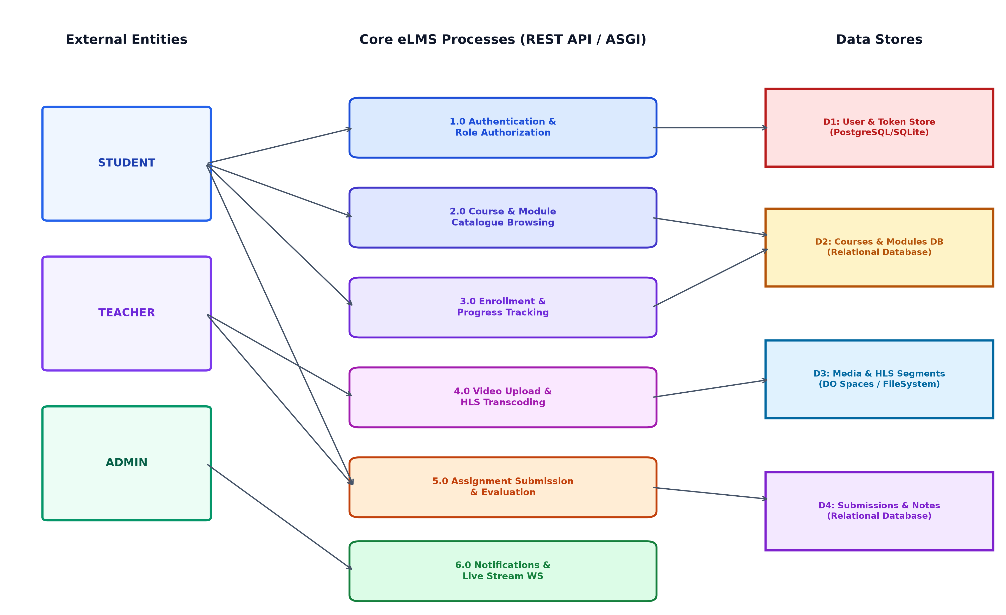
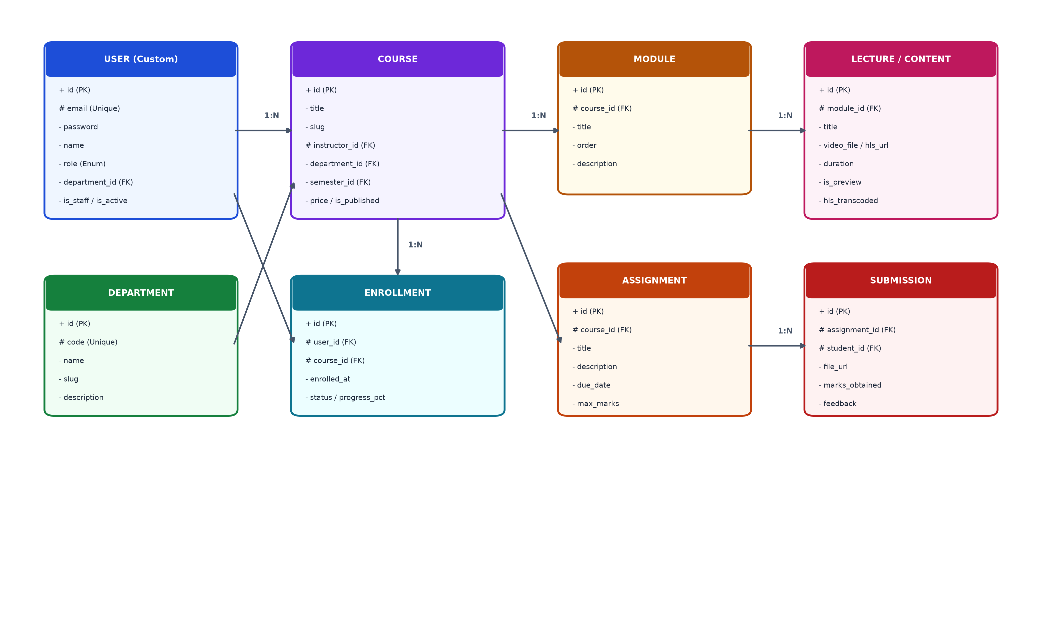
System Modeling: DFD & ER Diagram
DATA ARCHITECTURE & ENTITY RELATIONSHIPS
Level 1 Data Flow Diagram (DFD)
Entity-Relationship (ER) Schema Model

Slide 7
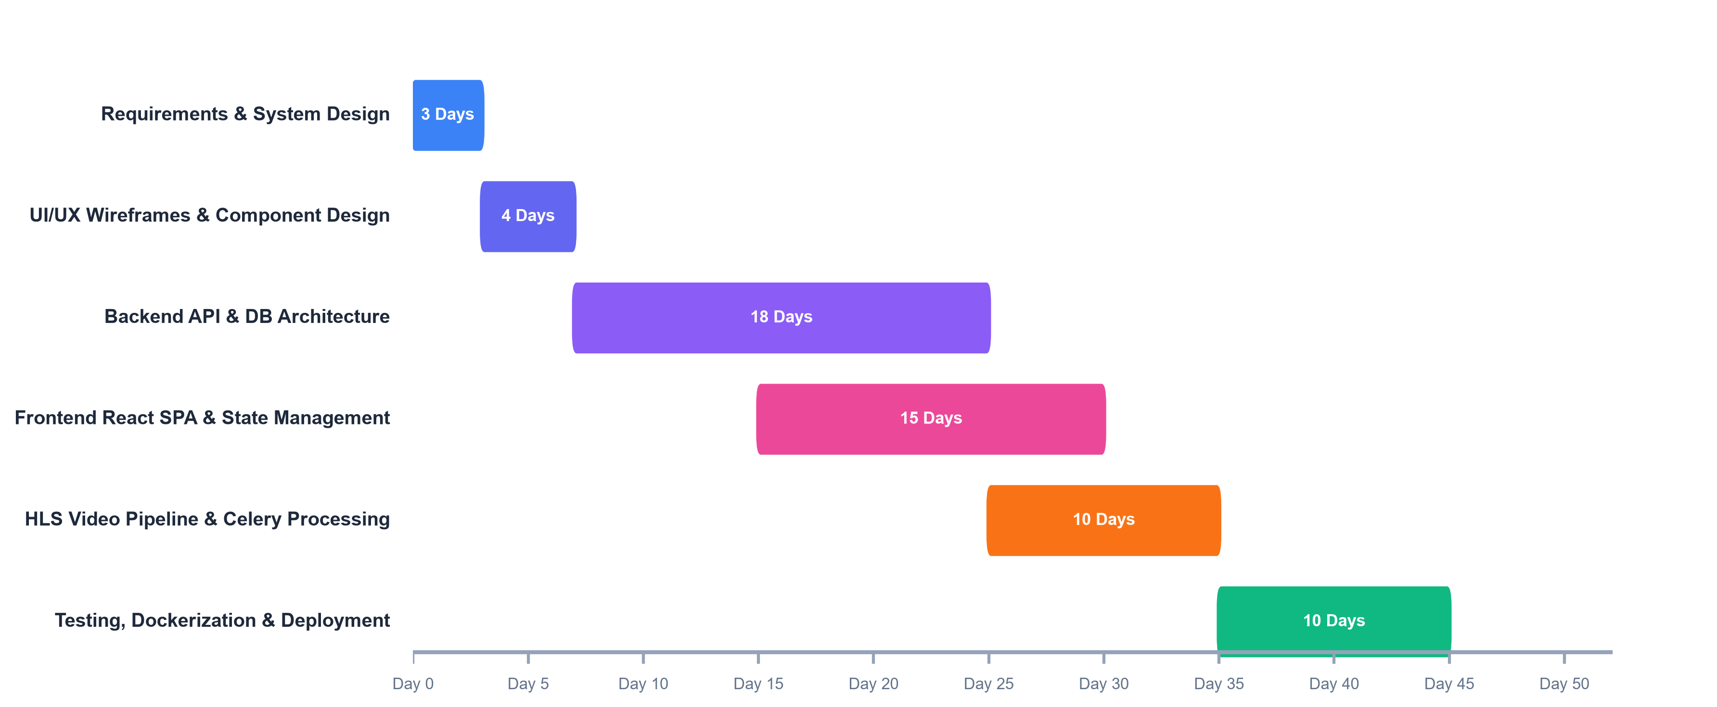
Timeline, Outcomes & Budget Considerations
PROJECT EXECUTION & PLANNING
Expected Outcomes
• Production-ready, containerized eLMS platform
• Concurrent support for 500–1000 active users
• Fully responsive UX across mobile, tablet & desktop
• Automated HLS video pipeline with adaptive bitrate
• Comprehensive academic management workflow
Budget & Infrastructure Estimates
• DigitalOcean Droplet (4 vCPU, 8GB RAM): ~$24 / month
• DigitalOcean Spaces (S3-compatible 250GB storage): ~$5 / month
• Custom Domain Name & SSL (Cloudflare / Namecheap): ~$12 / year
• Development Environment (Local SQLite & Docker): $0 (Free Tier)
Known Limitations & Mitigations
• Video Transcoding CPU Usage: High concurrent uploads may stress server CPU; mitigated by Celery concurrency limits and queue scheduling.
• Simulated Live Video: Live sessions use calendar meeting links (Zoom/Meet/Jitsi) rather than on-premise WebRTC media relay.
• Payment Processing: Focused on academic registration; real monetary transactions excluded in initial phase.

Slide 8
CONCLUSION
eLMS demonstrates a complete, industry-standard full-stack web application designed for scalable real-world learning. By uniting React 18, Django REST Framework, HLS video pipelines, Celery background workers, and Docker containerization, the project bridges theoretical software engineering concepts with practical, high-performance web architecture.
THANK YOU!
Questions & Feedback Welcome
Software Development Management Lab – 0613-307
eLMS Development Team

